Slide 1
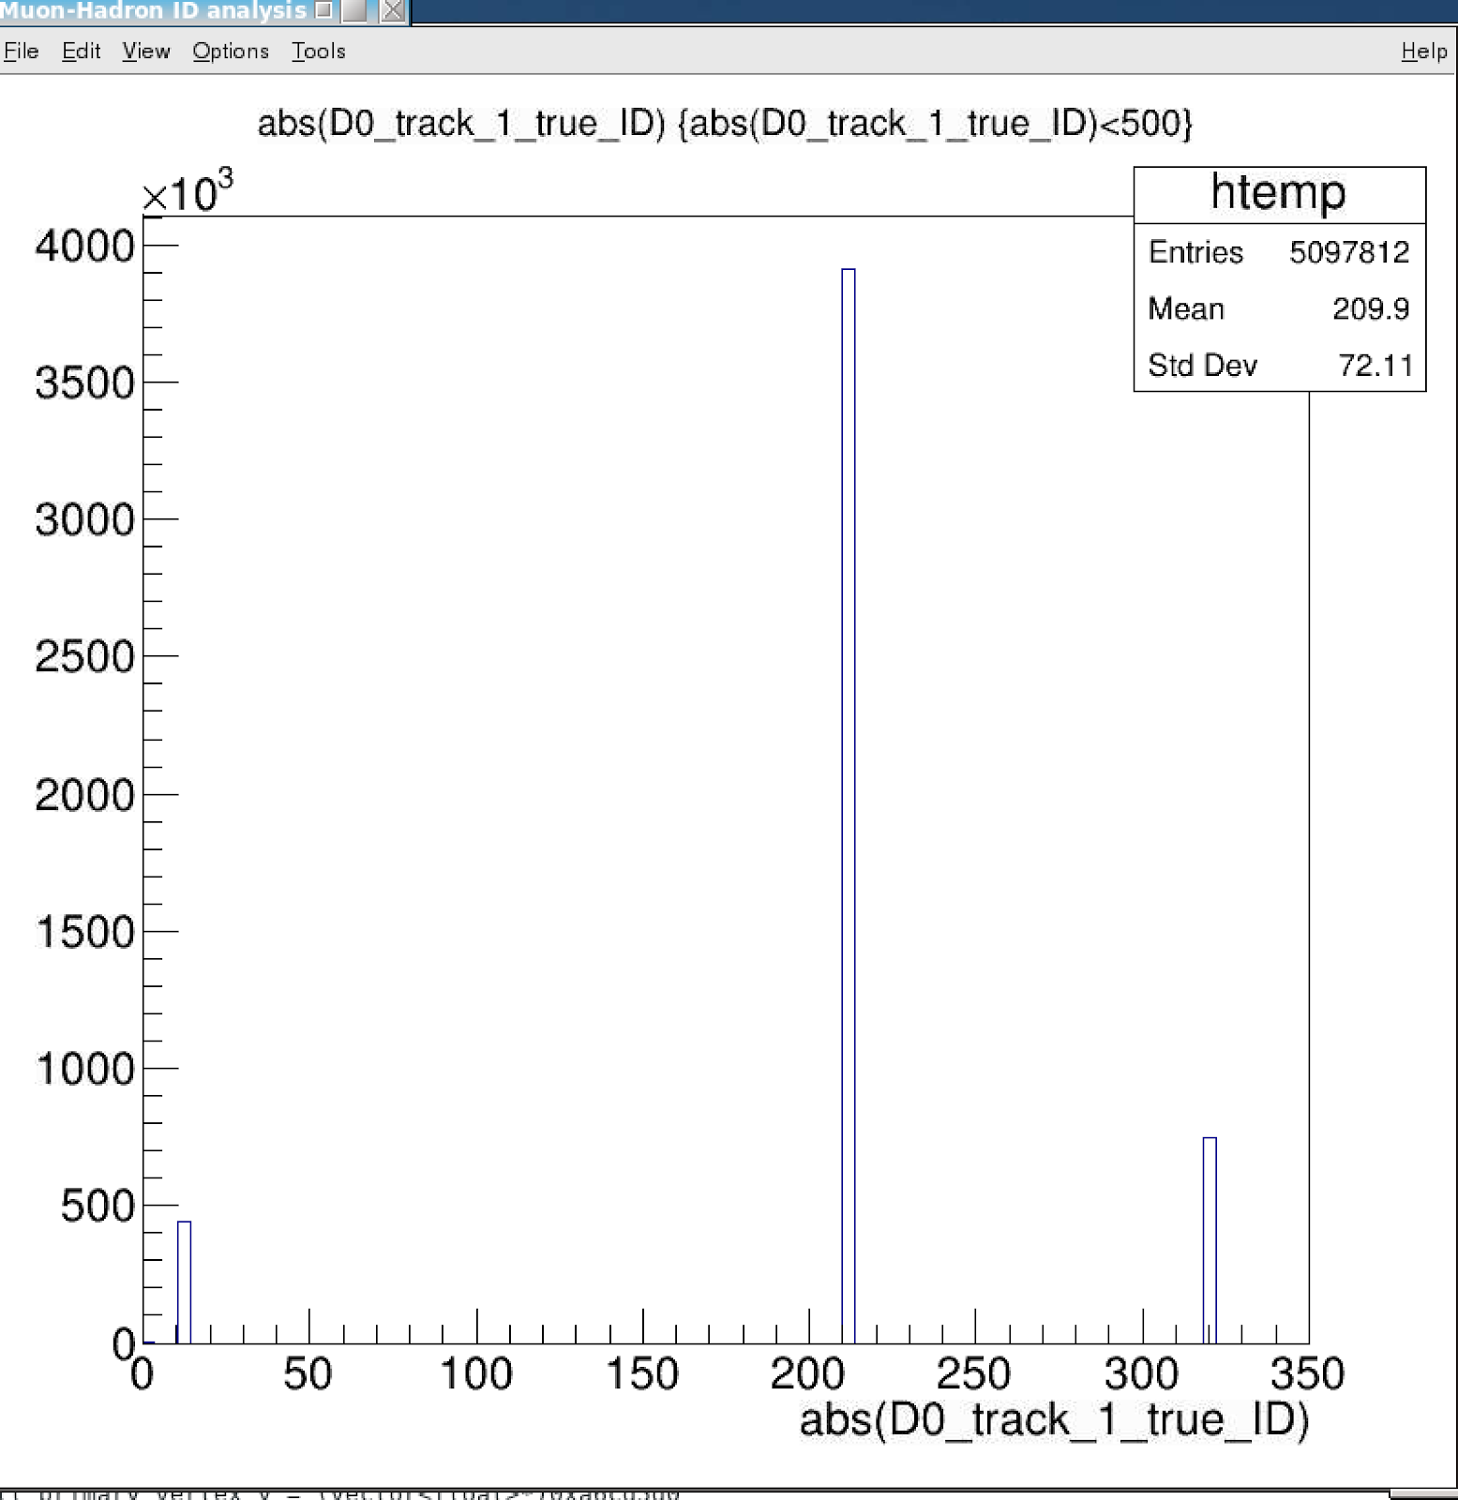
Muon Identification with ML - Cameron, Ming 06/14/2021
Tracks’ true ID
Tracking information, p, DCA, chi2 etc.
Mostly hadrons, ~5% muons
dE and matchings in dPhi, dEta, E/p
EMCal
IHCal
OHcal
The correlation is quite complicated, a good example where ML could help
Training/Testing samples (mostly muons, pi/K)
Cameron’s KFParticle output for J/Psi analysis, from bbbar events
Track p> 3GeV
EMCal>0, iHCal >0, oHCal > 0
Similar results observed for p >2GeV samples
DataRobot package provides 20+ Machine Learning Models for classification
Identify “muons” from the training samples
Selected top performers
Pi+/-
K+/-
e,mu

Slide 2
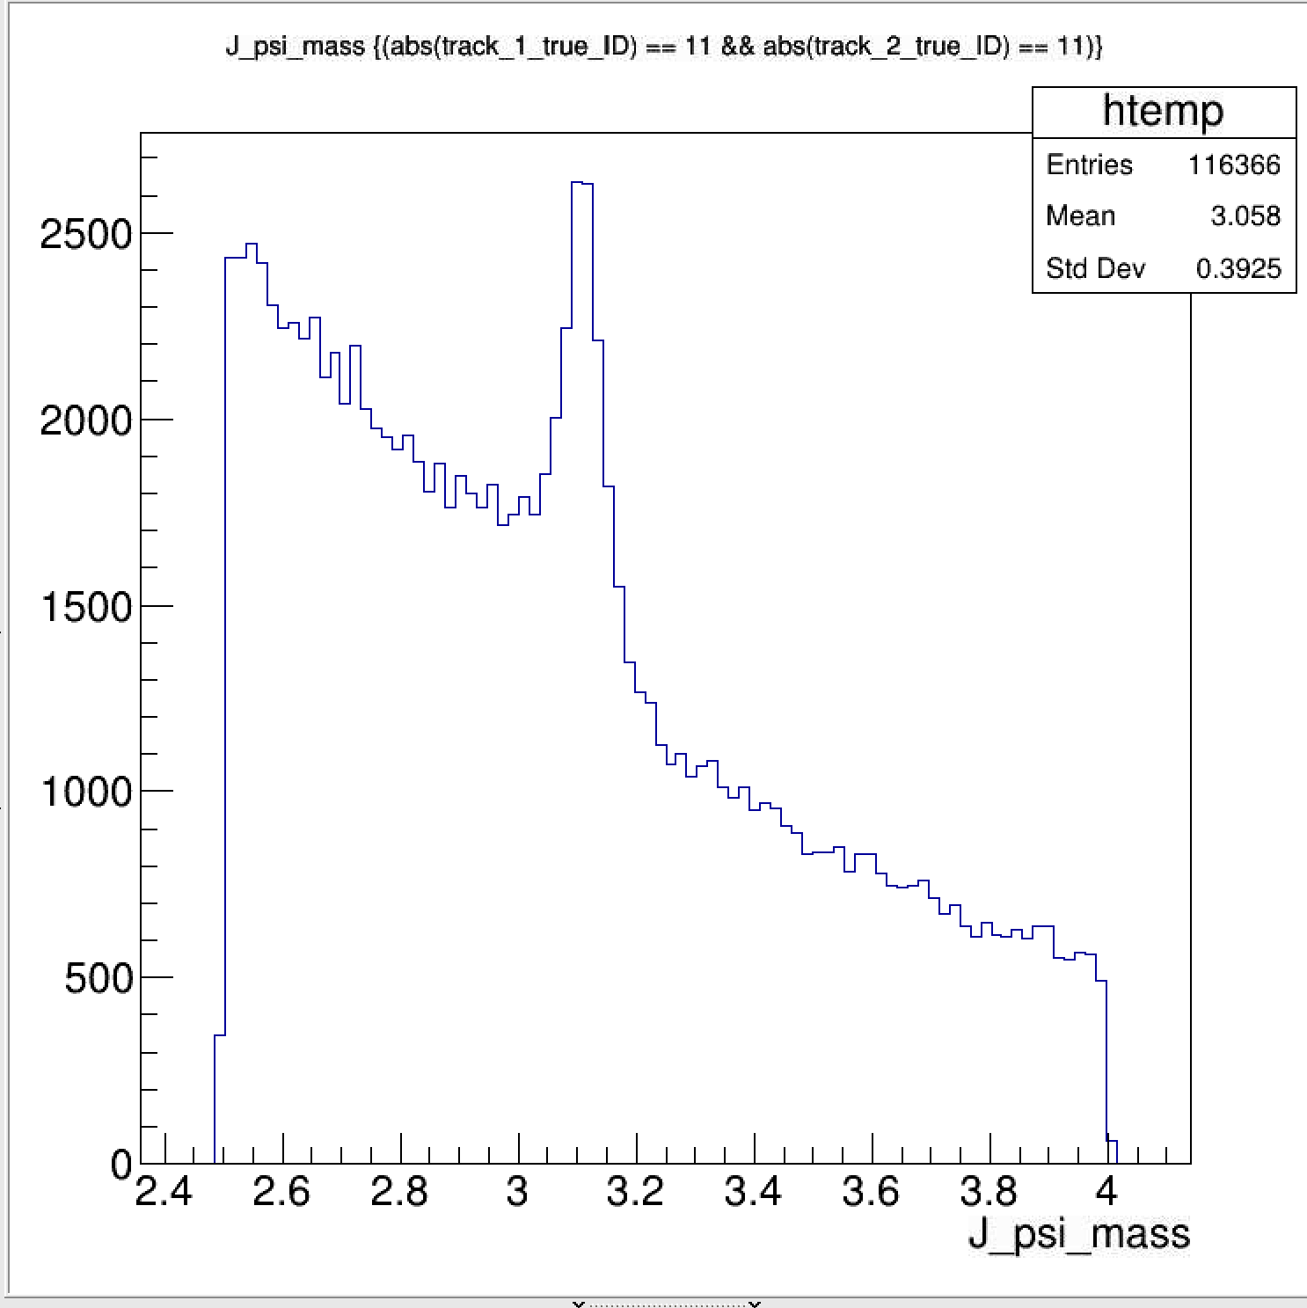
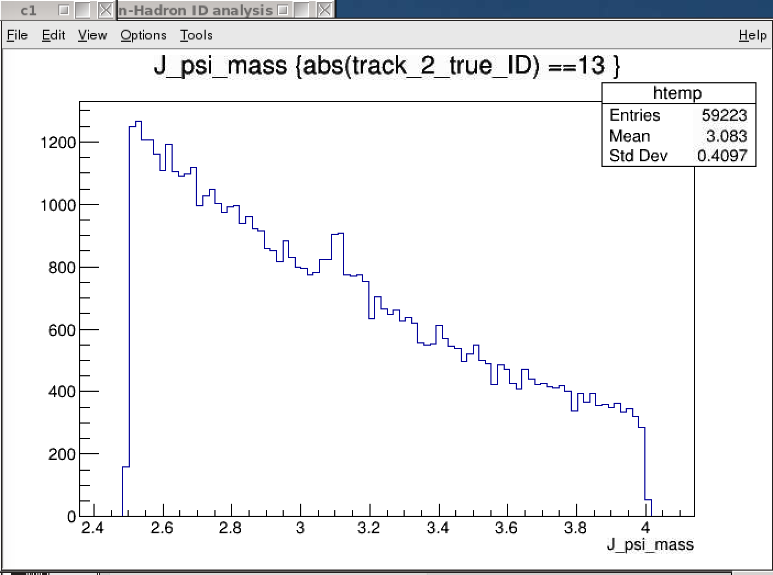
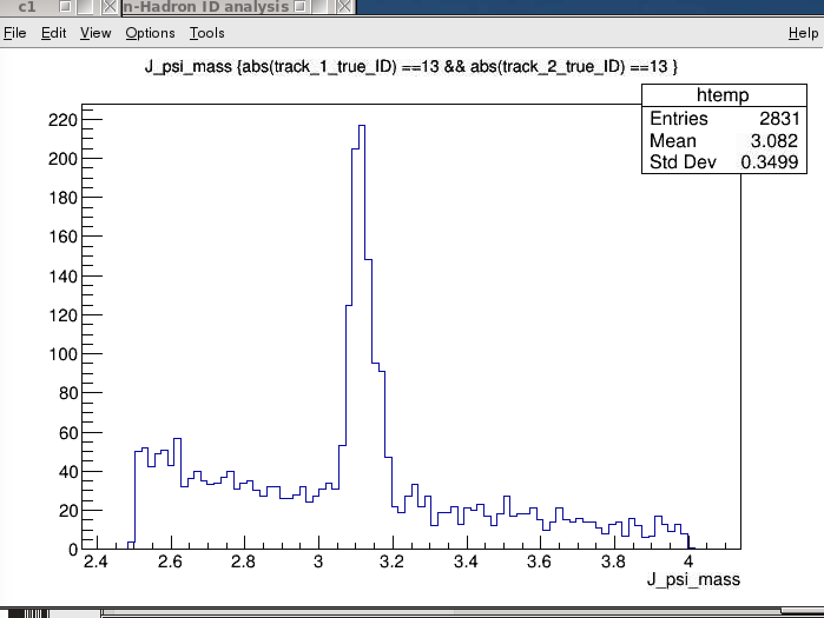
J/Psi Candidates with “di-muons” - later also for di-electrons, possibably
Two electrons identified
– note the high background
One muon identified
Two muons identified

Slide 3
Muon Identification
Study the EMCal, iHCal and oHCal responses to muon, electron and hadrons

Slide 4
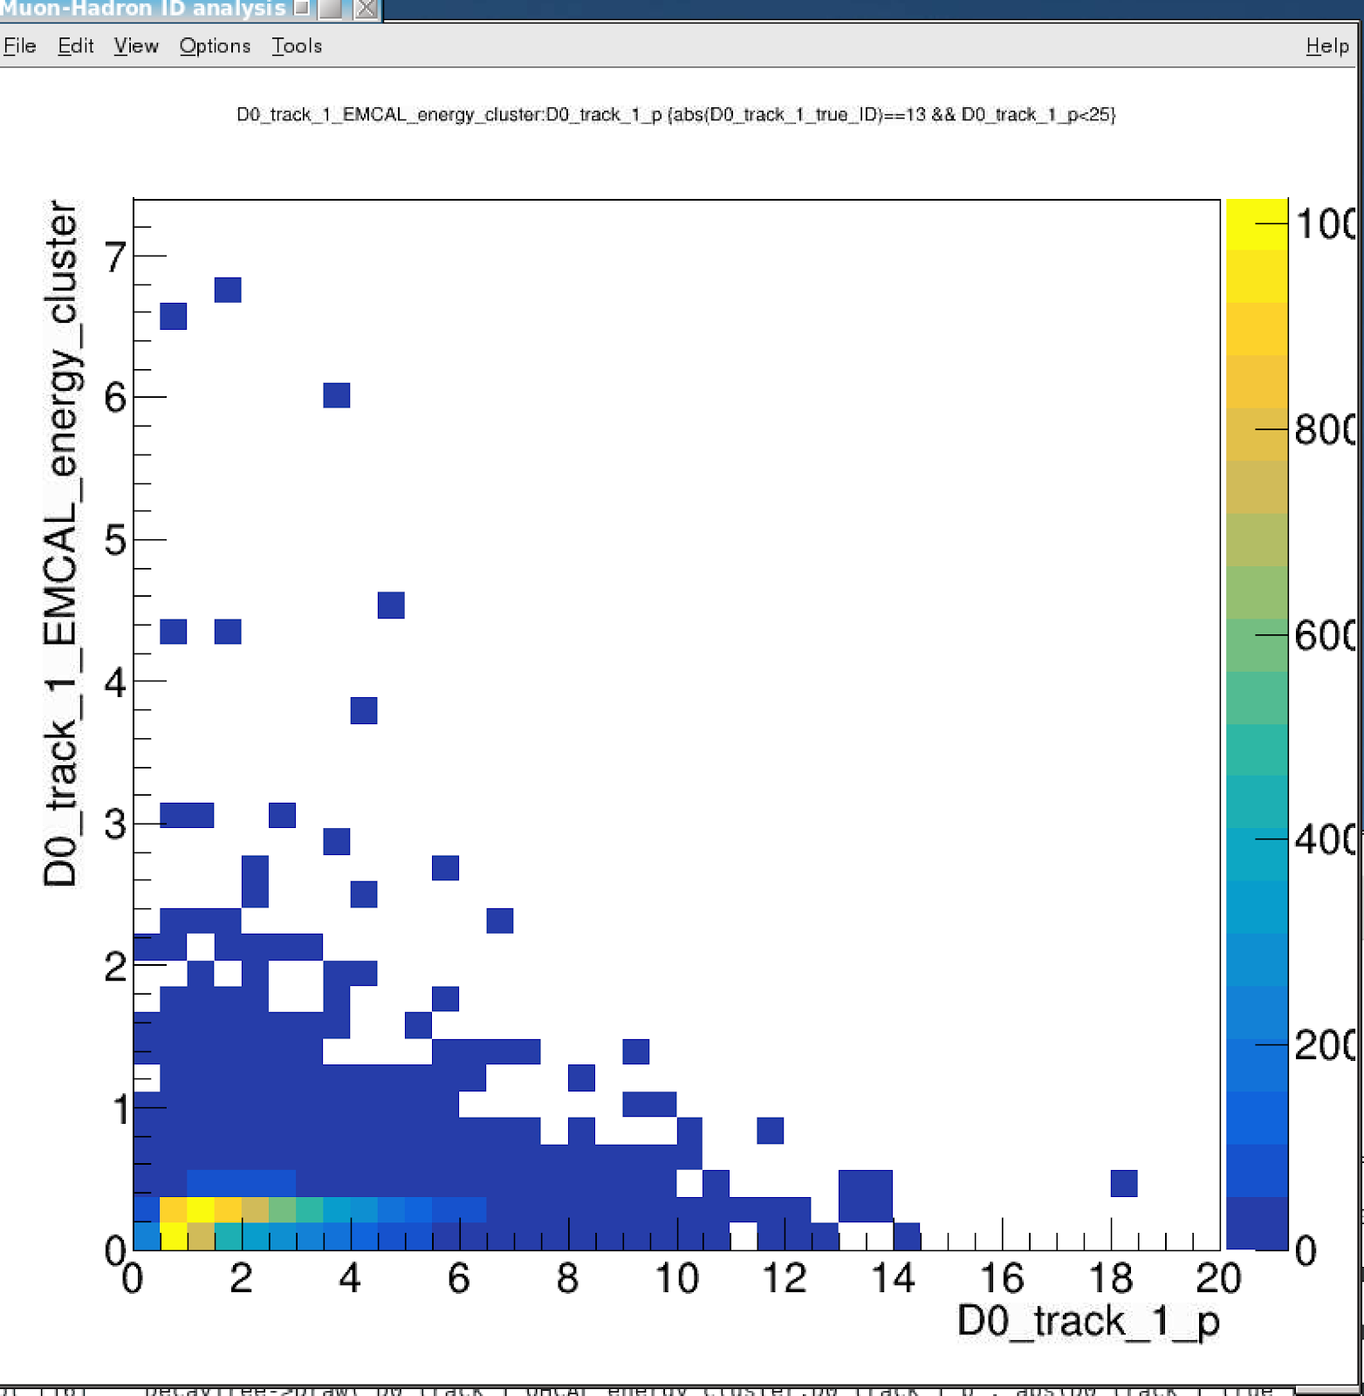
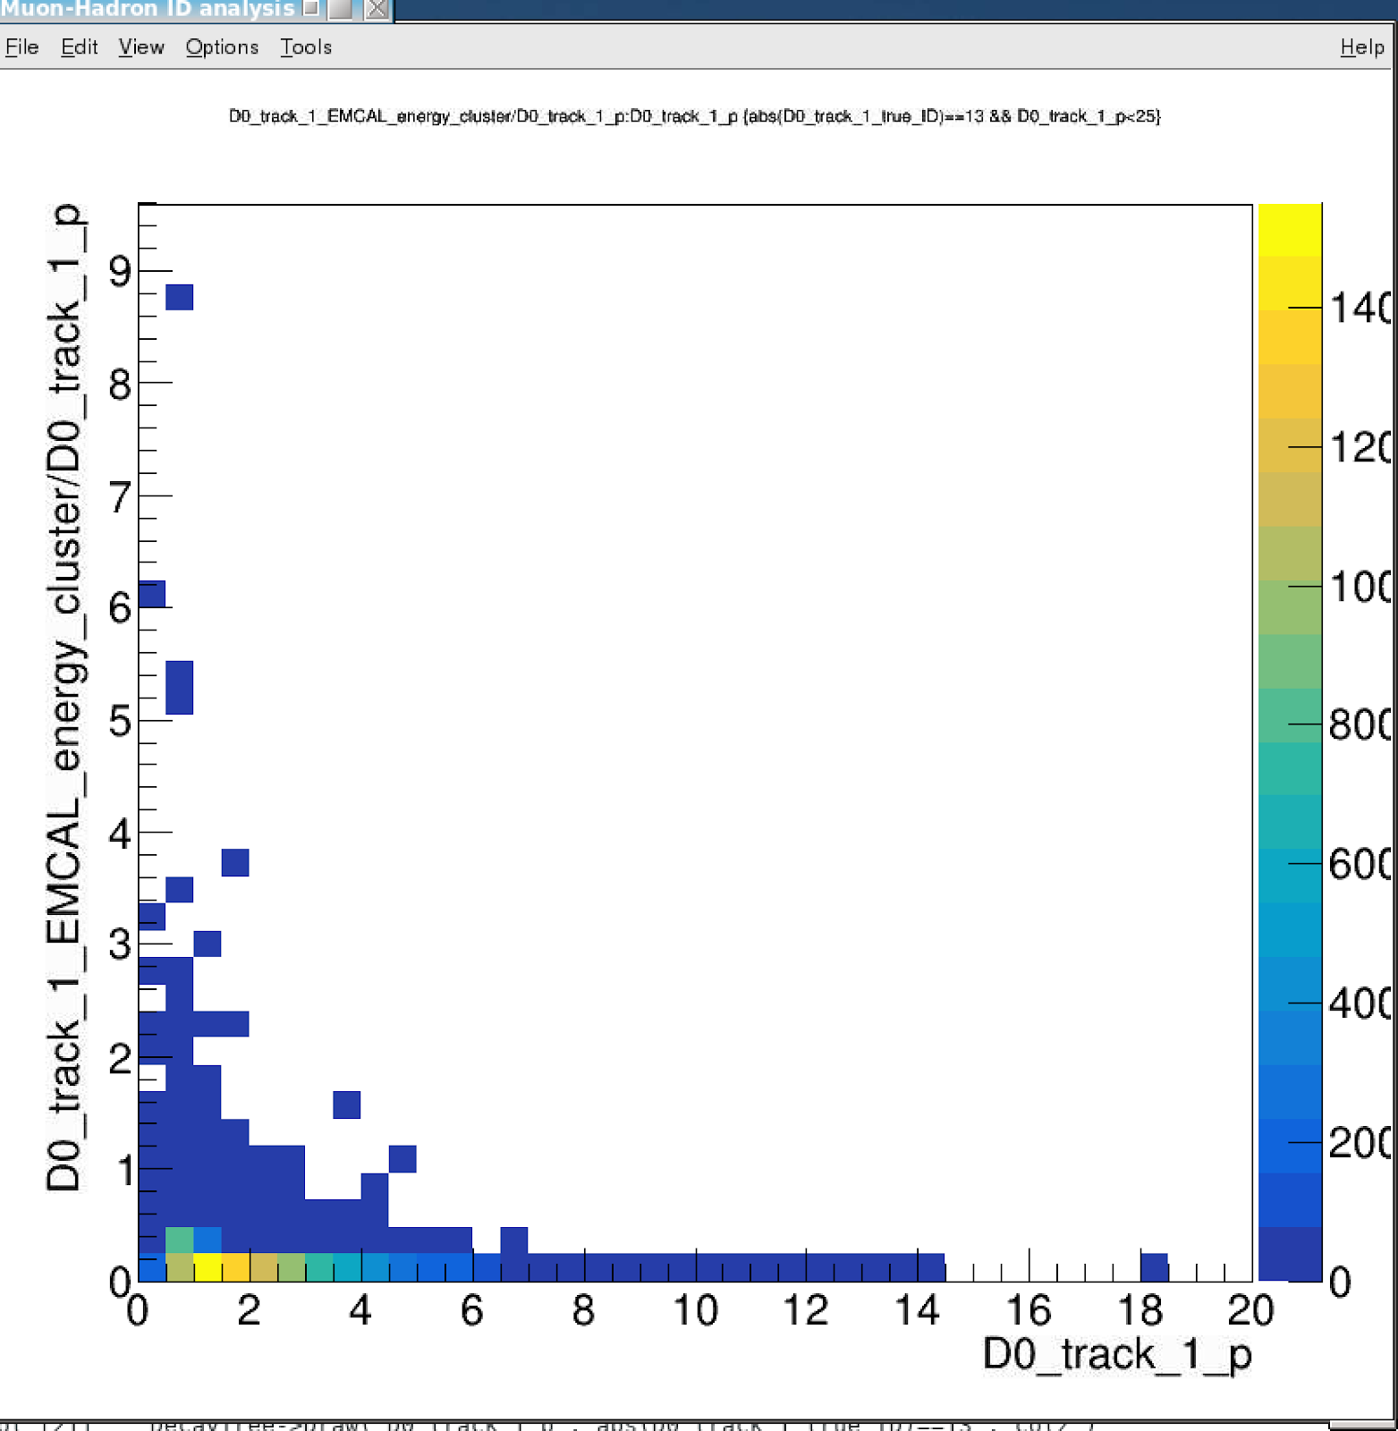
BBbar -> J/Psi, KFParticle Outputs
EMCal_energy_cluster vs p: Muons
E vs P
E/p vs p

Slide 5
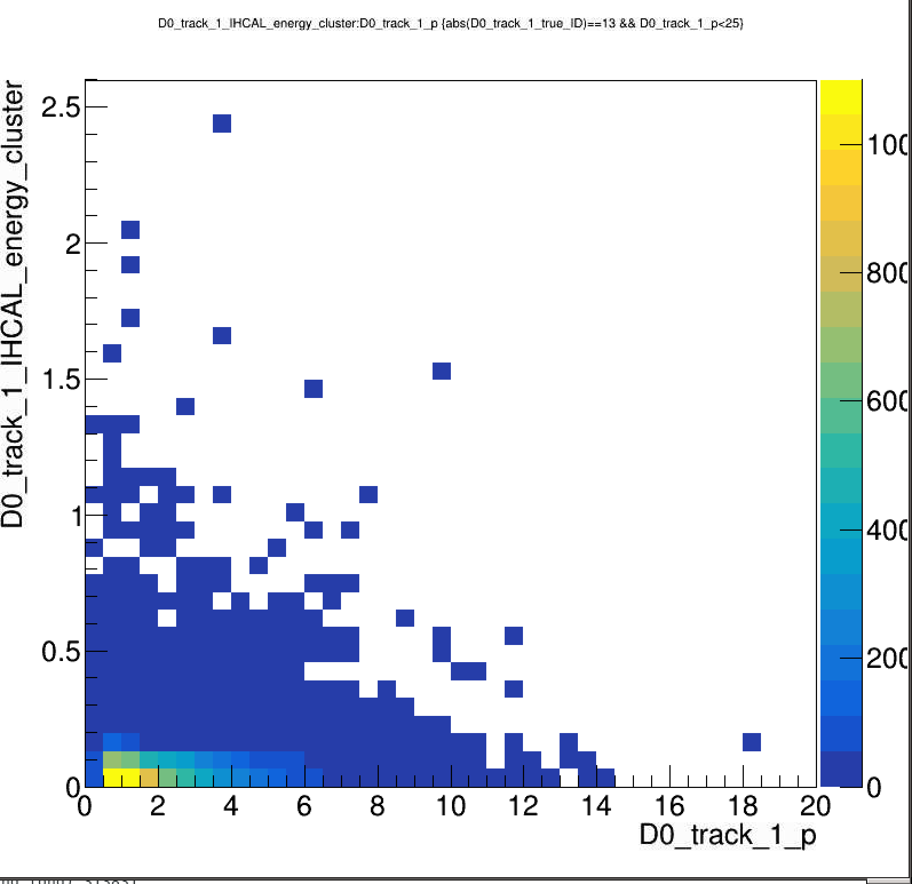
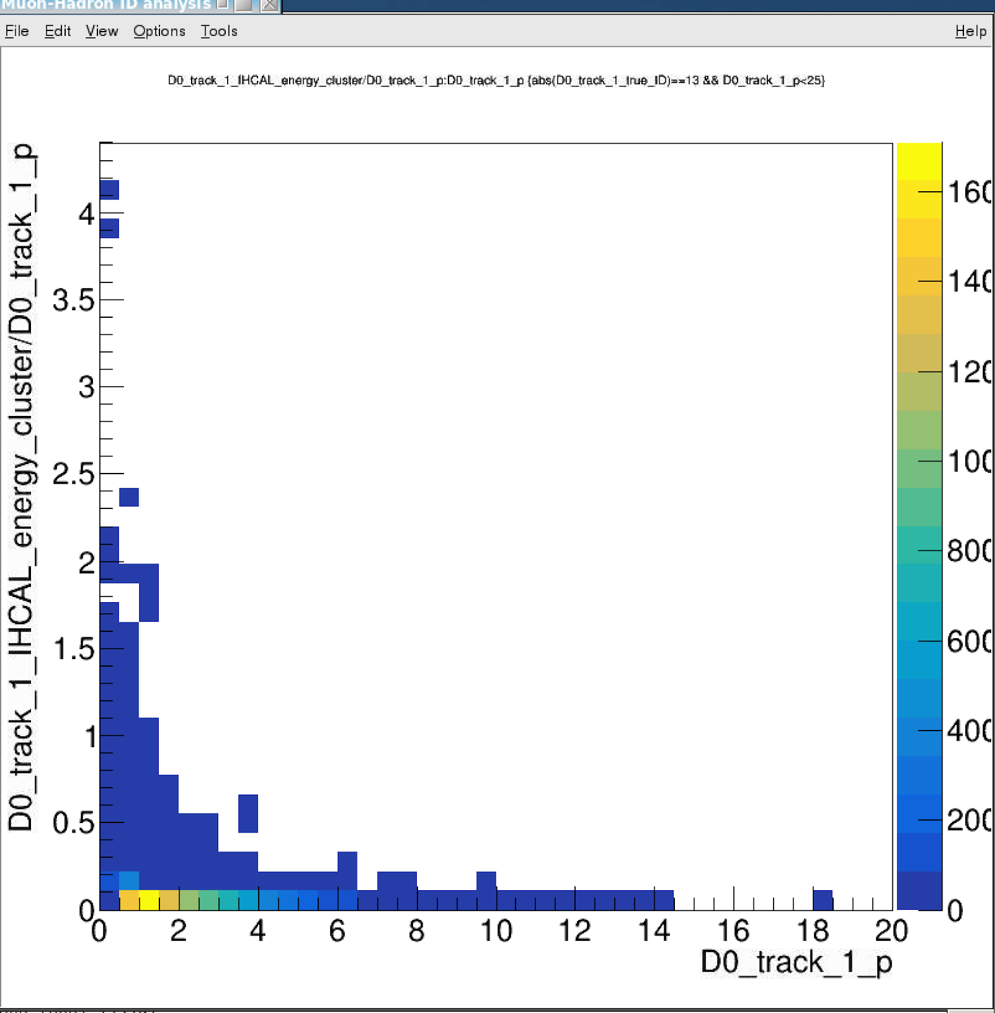
BBbar -> J/Psi, KFParticle Outputs
IHCal_energy_cluster vs p: Muons
E vs P
E/p vs p

Slide 6
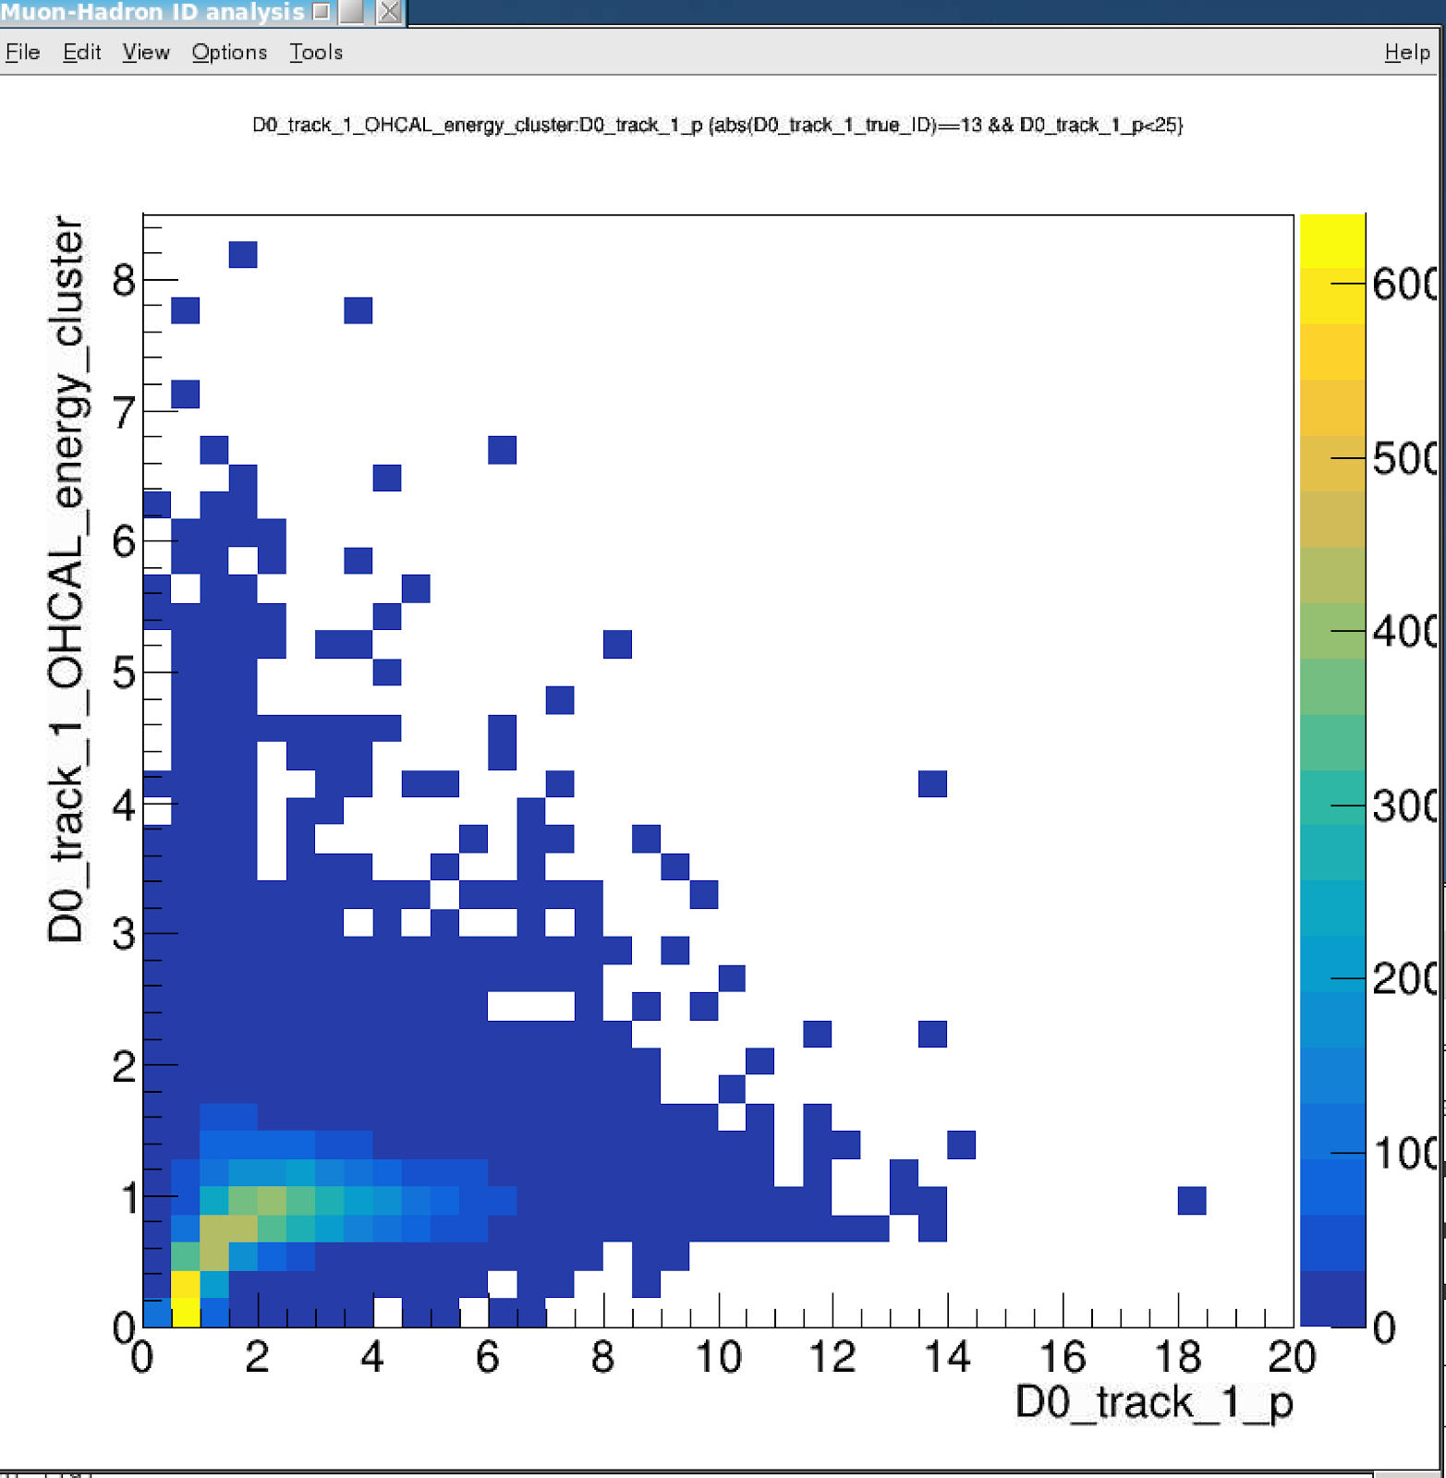
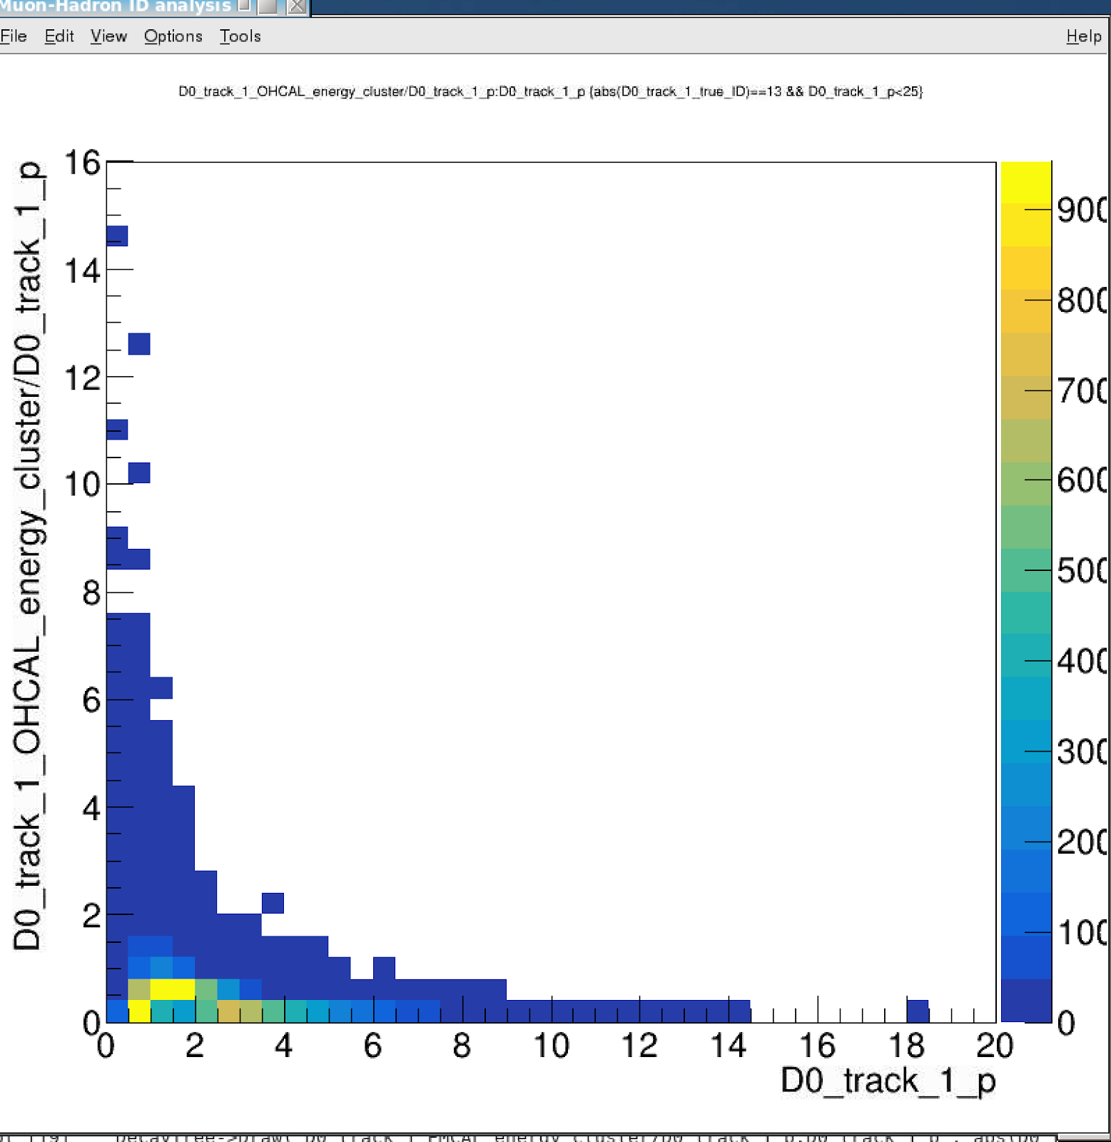
BBbar -> J/Psi, KFParticle Outputs
OHCal_energy_cluster vs p: Muons
E vs P
E/p vs p
MIP signal
from muons

Slide 7
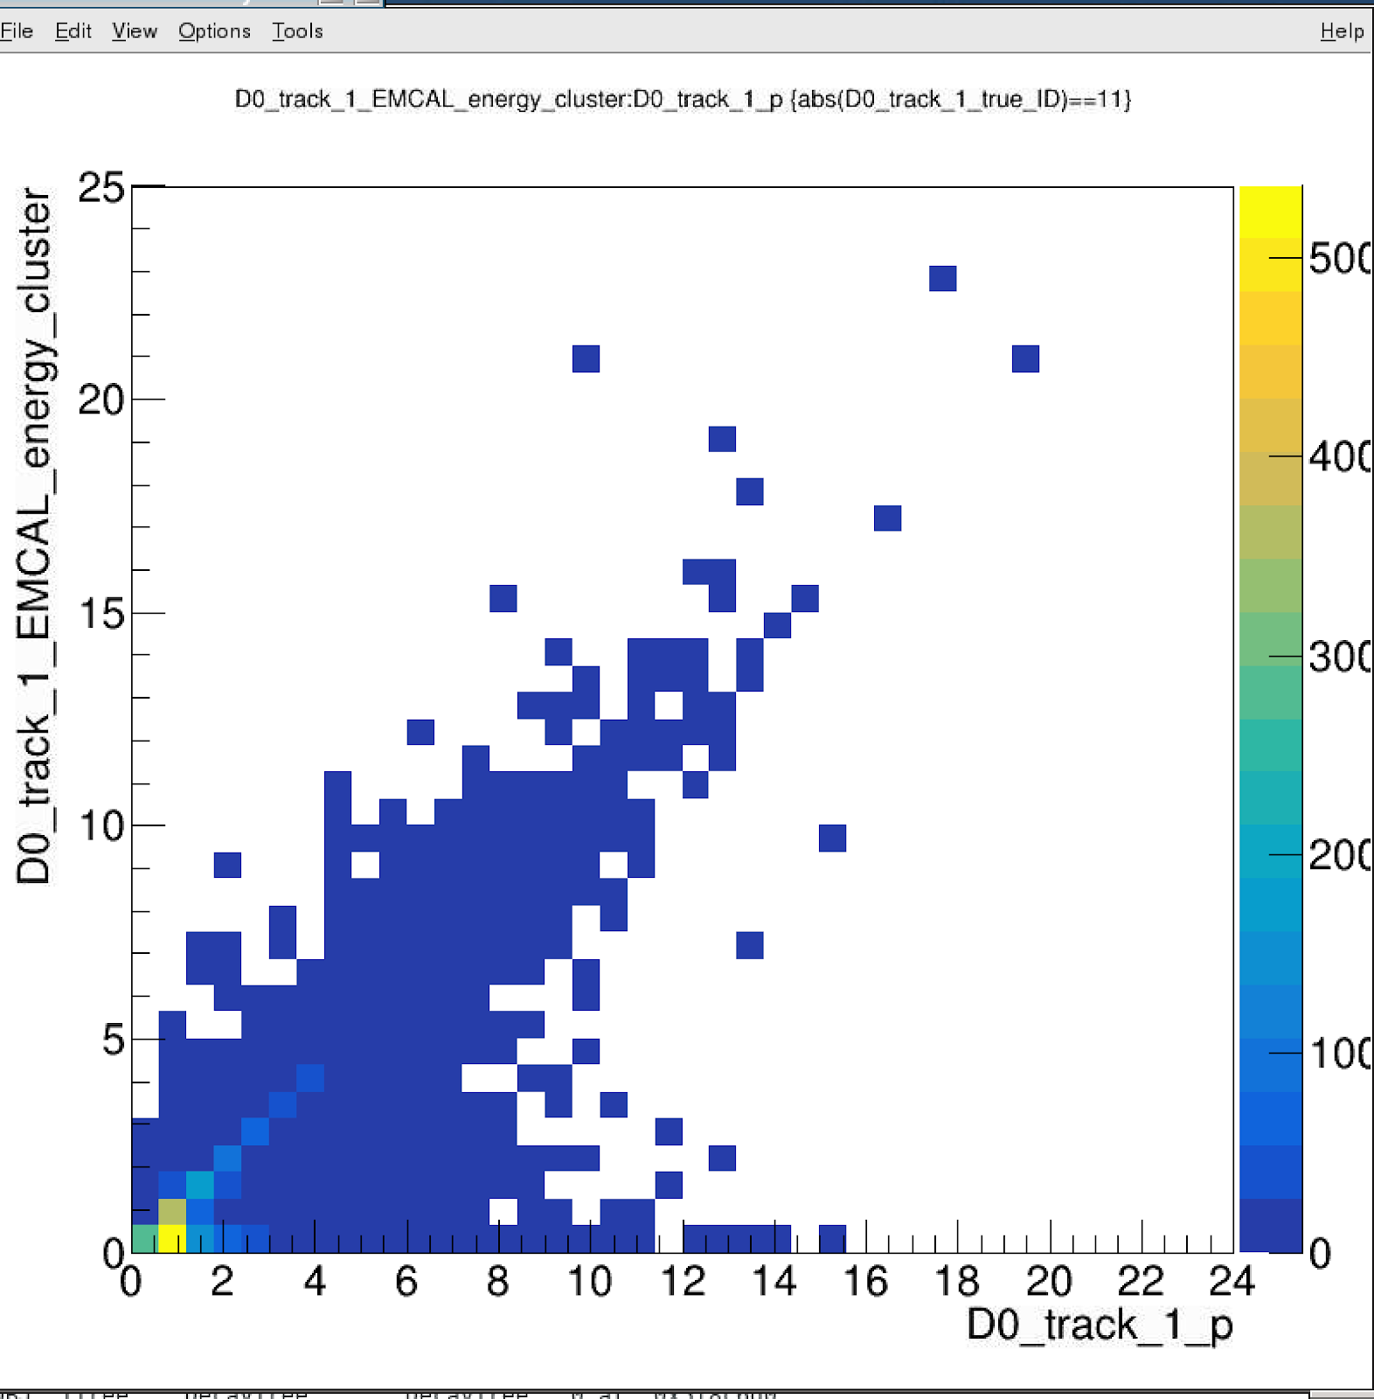
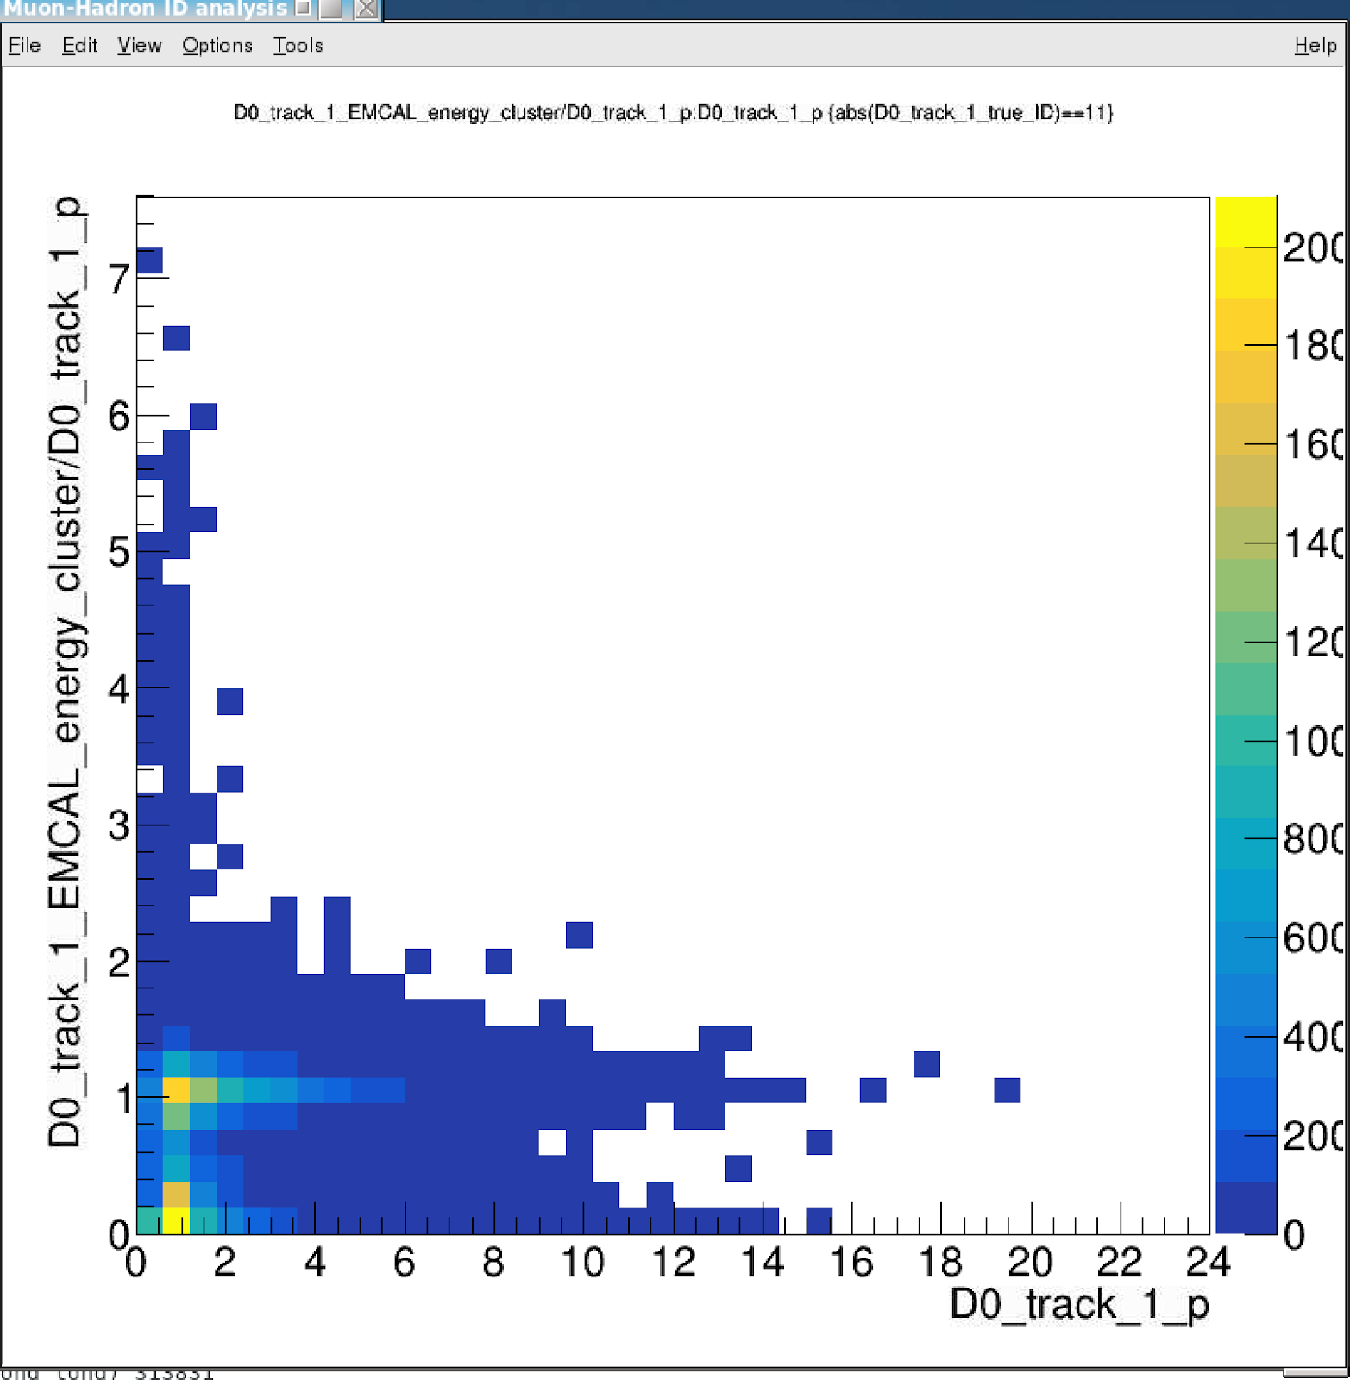
BBbar -> J/Psi, KFParticle Outputs
EMCal_energy_cluster vs p: electrons
E vs p
E/p vs p

Slide 8
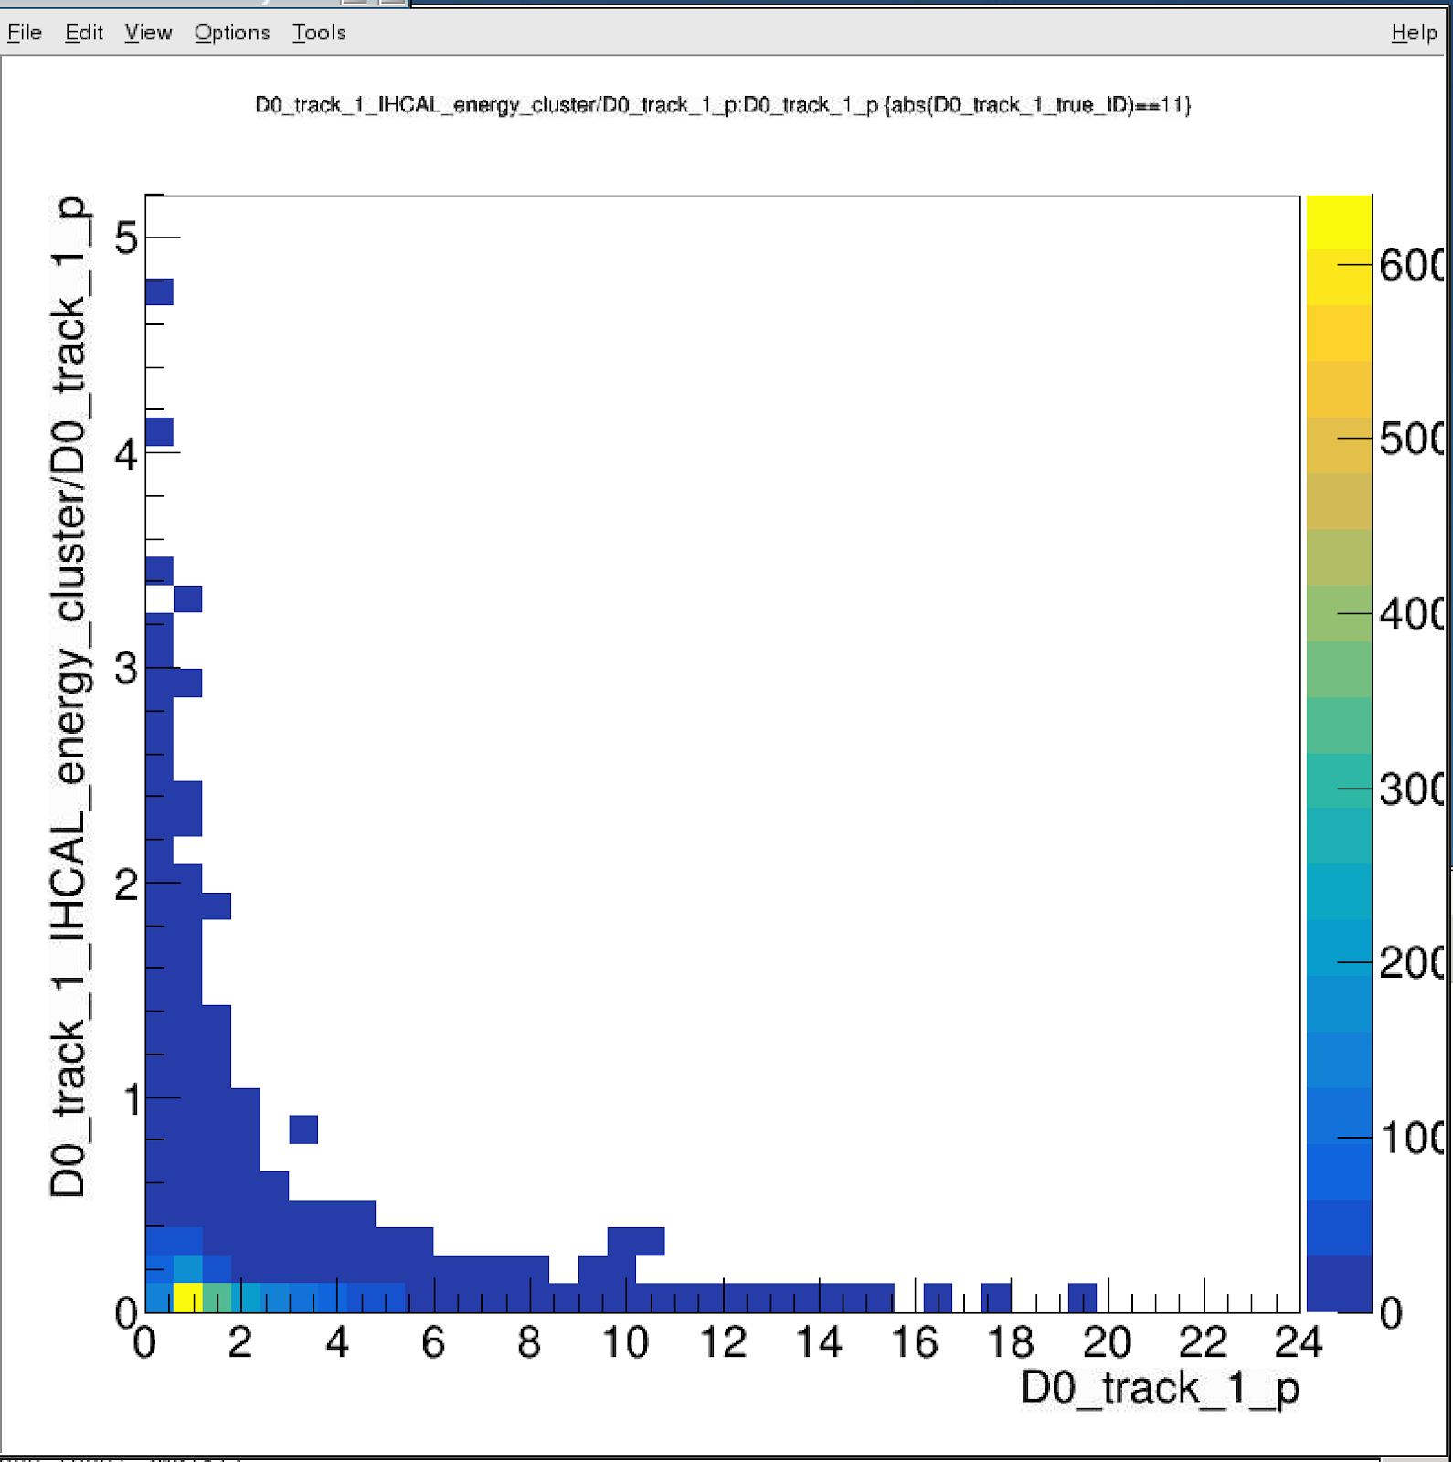
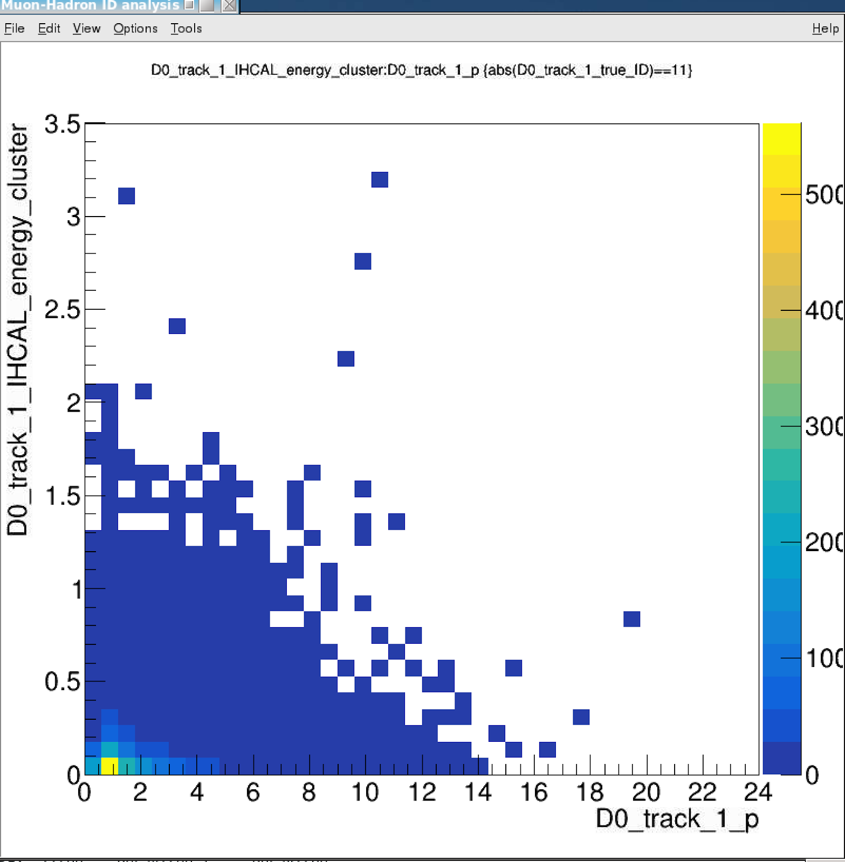
BBbar -> J/Psi, KFParticle Outputs
IHCal_energy_cluster vs p: electrons
E vs p
E/p vs p

Slide 9
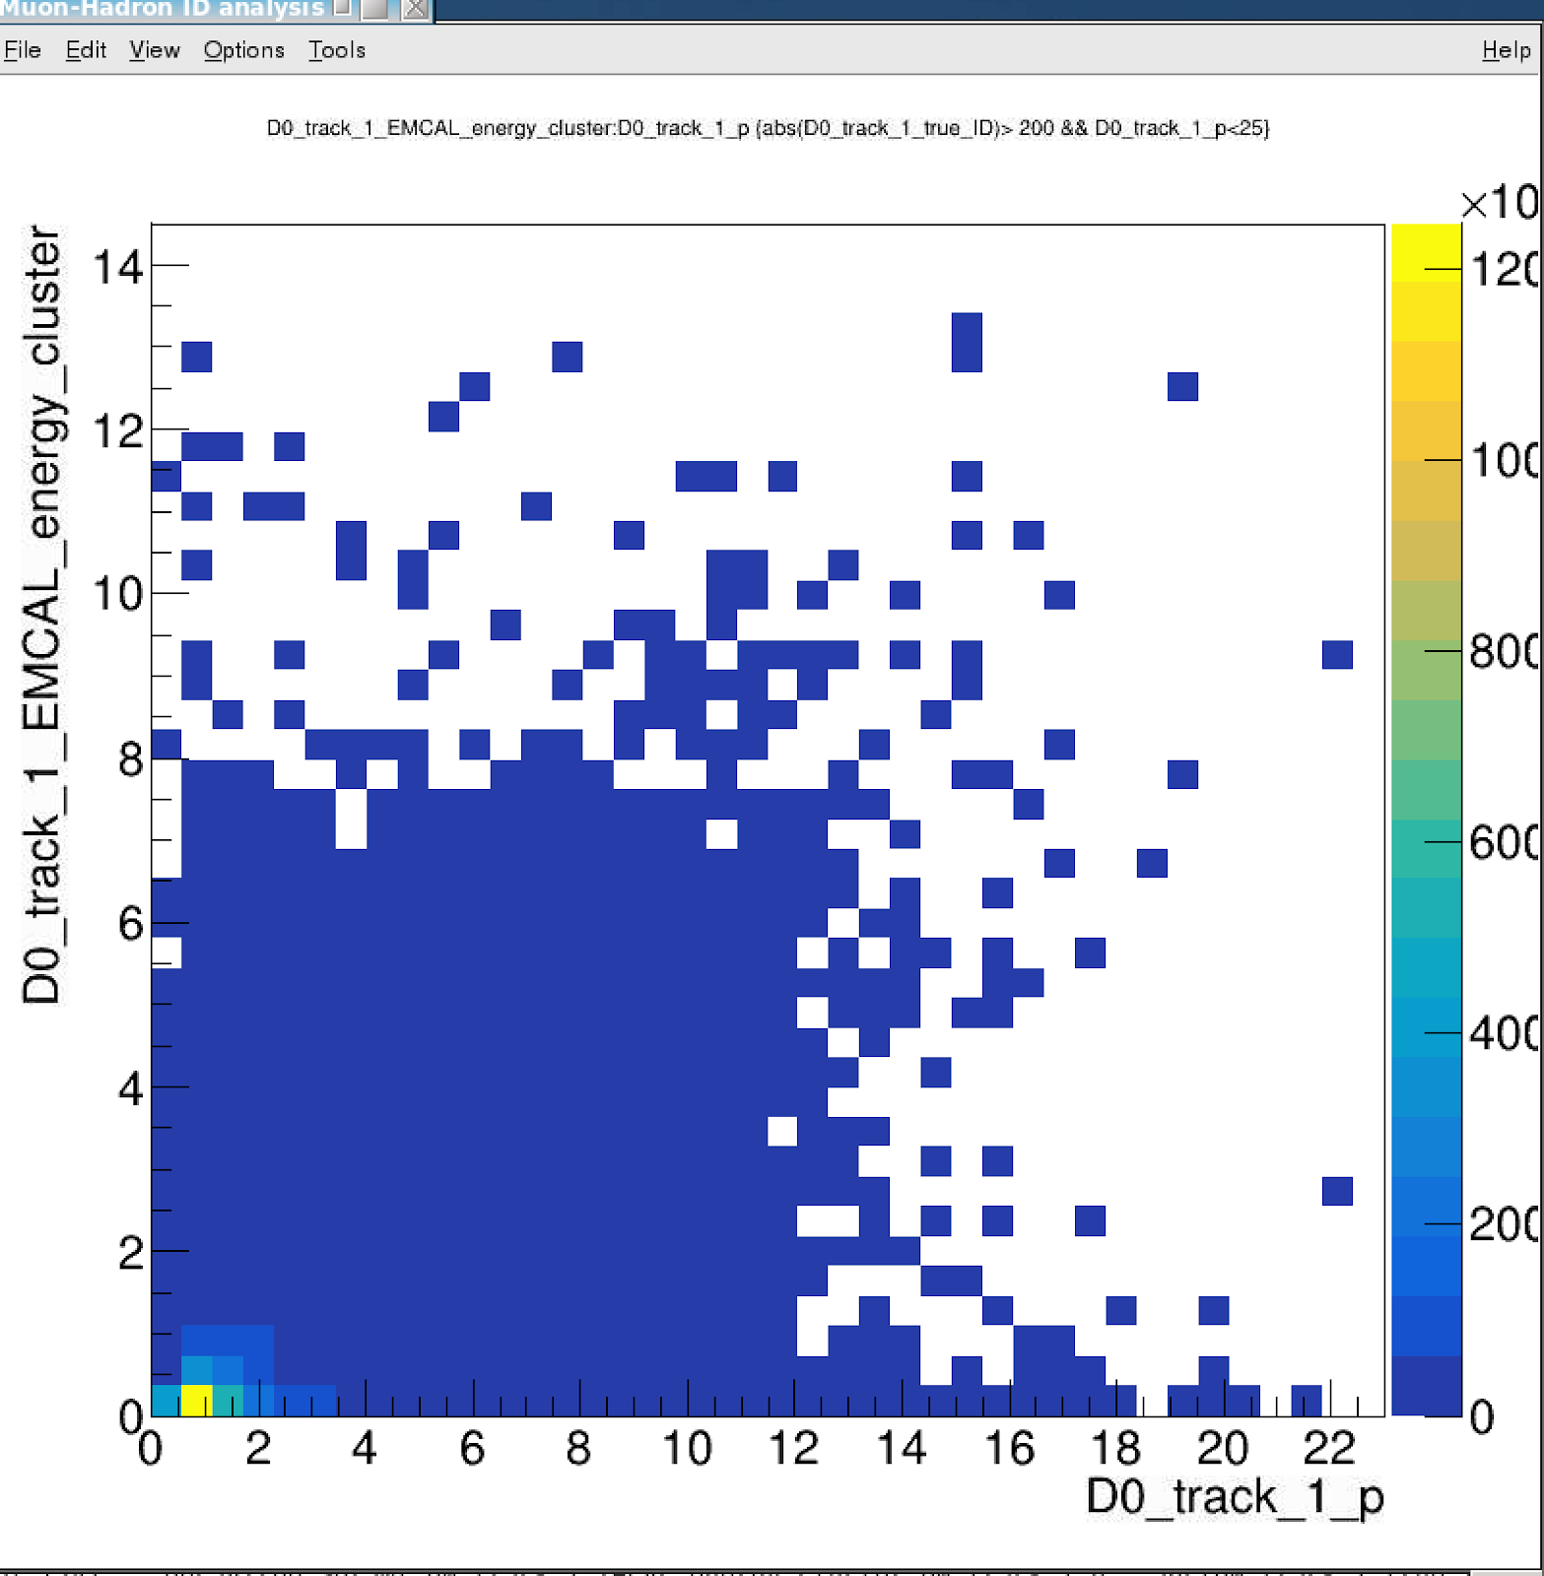
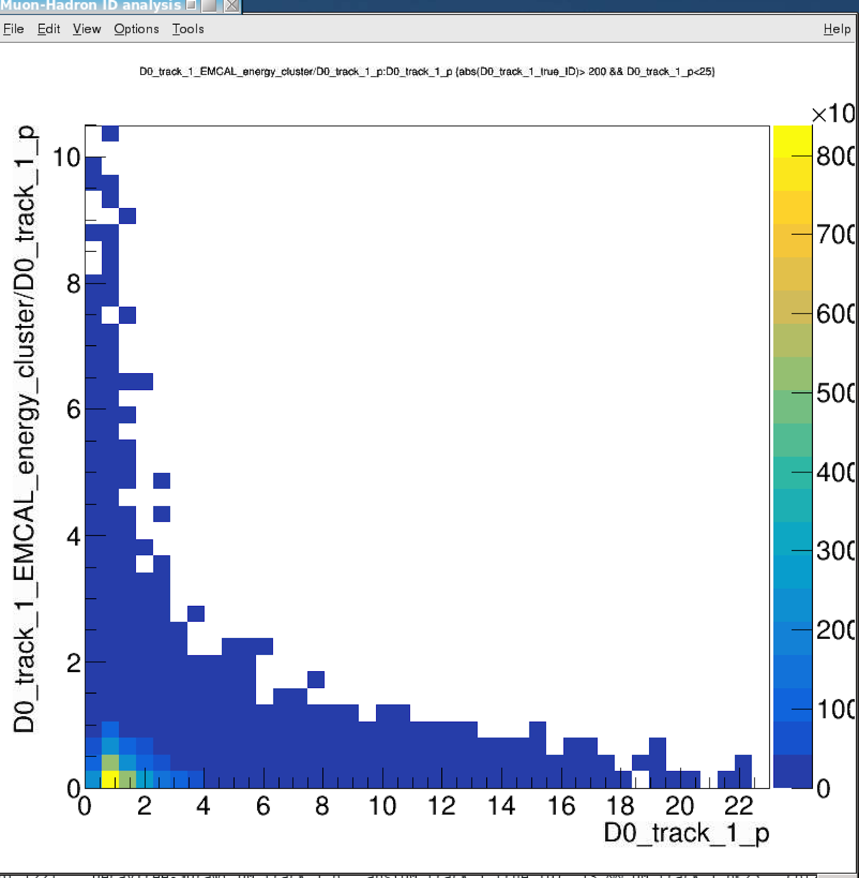
BBbar -> J/Psi, KFParticle Outputs
EMCal_energy_cluster vs p: pi+/- & K+/-
E vs p
E/p vs p

Slide 10
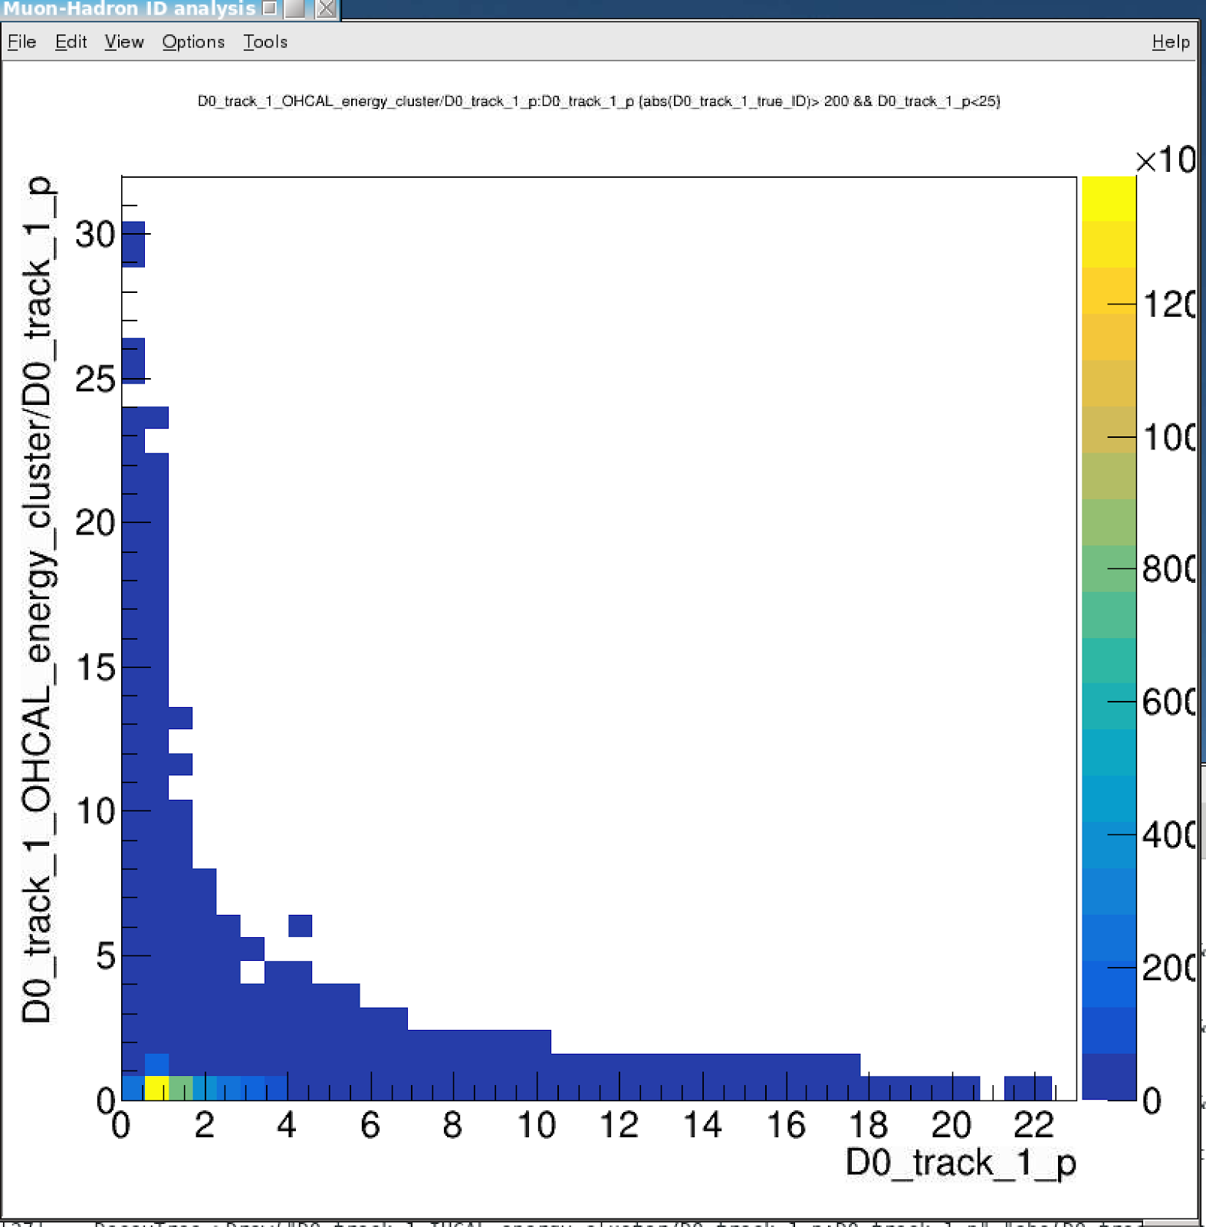
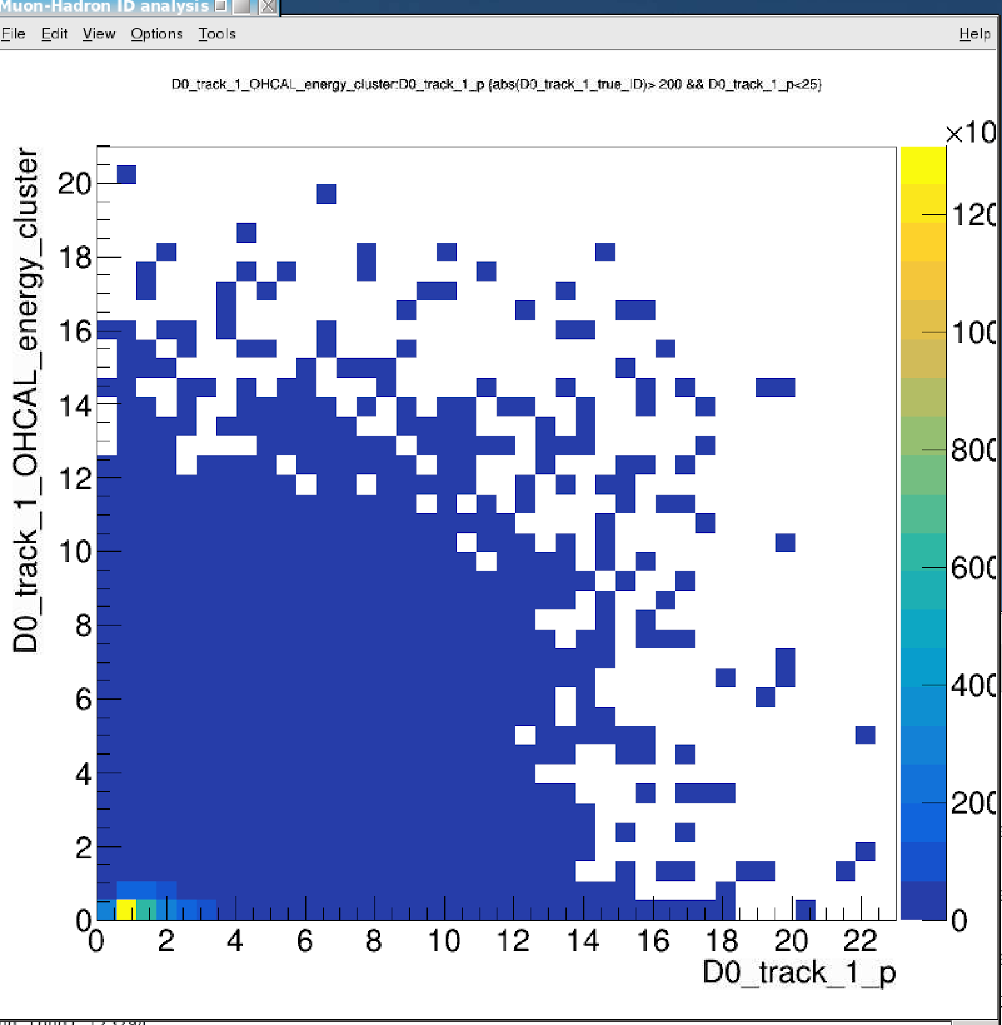
BBbar -> J/Psi, KFParticle Outputs
OHCal_energy_cluster vs p: pi+/- & K+/-
E vs p
E/p vs p

Slide 11
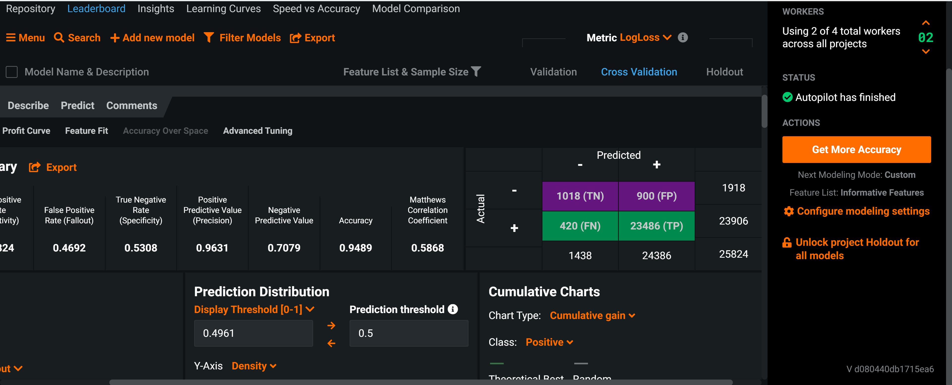
Random Forest Model: - 71% purity and 53% Eff for Muons

Slide 12
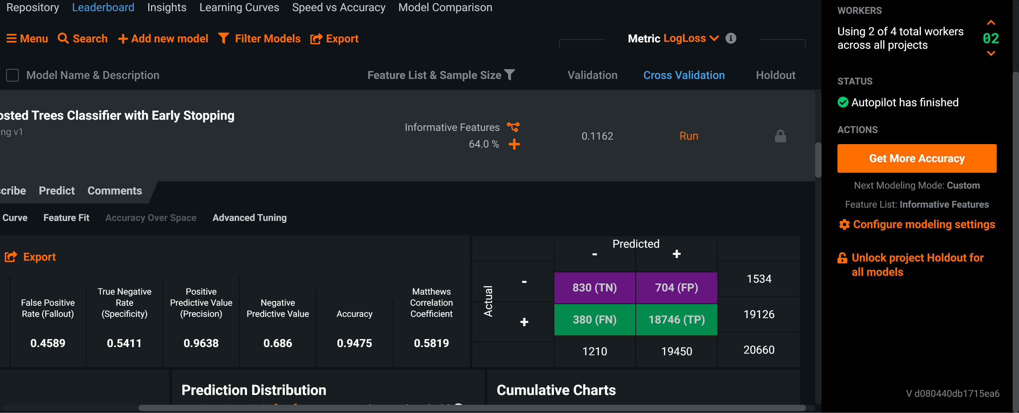
Boosted Tree with Early Stopping - 69% Purity and 54% Eff. for Muons

Slide 13
Summary and Todo List
It seems very feasible to tag high energy muons ~> 2GeV
More detailed study in progress
Test with ROOT/TMVA, PyTorch and other NNs for improvements
New experimental probes with “muons”, “electrons” etc,
Track DCA seems not fully utilized/realized in the models in the ML
HF Physics motivated improvement possible in NN
B->J/Psi +X, B+ -> J/Psi +K; Bs -> J/Psi + Phi
J/Psi -> dimuon (di-electron)
B-> high pT muon (electron), semi-leptonic decay channels etc.

