Slide 1
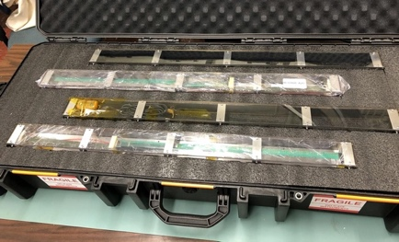
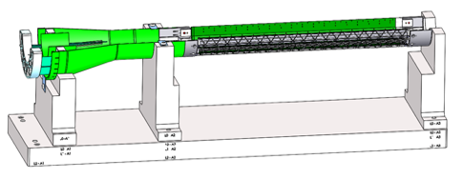
sPHENIX MVTX Project Highlights
On track to complete the full detectors by 2021
Sensor production
  48 Gold staves produced at CERN(Full MVTX detector)
    Spares production in progress, to complete ~3/2021
  Commercial shipping from CERN to US tested
Electronics production
  All 60 frontend Readout Units (RU) produced and tested;
    3 problematic boards repair in progress
  All 30 Power Boards produced and calibrated
  All 100 electronics cooling plates produced
  8 backend FELIX boards order in place
Carbon structure production in progress
  1st layer-0 End-Wheel produced
  Finish production by 4/2021
Detector assembly jigs designed
MVTX insertion system design
  Full scale mock-up in progress
Readout and control system tested
  Firmware/software updated
Negative pressure cooling system tested
Legend
- Sensors & Electronics
- Mechanical Structure
- Global Integration

