Slide 1
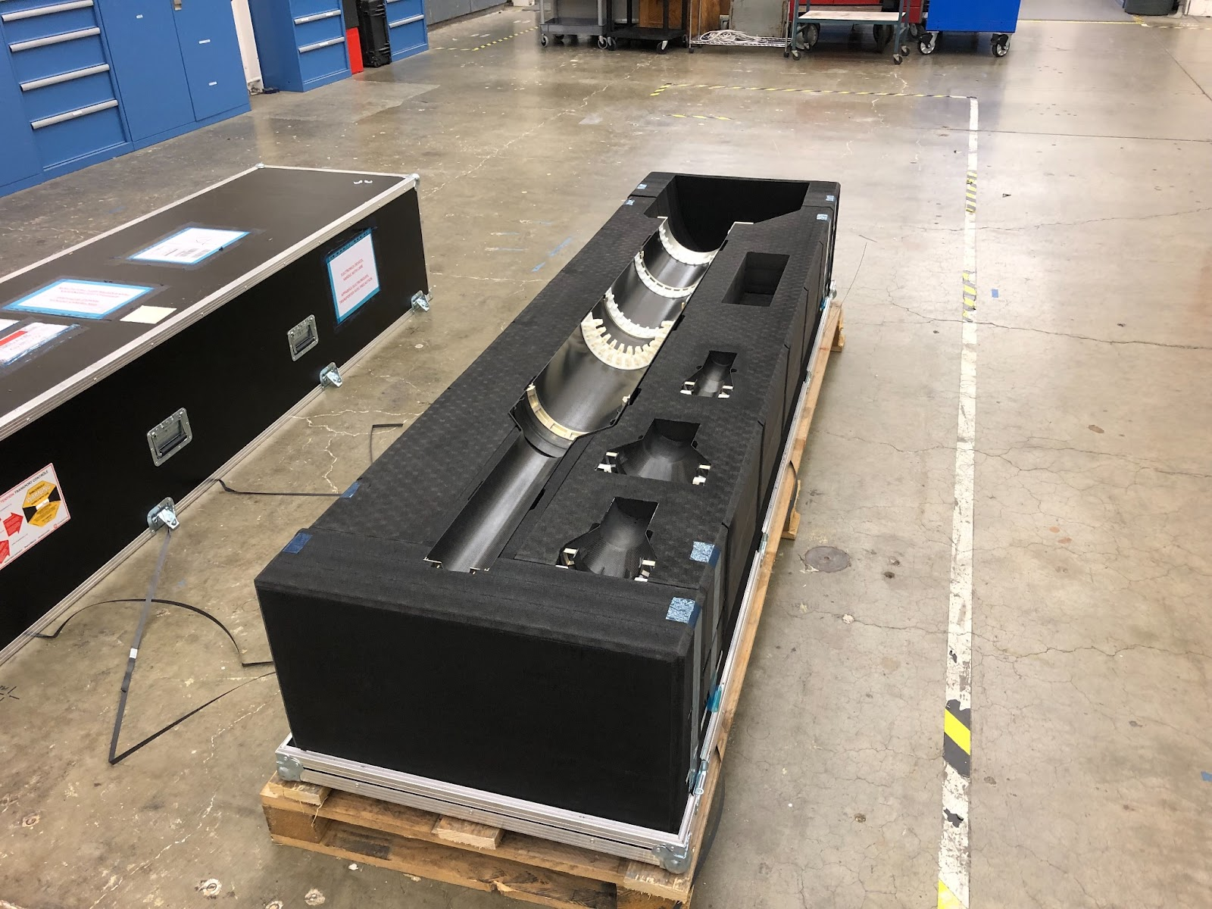
MVTX Status and Plan 7/26/2021
Half-detector assembly at LBNL
Fixtures, manual
Assembly schedule, review in late August?
Stave QA
Threshold scan, visit LBNL?
sPHENIX DB
Electrical system integration
Readout and power
DCS
Mechanical system integration
Insertion system mockup
Cooling system test
Commissioning @BNL
Half detector test
System operation

Slide 2
MVTX project Schedule

