Slide 1
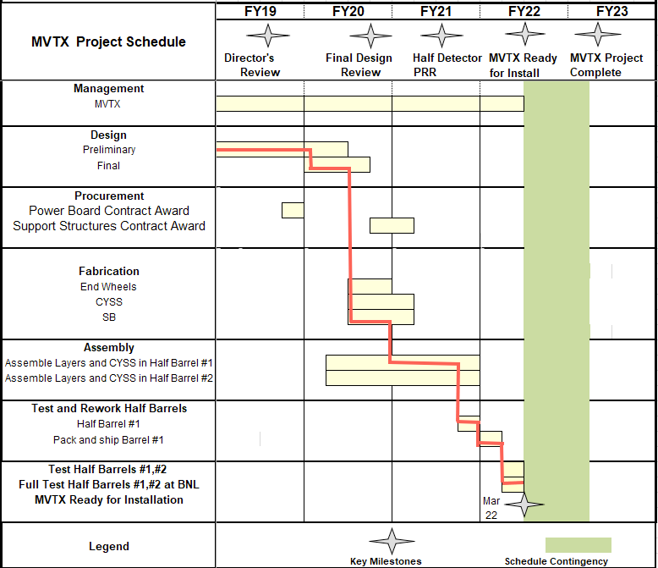
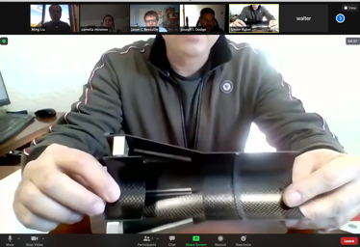
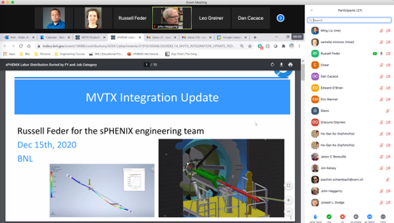
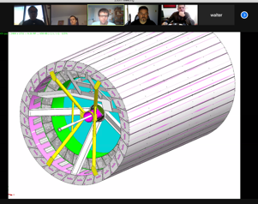
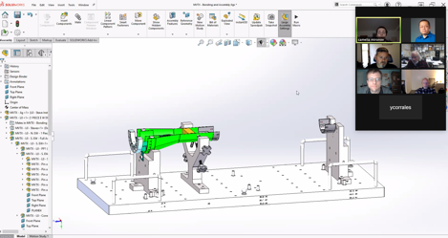
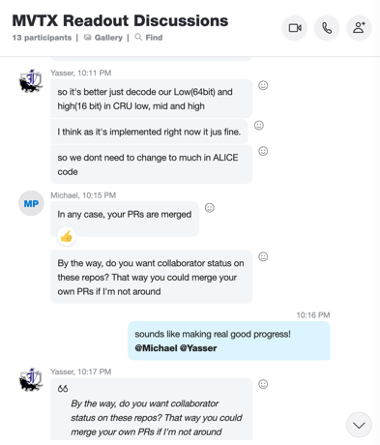
Schedule
Pre-COVID19 Schedule
Today
Some delay in CFC production:
- complete by June, 2021
Still on track for completing
the assembly work in 2021
Assembly review early Aug. ?
@LBNL
Readout, Control and Electrical System Integration
FW/SW synced to latest ALICE/ATLAS, new data format
Low-level slow control under testing
mGTM progress at LANL (160MHz/LHC)
Readout and service cables and power system
MVTX
installation
~9/2022
@BNL

Slide 2
Near Term Plan: 6/14/2021
Preparation for half-detector assembly at LBNL
- CFC shipping from WorkShape
- Assembly jigs
- Test fitting & review
~ early Aug. 2021, in person @LBNL?
Half-detector assembly, readout and monitoring
Single stave with MOSAIC
Possible trip to LBNL ~end of July for MOSAIC system test?
QA DB, threshold & noise issue
Stave cooling and monitoring
Insertion mockup @MIT
sPHENIX, INTT etc.
Test/fix cable lengthes
Cooling system validation
Stave cooling
Rack RU/PU cooling
Slow control
BNL commission plan ~Jan. 2022
Setup clean tent @1008
Half detector test, fix?
Stave shipping:
10/trip, ~ 2 months
Cables for half-detector test
SamTec for MOSAIC
LV, BV cables
CEAN system
- Control and monitor

Slide 3
Installation Schedule, as of 5/19/2021
MVTX:
9/23/2022;
ORR: 11/21/2022

Slide 4
MVTX pre-installation test:2/2022 - 9/2022
Laser room/MVTX clean tent?
Single stave readout, QA, with MOSAIC test bench
Fix bad staves/cables
Highly desired:
Multiple staves (8/24/48?) readout with RU+FELIX+PU
Half-detector 24 stave cosmis data?
Alignment & calibration
Exercise the full electrical system before IR installation

