Slide 1
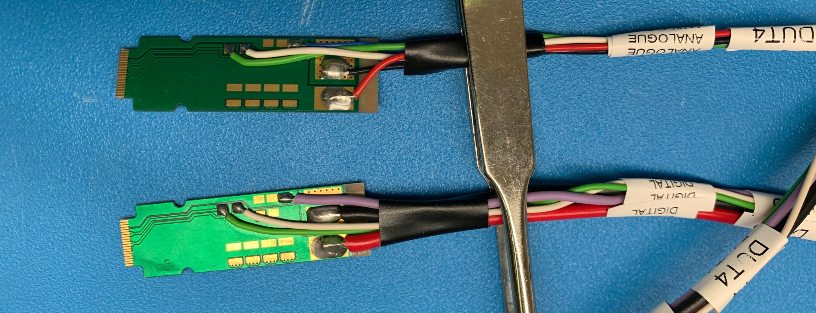
MVTX Power Connectors: 02/04/2021 Yasser, Ming
More information --- https://www.phenix.bnl.gov/WWW/publish/mxliu/sPHENIX/Staves/Stave-power-cables/
VBB
Analogy power
adaptor
PT100
- AGND
- AVDD
PT100,
Not used?
Stave frame GND
Digital power
adaptor
- DGND
- DVDD

Slide 2
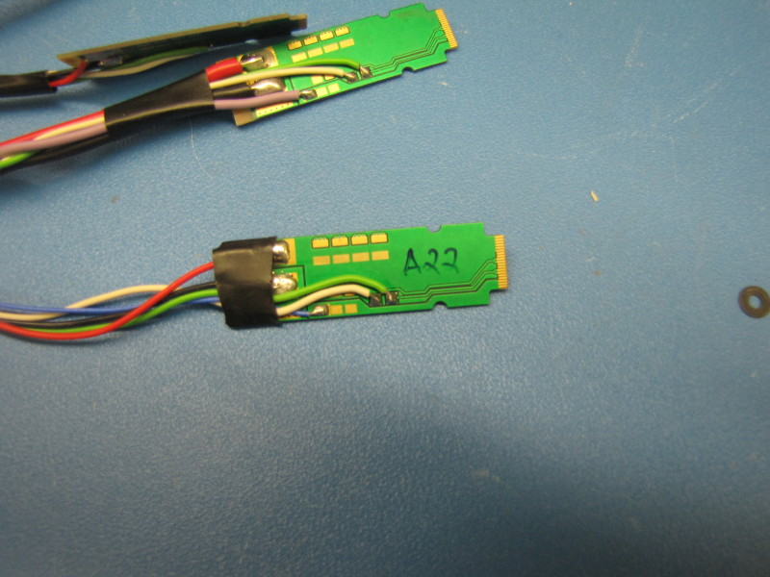
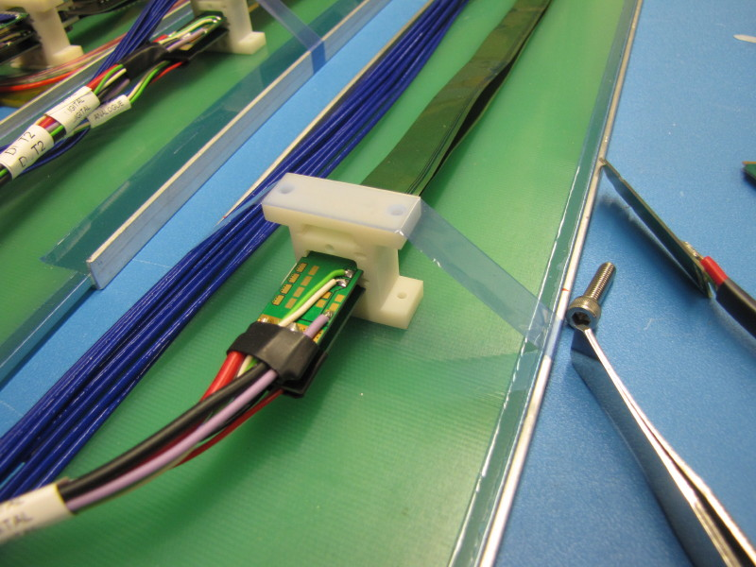
Analog and digital power cable ends:
Digital power
adaptor
PT100,
not used?
Stave frame ground
Analogy power
adaptor
PT100
VBB, share the same
GND with AVDD
Power extension cable attached to stave power cable extension, this would be in MVTX PP2, no spring clip
Notch in cable end that is captured by metal spring in patch panel

Slide 3
Power Adaptor (physically identical for analogy and digital)

