Slide 1
MVTX Status and Plan
Camelia, Grazyna and Ming
10/04/2021
MVTX Bi-Weekly Project Meeting

Slide 2
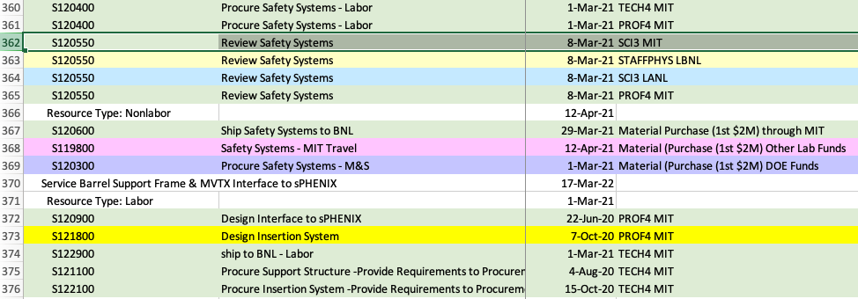
A Few Urgent Items
Assembly schedule challenge:
Complete by Feb. 2022:
Need to work out a schedule backward to determine the deadlines for staves, fixtures etc.
Missing parts:
EW pins arrived at LBNL
Assembly fixtures, L1 and L2
New: desired longer readout cables: (12 + 1.64)m
PP3-> 2E1/rack: 12m cable to be tested
Short ones submitted for PO at LANL, 8-10 wks
Update MVTX project tasks/schedules for FY22:
X-wing and insertion system:
fully exercised at MIT (~summer 2022) and BNL (by ~9/2022)
Cooling system, procured and tested ~March 2022
ready for half-detector commissioning at BNL
Electrical system ready for half-detector commissioning ~early spring 2022
Readout and slow controls
CAEN power system
Funding requests for FY22
LANL, LBNL, ORNL, MIT …
Long PP3->2E1 cable installation likely in late summer 2022
-> propose to make a few long test cables, also used later for the commissioning
P6 dump

Slide 3
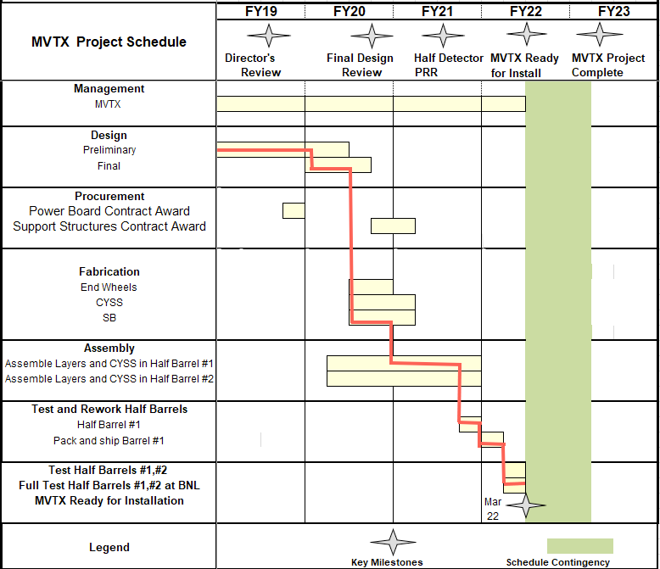
MVTX Milestones
Pre-COVID19 Schedule in MVTX PMP
Carbon Fiber Components: completed 7/2021 (Workshape/France)
Assembly fixtures: designed
Assembly manual: completed
Stave production: completed 5/2021 (CERN)
Half-detector assembly: ongoing (LBNL)
CFC CMM & test fitting: since July, 2021
Half-detector assembly review: 09/09-10, 2021
Complete assembly: by Feb. 2022
Aim to meet the original MVTX installation dates
- MVTX pre-installation commissioning at BNL: March- Oct., 2022
- IR available for MVTX installation: Oct. 23, 2022
The original P6 project task/schedule out of date:
Need to update it with more detailed task/schedule for FY22
Assembly review, 9/9/2021

Slide 4
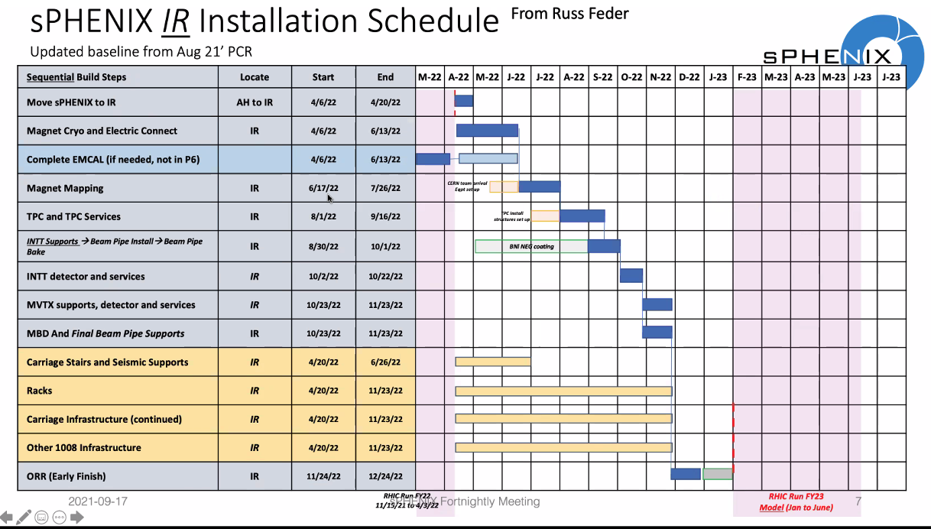
New sPHENIX Installation Schedule:
MVTX: 10/23-11/23, 2022

Slide 5
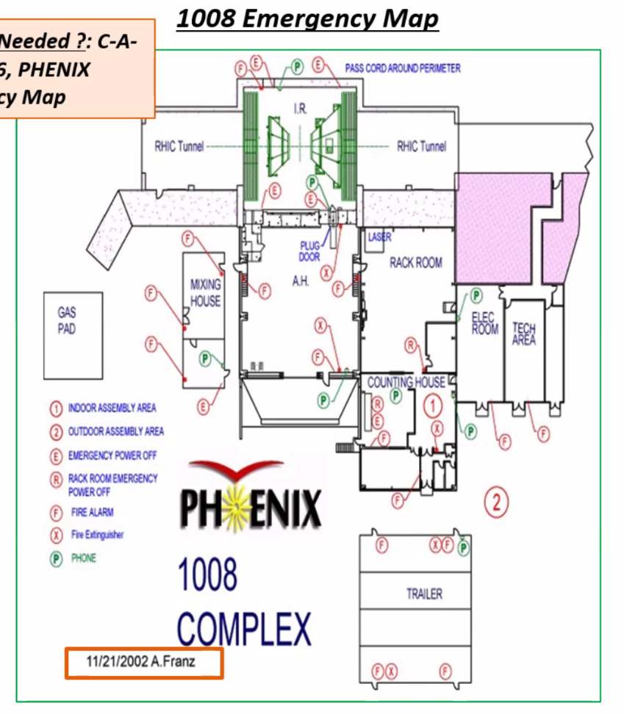
Pre-installation @ 1008: Jan. – Sept., 2022
Setup clean tent at 1008
Laser room for detector and assembly work?
other services stay outside of clean tent
MOSAIC test stand for stave QA
PU+MOSAIC reside in a VME Crate
2 test stands
QA two half-detectors
Single stave QA, one-by-one, 48 total
48 SamTec readout cables
48 DVDD cables
48 AVDD cables
48 “HV” bias cables
48 PT100 T-readback
QA time: 4hrs/stave
Two MOSAIC systems available, ~24 days
MOSAIC
Test Stand
MVTX Detector

