Slide 1
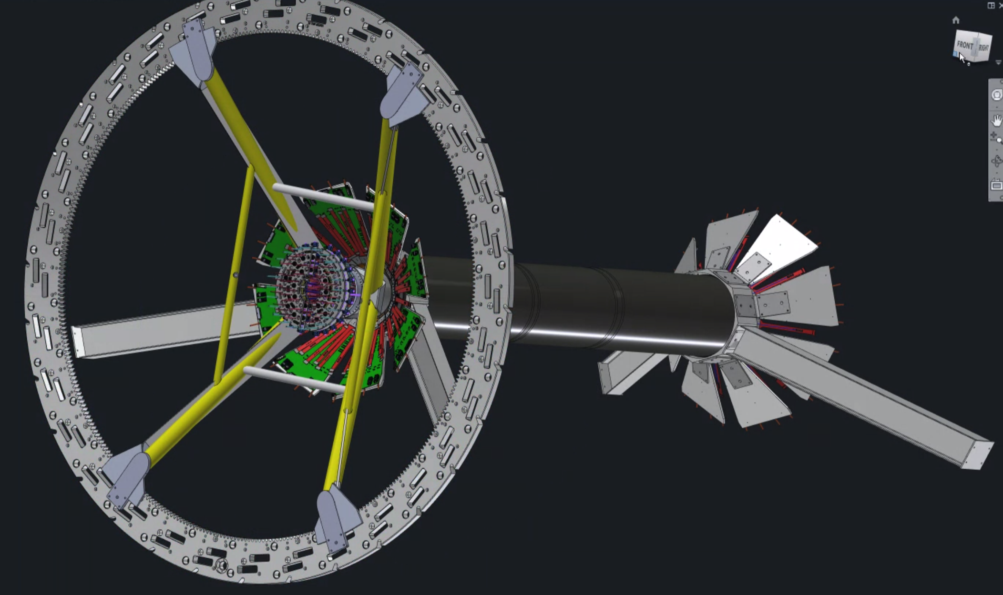
From Dan Cacace
MVTX Status
MVTX + INTT
X-Wing
Ming Liu for the MVTX Group
sPHENIX Collaboration Meeting (Online)
January 21-22, 2021
https://indico.bnl.gov/event/10568/

Slide 2
Outline
MVTX detector introduction
Readout and control
Mechanical system
Detector assembly
Stave production, shipping and QA
Services: power and cooling system

Slide 3

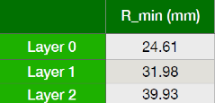
MVTX Detector
Excellent track DCA resolutions in pp, pAu and AuAu
3-layer sensor barrel:
- pixel size: 27 x 29 um
- stave thickness: 0.35%X₀
- Timing resolution: 5us
- 48 staves, 27.1cm long
7/6/20
MVTX Status @sPHENIX Collaboration Meeting
MVTX beam view

Slide 4
Track DCA Resolutions: to True Collision VTX
Joe Osborn
MDC-1
Latest work in progress …
DCA_XY
DCA_Z
10um
25um

Slide 5

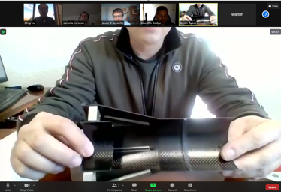
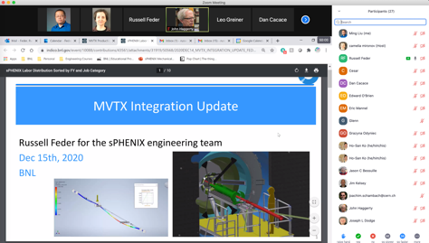

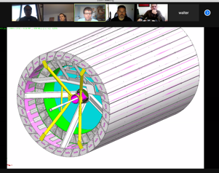
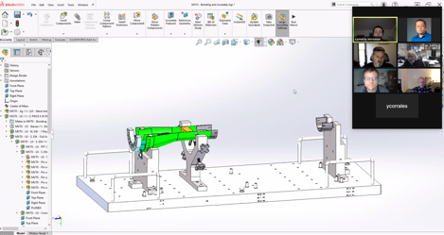
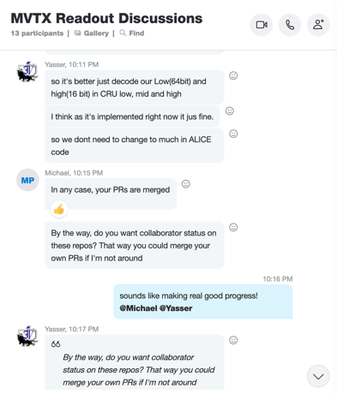

Status & Plan
Pre-COVID19 Schedule
Today
production started
Some delay in CFC production,
but still on track for completing
the assembly work in 2021
Assembly review
@LBNL
Readout, Control and Electrical System Integration
60 RU 1st round test completed
FW/SW synced to latest ALICE/ATLAS code
Low-level slow control under testing
mGTM in progress at BNL (40MHz/LHC)
Readout and service cables and power system
MVTX
installation
~9/2022

Slide 6

48th Gold Stave Produced at CERN in 12/2020!
(One full MVTX detector)

Slide 7
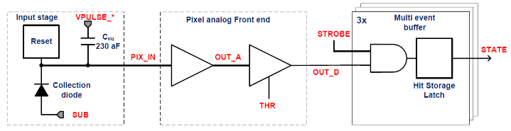
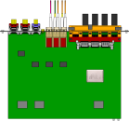

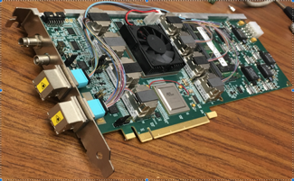

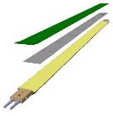
MVTX Readout, Power and Controls Overview
mGTM
(40MHz)
CAN BUS
DCS
Trigger & Clock
Readout Unit
Front End
GBT Optical Links
one pixel
9 Data (1.2Gbps)
1 Clock
1 Control/Trigger
Control
Data (9.6 Gb/s max)
Trigger
9-sensor Stave
Samtec Twinax “FireFly”, ~10m
FELIX
Back End
FPC
Power
Alpide Sensors
ATLAS Front-End Link eXchange (FELIX):
also used by TPC, INTT
Flex PCB Filtering Capacitors
regulators
Power
Regulated Power
CAEN Power supplies
Cold Plate
ALPIDE pixel:
Shaping
Digitization
Zero-suppression
3x buffer
Power Board
Interaction Region
Experimental Hall
Counting House
MVTX electronics consists of three main parts
Sensor-Stave (9 ALPIDE chips) | Front End-Readout Unit | Back End-FELIX/DAM

Slide 8
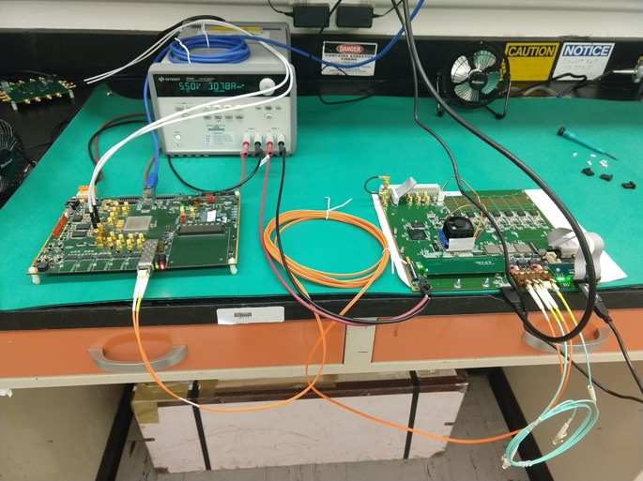
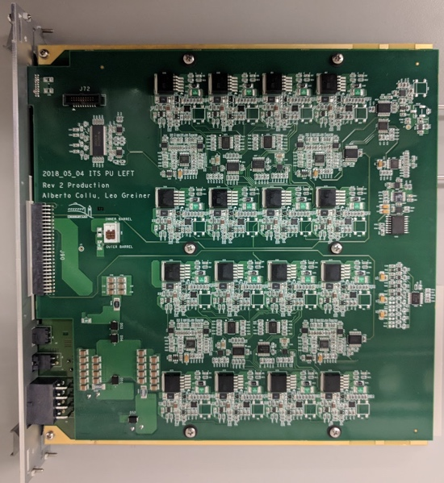
MVTX Readout and Slow Control
60+10 RUs QA Summary, from Jo
Tested all 60 production RUs at ORNL
  Additional 10 RUs for LANL R&D already tested 2019
  Debugging of failing RUs in progress
  2 shipped to LANL for R&D
  More spare VTRx/VTTx optical transceivers desired
Produced and calibrated all 30 production PUs
  2 shipped to LANL for R&D
FELIX production (8) in progress (w/ TPC)
Updated FW/SW to the latest ALICE/ITS code
  Receive triggers from GTM
  One readout data path tested
  GBT Slow Controls tested
  CANBUS low level communication tested
In progress:
  New data format (ALICE ITS) and Continuous Readout (CR)
  Full bandwidth readout w/ 3-fiber
  DCS slow control and monitoring (ALICE) software integration
  Detector safety interlock into sPHENIX (T, V, I etc.)
  mGTM integration and a full detector system test (8-stave telescope)
RU test @ ORNL
Power Board @LBNL

Slide 9
Slow Control and Detector Safety System
- take advantage of ALICE and ATLAS development work
Michael Peters
Low-level Server
FRED / ITSCommLayer
LLA
Front-End Electronics
FELIX card
libflxCard
FELIX wrapper
ALF
High-level control software (WinCC-OA)
FELIX driver interface (libflxCard) provided by ATLAS
ATLAS interface connected to ALICE Online-Offline (O²) interface via FELIXwrapper library
  Status: working for PCIe Base Address Register (BAR) access
Modified version of Low-Level Arbitration (LLA) library from ALICE O²
  FELIXwrapper replaces external O² dependency (except for a single logging library)
  Status: working (pending more comprehensive testing)
Modified version of ALICE Low-level Frontend server (ALF)
  Status: in progress (SWT and LLA done)
Middle-level command translation server (FRED / ITSCommLayer)
  Status: awaiting ALF completion
High-level slow control software
  Status: details TBD – can use large existing software base using WinCC-OA
Detector safety system concept draft recently developed, beginning to iterate with infrastructure and detector safety personnel

Slide 10
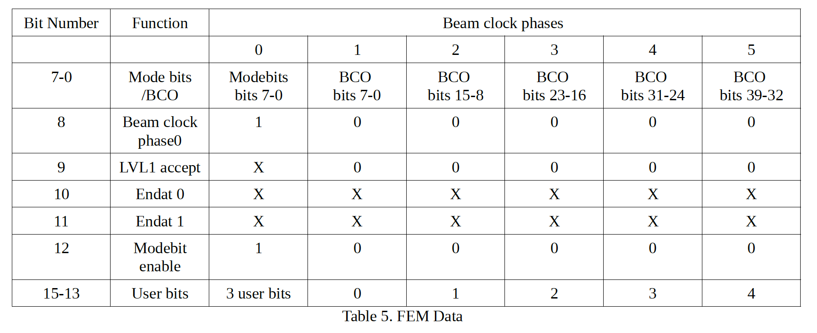
mGTM Development for MVTX (40MHz/LHC)
Yasser, Cameron, Jo, Gerd, Martin/Joe et al
sPHENIX GTM Bits: RHIC_CLK x 6
With N(4) x 40MHz CLK, we can keep a full MVTX gtm packet within one RHIC CLK;
→ Use the same sPHENIX GTM mode bit pattern
the same 1st bit of the GTM Bit Number 9 to send the physics trigger to MVTX;
This trigger timing will be slightly off from the sPHENIX LVL-1 trigger by a fraction of RHIC CLK, depending on the length of Comma words;
User mode bits:
Flag MVTX readout mode:
Triggered mode
Cont. readout mode (C.R.)
For C.R.
  A user-bit to flag “readout strobe”, associated with a specific RHIC Xing bunch, like start of the abort-gap etc.
  Readout per revolution (~12.7us)
LVL-1 Trigger
RHIC
RHIC
RHIC
GTM
1 RHIC CLK
1 RHIC CLK
1 RHIC CLK
mGTM
MVTX
MVTX,
N x 40MHz
MVTX
N1xComma + (Fixed length MVTX gtm packet) + N2xComma;
Comma == various length, to keep the MVTX GTM packet within one RHIC CLK;
A special GTM for MVTX under development at BNL – mGTM, aim to test the system at next TB (if possible) in 2021

Slide 11
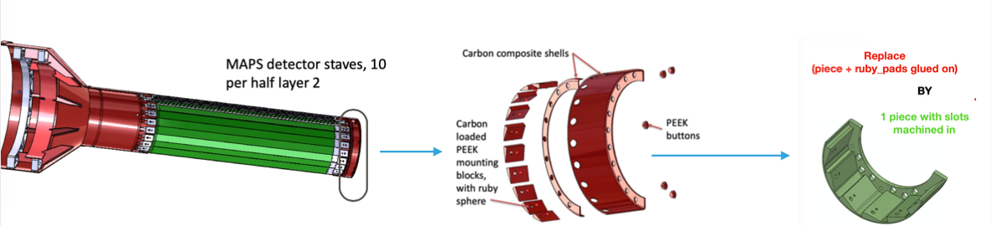
Mechanical Supporting Structure Designed
CYSS
Jason, Joe, Walt, Jim, Camelia et al
Carbon Fiber Composite Structures (CFC)
Layer-2
Layer-1
Layer-0
Service Barrel (SB)
One-Piece Endwheel design to simplify production – Results of Al EW test pieces are good

Slide 12
CFC Test Article: Layer-0
EW designed and Layer-0 prototyped, met all design specs
  3rd-party inspection confirmed the results from manufacturer
  Layer-0,1,2 are the most complex components with the tightest tolerances
CFC structure full production started @WorkShape: EW, CYSS, SB
  Successful Production Readiness Review, 12/15/2020
  1st half delivery in March, the 2nd half in April
WorkShape (France)

Slide 13
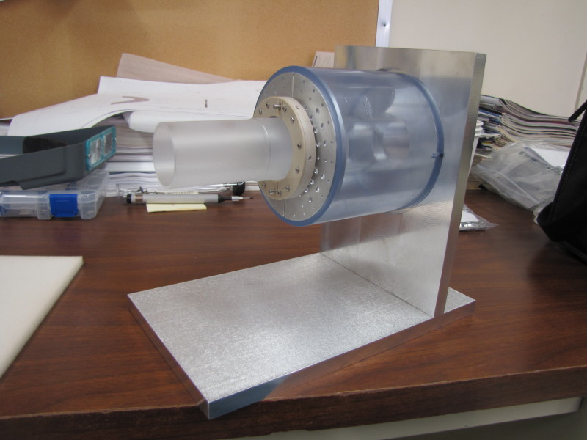
FEA Studies: Nose Roller and Sagging
Nose Roller that interconnects ends of MVTX halves effectively reduces sag by over 0.3 mm
Jason, Walt et al
3-D mockup of Nose Roller
Sagging ~ 0.3mm
MVTX/BP clearance ~1.5mm

Slide 14
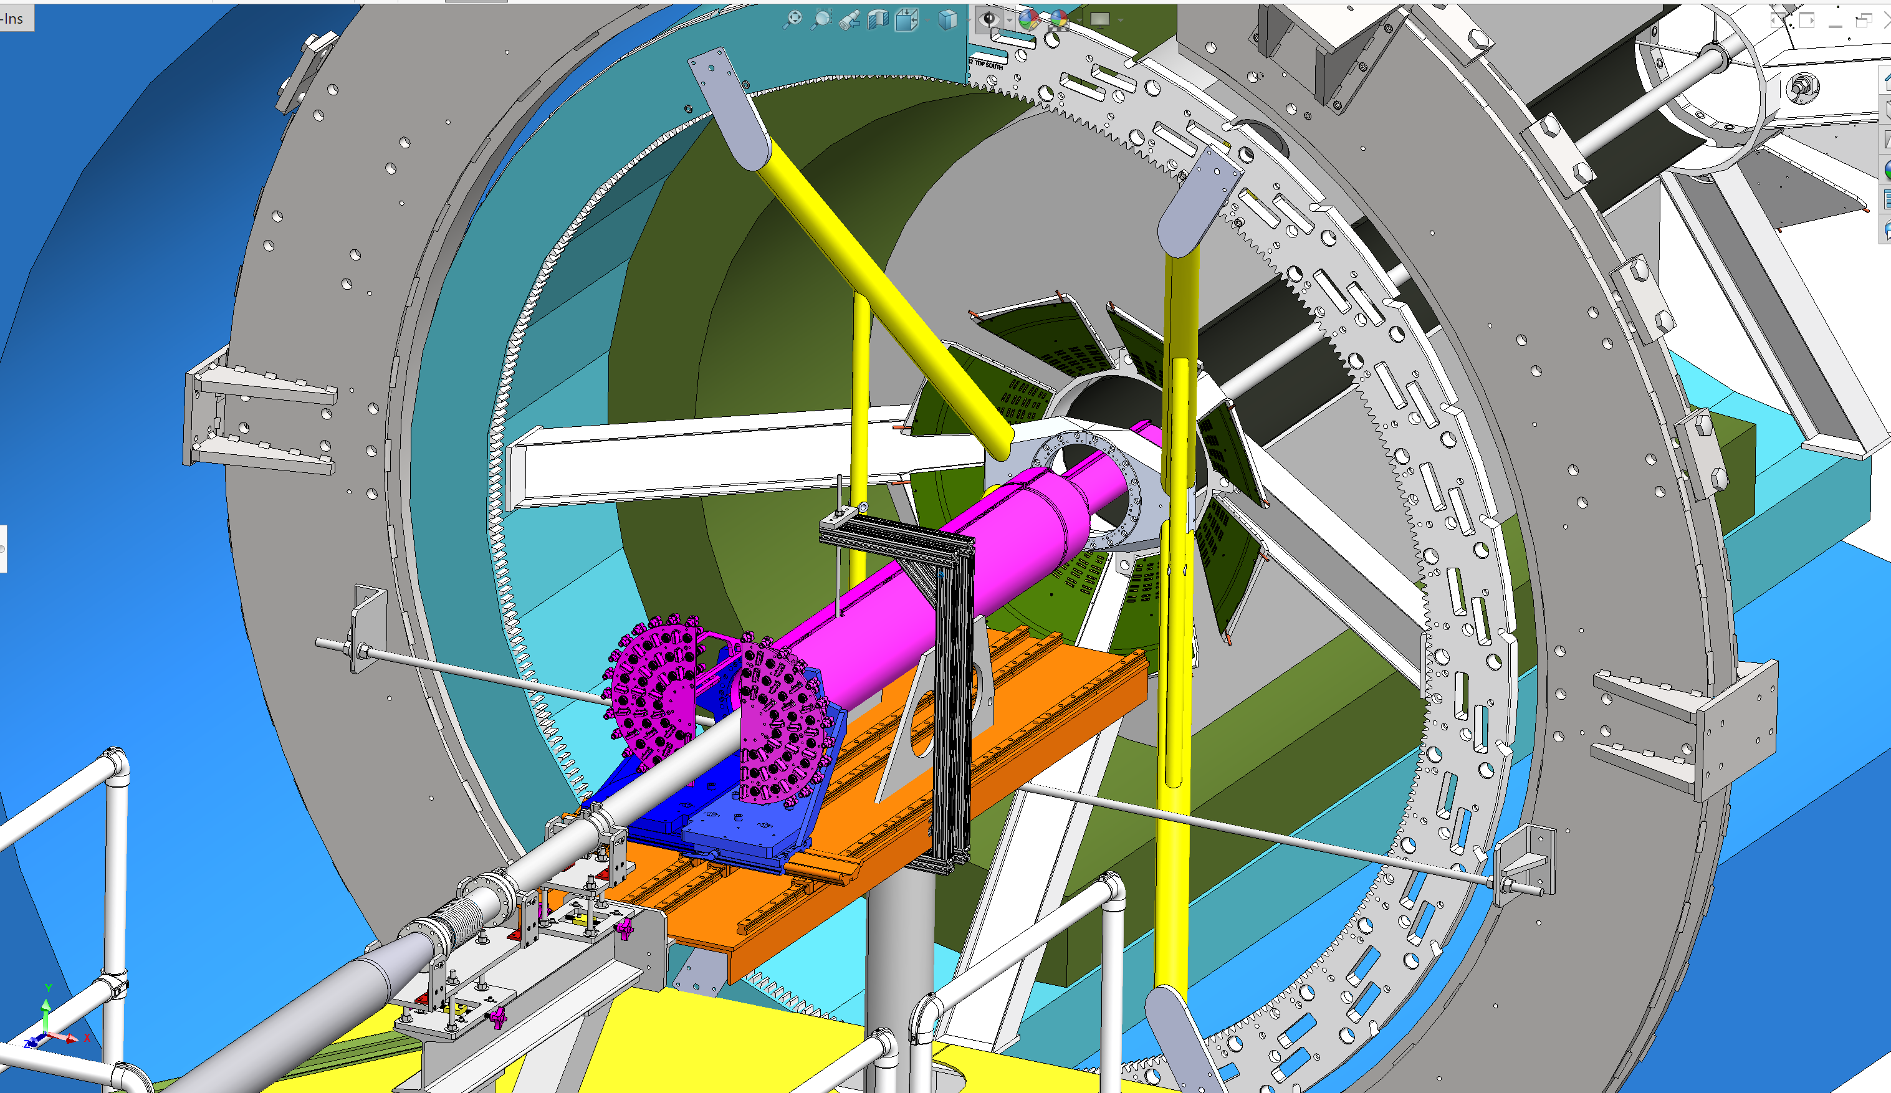
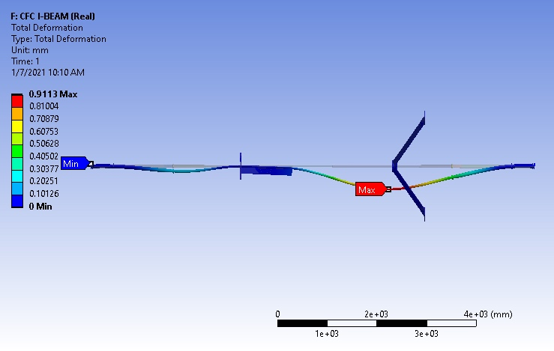
MVTX Detector Insertion System Designed
Jason, Joe, Walt et al
X-Wing
Final position:
mounted on X-Wing
MVTX
MVTX
New beam pipe supports
to minimize sagging
Insertion system
From Brian Brenton/BNL
sPHENIX integration 1/19/2021

Slide 15
Detector Assembly Fixture Designed
Joe, Jason, Walt et al
MIT+LANL+LBNL
Assembly procedure document drafted and reviewed @PRR 12/2020

Slide 16
Simplified Half-Layer Assembly Procedure

Slide 17
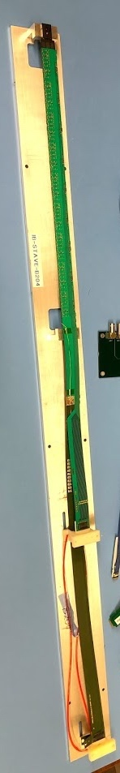
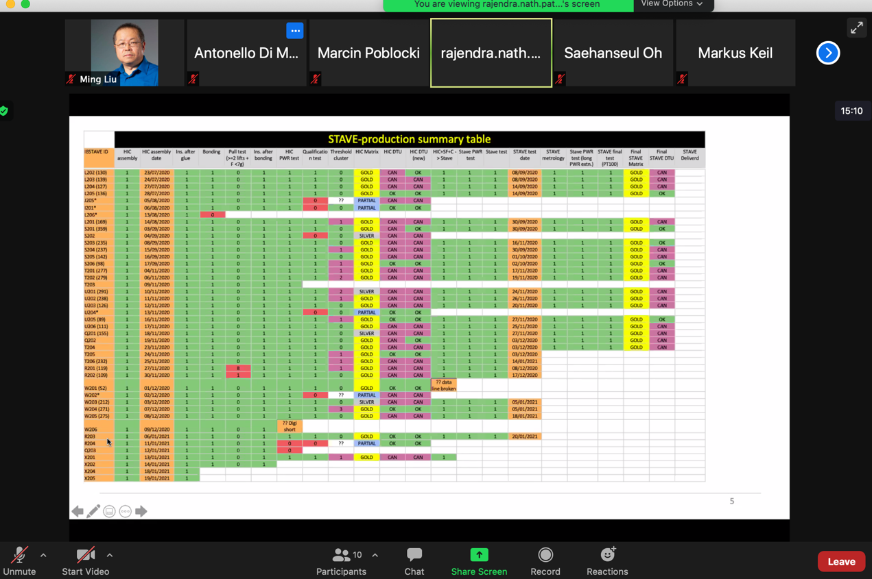
Stave Production at CERN
Stave Production Meetings with CERN every 3 weeks
to keep track of progress and address issues timely, latest meeting 1/20/2021
4 STAVEs (3 Gold + 1 Silver) delivered to LBNL
45 Gold Staves are ready to deliver
6 new Gold Staves passed metrology
  Rate: ~4-stave/week
  Complete full production by 3/2021
Stave production steps and QA chart
~80cm long

Slide 18
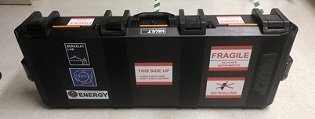
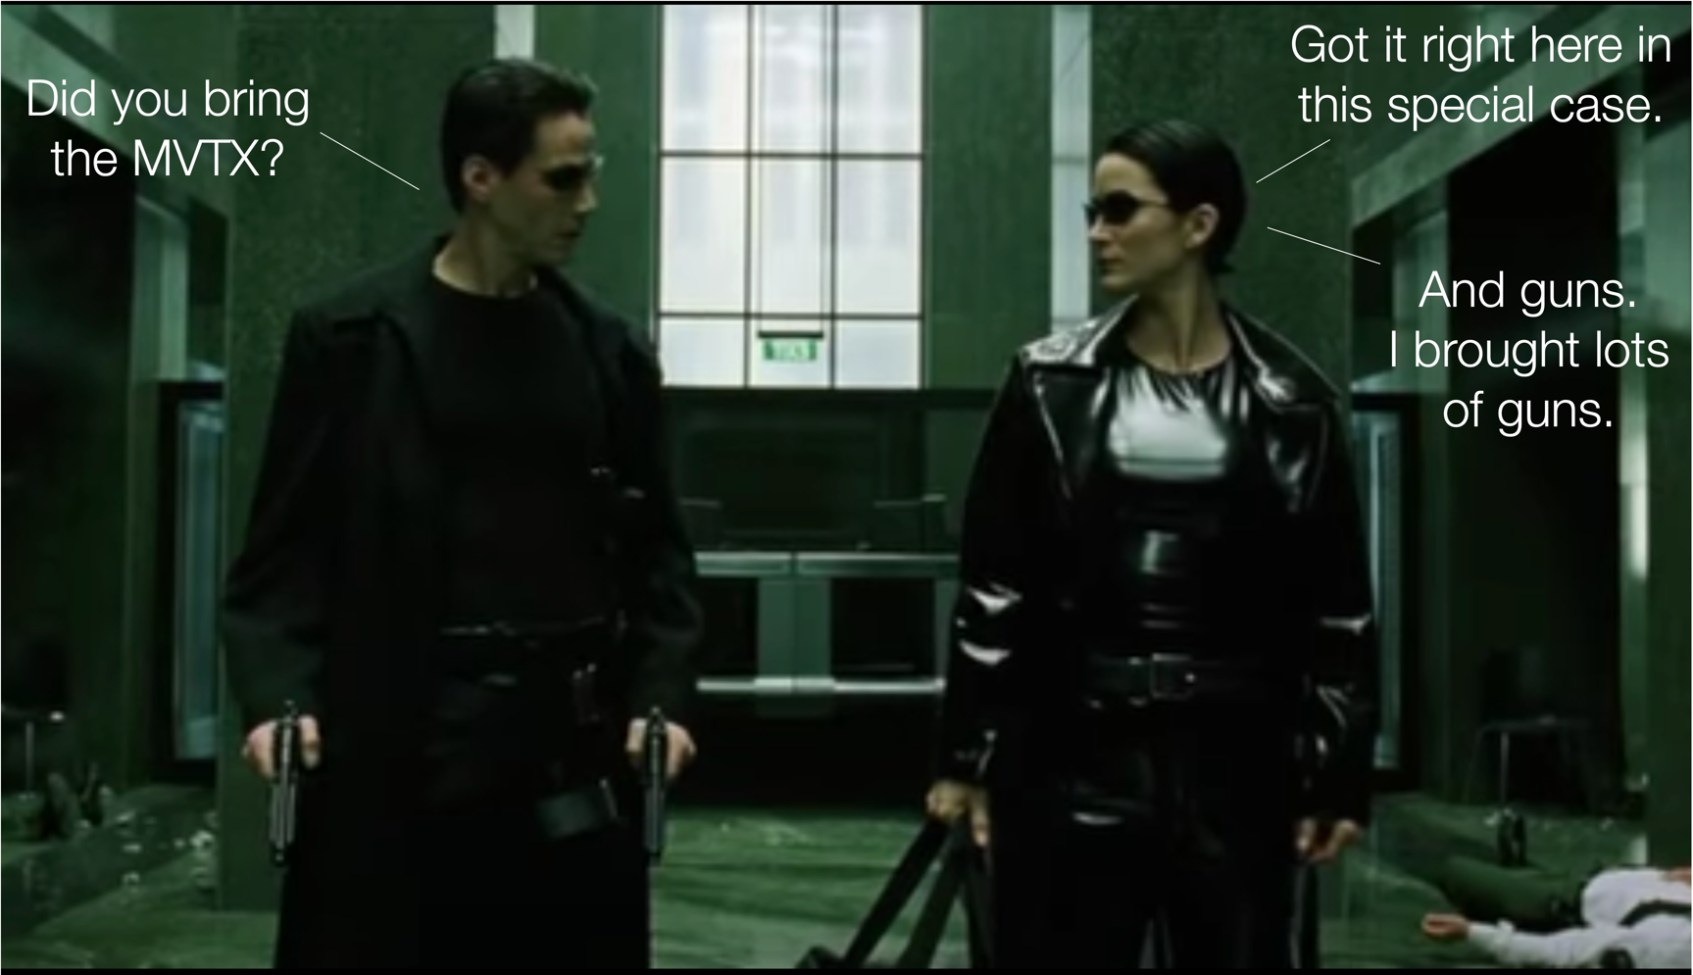
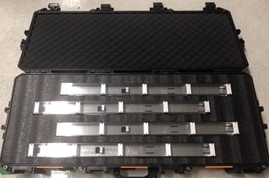

Stave Shipping and Reception Test
The original plan: hand-carry on airplane, CERN->LBNL
New - commercial option due to COVID travel restriction
Yuan, Hanseul, Ho-San et al
Modified rifle case for staves
~80cm long
From DaveM

Slide 19
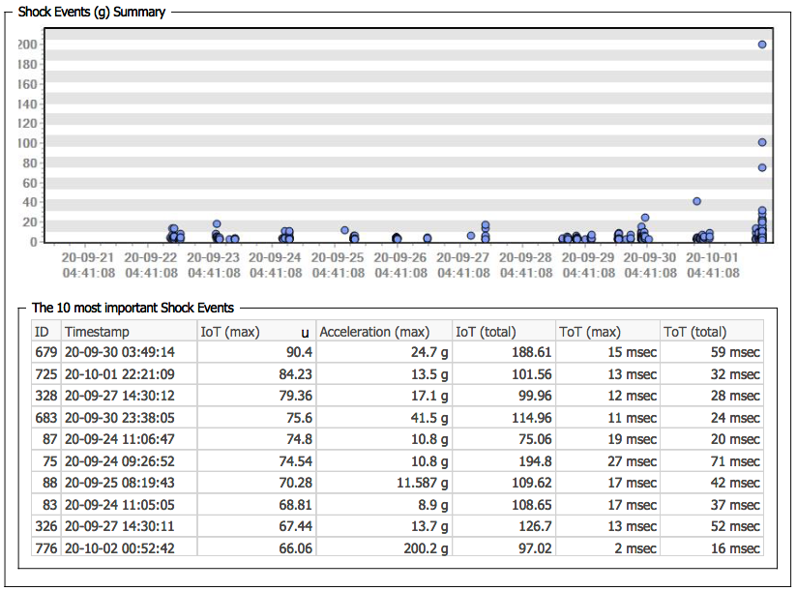
Commercial Transportation Checked
- Shock, temperature, pressure variations during the transportation
Vibration test @CERN
Also did drop tests to the floor,
dragging, car-riding etc.
Shocks logged during the transportation LBNL -> CERN (9/21 - 10/1)
Reproduce transportation “shocking” at Lab, with a test stave

Slide 20
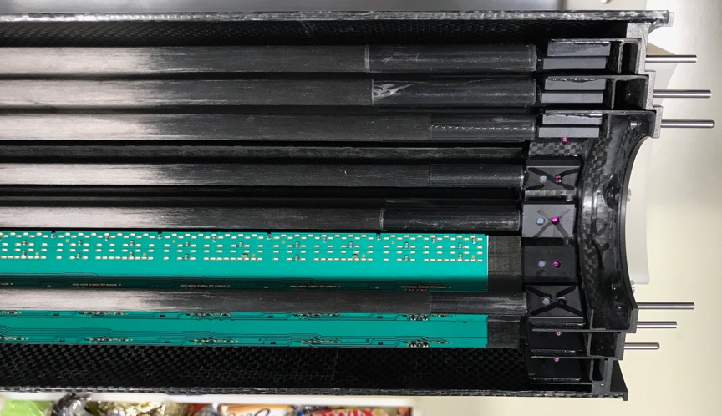
Stave Wire Bonds Pull Test
Status | Mean (gm) | StdDev (gm)
HIC | 9.874 | 0.828
Before test | 10.137 | 0.529
After shock test | 9.938 | 0.586
After vibration test | 9.811 | 0.512
Stave
More details of the vibration test: https://docs.google.com/presentation/d/14iu-azMwnL_OYsT7XyApULv_z7TGYQZZ7IP8hkWnOyI/edit#slide=id.ga48628e3f0_4_41
No difference observed after the tests (pull test, electrical functionality check)
First test shipment in December: 1 Silver + 3 Gold staves to LBNL

Slide 21
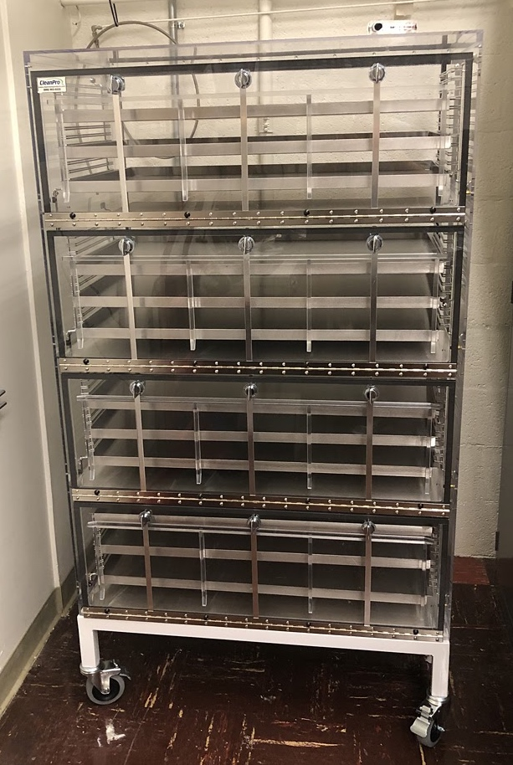
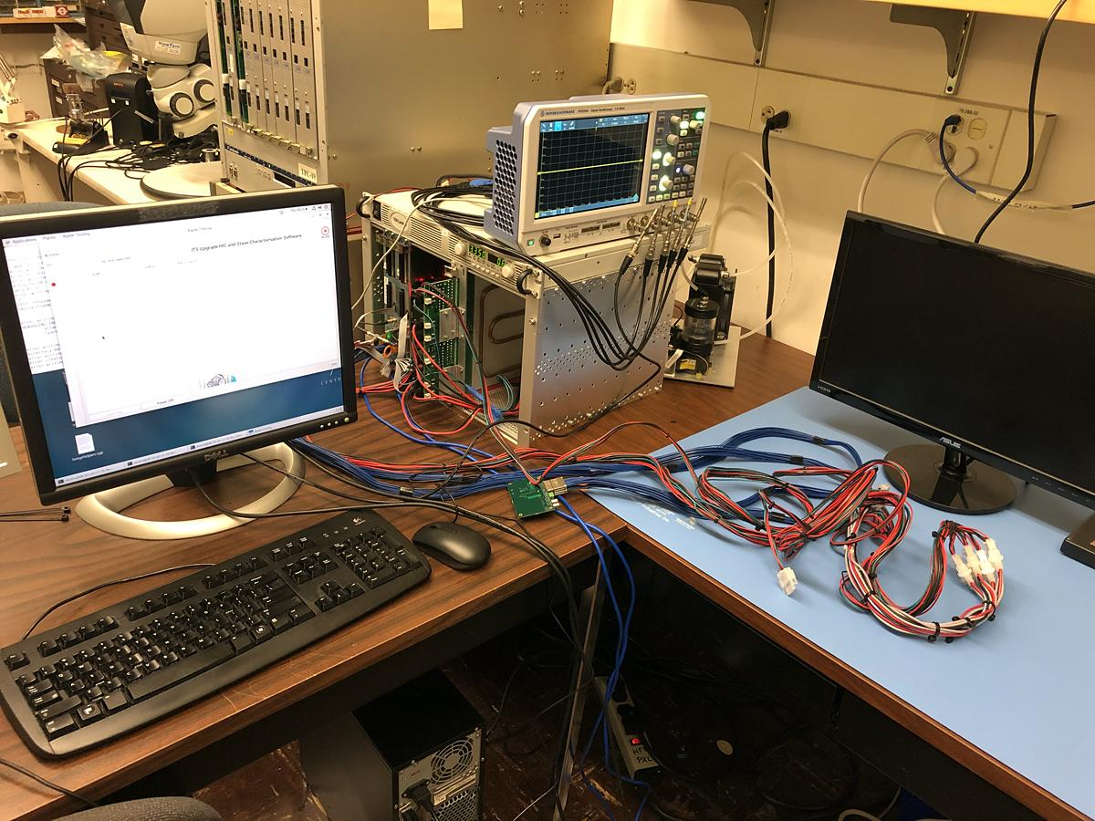
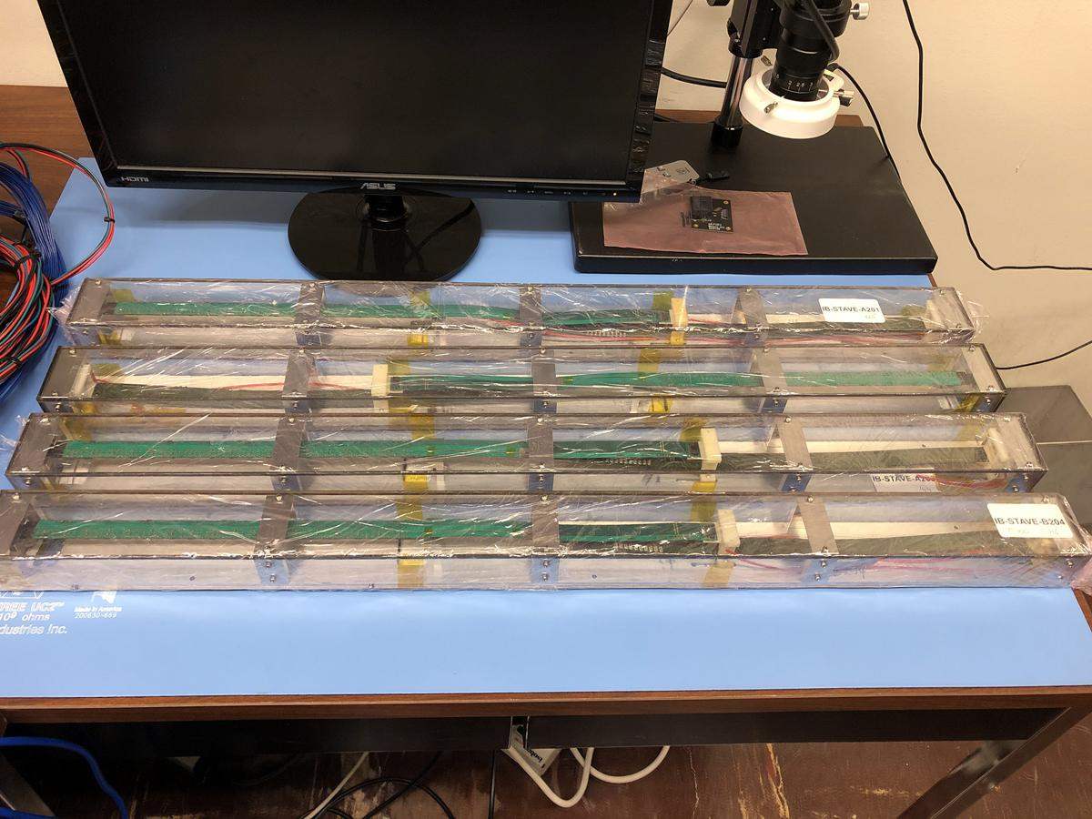
Stave Reception Test at LBNL
Yuan, Hanseul, Ho-San, Yasser, Cameron et al
Setup an identical stave test station at LBNL
Follow the same test procedures used at CERN
4 staves @LBNL
Stave storage

Slide 22
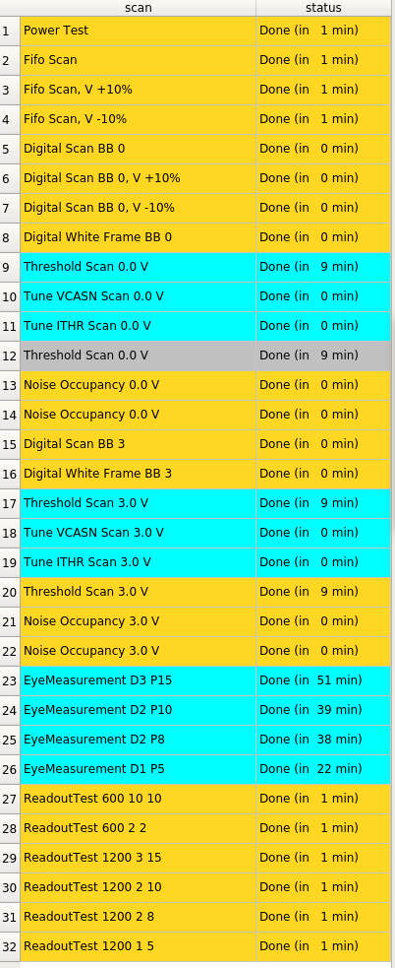
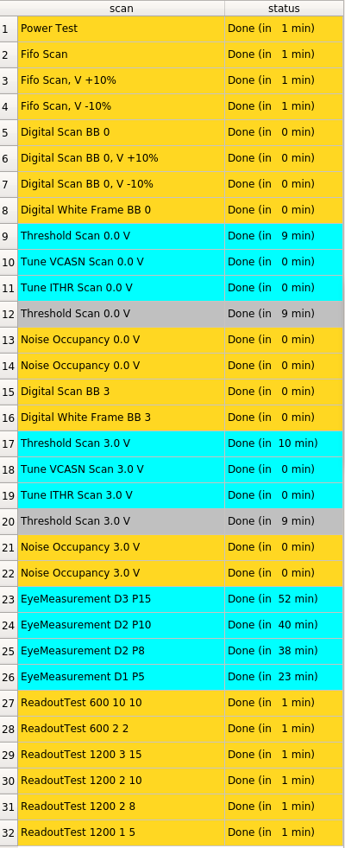
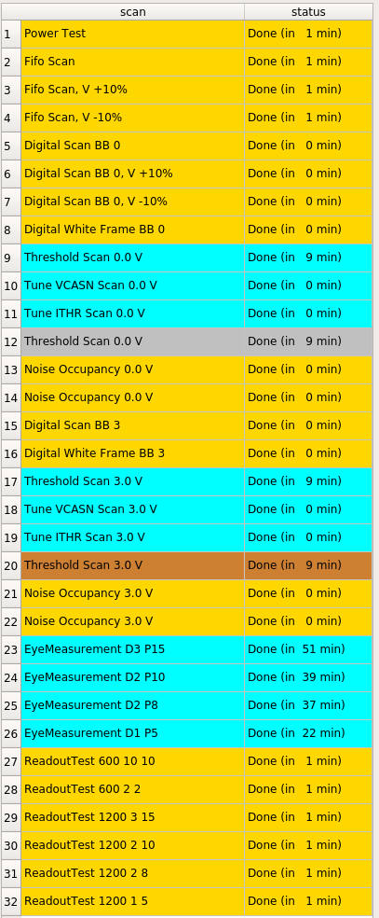
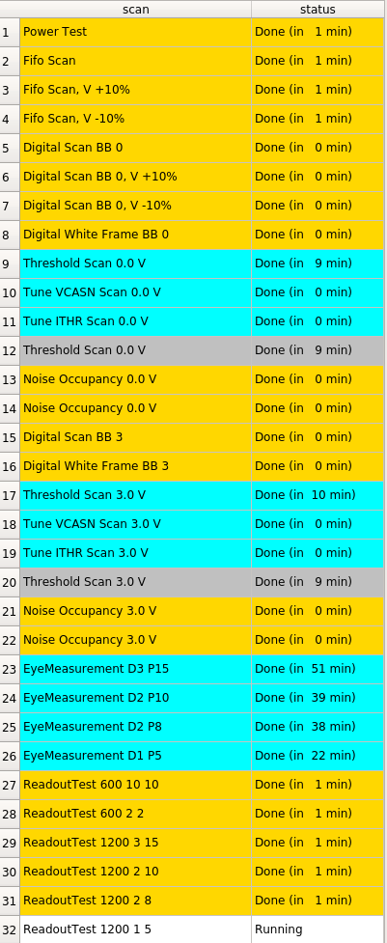
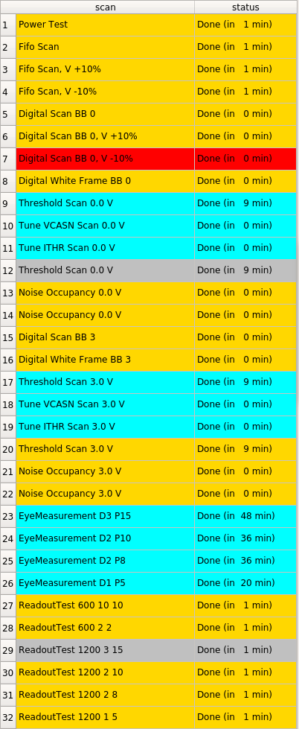
Stave QA Results - A204 (Gold)
(Digital, Analogue, Digital Grd, Analogue Grd)
(0.32, 0.32, 0.16, 0.16)
(0.246, 0.372, 0.0, 0.0)
(0.246, 0.372, 0.123, 0.186)
(0.246, 0.372, 0.246, 0.372)
(0.123, 0.186, 0.123, 0.186)
Most of the test results from LBNL are consistent with those from CERN
Threshold scan results need to be checked by CERN folks before drawing conclusions
Next stave shipment is under discussion

Slide 23
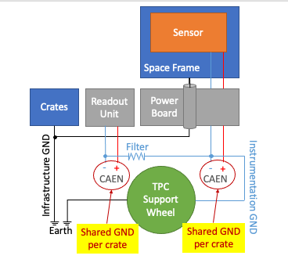
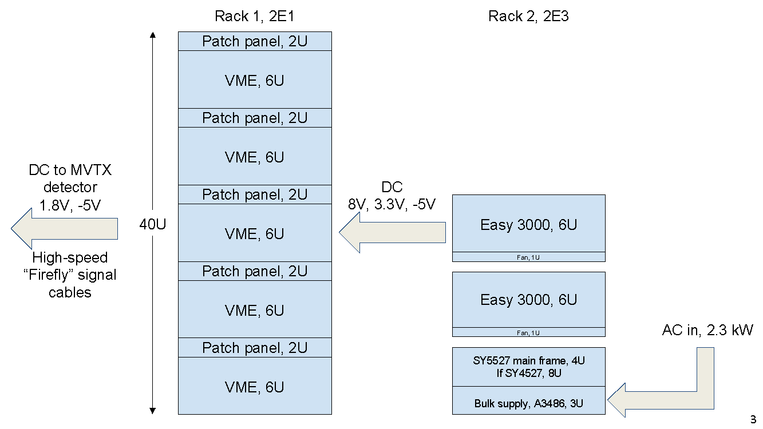
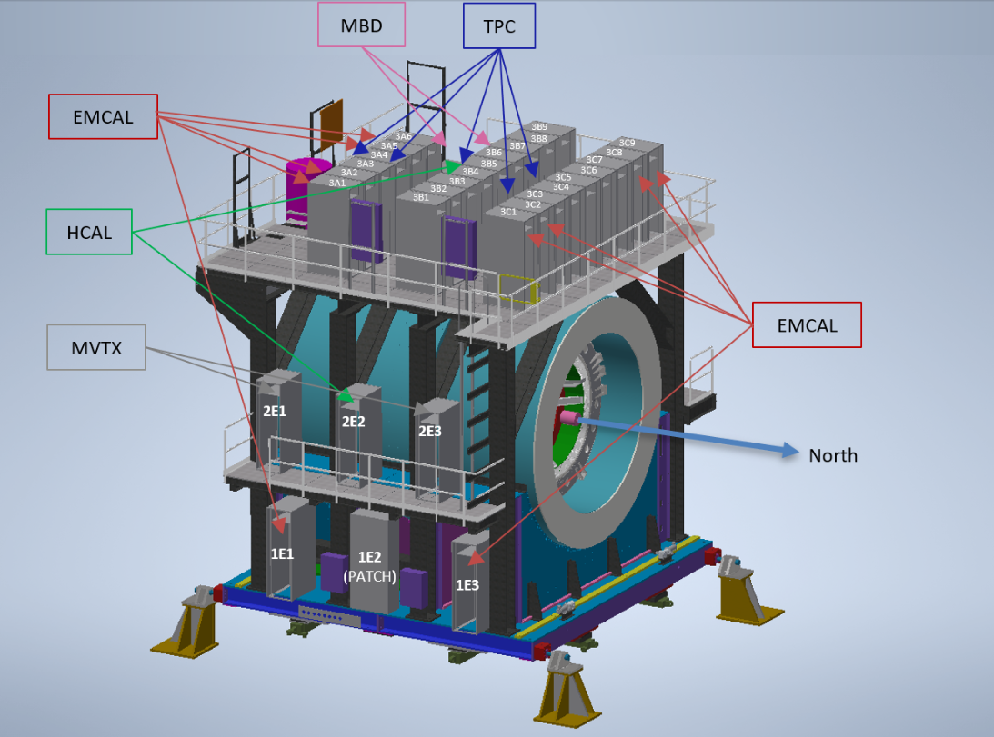
Other MVTX Detector Services
Power system, grounding
Cable routing
Cooling system
Yuan, Ho-San, Jo, Yasser, Cameron
Russ, Joel et al
sPHENIX AC/DC Review 7/15/2020
DC to MVTX
detector
1.8V, -3V
DC
7V, 3.3V, -5V
Rack 2, 2E3

Slide 24
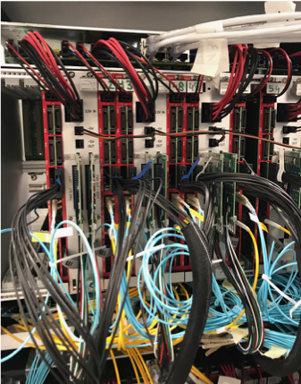
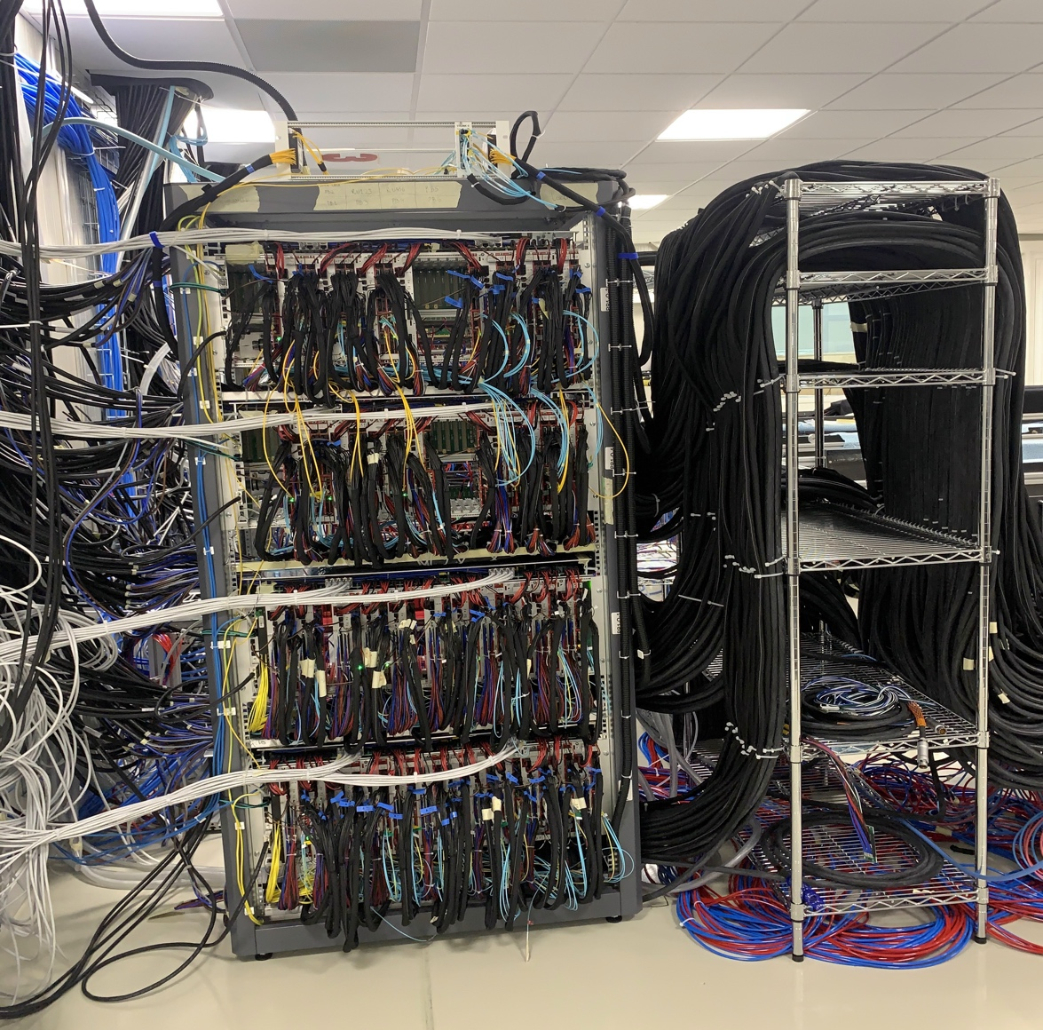
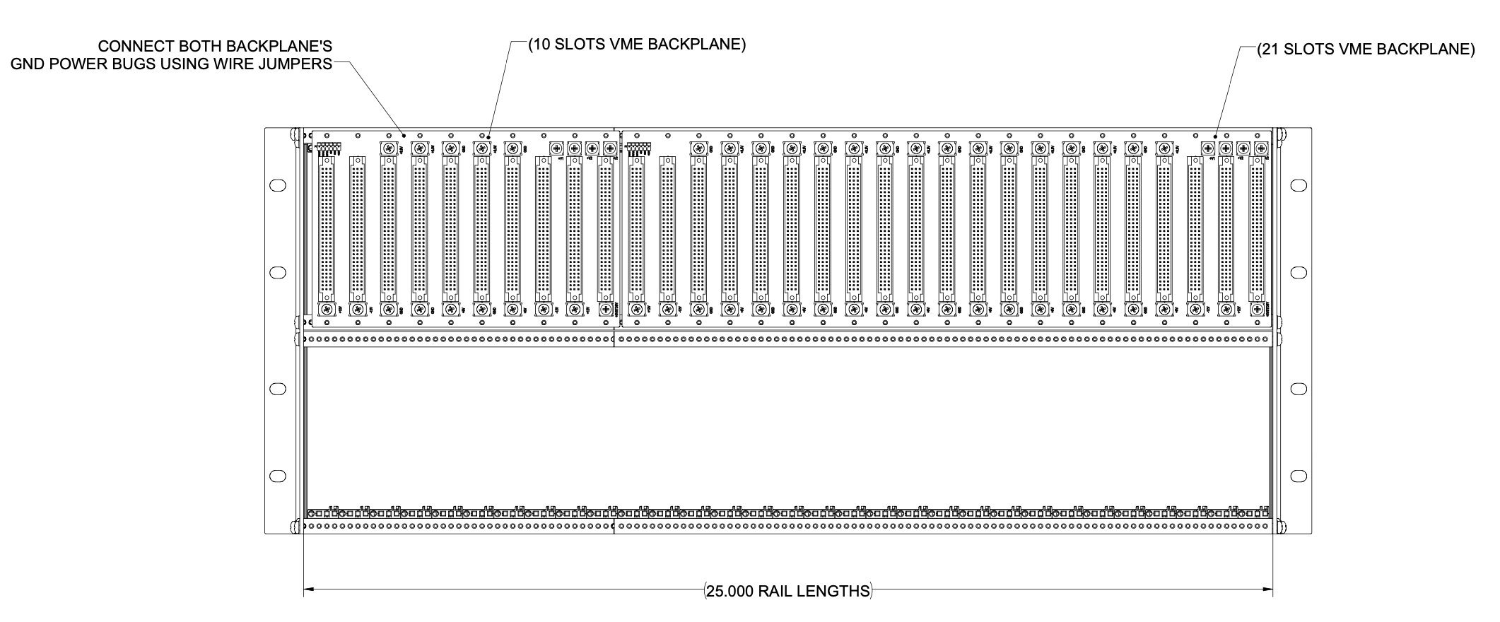
Cabling and Crate Setup
Ho-San, Yuan, Jo et al
27’’ subrack designed and ordered for testing
  subrack for power boards & readout units
  standard 19’’ will make 2E1 too crowded with cables.
  Two VME backplanes (for groundings) joint
Cable plan developed
https://docs.google.com/drawings/d/1AeE-mCyG4cHCX9HjtLNjmEs3yVwiJ6QZpsQ4mHUnRmw/edit?usp=sharing
Custom 27” wide VME crate (Std 19”)
ITS/IB RUs+PUs+cables

Slide 25
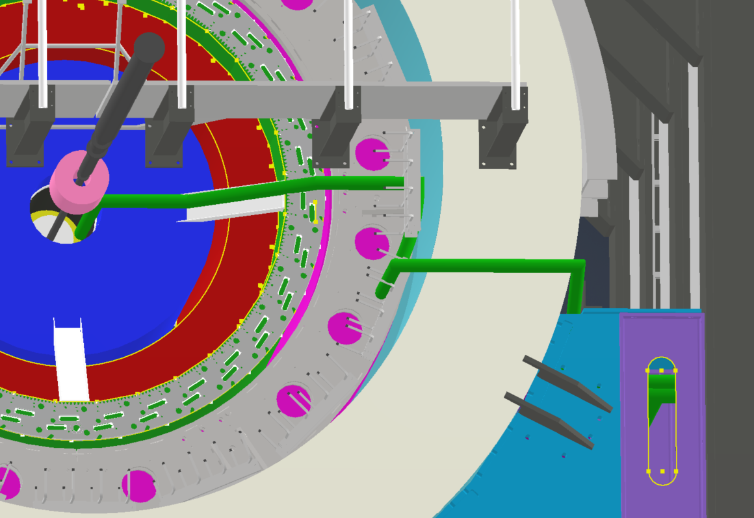
MVTX Cable Routing Plan: from MVTX to 2E1 and 2E3
Section | Longest cable length estimate (m)​
Patch Panel to 2E1 | 7.8m​ *
2E1 to 2E3 | 5.6m​ *
Roland Wimmer /BNL
@MVTX Electrical system integration
Meeting, 12/4/2020
MVTX
cables

Slide 26
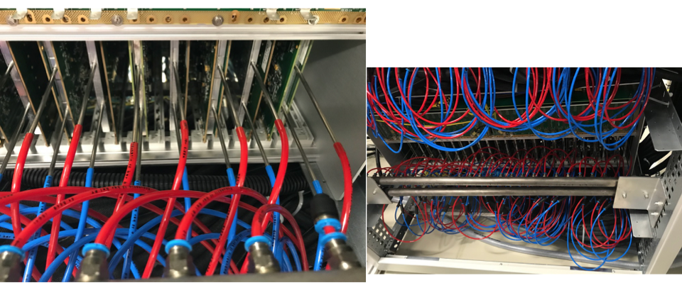
RU and PU Cooling (ITS/IB ~ MVTX)
“negative” pressure water cooling
For staves, RUs and PUs

Slide 27
Preliminary MVTX Cooling System Designed and Tested
Jason, Joe, Walt, Jim et al
Propose to use same chiller system, for MVTX & INTT,
- share spare and cost
Robert P. Pisani
@BNL

Slide 28
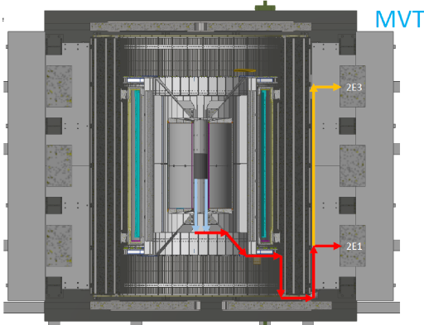
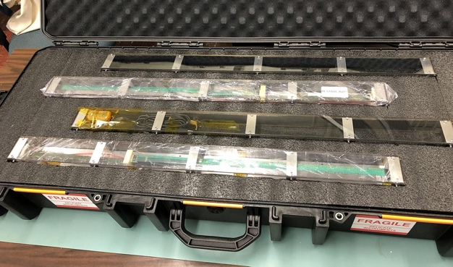
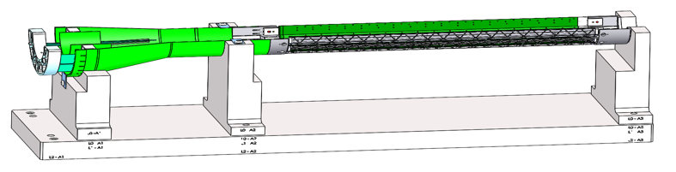
Summary and Outlook
Accomplished a lot, still many challenges ahead
  Mechanical system
  Electrical system
  Integration
Half-detector assembly at LBNL
  Stave shipping and test
  CFC production and test fitting
  Assembly half-detectors and QA
Readout & control system integration
  New data format, continuous readout etc
  mGTM development and integration
  Slow control, monitoring and detector safety
Other services
  Cooling system final design and test
  Clean tent at BNL in late Fall 2021 for commissioning
Upcoming reviews
  sPHENIX MVTX/INTT/BP integration Review: ~ Mar/Apr 2021
    Complete MVTX insertion system mockup
  Cables safety review/approval, early 2021
    Racks and cable layout
    Power and data cable procurements and QA
  Half-detector assembly review, ~May 2021

Slide 29
Backup slides

Slide 30
 | STAVE-production summary table
IBSTAVE ID | HIC assembly | HIC assembly date | Ins. after glue | Bonding | Pull test (>=2 lifts + F <7g) | Ins. after bonding | HIC PWR test | Qualification test | Threshold cluster | HIC Matrix | HIC DTU | HIC DTU (new) | HIC+SF+C -> Stave | Stave PWR test | Stave test | STAVE test date | STAVE metrology | Stave PWR test (long PWR extn.) | STAVE final test (PT100) | Final STAVE Matrix | Final STAVE DTU | STAVE Deliverd
TOTAL | 83 |  | 83 | 80 |  | 80 | 76 | 62 |  |  |  |  | 58 | 57 | 57 |  | 49 | 49 | 49 |  |  | 4
A201 (326) | 1 | 03/10/2019 | 1 | 1 | 1 | 1 | 1 | 1 | 1 | GOLD | OK | OK | 1 | 1 | 1 | 01/11/2019 | 1 | 1 | 1 | GOLD | OK | 1
A202* | 1 | 07/10/2019 | 1 | 1 | 0 | 1 | 1 | 0 | ?? | PARTIAL | OK | OK
A203 (144) | 1 | 08/10/2019 | 1 | 1 | 0 | 1 | 1 | 1 | 0 | GOLD | OK | OK | 1 | 1 | 1 | 04/11/2019 | 1 | 1 | 1 | GOLD | OK | 1
A204 (158) | 1 | 22/10/2019 | 1 | 1 | 1 | 1 | 1 | 1 | 0 | GOLD | OK | OK | 1 | 1 | 1 | 07/11/2019 | 1 | 1 | 1 | GOLD | OK | 1
A205 (167) | 1 | 23/10/2019 | 1 | 1 | 4 | 1 | 1 | 1 | 0 | GOLD | CAN | OK | 1 | 1 | 1 | 08/11/2019 | 1 | 1 | 1 | GOLD | OK
A206 (204) | 1 | 30/10/2019 | 1 | 1 | 3 | 1 | 1 | 1 | 2 | GOLD | CAN | CAN | 1 | 1 | 1 | 24/01/2020 | 1 | 1 | 1 | GOLD | CAN
B201 (352) | 1 | 30/10/2019 | 1 | 1 | 0 | 1 | 1 | 1 | 0 | GOLD | CAN | CAN | 1 | 1 | 1 | 28/05/2020 | 1 | 1 | 1 | GOLD | OK
B202* | 1 | 31/10/2019 | 1 | 1 | 0 | 1 | 1 | 0 |  | Broken
B203 (114) | 1 | 07/11/2019 | 1 | 1 | 1 | 1 | 1 | 1 | 0 | GOLD | CAN | CAN | 1 | 1 | 1 | 29/05/2020 | 1 | 1 | 1 | GOLD | CAN
B204 (116) | 1 | 13/11/2019 | 1 | 1 | 0 | 1 | 1 | 1 | 1 | SILVER | CAN | CAN | 1 | 1 | 1 | 28/05/2020 | 1 | 1 | 1 | SILVER | CAN | 1
B205 (115) | 1 | 14/01/2020 | 1 | 1 | 2 | 1 | 1 | 1 | 0 | GOLD | CAN | CAN | 1 | 1 | 1 | 02/06/2020 | 1 | 1 | 1 | GOLD | OK
B206 (295) | 1 | 15/01/2020 | 1 | 1 | 2 | 1 | 1 | 1 | 0 | GOLD | CAN | OK | 1 | 1 | 1 | 02/06/2020 | 1 | 1 | 1 | GOLD | OK
F201* | 1 | 27/02/2020 | 1 | 1 | 1 | 1 | 1 | 0 | ?? | PARTIAL | OK | OK
F202 (230) | 1 | 28/02/2020 | 1 | 1 | 3 | 1 | 1 | 1 | 0 | GOLD | CAN | OK | 1 | 1 | 1 | 04/06/2020 | 1 | 1 | 1 | GOLD | CAN
F204 | 1 | 29/02/2020 | 1 | 1 | 5 | 1 | 1 | 1 | 2 | GOLD | CAN | OK
G202 (234) | 1 | 10/02/2020 | 1 | 1 | 0 | 1 | 1 | 1 | 1 | GOLD | OK | OK | 1 | 1 | 1 | 04/06/2020 | 1 | 1 | 1 | GOLD | OK
G203 | 1 | 12/02/2020 | 1 | 1 | 1 | 1 | 1 | 1 | 1 | GOLD | CAN | CAN
F203* | dummy
H202 (294) | 1 | 24/02/2020 | 1 | 1 | 0 | 1 | 1 | 1 | 0 | GOLD | OK | OK | 1 | 1 | 1 | 05/06/2020 | 1 | 1 | 1 | GOLD | OK
H203 (302) | 1 | 26/02/2020 | 1 | 1 | 0 | 1 | 1 | 1 | 0 | GOLD | OK | OK | 1 | 1 | 1 | 05/06/2020 | 1 | 1 | 1 | GOLD | OK
H204 (354) | 1 | 27/02/2020 | 1 | 1 | 0 | 1 | 1 | 1 | 0 | GOLD | OK | OK | 1 | 1 | 1 | 11/06/2020 | 1 | 1 | 1 | GOLD | OK
H206* | 1 | 04/03/2020 | 1 | 1 | 0 | 1 | 1 | 0 | ?? | PARTIAL | OK | OK
E204 (110) | 1 | 05/03/2020 | 1 | 1 | 0 | 1 | 1 | 1 | 1 | GOLD | CAN | CAN | 1 | 1 | 1 | 22/06/2020 | 1 | 1 | 1 | GOLD | CAN
E201* | 1 | 12/02/2020 | 1 | 1 | 0 | 1 | 1 | 0 | 3 | PARTIAL | CAN | OK
E202 | 1 | 10/03/2020 | 1 | 1 | 1 | 1 | 1 | 1 | 1 | GOLD | CAN (bad driver) | CAN (bad driver)
E206 (101) | 1 | 12/03/2020 | 1 | 1 | 0 | 1 | 1 | 1 | 1 | GOLD | OK | OK | 1 | 1 | 1 | 16/06/2020 | 1 | 1 | 1 | GOLD | OK
H205 | 1 | 11/06/2020 | 1 | 1 | 0 | 1 | 1 | 0 | 1 | SILVER | OK | OK
I202 (175) | 1 | 15/06/2020 | 1 | 1 | 0 | 1 | 1 | 1 | 0 | GOLD | OK | OK | 1 | 1 | 1 | 22/06/2020 | 1 | 1 | 1 | GOLD | OK
I203 (187) | 1 | 16/06/2020 | 1 | 1 | 0 | 1 | 1 | 1 | 0 | GOLD | OK | OK | 1 | 1 | 1 | 26/06/2020 | 1 | 1 | 1 | GOLD | OK
I204* | 1 | 17/06/2020 | 1 | 1 | 0 | 1 | 1 | 0 | 0 | PARTIAL | OK | OK
I205 (266) | 1 | 22/06/2020 | 1 | 1 | 0 | 1 | 1 | 1 | 0 | GOLD | OK | OK | 1 | 1 | 1 | 26/06/2020 | 1 | 1 | 1 | GOLD | OK
J201* | 1 | 23/06/2020 | 1 | 1 | 0 | 1 | 1 | 0 | ?? | PARTIAL | OK | OK
J202 (207) | 1 | 24/06/2020 | 1 | 1 | 0 | 1 | 1 | 1 | 0 | GOLD | CAN | OK | 1 | 1 | 1 | 16/07/2020 | 1 | 1 | 1 | GOLD | CAN
J203 (245) 345 right | 1 | 29/06/2020 | 1 | 1 | 0 | 1 | 1 | 1 | 0 | GOLD | CAN | CAN | 1 | 1 | 1 | 17/07/2020 | 1 | 1 | 1 | GOLD | CAN
J204 (252) | 1 | 30/06/2020 | 1 | 1 | 0 | 1 | 1 | 1 | 0 | GOLD | OK | OK | 1 | 1 | 1 | 03/07/2020 | 1 | 1 | 1 | GOLD | OK
J206 (260) | 1 | 01/07/2020 | 1 | 1 | 0 | 1 | 1 | 1 | 0 | GOLD | OK | OK | 1 | 1 | 1 | 03/07/2020 | 1 | 1 | 1 | GOLD | OK
K202 (122) | 1 | 07/07/2020 | 1 | 1 | 0 | 1 | 1 | 1 | 1 | GOLD | OK | OK | 1 | 1 | 1 | 18/08/2020 | 1 | 1 | 1 | GOLD | OK
K203 (125) | 1 | 08/07/2020 | 1 | 1 | 0 | 1 | 1 | 1 | 0 | GOLD | OK | OK | 1 | 1 | 1 | 18/08/2020 | 1 | 1 | 1 | GOLD | OK
K204 (129) | 1 | 09/07/2020 | 1 | 1 | 0 | 1 | 1 | 1 | 0 | GOLD | CAN | OK | 1 | 1 | 1 | 04/09/2020 | 1 | 1 | 1 | GOLD | OK
K205 (128) | 1 | 13/07/2020 | 1 | 1 | 0 | 1 | 1 | 1 | 1 | GOLD | CAN | CAN | 1 | 1 | 1 | 04/09/2020 | 1 | 1 | 1 | GOLD | CAN
K206 (347) | 1 | 14/07/2020 | 1 | 1 | 0 | 1 | 1 | 1 | 0 | GOLD | OK | OK | 1 | 1 | 1 | 28/09/2020 | 1 | 1 | 1 | GOLD | OK
Stave Production meeting
with CERN1/19/2021
* Partial/Not functioning

Slide 31
 | STAVE-production summary table
IBSTAVE ID | HIC assembly | HIC assembly date | Ins. after glue | Bonding | Pull test (>=2 lifts + F <7g) | Ins. after bonding | HIC PWR test | Qualification test | Threshold cluster | HIC Matrix | HIC DTU | HIC DTU (new) | HIC+SF+C -> Stave | Stave PWR test | Stave test | STAVE test date | STAVE metrology | Stave PWR test (long PWR extn.) | STAVE final test (PT100) | Final STAVE Matrix | Final STAVE DTU | STAVE Deliverd
L202 (130) | 1 | 23/07/2020 | 1 | 1 | 0 | 1 | 1 | 1 | 0 | GOLD | CAN | OK | 1 | 1 | 1 | 08/09/2020 | 1 | 1 | 1 | GOLD | CAN
L203 (139) | 1 | 24/07/2020 | 1 | 1 | 0 | 1 | 1 | 1 | 0 | GOLD | CAN | CAN | 1 | 1 | 1 | 08/09/2020 | 1 | 1 | 1 | GOLD | CAN
L204 (127) | 1 | 27/07/2020 | 1 | 1 | 0 | 1 | 1 | 1 | 0 | GOLD | CAN | CAN | 1 | 1 | 1 | 14/09/2020 | 1 | 1 | 1 | GOLD | CAN
L205 (136) | 1 | 28/07/2020 | 1 | 1 | 0 | 1 | 1 | 1 | 0 | GOLD | OK | OK | 1 | 1 | 1 | 14/09/2020 | 1 | 1 | 1 | GOLD | OK
J205* | 1 | 05/08/2020 | 1 | 1 | 0 | 1 | 1 | 0 | ?? | PARTIAL | CAN | CAN
I201* | 1 | 06/08/2020 | 1 | 1 | 0 | 1 | 1 | 0 | 0 | PARTIAL | OK | OK
L206* | 1 | 13/08/2020 | 1 | 0
L201 (169) | 1 | 14/08/2020 | 1 | 1 | 0 | 1 | 1 | 1 | 1 | GOLD | CAN | CAN | 1 | 1 | 1 | 30/09/2020 | 1 | 1 | 1 | GOLD | CAN
S201 (359) | 1 | 03/09/2020 | 1 | 1 | 0 | 1 | 1 | 1 | 0 | GOLD | CAN | OK | 1 | 1 | 1 | 30/09/2020 | 1 | 1 | 1 | GOLD | OK
S202 | 1 | 04/09/2020 | 1 | 1 | 0 | 1 | 1 | 0 | 0 | SILVER | CAN | CAN
S203 (235) | 1 | 08/09/2020 | 1 | 1 | 0 | 1 | 1 | 1 | 0 | GOLD | CAN | CAN | 1 | 1 | 1 | 16/11/2020 | 1 | 1 | 1 | GOLD | OK
S204 (237) | 1 | 15/09/2020 | 1 | 1 | 0 | 1 | 1 | 1 | 1 | GOLD | CAN | CAN | 1 | 1 | 1 | 30/09/2020 | 1 | 1 | 1 | GOLD | CAN
S205 (142) | 1 | 16/09/2020 | 1 | 1 | 0 | 1 | 1 | 1 | 0 | GOLD | CAN | CAN | 1 | 1 | 1 | 01/10/2020 | 1 | 1 | 1 | GOLD | CAN
S206 (98) | 1 | 17/09/2020 | 1 | 1 | 0 | 1 | 1 | 1 | 1 | GOLD | OK | OK | 1 | 1 | 1 | 02/10/2020 | 1 | 1 | 1 | GOLD | OK
T201 (277) | 1 | 04/11/2020 | 1 | 1 | 0 | 1 | 1 | 1 | 1 | GOLD | CAN | CAN | 1 | 1 | 1 | 17/11/2020 | 1 | 1 | 1 | GOLD | CAN
T202 (279) | 1 | 06/11/2020 | 1 | 1 | 0 | 1 | 1 | 1 | 2 | GOLD | CAN | CAN | 1 | 1 | 1 | 19/11/2020 | 1 | 1 | 1 | GOLD | CAN
T203 | 1 | 09/11/2020 | 1 | 1 | 0 | 1 | 1
U201 (291) | 1 | 10/11/2020 | 1 | 1 | 0 | 1 | 1 | 1 | 2 | SILVER | CAN | CAN | 1 | 1 | 1 | 24/11/2020 | 1 | 1 | 1 | GOLD | CAN
U202 (238) | 1 | 11/11/2020 | 1 | 1 | 0 | 1 | 1 | 1 | 1 | GOLD | CAN | CAN | 1 | 1 | 1 | 26/11/2020 | 1 | 1 | 1 | GOLD | CAN
U203 (126) | 1 | 12/11/2020 | 1 | 1 | 0 | 1 | 1 | 1 | 0 | GOLD | CAN | CAN | 1 | 1 | 1 | 20/11/2020 | 1 | 1 | 1 | GOLD | CAN
U204* | 1 | 13/11/2020 | 1 | 1 | 0 | 1 | 1 | 0 | 0 | PARTIAL | OK | OK
U205 (89) | 1 | 16/11/2020 | 1 | 1 | 0 | 1 | 1 | 1 | 1 | GOLD | OK | OK | 1 | 1 | 1 | 27/11/2020 | 1 | 1 | 1 | GOLD | OK
U206 (111) | 1 | 17/11/2020 | 1 | 1 | 0 | 1 | 1 | 1 | 0 | GOLD | CAN | CAN | 1 | 1 | 1 | 25/11/2020 | 1 | 1 | 1 | GOLD | CAN
Q201 (155) | 1 | 18/11/2020 | 1 | 1 | 0 | 1 | 1 | 1 | 0 | SILVER | CAN | CAN | 1 | 1 | 1 | 27/11/2020 | 1 | 1 | 1 | GOLD | CAN
Q202 | 1 | 19/11/2020 | 1 | 1 | 0 | 1 | 1 | 1 | 0 | GOLD | CAN | OK | 1 | 1 | 1 | 03/12/2020 | 1 | 1 | 1 | GOLD | CAN
T204 | 1 | 23/11/2020 | 1 | 1 | 0 | 1 | 1 | 1 | 0 | GOLD | CAN | CAN | 1 | 1 | 1 | 03/12/2020 | 1 | 1 | 1 | GOLD | CAN
T205 | 1 | 24/11/2020 | 1 | 1 | 0 | 1 | 1 | 1 | 1 | GOLD | OK | OK | 1 | 1 | 1 | 03/12/2020
T206 (232) | 1 | 25/11/2020 | 1 | 1 | 0 | 1 | 1 | 1 | 1 | GOLD | CAN | CAN | 1 | 1 | 1 | 14/01/2021
R201 (119) | 1 | 27/11/2020 | 1 | 1 | 8 | 1 | 1 | 1 | 1 | GOLD | CAN | CAN | 1 | 1 | 1 | 08/12/2020
R202 (109) | 1 | 30/11/2020 | 1 | 1 | 1 | 1 | 1 | 1 | 0 | GOLD | CAN | CAN | 1 | 1 | 1 | 17/12/2020
W201 (52) | 1 | 01/12/2020 | 1 | 1 | 0 | 1 | 1 | 1 | 0 | GOLD | OK | OK | ?? data line broken
W202* | 1 | 02/12/2020 | 1 | 1 | 0 | 1 | 1 | 0 | ?? | PARTIAL | CAN | CAN
W203 (212) | 1 | 03/12/2020 | 1 | 1 | 0 | 1 | 1 | 1 | 0 | SILVER | CAN | CAN | 1 | 1 | 1 | 05/01/2021
W204 (271) | 1 | 07/12/2020 | 1 | 1 | 0 | 1 | 1 | 1 | 3 | GOLD | OK | OK | 1 | 1 | 1 | 05/01/2021
W205 (275) | 1 | 08/12/2020 | 1 | 1 | 0 | 1 | 1 | 1 | 0 | GOLD | CAN | CAN | 1 | 1 | 1 | 18/01/2021
W206 | 1 | 09/12/2020 | 1 | 1 | 0 | 1 | ?? Digi short
R203 | 1 | 06/01/2021 | 1 | 1 | 0 | 1 | 1 | 1 | 0 | GOLD | OK | OK | 1 | 1 | 1 | 20/01/2021
R204 | 1 | 11/01/2021 | 1 | 1 | 0 | 1 | 0 | 0 | ?? | PARTIAL | OK | OK
Q203 | 1 | 12/01/2021 | 1 | 1 | 0 | 1 | 0
X201 | 1 | 13/01/2021 | 1 | 1 | 0 | 1 | 1 | 1 | 1 | GOLD | CAN | CAN | 1
X202 | 1 | 14/01/2021 | 1 | 1 | 0 | 1
X204 | 1 | 18/01/2021 | 1
X205 | 1 | 19/01/2021 | 1

Slide 32
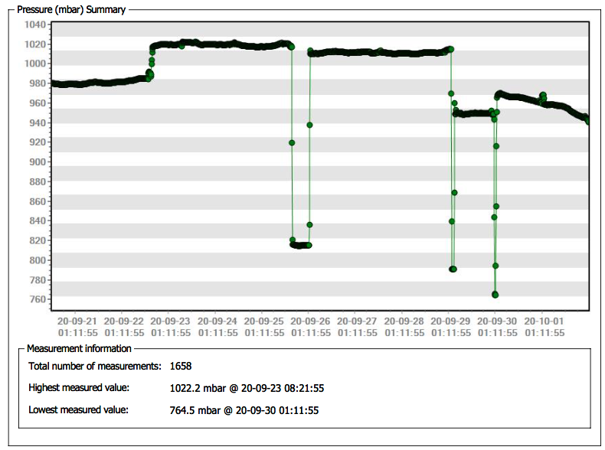
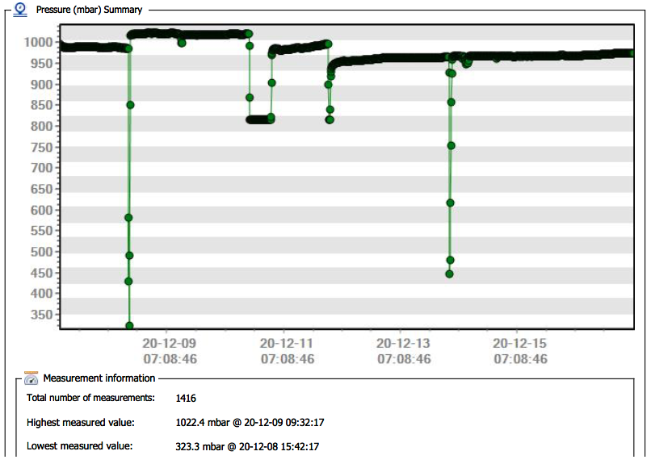
Transportation conditions
Pressure
?
?
LBNL -> CERN (9/21 - 10/1)
LBNL -> CERN (12/8 - 12/15)

Slide 33
Stave test - B204
Previous tests (for the silver stave) used various resistance values, which were determined based on the voltage on the adaptor
Some configurations reproduced similar test results as those from CERN, but some failed or produced different results
In addition to the cable resistances, FPC power extension resistances were measured, and added to the calibration
Cable + FPC power extension resistance for Digital and Analogue are 0.246 Ohm and 0.372 Ohm, respectively
We compare results of 4 calibration configurations
(Digital, Analogue, Digital Grd, Analogue Grd)
(0.32, 0.32, 0.16, 0.16)
(0.246, 0.372, 0, 0)
(0.246, 0.372, 0.123, 0.186)
(0.246, 0.372, 0.246, 0.372)
Previous configuration
1.8V at the adaptor

Slide 34
VTRx Issue at LHC
From Jo
Multi Mode (data) relative signal, 100% ≈ 340 µA
Single Mode (trigger) relative signal, 100% ≈ 40 µA
Link loss threshold
Interventions
Link loss threshold
Interventions
4 Months
4 Months
In many VTRx modules we observed a degrading optical signal,
This happens for both Multi Mode (MM) modules (data) and Single Mode (SM) modules (trigger)

Slide 35
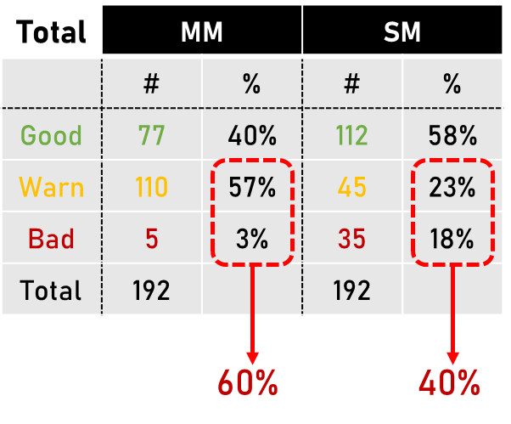
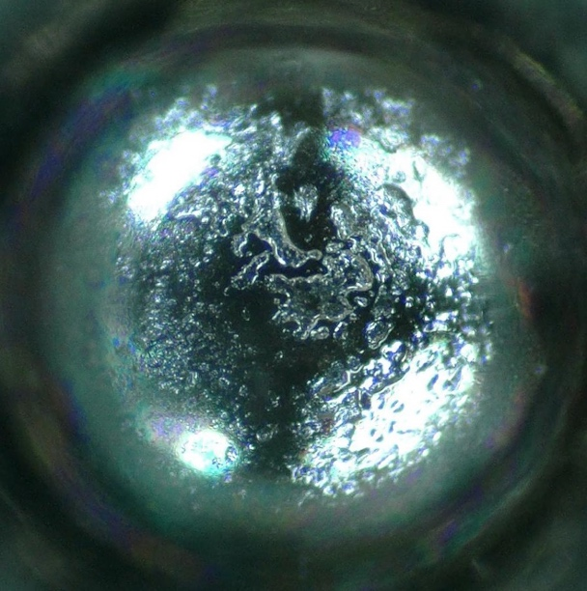
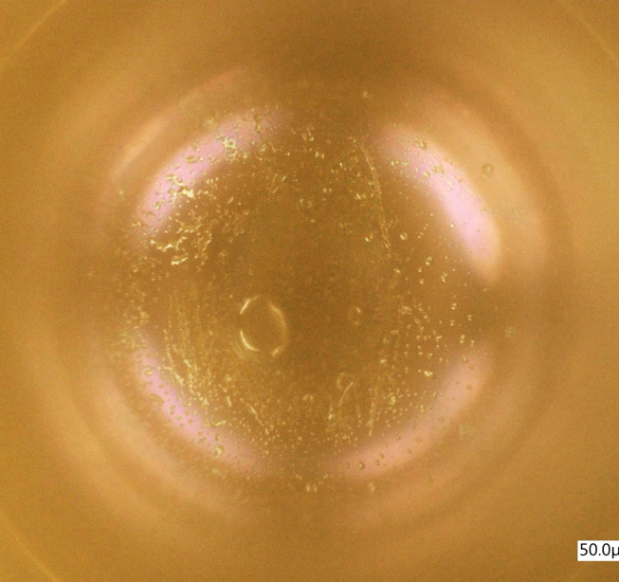
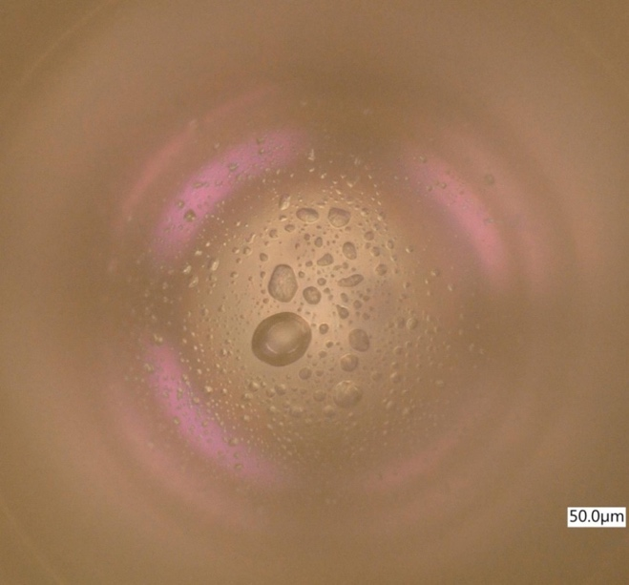
Accounting of VTRx problem in ALICE ITS
good if it never dropped below 10% of the expected RSSI .
warn if the measured RSSI dropped more than 10% once or more during its operations.
bad is the current ever dropped below the broken link threshold.
L0_09 (SM) lens after scalpel cut
VTRx 301350 (SM) lens BEFORE heating
VTRx 301350 (SM) lens AFTER heating

Slide 36

Cable Routing Plan
MVTX cable routing plan
Roland

Slide 37

Beam Pipe Analysis
Old Beampipe FEA results and changes (Target 0.5mm Defletion)
New design/Integration of New design
Brian

Slide 38

Stiffener (0.91mm)

Slide 39

Beam Pipe, MVTX, INTT and MBD Integration
Brian
Need to run FEA on New Beampipe Support
Deflection can be compensated by adjusting New Beampipe Support height on North end.
Additional/temporary supports on South end during MVTX install may need to be added.

Slide 40



Jo is testing the sPHENIX readout cables @CERN

Slide 41

MVTX Readout and Power Cable Route
PWR
sPHENIX MVTX: 7.9+m to 2E1
  Cable-A: 1.4 m
  Cable-B: 6.5+ m
  Power cable:4.7+ m
Desired ~10m
RU
PU
BNL has approved “non-halogen free” cables for sPHENIX

Slide 42


Cabling & Crate Setup (ITS/IB)

Slide 43



Study MAPS Performance with Laser @LANL
Inject “MIP” signal, focused laser beam
  850 nm laser, 4ns wide pulse, ~1 MIP
  50kHz trigger
  Find optimal MAPS operating parameters
Laser system
MOSAIC Testbench
Pixel hits

Slide 44


Laser Scan Data – Pixel Hit Efficiency vs Trigger Delay
One of “Stretched Settings” for sPHENIX trigger
Expected trigger latency: ~4us
MAX: 64 cells x 106nS = 6.8uS
Pixel (Row-Col)
Pixel (Row-Col)
~ 4.7 us
sPHENIX Trigger
~ 4.7 us
sPHENIX Trigger latency

