Slide 1
MVTX Status and Plan
Ming Liu
1/11/2021

Slide 2

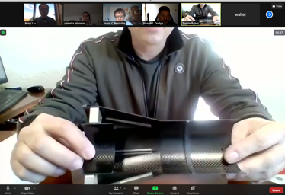
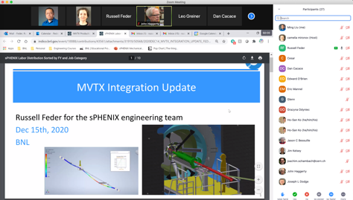

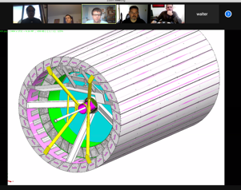
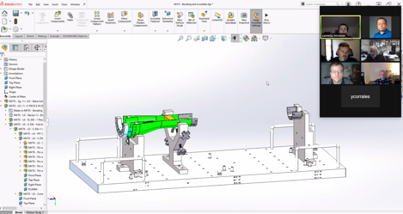
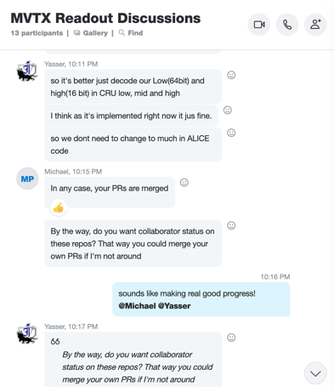

2020 Highlights
Pre-COVID19 Schedule
Today
production starts soon
Some delay in CFC production,
but still on track for completing
the assembly work in 2021
Assembly review
@LBNL
Readout & Controls
60 RU 1st round test completed
FW/SW synced to latest ALICE/ATLAS code
Low-level slow control hardware interface established, high-level software interface under testing
mGTM in progress at BNL

Slide 3

48 Gold Staves Produced!
(One full MVTX detector)

Slide 4
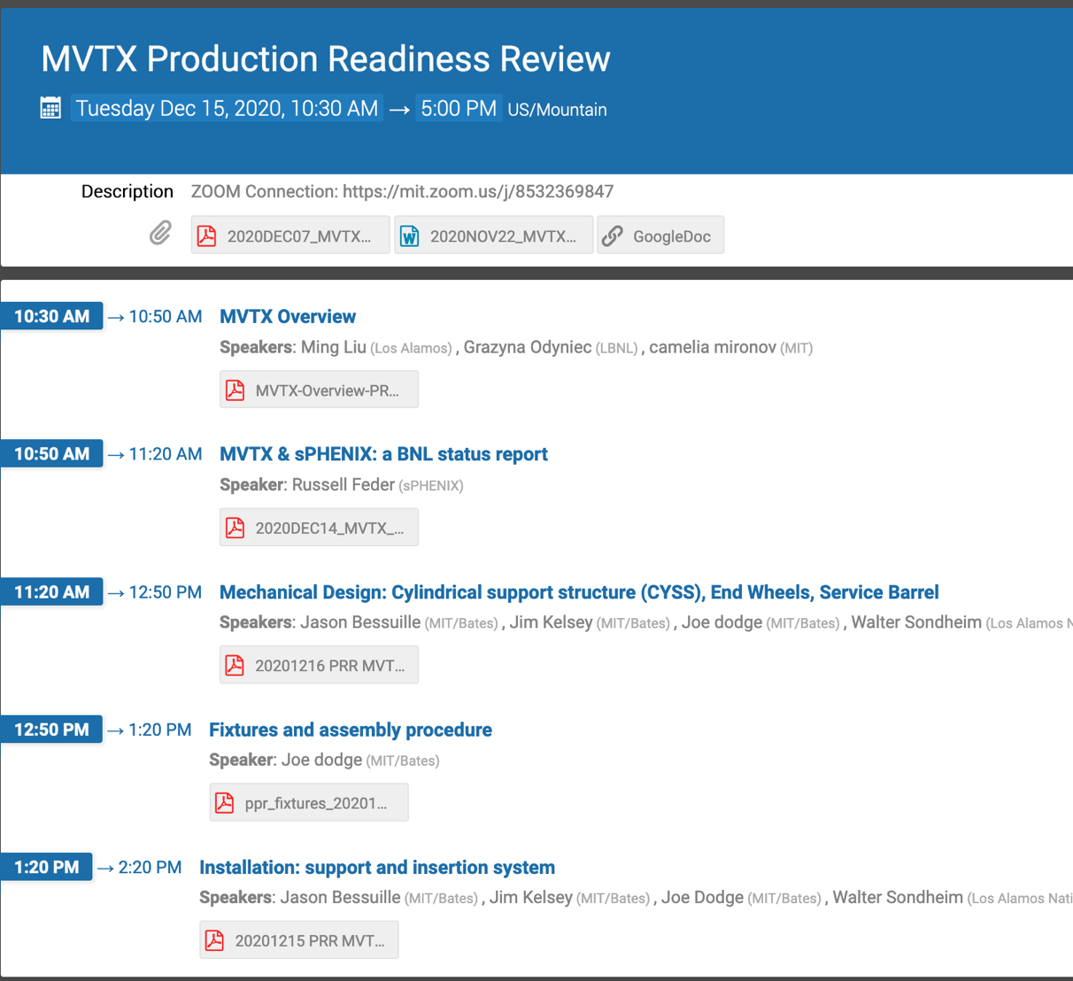
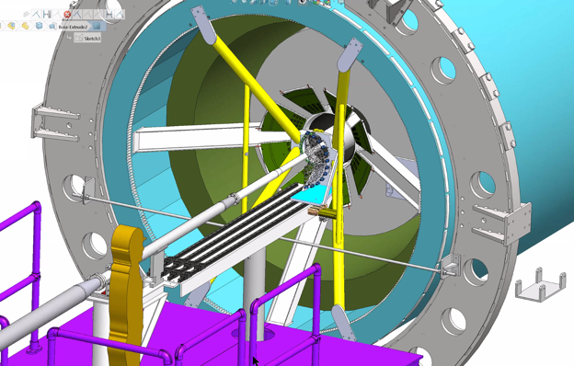
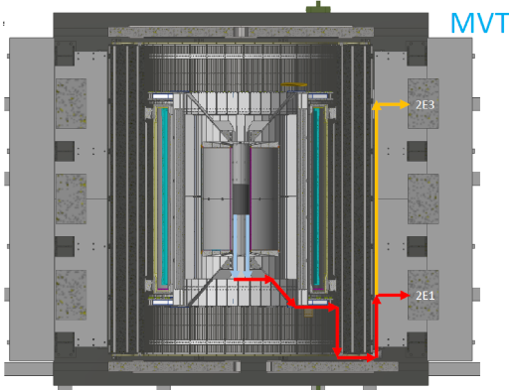
Project Status & Plan
Mechanical system
  MVTX PRR 12/15/2020, went very well - draft report discussed
  Next:
    Insertion system and mockup, in progress
    Start CFC production soon
Electrical system integration
  60 production RU testing at ORNL completed, debugging in progress
    5 RUs for factory repair
    Need more spares VTRx optical transceivers
  A new AMD server setup in progress at LANL
  Initial test with Slow Control software – LLA , MIT, LANL
  40MHz mGTM in progress @BNL, meeting w/ BNL engineers soon
Stave production and transportation – 48 gold staves produced!
  45+ gold staves at CERN
  4 staves (3 Gold + 1 Silver) under test at LBNL
Detector assembly plan at LBNL
  CFC test fit
  Assembly review, ~ May 2021
MVTX insertion system

Slide 5
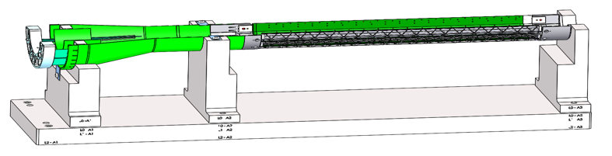
Near Term To Do’s and Challenges
Reviews
  sPHENIX MVTX/INTT/BP integration Review: ~Feb 2021?
    Finish MVTX and insertion system mockup
    X-wing supporting structure production
  Power cables safety review, early 2021?
    Cable procurements and QA
Half-detector assembly at LBNL
  Stave shipping and test
    be ready for half-detector assembly ~May 2021
  Assembly fixture design & fabrication
  CFC production and test fitting
Readout & control system integration
  Continuous readout mode
    synchronization across subsystems, new data format?
  mGTM development
    40MHz system clock for MVTX
  Slow control and monitoring
  To be ready for half-detector commissioning ~summer 2021
Other services
  Cooling system design and test
  Setup clean tent at BNL in ~Fall
Half-detector assembly & test @LBNL
May – December, 2021

Slide 6
LANL’s Focus in FY21
Complete 8-stave/RU telescope readout & control development
  FELIX FW, new data format, CR
  mGTM integration
  System test and optimization
    Slow control and monitoring
    ALPIDE study with laser pulses
Mechanical system integration
  Finalize detector assembly design etc.
    Connectors, cables, grounding etc.
  Insertion system design & mockup
Mock Data Challenge (MDC)
  Simulation and analysis
  Full B-hadron reconstruction, sensitivity study, using KFParticle, @low pT
  B-jet tagging and physics study,
Excellent opportunity for new comers to make big contributions to detector & simulation work
Possible Test Beam at Fermilab late 2021?
sPHENIX tracking + Emcal/Hcal system test?
Other key players:
MIT: mechanics, mock up, cooling, slow control & detector safety …
LBNL: stave shipping, testing, assembly, power system …
ORNL: RU, readout cables test, electrical system integration …
BNL: beam pipe, system integration, mockup …

Slide 7
Backup slides

Slide 8
0 | STAVE-production summary table
IBSTAVE ID | HIC assembly | HIC assembly date | Ins. after glue | Bonding | Pull test (>=2 lifts + F <7g) | Ins. after bonding | HIC PWR test | Qualification test | Threshold cluster | HIC Matrix | HIC DTU | HIC DTU (new) | HIC+SF+C -> Stave | Stave PWR test | Stave test | STAVE test date | STAVE metrology | Stave PWR test (long PWR extn.) | STAVE final test (PT100) | Final STAVE Matrix | Final STAVE DTU | STAVE Deliverd
TOTAL | 76 |  | 76 | 75 |  | 75 | 74 | 59 |  |  |  |  | 54 | 54 | 51 |  | 49 | 49 | 49 |  |  | 4
A201 (326) | 1 | 03/10/2019 | 1 | 1 | 1 | 1 | 1 | 1 | 1 | GOLD | OK | OK | 1 | 1 | 1 | 01/11/2019 | 1 | 1 | 1 | GOLD | OK | 1
A202* | 1 | 07/10/2019 | 1 | 1 | 0 | 1 | 1 | 0 | ?? | PARTIAL | OK | OK
A203 (144) | 1 | 08/10/2019 | 1 | 1 | 0 | 1 | 1 | 1 | 0 | GOLD | OK | OK | 1 | 1 | 1 | 04/11/2019 | 1 | 1 | 1 | GOLD | OK | 1
A204 (158) | 1 | 22/10/2019 | 1 | 1 | 1 | 1 | 1 | 1 | 0 | GOLD | OK | OK | 1 | 1 | 1 | 07/11/2019 | 1 | 1 | 1 | GOLD | OK | 1
A205 (167) | 1 | 23/10/2019 | 1 | 1 | 4 | 1 | 1 | 1 | 0 | GOLD | CAN | OK | 1 | 1 | 1 | 08/11/2019 | 1 | 1 | 1 | GOLD | OK
A206 (204) | 1 | 30/10/2019 | 1 | 1 | 3 | 1 | 1 | 1 | 2 | GOLD | CAN | CAN | 1 | 1 | 1 | 24/01/2020 | 1 | 1 | 1 | GOLD | CAN
B201 (352) | 1 | 30/10/2019 | 1 | 1 | 0 | 1 | 1 | 1 | 0 | GOLD | CAN | CAN | 1 | 1 | 1 | 28/05/2020 | 1 | 1 | 1 | GOLD | OK
B202* | 1 | 31/10/2019 | 1 | 1 | 0 | 1 | 1 | 0 |  | Broken
B203 (114) | 1 | 07/11/2019 | 1 | 1 | 1 | 1 | 1 | 1 | 0 | GOLD | CAN | CAN | 1 | 1 | 1 | 29/05/2020 | 1 | 1 | 1 | GOLD | CAN
B204 (116) | 1 | 13/11/2019 | 1 | 1 | 0 | 1 | 1 | 1 | 1 | SILVER | CAN | CAN | 1 | 1 | 1 | 28/05/2020 | 1 | 1 | 1 | SILVER | CAN | 1
B205 (115) | 1 | 14/01/2020 | 1 | 1 | 2 | 1 | 1 | 1 | 0 | GOLD | CAN | CAN | 1 | 1 | 1 | 02/06/2020 | 1 | 1 | 1 | GOLD | OK
B206 (295) | 1 | 15/01/2020 | 1 | 1 | 2 | 1 | 1 | 1 | 0 | GOLD | CAN | OK | 1 | 1 | 1 | 02/06/2020 | 1 | 1 | 1 | GOLD | OK
F201* | 1 | 27/02/2020 | 1 | 1 | 1 | 1 | 1 | 0 | ?? | PARTIAL | OK | OK
F202 (230) | 1 | 28/02/2020 | 1 | 1 | 3 | 1 | 1 | 1 | 0 | GOLD | CAN | OK | 1 | 1 | 1 | 04/06/2020 | 1 | 1 | 1 | GOLD | CAN
F204 | 1 | 29/02/2020 | 1 | 1 | 5 | 1 | 1 | 1 | 2 | GOLD | CAN | OK
G202 (234) | 1 | 10/02/2020 | 1 | 1 | 0 | 1 | 1 | 1 | 1 | GOLD | OK | OK | 1 | 1 | 1 | 04/06/2020 | 1 | 1 | 1 | GOLD | OK
G203 | 1 | 12/02/2020 | 1 | 1 | 1 | 1 | 1 | 1 | 1 | GOLD | CAN | CAN
F203* | dummy
H202 (294) | 1 | 24/02/2020 | 1 | 1 | 0 | 1 | 1 | 1 | 0 | GOLD | OK | OK | 1 | 1 | 1 | 05/06/2020 | 1 | 1 | 1 | GOLD | OK
H203 (302) | 1 | 26/02/2020 | 1 | 1 | 0 | 1 | 1 | 1 | 0 | GOLD | OK | OK | 1 | 1 | 1 | 05/06/2020 | 1 | 1 | 1 | GOLD | OK
H204 (354) | 1 | 27/02/2020 | 1 | 1 | 0 | 1 | 1 | 1 | 0 | GOLD | OK | OK | 1 | 1 | 1 | 11/06/2020 | 1 | 1 | 1 | GOLD | OK
H206* | 1 | 04/03/2020 | 1 | 1 | 0 | 1 | 1 | 0 | ?? | PARTIAL | OK | OK
E204 (110) | 1 | 05/03/2020 | 1 | 1 | 0 | 1 | 1 | 1 | 1 | GOLD | CAN | CAN | 1 | 1 | 1 | 22/06/2020 | 1 | 1 | 1 | GOLD | CAN
E201* | 1 | 12/02/2020 | 1 | 1 | 0 | 1 | 1 | 0 | 3 | PARTIAL | CAN | OK
E202 | 1 | 10/03/2020 | 1 | 1 | 1 | 1 | 1 | 1 | 1 | GOLD | CAN (bad driver) | CAN (bad driver)
E206 (101) | 1 | 12/03/2020 | 1 | 1 | 0 | 1 | 1 | 1 | 1 | GOLD | OK | OK | 1 | 1 | 1 | 16/06/2020 | 1 | 1 | 1 | GOLD | OK
H205 | 1 | 11/06/2020 | 1 | 1 | 0 | 1 | 1 | 0 | 1 | SILVER | OK | OK
I202 (175) | 1 | 15/06/2020 | 1 | 1 | 0 | 1 | 1 | 1 | 0 | GOLD | OK | OK | 1 | 1 | 1 | 22/06/2020 | 1 | 1 | 1 | GOLD | OK
I203 (187) | 1 | 16/06/2020 | 1 | 1 | 0 | 1 | 1 | 1 | 0 | GOLD | OK | OK | 1 | 1 | 1 | 26/06/2020 | 1 | 1 | 1 | GOLD | OK
I204* | 1 | 17/06/2020 | 1 | 1 | 0 | 1 | 1 | 0 | 0 | PARTIAL | OK | OK
I205 (266) | 1 | 22/06/2020 | 1 | 1 | 0 | 1 | 1 | 1 | 0 | GOLD | OK | OK | 1 | 1 | 1 | 26/06/2020 | 1 | 1 | 1 | GOLD | OK
J201* | 1 | 23/06/2020 | 1 | 1 | 0 | 1 | 1 | 0 | ?? | PARTIAL | OK | OK
J202 (207) | 1 | 24/06/2020 | 1 | 1 | 0 | 1 | 1 | 1 | 0 | GOLD | CAN | OK | 1 | 1 | 1 | 16/07/2020 | 1 | 1 | 1 | GOLD | CAN
J203 (245) 345 right | 1 | 29/06/2020 | 1 | 1 | 0 | 1 | 1 | 1 | 0 | GOLD | CAN | CAN | 1 | 1 | 1 | 17/07/2020 | 1 | 1 | 1 | GOLD | CAN
J204 (252) | 1 | 30/06/2020 | 1 | 1 | 0 | 1 | 1 | 1 | 0 | GOLD | OK | OK | 1 | 1 | 1 | 03/07/2020 | 1 | 1 | 1 | GOLD | OK
J206 (260) | 1 | 01/07/2020 | 1 | 1 | 0 | 1 | 1 | 1 | 0 | GOLD | OK | OK | 1 | 1 | 1 | 03/07/2020 | 1 | 1 | 1 | GOLD | OK
K202 (122) | 1 | 07/07/2020 | 1 | 1 | 0 | 1 | 1 | 1 | 1 | GOLD | OK | OK | 1 | 1 | 1 | 18/08/2020 | 1 | 1 | 1 | GOLD | OK
K203 (125) | 1 | 08/07/2020 | 1 | 1 | 0 | 1 | 1 | 1 | 0 | GOLD | OK | OK | 1 | 1 | 1 | 18/08/2020 | 1 | 1 | 1 | GOLD | OK
K204 (129) | 1 | 09/07/2020 | 1 | 1 | 0 | 1 | 1 | 1 | 0 | GOLD | CAN | OK | 1 | 1 | 1 | 04/09/2020 | 1 | 1 | 1 | GOLD | OK
K205 (128) | 1 | 13/07/2020 | 1 | 1 | 0 | 1 | 1 | 1 | 1 | GOLD | CAN | CAN | 1 | 1 | 1 | 04/09/2020 | 1 | 1 | 1 | GOLD | CAN
K206 (347) | 1 | 14/07/2020 | 1 | 1 | 0 | 1 | 1 | 1 | 0 | GOLD | OK | OK | 1 | 1 | 1 | 28/09/2020 | 1 | 1 | 1 | GOLD | OK
Report from Stave Production Meeting, 12/17/2020
11 new STAVEs are ready with final Test.
45 STAVES are ready to deliver.
4 STAVEs are delivered.
* Partial/Not functioning

Slide 9
 | STAVE-production summary table
IBSTAVE ID | HIC assembly | HIC assembly date | Ins. after glue | Bonding | Pull test (>=2 lifts + F <7g) | Ins. after bonding | HIC PWR test | Qualification test | Threshold cluster | HIC Matrix | HIC DTU | HIC DTU (new) | HIC+SF+C -> Stave | Stave PWR test | Stave test | STAVE test date | STAVE metrology | Stave PWR test (long PWR extn.) | STAVE final test (PT100) | Final STAVE Matrix | Final STAVE DTU | STAVE Deliverd
L202 (130) | 1 | 23/07/2020 | 1 | 1 | 0 | 1 | 1 | 1 | 0 | GOLD | CAN | OK | 1 | 1 | 1 | 08/09/2020 | 1 | 1 | 1 | GOLD | CAN
L203 (139) | 1 | 24/07/2020 | 1 | 1 | 0 | 1 | 1 | 1 | 0 | GOLD | CAN | CAN | 1 | 1 | 1 | 08/09/2020 | 1 | 1 | 1 | GOLD | CAN
L204 (127) | 1 | 27/07/2020 | 1 | 1 | 0 | 1 | 1 | 1 | 0 | GOLD | CAN | CAN | 1 | 1 | 1 | 14/09/2020 | 1 | 1 | 1 | GOLD | CAN
L205 (136) | 1 | 28/07/2020 | 1 | 1 | 0 | 1 | 1 | 1 | 0 | GOLD | OK | OK | 1 | 1 | 1 | 14/09/2020 | 1 | 1 | 1 | GOLD | OK
J205* | 1 | 05/08/2020 | 1 | 1 | 0 | 1 | 1 | 0 | ?? | PARTIAL | CAN | CAN
I201* | 1 | 06/08/2020 | 1 | 1 | 0 | 1 | 1 | 0 | 0 | PARTIAL | OK | OK
L206* | 1 | 13/08/2020 | 1 | 0
L201 (169) | 1 | 14/08/2020 | 1 | 1 | 0 | 1 | 1 | 1 | 1 | GOLD | CAN | CAN | 1 | 1 | 1 | 30/09/2020 | 1 | 1 | 1 | GOLD | CAN
S201 (359) | 1 | 03/09/2020 | 1 | 1 | 0 | 1 | 1 | 1 | 0 | GOLD | CAN | OK | 1 | 1 | 1 | 30/09/2020 | 1 | 1 | 1 | GOLD | OK
S202 | 1 | 04/09/2020 | 1 | 1 | 0 | 1 | 1 | 0 | 0 | SILVER | CAN | CAN
S203 (235) | 1 | 08/09/2020 | 1 | 1 | 0 | 1 | 1 | 1 | 0 | GOLD | CAN | CAN | 1 | 1 | 1 | 16/11/2020 | 1 | 1 | 1 | GOLD | OK
S204 (237) | 1 | 15/09/2020 | 1 | 1 | 0 | 1 | 1 | 1 | 1 | GOLD | CAN | CAN | 1 | 1 | 1 | 30/09/2020 | 1 | 1 | 1 | GOLD | CAN
S205 (142) | 1 | 16/09/2020 | 1 | 1 | 0 | 1 | 1 | 1 | 0 | GOLD | CAN | CAN | 1 | 1 | 1 | 01/10/2020 | 1 | 1 | 1 | GOLD | CAN
S206 (98) | 1 | 17/09/2020 | 1 | 1 | 0 | 1 | 1 | 1 | 1 | GOLD | OK | OK | 1 | 1 | 1 | 02/10/2020 | 1 | 1 | 1 | GOLD | OK
T201 (277) | 1 | 04/11/2020 | 1 | 1 | 0 | 1 | 1 | 1 | 1 | GOLD | CAN | CAN | 1 | 1 | 1 | 17/11/2020 | 1 | 1 | 1 | GOLD | CAN
T202 (279) | 1 | 06/11/2020 | 1 | 1 | 0 | 1 | 1 | 1 | 2 | GOLD | CAN | CAN | 1 | 1 | 1 | 19/11/2020 | 1 | 1 | 1 | GOLD | CAN
T203 | 1 | 09/11/2020 | 1 | 1 | 0 | 1 | 1
U201 (291) | 1 | 10/11/2020 | 1 | 1 | 0 | 1 | 1 | 1 | 2 | SILVER | CAN | CAN | 1 | 1 | 1 | 24/11/2020 | 1 | 1 | 1 | GOLD | CAN
U202 (238) | 1 | 11/11/2020 | 1 | 1 | 0 | 1 | 1 | 1 | 1 | GOLD | CAN | CAN | 1 | 1 | 1 | 26/11/2020 | 1 | 1 | 1 | GOLD | CAN
U203 (126) | 1 | 12/11/2020 | 1 | 1 | 0 | 1 | 1 | 1 | 0 | GOLD | CAN | CAN | 1 | 1 | 1 | 20/11/2020 | 1 | 1 | 1 | GOLD | CAN
U204* | 1 | 13/11/2020 | 1 | 1 | 0 | 1 | 1 | 0 | 0 | PARTIAL | OK | OK
U205 (89) | 1 | 16/11/2020 | 1 | 1 | 0 | 1 | 1 | 1 | 1 | GOLD | OK | OK | 1 | 1 | 1 | 27/11/2020 | 1 | 1 | 1 | GOLD | OK
U206 (111) | 1 | 17/11/2020 | 1 | 1 | 0 | 1 | 1 | 1 | 0 | GOLD | CAN | CAN | 1 | 1 | 1 | 25/11/2020 | 1 | 1 | 1 | GOLD | CAN
Q201 (155) | 1 | 18/11/2020 | 1 | 1 | 0 | 1 | 1 | 1 | 0 | SILVER | CAN | CAN | 1 | 1 | 1 | 27/11/2020 | 1 | 1 | 1 | GOLD | CAN
Q202 | 1 | 19/11/2020 | 1 | 1 | 0 | 1 | 1 | 1 | 0 | GOLD | CAN | OK | 1 | 1 | 1 | 03/12/2020 | 1 | 1 | 1 | GOLD | CAN
T204 | 1 | 23/11/2020 | 1 | 1 | 0 | 1 | 1 | 1 | 0 | GOLD | CAN | CAN | 1 | 1 | 1 | 03/12/2020 | 1 | 1 | 1 | GOLD | CAN
T205 | 1 | 24/11/2020 | 1 | 1 | 0 | 1 | 1 | 1 | 1 | GOLD | OK | OK | 1 | 1 | 1 | 03/12/2020
T206 | 1 | 25/11/2020 | 1 | 1 | 0 | 1 | 1 | 1 | 1 | GOLD | CAN | CAN
R201 | 1 | 27/11/2020 | 1 | 1 | 8 | 1 | 1 | 1 | 1 | GOLD | CAN | CAN | 1 | 1 | 1 | 08/12/2020
R202 | 1 | 30/11/2020 | 1 | 1 | 1 | 1 | 1 | 1 | 0 | GOLD | CAN | CAN | 1 | 1
W201 | 1 | 01/12/2020 | 1 | 1 | 0 | 1 | 1 | 1 | 0 | GOLD | OK | OK | ?? data line broken
W202* | 1 | 02/12/2020 | 1 | 1 | 0 | 1 | 1 | 0 | ?? | PARIAL | CAN | CAN
W203 | 1 | 03/12/2020 | 1 | 1 | 0 | 1 | 1 | 1 | 0 | SILVER | CAN | CAN | 1 | 1
W204 | 1 | 07/12/2020 | 1 | 1 | 0 | 1 | 1 | 1 | 3 | GOLD | OK | OK | 1 | 1
W205 | 1 | 08/12/2020 | 1 | 1 | 0 | 1 | 1
W206 | 1 | 09/12/2020 | 1 | 1 | 0 | 1 | ?? Digi short

Slide 10
60(Production) + 10(LANL) RU Test Data
48 needed for full readout
  60 production RU testing at ORNL completed, debugging in progress
    5 RUs for factory repair
    SN337, SN370, SN340, SN367, SN391
    Need more spares VTRx optical transceivers
    A few with minor issues, still usable for readout

