Slide 1
MVTX Status
Camelia, Grazyna, Ming
02/12/2021
sPHENIX L2 Project Meeting

Slide 2
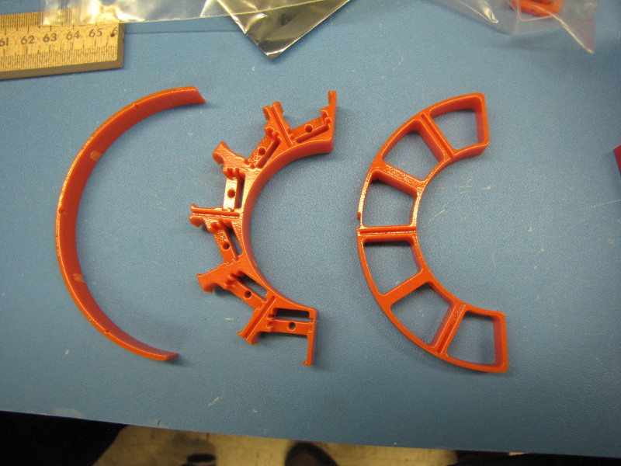
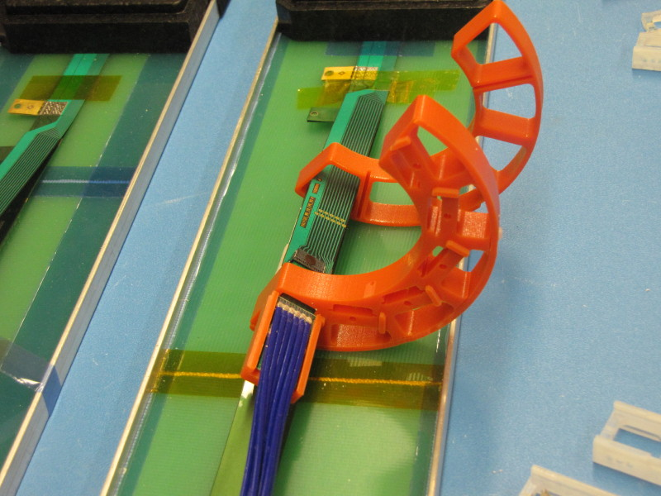
Mechanical Structures
CFC production on schedule
  A new all carbon Lay-0 EW, to replace test article
    In kind contribution from WorkShape
  Completion in 3rd week of March
X-Wing design near completion
  PP3 optimization (3D print)
  => finalize cable lengths, readout and power
Finalizing assembly jig design
PP1/2 design updated, confirmed w/ 3-D mockup
  Improve cable passthrough, locking

Slide 3
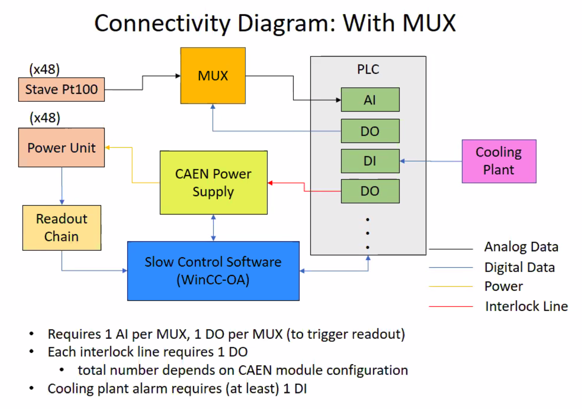
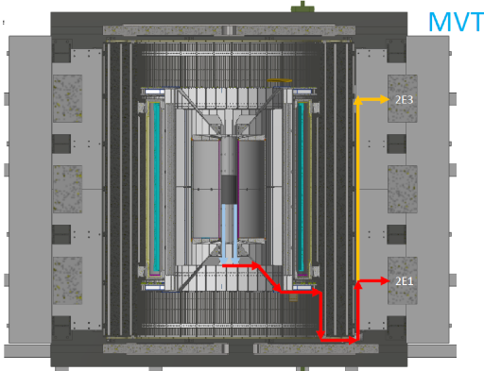
Readout and Electrical System
All 60 production RU tested
  3 require factory repair, paperwork in progress
  spare components,
    mezzanine cards ordered
    VTRx/VTTx under discussion
Detector safety system proposed
  Modify ALICE DCS
mGTM development in progress
  Preliminary design available for testing ~next week?
Readout in progress
  New data format and latest firmware
  Still have issues reading out data from AMD (DMA?)
  FELIX interface to mGTM
AMD server issues
  Slow control communication ok
  DMA data transfer broken
Power system, racks, cables etc.

Slide 4
Stave Production, Transportation and QA
48 + spares Gold staves produced
  6 new staves finished metrology (as of 1/20/2021)
4 (3 Gold + 1 Silver) under test at LBNL
  Mostly consistent with CERN data
  Some details under investigation
One more test shipping this week
  1 HIC, several monitoring loggers
Power board calibration
and stave QA
DVDD
AVDD

Slide 5
 | STAVE-production summary table
IBSTAVE ID | HIC assembly | HIC assembly date | Ins. after glue | Bonding | Pull test (>=2 lifts + F <7g) | Ins. after bonding | HIC PWR test | Qualification test | Threshold cluster | HIC Matrix | HIC DTU | HIC DTU (new) | HIC+SF+C -> Stave | Stave PWR test | Stave test | STAVE test date | STAVE metrology | Stave PWR test (long PWR extn.) | STAVE final test (PT100) | Final STAVE Matrix | Final STAVE DTU | STAVE Deliverd
TOTAL | 83 |  | 83 | 80 |  | 80 | 76 | 62 |  |  |  |  | 58 | 57 | 57 |  | 49 | 49 | 49 |  |  | 4
A201 (326) | 1 | 03/10/2019 | 1 | 1 | 1 | 1 | 1 | 1 | 1 | GOLD | OK | OK | 1 | 1 | 1 | 01/11/2019 | 1 | 1 | 1 | GOLD | OK | 1
A202* | 1 | 07/10/2019 | 1 | 1 | 0 | 1 | 1 | 0 | ?? | PARTIAL | OK | OK
A203 (144) | 1 | 08/10/2019 | 1 | 1 | 0 | 1 | 1 | 1 | 0 | GOLD | OK | OK | 1 | 1 | 1 | 04/11/2019 | 1 | 1 | 1 | GOLD | OK | 1
A204 (158) | 1 | 22/10/2019 | 1 | 1 | 1 | 1 | 1 | 1 | 0 | GOLD | OK | OK | 1 | 1 | 1 | 07/11/2019 | 1 | 1 | 1 | GOLD | OK | 1
A205 (167) | 1 | 23/10/2019 | 1 | 1 | 4 | 1 | 1 | 1 | 0 | GOLD | CAN | OK | 1 | 1 | 1 | 08/11/2019 | 1 | 1 | 1 | GOLD | OK
A206 (204) | 1 | 30/10/2019 | 1 | 1 | 3 | 1 | 1 | 1 | 2 | GOLD | CAN | CAN | 1 | 1 | 1 | 24/01/2020 | 1 | 1 | 1 | GOLD | CAN
B201 (352) | 1 | 30/10/2019 | 1 | 1 | 0 | 1 | 1 | 1 | 0 | GOLD | CAN | CAN | 1 | 1 | 1 | 28/05/2020 | 1 | 1 | 1 | GOLD | OK
B202* | 1 | 31/10/2019 | 1 | 1 | 0 | 1 | 1 | 0 |  | Broken
B203 (114) | 1 | 07/11/2019 | 1 | 1 | 1 | 1 | 1 | 1 | 0 | GOLD | CAN | CAN | 1 | 1 | 1 | 29/05/2020 | 1 | 1 | 1 | GOLD | CAN
B204 (116) | 1 | 13/11/2019 | 1 | 1 | 0 | 1 | 1 | 1 | 1 | SILVER | CAN | CAN | 1 | 1 | 1 | 28/05/2020 | 1 | 1 | 1 | SILVER | CAN | 1
B205 (115) | 1 | 14/01/2020 | 1 | 1 | 2 | 1 | 1 | 1 | 0 | GOLD | CAN | CAN | 1 | 1 | 1 | 02/06/2020 | 1 | 1 | 1 | GOLD | OK
B206 (295) | 1 | 15/01/2020 | 1 | 1 | 2 | 1 | 1 | 1 | 0 | GOLD | CAN | OK | 1 | 1 | 1 | 02/06/2020 | 1 | 1 | 1 | GOLD | OK
F201* | 1 | 27/02/2020 | 1 | 1 | 1 | 1 | 1 | 0 | ?? | PARTIAL | OK | OK
F202 (230) | 1 | 28/02/2020 | 1 | 1 | 3 | 1 | 1 | 1 | 0 | GOLD | CAN | OK | 1 | 1 | 1 | 04/06/2020 | 1 | 1 | 1 | GOLD | CAN
F204 | 1 | 29/02/2020 | 1 | 1 | 5 | 1 | 1 | 1 | 2 | GOLD | CAN | OK
G202 (234) | 1 | 10/02/2020 | 1 | 1 | 0 | 1 | 1 | 1 | 1 | GOLD | OK | OK | 1 | 1 | 1 | 04/06/2020 | 1 | 1 | 1 | GOLD | OK
G203 | 1 | 12/02/2020 | 1 | 1 | 1 | 1 | 1 | 1 | 1 | GOLD | CAN | CAN
F203* | dummy
H202 (294) | 1 | 24/02/2020 | 1 | 1 | 0 | 1 | 1 | 1 | 0 | GOLD | OK | OK | 1 | 1 | 1 | 05/06/2020 | 1 | 1 | 1 | GOLD | OK
H203 (302) | 1 | 26/02/2020 | 1 | 1 | 0 | 1 | 1 | 1 | 0 | GOLD | OK | OK | 1 | 1 | 1 | 05/06/2020 | 1 | 1 | 1 | GOLD | OK
H204 (354) | 1 | 27/02/2020 | 1 | 1 | 0 | 1 | 1 | 1 | 0 | GOLD | OK | OK | 1 | 1 | 1 | 11/06/2020 | 1 | 1 | 1 | GOLD | OK
H206* | 1 | 04/03/2020 | 1 | 1 | 0 | 1 | 1 | 0 | ?? | PARTIAL | OK | OK
E204 (110) | 1 | 05/03/2020 | 1 | 1 | 0 | 1 | 1 | 1 | 1 | GOLD | CAN | CAN | 1 | 1 | 1 | 22/06/2020 | 1 | 1 | 1 | GOLD | CAN
E201* | 1 | 12/02/2020 | 1 | 1 | 0 | 1 | 1 | 0 | 3 | PARTIAL | CAN | OK
E202 | 1 | 10/03/2020 | 1 | 1 | 1 | 1 | 1 | 1 | 1 | GOLD | CAN (bad driver) | CAN (bad driver)
E206 (101) | 1 | 12/03/2020 | 1 | 1 | 0 | 1 | 1 | 1 | 1 | GOLD | OK | OK | 1 | 1 | 1 | 16/06/2020 | 1 | 1 | 1 | GOLD | OK
H205 | 1 | 11/06/2020 | 1 | 1 | 0 | 1 | 1 | 0 | 1 | SILVER | OK | OK
I202 (175) | 1 | 15/06/2020 | 1 | 1 | 0 | 1 | 1 | 1 | 0 | GOLD | OK | OK | 1 | 1 | 1 | 22/06/2020 | 1 | 1 | 1 | GOLD | OK
I203 (187) | 1 | 16/06/2020 | 1 | 1 | 0 | 1 | 1 | 1 | 0 | GOLD | OK | OK | 1 | 1 | 1 | 26/06/2020 | 1 | 1 | 1 | GOLD | OK
I204* | 1 | 17/06/2020 | 1 | 1 | 0 | 1 | 1 | 0 | 0 | PARTIAL | OK | OK
I205 (266) | 1 | 22/06/2020 | 1 | 1 | 0 | 1 | 1 | 1 | 0 | GOLD | OK | OK | 1 | 1 | 1 | 26/06/2020 | 1 | 1 | 1 | GOLD | OK
J201* | 1 | 23/06/2020 | 1 | 1 | 0 | 1 | 1 | 0 | ?? | PARTIAL | OK | OK
J202 (207) | 1 | 24/06/2020 | 1 | 1 | 0 | 1 | 1 | 1 | 0 | GOLD | CAN | OK | 1 | 1 | 1 | 16/07/2020 | 1 | 1 | 1 | GOLD | CAN
J203 (245) 345 right | 1 | 29/06/2020 | 1 | 1 | 0 | 1 | 1 | 1 | 0 | GOLD | CAN | CAN | 1 | 1 | 1 | 17/07/2020 | 1 | 1 | 1 | GOLD | CAN
J204 (252) | 1 | 30/06/2020 | 1 | 1 | 0 | 1 | 1 | 1 | 0 | GOLD | OK | OK | 1 | 1 | 1 | 03/07/2020 | 1 | 1 | 1 | GOLD | OK
J206 (260) | 1 | 01/07/2020 | 1 | 1 | 0 | 1 | 1 | 1 | 0 | GOLD | OK | OK | 1 | 1 | 1 | 03/07/2020 | 1 | 1 | 1 | GOLD | OK
K202 (122) | 1 | 07/07/2020 | 1 | 1 | 0 | 1 | 1 | 1 | 1 | GOLD | OK | OK | 1 | 1 | 1 | 18/08/2020 | 1 | 1 | 1 | GOLD | OK
K203 (125) | 1 | 08/07/2020 | 1 | 1 | 0 | 1 | 1 | 1 | 0 | GOLD | OK | OK | 1 | 1 | 1 | 18/08/2020 | 1 | 1 | 1 | GOLD | OK
K204 (129) | 1 | 09/07/2020 | 1 | 1 | 0 | 1 | 1 | 1 | 0 | GOLD | CAN | OK | 1 | 1 | 1 | 04/09/2020 | 1 | 1 | 1 | GOLD | OK
K205 (128) | 1 | 13/07/2020 | 1 | 1 | 0 | 1 | 1 | 1 | 1 | GOLD | CAN | CAN | 1 | 1 | 1 | 04/09/2020 | 1 | 1 | 1 | GOLD | CAN
K206 (347) | 1 | 14/07/2020 | 1 | 1 | 0 | 1 | 1 | 1 | 0 | GOLD | OK | OK | 1 | 1 | 1 | 28/09/2020 | 1 | 1 | 1 | GOLD | OK
Stave Production meeting
with CERN1/19/2021
6 new stave metrology done
* Partial/Not functioning

Slide 6
 | STAVE-production summary table
IBSTAVE ID | HIC assembly | HIC assembly date | Ins. after glue | Bonding | Pull test (>=2 lifts + F <7g) | Ins. after bonding | HIC PWR test | Qualification test | Threshold cluster | HIC Matrix | HIC DTU | HIC DTU (new) | HIC+SF+C -> Stave | Stave PWR test | Stave test | STAVE test date | STAVE metrology | Stave PWR test (long PWR extn.) | STAVE final test (PT100) | Final STAVE Matrix | Final STAVE DTU | STAVE Deliverd
L202 (130) | 1 | 23/07/2020 | 1 | 1 | 0 | 1 | 1 | 1 | 0 | GOLD | CAN | OK | 1 | 1 | 1 | 08/09/2020 | 1 | 1 | 1 | GOLD | CAN
L203 (139) | 1 | 24/07/2020 | 1 | 1 | 0 | 1 | 1 | 1 | 0 | GOLD | CAN | CAN | 1 | 1 | 1 | 08/09/2020 | 1 | 1 | 1 | GOLD | CAN
L204 (127) | 1 | 27/07/2020 | 1 | 1 | 0 | 1 | 1 | 1 | 0 | GOLD | CAN | CAN | 1 | 1 | 1 | 14/09/2020 | 1 | 1 | 1 | GOLD | CAN
L205 (136) | 1 | 28/07/2020 | 1 | 1 | 0 | 1 | 1 | 1 | 0 | GOLD | OK | OK | 1 | 1 | 1 | 14/09/2020 | 1 | 1 | 1 | GOLD | OK
J205* | 1 | 05/08/2020 | 1 | 1 | 0 | 1 | 1 | 0 | ?? | PARTIAL | CAN | CAN
I201* | 1 | 06/08/2020 | 1 | 1 | 0 | 1 | 1 | 0 | 0 | PARTIAL | OK | OK
L206* | 1 | 13/08/2020 | 1 | 0
L201 (169) | 1 | 14/08/2020 | 1 | 1 | 0 | 1 | 1 | 1 | 1 | GOLD | CAN | CAN | 1 | 1 | 1 | 30/09/2020 | 1 | 1 | 1 | GOLD | CAN
S201 (359) | 1 | 03/09/2020 | 1 | 1 | 0 | 1 | 1 | 1 | 0 | GOLD | CAN | OK | 1 | 1 | 1 | 30/09/2020 | 1 | 1 | 1 | GOLD | OK
S202 | 1 | 04/09/2020 | 1 | 1 | 0 | 1 | 1 | 0 | 0 | SILVER | CAN | CAN
S203 (235) | 1 | 08/09/2020 | 1 | 1 | 0 | 1 | 1 | 1 | 0 | GOLD | CAN | CAN | 1 | 1 | 1 | 16/11/2020 | 1 | 1 | 1 | GOLD | OK
S204 (237) | 1 | 15/09/2020 | 1 | 1 | 0 | 1 | 1 | 1 | 1 | GOLD | CAN | CAN | 1 | 1 | 1 | 30/09/2020 | 1 | 1 | 1 | GOLD | CAN
S205 (142) | 1 | 16/09/2020 | 1 | 1 | 0 | 1 | 1 | 1 | 0 | GOLD | CAN | CAN | 1 | 1 | 1 | 01/10/2020 | 1 | 1 | 1 | GOLD | CAN
S206 (98) | 1 | 17/09/2020 | 1 | 1 | 0 | 1 | 1 | 1 | 1 | GOLD | OK | OK | 1 | 1 | 1 | 02/10/2020 | 1 | 1 | 1 | GOLD | OK
T201 (277) | 1 | 04/11/2020 | 1 | 1 | 0 | 1 | 1 | 1 | 1 | GOLD | CAN | CAN | 1 | 1 | 1 | 17/11/2020 | 1 | 1 | 1 | GOLD | CAN
T202 (279) | 1 | 06/11/2020 | 1 | 1 | 0 | 1 | 1 | 1 | 2 | GOLD | CAN | CAN | 1 | 1 | 1 | 19/11/2020 | 1 | 1 | 1 | GOLD | CAN
T203 | 1 | 09/11/2020 | 1 | 1 | 0 | 1 | 1
U201 (291) | 1 | 10/11/2020 | 1 | 1 | 0 | 1 | 1 | 1 | 2 | SILVER | CAN | CAN | 1 | 1 | 1 | 24/11/2020 | 1 | 1 | 1 | GOLD | CAN
U202 (238) | 1 | 11/11/2020 | 1 | 1 | 0 | 1 | 1 | 1 | 1 | GOLD | CAN | CAN | 1 | 1 | 1 | 26/11/2020 | 1 | 1 | 1 | GOLD | CAN
U203 (126) | 1 | 12/11/2020 | 1 | 1 | 0 | 1 | 1 | 1 | 0 | GOLD | CAN | CAN | 1 | 1 | 1 | 20/11/2020 | 1 | 1 | 1 | GOLD | CAN
U204* | 1 | 13/11/2020 | 1 | 1 | 0 | 1 | 1 | 0 | 0 | PARTIAL | OK | OK
U205 (89) | 1 | 16/11/2020 | 1 | 1 | 0 | 1 | 1 | 1 | 1 | GOLD | OK | OK | 1 | 1 | 1 | 27/11/2020 | 1 | 1 | 1 | GOLD | OK
U206 (111) | 1 | 17/11/2020 | 1 | 1 | 0 | 1 | 1 | 1 | 0 | GOLD | CAN | CAN | 1 | 1 | 1 | 25/11/2020 | 1 | 1 | 1 | GOLD | CAN
Q201 (155) | 1 | 18/11/2020 | 1 | 1 | 0 | 1 | 1 | 1 | 0 | SILVER | CAN | CAN | 1 | 1 | 1 | 27/11/2020 | 1 | 1 | 1 | GOLD | CAN
Q202 | 1 | 19/11/2020 | 1 | 1 | 0 | 1 | 1 | 1 | 0 | GOLD | CAN | OK | 1 | 1 | 1 | 03/12/2020 | 1 | 1 | 1 | GOLD | CAN
T204 | 1 | 23/11/2020 | 1 | 1 | 0 | 1 | 1 | 1 | 0 | GOLD | CAN | CAN | 1 | 1 | 1 | 03/12/2020 | 1 | 1 | 1 | GOLD | CAN
T205 | 1 | 24/11/2020 | 1 | 1 | 0 | 1 | 1 | 1 | 1 | GOLD | OK | OK | 1 | 1 | 1 | 03/12/2020
T206 (232) | 1 | 25/11/2020 | 1 | 1 | 0 | 1 | 1 | 1 | 1 | GOLD | CAN | CAN | 1 | 1 | 1 | 14/01/2021
R201 (119) | 1 | 27/11/2020 | 1 | 1 | 8 | 1 | 1 | 1 | 1 | GOLD | CAN | CAN | 1 | 1 | 1 | 08/12/2020
R202 (109) | 1 | 30/11/2020 | 1 | 1 | 1 | 1 | 1 | 1 | 0 | GOLD | CAN | CAN | 1 | 1 | 1 | 17/12/2020
W201 (52) | 1 | 01/12/2020 | 1 | 1 | 0 | 1 | 1 | 1 | 0 | GOLD | OK | OK | ?? data line broken
W202* | 1 | 02/12/2020 | 1 | 1 | 0 | 1 | 1 | 0 | ?? | PARTIAL | CAN | CAN
W203 (212) | 1 | 03/12/2020 | 1 | 1 | 0 | 1 | 1 | 1 | 0 | SILVER | CAN | CAN | 1 | 1 | 1 | 05/01/2021
W204 (271) | 1 | 07/12/2020 | 1 | 1 | 0 | 1 | 1 | 1 | 3 | GOLD | OK | OK | 1 | 1 | 1 | 05/01/2021
W205 (275) | 1 | 08/12/2020 | 1 | 1 | 0 | 1 | 1 | 1 | 0 | GOLD | CAN | CAN | 1 | 1 | 1 | 18/01/2021
W206 | 1 | 09/12/2020 | 1 | 1 | 0 | 1 | ?? Digi short
R203 | 1 | 06/01/2021 | 1 | 1 | 0 | 1 | 1 | 1 | 0 | GOLD | OK | OK | 1 | 1 | 1 | 20/01/2021
R204 | 1 | 11/01/2021 | 1 | 1 | 0 | 1 | 0 | 0 | ?? | PARTIAL | OK | OK
Q203 | 1 | 12/01/2021 | 1 | 1 | 0 | 1 | 0
X201 | 1 | 13/01/2021 | 1 | 1 | 0 | 1 | 1 | 1 | 1 | GOLD | CAN | CAN | 1
X202 | 1 | 14/01/2021 | 1 | 1 | 0 | 1
X204 | 1 | 18/01/2021 | 1
X205 | 1 | 19/01/2021 | 1

Slide 7
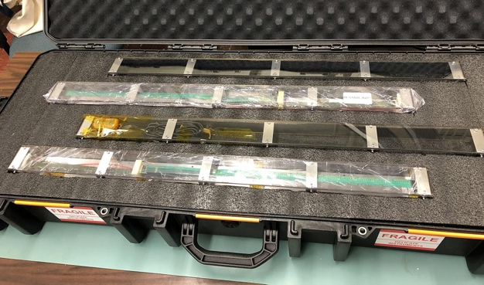
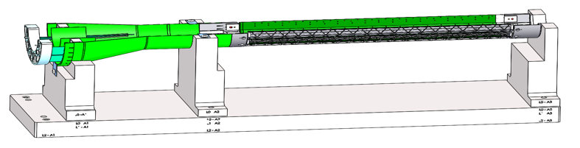
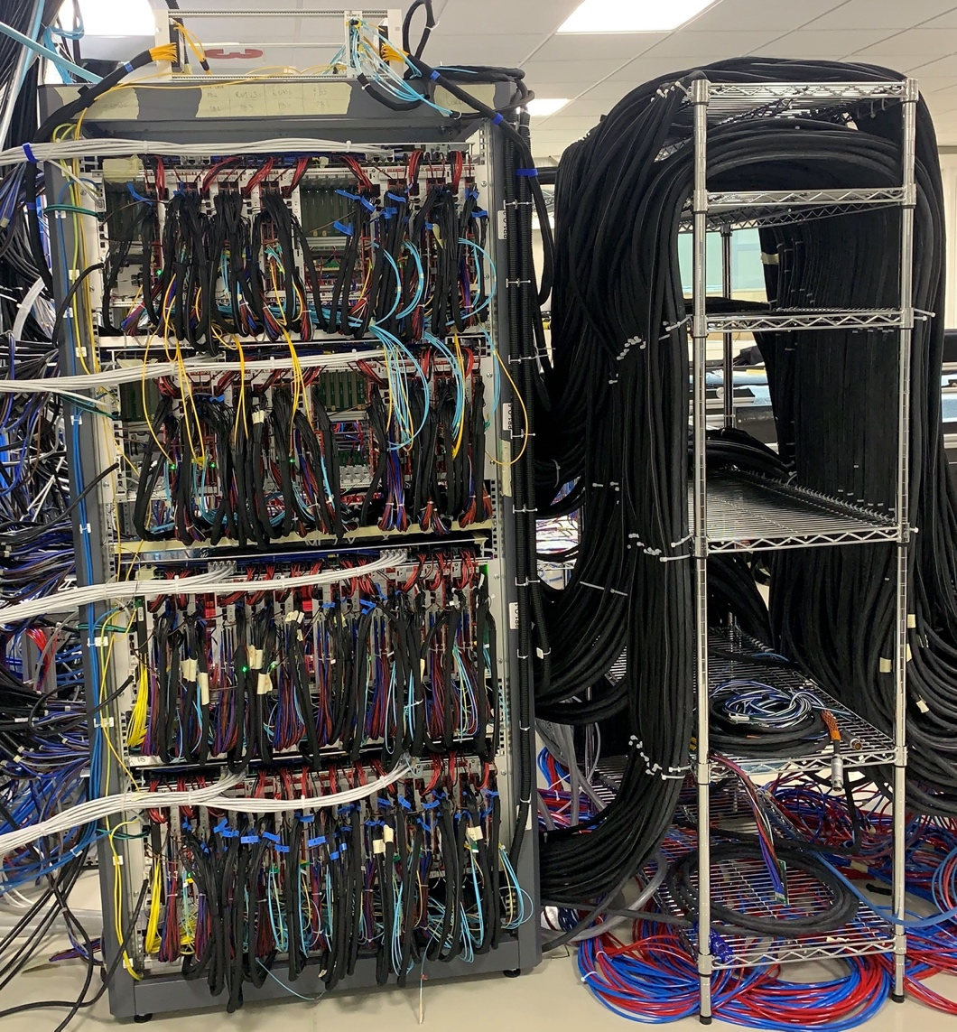
Near Term Plan
Coninue CFC production at WorkShape
  Produce low-cost “evil-twin” at the end of production
Finished X-wing design, fabrication
  Mockup
Stave shipping & QA
  Prepare for detector assembly
Readout and control
  AMD issues
  mGTM integration
  Slow ontrol
MVTX detector safety system
  Interface to sPHENIX safety system
Experimental Safety Review
  Cables etc.
Power system Cooling system

Slide 8

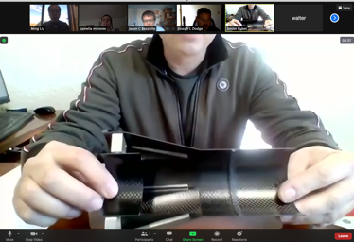
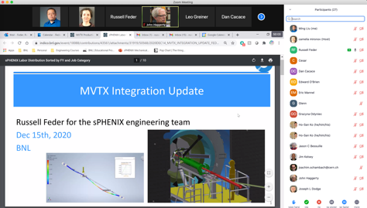

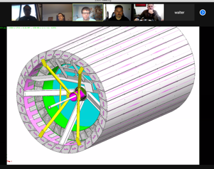
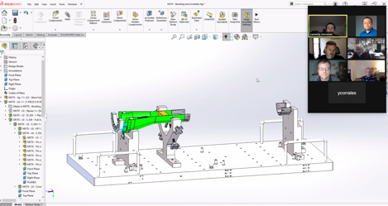
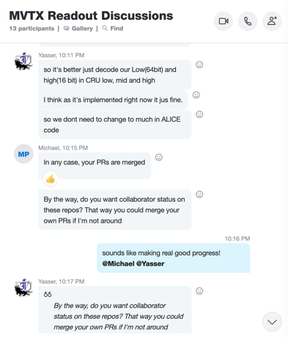

Status & Plan
Pre-COVID19 Schedule
Today
production started
Some delay in CFC production,
but still on track for completing
the assembly work in 2021
Assembly review
@LBNL
Readout, Control and Electrical System Integration
Repair 3 RUs
FW/SW synced to latest ALICE/ATLAS code
Low-level slow control under testing
mGTM in progress at BNL (40MHz/LHC)
Readout and service cables and power system
MVTX
installation
~9/2022

Slide 9
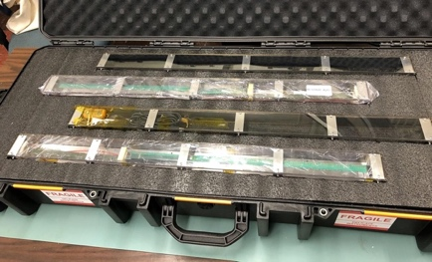

sPHENIX MVTX Project Highlights
On track to complete the full detectors by 2021
Sensor production
  48 Gold staves produced at CERN(Full MVTX detector)
    Spares production in progress, to complete ~3/2021
  Commercial shipping from CERN to US tested
Electronics production
  All 60 frontend Readout Units (RU) produced and tested;
    3 problematic boards repair in progress
  All 30 Power Boards produced and calibrated
  All 100 electronics cooling plates produced
  8 backend FELIX boards order in place
Carbon structure production in progress
  1st layer-0 End-Wheel produced
  Finish production by 4/2021
Detector assembly jigs designed
MVTX insertion system design
  Full scale mock-up in progress
Readout and control system tested
  Firmware/software updated
Negative pressure cooling system tested
Legend
- Sensors & Electronics
- Mechanical Structure
- Global Integration

