Slide 1
MVTX Status
Camelia, Grazyna, Ming
02/12/2021
sPHENIX L2 Project Meeting

Slide 2
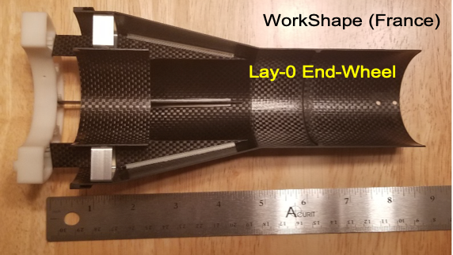
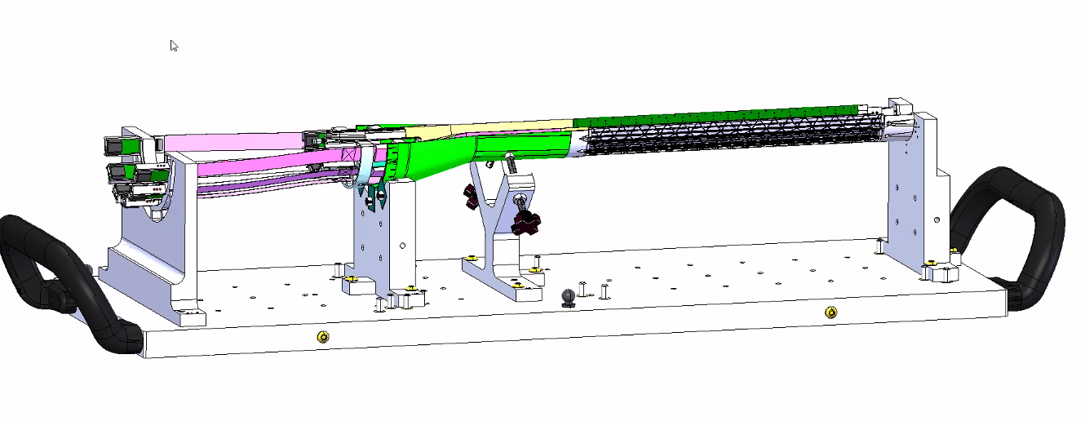
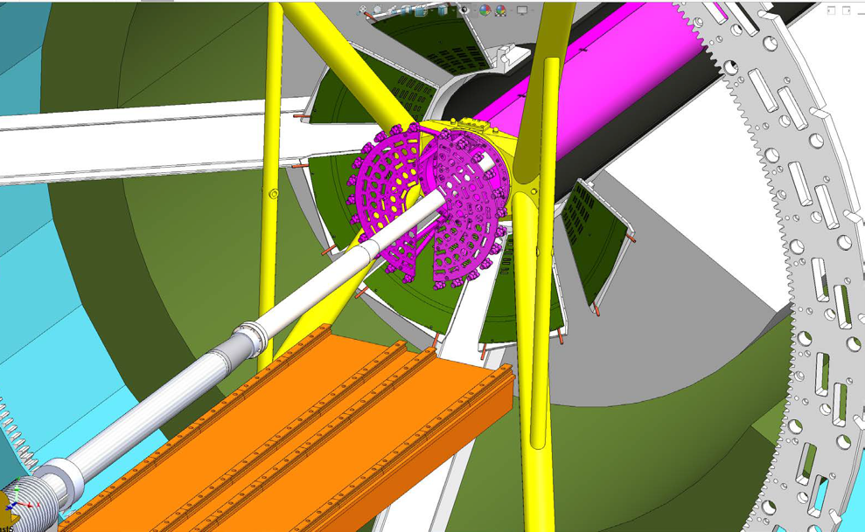
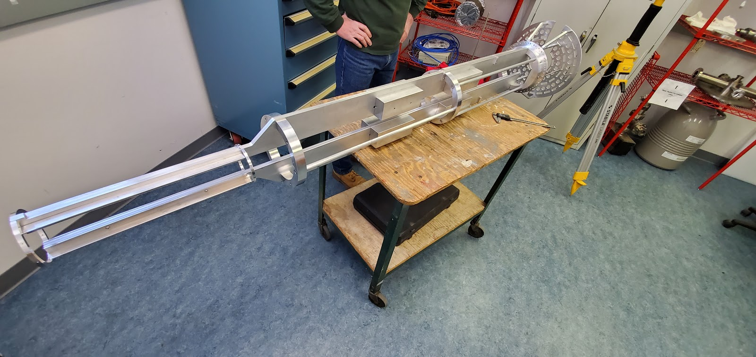
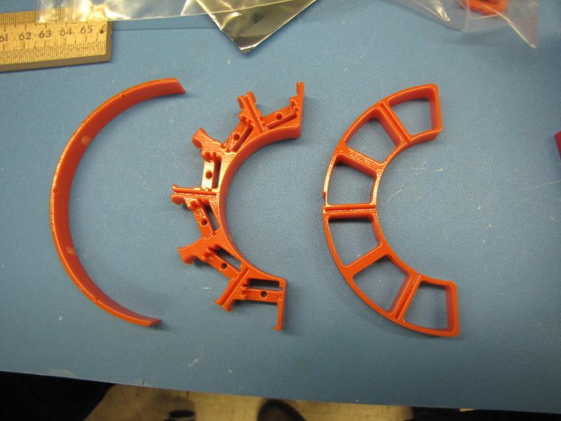
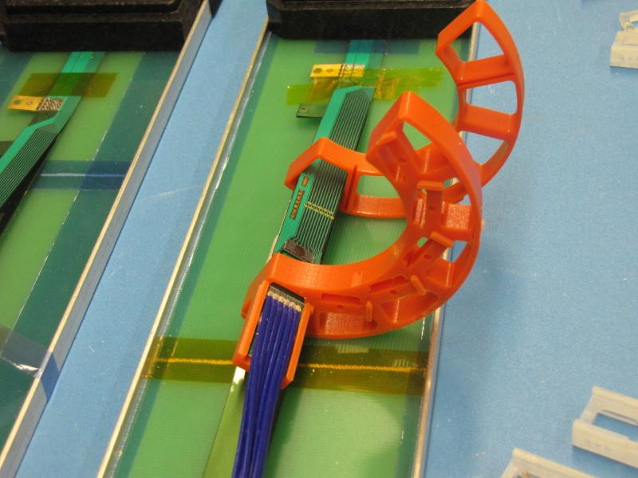
Mechanical Structures & Integration
CFC production on schedule
A new all carbon Lay-0 EW, to replace the test article
In kind contribution from WorkShape
Complete in 3rd week of March
X-Wing design near completion
PP3 optimization (3D print)
=> finalize cable lengths, for readout and power
Finalizing assembly jig design
meeting with LBNL next week
PP1/2 designs updated, confirmed w/ 3-D mockups
Improve cable passthrough, locking
Budget update -> more engineering support
LANL, add 0.3FTE on MVTX + WBS2.x, ~$150k
LBNL, add “setup clean room”, ~$20k
MIT, in progress
-> finish X-wing+insertion system, assembly fixtures, cooling system, extra lower cost
“Evil MVTX CYSS/SB” (for insertion dry run in BNL, WBS2.x scope), etc.
-> might need extra 200-250K from P6, and +~50K WBS2x
Assembly Jig
X-Wing
MVTX detector mockup @MIT

Slide 3
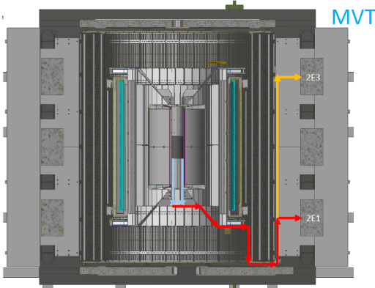
Readout and Electrical System
All 60 production RU tested
3 sent to factory for repair
spare components procurements
mezzanine cards ordered
VTRx/VTTx under discussion, repurpose UT-A RU-test travel fund?
Detector safety system proposed – (T, V, I )
Modify from ALICE “ITS2S”
mGTM development in progress
Preliminary design available for testing ~next week?
Readout in progress
New data format and latest firmware
mGTM and FELIX interface
AMD server integration in progress
Slow control communication ok
DMA data transfer ok
Power system, racks, cables etc
Budget update for FY21:
Spare components
RU mezzanine cards ordered (<$10K)
VTTx/VTRx ~ $12k, try to repurpose RU test travel $ (UT-A) to small item purchase?
Miscellaneous items:
VME crates (~$6K), 4 fanout boards($10k?), patch panels, CANBUS cables, optical fibers etc.
Safety system -> MVTX + WBS2.x

Slide 4
Stave Production, Transportation and QA
48 + spares Gold staves produced
6 new staves finished metrology (as of 1/20/2021)
Production rate: 4~5 HICs/week
4 (3 Gold + 1 Silver) under test at LBNL
Mostly consistent with CERN data
Some details under investigation
One more test shipping this week
1 HIC, several monitoring loggers
Next Meeting with CERN @2/18
one HIC on the way to LBNL,
Double check transportation loggers
Budget: no change
Power board calibration and stave QA @LBNL
DVDD, AVDD
FPC power cable resistance values

Slide 5
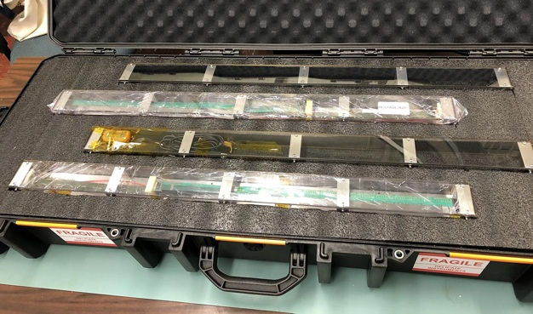
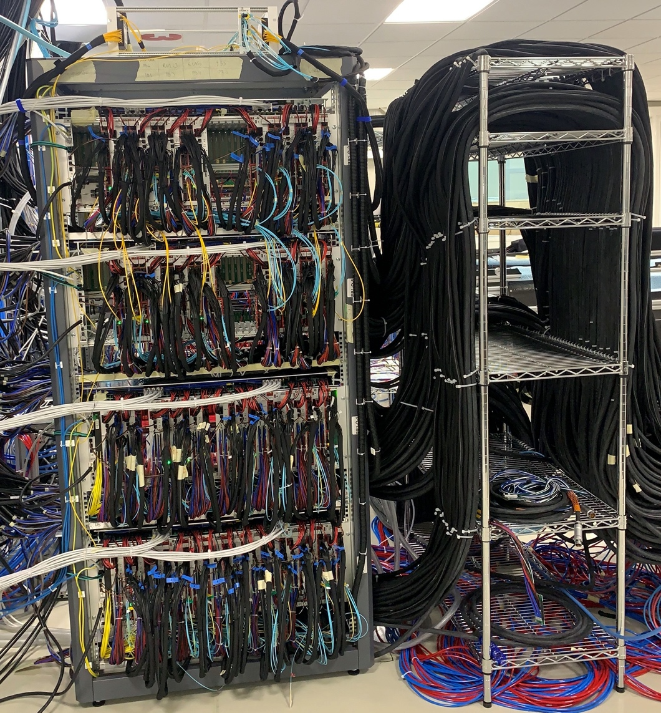
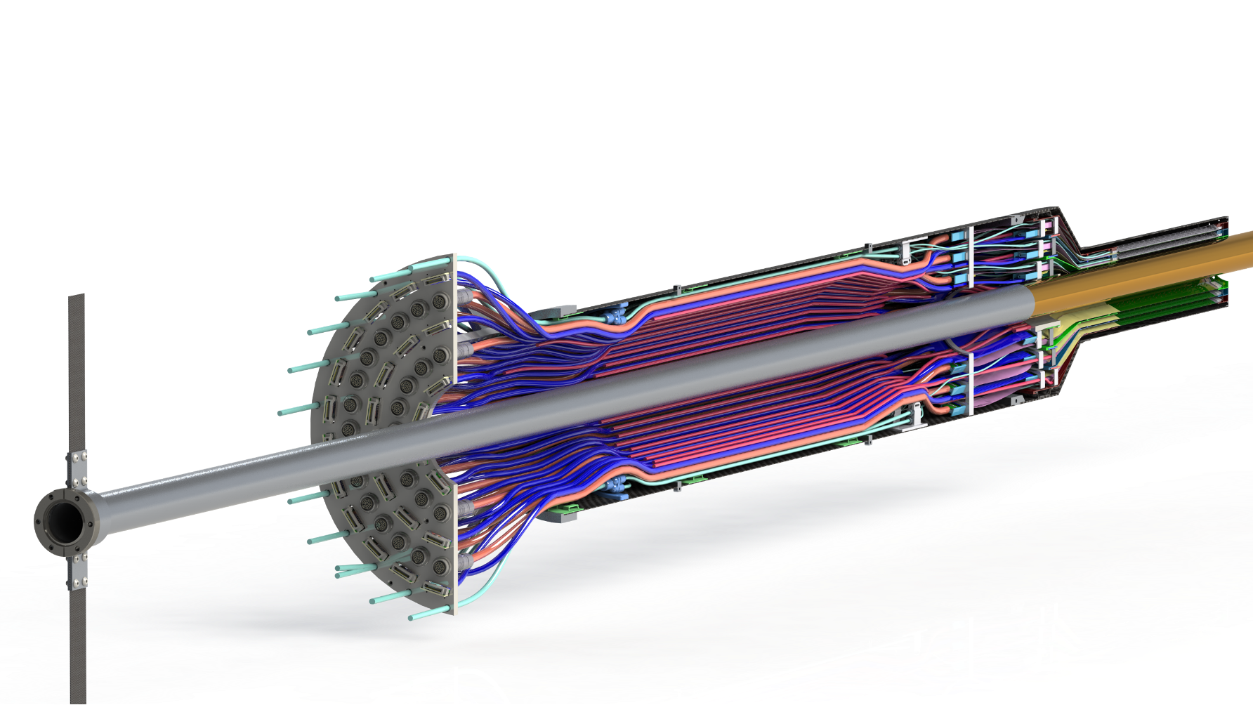
Near Term Plan
Mechanical structures
Continue CFC production at WorkShape
Produce low-cost “evil-twin” at the end of production
Finished X-wing design, fabrication
Mockup
Finish assembly fixtures
Stave shipping & QA
Prepare for detector assembly
Readout and control
AMD full integration
mGTM integration
Slow Control
MVTX detector safety system
Interface to sPHENIX safety system
Experimental Safety Review
power cables etc.
Power system & Cooling system
system tests and procurements
- Test fit in Mar-April
- Assembly review, ~May 2021
Complete assembly 12/2021

Slide 6
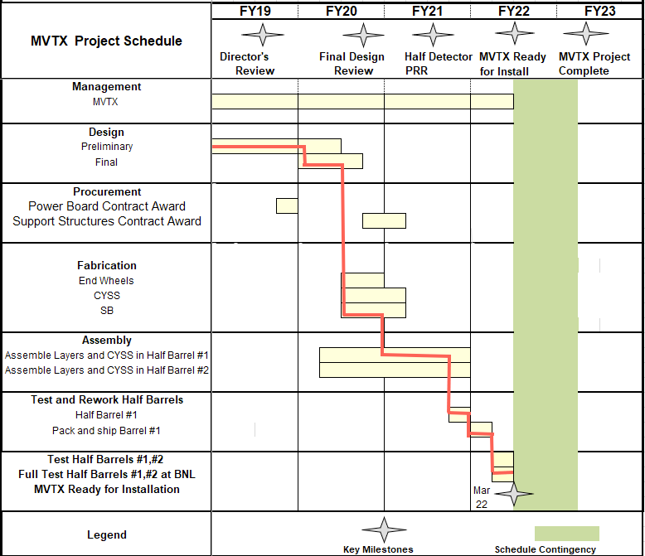
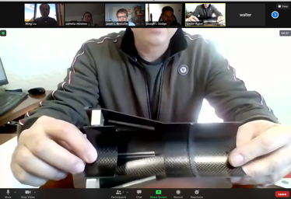
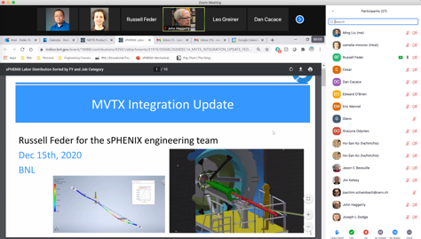
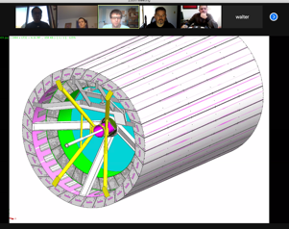
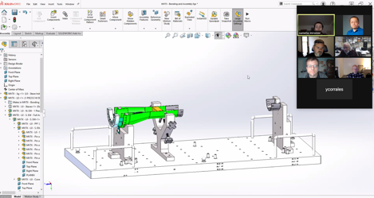
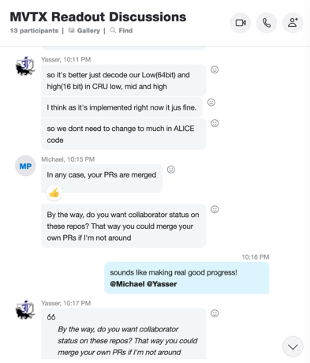
Status & Plan
Pre-COVID19 Schedule
Today
Production in progress
Some delay in CFC production,
but still on track for completing
the assembly work in 2021
Assembly review
@LBNL
Readout, Control and Electrical System Integration
3 RUs sent to factory@UK for repair
FW/SW synced to latest ALICE/ATLAS code
Low-level slow control under testing
mGTM progress at BNL (40MHz/LHC)
Readout and service cables and power system
MVTX
installation
~9/2022

Slide 7
 | STAVE-production summary table
IBSTAVE ID | HIC assembly | HIC assembly date | Ins. after glue | Bonding | Pull test (>=2 lifts + F <7g) | Ins. after bonding | HIC PWR test | Qualification test | Threshold cluster | HIC Matrix | HIC DTU | HIC DTU (new) | HIC+SF+C -> Stave | Stave PWR test | Stave test | STAVE test date | STAVE metrology | Stave PWR test (long PWR extn.) | STAVE final test (PT100) | Final STAVE Matrix | Final STAVE DTU | STAVE Deliverd
TOTAL | 83 |  | 83 | 80 |  | 80 | 76 | 62 |  |  |  |  | 58 | 57 | 57 |  | 49 | 49 | 49 |  |  | 4
A201 (326) | 1 | 03/10/2019 | 1 | 1 | 1 | 1 | 1 | 1 | 1 | GOLD | OK | OK | 1 | 1 | 1 | 01/11/2019 | 1 | 1 | 1 | GOLD | OK | 1
A202* | 1 | 07/10/2019 | 1 | 1 | 0 | 1 | 1 | 0 | ?? | PARTIAL | OK | OK
A203 (144) | 1 | 08/10/2019 | 1 | 1 | 0 | 1 | 1 | 1 | 0 | GOLD | OK | OK | 1 | 1 | 1 | 04/11/2019 | 1 | 1 | 1 | GOLD | OK | 1
A204 (158) | 1 | 22/10/2019 | 1 | 1 | 1 | 1 | 1 | 1 | 0 | GOLD | OK | OK | 1 | 1 | 1 | 07/11/2019 | 1 | 1 | 1 | GOLD | OK | 1
A205 (167) | 1 | 23/10/2019 | 1 | 1 | 4 | 1 | 1 | 1 | 0 | GOLD | CAN | OK | 1 | 1 | 1 | 08/11/2019 | 1 | 1 | 1 | GOLD | OK
A206 (204) | 1 | 30/10/2019 | 1 | 1 | 3 | 1 | 1 | 1 | 2 | GOLD | CAN | CAN | 1 | 1 | 1 | 24/01/2020 | 1 | 1 | 1 | GOLD | CAN
B201 (352) | 1 | 30/10/2019 | 1 | 1 | 0 | 1 | 1 | 1 | 0 | GOLD | CAN | CAN | 1 | 1 | 1 | 28/05/2020 | 1 | 1 | 1 | GOLD | OK
B202* | 1 | 31/10/2019 | 1 | 1 | 0 | 1 | 1 | 0 |  | Broken
B203 (114) | 1 | 07/11/2019 | 1 | 1 | 1 | 1 | 1 | 1 | 0 | GOLD | CAN | CAN | 1 | 1 | 1 | 29/05/2020 | 1 | 1 | 1 | GOLD | CAN
B204 (116) | 1 | 13/11/2019 | 1 | 1 | 0 | 1 | 1 | 1 | 1 | SILVER | CAN | CAN | 1 | 1 | 1 | 28/05/2020 | 1 | 1 | 1 | SILVER | CAN | 1
B205 (115) | 1 | 14/01/2020 | 1 | 1 | 2 | 1 | 1 | 1 | 0 | GOLD | CAN | CAN | 1 | 1 | 1 | 02/06/2020 | 1 | 1 | 1 | GOLD | OK
B206 (295) | 1 | 15/01/2020 | 1 | 1 | 2 | 1 | 1 | 1 | 0 | GOLD | CAN | OK | 1 | 1 | 1 | 02/06/2020 | 1 | 1 | 1 | GOLD | OK
F201* | 1 | 27/02/2020 | 1 | 1 | 1 | 1 | 1 | 0 | ?? | PARTIAL | OK | OK
F202 (230) | 1 | 28/02/2020 | 1 | 1 | 3 | 1 | 1 | 1 | 0 | GOLD | CAN | OK | 1 | 1 | 1 | 04/06/2020 | 1 | 1 | 1 | GOLD | CAN
F204 | 1 | 29/02/2020 | 1 | 1 | 5 | 1 | 1 | 1 | 2 | GOLD | CAN | OK
G202 (234) | 1 | 10/02/2020 | 1 | 1 | 0 | 1 | 1 | 1 | 1 | GOLD | OK | OK | 1 | 1 | 1 | 04/06/2020 | 1 | 1 | 1 | GOLD | OK
G203 | 1 | 12/02/2020 | 1 | 1 | 1 | 1 | 1 | 1 | 1 | GOLD | CAN | CAN
F203* | dummy
H202 (294) | 1 | 24/02/2020 | 1 | 1 | 0 | 1 | 1 | 1 | 0 | GOLD | OK | OK | 1 | 1 | 1 | 05/06/2020 | 1 | 1 | 1 | GOLD | OK
H203 (302) | 1 | 26/02/2020 | 1 | 1 | 0 | 1 | 1 | 1 | 0 | GOLD | OK | OK | 1 | 1 | 1 | 05/06/2020 | 1 | 1 | 1 | GOLD | OK
H204 (354) | 1 | 27/02/2020 | 1 | 1 | 0 | 1 | 1 | 1 | 0 | GOLD | OK | OK | 1 | 1 | 1 | 11/06/2020 | 1 | 1 | 1 | GOLD | OK
H206* | 1 | 04/03/2020 | 1 | 1 | 0 | 1 | 1 | 0 | ?? | PARTIAL | OK | OK
E204 (110) | 1 | 05/03/2020 | 1 | 1 | 0 | 1 | 1 | 1 | 1 | GOLD | CAN | CAN | 1 | 1 | 1 | 22/06/2020 | 1 | 1 | 1 | GOLD | CAN
E201* | 1 | 12/02/2020 | 1 | 1 | 0 | 1 | 1 | 0 | 3 | PARTIAL | CAN | OK
E202 | 1 | 10/03/2020 | 1 | 1 | 1 | 1 | 1 | 1 | 1 | GOLD | CAN (bad driver) | CAN (bad driver)
E206 (101) | 1 | 12/03/2020 | 1 | 1 | 0 | 1 | 1 | 1 | 1 | GOLD | OK | OK | 1 | 1 | 1 | 16/06/2020 | 1 | 1 | 1 | GOLD | OK
H205 | 1 | 11/06/2020 | 1 | 1 | 0 | 1 | 1 | 0 | 1 | SILVER | OK | OK
I202 (175) | 1 | 15/06/2020 | 1 | 1 | 0 | 1 | 1 | 1 | 0 | GOLD | OK | OK | 1 | 1 | 1 | 22/06/2020 | 1 | 1 | 1 | GOLD | OK
I203 (187) | 1 | 16/06/2020 | 1 | 1 | 0 | 1 | 1 | 1 | 0 | GOLD | OK | OK | 1 | 1 | 1 | 26/06/2020 | 1 | 1 | 1 | GOLD | OK
I204* | 1 | 17/06/2020 | 1 | 1 | 0 | 1 | 1 | 0 | 0 | PARTIAL | OK | OK
I205 (266) | 1 | 22/06/2020 | 1 | 1 | 0 | 1 | 1 | 1 | 0 | GOLD | OK | OK | 1 | 1 | 1 | 26/06/2020 | 1 | 1 | 1 | GOLD | OK
J201* | 1 | 23/06/2020 | 1 | 1 | 0 | 1 | 1 | 0 | ?? | PARTIAL | OK | OK
J202 (207) | 1 | 24/06/2020 | 1 | 1 | 0 | 1 | 1 | 1 | 0 | GOLD | CAN | OK | 1 | 1 | 1 | 16/07/2020 | 1 | 1 | 1 | GOLD | CAN
J203 (245) 345 right | 1 | 29/06/2020 | 1 | 1 | 0 | 1 | 1 | 1 | 0 | GOLD | CAN | CAN | 1 | 1 | 1 | 17/07/2020 | 1 | 1 | 1 | GOLD | CAN
J204 (252) | 1 | 30/06/2020 | 1 | 1 | 0 | 1 | 1 | 1 | 0 | GOLD | OK | OK | 1 | 1 | 1 | 03/07/2020 | 1 | 1 | 1 | GOLD | OK
J206 (260) | 1 | 01/07/2020 | 1 | 1 | 0 | 1 | 1 | 1 | 0 | GOLD | OK | OK | 1 | 1 | 1 | 03/07/2020 | 1 | 1 | 1 | GOLD | OK
K202 (122) | 1 | 07/07/2020 | 1 | 1 | 0 | 1 | 1 | 1 | 1 | GOLD | OK | OK | 1 | 1 | 1 | 18/08/2020 | 1 | 1 | 1 | GOLD | OK
K203 (125) | 1 | 08/07/2020 | 1 | 1 | 0 | 1 | 1 | 1 | 0 | GOLD | OK | OK | 1 | 1 | 1 | 18/08/2020 | 1 | 1 | 1 | GOLD | OK
K204 (129) | 1 | 09/07/2020 | 1 | 1 | 0 | 1 | 1 | 1 | 0 | GOLD | CAN | OK | 1 | 1 | 1 | 04/09/2020 | 1 | 1 | 1 | GOLD | OK
K205 (128) | 1 | 13/07/2020 | 1 | 1 | 0 | 1 | 1 | 1 | 1 | GOLD | CAN | CAN | 1 | 1 | 1 | 04/09/2020 | 1 | 1 | 1 | GOLD | CAN
K206 (347) | 1 | 14/07/2020 | 1 | 1 | 0 | 1 | 1 | 1 | 0 | GOLD | OK | OK | 1 | 1 | 1 | 28/09/2020 | 1 | 1 | 1 | GOLD | OK
Stave Production meeting
with CERN, 1/19/2021
6 new stave metrology done
* Partial/Not functioning

Slide 8
 | STAVE-production summary table
IBSTAVE ID | HIC assembly | HIC assembly date | Ins. after glue | Bonding | Pull test (>=2 lifts + F <7g) | Ins. after bonding | HIC PWR test | Qualification test | Threshold cluster | HIC Matrix | HIC DTU | HIC DTU (new) | HIC+SF+C -> Stave | Stave PWR test | Stave test | STAVE test date | STAVE metrology | Stave PWR test (long PWR extn.) | STAVE final test (PT100) | Final STAVE Matrix | Final STAVE DTU | STAVE Deliverd
L202 (130) | 1 | 23/07/2020 | 1 | 1 | 0 | 1 | 1 | 1 | 0 | GOLD | CAN | OK | 1 | 1 | 1 | 08/09/2020 | 1 | 1 | 1 | GOLD | CAN
L203 (139) | 1 | 24/07/2020 | 1 | 1 | 0 | 1 | 1 | 1 | 0 | GOLD | CAN | CAN | 1 | 1 | 1 | 08/09/2020 | 1 | 1 | 1 | GOLD | CAN
L204 (127) | 1 | 27/07/2020 | 1 | 1 | 0 | 1 | 1 | 1 | 0 | GOLD | CAN | CAN | 1 | 1 | 1 | 14/09/2020 | 1 | 1 | 1 | GOLD | CAN
L205 (136) | 1 | 28/07/2020 | 1 | 1 | 0 | 1 | 1 | 1 | 0 | GOLD | OK | OK | 1 | 1 | 1 | 14/09/2020 | 1 | 1 | 1 | GOLD | OK
J205* | 1 | 05/08/2020 | 1 | 1 | 0 | 1 | 1 | 0 | ?? | PARTIAL | CAN | CAN
I201* | 1 | 06/08/2020 | 1 | 1 | 0 | 1 | 1 | 0 | 0 | PARTIAL | OK | OK
L206* | 1 | 13/08/2020 | 1 | 0
L201 (169) | 1 | 14/08/2020 | 1 | 1 | 0 | 1 | 1 | 1 | 1 | GOLD | CAN | CAN | 1 | 1 | 1 | 30/09/2020 | 1 | 1 | 1 | GOLD | CAN
S201 (359) | 1 | 03/09/2020 | 1 | 1 | 0 | 1 | 1 | 1 | 0 | GOLD | CAN | OK | 1 | 1 | 1 | 30/09/2020 | 1 | 1 | 1 | GOLD | OK
S202 | 1 | 04/09/2020 | 1 | 1 | 0 | 1 | 1 | 0 | 0 | SILVER | CAN | CAN
S203 (235) | 1 | 08/09/2020 | 1 | 1 | 0 | 1 | 1 | 1 | 0 | GOLD | CAN | CAN | 1 | 1 | 1 | 16/11/2020 | 1 | 1 | 1 | GOLD | OK
S204 (237) | 1 | 15/09/2020 | 1 | 1 | 0 | 1 | 1 | 1 | 1 | GOLD | CAN | CAN | 1 | 1 | 1 | 30/09/2020 | 1 | 1 | 1 | GOLD | CAN
S205 (142) | 1 | 16/09/2020 | 1 | 1 | 0 | 1 | 1 | 1 | 0 | GOLD | CAN | CAN | 1 | 1 | 1 | 01/10/2020 | 1 | 1 | 1 | GOLD | CAN
S206 (98) | 1 | 17/09/2020 | 1 | 1 | 0 | 1 | 1 | 1 | 1 | GOLD | OK | OK | 1 | 1 | 1 | 02/10/2020 | 1 | 1 | 1 | GOLD | OK
T201 (277) | 1 | 04/11/2020 | 1 | 1 | 0 | 1 | 1 | 1 | 1 | GOLD | CAN | CAN | 1 | 1 | 1 | 17/11/2020 | 1 | 1 | 1 | GOLD | CAN
T202 (279) | 1 | 06/11/2020 | 1 | 1 | 0 | 1 | 1 | 1 | 2 | GOLD | CAN | CAN | 1 | 1 | 1 | 19/11/2020 | 1 | 1 | 1 | GOLD | CAN
T203 | 1 | 09/11/2020 | 1 | 1 | 0 | 1 | 1
U201 (291) | 1 | 10/11/2020 | 1 | 1 | 0 | 1 | 1 | 1 | 2 | SILVER | CAN | CAN | 1 | 1 | 1 | 24/11/2020 | 1 | 1 | 1 | GOLD | CAN
U202 (238) | 1 | 11/11/2020 | 1 | 1 | 0 | 1 | 1 | 1 | 1 | GOLD | CAN | CAN | 1 | 1 | 1 | 26/11/2020 | 1 | 1 | 1 | GOLD | CAN
U203 (126) | 1 | 12/11/2020 | 1 | 1 | 0 | 1 | 1 | 1 | 0 | GOLD | CAN | CAN | 1 | 1 | 1 | 20/11/2020 | 1 | 1 | 1 | GOLD | CAN
U204* | 1 | 13/11/2020 | 1 | 1 | 0 | 1 | 1 | 0 | 0 | PARTIAL | OK | OK
U205 (89) | 1 | 16/11/2020 | 1 | 1 | 0 | 1 | 1 | 1 | 1 | GOLD | OK | OK | 1 | 1 | 1 | 27/11/2020 | 1 | 1 | 1 | GOLD | OK
U206 (111) | 1 | 17/11/2020 | 1 | 1 | 0 | 1 | 1 | 1 | 0 | GOLD | CAN | CAN | 1 | 1 | 1 | 25/11/2020 | 1 | 1 | 1 | GOLD | CAN
Q201 (155) | 1 | 18/11/2020 | 1 | 1 | 0 | 1 | 1 | 1 | 0 | SILVER | CAN | CAN | 1 | 1 | 1 | 27/11/2020 | 1 | 1 | 1 | GOLD | CAN
Q202 | 1 | 19/11/2020 | 1 | 1 | 0 | 1 | 1 | 1 | 0 | GOLD | CAN | OK | 1 | 1 | 1 | 03/12/2020 | 1 | 1 | 1 | GOLD | CAN
T204 | 1 | 23/11/2020 | 1 | 1 | 0 | 1 | 1 | 1 | 0 | GOLD | CAN | CAN | 1 | 1 | 1 | 03/12/2020 | 1 | 1 | 1 | GOLD | CAN
T205 | 1 | 24/11/2020 | 1 | 1 | 0 | 1 | 1 | 1 | 1 | GOLD | OK | OK | 1 | 1 | 1 | 03/12/2020
T206 (232) | 1 | 25/11/2020 | 1 | 1 | 0 | 1 | 1 | 1 | 1 | GOLD | CAN | CAN | 1 | 1 | 1 | 14/01/2021
R201 (119) | 1 | 27/11/2020 | 1 | 1 | 8 | 1 | 1 | 1 | 1 | GOLD | CAN | CAN | 1 | 1 | 1 | 08/12/2020
R202 (109) | 1 | 30/11/2020 | 1 | 1 | 1 | 1 | 1 | 1 | 0 | GOLD | CAN | CAN | 1 | 1 | 1 | 17/12/2020
W201 (52) | 1 | 01/12/2020 | 1 | 1 | 0 | 1 | 1 | 1 | 0 | GOLD | OK | OK | ?? data line broken
W202* | 1 | 02/12/2020 | 1 | 1 | 0 | 1 | 1 | 0 | ?? | PARTIAL | CAN | CAN
W203 (212) | 1 | 03/12/2020 | 1 | 1 | 0 | 1 | 1 | 1 | 0 | SILVER | CAN | CAN | 1 | 1 | 1 | 05/01/2021
W204 (271) | 1 | 07/12/2020 | 1 | 1 | 0 | 1 | 1 | 1 | 3 | GOLD | OK | OK | 1 | 1 | 1 | 05/01/2021
W205 (275) | 1 | 08/12/2020 | 1 | 1 | 0 | 1 | 1 | 1 | 0 | GOLD | CAN | CAN | 1 | 1 | 1 | 18/01/2021
W206 | 1 | 09/12/2020 | 1 | 1 | 0 | 1 | ?? Digi short
R203 | 1 | 06/01/2021 | 1 | 1 | 0 | 1 | 1 | 1 | 0 | GOLD | OK | OK | 1 | 1 | 1 | 20/01/2021
R204 | 1 | 11/01/2021 | 1 | 1 | 0 | 1 | 0 | 0 | ?? | PARTIAL | OK | OK
Q203 | 1 | 12/01/2021 | 1 | 1 | 0 | 1 | 0
X201 | 1 | 13/01/2021 | 1 | 1 | 0 | 1 | 1 | 1 | 1 | GOLD | CAN | CAN | 1
X202 | 1 | 14/01/2021 | 1 | 1 | 0 | 1
X204 | 1 | 18/01/2021 | 1
X205 | 1 | 19/01/2021 | 1
From last stave Production
meeting with CERN, 1/19/2021

