Slide 1
MVTX Status and Plan
Ming Liu
1/7/2021
sPHENIX L2 Meeting

Slide 2

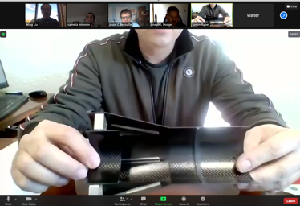
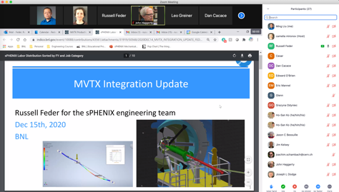

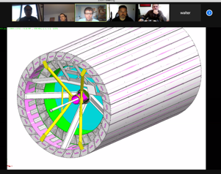
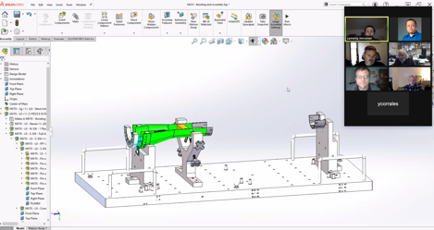
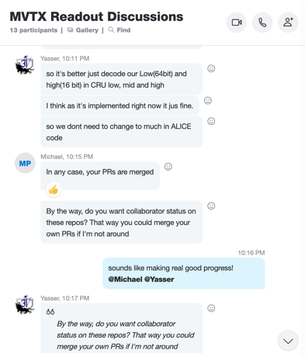

2020 Highlights
Pre-COVID19 Schedule
Today
production starts soon
Some delay in CFC production,
but still on track for completing
the assembly work in 2021
Assembly review
Readout & Controls
60 RU 1st round test completed
FW/SW synced to latest ALICE/ATLAS code
Low-level slow control hardware interface established, high-level software interface under testing
mGTM in progress at BNL

Slide 3

48 Gold Staves Produced!
(One full MVTX detector)

Slide 4
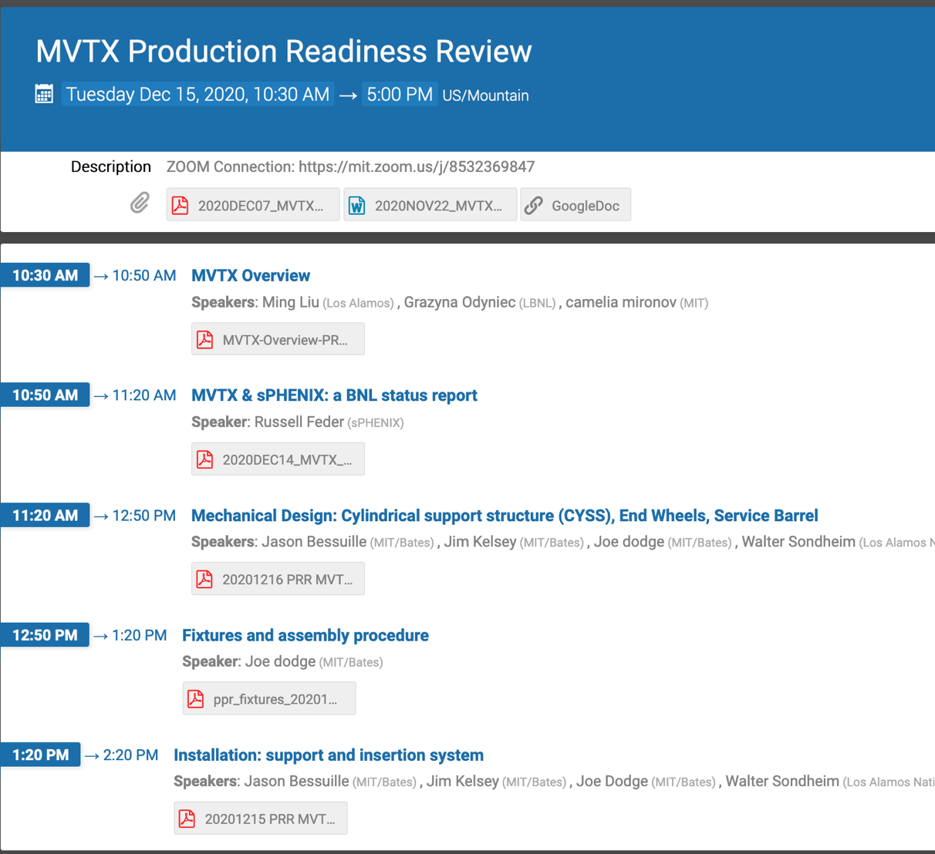
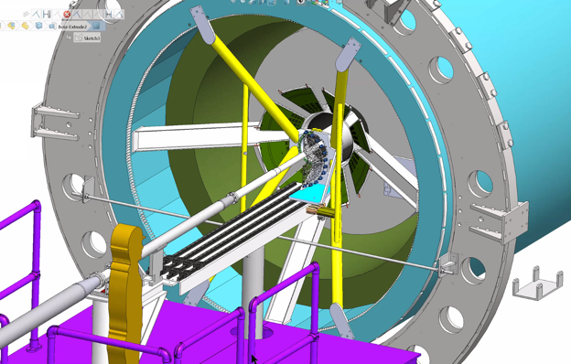
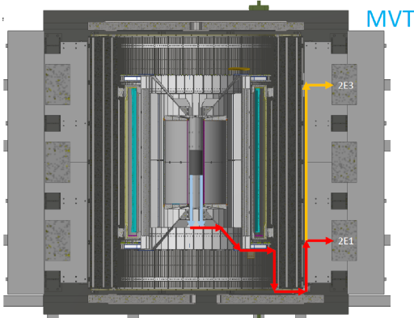
Project Status
Mechanical system
  MVTX PRR 12/15/2020, went very well - draft report soon
  Next:
    Insertion system and mockup, in progress
    Start CFC production soon
Electrical system integration
  60 production RU testing at ORNL completed, debugging in progress
    5 RUs for factory repair
    Need more spares VTRx optical transceivers
  A new AMD server setup good progress at LANL
  Excellent progress with Slow Control software – LLA , MIT
  40MHz mGTM in progress @BNL, meeting w/ BNL engineers soon
Stave production and transportation – 48 gold staves produced!
  45+ gold staves at CERN
  4 staves (3 Gold + 1 Silver) under test at LBNL
FY21 budget/schedule
  Updated budget/schedule submitted to BNL
  ORNL’s budget received, LANL’s new contract in progress
  P6 procurements – MVTX related (WBS 2.X)
    MVTX Supports – M&S, 4/21 – 6/18, 2021, $50K
    MVTX integration/installation tooling/fixtures – M&S, 12/30/2020 – 3/29/2021, $30K
MVTX insertion system

Slide 5
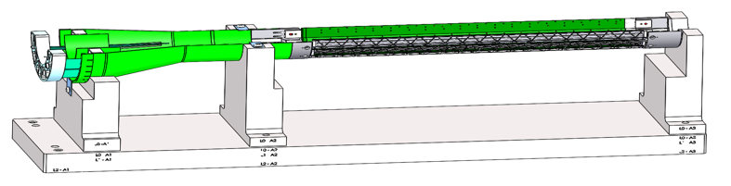
Near Term To Do’s and Challenges
Reviews
  sPHENIX MVTX/INTT/BP integration Review: ~Feb 2021?
    Finish MVTX and insertion system mockup
    X-wing supporting structure production
  Power cables safety review, early 2021?
    Cable procurements and QA
Half-detector assembly at LBNL
  Stave shipping and test
    be ready for half-detector assembly ~May 2021
  Assembly fixture fabrication
  CFC production and test fitting
Readout & control system integration
  Continuous readout mode
    synchronization across subsystems, new data format?
  mGTM development
    40MHz system clock for MVTX
  Slow control and monitoring
  To be ready for half-detector commissioning ~summer 2021
Other services
  Cooling system
  Setup clean tent at BNL in ~Fall
Half-detector assembly & test @LBNL
May – December, 2021

Slide 6
Backup slides

Slide 7
0 | STAVE-production summary table
IBSTAVE ID | HIC assembly | HIC assembly date | Ins. after glue | Bonding | Pull test (>=2 lifts + F <7g) | Ins. after bonding | HIC PWR test | Qualification test | Threshold cluster | HIC Matrix | HIC DTU | HIC DTU (new) | HIC+SF+C -> Stave | Stave PWR test | Stave test | STAVE test date | STAVE metrology | Stave PWR test (long PWR extn.) | STAVE final test (PT100) | Final STAVE Matrix | Final STAVE DTU | STAVE Deliverd
TOTAL | 76 |  | 76 | 75 |  | 75 | 74 | 59 |  |  |  |  | 54 | 54 | 51 |  | 49 | 49 | 49 |  |  | 4
A201 (326) | 1 | 03/10/2019 | 1 | 1 | 1 | 1 | 1 | 1 | 1 | GOLD | OK | OK | 1 | 1 | 1 | 01/11/2019 | 1 | 1 | 1 | GOLD | OK | 1
A202* | 1 | 07/10/2019 | 1 | 1 | 0 | 1 | 1 | 0 | ?? | PARTIAL | OK | OK
A203 (144) | 1 | 08/10/2019 | 1 | 1 | 0 | 1 | 1 | 1 | 0 | GOLD | OK | OK | 1 | 1 | 1 | 04/11/2019 | 1 | 1 | 1 | GOLD | OK | 1
A204 (158) | 1 | 22/10/2019 | 1 | 1 | 1 | 1 | 1 | 1 | 0 | GOLD | OK | OK | 1 | 1 | 1 | 07/11/2019 | 1 | 1 | 1 | GOLD | OK | 1
A205 (167) | 1 | 23/10/2019 | 1 | 1 | 4 | 1 | 1 | 1 | 0 | GOLD | CAN | OK | 1 | 1 | 1 | 08/11/2019 | 1 | 1 | 1 | GOLD | OK
A206 (204) | 1 | 30/10/2019 | 1 | 1 | 3 | 1 | 1 | 1 | 2 | GOLD | CAN | CAN | 1 | 1 | 1 | 24/01/2020 | 1 | 1 | 1 | GOLD | CAN
B201 (352) | 1 | 30/10/2019 | 1 | 1 | 0 | 1 | 1 | 1 | 0 | GOLD | CAN | CAN | 1 | 1 | 1 | 28/05/2020 | 1 | 1 | 1 | GOLD | OK
B202* | 1 | 31/10/2019 | 1 | 1 | 0 | 1 | 1 | 0 |  | Broken
B203 (114) | 1 | 07/11/2019 | 1 | 1 | 1 | 1 | 1 | 1 | 0 | GOLD | CAN | CAN | 1 | 1 | 1 | 29/05/2020 | 1 | 1 | 1 | GOLD | CAN
B204 (116) | 1 | 13/11/2019 | 1 | 1 | 0 | 1 | 1 | 1 | 1 | SILVER | CAN | CAN | 1 | 1 | 1 | 28/05/2020 | 1 | 1 | 1 | SILVER | CAN | 1
B205 (115) | 1 | 14/01/2020 | 1 | 1 | 2 | 1 | 1 | 1 | 0 | GOLD | CAN | CAN | 1 | 1 | 1 | 02/06/2020 | 1 | 1 | 1 | GOLD | OK
B206 (295) | 1 | 15/01/2020 | 1 | 1 | 2 | 1 | 1 | 1 | 0 | GOLD | CAN | OK | 1 | 1 | 1 | 02/06/2020 | 1 | 1 | 1 | GOLD | OK
F201* | 1 | 27/02/2020 | 1 | 1 | 1 | 1 | 1 | 0 | ?? | PARTIAL | OK | OK
F202 (230) | 1 | 28/02/2020 | 1 | 1 | 3 | 1 | 1 | 1 | 0 | GOLD | CAN | OK | 1 | 1 | 1 | 04/06/2020 | 1 | 1 | 1 | GOLD | CAN
F204 | 1 | 29/02/2020 | 1 | 1 | 5 | 1 | 1 | 1 | 2 | GOLD | CAN | OK
G202 (234) | 1 | 10/02/2020 | 1 | 1 | 0 | 1 | 1 | 1 | 1 | GOLD | OK | OK | 1 | 1 | 1 | 04/06/2020 | 1 | 1 | 1 | GOLD | OK
G203 | 1 | 12/02/2020 | 1 | 1 | 1 | 1 | 1 | 1 | 1 | GOLD | CAN | CAN
F203* | dummy
H202 (294) | 1 | 24/02/2020 | 1 | 1 | 0 | 1 | 1 | 1 | 0 | GOLD | OK | OK | 1 | 1 | 1 | 05/06/2020 | 1 | 1 | 1 | GOLD | OK
H203 (302) | 1 | 26/02/2020 | 1 | 1 | 0 | 1 | 1 | 1 | 0 | GOLD | OK | OK | 1 | 1 | 1 | 05/06/2020 | 1 | 1 | 1 | GOLD | OK
H204 (354) | 1 | 27/02/2020 | 1 | 1 | 0 | 1 | 1 | 1 | 0 | GOLD | OK | OK | 1 | 1 | 1 | 11/06/2020 | 1 | 1 | 1 | GOLD | OK
H206* | 1 | 04/03/2020 | 1 | 1 | 0 | 1 | 1 | 0 | ?? | PARTIAL | OK | OK
E204 (110) | 1 | 05/03/2020 | 1 | 1 | 0 | 1 | 1 | 1 | 1 | GOLD | CAN | CAN | 1 | 1 | 1 | 22/06/2020 | 1 | 1 | 1 | GOLD | CAN
E201* | 1 | 12/02/2020 | 1 | 1 | 0 | 1 | 1 | 0 | 3 | PARTIAL | CAN | OK
E202 | 1 | 10/03/2020 | 1 | 1 | 1 | 1 | 1 | 1 | 1 | GOLD | CAN (bad driver) | CAN (bad driver)
E206 (101) | 1 | 12/03/2020 | 1 | 1 | 0 | 1 | 1 | 1 | 1 | GOLD | OK | OK | 1 | 1 | 1 | 16/06/2020 | 1 | 1 | 1 | GOLD | OK
H205 | 1 | 11/06/2020 | 1 | 1 | 0 | 1 | 1 | 0 | 1 | SILVER | OK | OK
I202 (175) | 1 | 15/06/2020 | 1 | 1 | 0 | 1 | 1 | 1 | 0 | GOLD | OK | OK | 1 | 1 | 1 | 22/06/2020 | 1 | 1 | 1 | GOLD | OK
I203 (187) | 1 | 16/06/2020 | 1 | 1 | 0 | 1 | 1 | 1 | 0 | GOLD | OK | OK | 1 | 1 | 1 | 26/06/2020 | 1 | 1 | 1 | GOLD | OK
I204* | 1 | 17/06/2020 | 1 | 1 | 0 | 1 | 1 | 0 | 0 | PARTIAL | OK | OK
I205 (266) | 1 | 22/06/2020 | 1 | 1 | 0 | 1 | 1 | 1 | 0 | GOLD | OK | OK | 1 | 1 | 1 | 26/06/2020 | 1 | 1 | 1 | GOLD | OK
J201* | 1 | 23/06/2020 | 1 | 1 | 0 | 1 | 1 | 0 | ?? | PARTIAL | OK | OK
J202 (207) | 1 | 24/06/2020 | 1 | 1 | 0 | 1 | 1 | 1 | 0 | GOLD | CAN | OK | 1 | 1 | 1 | 16/07/2020 | 1 | 1 | 1 | GOLD | CAN
J203 (245) 345 right | 1 | 29/06/2020 | 1 | 1 | 0 | 1 | 1 | 1 | 0 | GOLD | CAN | CAN | 1 | 1 | 1 | 17/07/2020 | 1 | 1 | 1 | GOLD | CAN
J204 (252) | 1 | 30/06/2020 | 1 | 1 | 0 | 1 | 1 | 1 | 0 | GOLD | OK | OK | 1 | 1 | 1 | 03/07/2020 | 1 | 1 | 1 | GOLD | OK
J206 (260) | 1 | 01/07/2020 | 1 | 1 | 0 | 1 | 1 | 1 | 0 | GOLD | OK | OK | 1 | 1 | 1 | 03/07/2020 | 1 | 1 | 1 | GOLD | OK
K202 (122) | 1 | 07/07/2020 | 1 | 1 | 0 | 1 | 1 | 1 | 1 | GOLD | OK | OK | 1 | 1 | 1 | 18/08/2020 | 1 | 1 | 1 | GOLD | OK
K203 (125) | 1 | 08/07/2020 | 1 | 1 | 0 | 1 | 1 | 1 | 0 | GOLD | OK | OK | 1 | 1 | 1 | 18/08/2020 | 1 | 1 | 1 | GOLD | OK
K204 (129) | 1 | 09/07/2020 | 1 | 1 | 0 | 1 | 1 | 1 | 0 | GOLD | CAN | OK | 1 | 1 | 1 | 04/09/2020 | 1 | 1 | 1 | GOLD | OK
K205 (128) | 1 | 13/07/2020 | 1 | 1 | 0 | 1 | 1 | 1 | 1 | GOLD | CAN | CAN | 1 | 1 | 1 | 04/09/2020 | 1 | 1 | 1 | GOLD | CAN
K206 (347) | 1 | 14/07/2020 | 1 | 1 | 0 | 1 | 1 | 1 | 0 | GOLD | OK | OK | 1 | 1 | 1 | 28/09/2020 | 1 | 1 | 1 | GOLD | OK
Report from Stave Production Meeting, 12/17/2020
11 new STAVEs are ready with final Test.
45 STAVES are ready to deliver.
4 STAVEs are delivered.
* Partial/Not functioning

Slide 8
 | STAVE-production summary table
IBSTAVE ID | HIC assembly | HIC assembly date | Ins. after glue | Bonding | Pull test (>=2 lifts + F <7g) | Ins. after bonding | HIC PWR test | Qualification test | Threshold cluster | HIC Matrix | HIC DTU | HIC DTU (new) | HIC+SF+C -> Stave | Stave PWR test | Stave test | STAVE test date | STAVE metrology | Stave PWR test (long PWR extn.) | STAVE final test (PT100) | Final STAVE Matrix | Final STAVE DTU | STAVE Deliverd
L202 (130) | 1 | 23/07/2020 | 1 | 1 | 0 | 1 | 1 | 1 | 0 | GOLD | CAN | OK | 1 | 1 | 1 | 08/09/2020 | 1 | 1 | 1 | GOLD | CAN
L203 (139) | 1 | 24/07/2020 | 1 | 1 | 0 | 1 | 1 | 1 | 0 | GOLD | CAN | CAN | 1 | 1 | 1 | 08/09/2020 | 1 | 1 | 1 | GOLD | CAN
L204 (127) | 1 | 27/07/2020 | 1 | 1 | 0 | 1 | 1 | 1 | 0 | GOLD | CAN | CAN | 1 | 1 | 1 | 14/09/2020 | 1 | 1 | 1 | GOLD | CAN
L205 (136) | 1 | 28/07/2020 | 1 | 1 | 0 | 1 | 1 | 1 | 0 | GOLD | OK | OK | 1 | 1 | 1 | 14/09/2020 | 1 | 1 | 1 | GOLD | OK
J205* | 1 | 05/08/2020 | 1 | 1 | 0 | 1 | 1 | 0 | ?? | PARTIAL | CAN | CAN
I201* | 1 | 06/08/2020 | 1 | 1 | 0 | 1 | 1 | 0 | 0 | PARTIAL | OK | OK
L206* | 1 | 13/08/2020 | 1 | 0
L201 (169) | 1 | 14/08/2020 | 1 | 1 | 0 | 1 | 1 | 1 | 1 | GOLD | CAN | CAN | 1 | 1 | 1 | 30/09/2020 | 1 | 1 | 1 | GOLD | CAN
S201 (359) | 1 | 03/09/2020 | 1 | 1 | 0 | 1 | 1 | 1 | 0 | GOLD | CAN | OK | 1 | 1 | 1 | 30/09/2020 | 1 | 1 | 1 | GOLD | OK
S202 | 1 | 04/09/2020 | 1 | 1 | 0 | 1 | 1 | 0 | 0 | SILVER | CAN | CAN
S203 (235) | 1 | 08/09/2020 | 1 | 1 | 0 | 1 | 1 | 1 | 0 | GOLD | CAN | CAN | 1 | 1 | 1 | 16/11/2020 | 1 | 1 | 1 | GOLD | OK
S204 (237) | 1 | 15/09/2020 | 1 | 1 | 0 | 1 | 1 | 1 | 1 | GOLD | CAN | CAN | 1 | 1 | 1 | 30/09/2020 | 1 | 1 | 1 | GOLD | CAN
S205 (142) | 1 | 16/09/2020 | 1 | 1 | 0 | 1 | 1 | 1 | 0 | GOLD | CAN | CAN | 1 | 1 | 1 | 01/10/2020 | 1 | 1 | 1 | GOLD | CAN
S206 (98) | 1 | 17/09/2020 | 1 | 1 | 0 | 1 | 1 | 1 | 1 | GOLD | OK | OK | 1 | 1 | 1 | 02/10/2020 | 1 | 1 | 1 | GOLD | OK
T201 (277) | 1 | 04/11/2020 | 1 | 1 | 0 | 1 | 1 | 1 | 1 | GOLD | CAN | CAN | 1 | 1 | 1 | 17/11/2020 | 1 | 1 | 1 | GOLD | CAN
T202 (279) | 1 | 06/11/2020 | 1 | 1 | 0 | 1 | 1 | 1 | 2 | GOLD | CAN | CAN | 1 | 1 | 1 | 19/11/2020 | 1 | 1 | 1 | GOLD | CAN
T203 | 1 | 09/11/2020 | 1 | 1 | 0 | 1 | 1
U201 (291) | 1 | 10/11/2020 | 1 | 1 | 0 | 1 | 1 | 1 | 2 | SILVER | CAN | CAN | 1 | 1 | 1 | 24/11/2020 | 1 | 1 | 1 | GOLD | CAN
U202 (238) | 1 | 11/11/2020 | 1 | 1 | 0 | 1 | 1 | 1 | 1 | GOLD | CAN | CAN | 1 | 1 | 1 | 26/11/2020 | 1 | 1 | 1 | GOLD | CAN
U203 (126) | 1 | 12/11/2020 | 1 | 1 | 0 | 1 | 1 | 1 | 0 | GOLD | CAN | CAN | 1 | 1 | 1 | 20/11/2020 | 1 | 1 | 1 | GOLD | CAN
U204* | 1 | 13/11/2020 | 1 | 1 | 0 | 1 | 1 | 0 | 0 | PARTIAL | OK | OK
U205 (89) | 1 | 16/11/2020 | 1 | 1 | 0 | 1 | 1 | 1 | 1 | GOLD | OK | OK | 1 | 1 | 1 | 27/11/2020 | 1 | 1 | 1 | GOLD | OK
U206 (111) | 1 | 17/11/2020 | 1 | 1 | 0 | 1 | 1 | 1 | 0 | GOLD | CAN | CAN | 1 | 1 | 1 | 25/11/2020 | 1 | 1 | 1 | GOLD | CAN
Q201 (155) | 1 | 18/11/2020 | 1 | 1 | 0 | 1 | 1 | 1 | 0 | SILVER | CAN | CAN | 1 | 1 | 1 | 27/11/2020 | 1 | 1 | 1 | GOLD | CAN
Q202 | 1 | 19/11/2020 | 1 | 1 | 0 | 1 | 1 | 1 | 0 | GOLD | CAN | OK | 1 | 1 | 1 | 03/12/2020 | 1 | 1 | 1 | GOLD | CAN
T204 | 1 | 23/11/2020 | 1 | 1 | 0 | 1 | 1 | 1 | 0 | GOLD | CAN | CAN | 1 | 1 | 1 | 03/12/2020 | 1 | 1 | 1 | GOLD | CAN
T205 | 1 | 24/11/2020 | 1 | 1 | 0 | 1 | 1 | 1 | 1 | GOLD | OK | OK | 1 | 1 | 1 | 03/12/2020
T206 | 1 | 25/11/2020 | 1 | 1 | 0 | 1 | 1 | 1 | 1 | GOLD | CAN | CAN
R201 | 1 | 27/11/2020 | 1 | 1 | 8 | 1 | 1 | 1 | 1 | GOLD | CAN | CAN | 1 | 1 | 1 | 08/12/2020
R202 | 1 | 30/11/2020 | 1 | 1 | 1 | 1 | 1 | 1 | 0 | GOLD | CAN | CAN | 1 | 1
W201 | 1 | 01/12/2020 | 1 | 1 | 0 | 1 | 1 | 1 | 0 | GOLD | OK | OK | ?? data line broken
W202* | 1 | 02/12/2020 | 1 | 1 | 0 | 1 | 1 | 0 | ?? | PARIAL | CAN | CAN
W203 | 1 | 03/12/2020 | 1 | 1 | 0 | 1 | 1 | 1 | 0 | SILVER | CAN | CAN | 1 | 1
W204 | 1 | 07/12/2020 | 1 | 1 | 0 | 1 | 1 | 1 | 3 | GOLD | OK | OK | 1 | 1
W205 | 1 | 08/12/2020 | 1 | 1 | 0 | 1 | 1
W206 | 1 | 09/12/2020 | 1 | 1 | 0 | 1 | ?? Digi short

Slide 9
60(Production) + 10(LANL) RU Test Data
48 needed for full readout
  60 production RU testing at ORNL completed, debugging in progress
    5 RUs for factory repair
    SN337, SN370, SN340, SN367, SN391
    Need more spares VTRx optical transceivers
    A few with minor issues, still usable for readout

