Slide 1
MVTX Status
Camelia, Grazyna and Ming
MVTX Bi-Weekly Meeting
06/07/2021

Slide 2
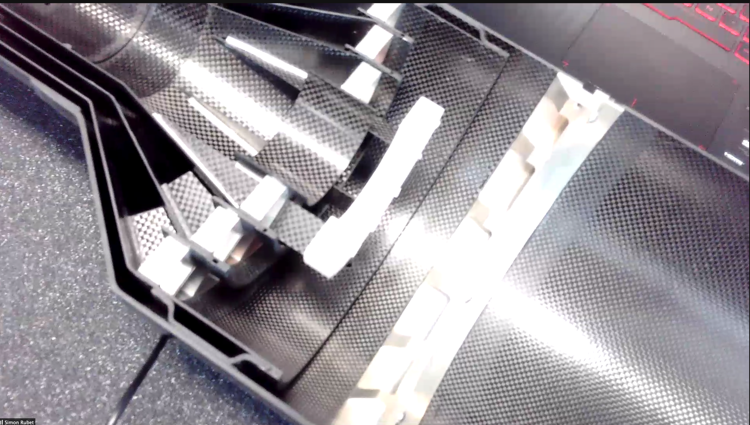
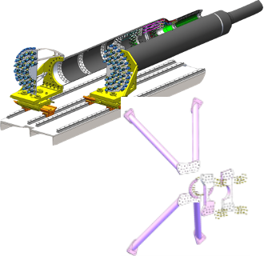
Production Status
CYSS
Mechanical system
CFC 1st half completed, 2nd one ready by the end of June
X-Wing preliminary design done -> will be used for mockup
Assembly fixtures and dummy staves
Full mockup in progress at MIT
Readout and control
mGTM integration in progress at LANL
New readout scheme tested at ORNL
Slow control and interlock in progress, CANALF tested at ORNL
CAEN PS, work in progress, bad modules?
Stave shipping, QA and assembly @LBNL
Last transportation test, 4 Silver staves under test @LBNL
Stave QA, noise/threshold issue remains …
Assembly test fit @LBNL in July 2021
MVTX assembly review, late July/ early Aug, 2021
Stave QA software and analysis
Initial study of MVTX alignment with NN (Yonsei group)
Obtain stave QA data dump from CERN → store in sPHENIX DB(?)
Layer-0,1,2
SB

Slide 3
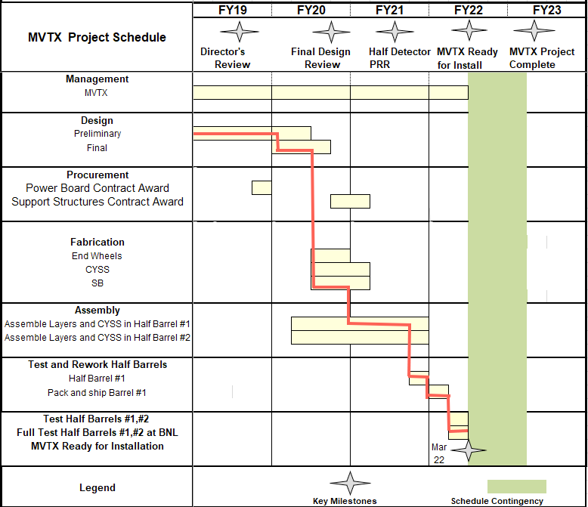
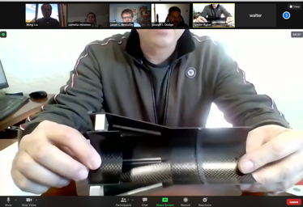
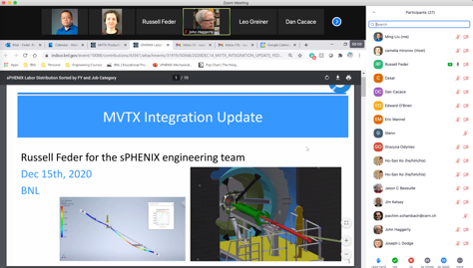
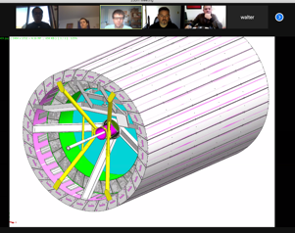
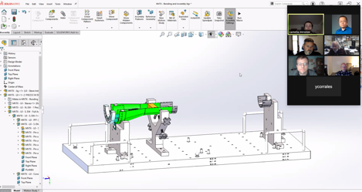
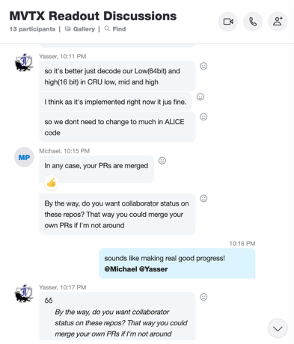
Schedule
Pre-COVID19 Schedule
Today
Some delay in CFC production:
- June, 2021
Still on track for completing
the assembly work in 2021
production in progress
@LBNL
Assembly review late in July ?
Readout, Control and Electrical System Integration
FW/SW synced to latest ALICE/ATLAS, new data format
Low-level slow control under testing
mGTM progress at LANL (160MHz/LHC)
Readout and service cables and power system
MVTX
installation
~9/2022

Slide 4
sPHENIX Commissioning Plan - From John H.
Update 06/03/2021
John showed his view of the commissioning stages: https://indico.bnl.gov/event/11817/note/
1.Pre-installation commissioning and testing ===> MVTX @BNL Feb - Sep, 2022
2.Installation commissioning ===> MVTX, installation starts ~9/23/2022
3.Post-installation commissioning ===> MVTX, Sept - Dec. 2022 @IR
4.Magnet commissioning
5.DAQ and Electronics Commissioning and Installation
6.Full detector commissioning (essentially DAQ and computing commissioning)
7.Trigger commissioning
8.Cosmic ray running
9.Beam operation (as early as ~ Jan. 2023)
MVTX:
9/23 - 10/18, 2022;
Can we do electrical test of the detectors during this period?
Minimal test of communications, and better to have readout also
ORR:
10/18/ - 11/21, 2022

Slide 5
Preparing for sPHENIX/MVTX Commissioning
sPHENIX Commissioning Task-Force Kick-off Meeting, 5/19/2021,https://indico.bnl.gov/event/11817/
MVTX commissioning plan doc:
https://docs.google.com/presentation/d/1CYn0g2FkmQzHUbXfIOD8elDWMbOzizJn8zK36RyVFvA/edit?usp=sharing
=> Two half-detectors arrive at BNL: Jan.~Feb., 2022
Pre-installation commissioning at BNL: Feb. 2022 - Sept. 2022
2 Half detectors test with MOSAIC testbench
possible rework on cables and staves
Cosmic run for half-detector alignment study etc.
Post-installation commissioning: Oct. - Dec., 2022
Full readout and online data monitoring
Cosmic run for tracking alignment: MVTX + INTT + TPC ...
Slow control and detector safety system
To be ready by 12/2021:
Full detector readout and controls
Power system & controls
Cooling system and controls

Slide 6
backup

Slide 7
Installation Schedule, as of 5/19/2021
MVTX:
9/23/2022;
ORR: 11/21/2022

Slide 8
MVTX pre-installation test:2/2022 - 9/2022
Laser room/MVTX clean tent?
Single stave readout, QA, with MOSAIC test bench
Fix bad staves/cables
Highly desired:
Multiple staves (8/24/48?) readout with RU+FELIX+PU
Half-detector 24 stave cosmis data?
Alignment calibration
Exercise the full electrical system before IR installation

Slide 9
Detector Alignment Plan
Simulation data:
Mis-align stave in the GEANT
Apply alignment correction to restore true location
Evaluate tracking performance
Cosmic/Real data:
Alignment work with cosmics ray data, half-detectors
Full detector alignment with cosmic data, post-installation
Zero-field collision data for alignment: MVTX+INTT+TPC…
Full-field data, check/improve alignment

