Slide 1
MVTX Status
Camelia, Grazyna and Ming
MVTX Bi-Weekly Meeting
05/21/2021

Slide 2
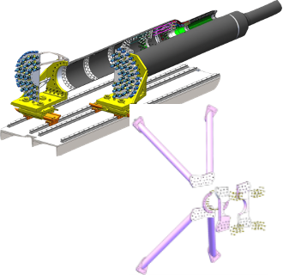
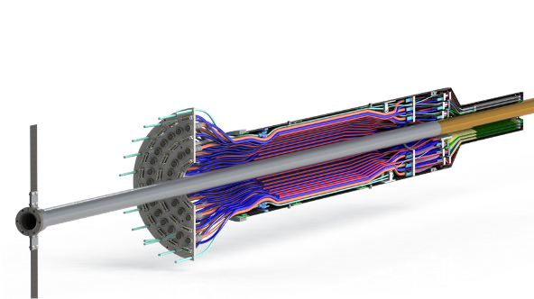
Production Status
Mechanical system
CFC in progress at WorkShape
X-Wing preliminary design done -> mockup
Assembly fixtures, finalizing the design
Full mockup in progress at MIT
Readout and control
mGTM integration in progress at LANL
New readout scheme under test at ORNL
Slow control and interlock in progress
CAEN PS, work in progress
Stave shipping, QA and assembly @LBNL
Last transportation test, 4 Silver staves
Stave QA, noise/threshold issue
Assembly test fit @LBNL ~ 6/2021
MVTX assembly review July/Aug, 2021
Stave QA software and analysis
Stave QA data dump from CERN
LBNL stave test data comparison
Yonsei Univ., Korea
QA data
Alignment

Slide 3
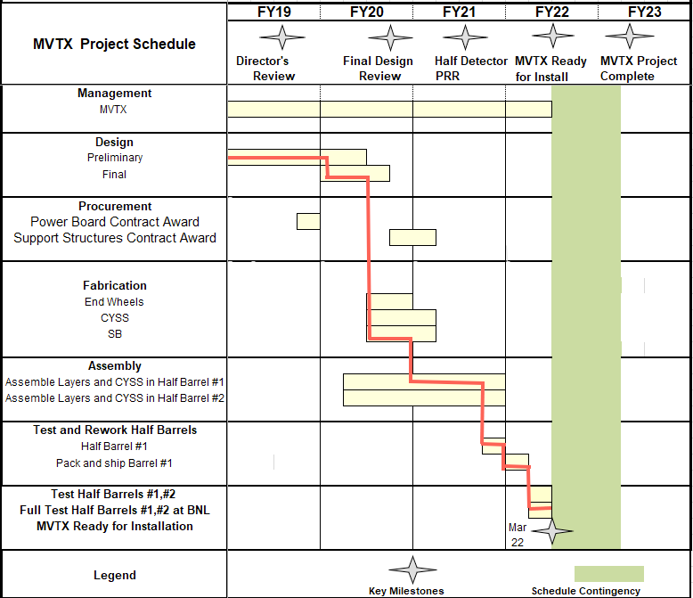
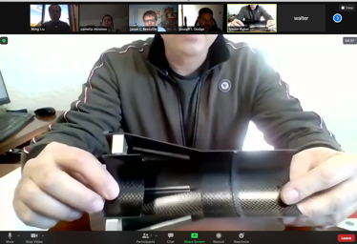
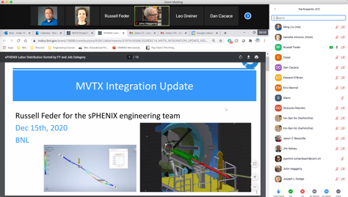
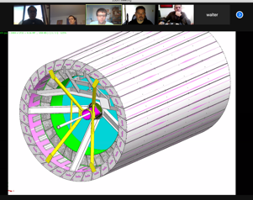
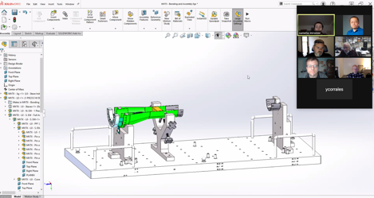
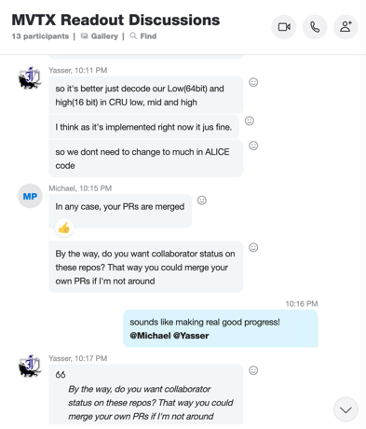
Schedule
Pre-COVID19 Schedule
Today
Some delay in CFC production:
- May-June, 2021
Still on track for completing
the assembly work in 2021
production in progress
Assembly review
~ 7/30/2021?
@LBNL
Readout, Control and Electrical System Integration
3 RUs sent to factory@UK for repair
FW/SW synced to latest ALICE/ATLAS code
Low-level slow control under testing
mGTM progress at BNL (40MHz/LHC)
Readout and service cables and power system
MVTX
installation
~9/2022

Slide 4
Preparing for sPHENIX/MVTX Commissioning
sPHENIX Commissioning Task-Force Kick-off Meeting, 5/19/2021,https://indico.bnl.gov/event/11817/
MVTX commissioning plan doc (this one):
https://docs.google.com/presentation/d/1CYn0g2FkmQzHUbXfIOD8elDWMbOzizJn8zK36RyVFvA/edit?usp=sharing
=> Two half-detectors arrive at BNL: ~Jan. 2022
Pre-installation commissioning at BNL: Feb. 2022 - Sept. 2022
2 Half detectors test
possible rework on cables and staves
Cosmic run for half-detector alignment
Post-installation commissioning: Oct. - Dec., 2022
Full readout and online data monitoring
Cosmic run for tracking alignment: MVTX + INTT + TPC ...
Slow control and detector safety system

Slide 5
MVTX pre-installation test:2/2022 - 9/2022
Laser room/MVTX clean tent?
Single stave readout, QA, with MOSAIC test bench
Fix bad staves/cables
Highly desired:
Multiple staves (8/24/48?) readout with RU+FELIX+PU
Half-detector 24 stave cosmis data?
Alignment calibration
Exercise the full electrical system before IR installation

Slide 6
Detector Alignment Plan
Simulation data:
Mis-align stave in the GEANT
Apply alignment correction to restore true location
Evaluate tracking performance
Cosmic/Real data:
Alignment work with cosmics ray data, half-detectors
Full detector alignment with cosmic data, post-installation
Zero-field collision data for alignment: MVTX+INTT+TPC…
Full-field data, check/improve alignment

Slide 7
A new meeting time - at a fixed weekly schedule?
Currently we have two general (bi-weekly) meetings
Every other Friday (this one) 12:00Noon/ET
General topics, from simulations to hardware
Every other Monday 1:00PM/ET
More project/budget, schedule and hardware progress focused

