Slide 1
MVTX Status
Camelia, Grazyna, Ming
04/09/2021

Slide 2
Mechanical System
CFC production in progress at WorkShape
  Complete by the end of April
3-D mockup to check PP-cable interferences
  Tested and updated designs of Layler-0,1,2
  Checked power FPC length and PP2
  A “Silver stave” arrived at LANL for testing
    Production stave, final cables and connectors
  Cooling system design and test in progress
    Preliminary designed for stave cooling done by MIT
    Electronics RU & PU rack cooling design stared at LANL
Pre-installation “training” at LBNL with 3-D print mockup
PP1

Slide 3
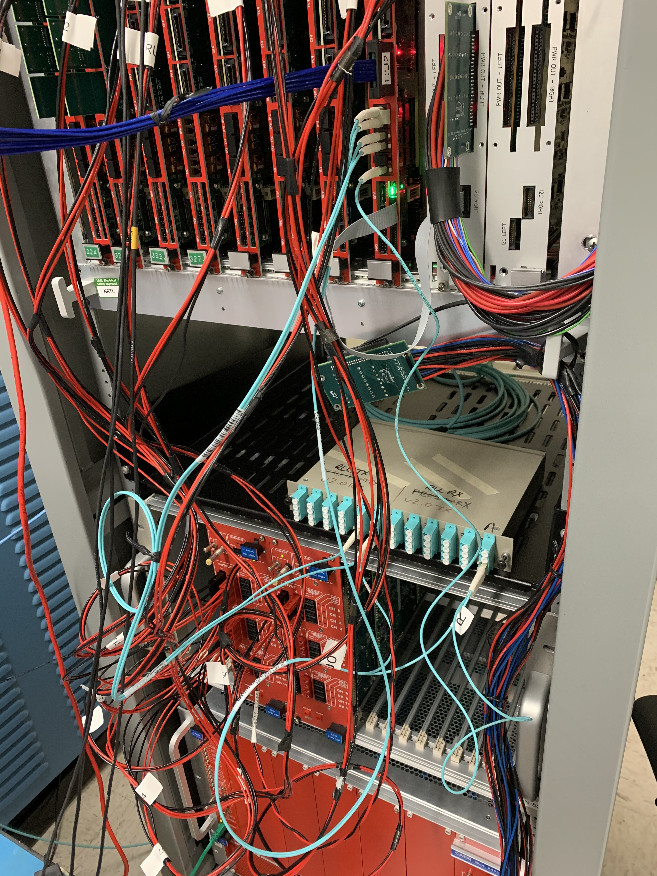
Readout, Slow Controls and Power
A “silver stave” arrived and tested at LANL
  Did initial QA, okey, some issues
  It is used for mechanical 3D mockup test
3-fiber readout in progress
  Successfully readout GBTx1 Data link with FELIX, with a local fix in FELIX FW
  All 3 downlinks and 2 uplinks okey
  Testing new data format, in progress
Detector safety system design in progress
  Meetings with BNL (Michael, Jo, Ho-San, Yasser et al)
    Working on the rack layout
  Continue online monitoring and detector QA discussion
To do’s – system integration
  mGTM arrived and being tested @BNL
  CAEN PS
- Data/SWT_Out (GBTx0)
- SWT/SCA_In (GBTx0)
- Data_Out (GBTx1)
- Data_Out (GBTx2)
- Trigger_In (GBTx2)

Slide 4
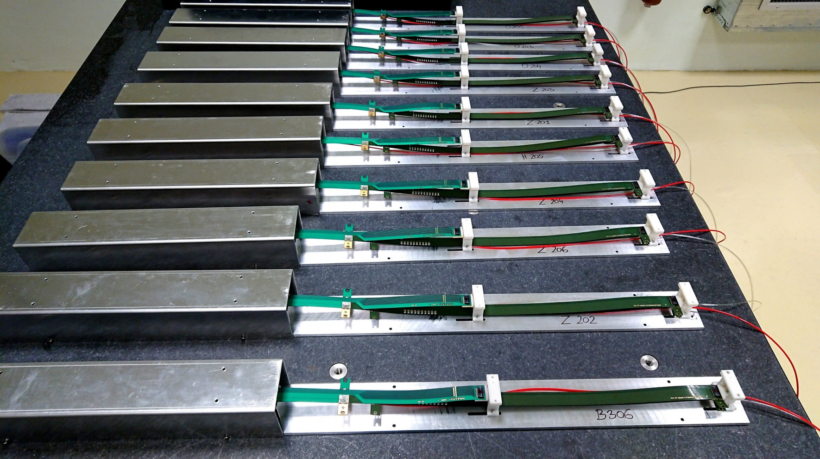
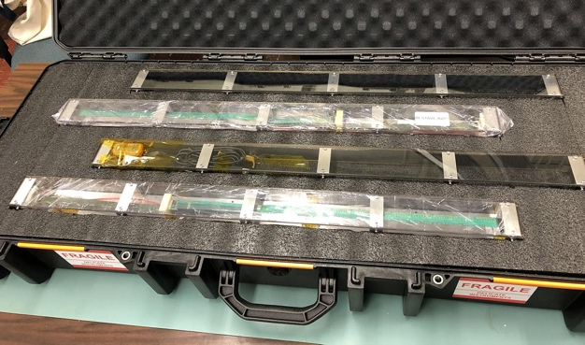
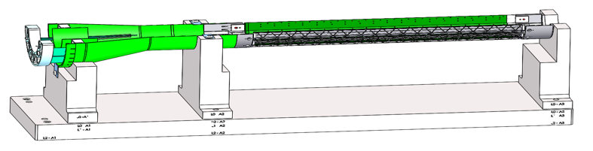
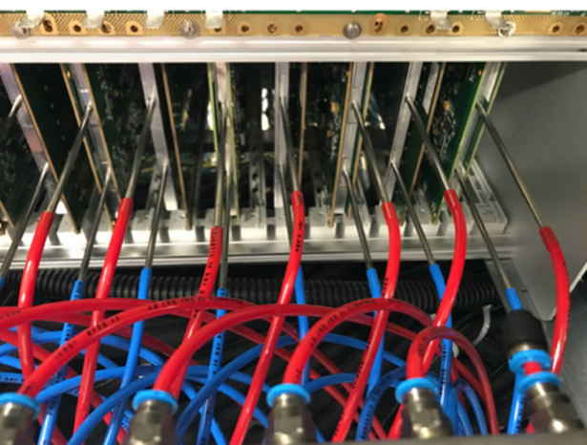
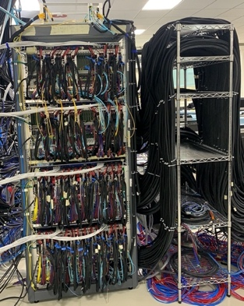
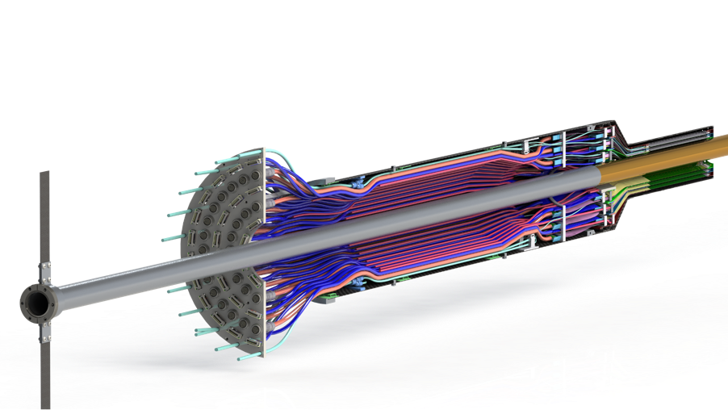
Near Term Plan
sPHENIX Staves
@CERN
72+ available
Mechanical structures
  Continue CFC production at WorkShape
    Produce low-cost “evil-twin” at the end of production
  Finished X-wing design, fabrication
    Build full mockup, w/ beam pipe @MIT
  Finish assembly fixtures
Stave shipping & QA
  Prepare for detector assembly
  sPHENIX QA DB?
Readout and control integration
  AMD server full readout
  mGTM
  Slow control
  Update FW and SW
MVTX detector safety system
  Integrated into sPHENIX safety system
Experimental Safety Review
  power cables etc.
Power & Cooling systems
  system tests and procurements
Budget update -> more engineering support in FY21
LBNL, in progress
MIT, in progress ->
MDC and analysis
Test fit @LBNL: ~May, 2021
Detector assembly Review: ~June 2021 (?)
Readout & Test @LBNL:
full or partial detector?
1, 6/L0, 8/L1, 10/L2
Racks + Cooling
(ITS system)

Slide 5
backup

Slide 6
Stave Production Near Completion
Goal: 84 Gold/Silver Staves
Stave production meeting with CERN
@March 11, 2021
76 staves produced
  71 Gold → Full MVTX with Gold Staves (48)
  5 Silver
  6 more to complete the production
Next:
  Shipping and QA at LBNL

Slide 7
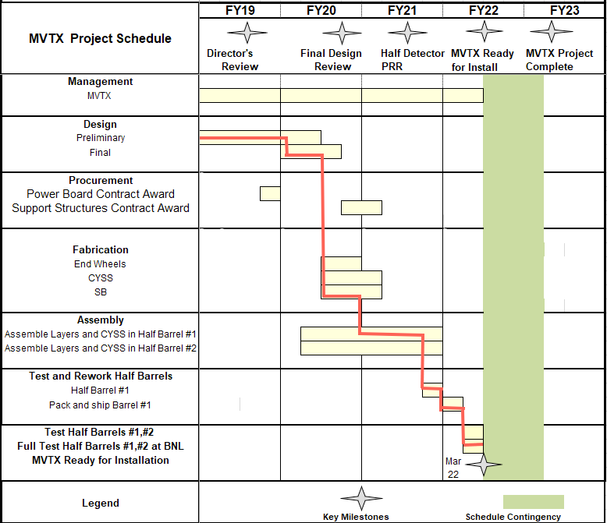

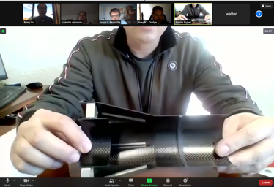
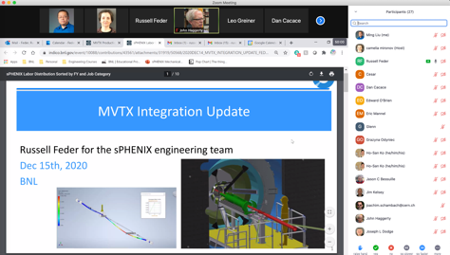

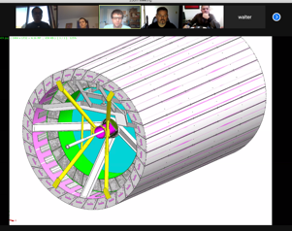
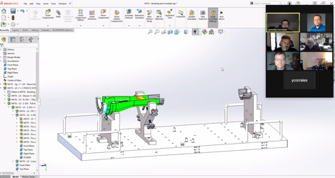
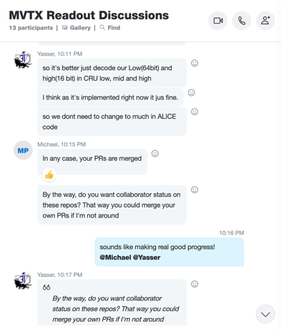

Status & Plan
Pre-COVID19 Schedule
Today
production started
Some delay in CFC production,
but still on track for completing
the assembly work in 2021
Assembly review
@LBNL
Readout, Control and Electrical System Integration
3 RUs sent to factory@UK for repair
FW/SW synced to latest ALICE/ATLAS code
Low-level slow control under testing
mGTM progress at BNL (40MHz/LHC)
Readout and service cables and power system
MVTX
installation
~9/2022

