Slide 1
MVTX Status
Camelia, Grazyna, Ming
03/26/2021

Slide 2
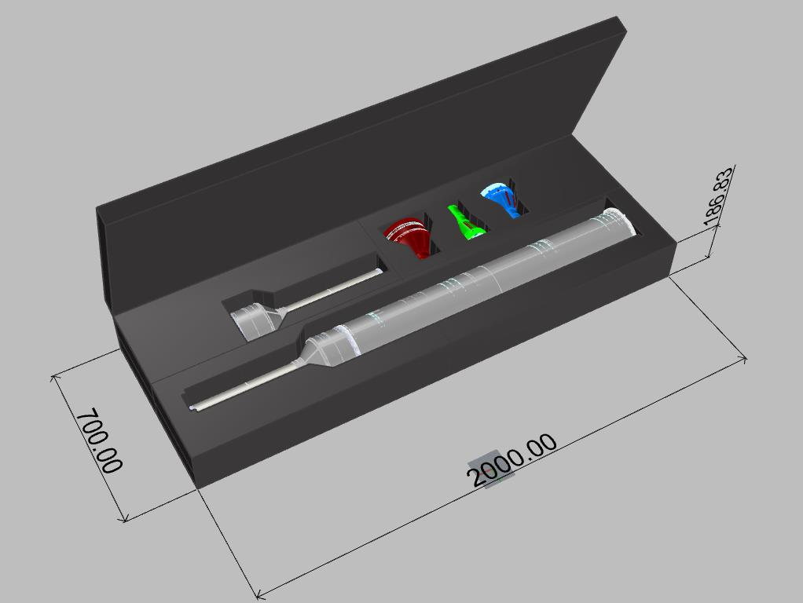
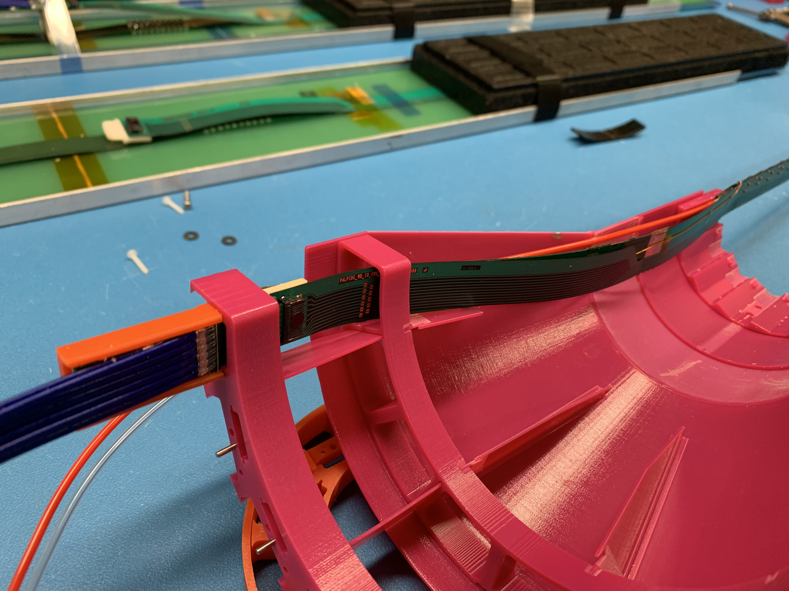
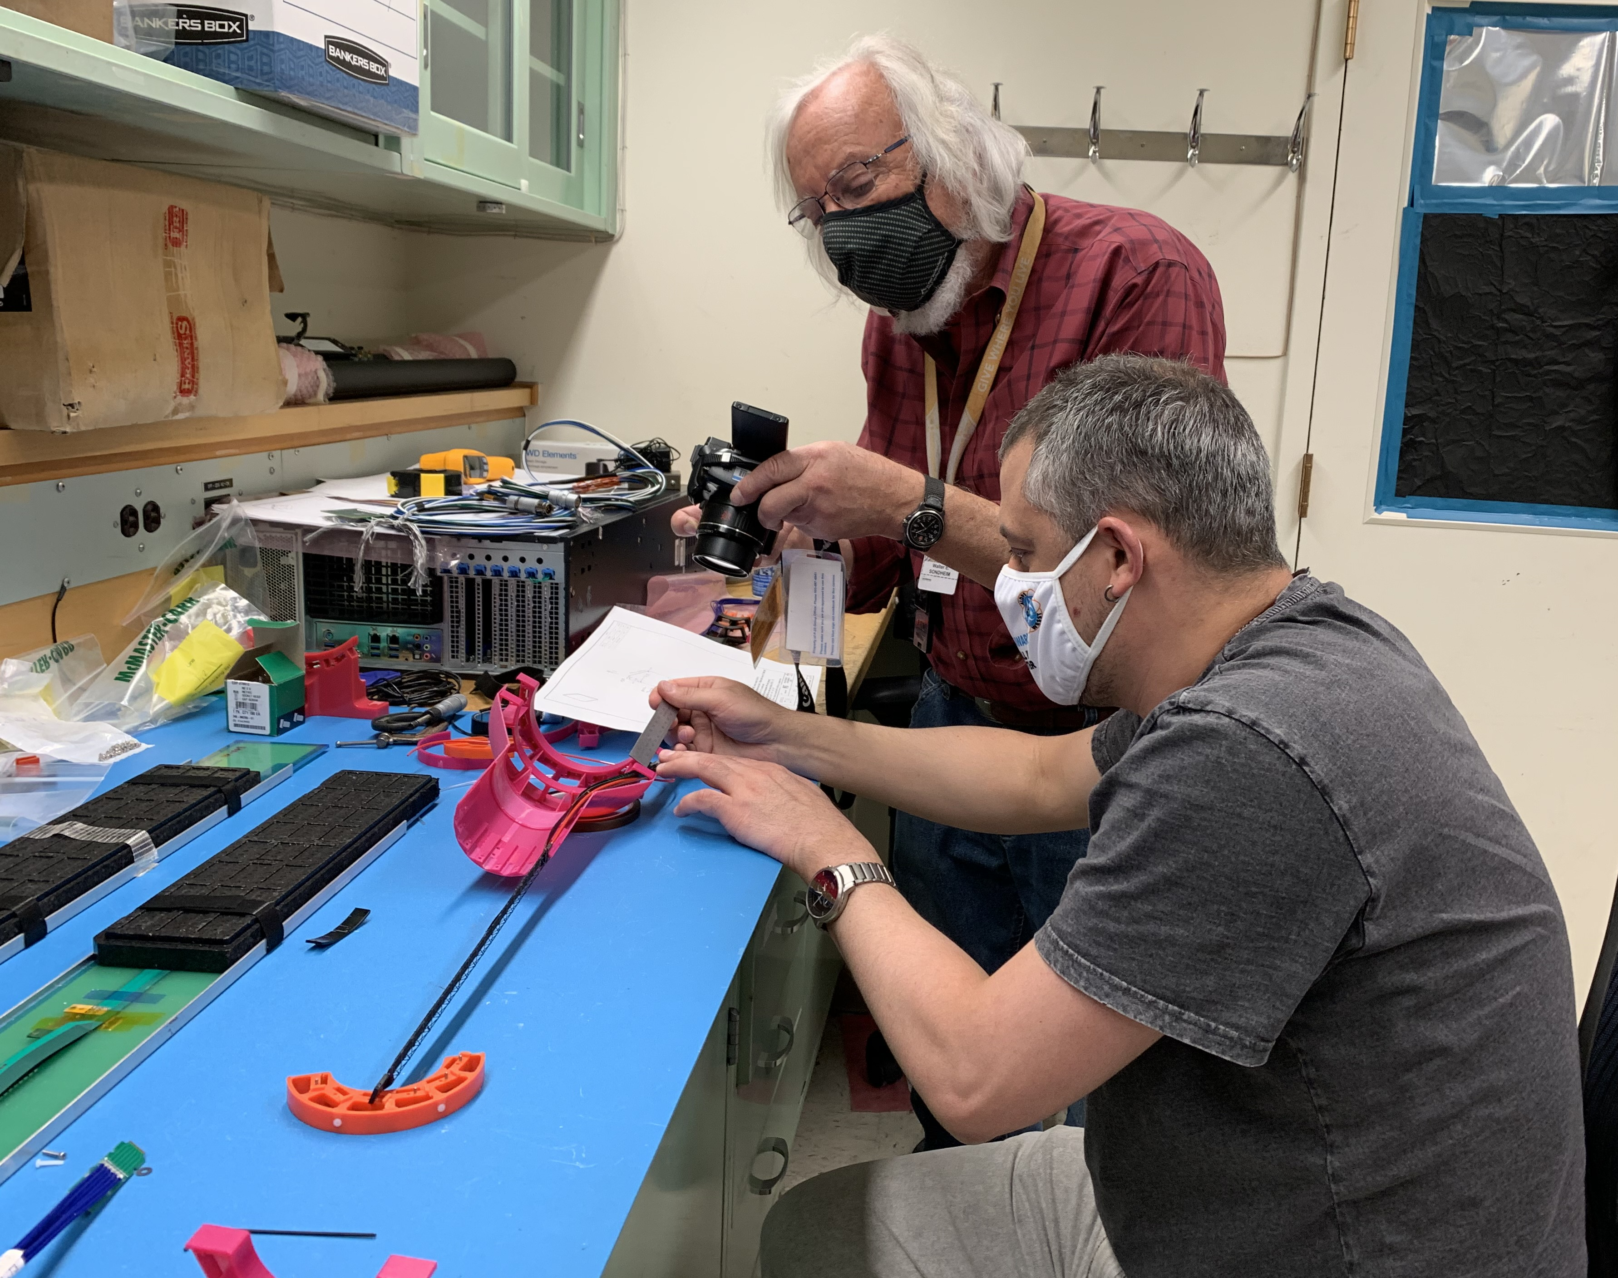
Mechanical Structures
CFC production in good progress at WorkShape
  Schedule delayed, complete by the end of April
3-D mockup to check PP-cable interferences
  Tested and updated designs of Layler-0 and Layler-1
  Layer-2, 3-D print in progress
Cooling system design and test in progress
  Initial test @BNL, obtained quote for chillers
  Preliminary designed for stave cooling done by MIT
  Electronics RU & PU cooling & safety system in progress
    LANL, ORNL, MIT
Pre-installation “training” at LBNL with 3-D print mockup
Half-detector transportation box
PP1
Layer-1

Slide 3
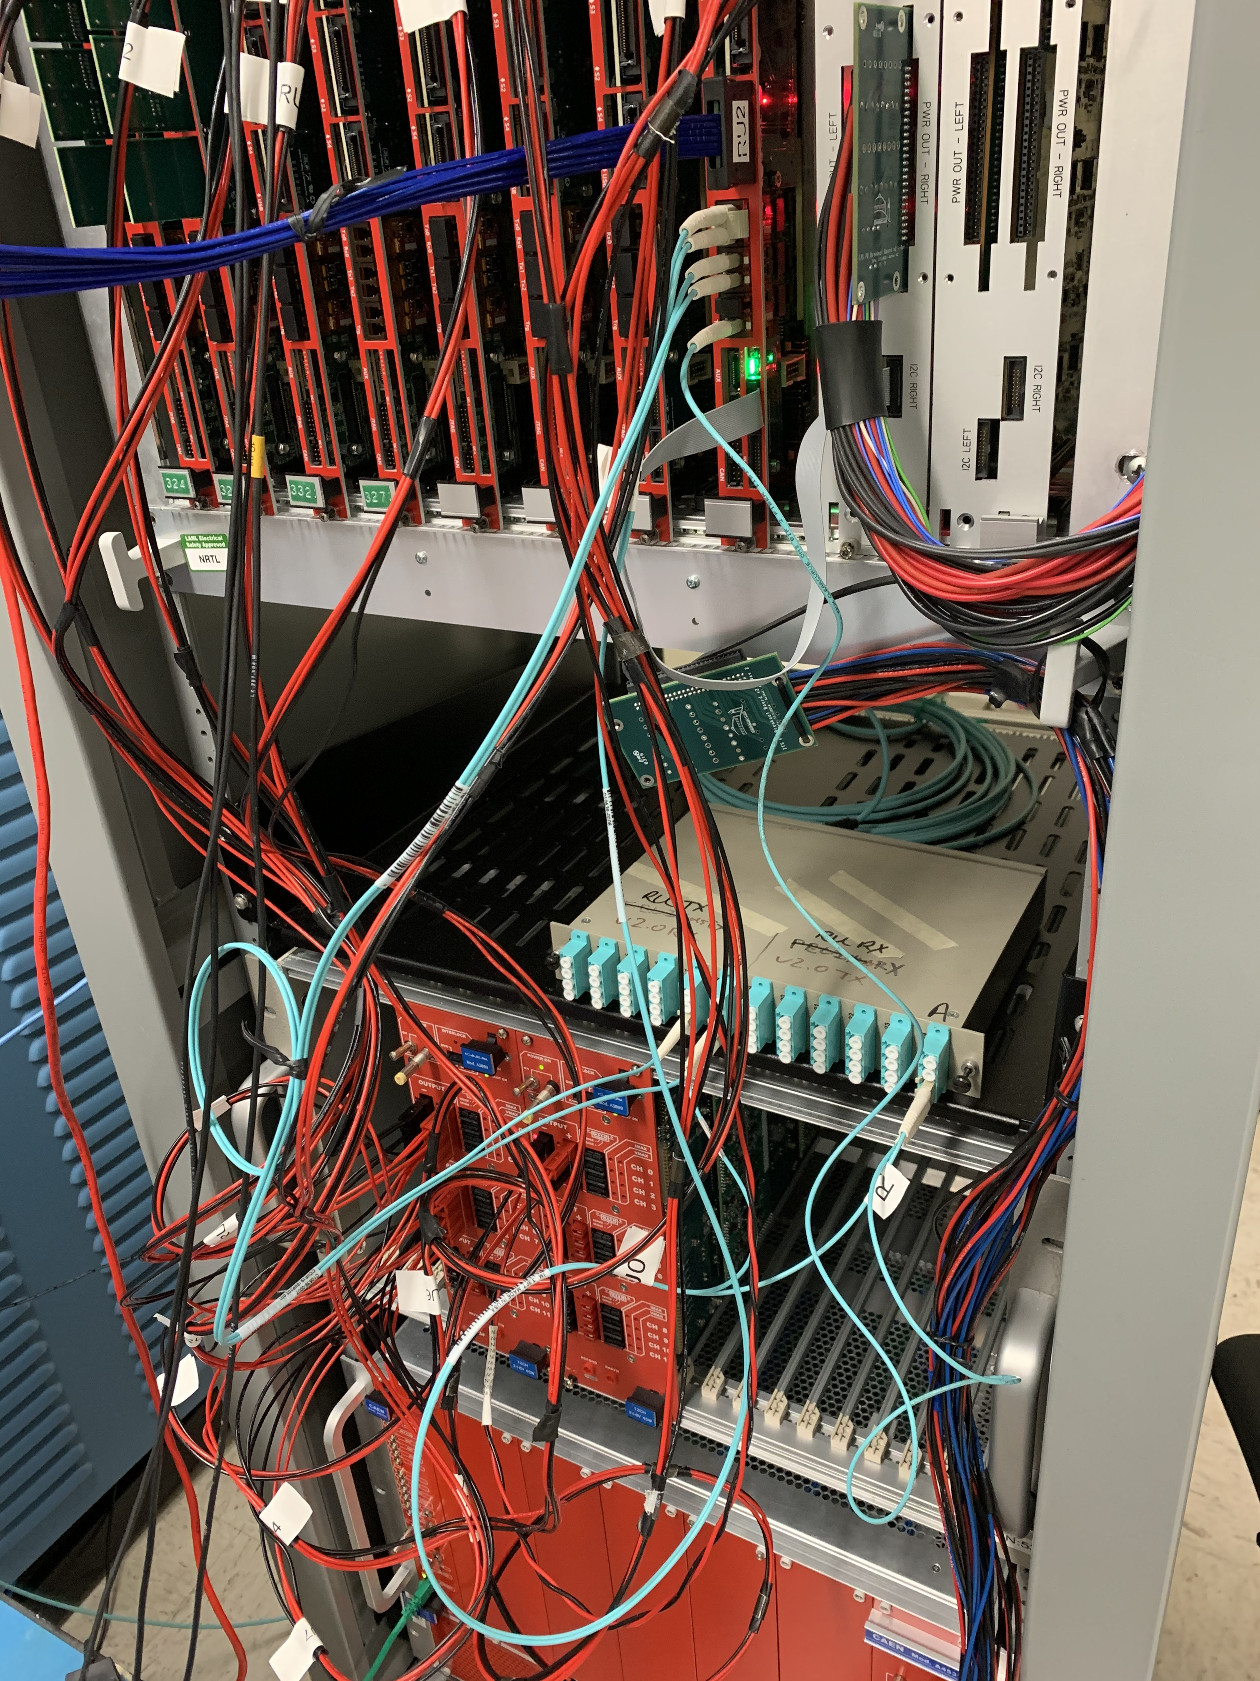
Readout, Slow Controls and Power
HIC tested okey at LANL
  Noise level ~ 5e, “Gold”
  Shipped to ORNL
  Continue stave testing at LBNL, cross checking at LANL
3-fiber readout in progress
  Unstable GBTx1 Data link with FELIX, debugging in progress
  GBTX0(Data, SWT/SCA), GBTx2(Trigger), GBTx2(Data) okey
Detector safety system design in progress
  Meetings with BNL (Michael, Jo, Ho-San, Yasser et al)
    Working on the rack layout
  Slow control integration
To do’s – system integration
  mGTM development @BNL
  Slow controls
  Power & safety system
- Data/SWT_Out (GBTx0)
- SWT/SCA_In (GBTx0)
- Data_Out (GBTx1)
- Data_Out (GBTx2)
- Trigger_In (GBTx2)

Slide 4
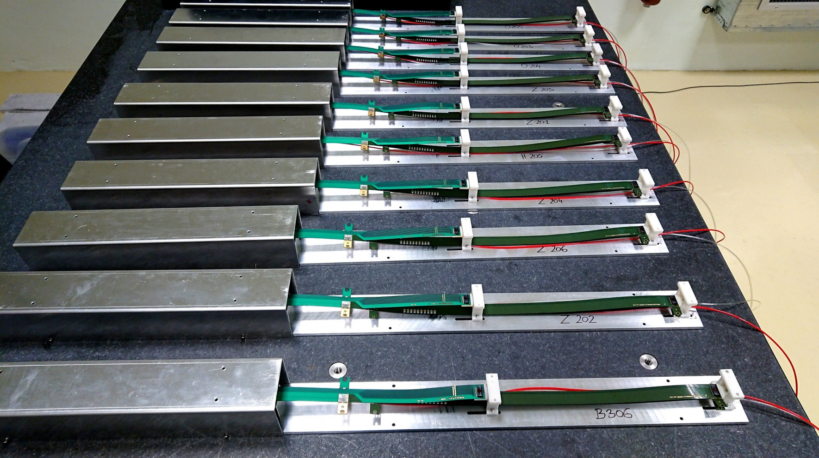
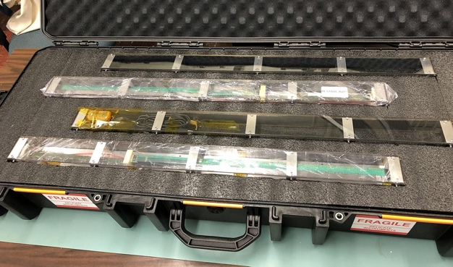
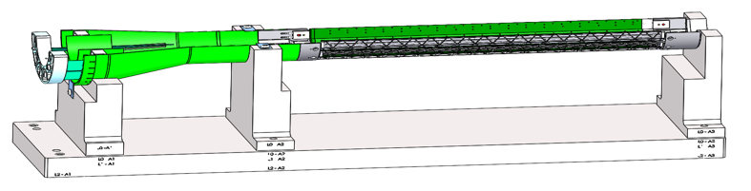
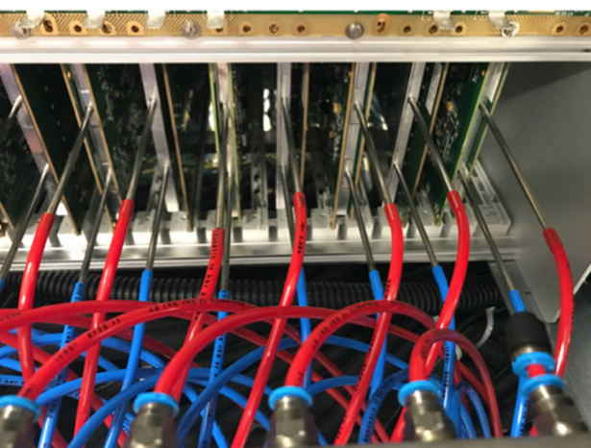
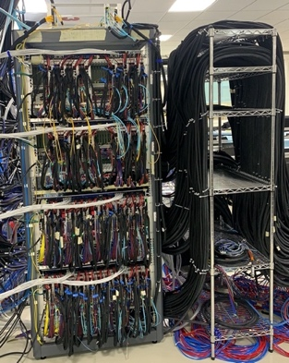
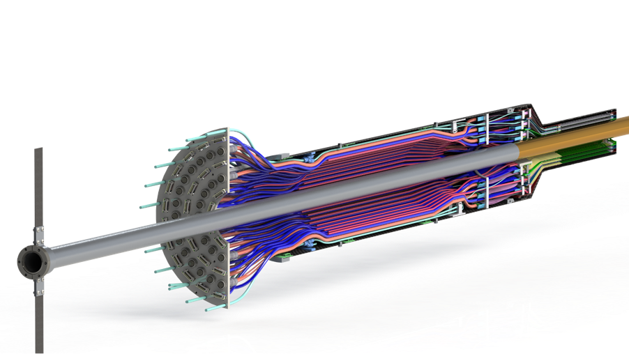
Near Term Plan
sPHENIX Staves
@CERN
72+ available
Mechanical structures
  Continue CFC production at WorkShape
    Produce low-cost “evil-twin” at the end of production
  Finished X-wing design, fabrication
    Build full mockup, w/ beam pipe @MIT
  Finish assembly fixtures
Stave shipping & QA
  Prepare for detector assembly
  sPHENIX QA DB?
Readout and control integration
  AMD server full readout
  mGTM
  Slow control
  Update FW and SW
MVTX detector safety system
  Integrated into sPHENIX safety system
Experimental Safety Review
  power cables etc.
Power & Cooling systems
  system tests and procurements
Budget update -> more engineering support in FY21
LBNL, in progress
MIT, in progress ->
  Split cooling system design work, LANL and ORNL
Test fit @LBNL: ~May, 2021
Detector assembly Review: ~June 2021 (?)
Readout & Test @LBNL:
full or partial detector?
1, 6/L0, 8/L1, 10/L2
Racks + Cooling
(ITS system)

Slide 5
backup

Slide 6
Stave Production Near Completion
Goal: 84 Gold/Silver Staves
Stave production meeting with CERN
@March 11, 2021
76 staves produced
  71 Gold → Full MVTX with Gold Staves (48)
  5 Silver
  6 more to complete the production
Next:
  Shipping and QA at LBNL

Slide 7
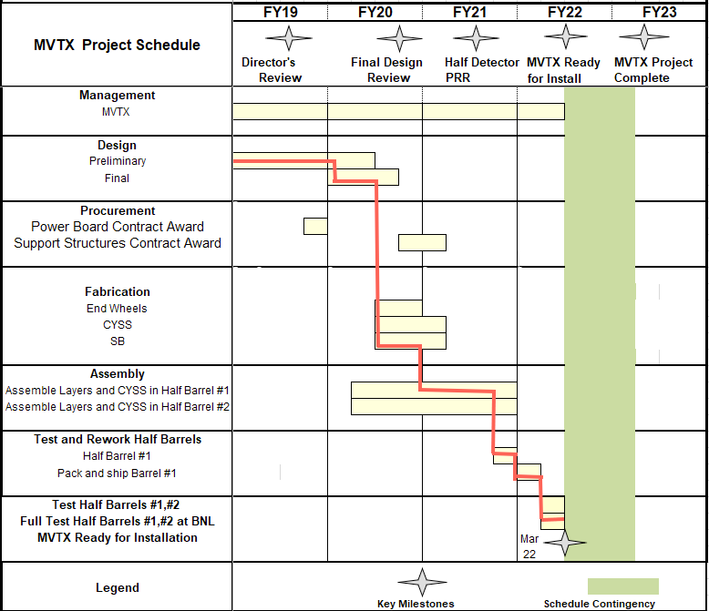

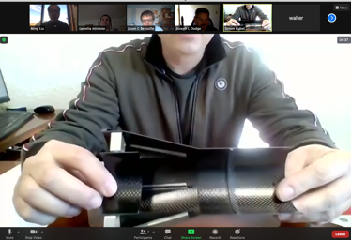
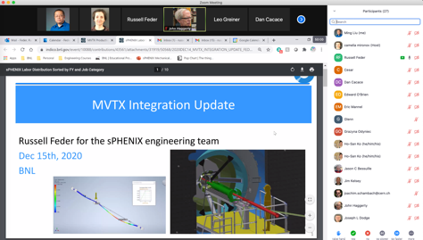

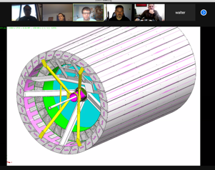
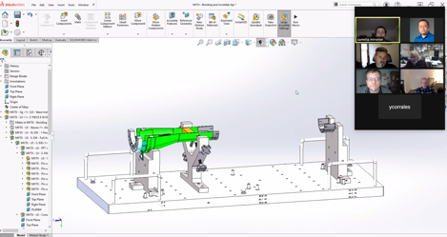
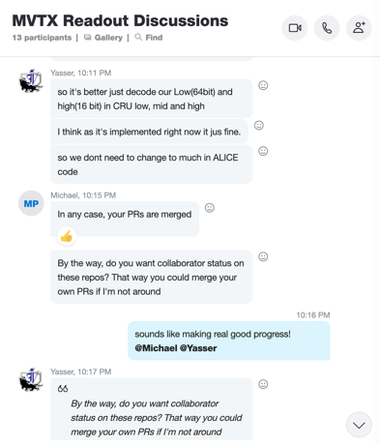

Status & Plan
Pre-COVID19 Schedule
Today
production started
Some delay in CFC production,
but still on track for completing
the assembly work in 2021
Assembly review
@LBNL
Readout, Control and Electrical System Integration
3 RUs sent to factory@UK for repair
FW/SW synced to latest ALICE/ATLAS code
Low-level slow control under testing
mGTM progress at BNL (40MHz/LHC)
Readout and service cables and power system
MVTX
installation
~9/2022

