Slide 1
MVTX Status
Camelia, Grazyna, Ming
03/15/2021

Slide 2
Stave Production Near Completion
Goal: 84 Gold/Silver Staves
Stave production meeting with CERN
@March 11, 2021
76 staves produced
  71 Gold → Full MVTX with Gold Staves (48)
  5 Silver
  6 more to complete the production
Next:
  Shipping and QA at LBNL

Slide 3
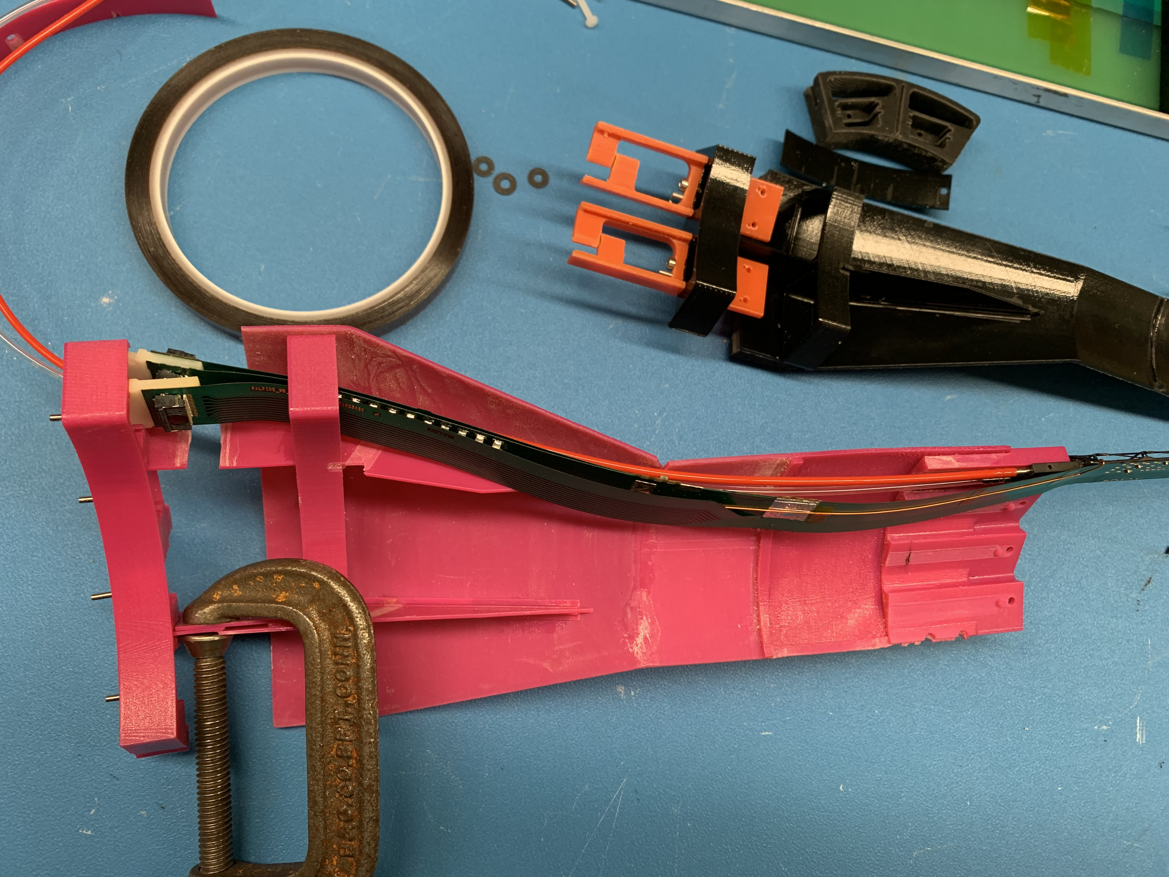
Mechanical Structures
@WorkShape
CFC production in good progress at WorkShape
  Spring-back issues being addressed
  Possible schedule delay 1~2 weeks?
3-D mockup to check PP-cable interferences
Cooling system design and test in progress
  Initial test @BNL
  Stave cooling, preliminary design available
  Electronics RU & PU cooling, later, by MIT/LANL
3D mockup @LANL

Slide 4
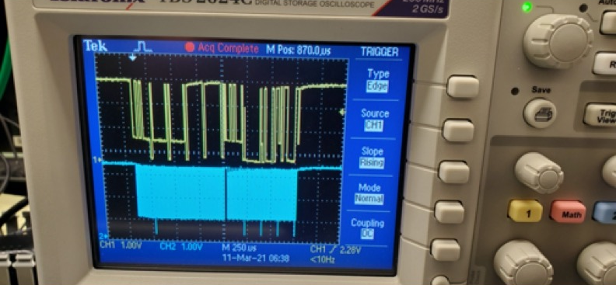
Readout and Slow Controls
Power board I2C issues resolved
Detector safety system design in progress
  Meetings with BNL last week
HIC tested at LANL
  Noise level ~ 5e, Gold,
To do’s – system integration
  mGTM development @BNL
    MVTX firmware
  AMD full readout test
  Slow controls
  Power system

Slide 5
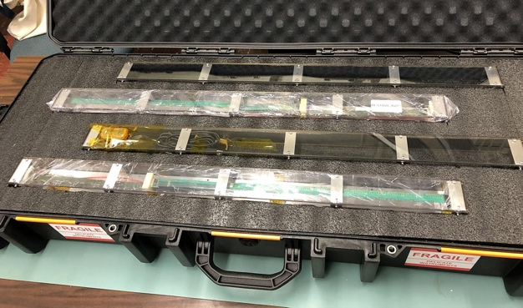
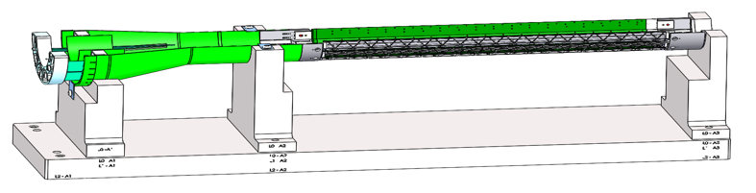
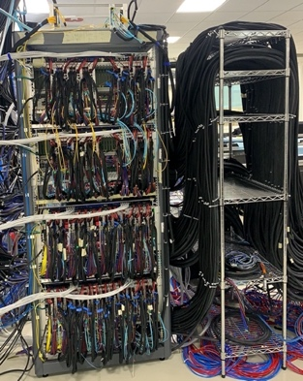
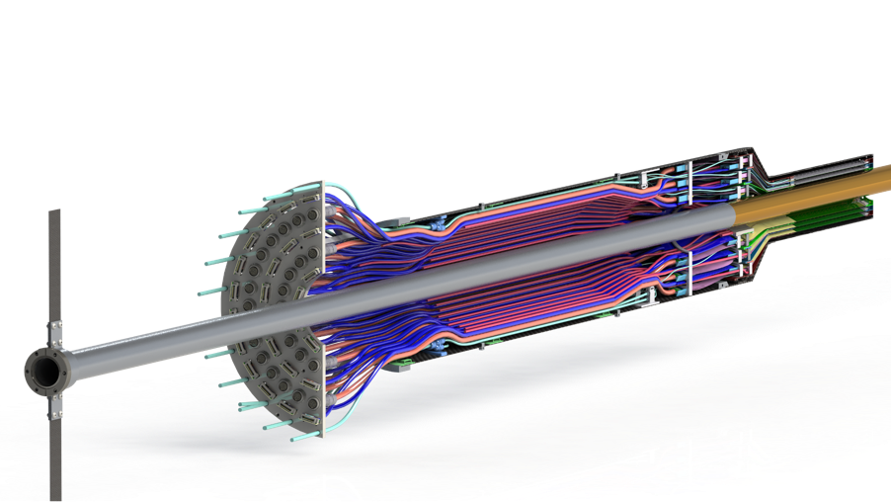
Near Term Plan
Mechanical structures
  Continue CFC production at WorkShape
    Produce low-cost “evil-twin” at the end of production
  Finished X-wing design, fabrication
    Build full mockup, w/ beam pipe @MIT
  Finish assembly fixtures
Stave shipping & QA
  Prepare for detector assembly
  sPHENIX QA DB?
Readout and control integration
  AMD server
  mGTM
  Slow control
  Update FW and SW
MVTX detector safety system
  Integrated into sPHENIX safety system
Experimental Safety Review
  power cables etc.
Power & Cooling systems
  system tests and procurements
Budget update -> more engineering support in FY21
LBNL, in progress
MIT, in progress ->
  finish X-wing +insertion system, assembly fixtures, cooling system
  extra evil MVTX (for insertion dry testing in BNL)
Test fit @LBNL: ~April, 2021
Detector assembly Review: ~May 2021
Readout & Test @LBNL:
full or partial detector?
1, 6/L0, 8/L1, 10/L2

Slide 6
backup

Slide 7
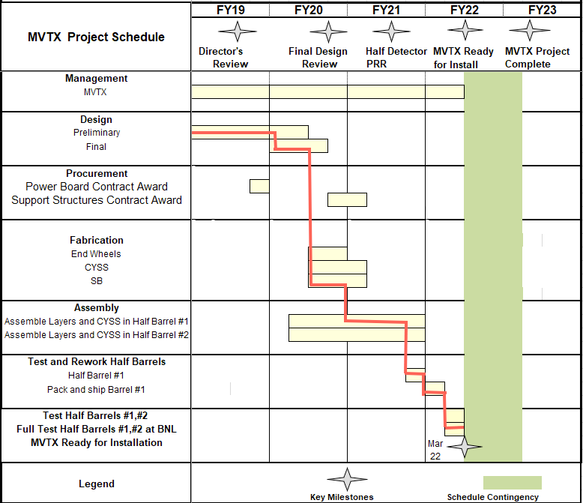

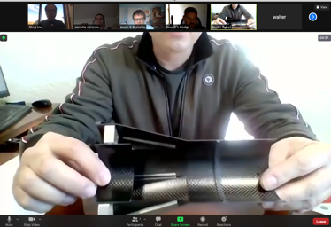
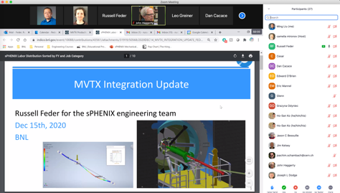

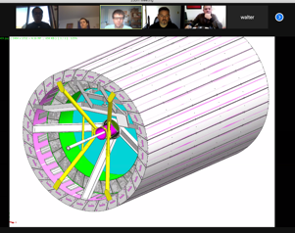
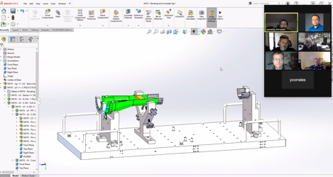
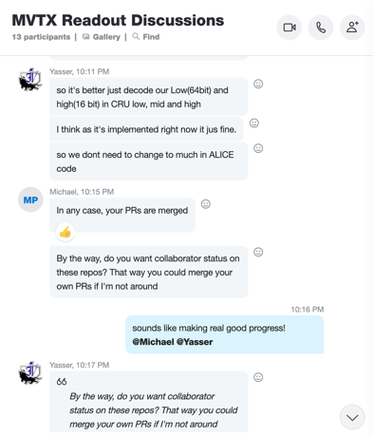

Status & Plan
Pre-COVID19 Schedule
Today
production started
Some delay in CFC production,
but still on track for completing
the assembly work in 2021
Assembly review
@LBNL
Readout, Control and Electrical System Integration
3 RUs sent to factory@UK for repair
FW/SW synced to latest ALICE/ATLAS code
Low-level slow control under testing
mGTM progress at BNL (40MHz/LHC)
Readout and service cables and power system
MVTX
installation
~9/2022

