Slide 1
MVTX Status
Camelia, Grazyna, Ming
02/26/2021

Slide 2
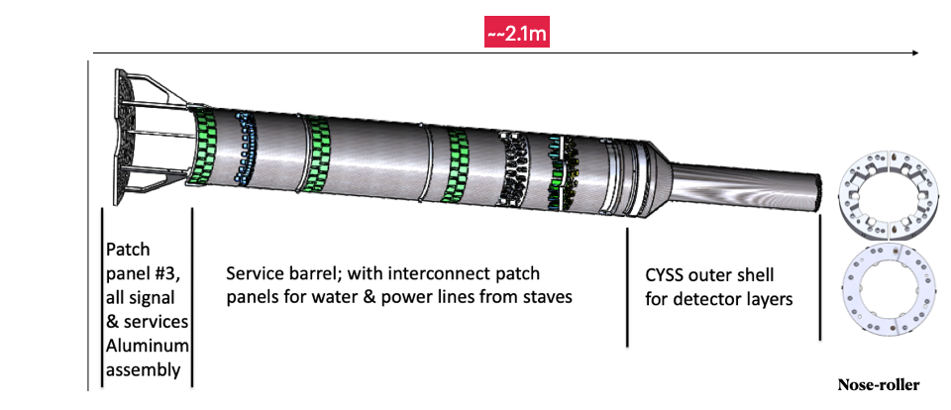
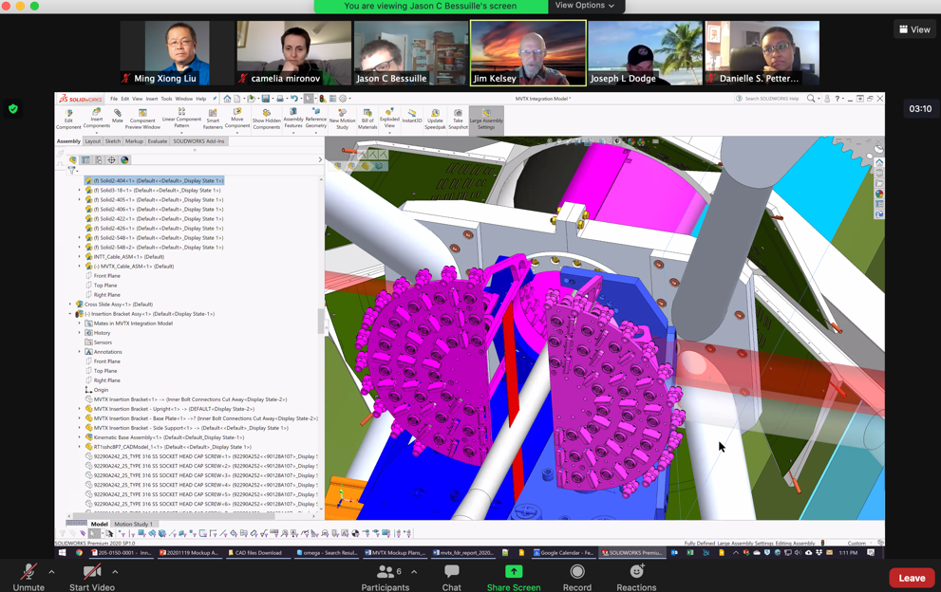
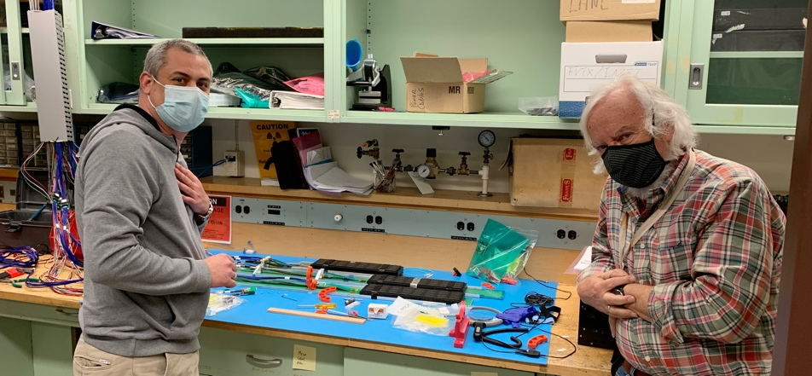
Mechanical Structures
CFC production on schedule
1st full-half detector to LBNL ~end of March
Finalizing assembly jig design, w/ LBNL last week
Build 3 set assembly jigs first + 3 cradles …
MVTX insertion system design in progress
=> finalize cable lengths, readout and power
PP1/2 design updated
Reducing data and power cable shift/twist

Slide 3
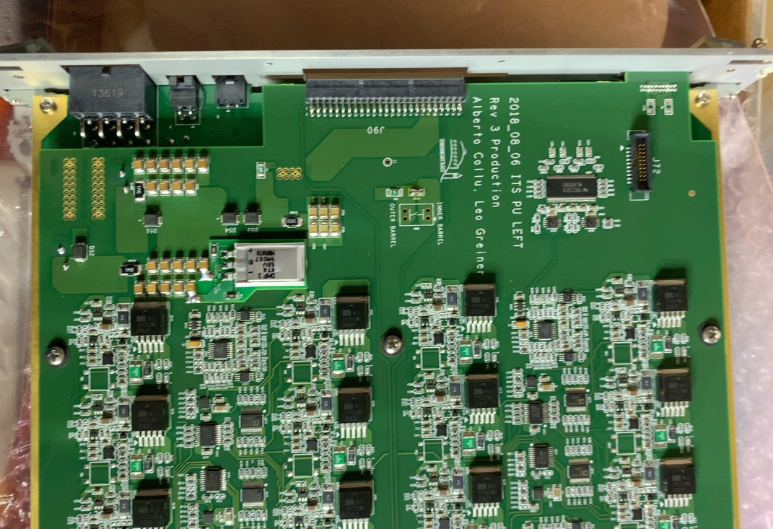
Readout and Electrical System
mGTM simulation from Joe Mead
All 60 production RU tested
3 arrived at factory for repair
Spare components
mGTM development in progress
Preliminary design developed, good discussion this week, 80MHz or 160MHz options
1st prototype mGTM available in ~3 weeks
AMD server integration
Testing new RU firmware in progress
New data format
Power system, racks, cables etc
ESR dry run with BNL engineers last week, received good suggestions
Detector Safety System kickoff meeting between BNL and Michael next week
Budget update for FY21:
Spare electronics components
VTTx/VTRx ~ $12k.
Miscellaneous items:
VME crates (~$6K), 4 fanout boards($10k?), patch panels, CANBUS cables, fibers etc.
Safety system -> MVTX + WBS2.x
sPHENIX PB Test – unstable I2C signal?
IB/Switch

Slide 4
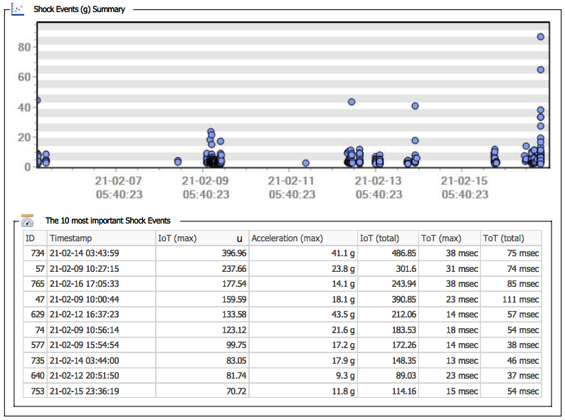
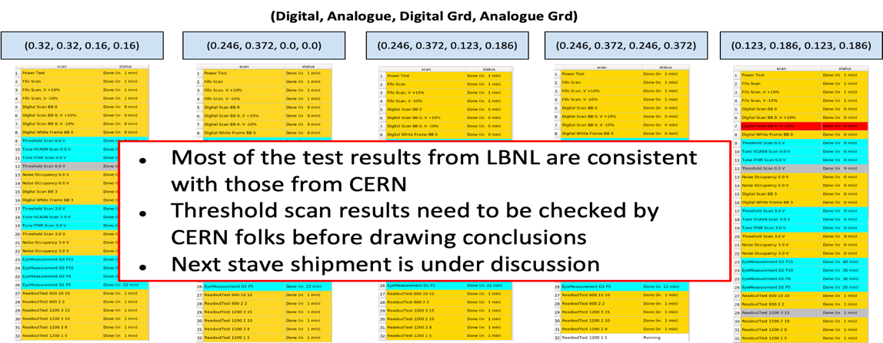
Stave Production, Transportation and QA
New Logger MSR 175: Feb. 5 – 16, 2021. CERN→ LBNL
50 gold staves ready for shipping
16 new HICs produced
11 staves under test
7 staves done metrology
Production rate: ~5 HICs/week
4 (3 Gold + 1 Silver) under test at LBNL
Mostly consistent with CERN data
Some details under investigation
1 partially working HIC for ORNL
Arrived with new loggers at LBNL
Tested at LBNL
To be tested at LANL before shipping to ORNL
Shock

Slide 5
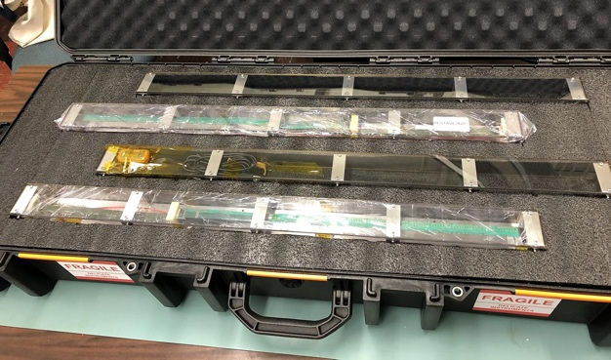
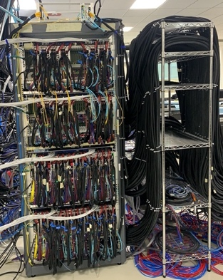
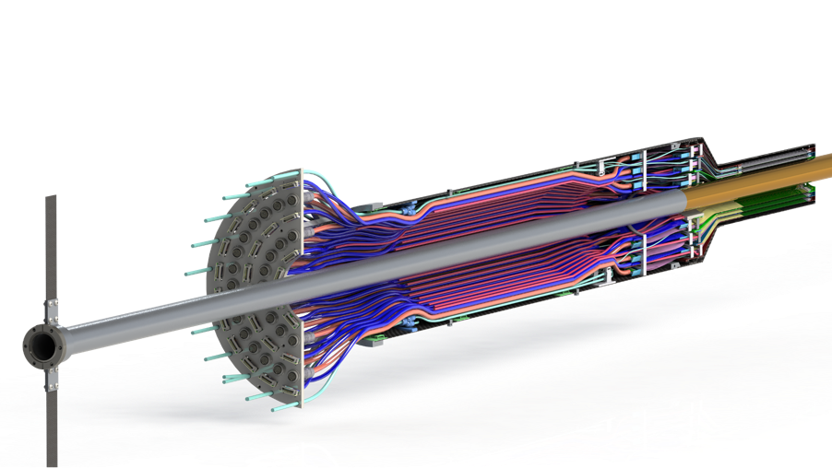
Near Term Plan
Mechanical structures
Continue CFC production at WorkShape
Produce low-cost “evil-twin” at the end of production
Finished X-wing design, fabrication
Build full mockup, w/ beam pipe @MIT
Finish assembly fixtures
Stave shipping & QA
Prepare for detector assembly
Readout and control integration
AMD server
mGTM
Slow control
Update FW and SW
MVTX detector safety system
Interface to sPHENIX safety system
Experimental Safety Review
power cables etc.
Power system & Cooling system
system tests and procurements
Budget update -> more engineering support in FY21
LBNL, add “setup clean room”, ~$20k, (need to double check)
MIT, TBD, in progress -> finish X-wing +insertion system, assembly fixtures, cooling sytem, extra evil MVTX (for insertion dry testing in BNL), etc. (might need extra 200-250K from P6, + ~50K WBS2x
Test fit: Mar-April, 2021
Detector assembly Review: ~May 2021
Readout & Test @LBNL:
full or partial detector?
1, 6/L0, 8/L1, 10/L2

Slide 6
backup

Slide 7
 | STAVE-production summary table
IBSTAVE ID | HIC assembly | HIC assembly date | Ins. after glue | Bonding | Pull test (>=2 lifts + F <7g) | Ins. after bonding | HIC PWR test | Qualification test | Threshold cluster | HIC Matrix | HIC DTU | HIC DTU (new) | HIC+SF+C -> Stave | Stave PWR test | Stave test | STAVE test date | STAVE metrology | Stave PWR test (long PWR extn.) | STAVE final test (PT100) | Final STAVE Matrix | Final STAVE DTU | STAVE Deliverd
TOTAL | 94 |  | 94 | 92 |  | 91 | 88 | 74 |  |  |  |  | 66 | 65 | 65 |  | 61 | 54 | 54 |  |  | 4
A201 (326) | 1 | 03/10/2019 | 1 | 1 | 1 | 1 | 1 | 1 | 1 | GOLD | OK | OK | 1 | 1 | 1 | 01/11/2019 | 1 | 1 | 1 | GOLD | OK | 1
A202* | 1 | 07/10/2019 | 1 | 1 | 0 | 1 | 1 | 0 | ?? | PARTIAL | OK | OK
A203 (144) | 1 | 08/10/2019 | 1 | 1 | 0 | 1 | 1 | 1 | 0 | GOLD | OK | OK | 1 | 1 | 1 | 04/11/2019 | 1 | 1 | 1 | GOLD | OK | 1
A204 (158) | 1 | 22/10/2019 | 1 | 1 | 1 | 1 | 1 | 1 | 0 | GOLD | OK | OK | 1 | 1 | 1 | 07/11/2019 | 1 | 1 | 1 | GOLD | OK | 1
A205 (167) | 1 | 23/10/2019 | 1 | 1 | 4 | 1 | 1 | 1 | 0 | GOLD | CAN | OK | 1 | 1 | 1 | 08/11/2019 | 1 | 1 | 1 | GOLD | OK
A206 (204) | 1 | 30/10/2019 | 1 | 1 | 3 | 1 | 1 | 1 | 2 | GOLD | CAN | CAN | 1 | 1 | 1 | 24/01/2020 | 1 | 1 | 1 | GOLD | CAN
B201 (352) | 1 | 30/10/2019 | 1 | 1 | 0 | 1 | 1 | 1 | 0 | GOLD | CAN | CAN | 1 | 1 | 1 | 28/05/2020 | 1 | 1 | 1 | GOLD | OK
B202* | 1 | 31/10/2019 | 1 | 1 | 0 | 1 | 1 | 0 |  | Broken
B203 (114) | 1 | 07/11/2019 | 1 | 1 | 1 | 1 | 1 | 1 | 0 | GOLD | CAN | CAN | 1 | 1 | 1 | 29/05/2020 | 1 | 1 | 1 | GOLD | CAN
B204 (116) | 1 | 13/11/2019 | 1 | 1 | 0 | 1 | 1 | 1 | 1 | SILVER | CAN | CAN | 1 | 1 | 1 | 28/05/2020 | 1 | 1 | 1 | SILVER | CAN | 1
B205 (115) | 1 | 14/01/2020 | 1 | 1 | 2 | 1 | 1 | 1 | 0 | GOLD | CAN | CAN | 1 | 1 | 1 | 02/06/2020 | 1 | 1 | 1 | GOLD | OK
B206 (295) | 1 | 15/01/2020 | 1 | 1 | 2 | 1 | 1 | 1 | 0 | GOLD | CAN | OK | 1 | 1 | 1 | 02/06/2020 | 1 | 1 | 1 | GOLD | OK
F201* | 1 | 27/02/2020 | 1 | 1 | 1 | 1 | 1 | 0 | ?? | PARTIAL | OK | OK
F202 (230) | 1 | 28/02/2020 | 1 | 1 | 3 | 1 | 1 | 1 | 0 | GOLD | CAN | OK | 1 | 1 | 1 | 04/06/2020 | 1 | 1 | 1 | GOLD | CAN
F204 | 1 | 29/02/2020 | 1 | 1 | 5 | 1 | 1 | 1 | 2 | GOLD | CAN | OK
G202 (234) | 1 | 10/02/2020 | 1 | 1 | 0 | 1 | 1 | 1 | 1 | GOLD | OK | OK | 1 | 1 | 1 | 04/06/2020 | 1 | 1 | 1 | GOLD | OK
G203 | 1 | 12/02/2020 | 1 | 1 | 1 | 1 | 1 | 1 | 1 | GOLD | CAN | CAN
F203* | dummy
H202 (294) | 1 | 24/02/2020 | 1 | 1 | 0 | 1 | 1 | 1 | 0 | GOLD | OK | OK | 1 | 1 | 1 | 05/06/2020 | 1 | 1 | 1 | GOLD | OK
H203 (302) | 1 | 26/02/2020 | 1 | 1 | 0 | 1 | 1 | 1 | 0 | GOLD | OK | OK | 1 | 1 | 1 | 05/06/2020 | 1 | 1 | 1 | GOLD | OK
H204 (354) | 1 | 27/02/2020 | 1 | 1 | 0 | 1 | 1 | 1 | 0 | GOLD | OK | OK | 1 | 1 | 1 | 11/06/2020 | 1 | 1 | 1 | GOLD | OK
H206* | 1 | 04/03/2020 | 1 | 1 | 0 | 1 | 1 | 0 | ?? | PARTIAL | OK | OK
E204 (110) | 1 | 05/03/2020 | 1 | 1 | 0 | 1 | 1 | 1 | 1 | GOLD | CAN | CAN | 1 | 1 | 1 | 22/06/2020 | 1 | 1 | 1 | GOLD | CAN
E201* | 1 | 12/02/2020 | 1 | 1 | 0 | 1 | 1 | 0 | 3 | PARTIAL | CAN | OK
E202 | 1 | 10/03/2020 | 1 | 1 | 1 | 1 | 1 | 1 | 1 | GOLD | CAN (bad driver) | CAN (bad driver)
E206 (101) | 1 | 12/03/2020 | 1 | 1 | 0 | 1 | 1 | 1 | 1 | GOLD | OK | OK | 1 | 1 | 1 | 16/06/2020 | 1 | 1 | 1 | GOLD | OK
H205 | 1 | 11/06/2020 | 1 | 1 | 0 | 1 | 1 | 0 | 1 | SILVER | OK | OK
I202 (175) | 1 | 15/06/2020 | 1 | 1 | 0 | 1 | 1 | 1 | 0 | GOLD | OK | OK | 1 | 1 | 1 | 22/06/2020 | 1 | 1 | 1 | GOLD | OK
I203 (187) | 1 | 16/06/2020 | 1 | 1 | 0 | 1 | 1 | 1 | 0 | GOLD | OK | OK | 1 | 1 | 1 | 26/06/2020 | 1 | 1 | 1 | GOLD | OK
I204* | 1 | 17/06/2020 | 1 | 1 | 0 | 1 | 1 | 0 | 0 | PARTIAL | OK | OK
I205 (266) | 1 | 22/06/2020 | 1 | 1 | 0 | 1 | 1 | 1 | 0 | GOLD | OK | OK | 1 | 1 | 1 | 26/06/2020 | 1 | 1 | 1 | GOLD | OK
J201* | 1 | 23/06/2020 | 1 | 1 | 0 | 1 | 1 | 0 | ?? | PARTIAL | OK | OK
J202 (207) | 1 | 24/06/2020 | 1 | 1 | 0 | 1 | 1 | 1 | 0 | GOLD | CAN | OK | 1 | 1 | 1 | 16/07/2020 | 1 | 1 | 1 | GOLD | CAN
J203 (245) 345 right | 1 | 29/06/2020 | 1 | 1 | 0 | 1 | 1 | 1 | 0 | GOLD | CAN | CAN | 1 | 1 | 1 | 17/07/2020 | 1 | 1 | 1 | GOLD | CAN
J204 (252) | 1 | 30/06/2020 | 1 | 1 | 0 | 1 | 1 | 1 | 0 | GOLD | OK | OK | 1 | 1 | 1 | 03/07/2020 | 1 | 1 | 1 | GOLD | OK
J206 (260) | 1 | 01/07/2020 | 1 | 1 | 0 | 1 | 1 | 1 | 0 | GOLD | OK | OK | 1 | 1 | 1 | 03/07/2020 | 1 | 1 | 1 | GOLD | OK
K202 (122) | 1 | 07/07/2020 | 1 | 1 | 0 | 1 | 1 | 1 | 1 | GOLD | OK | OK | 1 | 1 | 1 | 18/08/2020 | 1 | 1 | 1 | GOLD | OK
K203 (125) | 1 | 08/07/2020 | 1 | 1 | 0 | 1 | 1 | 1 | 0 | GOLD | OK | OK | 1 | 1 | 1 | 18/08/2020 | 1 | 1 | 1 | GOLD | OK
K204 (129) | 1 | 09/07/2020 | 1 | 1 | 0 | 1 | 1 | 1 | 0 | GOLD | CAN | OK | 1 | 1 | 1 | 04/09/2020 | 1 | 1 | 1 | GOLD | OK
K205 (128) | 1 | 13/07/2020 | 1 | 1 | 0 | 1 | 1 | 1 | 1 | GOLD | CAN | CAN | 1 | 1 | 1 | 04/09/2020 | 1 | 1 | 1 | GOLD | CAN
K206 (347) | 1 | 14/07/2020 | 1 | 1 | 0 | 1 | 1 | 1 | 0 | GOLD | OK | OK | 1 | 1 | 1 | 28/09/2020 | 1 | 1 | 1 | GOLD | OK
L202 (130) | 1 | 23/07/2020 | 1 | 1 | 0 | 1 | 1 | 1 | 0 | GOLD | CAN | OK | 1 | 1 | 1 | 08/09/2020 | 1 | 1 | 1 | GOLD | CAN
L203 (139) | 1 | 24/07/2020 | 1 | 1 | 0 | 1 | 1 | 1 | 0 | GOLD | CAN | CAN | 1 | 1 | 1 | 08/09/2020 | 1 | 1 | 1 | GOLD | CAN
L204 (127) | 1 | 27/07/2020 | 1 | 1 | 0 | 1 | 1 | 1 | 0 | GOLD | CAN | CAN | 1 | 1 | 1 | 14/09/2020 | 1 | 1 | 1 | GOLD | CAN
L205 (136) | 1 | 28/07/2020 | 1 | 1 | 0 | 1 | 1 | 1 | 0 | GOLD | OK | OK | 1 | 1 | 1 | 14/09/2020 | 1 | 1 | 1 | GOLD | OK
J205* | 1 | 05/08/2020 | 1 | 1 | 0 | 1 | 1 | 0 | ?? | PARTIAL | CAN | CAN
I201* | 1 | 06/08/2020 | 1 | 1 | 0 | 1 | 1 | 0 | 0 | PARTIAL | OK | OK
L206* | 1 | 13/08/2020 | 1 | 0
L201 (169) | 1 | 14/08/2020 | 1 | 1 | 0 | 1 | 1 | 1 | 1 | GOLD | CAN | CAN | 1 | 1 | 1 | 30/09/2020 | 1 | 1 | 1 | GOLD | CAN
Stave production meeting
2/18/2021, from Rajendra
7 new STAVEs with metrology tests.
50 STAVES are ready to deliver.
4 STAVEs are delivered.
* Partial/Not functioning

Slide 8
IBSTAVE ID | HIC assembly | HIC assembly date | Ins. after glue | Bonding | Pull test (>=2 lifts + F <7g) | Ins. after bonding | HIC PWR test | Qualification test | Threshold cluster | HIC Matrix | HIC DTU | HIC DTU (new) | HIC+SF+C -> Stave | Stave PWR test | Stave test | STAVE test date | STAVE metrology | Stave PWR test (long PWR extn.) | STAVE final test (PT100) | Final STAVE Matrix | Final STAVE DTU | STAVE Deliverd
S201 (359) | 1 | 03/09/2020 | 1 | 1 | 0 | 1 | 1 | 1 | 0 | GOLD | CAN | OK | 1 | 1 | 1 | 30/09/2020 | 1 | 1 | 1 | GOLD | OK
S202 | 1 | 04/09/2020 | 1 | 1 | 0 | 1 | 1 | 0 | 0 | SILVER | CAN | CAN
S203 (235) | 1 | 08/09/2020 | 1 | 1 | 0 | 1 | 1 | 1 | 0 | GOLD | CAN | CAN | 1 | 1 | 1 | 16/11/2020 | 1 | 1 | 1 | GOLD | OK
S204 (237) | 1 | 15/09/2020 | 1 | 1 | 0 | 1 | 1 | 1 | 1 | GOLD | CAN | CAN | 1 | 1 | 1 | 30/09/2020 | 1 | 1 | 1 | GOLD | CAN
S205 (142) | 1 | 16/09/2020 | 1 | 1 | 0 | 1 | 1 | 1 | 0 | GOLD | CAN | CAN | 1 | 1 | 1 | 01/10/2020 | 1 | 1 | 1 | GOLD | CAN
S206 (98) | 1 | 17/09/2020 | 1 | 1 | 0 | 1 | 1 | 1 | 1 | GOLD | OK | OK | 1 | 1 | 1 | 02/10/2020 | 1 | 1 | 1 | GOLD | OK
T201 (277) | 1 | 04/11/2020 | 1 | 1 | 0 | 1 | 1 | 1 | 1 | GOLD | CAN | CAN | 1 | 1 | 1 | 17/11/2020 | 1 | 1 | 1 | GOLD | CAN
T202 (279) | 1 | 06/11/2020 | 1 | 1 | 0 | 1 | 1 | 1 | 2 | GOLD | CAN | CAN | 1 | 1 | 1 | 19/11/2020 | 1 | 1 | 1 | GOLD | CAN
T203 | 1 | 09/11/2020 | 1 | 1 | 0 | 1 | 1
U201 (291) | 1 | 10/11/2020 | 1 | 1 | 0 | 1 | 1 | 1 | 2 | SILVER | CAN | CAN | 1 | 1 | 1 | 24/11/2020 | 1 | 1 | 1 | GOLD | CAN
U202 (238) | 1 | 11/11/2020 | 1 | 1 | 0 | 1 | 1 | 1 | 1 | GOLD | CAN | CAN | 1 | 1 | 1 | 26/11/2020 | 1 | 1 | 1 | GOLD | CAN
U203 (126) | 1 | 12/11/2020 | 1 | 1 | 0 | 1 | 1 | 1 | 0 | GOLD | CAN | CAN | 1 | 1 | 1 | 20/11/2020 | 1 | 1 | 1 | GOLD | CAN
U204* | 1 | 13/11/2020 | 1 | 1 | 0 | 1 | 1 | 0 | 0 | PARTIAL | OK | OK
U205 (89) | 1 | 16/11/2020 | 1 | 1 | 0 | 1 | 1 | 1 | 1 | GOLD | OK | OK | 1 | 1 | 1 | 27/11/2020 | 1 | 1 | 1 | GOLD | OK
U206 (111) | 1 | 17/11/2020 | 1 | 1 | 0 | 1 | 1 | 1 | 0 | GOLD | CAN | CAN | 1 | 1 | 1 | 25/11/2020 | 1 | 1 | 1 | GOLD | CAN
Q201 (155) | 1 | 18/11/2020 | 1 | 1 | 0 | 1 | 1 | 1 | 0 | SILVER | CAN | CAN | 1 | 1 | 1 | 27/11/2020 | 1 | 1 | 1 | GOLD | CAN
Q202 (140) | 1 | 19/11/2020 | 1 | 1 | 0 | 1 | 1 | 1 | 0 | GOLD | CAN | OK | 1 | 1 | 1 | 03/12/2020 | 1 | 1 | 1 | GOLD | CAN
T204 (107) | 1 | 23/11/2020 | 1 | 1 | 0 | 1 | 1 | 1 | 0 | GOLD | CAN | CAN | 1 | 1 | 1 | 03/12/2020 | 1 | 1 | 1 | GOLD | CAN
T205 (168) | 1 | 24/11/2020 | 1 | 1 | 0 | 1 | 1 | 1 | 1 | GOLD | OK | OK | 1 | 1 | 1 | 03/12/2020 | 1 | 1 | 1 | GOLD | OK
T206 (232) | 1 | 25/11/2020 | 1 | 1 | 0 | 1 | 1 | 1 | 1 | GOLD | CAN | CAN | 1 | 1 | 1 | 14/01/2021 | 1
R201 (119) | 1 | 27/11/2020 | 1 | 1 | 8 | 1 | 1 | 1 | 1 | GOLD | CAN | CAN | 1 | 1 | 1 | 08/12/2020 | 1 | 1 | 1 | GOLD | CAN
R202 (109) | 1 | 30/11/2020 | 1 | 1 | 1 | 1 | 1 | 1 | 0 | GOLD | CAN | CAN | 1 | 1 | 1 | 17/12/2020 | 1 | 1 | 1 | GOLD | CAN
W201 (52) | 1 | 01/12/2020 | 1 | 1 | 0 | 1 | 1 | 1 | 0 | GOLD | OK | OK | data line broken
W202* | 1 | 02/12/2020 | 1 | 1 | 0 | 1 | 1 | 0 | ?? | PARTIAL | CAN | CAN
W203 (212) | 1 | 03/12/2020 | 1 | 1 | 0 | 1 | 1 | 1 | 0 | SILVER | CAN | CAN | 1 | 1 | 1 | 05/01/2021 | 1 | 1 | 1 | SILVER | OK
W204 (271) | 1 | 07/12/2020 | 1 | 1 | 0 | 1 | 1 | 1 | 3 | GOLD | OK | OK | 1 | 1 | 1 | 05/01/2021 | 1 | 1 | 1 | GOLD | OK
W205 (275) | 1 | 08/12/2020 | 1 | 1 | 0 | 1 | 1 | 1 | 0 | GOLD | CAN | CAN | 1 | 1 | 1 | 18/01/2021 | 1
W206 | 1 | 09/12/2020 | 1 | 1 | 0 | 1 | ?? Digi short
R203 (322) | 1 | 06/01/2021 | 1 | 1 | 0 | 1 | 1 | 1 | 0 | GOLD | OK | OK | 1 | 1 | 1 | 20/01/2021
R204* | 1 | 11/01/2021 | 1 | 1 | 0 | 1 | 0 | 0 | ?? | PARTIAL | OK | OK
Q203* | 1 | 12/01/2021 | 1 | 1 | 0 | 1 | 0
X201 (102) | 1 | 13/01/2021 | 1 | 1 | 0 | 1 | 1 | 1 | 1 | GOLD | CAN | CAN | 1 | 1 | 1 | 21/01/2021 | 1
X202 (209) | 1 | 14/01/2021 | 1 | 1 | 0 | 1 | 1 | 1 | 1 | GOLD | CAN | CAN | 1 | 1 | 1 | 27/01/2021 | 1
X204 (239) | 1 | 18/01/2021 | 1 | 1 | 0 | 1 | 1 | 1 | 0 | GOLD | CAN | CAN | 1 | 1 | 1 | 27/01/2021 | 1
X205 (269) | 1 | 19/01/2021 | 1 | 1 | 0 | 1 | 1 | 1 | 0 | GOLD | CAN | CAN | 1 | 1 | 1 | 28/01/2021 | 1
X206 (296) | 1 | 21/01/2021 | 1 | 1 | 0 | 1 | 1 | 1 | 0 | GOLD | CAN | CAN | 1 | 1 | 1 | 28/01/2021 | 1
P202 | 1 | 22/01/2021 | 1 | 1 | 0 | 1 | 1 | 1 | 0 | GOLD | CAN | CAN
P203 | 1 | 25/01/2021 | 1 | 1 | 0 | 1 | 1 | 1 | 0 | GOLD | CAN | CAN
O201 (357) | 1 | 26/01/2021 | 1 | 1 | 0 | 1 | 1 | 1 | 0 | GOLD | CAN | CAN | 1 | 1 | 1 | 11/02/2021
O203 (292) | 1 | 27/01/2021 | 1 | 1 | 0 | 1 | 1 | 1 | 0 | GOLD | OK | OK | 1 | 1 | 1 | 11/02/2021
O204 (100) | 1 | 28/01/2021 | 1 | 1 | 0 | 1 | 1 | 1 | 0 | GOLD | CAN | CAN | 1 | 1 | 1 | 16/02/2021
O205 (351) | 1 | 29/01/2021 | 1 | 1 | 0 | 1 | 1 | 1 | 0 | GOLD | OK | OK | 1
P204 | 1 | 10/02/2021 | 1 | 1 | 0 | 1 | 1 | 1 | 1 | GOLD | OK | OK
B301 | 1 | 11/02/2021 | 1 | 1 | 0 | 1 | 1 | 1 |  | SILVER | OK | OK
B303 | 1 | 12/02/2021 | 1 | 1 | 0
B304 | 1 | 15/02/2021 | 1
B305 | 1 | 16/02/2021

Slide 9
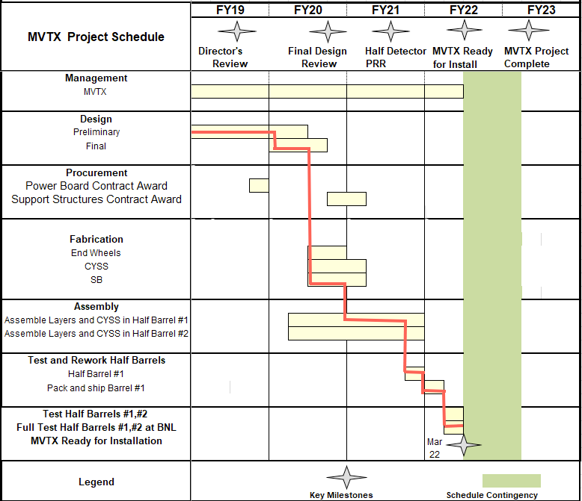
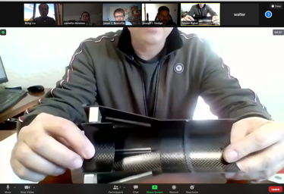
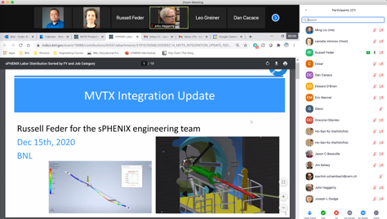
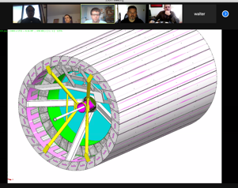
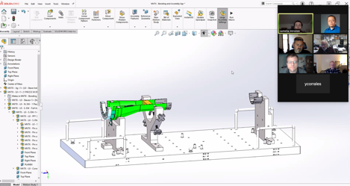
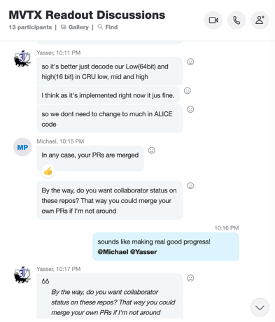
Status & Plan
Pre-COVID19 Schedule
Today
production started
Some delay in CFC production,
but still on track for completing
the assembly work in 2021
Assembly review
@LBNL
Readout, Control and Electrical System Integration
3 RUs sent to factory@UK for repair
FW/SW synced to latest ALICE/ATLAS code
Low-level slow control under testing
mGTM progress at BNL (40MHz/LHC)
Readout and service cables and power system
MVTX
installation
~9/2022

