Slide 1
MVTX Status
Camelia, Grazyna, Ming
02/12/2021
sPHENIX L2 Project Meeting

Slide 2
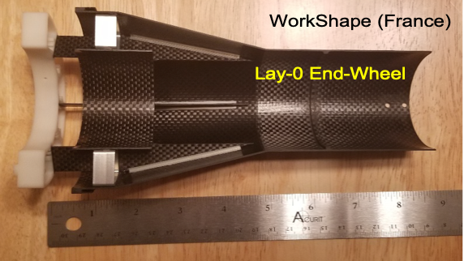
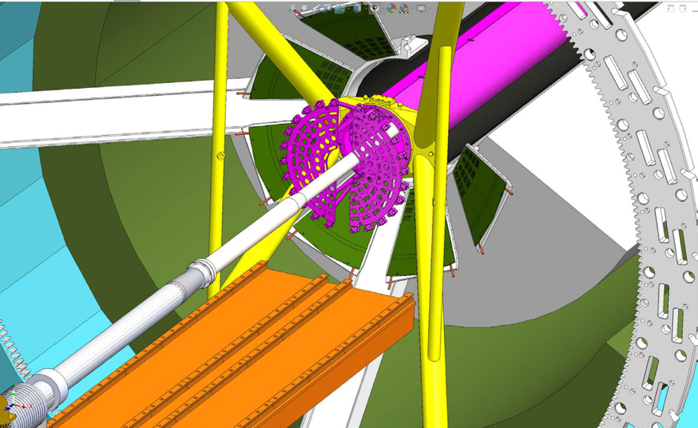
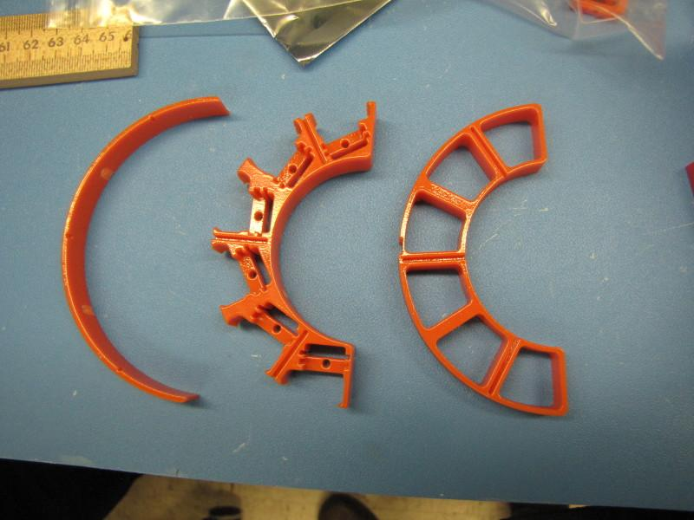
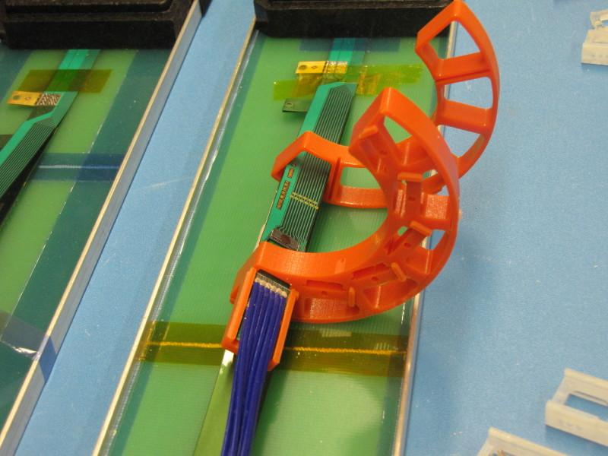
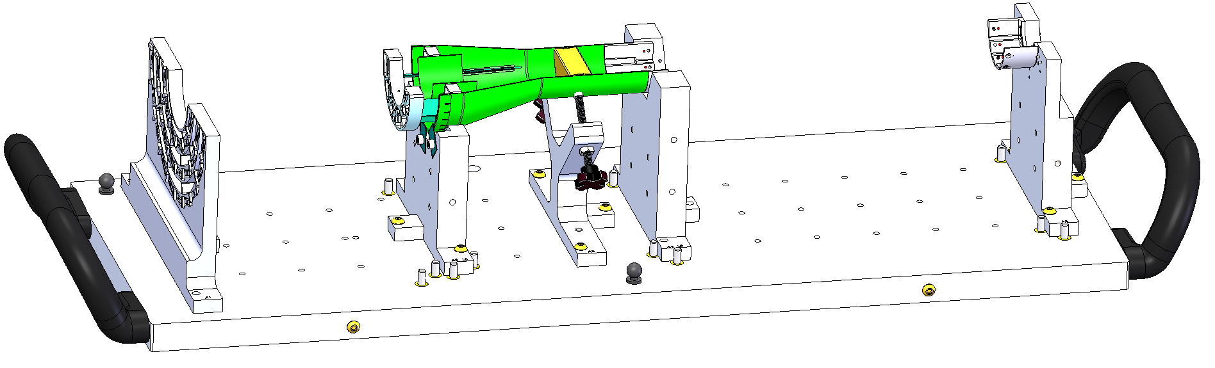
Mechanical Structures
CFC production on schedule
  A new all carbon Lay-0 EW, to replace the test article
    In kind contribution from WorkShape
  Complete in 3rd week of March
X-Wing design near completion
  PP3 optimization (3D print)
  => finalize cable lengths, readout and power
Finalizing assembly jig design, w/ LBNL meeting next week
PP1/2 design updated, confirmed w/ 3-D mockups
  Improve cable passthrough, locking
Budget update -> more engineering support
LANL, add 0.3FTE on MVTX + WBS2.x, ~$150k
LBNL, add “setup clean room”, ~$20k
MIT, TBD, in progress -> finish X-wing+insertion system, assembly fixtures, cooling sytem, extra evil MVTX (for insertion dry testing in BNL), etc. (might need extra 200-250K from P6, + ~50K WBS2x
X-Wing
Detector Assembly Jig

Slide 3
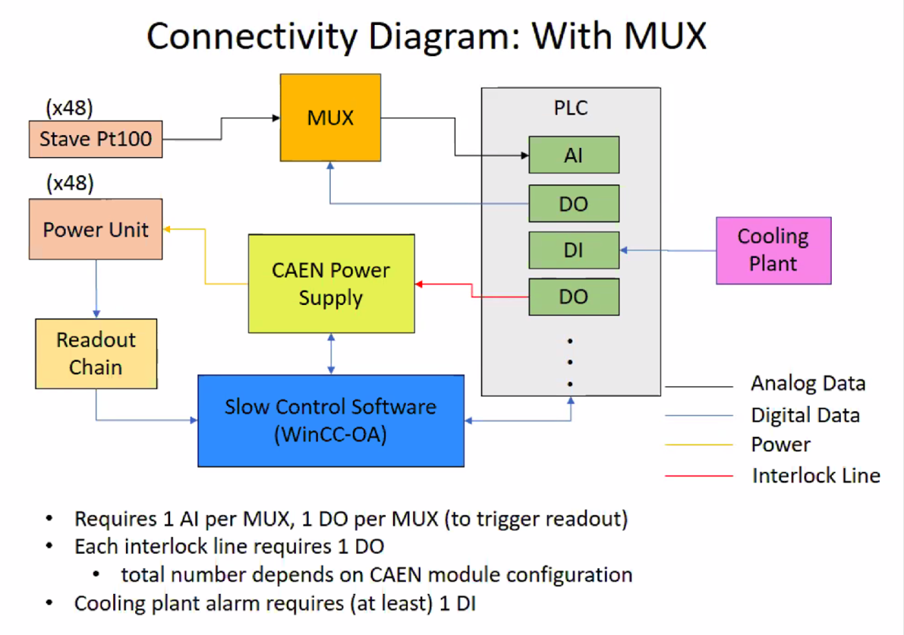
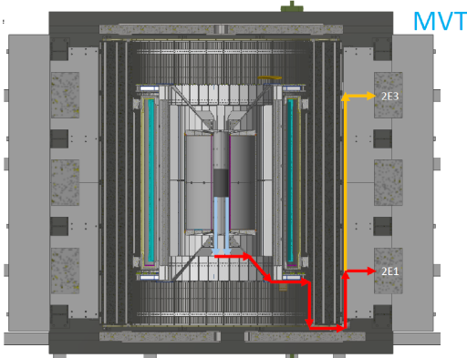
Readout and Electrical System
From Michael Peters
All 60 production RU tested
  3 sent to factory for repair
  Spare components procurements
    mezzanine cards ordered
    VTRx/VTTx under discussion w/ BNL, repurpose UT-A RU-test travel fund?
mGTM development in progress
  Preliminary design available for testing ~next week?
AMD server integration
  Slow control communication ok
  DMA data transfer ok
Readout in progress
  New data format and latest firmware
  mGTM and FELIX interface
Power system, racks, cables etc
  ESR under preparation
Detector safety system proposed – (T, V, I )
  Modify from ALICE “ITS2S”
Budget update for FY21:
Repurpose RU test travel $ (UT-A) to small item purchase?
  VTTx/VTRx ~ $12k.
Miscellaneous items:
  VME crates (~$6K), 4 fanout boards($10k?), patch panels, CANBUS cables, fibers etc.
  Safety system -> MVTX + WBS2.x

Slide 4
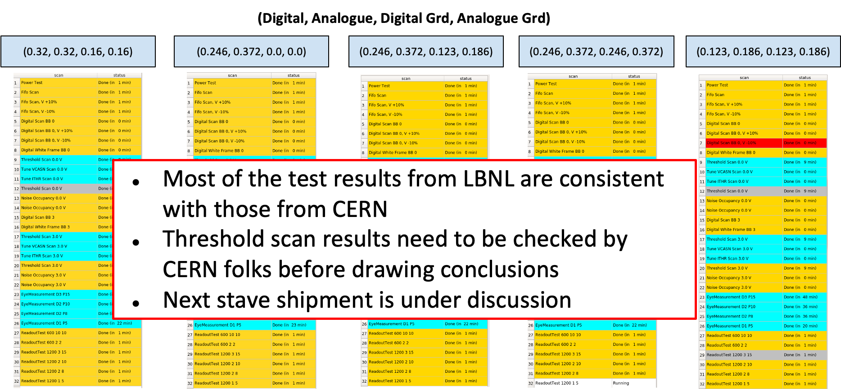
Stave Production, Transportation and QA
48 + spares Gold staves produced
  6 new staves finished metrology (as of 1/20/2021)
  Production rate: 4~5 HICs/week
4 (3 Gold + 1 Silver) under test at LBNL
  Mostly consistent with CERN data
  Some details under investigation
One more test shipping this week
  1 HIC, several monitoring loggers
Next Meeting with CERN @2/18
one HIC on the way to LBNL,
Double check transportation loggers
Power board calibration and stave QA @LBNL
DVDD, AVDD
FPC power cable resistance values

Slide 5
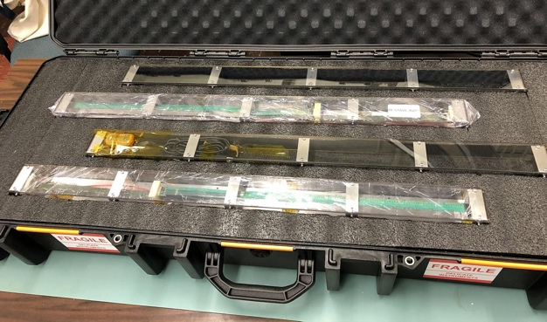
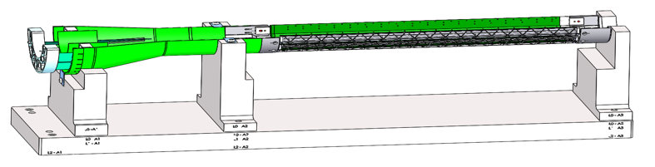
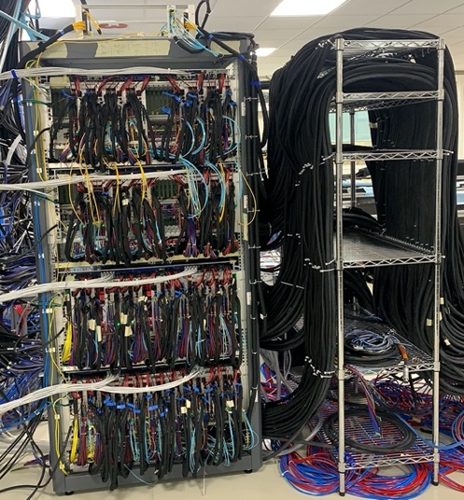
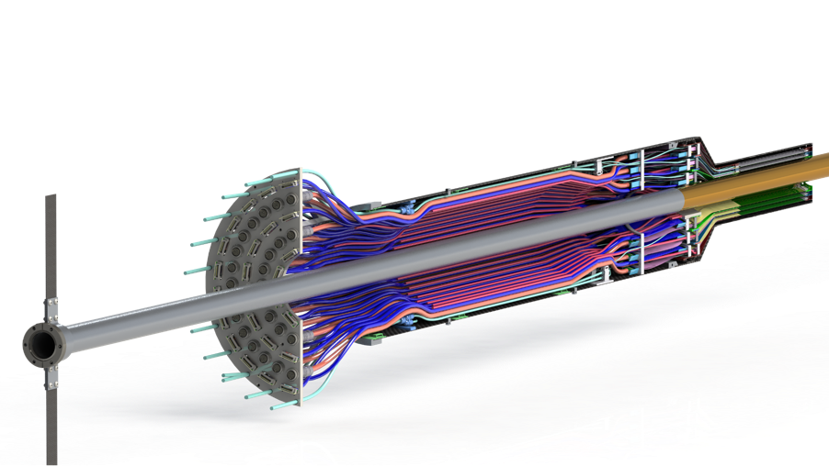
Near Term Plan
Mechanical structures
  Continue CFC production at WorkShape
    Produce low-cost “evil-twin” at the end of production
  Finished X-wing design, fabrication
    Build full mockup, w/ beam pipe
  Finish assembly fixtures
Stave shipping & QA
  Prepare for detector assembly
Readout and control
  AMD full integration
  mGTM integration
  Slow Control
MVTX detector safety system
  Interface to sPHENIX safety system
Experimental Safety Review
  power cables etc.
Power system & Cooling system
  system tests and procurements
Test fit: Mar-April, 2021
Detector assembly Review: ~May 2021
Readout & Test @LBNL:
full or partial detector?
1, 6/L0, 8/L1, 10/L2

Slide 6
backup

Slide 7
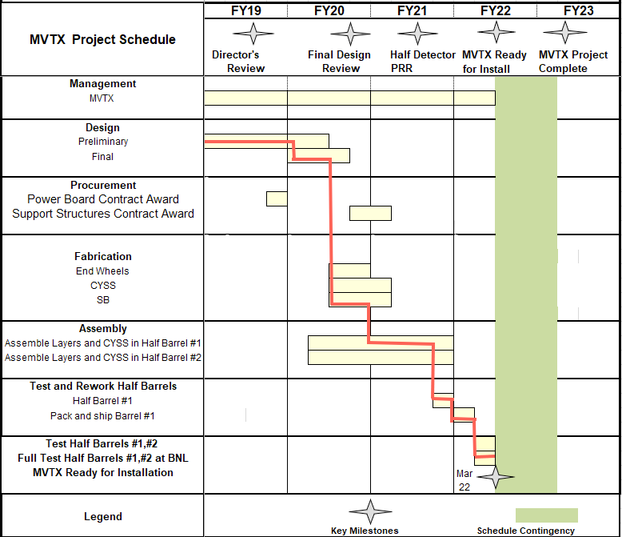

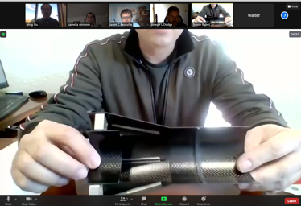
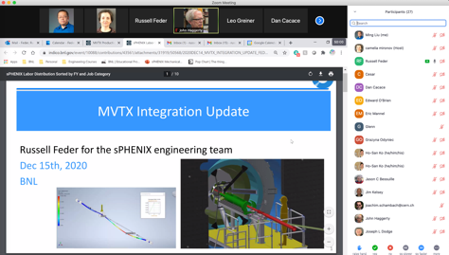

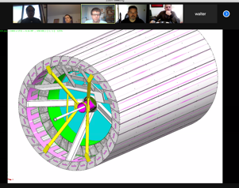
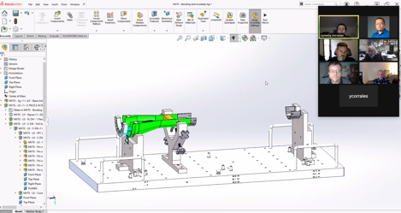
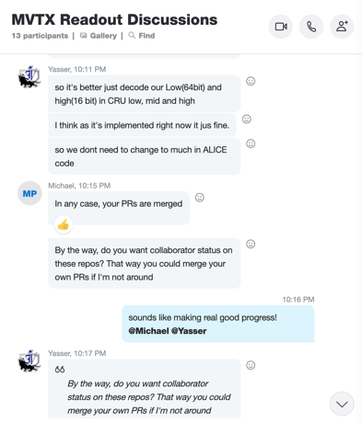

Status & Plan
Pre-COVID19 Schedule
Today
production started
Some delay in CFC production,
but still on track for completing
the assembly work in 2021
Assembly review
@LBNL
Readout, Control and Electrical System Integration
3 RUs sent to factory@UK for repair
FW/SW synced to latest ALICE/ATLAS code
Low-level slow control under testing
mGTM progress at BNL (40MHz/LHC)
Readout and service cables and power system
MVTX
installation
~9/2022

Slide 8
 | STAVE-production summary table
IBSTAVE ID | HIC assembly | HIC assembly date | Ins. after glue | Bonding | Pull test (>=2 lifts + F <7g) | Ins. after bonding | HIC PWR test | Qualification test | Threshold cluster | HIC Matrix | HIC DTU | HIC DTU (new) | HIC+SF+C -> Stave | Stave PWR test | Stave test | STAVE test date | STAVE metrology | Stave PWR test (long PWR extn.) | STAVE final test (PT100) | Final STAVE Matrix | Final STAVE DTU | STAVE Deliverd
TOTAL | 83 |  | 83 | 80 |  | 80 | 76 | 62 |  |  |  |  | 58 | 57 | 57 |  | 49 | 49 | 49 |  |  | 4
A201 (326) | 1 | 03/10/2019 | 1 | 1 | 1 | 1 | 1 | 1 | 1 | GOLD | OK | OK | 1 | 1 | 1 | 01/11/2019 | 1 | 1 | 1 | GOLD | OK | 1
A202* | 1 | 07/10/2019 | 1 | 1 | 0 | 1 | 1 | 0 | ?? | PARTIAL | OK | OK
A203 (144) | 1 | 08/10/2019 | 1 | 1 | 0 | 1 | 1 | 1 | 0 | GOLD | OK | OK | 1 | 1 | 1 | 04/11/2019 | 1 | 1 | 1 | GOLD | OK | 1
A204 (158) | 1 | 22/10/2019 | 1 | 1 | 1 | 1 | 1 | 1 | 0 | GOLD | OK | OK | 1 | 1 | 1 | 07/11/2019 | 1 | 1 | 1 | GOLD | OK | 1
A205 (167) | 1 | 23/10/2019 | 1 | 1 | 4 | 1 | 1 | 1 | 0 | GOLD | CAN | OK | 1 | 1 | 1 | 08/11/2019 | 1 | 1 | 1 | GOLD | OK
A206 (204) | 1 | 30/10/2019 | 1 | 1 | 3 | 1 | 1 | 1 | 2 | GOLD | CAN | CAN | 1 | 1 | 1 | 24/01/2020 | 1 | 1 | 1 | GOLD | CAN
B201 (352) | 1 | 30/10/2019 | 1 | 1 | 0 | 1 | 1 | 1 | 0 | GOLD | CAN | CAN | 1 | 1 | 1 | 28/05/2020 | 1 | 1 | 1 | GOLD | OK
B202* | 1 | 31/10/2019 | 1 | 1 | 0 | 1 | 1 | 0 |  | Broken
B203 (114) | 1 | 07/11/2019 | 1 | 1 | 1 | 1 | 1 | 1 | 0 | GOLD | CAN | CAN | 1 | 1 | 1 | 29/05/2020 | 1 | 1 | 1 | GOLD | CAN
B204 (116) | 1 | 13/11/2019 | 1 | 1 | 0 | 1 | 1 | 1 | 1 | SILVER | CAN | CAN | 1 | 1 | 1 | 28/05/2020 | 1 | 1 | 1 | SILVER | CAN | 1
B205 (115) | 1 | 14/01/2020 | 1 | 1 | 2 | 1 | 1 | 1 | 0 | GOLD | CAN | CAN | 1 | 1 | 1 | 02/06/2020 | 1 | 1 | 1 | GOLD | OK
B206 (295) | 1 | 15/01/2020 | 1 | 1 | 2 | 1 | 1 | 1 | 0 | GOLD | CAN | OK | 1 | 1 | 1 | 02/06/2020 | 1 | 1 | 1 | GOLD | OK
F201* | 1 | 27/02/2020 | 1 | 1 | 1 | 1 | 1 | 0 | ?? | PARTIAL | OK | OK
F202 (230) | 1 | 28/02/2020 | 1 | 1 | 3 | 1 | 1 | 1 | 0 | GOLD | CAN | OK | 1 | 1 | 1 | 04/06/2020 | 1 | 1 | 1 | GOLD | CAN
F204 | 1 | 29/02/2020 | 1 | 1 | 5 | 1 | 1 | 1 | 2 | GOLD | CAN | OK
G202 (234) | 1 | 10/02/2020 | 1 | 1 | 0 | 1 | 1 | 1 | 1 | GOLD | OK | OK | 1 | 1 | 1 | 04/06/2020 | 1 | 1 | 1 | GOLD | OK
G203 | 1 | 12/02/2020 | 1 | 1 | 1 | 1 | 1 | 1 | 1 | GOLD | CAN | CAN
F203* | dummy
H202 (294) | 1 | 24/02/2020 | 1 | 1 | 0 | 1 | 1 | 1 | 0 | GOLD | OK | OK | 1 | 1 | 1 | 05/06/2020 | 1 | 1 | 1 | GOLD | OK
H203 (302) | 1 | 26/02/2020 | 1 | 1 | 0 | 1 | 1 | 1 | 0 | GOLD | OK | OK | 1 | 1 | 1 | 05/06/2020 | 1 | 1 | 1 | GOLD | OK
H204 (354) | 1 | 27/02/2020 | 1 | 1 | 0 | 1 | 1 | 1 | 0 | GOLD | OK | OK | 1 | 1 | 1 | 11/06/2020 | 1 | 1 | 1 | GOLD | OK
H206* | 1 | 04/03/2020 | 1 | 1 | 0 | 1 | 1 | 0 | ?? | PARTIAL | OK | OK
E204 (110) | 1 | 05/03/2020 | 1 | 1 | 0 | 1 | 1 | 1 | 1 | GOLD | CAN | CAN | 1 | 1 | 1 | 22/06/2020 | 1 | 1 | 1 | GOLD | CAN
E201* | 1 | 12/02/2020 | 1 | 1 | 0 | 1 | 1 | 0 | 3 | PARTIAL | CAN | OK
E202 | 1 | 10/03/2020 | 1 | 1 | 1 | 1 | 1 | 1 | 1 | GOLD | CAN (bad driver) | CAN (bad driver)
E206 (101) | 1 | 12/03/2020 | 1 | 1 | 0 | 1 | 1 | 1 | 1 | GOLD | OK | OK | 1 | 1 | 1 | 16/06/2020 | 1 | 1 | 1 | GOLD | OK
H205 | 1 | 11/06/2020 | 1 | 1 | 0 | 1 | 1 | 0 | 1 | SILVER | OK | OK
I202 (175) | 1 | 15/06/2020 | 1 | 1 | 0 | 1 | 1 | 1 | 0 | GOLD | OK | OK | 1 | 1 | 1 | 22/06/2020 | 1 | 1 | 1 | GOLD | OK
I203 (187) | 1 | 16/06/2020 | 1 | 1 | 0 | 1 | 1 | 1 | 0 | GOLD | OK | OK | 1 | 1 | 1 | 26/06/2020 | 1 | 1 | 1 | GOLD | OK
I204* | 1 | 17/06/2020 | 1 | 1 | 0 | 1 | 1 | 0 | 0 | PARTIAL | OK | OK
I205 (266) | 1 | 22/06/2020 | 1 | 1 | 0 | 1 | 1 | 1 | 0 | GOLD | OK | OK | 1 | 1 | 1 | 26/06/2020 | 1 | 1 | 1 | GOLD | OK
J201* | 1 | 23/06/2020 | 1 | 1 | 0 | 1 | 1 | 0 | ?? | PARTIAL | OK | OK
J202 (207) | 1 | 24/06/2020 | 1 | 1 | 0 | 1 | 1 | 1 | 0 | GOLD | CAN | OK | 1 | 1 | 1 | 16/07/2020 | 1 | 1 | 1 | GOLD | CAN
J203 (245) 345 right | 1 | 29/06/2020 | 1 | 1 | 0 | 1 | 1 | 1 | 0 | GOLD | CAN | CAN | 1 | 1 | 1 | 17/07/2020 | 1 | 1 | 1 | GOLD | CAN
J204 (252) | 1 | 30/06/2020 | 1 | 1 | 0 | 1 | 1 | 1 | 0 | GOLD | OK | OK | 1 | 1 | 1 | 03/07/2020 | 1 | 1 | 1 | GOLD | OK
J206 (260) | 1 | 01/07/2020 | 1 | 1 | 0 | 1 | 1 | 1 | 0 | GOLD | OK | OK | 1 | 1 | 1 | 03/07/2020 | 1 | 1 | 1 | GOLD | OK
K202 (122) | 1 | 07/07/2020 | 1 | 1 | 0 | 1 | 1 | 1 | 1 | GOLD | OK | OK | 1 | 1 | 1 | 18/08/2020 | 1 | 1 | 1 | GOLD | OK
K203 (125) | 1 | 08/07/2020 | 1 | 1 | 0 | 1 | 1 | 1 | 0 | GOLD | OK | OK | 1 | 1 | 1 | 18/08/2020 | 1 | 1 | 1 | GOLD | OK
K204 (129) | 1 | 09/07/2020 | 1 | 1 | 0 | 1 | 1 | 1 | 0 | GOLD | CAN | OK | 1 | 1 | 1 | 04/09/2020 | 1 | 1 | 1 | GOLD | OK
K205 (128) | 1 | 13/07/2020 | 1 | 1 | 0 | 1 | 1 | 1 | 1 | GOLD | CAN | CAN | 1 | 1 | 1 | 04/09/2020 | 1 | 1 | 1 | GOLD | CAN
K206 (347) | 1 | 14/07/2020 | 1 | 1 | 0 | 1 | 1 | 1 | 0 | GOLD | OK | OK | 1 | 1 | 1 | 28/09/2020 | 1 | 1 | 1 | GOLD | OK
Stave Production meeting
with CERN, 1/19/2021
6 new stave metrology done
* Partial/Not functioning

Slide 9
 | STAVE-production summary table
IBSTAVE ID | HIC assembly | HIC assembly date | Ins. after glue | Bonding | Pull test (>=2 lifts + F <7g) | Ins. after bonding | HIC PWR test | Qualification test | Threshold cluster | HIC Matrix | HIC DTU | HIC DTU (new) | HIC+SF+C -> Stave | Stave PWR test | Stave test | STAVE test date | STAVE metrology | Stave PWR test (long PWR extn.) | STAVE final test (PT100) | Final STAVE Matrix | Final STAVE DTU | STAVE Deliverd
L202 (130) | 1 | 23/07/2020 | 1 | 1 | 0 | 1 | 1 | 1 | 0 | GOLD | CAN | OK | 1 | 1 | 1 | 08/09/2020 | 1 | 1 | 1 | GOLD | CAN
L203 (139) | 1 | 24/07/2020 | 1 | 1 | 0 | 1 | 1 | 1 | 0 | GOLD | CAN | CAN | 1 | 1 | 1 | 08/09/2020 | 1 | 1 | 1 | GOLD | CAN
L204 (127) | 1 | 27/07/2020 | 1 | 1 | 0 | 1 | 1 | 1 | 0 | GOLD | CAN | CAN | 1 | 1 | 1 | 14/09/2020 | 1 | 1 | 1 | GOLD | CAN
L205 (136) | 1 | 28/07/2020 | 1 | 1 | 0 | 1 | 1 | 1 | 0 | GOLD | OK | OK | 1 | 1 | 1 | 14/09/2020 | 1 | 1 | 1 | GOLD | OK
J205* | 1 | 05/08/2020 | 1 | 1 | 0 | 1 | 1 | 0 | ?? | PARTIAL | CAN | CAN
I201* | 1 | 06/08/2020 | 1 | 1 | 0 | 1 | 1 | 0 | 0 | PARTIAL | OK | OK
L206* | 1 | 13/08/2020 | 1 | 0
L201 (169) | 1 | 14/08/2020 | 1 | 1 | 0 | 1 | 1 | 1 | 1 | GOLD | CAN | CAN | 1 | 1 | 1 | 30/09/2020 | 1 | 1 | 1 | GOLD | CAN
S201 (359) | 1 | 03/09/2020 | 1 | 1 | 0 | 1 | 1 | 1 | 0 | GOLD | CAN | OK | 1 | 1 | 1 | 30/09/2020 | 1 | 1 | 1 | GOLD | OK
S202 | 1 | 04/09/2020 | 1 | 1 | 0 | 1 | 1 | 0 | 0 | SILVER | CAN | CAN
S203 (235) | 1 | 08/09/2020 | 1 | 1 | 0 | 1 | 1 | 1 | 0 | GOLD | CAN | CAN | 1 | 1 | 1 | 16/11/2020 | 1 | 1 | 1 | GOLD | OK
S204 (237) | 1 | 15/09/2020 | 1 | 1 | 0 | 1 | 1 | 1 | 1 | GOLD | CAN | CAN | 1 | 1 | 1 | 30/09/2020 | 1 | 1 | 1 | GOLD | CAN
S205 (142) | 1 | 16/09/2020 | 1 | 1 | 0 | 1 | 1 | 1 | 0 | GOLD | CAN | CAN | 1 | 1 | 1 | 01/10/2020 | 1 | 1 | 1 | GOLD | CAN
S206 (98) | 1 | 17/09/2020 | 1 | 1 | 0 | 1 | 1 | 1 | 1 | GOLD | OK | OK | 1 | 1 | 1 | 02/10/2020 | 1 | 1 | 1 | GOLD | OK
T201 (277) | 1 | 04/11/2020 | 1 | 1 | 0 | 1 | 1 | 1 | 1 | GOLD | CAN | CAN | 1 | 1 | 1 | 17/11/2020 | 1 | 1 | 1 | GOLD | CAN
T202 (279) | 1 | 06/11/2020 | 1 | 1 | 0 | 1 | 1 | 1 | 2 | GOLD | CAN | CAN | 1 | 1 | 1 | 19/11/2020 | 1 | 1 | 1 | GOLD | CAN
T203 | 1 | 09/11/2020 | 1 | 1 | 0 | 1 | 1
U201 (291) | 1 | 10/11/2020 | 1 | 1 | 0 | 1 | 1 | 1 | 2 | SILVER | CAN | CAN | 1 | 1 | 1 | 24/11/2020 | 1 | 1 | 1 | GOLD | CAN
U202 (238) | 1 | 11/11/2020 | 1 | 1 | 0 | 1 | 1 | 1 | 1 | GOLD | CAN | CAN | 1 | 1 | 1 | 26/11/2020 | 1 | 1 | 1 | GOLD | CAN
U203 (126) | 1 | 12/11/2020 | 1 | 1 | 0 | 1 | 1 | 1 | 0 | GOLD | CAN | CAN | 1 | 1 | 1 | 20/11/2020 | 1 | 1 | 1 | GOLD | CAN
U204* | 1 | 13/11/2020 | 1 | 1 | 0 | 1 | 1 | 0 | 0 | PARTIAL | OK | OK
U205 (89) | 1 | 16/11/2020 | 1 | 1 | 0 | 1 | 1 | 1 | 1 | GOLD | OK | OK | 1 | 1 | 1 | 27/11/2020 | 1 | 1 | 1 | GOLD | OK
U206 (111) | 1 | 17/11/2020 | 1 | 1 | 0 | 1 | 1 | 1 | 0 | GOLD | CAN | CAN | 1 | 1 | 1 | 25/11/2020 | 1 | 1 | 1 | GOLD | CAN
Q201 (155) | 1 | 18/11/2020 | 1 | 1 | 0 | 1 | 1 | 1 | 0 | SILVER | CAN | CAN | 1 | 1 | 1 | 27/11/2020 | 1 | 1 | 1 | GOLD | CAN
Q202 | 1 | 19/11/2020 | 1 | 1 | 0 | 1 | 1 | 1 | 0 | GOLD | CAN | OK | 1 | 1 | 1 | 03/12/2020 | 1 | 1 | 1 | GOLD | CAN
T204 | 1 | 23/11/2020 | 1 | 1 | 0 | 1 | 1 | 1 | 0 | GOLD | CAN | CAN | 1 | 1 | 1 | 03/12/2020 | 1 | 1 | 1 | GOLD | CAN
T205 | 1 | 24/11/2020 | 1 | 1 | 0 | 1 | 1 | 1 | 1 | GOLD | OK | OK | 1 | 1 | 1 | 03/12/2020
T206 (232) | 1 | 25/11/2020 | 1 | 1 | 0 | 1 | 1 | 1 | 1 | GOLD | CAN | CAN | 1 | 1 | 1 | 14/01/2021
R201 (119) | 1 | 27/11/2020 | 1 | 1 | 8 | 1 | 1 | 1 | 1 | GOLD | CAN | CAN | 1 | 1 | 1 | 08/12/2020
R202 (109) | 1 | 30/11/2020 | 1 | 1 | 1 | 1 | 1 | 1 | 0 | GOLD | CAN | CAN | 1 | 1 | 1 | 17/12/2020
W201 (52) | 1 | 01/12/2020 | 1 | 1 | 0 | 1 | 1 | 1 | 0 | GOLD | OK | OK | ?? data line broken
W202* | 1 | 02/12/2020 | 1 | 1 | 0 | 1 | 1 | 0 | ?? | PARTIAL | CAN | CAN
W203 (212) | 1 | 03/12/2020 | 1 | 1 | 0 | 1 | 1 | 1 | 0 | SILVER | CAN | CAN | 1 | 1 | 1 | 05/01/2021
W204 (271) | 1 | 07/12/2020 | 1 | 1 | 0 | 1 | 1 | 1 | 3 | GOLD | OK | OK | 1 | 1 | 1 | 05/01/2021
W205 (275) | 1 | 08/12/2020 | 1 | 1 | 0 | 1 | 1 | 1 | 0 | GOLD | CAN | CAN | 1 | 1 | 1 | 18/01/2021
W206 | 1 | 09/12/2020 | 1 | 1 | 0 | 1 | ?? Digi short
R203 | 1 | 06/01/2021 | 1 | 1 | 0 | 1 | 1 | 1 | 0 | GOLD | OK | OK | 1 | 1 | 1 | 20/01/2021
R204 | 1 | 11/01/2021 | 1 | 1 | 0 | 1 | 0 | 0 | ?? | PARTIAL | OK | OK
Q203 | 1 | 12/01/2021 | 1 | 1 | 0 | 1 | 0
X201 | 1 | 13/01/2021 | 1 | 1 | 0 | 1 | 1 | 1 | 1 | GOLD | CAN | CAN | 1
X202 | 1 | 14/01/2021 | 1 | 1 | 0 | 1
X204 | 1 | 18/01/2021 | 1
X205 | 1 | 19/01/2021 | 1
From last stave Production
meeting with CERN, 1/19/2021

