Slide 1
MVTX Status
Camelia, Grazyna, and Ming
08/16/2021

Slide 2
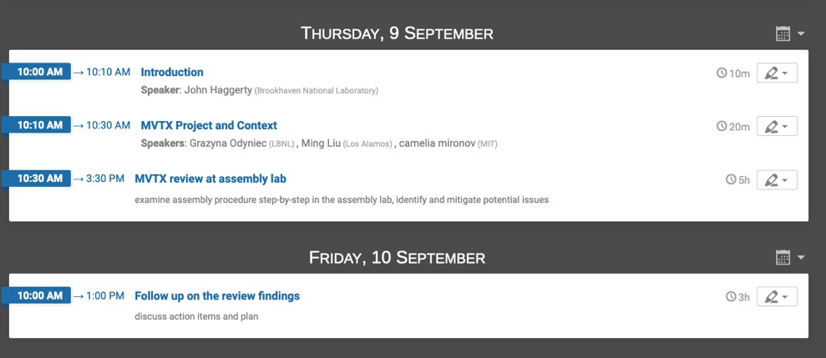
MVTX Assembly Review: Sept. 9-10th @LBNL
Planned originally for Aug 18-19th
rescheduled because of COVID travel policy (many approvals, including DOE)
Half-detector assembly will start only after the review
Still aim to finish assembly and be ready for shipping to BNL in the first months of 2022
Draft review agenda page:https://indico.bnl.gov/event/12699/
Time zone: MDT

Slide 3
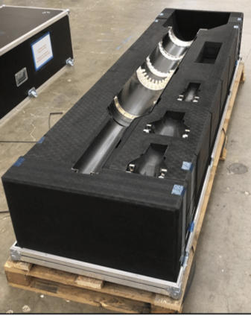
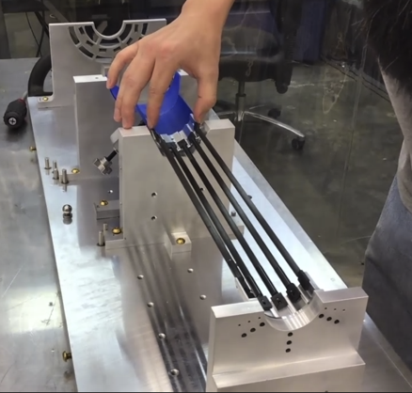
MVTX detector construction
ServiceBarrel
L0
All Carbon Fiber parts: delivered to LBNL
Fixtures for Layer-0 assembly: at LBNL
test fitting in progress with mock-up components
Assessing in parallel if any change to fixture is needed
Stave shipping & QA: in progress
10 staves received last week, under testing
Next shipment: 20 staves
Signal and power cable production:
long lead time (8~12 weeks?)
Fix the length ASAP, using final detector pieces
CYSS
L1
L2
Fixture

Slide 4
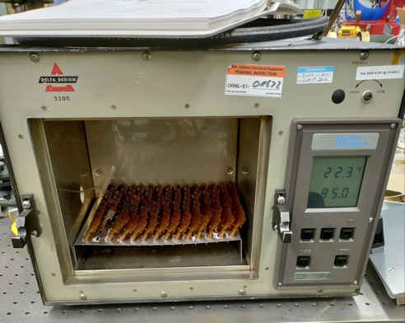
Electrical system
VTRx baking: in progress at ORNL
85C, 500hrs, 2 batches
mGTM integration and trigger framing: in progress, ~40MHz (160MHz)
FDAQ output looks okey
RCDAQ integration in progress, working on busy/interrupt integration
DCS and Detector Safety system: finished design
WinCC and PLCs, procurement in progress
DCS Software ported from ITS and successfully tested in hardware
CAEN power system: test in progress at LBNL
Cable and fiber routing plans: completed, under review
Full fiber fanout test planned later this summer

Slide 5
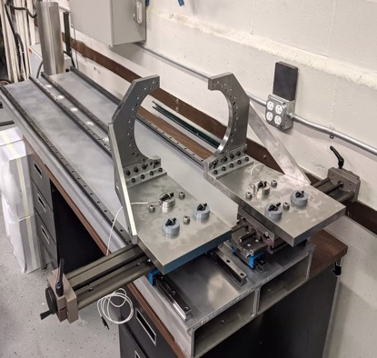
Near Term Tasks
Critical (potential delays)
MVTX half-detector assembly review
Half-detector assembly
Stave QA
MVTX insertion system mockup
To clear interference, MVXT support/INTT
Cooling system test
Stave cooling @ MIT
Electrics cooling @LANL
New GTM integration
DCS integration, online monitoring
MVTX alignment & MDC-2
Prepare for commissioning
Insertion
@MIT/Bates
INTT + MVTX/X-Wing
mockup @BNL
Signal+power cable fabrication
Re-designing anything (following review, or mock-ups results)

Slide 6
Backup slides

Slide 7
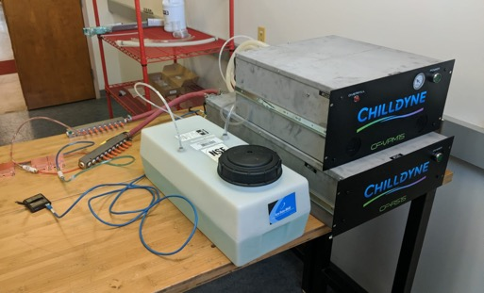
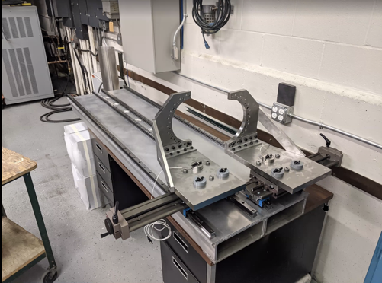
MVTX: other activities
Cooling circuits (PID): working on mock-up
Design finished for both racks (LANL) and detector (Bates)
Need to buy components for mock-up/cooling test
Some parts bought: Chilldyne units
Some delayed: waiting for fab account to be brought up in MIT (BNL money arrived)
Support and insertion: working on mock-up
Rails, ‘hands’, base plate w/ load cells, sliding mechanism, special table: all in Bates
Missing components:
X-wing (support structure) -- huge delays at the shop
INTT ROC + cables: Dan is preparing the shipment

