Slide 1
MVTX Status
Camelia, Grazyna and Ming
sPHENIX L2 Meeting
05/13/2021

Slide 2
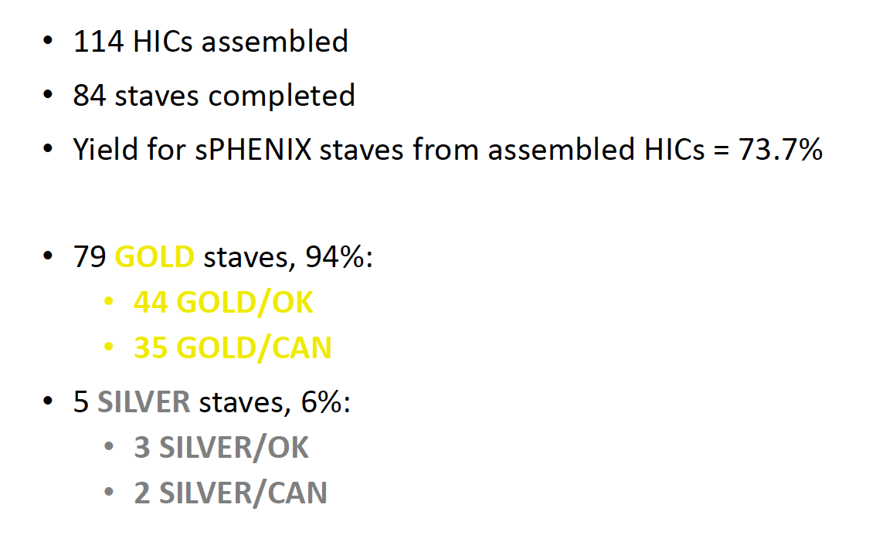
Stave Production Completed at CERN
next step: shipping!
Shipping status:
3 gold and 1 silver staves @LBNL
  Stave testing and QA in progress
4 Silver-staves shipping in preparation:
Double check issues observed in previous shippings (abnormal pressure drops recorded by the logger)
We have 2 transport cases, capable of shipping 20 staves per trip

Slide 3
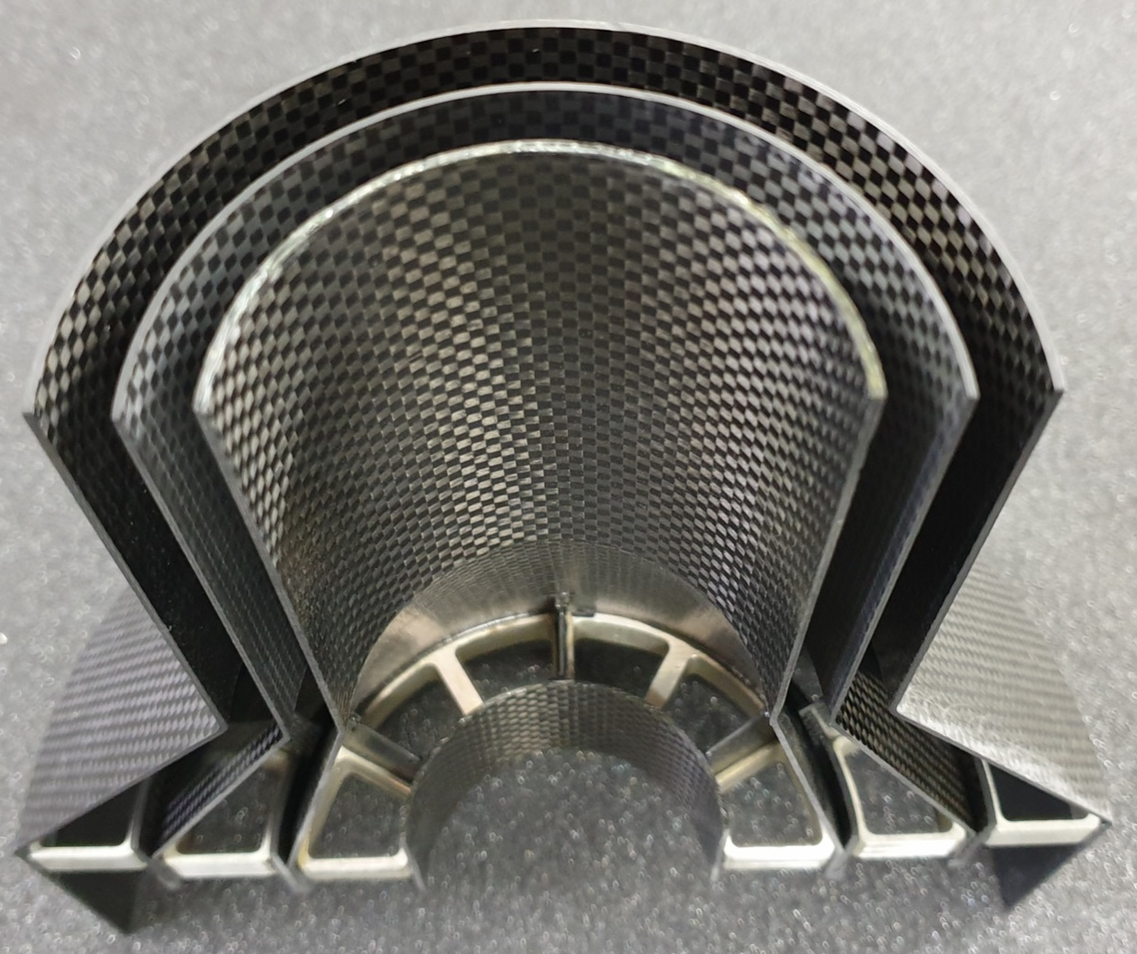
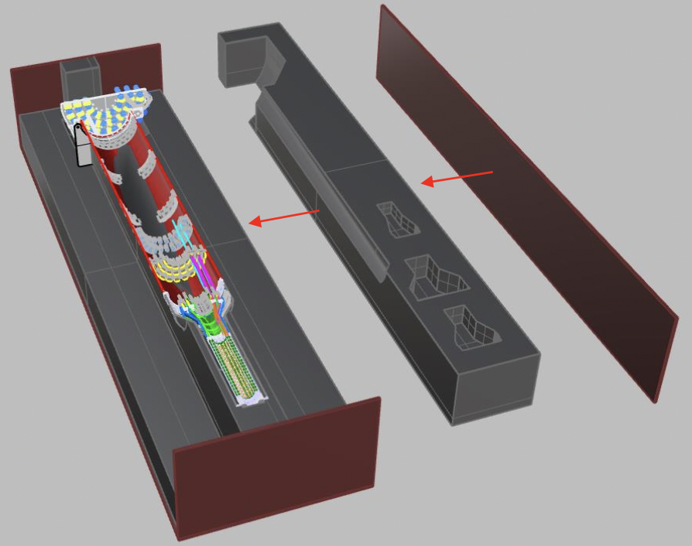
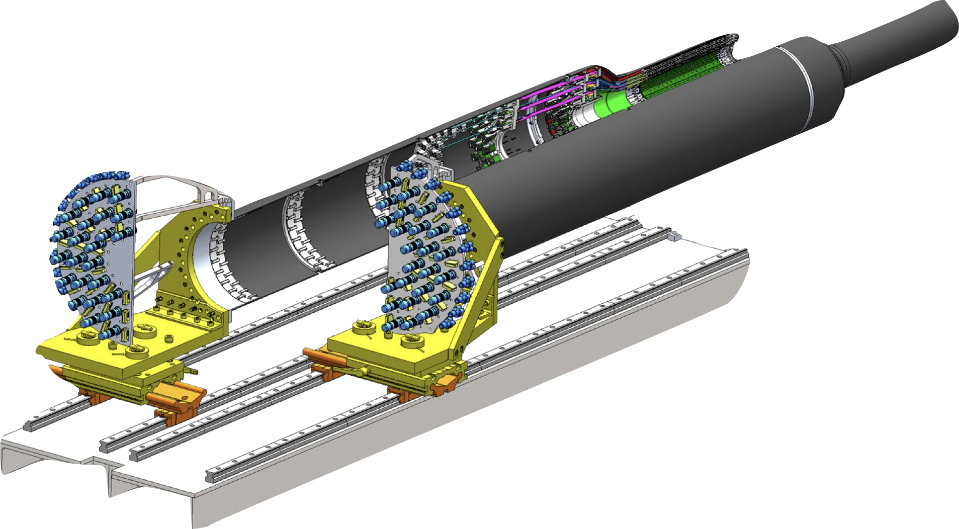
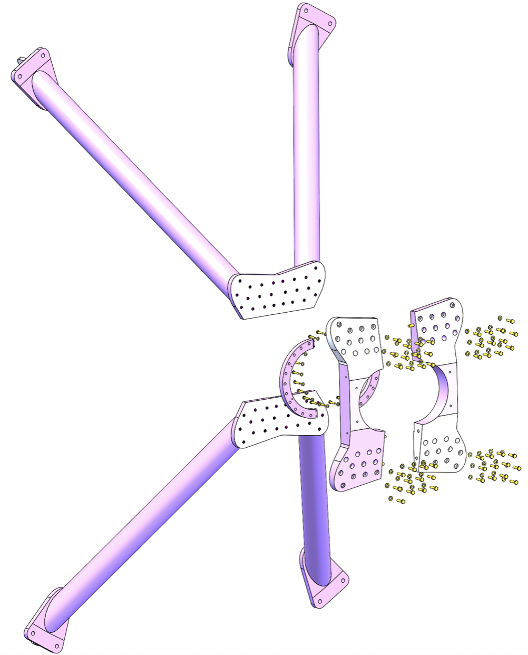
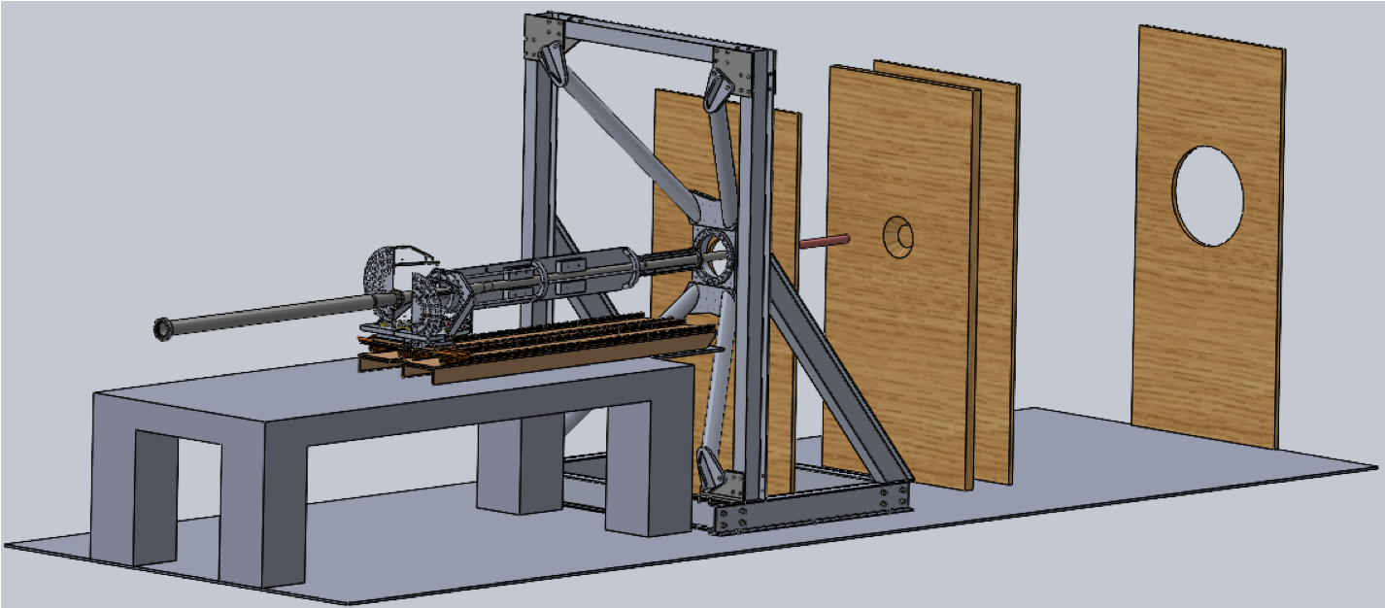
Mechanical Design and Production
Carbon fiber+Al pieces (Workshape/France)
  1st half of detector:
    all looks good so far for the layers & SB
    CYSS (the conical shell that houses all layers): going through 2nd iteration to deal with some spring-back
    Shipment: end of May
      Designing France->LBL shipment box to be used also as:
        Main assembly fixture in LBL
        LBL->BNL shipping box (w/ half fully assembled detector)
  2nd half: expected in LBL after ~3-4 weeks (some parts already made)
Insertion mock-up
  Essential work this year: define insertion sequence, define procedure to safely transfer from rails to X-wing, survey strategy, etc
  Support (X-wing) + insertion mechanism: ready to be ordered
  Ordering connectors, cooling lines, etc

Slide 4
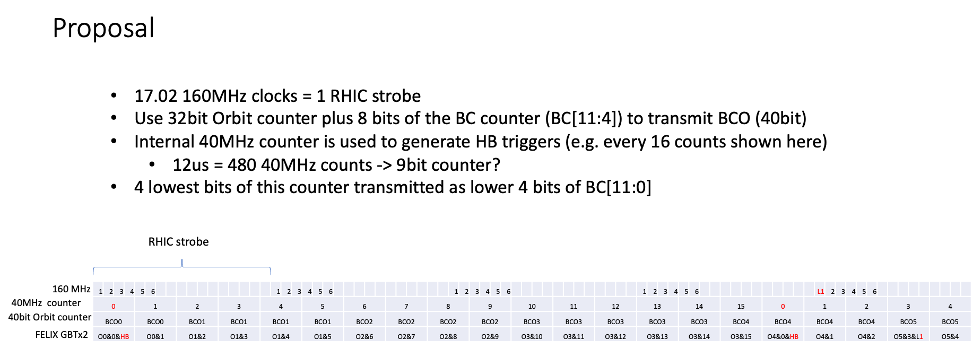
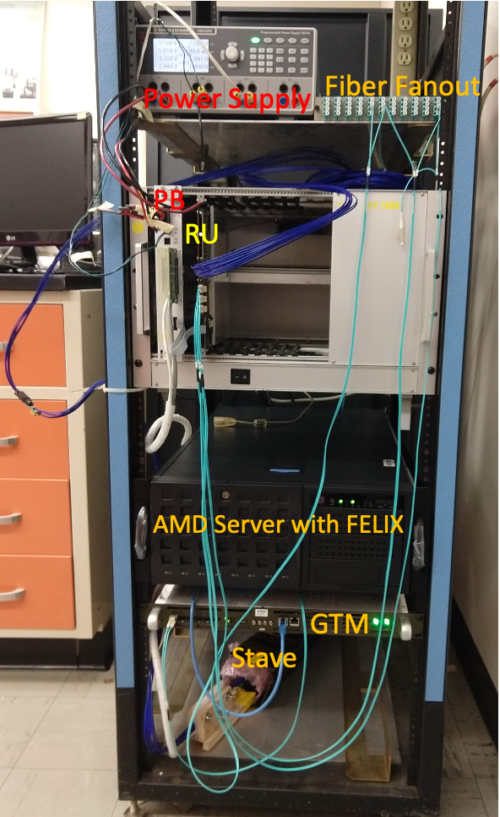
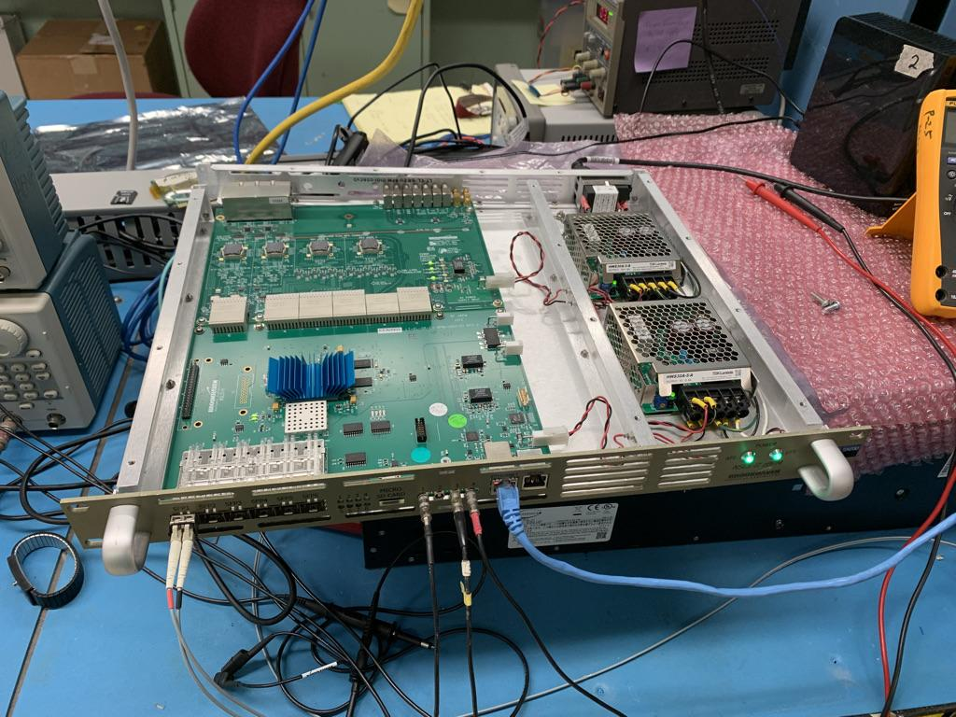
Readout Integration Progress
New data format and readout modes
  Triggered readout
  Continuous readout
mGTM integration in progress @LANL
  Powered up, testing underway
CAEN power system in progress
  Working w/ vendor on control SW
Slow control and monitoring
  2 CANbus controllers ordered and received
Readout system setup @ORNL
  First event readout with internal trigger sequencer
Readout
@ORNL
mGTM @LANL

Slide 5
Schedule and Risks
MVTX detector construction & installation
CFC production
  1st half-detector available end of May @LBNL
  2nd half ~end of June
Assembly test fit @LBNL
  June - July, testing
  Review ~end of July/early Aug. 2021
Half-detector assembly @LBNL
  per present P6:
    Aug. - Dec., 2021
    Ship to BNL in Jan, 2022
BNL commissioning (~Jan 2022 )
  Setup clean tent @1008 (PHENIX Laser room?)
  Money in P6 to buy one for MVTX (BNL)
Installation @IR ~9/2022
  is IR gonna be ready for MVTX or we know/expect already X month delays? (question for Ed)
Other activities:
Insertion mockup @Bates (over summer)
Cooling system (over summer/fall)
  detector (Bates), electronics (LANL)
  In the end: ship and final test @BNL
Detector safety system integration
  Under discussion with BNL
Stave test & QA @LBNL
  MOSAIC system for single stave readout from the half-detector
  Special readout cables @PP3

Slide 6
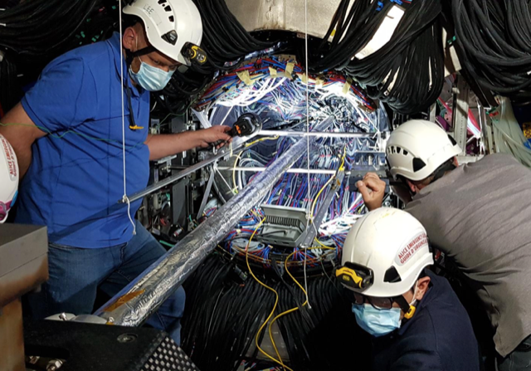
ITS IB Installed 5/12/2021…. MVTX Insertion System

