Slide 1
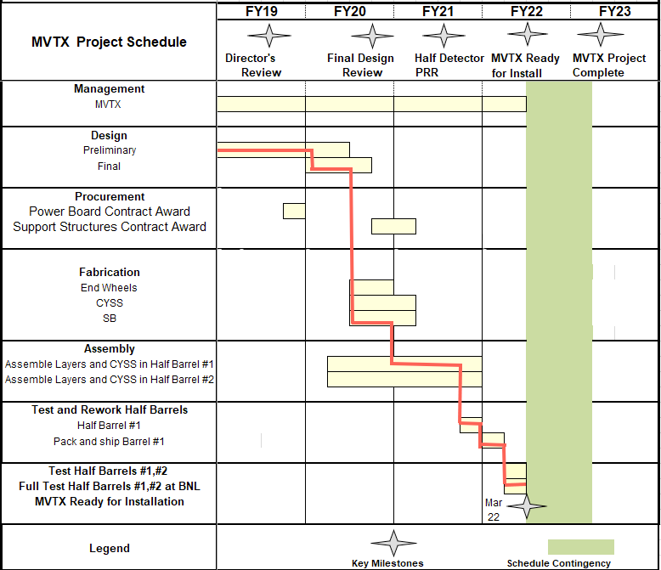
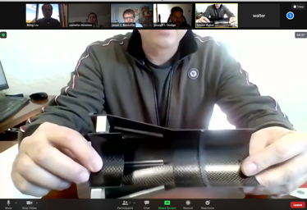
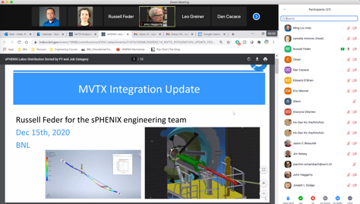
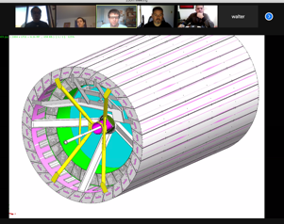
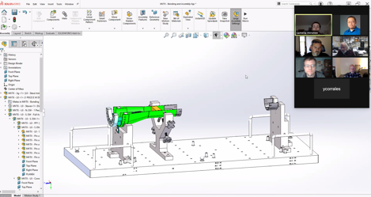
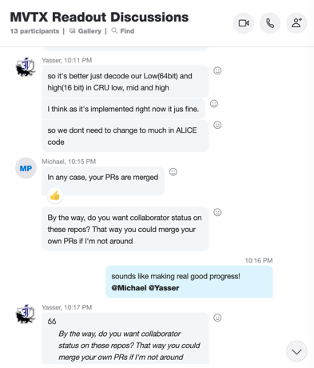
Schedule
Pre-COVID19 Schedule
Today
production in progress
Some delay in CFC production:
- May-June, 2021
Still on track for completing
the assembly work in 2021
Assembly review
~ 7/15/2021
@LBNL
Readout, Control and Electrical System Integration
3 RUs sent to factory@UK for repair
FW/SW synced to latest ALICE/ATLAS code
Low-level slow control under testing
mGTM progress at BNL (40MHz/LHC)
Readout and service cables and power system
MVTX
installation
~9/2022

