Slide 1
MVTX Commissioning Document Collections … BNLBox: https://bnlbox.sdcc.bnl.gov/index.php/f/16904602
ITS’ surface commissioning
Full system
Readout
DSC
Cooling
Safety interlock
Online monitoring
Endurance test
Half-detector test @LBNL, in late 2021
Single stave QA
Full system test @BNL, in early 2022

Slide 2
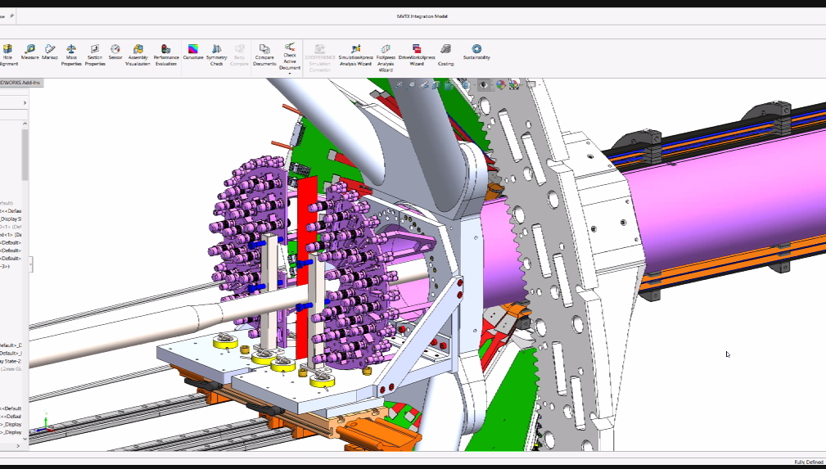
MVTX Half-Detector Test @LBNL
Test staves at each assembly step on the assembly jig, with MOSAIC setup
Noise/occupancy
Threshold
Dead pixels …
Also after each layer assembled
Repeat tests from #1, MOSAIC
After the half-detector assembled
Final connectors & cables installed
Need the full readout for testing?
MOSAIC requires a special data cable/connector @PP3 (Plan-A)
Multi-MOSAIC setups, 4?
Test again @BNL later also
- Test each stave on the assembly jig w/ MOSAIC
Plan-B for half-detector QA:
Connectors @PP3 are easy to manage for the final readout setup
Challenge is the “available time” to setup full readout chain @LBNL
FELIX, RU, PU, Server
Software development could be most time consuming
Test setup at LBNL:
MOSAIC system
Individual Stave QA
Good for step #1,2, and #3 with a special data cable
Small scale MVTX readout (plan-B)
FELIX + RU + PU
use the final readout cables
Possible multiple stave readout
QA software and online monitoring
Zhaozhong? Working on ITS QA,
Mario?
@PP3: power and signal connectors

Slide 3
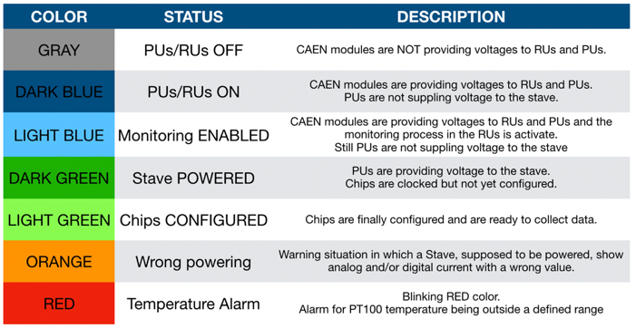
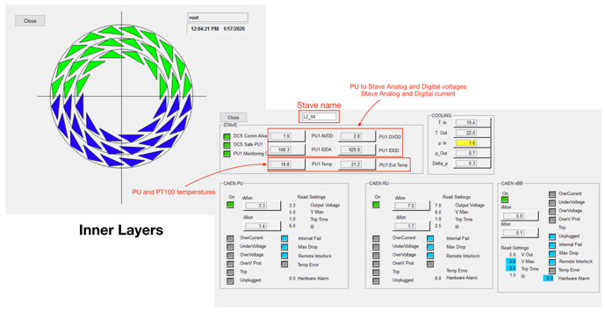
ALICE ITS Surface Commissioning Experience - detector control and status monitor
WinCC – required

Slide 4
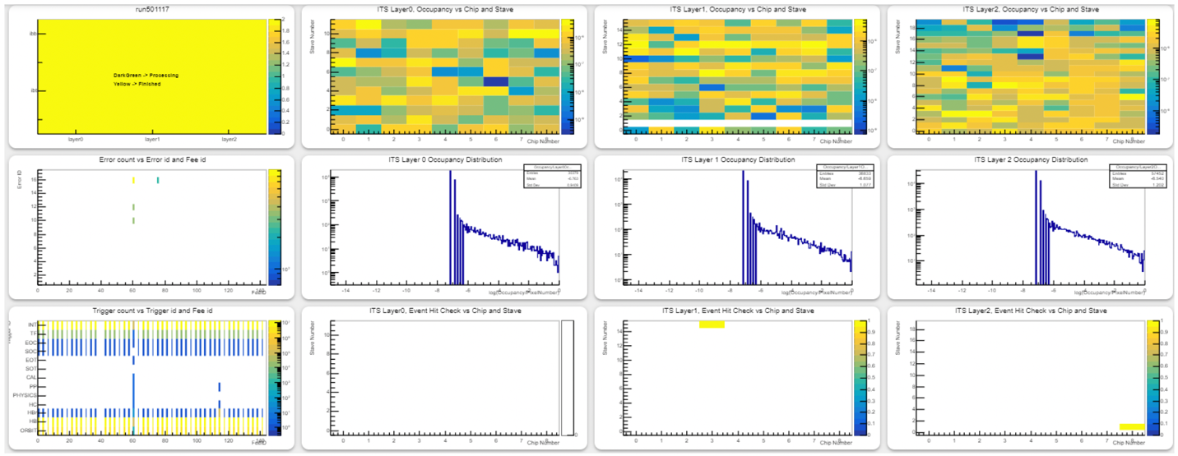
ITS Surface Commissioning: Checked all chips - hit occupancy, errors
WinCC – NOT required

Slide 5
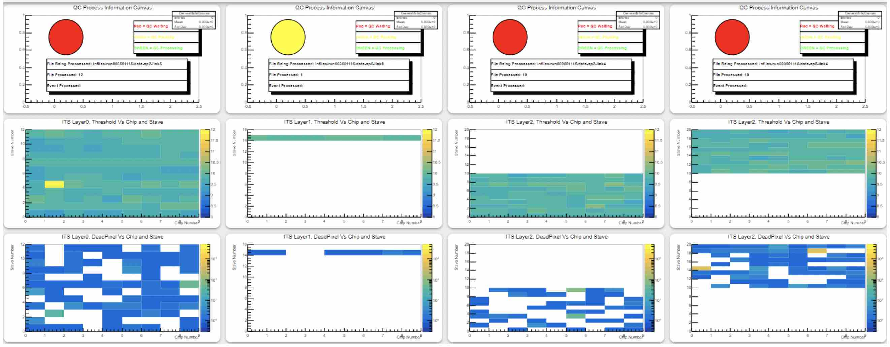
ITS Surface Commissioning: All Chips - threshold, dead pixels
WinCC – NOT required

Slide 6
MVTX QA and Online Software
Can we reuse/adapt ITS2 software?
Detector control (Win-CC required)
Detector monitoring (No Ein-CC)
WinCC required for online control, page 3
But not for page 4,5 monitoring outputs
Things special for sPHENIX
New data format in progress
FLX fdaq could be used for initial work
sPHENIX decoder

