Slide 1
MVTX Commissioning Document Collections … BNLBox: https://bnlbox.sdcc.bnl.gov/index.php/f/16904602
ITS’ surface commissioning
Full system
Readout
DSC
Cooling
Safety interlock
Online monitoring
Endurance test
Half-detector test @LBNL, in early 2021
Single stave QA
Full system test @BNL, in early 2022

Slide 2
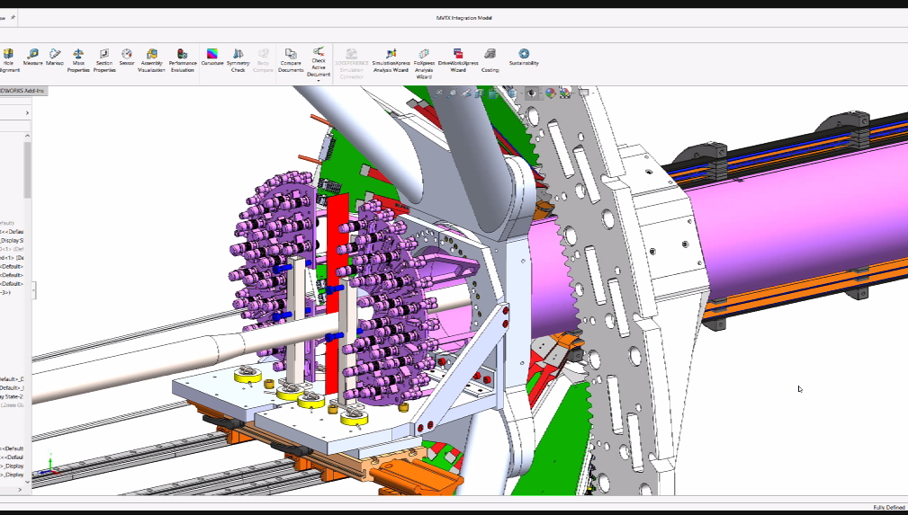
MVTX Half-Detector Test @LBNL
Test staves at each assembly step on the assembly jig, with MOSAIC setup
Noise/occupancy
Threshold
Dead pixels …
Also after each layer assembled
Repeat tests from #1, MOSAIC
After the half-detector assembled
Final connectors & cables installed
Need the full readout for testing?
@PP3: power and signal connectors
Test setup at LBNL:
MOSAIC system
Individual Stave QA
Good for setp #1
Small scale MVTX readout?
FELIX + RU + PU
use the final readout cables
Possible multiple stave readout
QA software and online monitoring

Slide 3
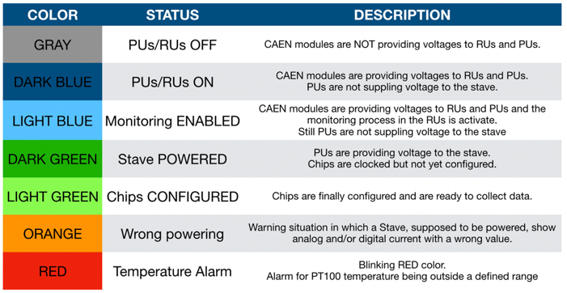
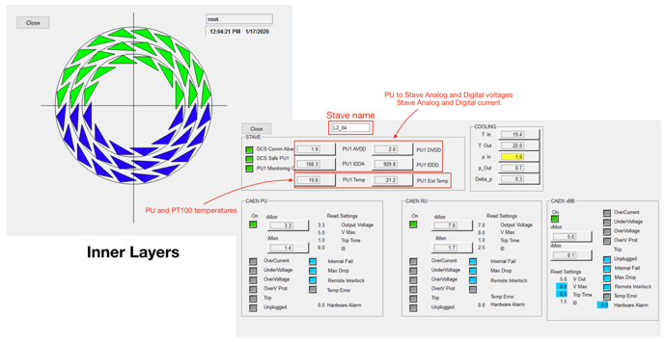
ALICE ITS Surface Commissioning Experience - detector control and status monitor

Slide 4
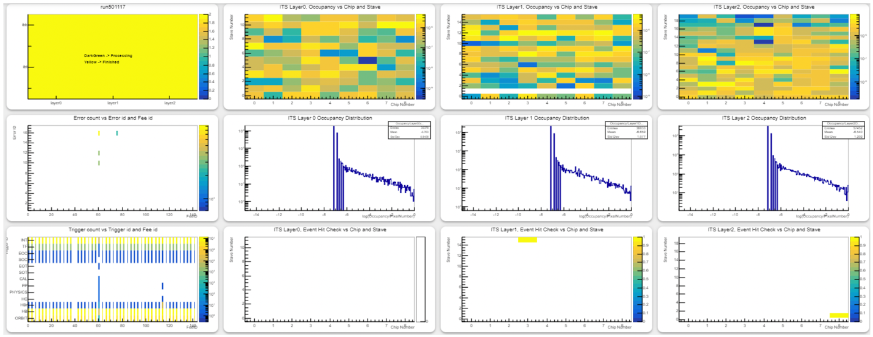
ITS Surface Commissioning: Checked all chips - hit occupancy, errors

Slide 5
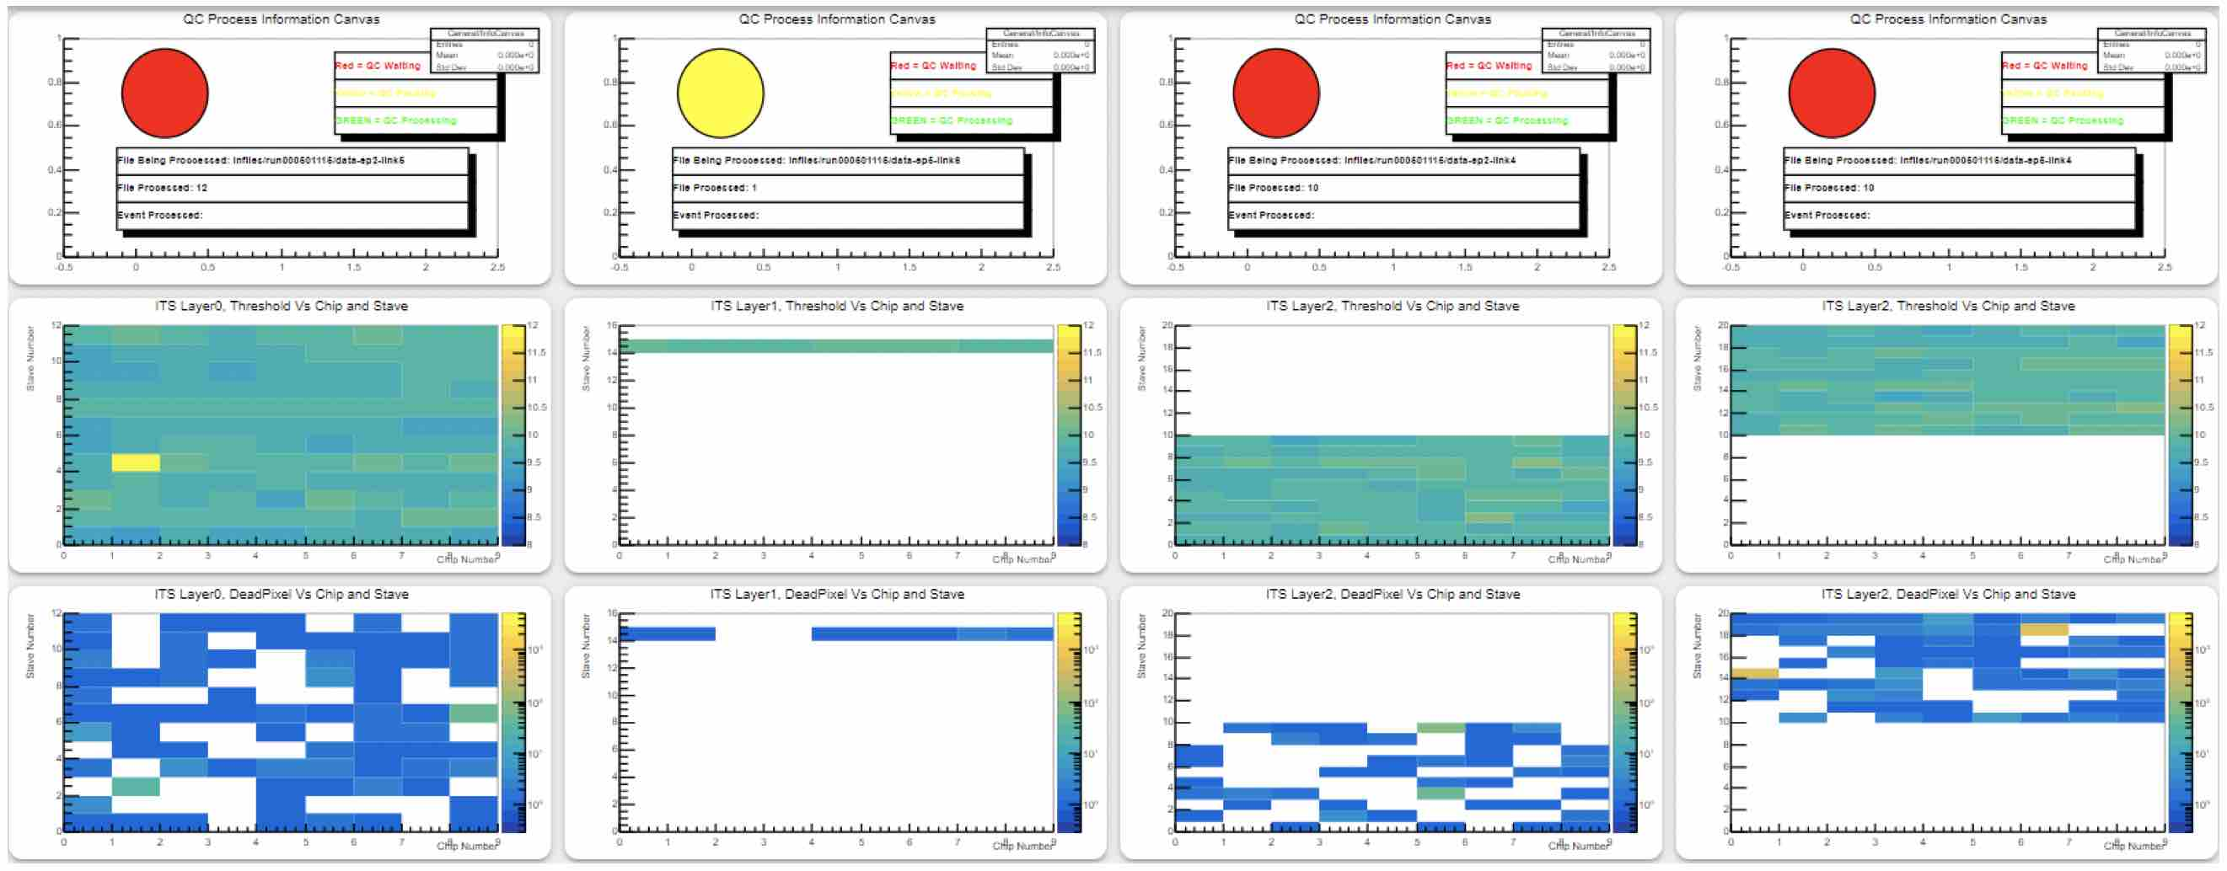
ITS Surface Commissioning: All Chips - threshold, dead pixels

Slide 6
MVTX QA and Online Software
Can we reuse/adapt ITS2 software?
Detector control
Detector monitoring
Things special for sPHENIX

