Slide 1
Stave Production at CERN
Yasser, Walt, Camelia, Ming
2/14/2020

Slide 2
Activities in last month (-from Rajendra Nath Patra)
•Assembly:
-IBHIC-B205, B206, F201*, F202, F204, G202, G203
-IBSTAVE-A206
•Tests:
-Power test of IBHIC-B202*, B204, B205, B206, F201*, F202, F204, G202
-Qualification test of IBHIC-B204, B205, B206, F201*, F202, F204, G202 (continuing..)
-Qualification test of IBSTAVE-A206
*B202: Communication issue, inspecting.
*F201: Chip2 is broken

Slide 3
IBHIC-production summary
IBSTAVE ID | HIC assembly | Ins. after glue | Bonding | Ins. after bonding | HIC PWR test | Qualification test | HIC+SF+C -> Stave | Stave PWR test | Stave test
TOTAL | 17 | 15 | 15 | 15 | 15 | 12 | 5 | 4 | 5
A201 | 1 | 1 | 1 | 1 | 1 | 1 | 1 | 1 | 1
A202* | 1 | 0 | 0 | 0 | 0 | 0 | 0 | 0 | 0
A203 | 1 | 1 | 1 | 1 | 1 | 1 | 1 | 1 | 1
A204 | 1 | 1 | 1 | 1 | 1 | 1 | 1 | 1 | 1
A205 | 1 | 1 | 1 | 1 | 1 | 1 | 1 | 1 | 1
A206 | 1 | 1 | 1 | 1 | 1 | 1 | 1 |  | 1
B201 | 1 | 1 | 1 | 1 | 1 | 1
B202* | 1 | 1 | 1 | 1 | 1 | ins
B203 | 1 | 1 | 1 | 1 | 1 | 1
B204 | 1 | 1 | 1 | 1 | 1 | 1
B205 | 1 | 1 | 1 | 1 | 1 | 1
B206 | 1 | 1 | 1 | 1 | 1 | 1
F201* | 1 | 1 | 1 | 1 | 1 | 0
F202 | 1 | 1 | 1 | 1 | 1 | 1
F204 | 1 | 1 | 1 | 1 | 1 | 1
G202 | 1 | 1 | 1 | 1 | 1
G203 | 1
7 HICs can be made to STAVEs. Waiting for final confirmation of the cooling pipes length.
* Partially working

Slide 4
STAVE production Status - from Antonello
Assembled HICs | HICs to be bonded | HICs NOK | HICs to be glued | STAVES OK | STAVES NOK
17 A201, A202, A203, A204, A205, A206, B201, B202, B203, B204, B205, B206, F201, F202, F204, G202, G203 | 1 G203 | 5 A202: broken chip due to glue seepage B202: chip damaged F201: chip damaged F202, F204: pull force test | 6 B201, B203, B204 , B205, B206, G202 | 5 A201(GOLD/OK), A203(GOLD/OK), A204(GOLD/CAN), A205(GOLD/CAN) A206(GOLD/CAN) | 0
Since previous meeting, assembled F201, F202, F204, G202, G203
Issue with pull force test on some HICs:
Visual inspection conform
Preparing sample for analysis of cross section of metallization (Ni/Au)
Completion of first set of 12 staves will depend on cooling pipes replacement
13/02/2020

Slide 5
FPC status -from Antonello
Batch # / name | status | comments
1: A2, B2, C2, D2 | completed | D2 NOK, C2 used for IB spares, A2: used, B2: used
2: E2, F2, G2, H2 | E2, F2, G2, H2 completed | F2: 5 used (F203 damaged), G2: 3 used, 3 available, E2: 5 pieces (E201 damaged), H2: 5 pieces (H201 has scratches in Al)
3: I2, J2, K2, L2 | Laser cut done | Delivered on Jan 28, ongoing: SMD, next: metrology, cleaning
4: M2, N2, O2, P2 | Al PVD done | Rejected (too high resistivity R2~ 13 mOhm instead of 9), used wrong Al source
5: Q2, R2, S2, T2 | Preparation for Al PVD | Waiting for validation test, samples under preparation
6: U2, V2, W2, X2 | Preparation for Al PVD | Waiting for validation test, samples under preparation
13 FPCs available today, + 24 of batch 3 will be ready by the end of Feb
After issue on batch 4, a test of new process for Al coating is going to be performed next week
Last three batches 4, 5 and 6 should be ready 12 weeks after validation test
13/02/2020

Slide 6
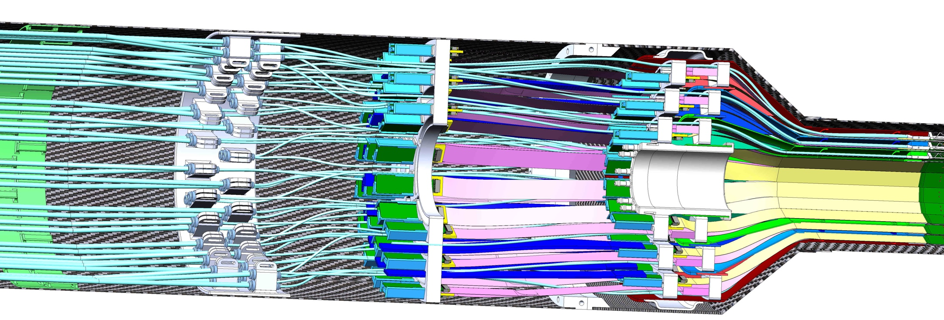
MVTX Stave Cooling Tube Replacement Discussion (02/04/2020)
- The pre-built stave cooling tubes are 5~10cm short to fit the current MVTX service support design.
We propose to replace all the cooling tubing with 70cm ones (currently ~55cm)
CERN requests EU$10K to replace 90 , 16 working days, LANL will work with CERN for the work
55cm tubes
(from ITS/IB design)
MVTX Stave produced at CERN, on a transport plate
Proposed 70cm tubes
for MVTX

Slide 7
Cooling pipes replacement @CERN -from Antonello
Material ordered, will be delivered next week
Established procedure
Unfortunately, it will not be possible to replace the pipes in 5 already assembled staves
Still good for MVTX detector assembly
Could also be used for 8-stave telescope this year
Provide feedback on feasibility and timing asap

Slide 8
Summary of bond pull force test
Test 20 bonds/chip out of ~ 180
Acceptance threshold on min force: 6 gr
13/02/2020

