Slide 1
Update on production status and plans
Antonello Di Mauro
CERN, 14/05/2020

Slide 2
FPC status
Batch # / name | status | comments
1: A2, B2, C2, D2 | completed | D2 NOK, C2 used for IB spares, A2: used, B2: used
2: E2, F2, G2, H2 | E2, F2, G2, H2 completed | F2: 3 used (F203 damaged); G2: 2 used, E2: 3 used (E203 damaged), H2: 4 used (H201 has scratches in Al)
3: I2, J2, K2, L2 | Final processing | I2: 6 ready; J2 @ metrology; K2 @ SMD; L2 in preparation for SMD.
4: M2, N2, O2, P2 | Ready for Al PVD | Previous batch with same ID rejected (too high resistivity R2~ 13 mΩ instead of 9-10, supplier mistake: used wrong Al source) . To be shipped to HEF
5: Q2, R2, S2, T2 | Ready for Al PVD | To be shipped to HEF
6: U2, V2, W2, X2 | Ready for Al PVD | To be shipped to HEF
F205, F206, G201, G204, G205, G206: available but kept as spare due to irregularities on pull test results, investigation to be completed
E205, E206, H205, I201, I202, I203, I205, I205, I206: available (covering 3 weeks)
Other 18 FPCs (J2, K2, L2) in last steps of processing, available in 1 to 4 weeks
After issue on batch 4, Al coating was performed with positive outcome (R2 = 9.5 mΩ)

Slide 3
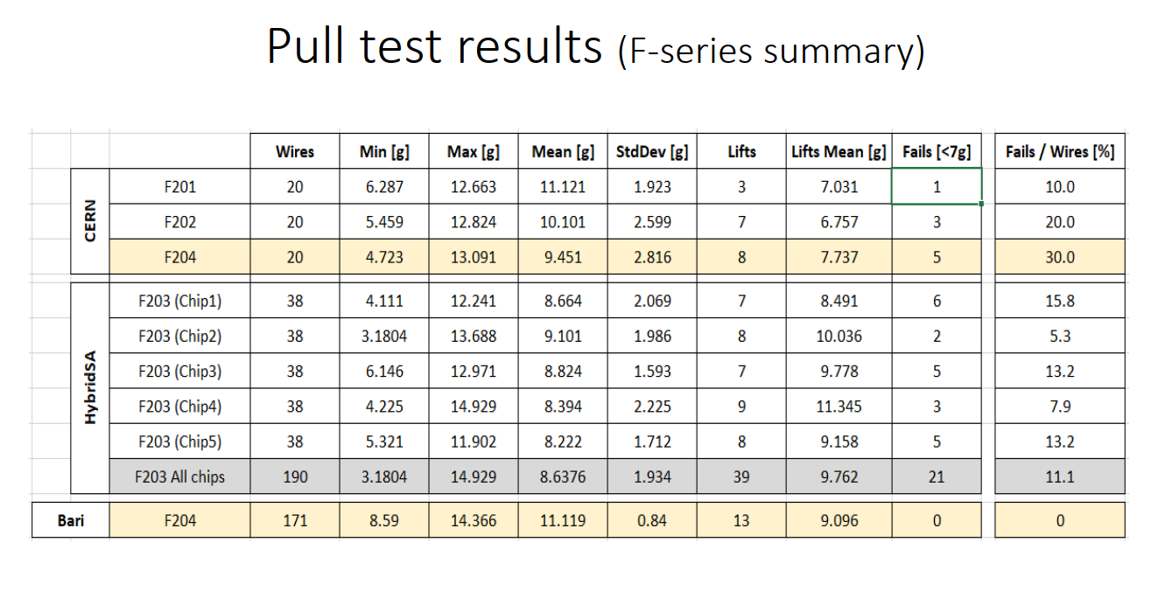
HIC discarded if min. force < 5 g
M. Poblocki

Slide 4
IBSTAVE IDc | HIC assembly | Insp. after glue | Bonding | Insp. after bonding | HIC PWR test | Qualif. test | HIC+SF -> Stave | Stave PWR test | Stave test | Stave test (with long PWR extn.) | Final test (with PT100 and metrology)
TOTAL | 24 | 23 | 20 | 20 | 20 | 18 | 5 | 5 | 5 | 3 | 3
A201 | 1 | 1 | 1 | 1 | 1 | 1 | 1 | 1 | 1 | 1 | 1
A202* | 1 | Damag. | chip
A203 | 1 | 1 | 1 | 1 | 1 | 1 | 1 | 1 | 1 | 1 | 1
A204 | 1 | 1 | 1 | 1 | 1 | 1 | 1 | 1 | 1 | 1 | 1
A205 | 1 | 1 | 1 | 1 | 1 | 1 | 1 | 1 | 1
A206 | 1 | 1 | 1 | 1 | 1 | 1 | 1 | 1 | 1
B201 | 1 | 1 | 1 | 1 | 1 | 1
B202* | 1 | 1 | 1 | 1 | 1 | * | Damag. chip
B203 | 1 | 1 | 1 | 1 | 1 | 1
B204 | 1 | 1 | 1 | 1 | 1 | 1
B205 | 1 | 1 | 1 | 1 | 1 | 1
B206 | 1 | 1 | 1 | 1 | 1 | 1
F201* | 1 | 1 | 1 | 1 | 1 | * | Damag. chip
F202 | 1 | 1 | 1 | 1 | 1 | 1
F204 | 1 | 1 | 1 | 1 | 1 | 1
G202 | 1 | 1 | 1 | 1 | 1 | 1
G203 | 1 | 1 | 1 | 1 | 1 | 1
F203 | dummy
H202 | 1 | 1 | 1 | 1 | 1 | 1
H203 | 1 | 1 | 1 | 1 | 1 | 1
H204 | 1 | 1 | 1 | 1 | 1 | 1
H206 | 1 | 1 | 1 | 1 | 1 | 1
E204 | 1 | 1
E201 | 1 | 1
E202 | 1 | 1
STAVE status
3 STAVEs ready for shipment
2 STAVEs ready for final tests
12 HICs are ready to be glued on STAVEs
3 HICs have to be bonded
Potentially 20/84 done
R. Nath Patra

Slide 5
Plans
DSF not accessible yet, clean room guidelines have been distributed by HSE unit, implementation might take 1-2 weeks. Probable restart date: June 2 (June 1 is bank holiday)
29 wk until the end of 2020, 64 modules to be produced with 80% yield -> 80 modules , i.e. 2.75 / wk , completion by Jan/Feb 2021 seems at reach

