Slide 1
MVTX Status
Yasser Corrales Morales for the MVTX Group
LANL
1/10/2020
sPHENIX General Meeting

Slide 2
Outline
MVTX Project Status
MVTX geometry and simulation update
Readout R&D highlights

Slide 3
Budget Distribution
BNL has opened MVTX budget account
  MVTX PMP has been approved and signed by BNL
  Detailed budget for each institution done, 12/3/2019
    Plan presented in July 2019 MVTX review
Paperwork submitted to BNL for fund transfer
  SOW, detailed budget sheet and cover letter from each institute
  LANL, LBNL, MIT, UT-A

Slide 4
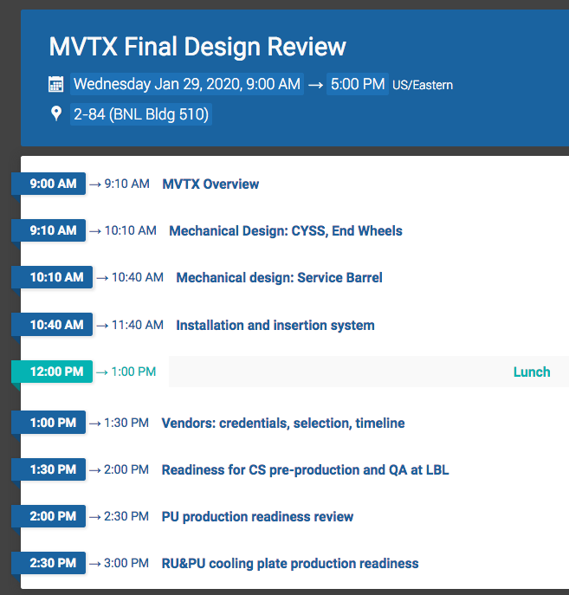
One-day MVTX Final Design Review Scheduled 1/29/2020 @BNL
Final review charge available later today
  Focus on the mechanical design readiness for carbon structure production
    Design
    Pre-production
    Vendor selection
  Also production readiness
    Power Units(PU)
    Electronics RU and PU cooling plates
Draft agenda page: https://indico.bnl.gov/event/7165/

Slide 5
Stave Production at CERN
In good progress, on schedule
  ~10 HICs/month, used up all good chips in December
  3 wafers delivered in mid December, 45 chips available now, expect 10 more
  Next chips delivery expected in late Janaury, 8 wafers, ie, ~120 gold chips, good for 13 weeks of assembly, last wafers by April 2020
  23 FPCs available for assembly
Plan
  Resume HIC production in week 2 of 2020
  Bond 4 HICs as soon as the bond lab available in January
  1st set of 10~12 staves ready for shipping to LBNL in mid Feb.
Bi-weekly meeting with CERN
  Last meeting, 12/19/2020
  Next one, 1/16/2020
A sPHENIX Stave mounted on the Transport Plate at CERN

Slide 6
HICs/Stave Production Status and Plan (Cont.)
Assembled HICs | HICs to be bonded | HICs NOK | HICs to be glued | STAVES OK | STAVES NOK
10 A201, A202, A203, A204, A205, A206, B201, B202, B203, B204 | 4 B201, B202, B203, B204 | 1 A202: broken chip due to glue seepage | 1 A206 | 4 A201(GOLD/OK), A203(GOLD/OK), A204(GOLD/CAN), A205(GOLD/CAN) | 0
Continue HIC production to create a stock of 10-12 modules in December, to be bonded later in 1/2020
LBNL obtained approval from ALICE/ITS to continue to use the same ALICE stave/HIC MOSAIC test stand for sPHENIX work

Slide 7
MVTX Geometry and Simulation Update
New stave GDML file (mvtx_stave_v1.gdml) is available, which matches ALPIDE chip description and dimensions from ALICE implementation in its geometry software:
  Fixes on the active matrix size and position in the chip -> Gives a accurate study of MVTX phi coverage with new layers configuration.
Implementation of latest configuration for MVTX layers (next slides)
  Change layer radius and stave tilt to improve stave overlaps on phi.
  Add a phi rotation offset for first stave_0 -> to match real geometry
Fixes some bugs in
  Fix pixel sizes -> right number of pixels (512 x 1024) per chip
  Fix a bug in function to get pixel number from local sensor coordinates.
None of the modifications have been committed yet. Waiting for a broad discussion inside MVTX group.

Slide 8
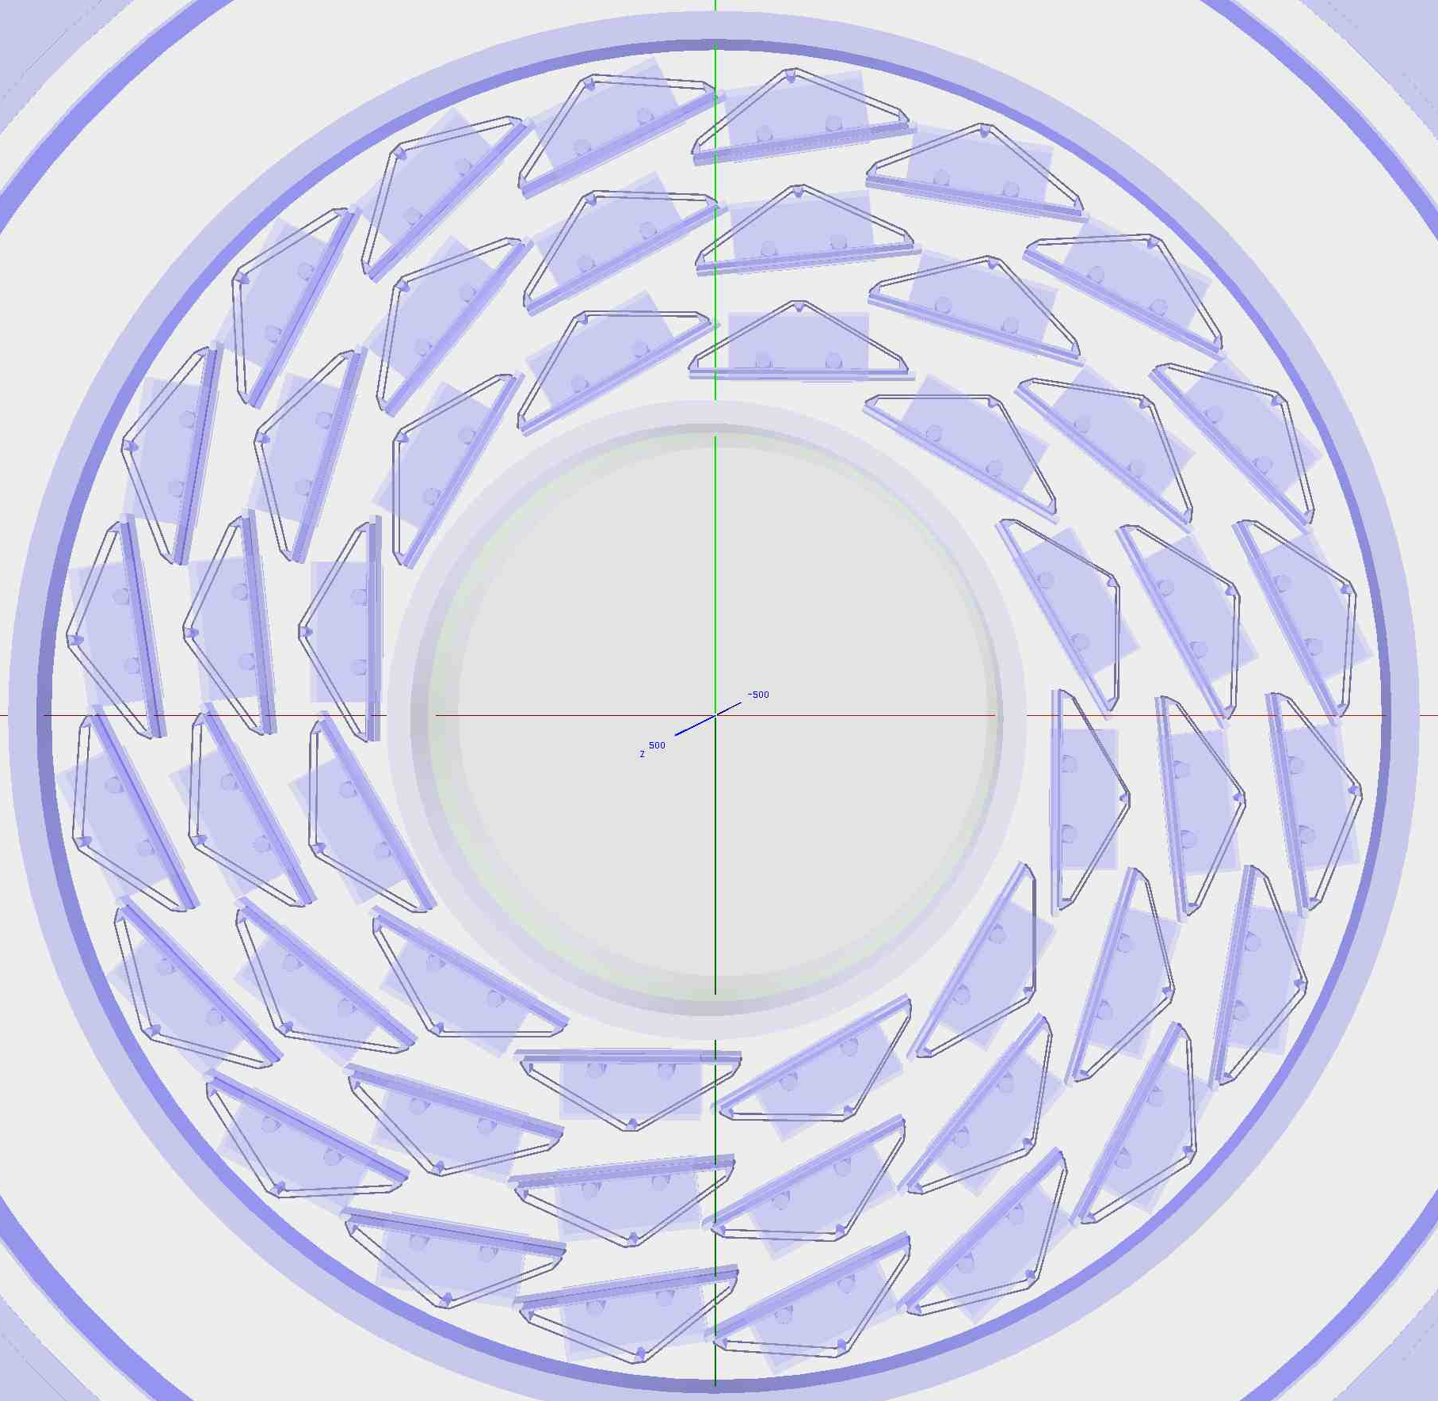
MVTX Geometry and Simulation Update (cont.)
MVTX geom in Geant4 (nose view)
MVTX assembly drawing
Current
New

Slide 9
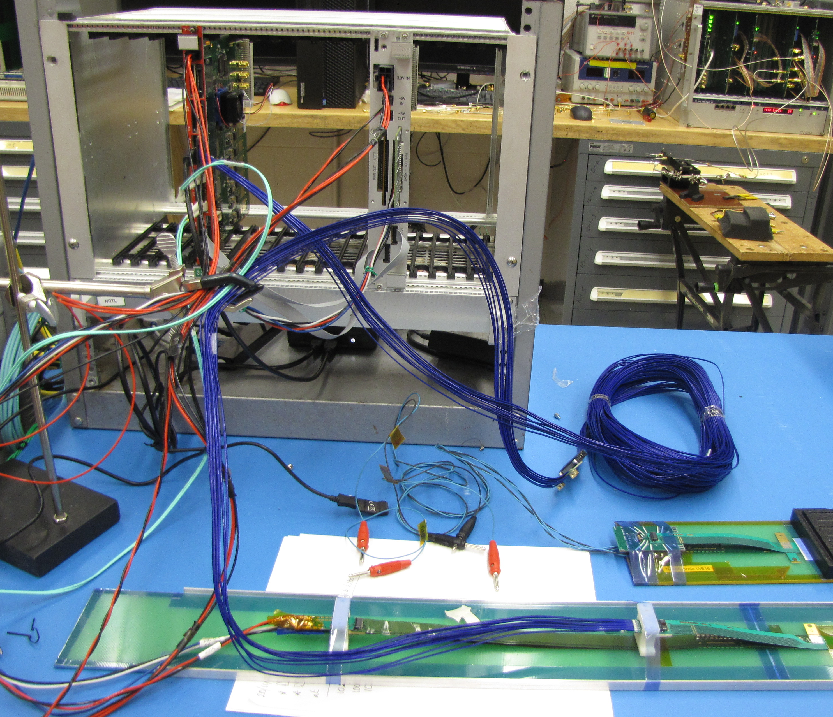
MVTX Readout R&D Highlights
10 production version Readout Units (v2) delivered to LANL in the Fall (LANL R&D order, not sPHENIX order)
  All boards successfully tested at UT-Austin (October ‘19)
  Moving from RUv1 firmware to RUv2 firmware, successful local communication with RUv2 and staves (December ‘19 to present)
  Working on firmware update to allow communication with back-end FELIX (December ‘19 to present)
11m data cables designed for sPHENIX have been delivered and successfully tested at LANL. (December ‘19)
  More cables have been ordered (January ‘20)
Power cables prototypes have been delivered to LANL (December ‘19)
  Allows us to power up to 8 RUs with realistic cable length and a patch panel rail for test beam
  1 extra cable has same PP connector from ALICE
RUv2
Power Unit
sPHENIX Data Cable

