Slide 1
MVTX Status and Plan
Camelia, Grazyna and Ming
12/18/2020
MVTX bi-Weekly Meeting

Slide 2
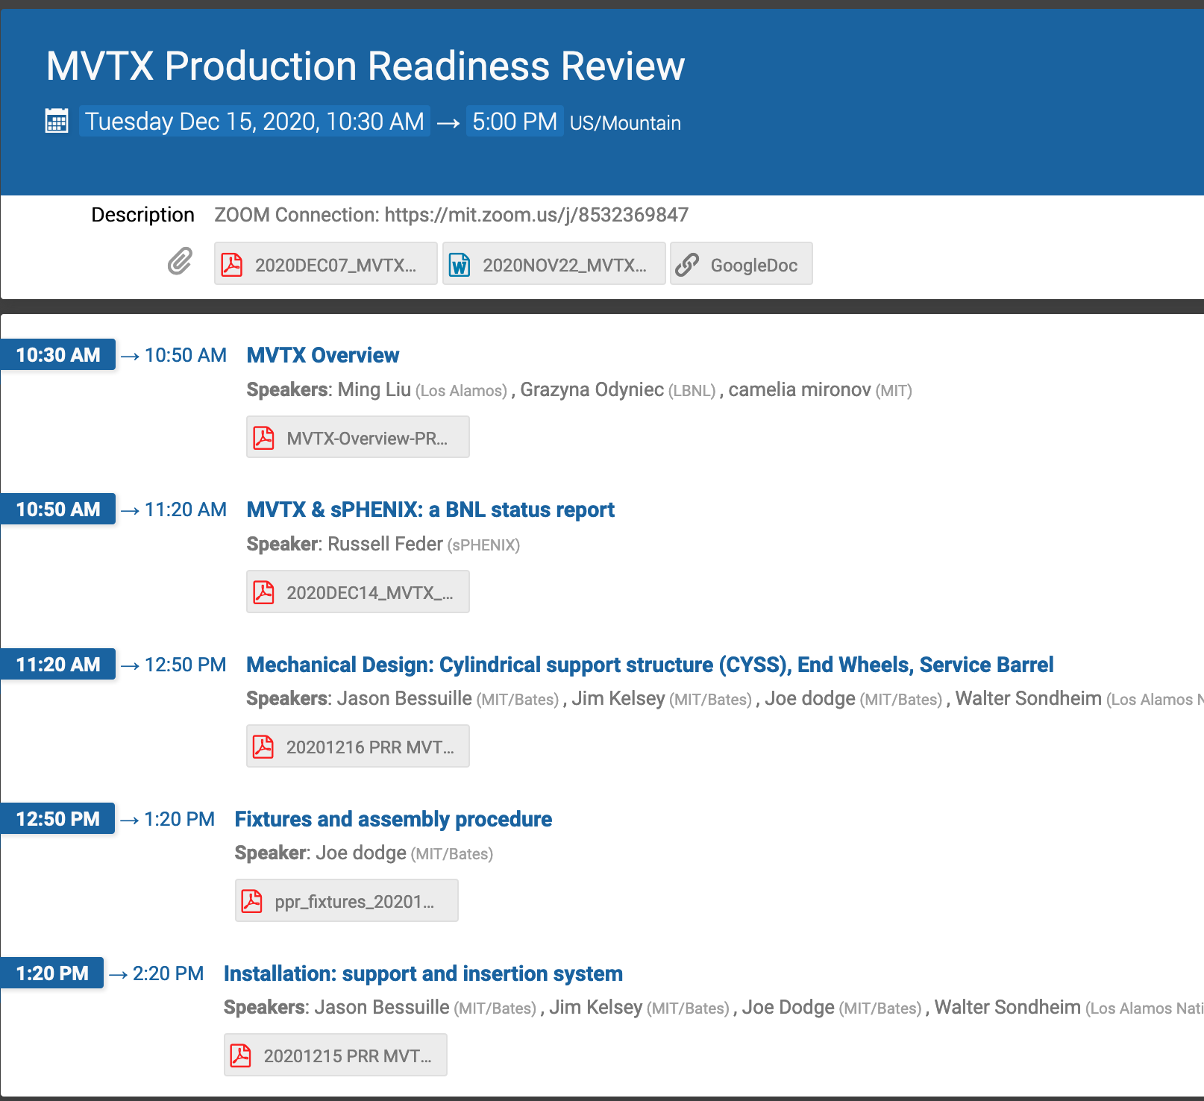
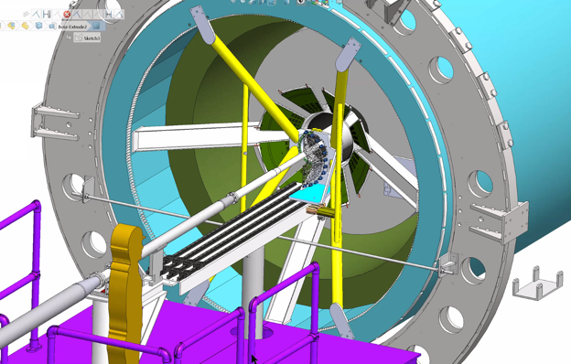
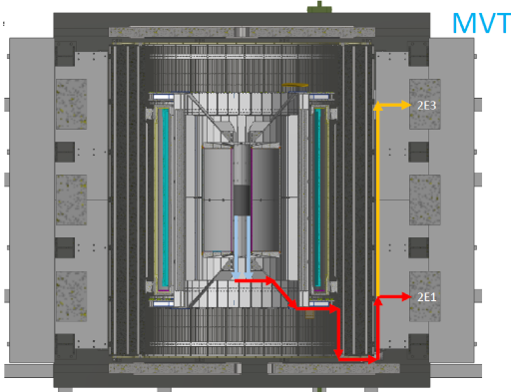
Project Status
Mechanical system
  MVTX PRR 12/15/2020, went very well - draft report soon
  Next:
    Insertion system and mockup, in progress
    Start CFC production
Electrical system integration
  RU testing at ORNL, 1st round completed, debugging in progress
  AMD server setup making good progress at LANL
  Excellent progress with Slow Control – LLA , MIT
  mGTM in progress @BNL, meeting next week w/ BNL engineers?
Stave production and transportation
  45+ gold staves at CERN
  4 staves (3 Gold + 1 Silver) under test at LBNL
FY21 budget/schedule
  ORNL’s budget received at ORNL
  Updated budget/schedule submitted to BNL
  P6 procurements – MVTX related (WBS 2.X)
    MVTX Supports – M&S, 4/21 – 6/18, 2021, $50K
    MVTX integration/installation tooling/fixtures – M&S, 12/30/2020 – 3/29/2021, $30K
MDC and physics study
  Next ~3 months
MVTX insertion system

Slide 3

48 Gold Staves Produced!
(One full MVTX detector)

Slide 4
0 | STAVE-production summary table
IBSTAVE ID | HIC assembly | HIC assembly date | Ins. after glue | Bonding | Pull test (>=2 lifts + F <7g) | Ins. after bonding | HIC PWR test | Qualification test | Threshold cluster | HIC Matrix | HIC DTU | HIC DTU (new) | HIC+SF+C -> Stave | Stave PWR test | Stave test | STAVE test date | STAVE metrology | Stave PWR test (long PWR extn.) | STAVE final test (PT100) | Final STAVE Matrix | Final STAVE DTU | STAVE Deliverd
TOTAL | 76 |  | 76 | 75 |  | 75 | 74 | 59 |  |  |  |  | 54 | 54 | 51 |  | 49 | 49 | 49 |  |  | 4
A201 (326) | 1 | 03/10/2019 | 1 | 1 | 1 | 1 | 1 | 1 | 1 | GOLD | OK | OK | 1 | 1 | 1 | 01/11/2019 | 1 | 1 | 1 | GOLD | OK | 1
A202* | 1 | 07/10/2019 | 1 | 1 | 0 | 1 | 1 | 0 | ?? | PARTIAL | OK | OK
A203 (144) | 1 | 08/10/2019 | 1 | 1 | 0 | 1 | 1 | 1 | 0 | GOLD | OK | OK | 1 | 1 | 1 | 04/11/2019 | 1 | 1 | 1 | GOLD | OK | 1
A204 (158) | 1 | 22/10/2019 | 1 | 1 | 1 | 1 | 1 | 1 | 0 | GOLD | OK | OK | 1 | 1 | 1 | 07/11/2019 | 1 | 1 | 1 | GOLD | OK | 1
A205 (167) | 1 | 23/10/2019 | 1 | 1 | 4 | 1 | 1 | 1 | 0 | GOLD | CAN | OK | 1 | 1 | 1 | 08/11/2019 | 1 | 1 | 1 | GOLD | OK
A206 (204) | 1 | 30/10/2019 | 1 | 1 | 3 | 1 | 1 | 1 | 2 | GOLD | CAN | CAN | 1 | 1 | 1 | 24/01/2020 | 1 | 1 | 1 | GOLD | CAN
B201 (352) | 1 | 30/10/2019 | 1 | 1 | 0 | 1 | 1 | 1 | 0 | GOLD | CAN | CAN | 1 | 1 | 1 | 28/05/2020 | 1 | 1 | 1 | GOLD | OK
B202* | 1 | 31/10/2019 | 1 | 1 | 0 | 1 | 1 | 0 |  | Broken
B203 (114) | 1 | 07/11/2019 | 1 | 1 | 1 | 1 | 1 | 1 | 0 | GOLD | CAN | CAN | 1 | 1 | 1 | 29/05/2020 | 1 | 1 | 1 | GOLD | CAN
B204 (116) | 1 | 13/11/2019 | 1 | 1 | 0 | 1 | 1 | 1 | 1 | SILVER | CAN | CAN | 1 | 1 | 1 | 28/05/2020 | 1 | 1 | 1 | SILVER | CAN | 1
B205 (115) | 1 | 14/01/2020 | 1 | 1 | 2 | 1 | 1 | 1 | 0 | GOLD | CAN | CAN | 1 | 1 | 1 | 02/06/2020 | 1 | 1 | 1 | GOLD | OK
B206 (295) | 1 | 15/01/2020 | 1 | 1 | 2 | 1 | 1 | 1 | 0 | GOLD | CAN | OK | 1 | 1 | 1 | 02/06/2020 | 1 | 1 | 1 | GOLD | OK
F201* | 1 | 27/02/2020 | 1 | 1 | 1 | 1 | 1 | 0 | ?? | PARTIAL | OK | OK
F202 (230) | 1 | 28/02/2020 | 1 | 1 | 3 | 1 | 1 | 1 | 0 | GOLD | CAN | OK | 1 | 1 | 1 | 04/06/2020 | 1 | 1 | 1 | GOLD | CAN
F204 | 1 | 29/02/2020 | 1 | 1 | 5 | 1 | 1 | 1 | 2 | GOLD | CAN | OK
G202 (234) | 1 | 10/02/2020 | 1 | 1 | 0 | 1 | 1 | 1 | 1 | GOLD | OK | OK | 1 | 1 | 1 | 04/06/2020 | 1 | 1 | 1 | GOLD | OK
G203 | 1 | 12/02/2020 | 1 | 1 | 1 | 1 | 1 | 1 | 1 | GOLD | CAN | CAN
F203* | dummy
H202 (294) | 1 | 24/02/2020 | 1 | 1 | 0 | 1 | 1 | 1 | 0 | GOLD | OK | OK | 1 | 1 | 1 | 05/06/2020 | 1 | 1 | 1 | GOLD | OK
H203 (302) | 1 | 26/02/2020 | 1 | 1 | 0 | 1 | 1 | 1 | 0 | GOLD | OK | OK | 1 | 1 | 1 | 05/06/2020 | 1 | 1 | 1 | GOLD | OK
H204 (354) | 1 | 27/02/2020 | 1 | 1 | 0 | 1 | 1 | 1 | 0 | GOLD | OK | OK | 1 | 1 | 1 | 11/06/2020 | 1 | 1 | 1 | GOLD | OK
H206* | 1 | 04/03/2020 | 1 | 1 | 0 | 1 | 1 | 0 | ?? | PARTIAL | OK | OK
E204 (110) | 1 | 05/03/2020 | 1 | 1 | 0 | 1 | 1 | 1 | 1 | GOLD | CAN | CAN | 1 | 1 | 1 | 22/06/2020 | 1 | 1 | 1 | GOLD | CAN
E201* | 1 | 12/02/2020 | 1 | 1 | 0 | 1 | 1 | 0 | 3 | PARTIAL | CAN | OK
E202 | 1 | 10/03/2020 | 1 | 1 | 1 | 1 | 1 | 1 | 1 | GOLD | CAN (bad driver) | CAN (bad driver)
E206 (101) | 1 | 12/03/2020 | 1 | 1 | 0 | 1 | 1 | 1 | 1 | GOLD | OK | OK | 1 | 1 | 1 | 16/06/2020 | 1 | 1 | 1 | GOLD | OK
H205 | 1 | 11/06/2020 | 1 | 1 | 0 | 1 | 1 | 0 | 1 | SILVER | OK | OK
I202 (175) | 1 | 15/06/2020 | 1 | 1 | 0 | 1 | 1 | 1 | 0 | GOLD | OK | OK | 1 | 1 | 1 | 22/06/2020 | 1 | 1 | 1 | GOLD | OK
I203 (187) | 1 | 16/06/2020 | 1 | 1 | 0 | 1 | 1 | 1 | 0 | GOLD | OK | OK | 1 | 1 | 1 | 26/06/2020 | 1 | 1 | 1 | GOLD | OK
I204* | 1 | 17/06/2020 | 1 | 1 | 0 | 1 | 1 | 0 | 0 | PARTIAL | OK | OK
I205 (266) | 1 | 22/06/2020 | 1 | 1 | 0 | 1 | 1 | 1 | 0 | GOLD | OK | OK | 1 | 1 | 1 | 26/06/2020 | 1 | 1 | 1 | GOLD | OK
J201* | 1 | 23/06/2020 | 1 | 1 | 0 | 1 | 1 | 0 | ?? | PARTIAL | OK | OK
J202 (207) | 1 | 24/06/2020 | 1 | 1 | 0 | 1 | 1 | 1 | 0 | GOLD | CAN | OK | 1 | 1 | 1 | 16/07/2020 | 1 | 1 | 1 | GOLD | CAN
J203 (245) 345 right | 1 | 29/06/2020 | 1 | 1 | 0 | 1 | 1 | 1 | 0 | GOLD | CAN | CAN | 1 | 1 | 1 | 17/07/2020 | 1 | 1 | 1 | GOLD | CAN
J204 (252) | 1 | 30/06/2020 | 1 | 1 | 0 | 1 | 1 | 1 | 0 | GOLD | OK | OK | 1 | 1 | 1 | 03/07/2020 | 1 | 1 | 1 | GOLD | OK
J206 (260) | 1 | 01/07/2020 | 1 | 1 | 0 | 1 | 1 | 1 | 0 | GOLD | OK | OK | 1 | 1 | 1 | 03/07/2020 | 1 | 1 | 1 | GOLD | OK
K202 (122) | 1 | 07/07/2020 | 1 | 1 | 0 | 1 | 1 | 1 | 1 | GOLD | OK | OK | 1 | 1 | 1 | 18/08/2020 | 1 | 1 | 1 | GOLD | OK
K203 (125) | 1 | 08/07/2020 | 1 | 1 | 0 | 1 | 1 | 1 | 0 | GOLD | OK | OK | 1 | 1 | 1 | 18/08/2020 | 1 | 1 | 1 | GOLD | OK
K204 (129) | 1 | 09/07/2020 | 1 | 1 | 0 | 1 | 1 | 1 | 0 | GOLD | CAN | OK | 1 | 1 | 1 | 04/09/2020 | 1 | 1 | 1 | GOLD | OK
K205 (128) | 1 | 13/07/2020 | 1 | 1 | 0 | 1 | 1 | 1 | 1 | GOLD | CAN | CAN | 1 | 1 | 1 | 04/09/2020 | 1 | 1 | 1 | GOLD | CAN
K206 (347) | 1 | 14/07/2020 | 1 | 1 | 0 | 1 | 1 | 1 | 0 | GOLD | OK | OK | 1 | 1 | 1 | 28/09/2020 | 1 | 1 | 1 | GOLD | OK
Report from Stave Production Meeting, 12/17/2020
11 new STAVEs are ready with final Test.
45 STAVES are ready to deliver.
4 STAVEs are delivered.
* Partial/Not functioning

Slide 5
 | STAVE-production summary table
IBSTAVE ID | HIC assembly | HIC assembly date | Ins. after glue | Bonding | Pull test (>=2 lifts + F <7g) | Ins. after bonding | HIC PWR test | Qualification test | Threshold cluster | HIC Matrix | HIC DTU | HIC DTU (new) | HIC+SF+C -> Stave | Stave PWR test | Stave test | STAVE test date | STAVE metrology | Stave PWR test (long PWR extn.) | STAVE final test (PT100) | Final STAVE Matrix | Final STAVE DTU | STAVE Deliverd
L202 (130) | 1 | 23/07/2020 | 1 | 1 | 0 | 1 | 1 | 1 | 0 | GOLD | CAN | OK | 1 | 1 | 1 | 08/09/2020 | 1 | 1 | 1 | GOLD | CAN
L203 (139) | 1 | 24/07/2020 | 1 | 1 | 0 | 1 | 1 | 1 | 0 | GOLD | CAN | CAN | 1 | 1 | 1 | 08/09/2020 | 1 | 1 | 1 | GOLD | CAN
L204 (127) | 1 | 27/07/2020 | 1 | 1 | 0 | 1 | 1 | 1 | 0 | GOLD | CAN | CAN | 1 | 1 | 1 | 14/09/2020 | 1 | 1 | 1 | GOLD | CAN
L205 (136) | 1 | 28/07/2020 | 1 | 1 | 0 | 1 | 1 | 1 | 0 | GOLD | OK | OK | 1 | 1 | 1 | 14/09/2020 | 1 | 1 | 1 | GOLD | OK
J205* | 1 | 05/08/2020 | 1 | 1 | 0 | 1 | 1 | 0 | ?? | PARTIAL | CAN | CAN
I201* | 1 | 06/08/2020 | 1 | 1 | 0 | 1 | 1 | 0 | 0 | PARTIAL | OK | OK
L206* | 1 | 13/08/2020 | 1 | 0
L201 (169) | 1 | 14/08/2020 | 1 | 1 | 0 | 1 | 1 | 1 | 1 | GOLD | CAN | CAN | 1 | 1 | 1 | 30/09/2020 | 1 | 1 | 1 | GOLD | CAN
S201 (359) | 1 | 03/09/2020 | 1 | 1 | 0 | 1 | 1 | 1 | 0 | GOLD | CAN | OK | 1 | 1 | 1 | 30/09/2020 | 1 | 1 | 1 | GOLD | OK
S202 | 1 | 04/09/2020 | 1 | 1 | 0 | 1 | 1 | 0 | 0 | SILVER | CAN | CAN
S203 (235) | 1 | 08/09/2020 | 1 | 1 | 0 | 1 | 1 | 1 | 0 | GOLD | CAN | CAN | 1 | 1 | 1 | 16/11/2020 | 1 | 1 | 1 | GOLD | OK
S204 (237) | 1 | 15/09/2020 | 1 | 1 | 0 | 1 | 1 | 1 | 1 | GOLD | CAN | CAN | 1 | 1 | 1 | 30/09/2020 | 1 | 1 | 1 | GOLD | CAN
S205 (142) | 1 | 16/09/2020 | 1 | 1 | 0 | 1 | 1 | 1 | 0 | GOLD | CAN | CAN | 1 | 1 | 1 | 01/10/2020 | 1 | 1 | 1 | GOLD | CAN
S206 (98) | 1 | 17/09/2020 | 1 | 1 | 0 | 1 | 1 | 1 | 1 | GOLD | OK | OK | 1 | 1 | 1 | 02/10/2020 | 1 | 1 | 1 | GOLD | OK
T201 (277) | 1 | 04/11/2020 | 1 | 1 | 0 | 1 | 1 | 1 | 1 | GOLD | CAN | CAN | 1 | 1 | 1 | 17/11/2020 | 1 | 1 | 1 | GOLD | CAN
T202 (279) | 1 | 06/11/2020 | 1 | 1 | 0 | 1 | 1 | 1 | 2 | GOLD | CAN | CAN | 1 | 1 | 1 | 19/11/2020 | 1 | 1 | 1 | GOLD | CAN
T203 | 1 | 09/11/2020 | 1 | 1 | 0 | 1 | 1
U201 (291) | 1 | 10/11/2020 | 1 | 1 | 0 | 1 | 1 | 1 | 2 | SILVER | CAN | CAN | 1 | 1 | 1 | 24/11/2020 | 1 | 1 | 1 | GOLD | CAN
U202 (238) | 1 | 11/11/2020 | 1 | 1 | 0 | 1 | 1 | 1 | 1 | GOLD | CAN | CAN | 1 | 1 | 1 | 26/11/2020 | 1 | 1 | 1 | GOLD | CAN
U203 (126) | 1 | 12/11/2020 | 1 | 1 | 0 | 1 | 1 | 1 | 0 | GOLD | CAN | CAN | 1 | 1 | 1 | 20/11/2020 | 1 | 1 | 1 | GOLD | CAN
U204* | 1 | 13/11/2020 | 1 | 1 | 0 | 1 | 1 | 0 | 0 | PARTIAL | OK | OK
U205 (89) | 1 | 16/11/2020 | 1 | 1 | 0 | 1 | 1 | 1 | 1 | GOLD | OK | OK | 1 | 1 | 1 | 27/11/2020 | 1 | 1 | 1 | GOLD | OK
U206 (111) | 1 | 17/11/2020 | 1 | 1 | 0 | 1 | 1 | 1 | 0 | GOLD | CAN | CAN | 1 | 1 | 1 | 25/11/2020 | 1 | 1 | 1 | GOLD | CAN
Q201 (155) | 1 | 18/11/2020 | 1 | 1 | 0 | 1 | 1 | 1 | 0 | SILVER | CAN | CAN | 1 | 1 | 1 | 27/11/2020 | 1 | 1 | 1 | GOLD | CAN
Q202 | 1 | 19/11/2020 | 1 | 1 | 0 | 1 | 1 | 1 | 0 | GOLD | CAN | OK | 1 | 1 | 1 | 03/12/2020 | 1 | 1 | 1 | GOLD | CAN
T204 | 1 | 23/11/2020 | 1 | 1 | 0 | 1 | 1 | 1 | 0 | GOLD | CAN | CAN | 1 | 1 | 1 | 03/12/2020 | 1 | 1 | 1 | GOLD | CAN
T205 | 1 | 24/11/2020 | 1 | 1 | 0 | 1 | 1 | 1 | 1 | GOLD | OK | OK | 1 | 1 | 1 | 03/12/2020
T206 | 1 | 25/11/2020 | 1 | 1 | 0 | 1 | 1 | 1 | 1 | GOLD | CAN | CAN
R201 | 1 | 27/11/2020 | 1 | 1 | 8 | 1 | 1 | 1 | 1 | GOLD | CAN | CAN | 1 | 1 | 1 | 08/12/2020
R202 | 1 | 30/11/2020 | 1 | 1 | 1 | 1 | 1 | 1 | 0 | GOLD | CAN | CAN | 1 | 1
W201 | 1 | 01/12/2020 | 1 | 1 | 0 | 1 | 1 | 1 | 0 | GOLD | OK | OK | ?? data line broken
W202* | 1 | 02/12/2020 | 1 | 1 | 0 | 1 | 1 | 0 | ?? | PARIAL | CAN | CAN
W203 | 1 | 03/12/2020 | 1 | 1 | 0 | 1 | 1 | 1 | 0 | SILVER | CAN | CAN | 1 | 1
W204 | 1 | 07/12/2020 | 1 | 1 | 0 | 1 | 1 | 1 | 3 | GOLD | OK | OK | 1 | 1
W205 | 1 | 08/12/2020 | 1 | 1 | 0 | 1 | 1
W206 | 1 | 09/12/2020 | 1 | 1 | 0 | 1 | ?? Digi short

Slide 6
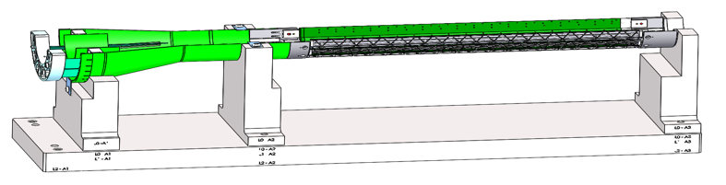
Near Term To Do’s
Reviews
  sPHENIX MVTX/INTT/BP integration Review: ~Jan/Feb 2021
    Finish MVTX and insertion system mockup
    Full production of X-wing supporting structures
  Power cables safety review, early 2021?
Stave shipping, QA and half-detector assembly
  45+ available at CERN
  To be ready for half-detector assembly ~May 2021
Readout & control system integration
  Continuous readout mode
    synchronization across subsystems, new data format?
  mGTM development
    40MHz system clock for MVTX
  Slow control and monitoring
  To be ready for half-detector commissioning ~summer 2021
Half-detector assembly & test @LBNL
May – December, 2021

Slide 7
backup

Slide 8
Upcoming Challenges
Pre-COVID19 Schedule
Mechanical support structures
  CF production and QA
    1st test article, Layer-0 EW CMM etc.
    CF FDR: Dec. 15, 2020
  CF full production starts ~ Jan. 2021
    1st half CF(EW+CYSS+SB) available in ~March 2021
    2nd half CF available in April
  Insertion system design & mockup
    System integration review: ~Jan 2021
Stave production and transportation
  Shipping and QA, to be ready for assembly in time
Half-detector assembly at LBNL
  CF and stave test fitting ~March 2021
  Half-detector assembly review, ~May 2021
  Complete the 2nd Half-detector by 12/2021
Power, readout and controls
  Ready for half-detector full readout and control test at LBNL, ~summer 2021
Tight schedule to meet the installation dates
Today
Assembly review

Slide 9
