Slide 1
MVTX Status and Plan
Camelia, Grazyna and Ming
12/04/2020
MVTX bi-Weekly Meeting

Slide 2
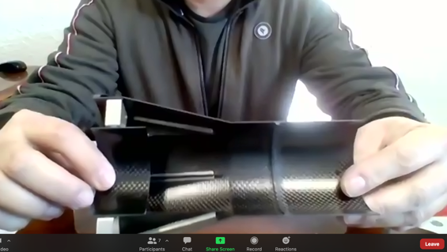
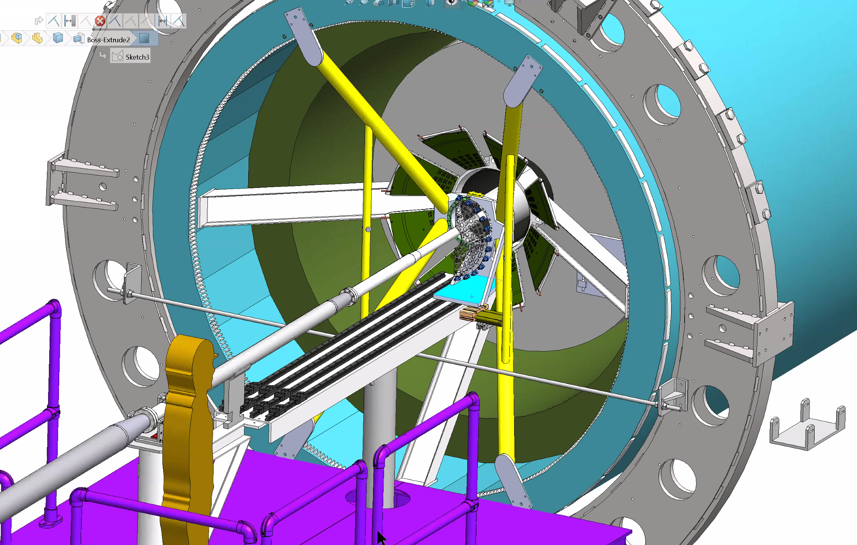
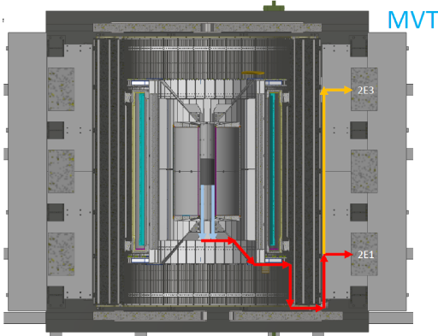
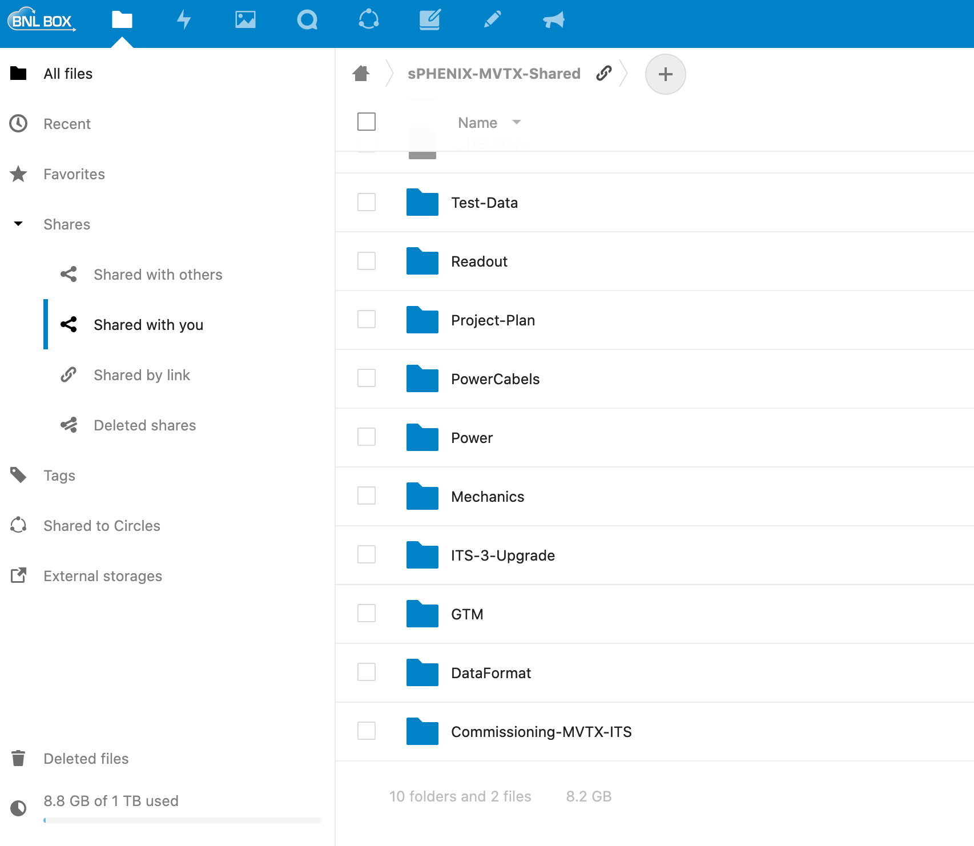
Project Status
Mechanical system
  1st test article arrived at MIT on Thursday 12/3!
  Insertion system design and mockup in progress
  Assembly fixtures designed
  Beam-pipe and MVTX detector mockups delivered to Bates
Electrical system integration
  RU testing in progress at ORNL, 60+% completed
  AMD server good progress at LANL
  Slow control in progress, MIT
  mGTM development in progress, meeting next week w/ BNL
  Power system and cable routing, next presentation
Stave production and transportation
  40+ gold staves at CERN
  4 staves (3 Gold + 1 Silver) arrived at LBNL safely
  In preparation for testing
FY21 budget/scheduled updated
  ORNL’s budget being processed at BNL
  Updated budget/schedule submitted to BNL
MDC and physics study
  Next ~3+ months
ITS commissioning remote shifts
  A few openings available
End Wheel: L0
@WorkShape
Cable routing
“sPHENIX-MVTX-Shared” @BNLBox
1TB Disk space approved!

Slide 3
 | STAVE-production summary table
IBSTAVE ID | HIC assembly | HIC assembly date | Ins. after glue | Bonding | Pull test (>=2 lifts + F <7g) | Ins. after bonding | HIC PWR test | Qualification test | Threshold cluster | HIC Matrix | HIC DTU | HIC DTU (new) | HIC+SF+C -> Stave | Stave PWR test | Stave test | STAVE test date | STAVE metrology | Stave PWR test (long PWR extn.) | STAVE final test (PT100) | Final STAVE Matrix | Final STAVE DTU | STAVE Deliverd
TOTAL | 68 |  | 68 | 65 |  | 65 | 65 | 51 |  |  |  |  | 46 | 44 | 44 |  | 38 | 38 | 38 |  |  | 4
A201 (326) | 1 | 03/10/2019 | 1 | 1 | 1 | 1 | 1 | 1 | 1 | GOLD | OK | OK | 1 | 1 | 1 | 01/11/2019 | 1 | 1 | 1 | GOLD | OK | 1
A202* | 1 | 07/10/2019 | 1 | 1 | 0 | 1 | 1 | 0 | ?? | PARTIAL | OK | OK
A203 (144) | 1 | 08/10/2019 | 1 | 1 | 0 | 1 | 1 | 1 | 0 | GOLD | OK | OK | 1 | 1 | 1 | 04/11/2019 | 1 | 1 | 1 | GOLD | OK | 1
A204 (158) | 1 | 22/10/2019 | 1 | 1 | 1 | 1 | 1 | 1 | 0 | GOLD | OK | OK | 1 | 1 | 1 | 07/11/2019 | 1 | 1 | 1 | GOLD | OK | 1
A205 (167) | 1 | 23/10/2019 | 1 | 1 | 4 | 1 | 1 | 1 | 0 | GOLD | CAN | OK | 1 | 1 | 1 | 08/11/2019 | 1 | 1 | 1 | GOLD | OK
A206 (204) | 1 | 30/10/2019 | 1 | 1 | 3 | 1 | 1 | 1 | 2 | GOLD | CAN | CAN | 1 | 1 | 1 | 24/01/2020 | 1 | 1 | 1 | GOLD | CAN
B201 (352) | 1 | 30/10/2019 | 1 | 1 | 0 | 1 | 1 | 1 | 0 | GOLD | CAN | CAN | 1 | 1 | 1 | 28/05/2020 | 1 | 1 | 1 | GOLD | OK
B202* | 1 | 31/10/2019 | 1 | 1 | 0 | 1 | 1 | 0 |  | Broken
B203 (114) | 1 | 07/11/2019 | 1 | 1 | 1 | 1 | 1 | 1 | 0 | GOLD | CAN | CAN | 1 | 1 | 1 | 29/05/2020 | 1 | 1 | 1 | GOLD | CAN
B204 (116) | 1 | 13/11/2019 | 1 | 1 | 0 | 1 | 1 | 1 | 1 | SILVER | CAN | CAN | 1 | 1 | 1 | 28/05/2020 | 1 | 1 | 1 | SILVER | CAN | 1
B205 (115) | 1 | 14/01/2020 | 1 | 1 | 2 | 1 | 1 | 1 | 0 | GOLD | CAN | CAN | 1 | 1 | 1 | 02/06/2020 | 1 | 1 | 1 | GOLD | OK
B206 (295) | 1 | 15/01/2020 | 1 | 1 | 2 | 1 | 1 | 1 | 0 | GOLD | CAN | OK | 1 | 1 | 1 | 02/06/2020 | 1 | 1 | 1 | GOLD | OK
F201* | 1 | 27/02/2020 | 1 | 1 | 1 | 1 | 1 | 0 | ?? | PARTIAL | OK | OK
F202 (230) | 1 | 28/02/2020 | 1 | 1 | 3 | 1 | 1 | 1 | 0 | GOLD | CAN | OK | 1 | 1 | 1 | 04/06/2020 | 1 | 1 | 1 | GOLD | CAN
F204 | 1 | 29/02/2020 | 1 | 1 | 5 | 1 | 1 | 1 | 2 | GOLD | CAN | OK
G202 (234) | 1 | 10/02/2020 | 1 | 1 | 0 | 1 | 1 | 1 | 1 | GOLD | OK | OK | 1 | 1 | 1 | 04/06/2020 | 1 | 1 | 1 | GOLD | OK
G203 | 1 | 12/02/2020 | 1 | 1 | 1 | 1 | 1 | 1 | 1 | GOLD | CAN | CAN
F203* | dummy
H202 (294) | 1 | 24/02/2020 | 1 | 1 | 0 | 1 | 1 | 1 | 0 | GOLD | OK | OK | 1 | 1 | 1 | 05/06/2020 | 1 | 1 | 1 | GOLD | OK
H203 (302) | 1 | 26/02/2020 | 1 | 1 | 0 | 1 | 1 | 1 | 0 | GOLD | OK | OK | 1 | 1 | 1 | 05/06/2020 | 1 | 1 | 1 | GOLD | OK
H204 (354) | 1 | 27/02/2020 | 1 | 1 | 0 | 1 | 1 | 1 | 0 | GOLD | OK | OK | 1 | 1 | 1 | 11/06/2020 | 1 | 1 | 1 | GOLD | OK
H206* | 1 | 04/03/2020 | 1 | 1 | 0 | 1 | 1 | 0 | ?? | PARTIAL | OK | OK
E204 (110) | 1 | 05/03/2020 | 1 | 1 | 0 | 1 | 1 | 1 | 1 | GOLD | CAN | CAN | 1 | 1 | 1 | 22/06/2020 | 1 | 1 | 1 | GOLD | CAN
E201* | 1 | 12/02/2020 | 1 | 1 | 0 | 1 | 1 | 0 | 3 | PARTIAL | CAN | OK
E202 | 1 | 10/03/2020 | 1 | 1 | 1 | 1 | 1 | 1 | 1 | GOLD | CAN (bad driver) | CAN (bad driver)
E206 (101) | 1 | 12/03/2020 | 1 | 1 | 0 | 1 | 1 | 1 | 1 | GOLD | OK | OK | 1 | 1 | 1 | 16/06/2020 | 1 | 1 | 1 | GOLD | OK
H205 | 1 | 11/06/2020 | 1 | 1 | 0 | 1 | 1 | 0 | 1 | SILVER | OK | OK
I202 (175) | 1 | 15/06/2020 | 1 | 1 | 0 | 1 | 1 | 1 | 0 | GOLD | OK | OK | 1 | 1 | 1 | 22/06/2020 | 1 | 1 | 1 | GOLD | OK
I203 (187) | 1 | 16/06/2020 | 1 | 1 | 0 | 1 | 1 | 1 | 0 | GOLD | OK | OK | 1 | 1 | 1 | 26/06/2020 | 1 | 1 | 1 | GOLD | OK
I204* | 1 | 17/06/2020 | 1 | 1 | 0 | 1 | 1 | 0 | 0 | PARTIAL | OK | OK
I205 (266) | 1 | 22/06/2020 | 1 | 1 | 0 | 1 | 1 | 1 | 0 | GOLD | OK | OK | 1 | 1 | 1 | 26/06/2020 | 1 | 1 | 1 | GOLD | OK
J201* | 1 | 23/06/2020 | 1 | 1 | 0 | 1 | 1 | 0 | ?? | PARTIAL | OK | OK
J202 (207) | 1 | 24/06/2020 | 1 | 1 | 0 | 1 | 1 | 1 | 0 | GOLD | CAN | OK | 1 | 1 | 1 | 16/07/2020 | 1 | 1 | 1 | GOLD | CAN
J203 (245) 345 right | 1 | 29/06/2020 | 1 | 1 | 0 | 1 | 1 | 1 | 0 | GOLD | CAN | CAN | 1 | 1 | 1 | 17/07/2020 | 1 | 1 | 1 | GOLD | CAN
J204 (252) | 1 | 30/06/2020 | 1 | 1 | 0 | 1 | 1 | 1 | 0 | GOLD | OK | OK | 1 | 1 | 1 | 03/07/2020 | 1 | 1 | 1 | GOLD | OK
J206 (260) | 1 | 01/07/2020 | 1 | 1 | 0 | 1 | 1 | 1 | 0 | GOLD | OK | OK | 1 | 1 | 1 | 03/07/2020 | 1 | 1 | 1 | GOLD | OK
K202 (122) | 1 | 07/07/2020 | 1 | 1 | 0 | 1 | 1 | 1 | 1 | GOLD | OK | OK | 1 | 1 | 1 | 18/08/2020 | 1 | 1 | 1 | GOLD | OK
K203 (125) | 1 | 08/07/2020 | 1 | 1 | 0 | 1 | 1 | 1 | 0 | GOLD | OK | OK | 1 | 1 | 1 | 18/08/2020 | 1 | 1 | 1 | GOLD | OK
K204 (129) | 1 | 09/07/2020 | 1 | 1 | 0 | 1 | 1 | 1 | 0 | GOLD | CAN | OK | 1 | 1 | 1 | 04/09/2020 | 1 | 1 | 1 | GOLD | OK
K205 (128) | 1 | 13/07/2020 | 1 | 1 | 0 | 1 | 1 | 1 | 1 | GOLD | CAN | CAN | 1 | 1 | 1 | 04/09/2020 | 1 | 1 | 1 | GOLD | CAN
K206 (347) | 1 | 14/07/2020 | 1 | 1 | 0 | 1 | 1 | 1 | 0 | GOLD | OK | OK | 1 | 1 | 1 | 28/09/2020 | 1 | 1 | 1 | GOLD | OK
Updated @11/26/2020
Stave production meeting
6 STAVEs will be soldered with long PWR extn.
34 STAVEs ready to deliver.
4 STAVEs are delivered
Production rate: 4~5 HICs/week

Slide 4
 | STAVE-production summary table
IBSTAVE ID | HIC assembly | HIC assembly date | Ins. after glue | Bonding | Pull test (>=2 lifts + F <7g) | Ins. after bonding | HIC PWR test | Qualification test | Threshold cluster | HIC Matrix | HIC DTU | HIC DTU (new) | HIC+SF+C -> Stave | Stave PWR test | Stave test | STAVE test date | STAVE metrology | Stave PWR test (long PWR extn.) | STAVE final test (PT100) | Final STAVE Matrix | Final STAVE DTU | STAVE Deliverd
L202 (130) | 1 | 23/07/2020 | 1 | 1 | 0 | 1 | 1 | 1 | 0 | GOLD | CAN | OK | 1 | 1 | 1 | 08/09/2020 | 1 | 1 | 1 | GOLD | CAN
L203 (139) | 1 | 24/07/2020 | 1 | 1 | 0 | 1 | 1 | 1 | 0 | GOLD | CAN | CAN | 1 | 1 | 1 | 08/09/2020 | 1 | 1 | 1 | GOLD | CAN
L204 (127) | 1 | 27/07/2020 | 1 | 1 | 0 | 1 | 1 | 1 | 0 | GOLD | CAN | CAN | 1 | 1 | 1 | 14/09/2020 | 1 | 1 | 1 | GOLD | CAN
L205 (136) | 1 | 28/07/2020 | 1 | 1 | 0 | 1 | 1 | 1 | 0 | GOLD | OK | OK | 1 | 1 | 1 | 14/09/2020 | 1 | 1 | 1 | GOLD | OK
J205* | 1 | 05/08/2020 | 1 | 1 | 0 | 1 | 1 | 0 | ?? | PARTIAL | CAN | CAN
I201* | 1 | 06/08/2020 | 1 | 1 | 0 | 1 | 1 | 0 | 0 | PARTIAL | OK | OK
L206* | 1 | 13/08/2020 | 1 | 0
L201 (169) | 1 | 14/08/2020 | 1 | 1 | 0 | 1 | 1 | 1 | 1 | GOLD | CAN | CAN | 1 | 1 | 1 | 30/09/2020 | 1 | 1 | 1 | GOLD | CAN
S201 (359) | 1 | 03/09/2020 | 1 | 1 | 0 | 1 | 1 | 1 | 0 | GOLD | CAN | OK | 1 | 1 | 1 | 30/09/2020 | 1 | 1 | 1 | GOLD | OK
S202 | 1 | 04/09/2020 | 1 | 1 | 0 | 1 | 1 | 0 | 0 | SILVER | CAN | CAN
S203 (235) | 1 | 08/09/2020 | 1 | 1 | 0 | 1 | 1 | 1 | 0 | GOLD | CAN | CAN | 1 | 1 | 1 | 16/11/2020
S204 (237) | 1 | 15/09/2020 | 1 | 1 | 0 | 1 | 1 | 1 | 1 | GOLD | CAN | CAN | 1 | 1 | 1 | 30/09/2020 | 1 | 1 | 1 | GOLD | CAN
S205 (142) | 1 | 16/09/2020 | 1 | 1 | 0 | 1 | 1 | 1 | 0 | GOLD | CAN | CAN | 1 | 1 | 1 | 01/10/2020 | 1 | 1 | 1 | GOLD | CAN
S206 (98) | 1 | 17/09/2020 | 1 | 1 | 0 | 1 | 1 | 1 | 1 | GOLD | OK | OK | 1 | 1 | 1 | 02/10/2020 | 1 | 1 | 1 | GOLD | OK
T201 (277) | 1 | 04/11/2020 | 1 | 1 | 0 | 1 | 1 | 1 | 1 | GOLD | CAN | CAN | 1 | 1 | 1 | 17/11/2020
T202 (209) | 1 | 06/11/2020 | 1 | 1 | 0 | 1 | 1 | 1 | 2 | GOLD | CAN | CAN | 1 | 1 | 1 | 19/11/2020
T203 | 1 | 09/11/2020 | 1 | 1 | 0 | 1 | 1
U201 | 1 | 10/11/2020 | 1 | 1 | 0 | 1 | 1 | 1 | 2 | SILVER | CAN | CAN | 1 | 1 | 1 | 24/11/2020
U202 | 1 | 11/11/2020 | 1 | 1 | 0 | 1 | 1 | 1 | 1 | GOLD | CAN | CAN | 1 | 1 | 1 | 26/11/2020
U203 | 1 | 12/11/2020 | 1 | 1 | 0 | 1 | 1 | 1 | 0 | GOLD | CAN | CAN | 1 | 1 | 1 | 20/11/2020
U204* | 1 | 13/11/2020 | 1 | 1 | 0 | 1 | 1 | 0 | 0 | PARTIAL | OK | OK
  Get a few less-Golden HICs for readout development/telescope work?

Slide 5
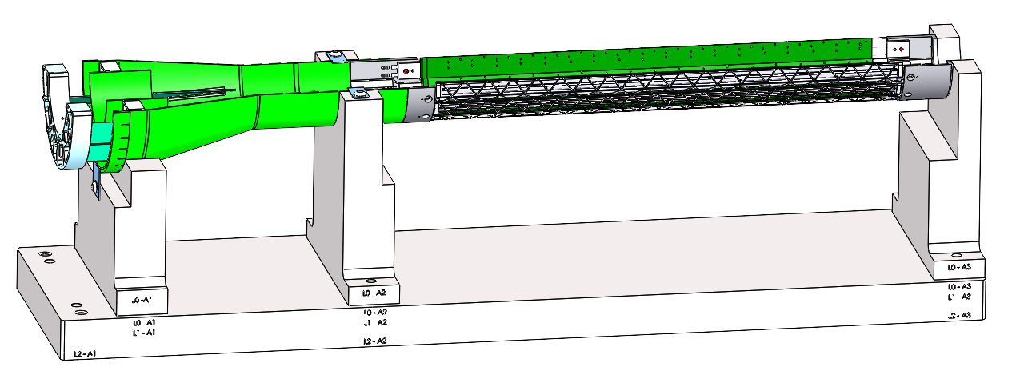
Near Term To Do’s
Two reviews
  MVTX CF PRR: 12/5/2020
    QA first test article
    Finish designs: assembly fixture, insertion system
  sPHENIX MVTX/INTT/BP integration Review: ~Jan. 2021
    MVTX and insertion system mockup
Stave shipping and QA
  40+ available at CERN
  To be ready for half-detector assembly ~May 2021
Readout & control system integration
  Continuous readout & synchronization across subsystems, new data format?
  mGTM development
  Slow control and monitoring
  To be ready for half-detector commissioning ~summer 2021

Slide 6
backup

Slide 7
Upcoming Challenges
Pre-COVID19 Schedule
Mechanical support structures
  CF production and QA
    1st test article, Layer-0 EW CMM etc.
    CF FDR: Dec. 15, 2020
  CF full production starts ~ Jan. 2021
    1st half CF(EW+CYSS+SB) available in ~March 2021
    2nd half CF available in April
  Insertion system design & mockup
    System integration review: ~Jan 2021
Stave production and transportation
  Shipping and QA, to be ready for assembly in time
Half-detector assembly at LBNL
  CF and stave test fitting ~March 2021
  Half-detector assembly review, ~May 2021
  Complete the 2nd Half-detector by 12/2021
Power, readout and controls
  Ready for half-detector full readout and control test at LBNL, ~summer 2021
Tight schedule to meet the installation dates
Today
Assembly review

