Slide 1
MVTX Status and Plan
Camelia, Grazyna and Ming
11/20/2020
MVTX bi-Weekly Meeting

Slide 2
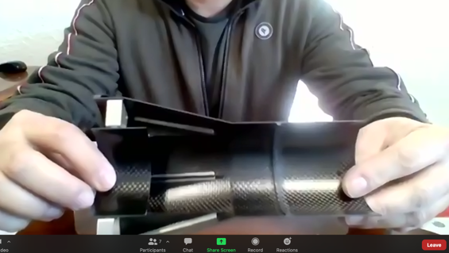
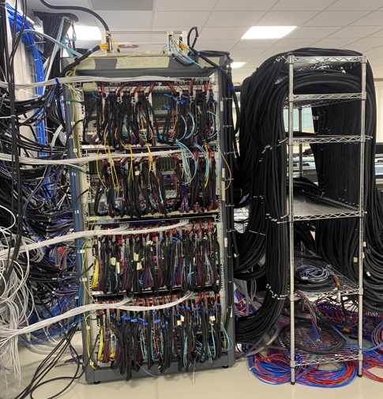
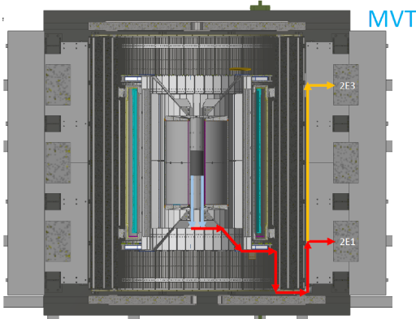
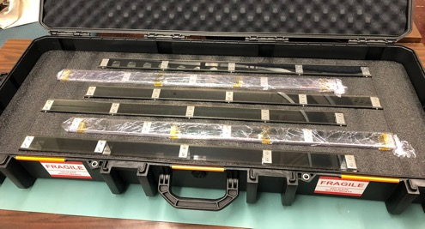
Project Status
Mechanical system
  1st test article produced at WorkShape!
  Insertion system design and mockup in progress, MIT/LANL
Electrical system integration
  RU testing in progress at ORNL
  AMD server made progress at LANL
  Power system and cable layout, LBNL
  Slow control, MIT
Stave production and transportation
  37+ gold staves at CERN, meeting next week(?)
  4 staves arrived at LBNL safely
MDC and physics study
  Next ~3+ months
FY21 budget
  ORNL’s budget being processed at BNL
  Didn’t receive detailed FY21 budget, under discussion
ITS commissioning remote shifts
  A few openings available
End Wheel: L0
@WorkShape
A lots of cables ….
ITS/IB readout and power
4 staves from CERN

Slide 3
Upcoming Challenges
Pre-COVID19 Schedule
Mechanical support structures
  CF production and QA
    1st test article, Layer-0 EW CMM etc.
    CF FDR: Dec. 15, 2020
  CF full production starts ~ Jan. 2021
    1st half CF(EW+CYSS+SB) available in ~March 2021
    2nd half CF available in April
  Insertion system design & mockup
    System integration review: ~Jan 2021
Stave production and transportation
  Shipping and QA, to be ready for assembly in time
Half-detector assembly at LBNL
  CF and stave test fitting ~March 2021
  Half-detector assembly review, ~May 2021
  Complete the 2nd Half-detector by 12/2021
Power, readout and controls
  Half-detector readout and control at LBNL, ~summer 2021
Tight schedule to meet the installation dates
Today
Assembly review

Slide 4
backup

Slide 5
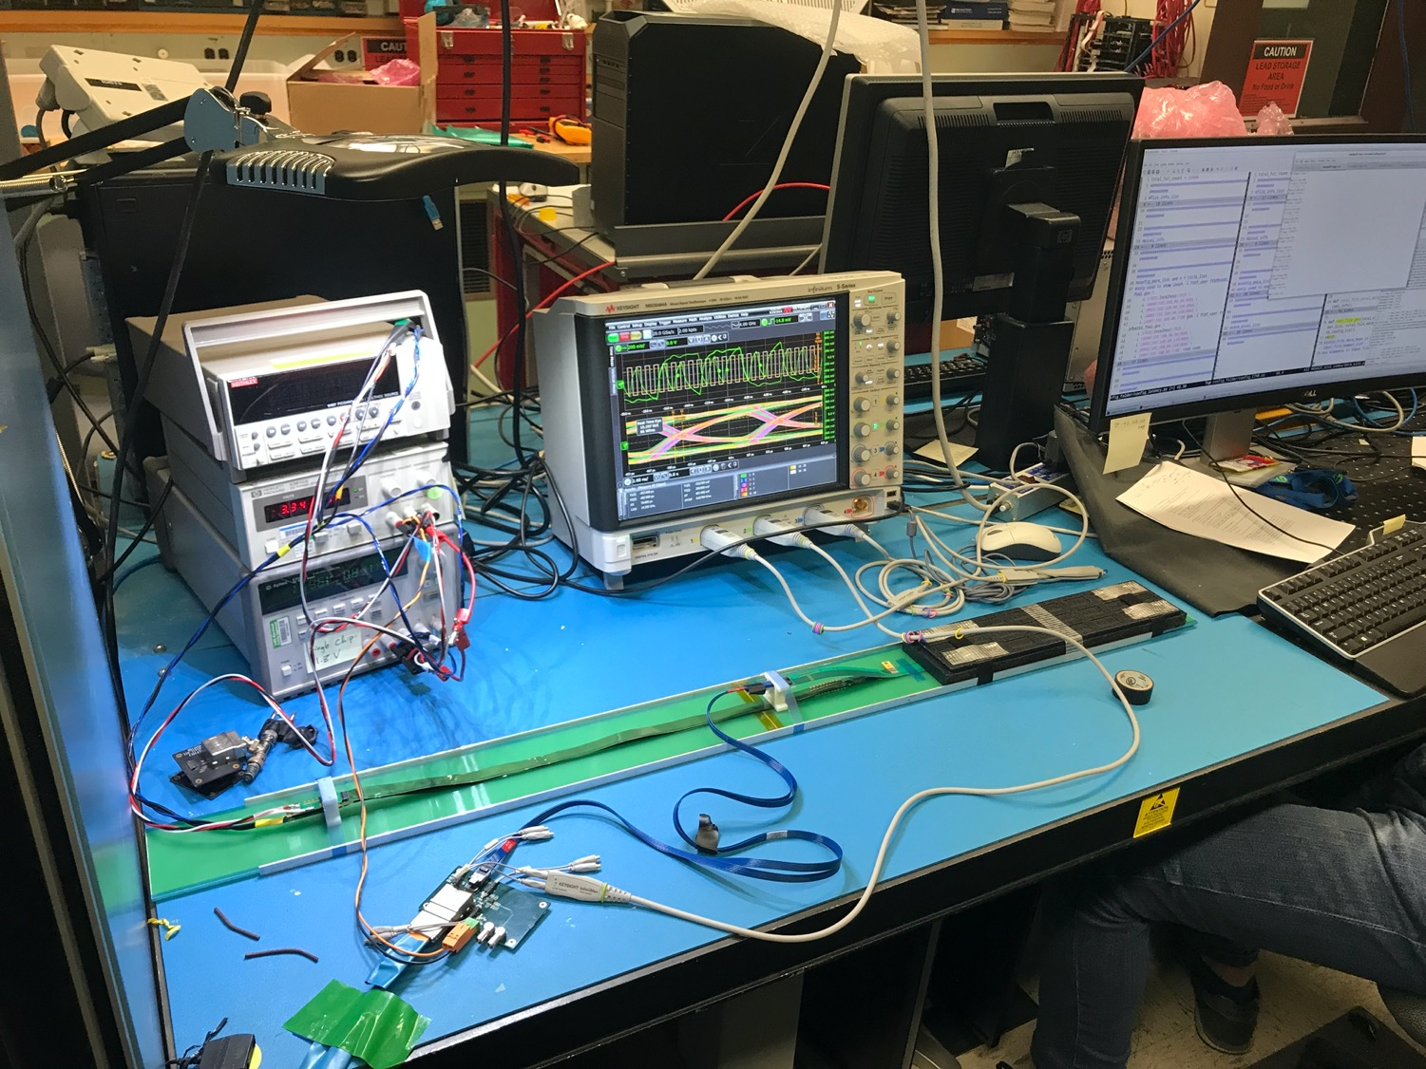
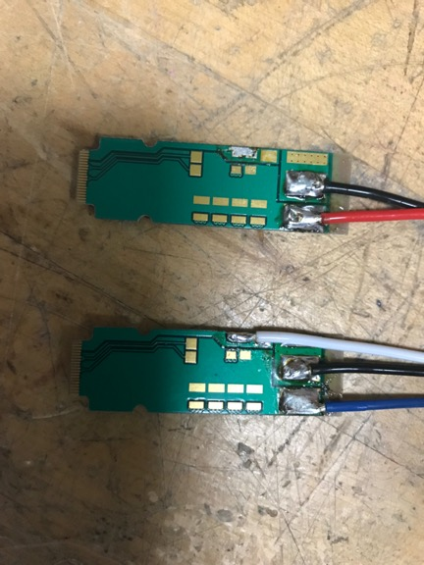
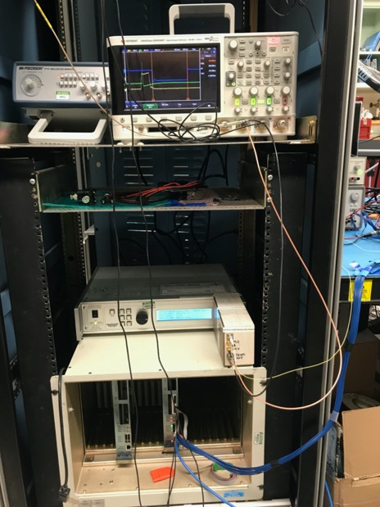
Stave MOSAIC Readout at LANL
DVDD: 1.8V
AVDD: 1.8V
MOSAIC
DV: 3.3V
To MOSAIC

Slide 6
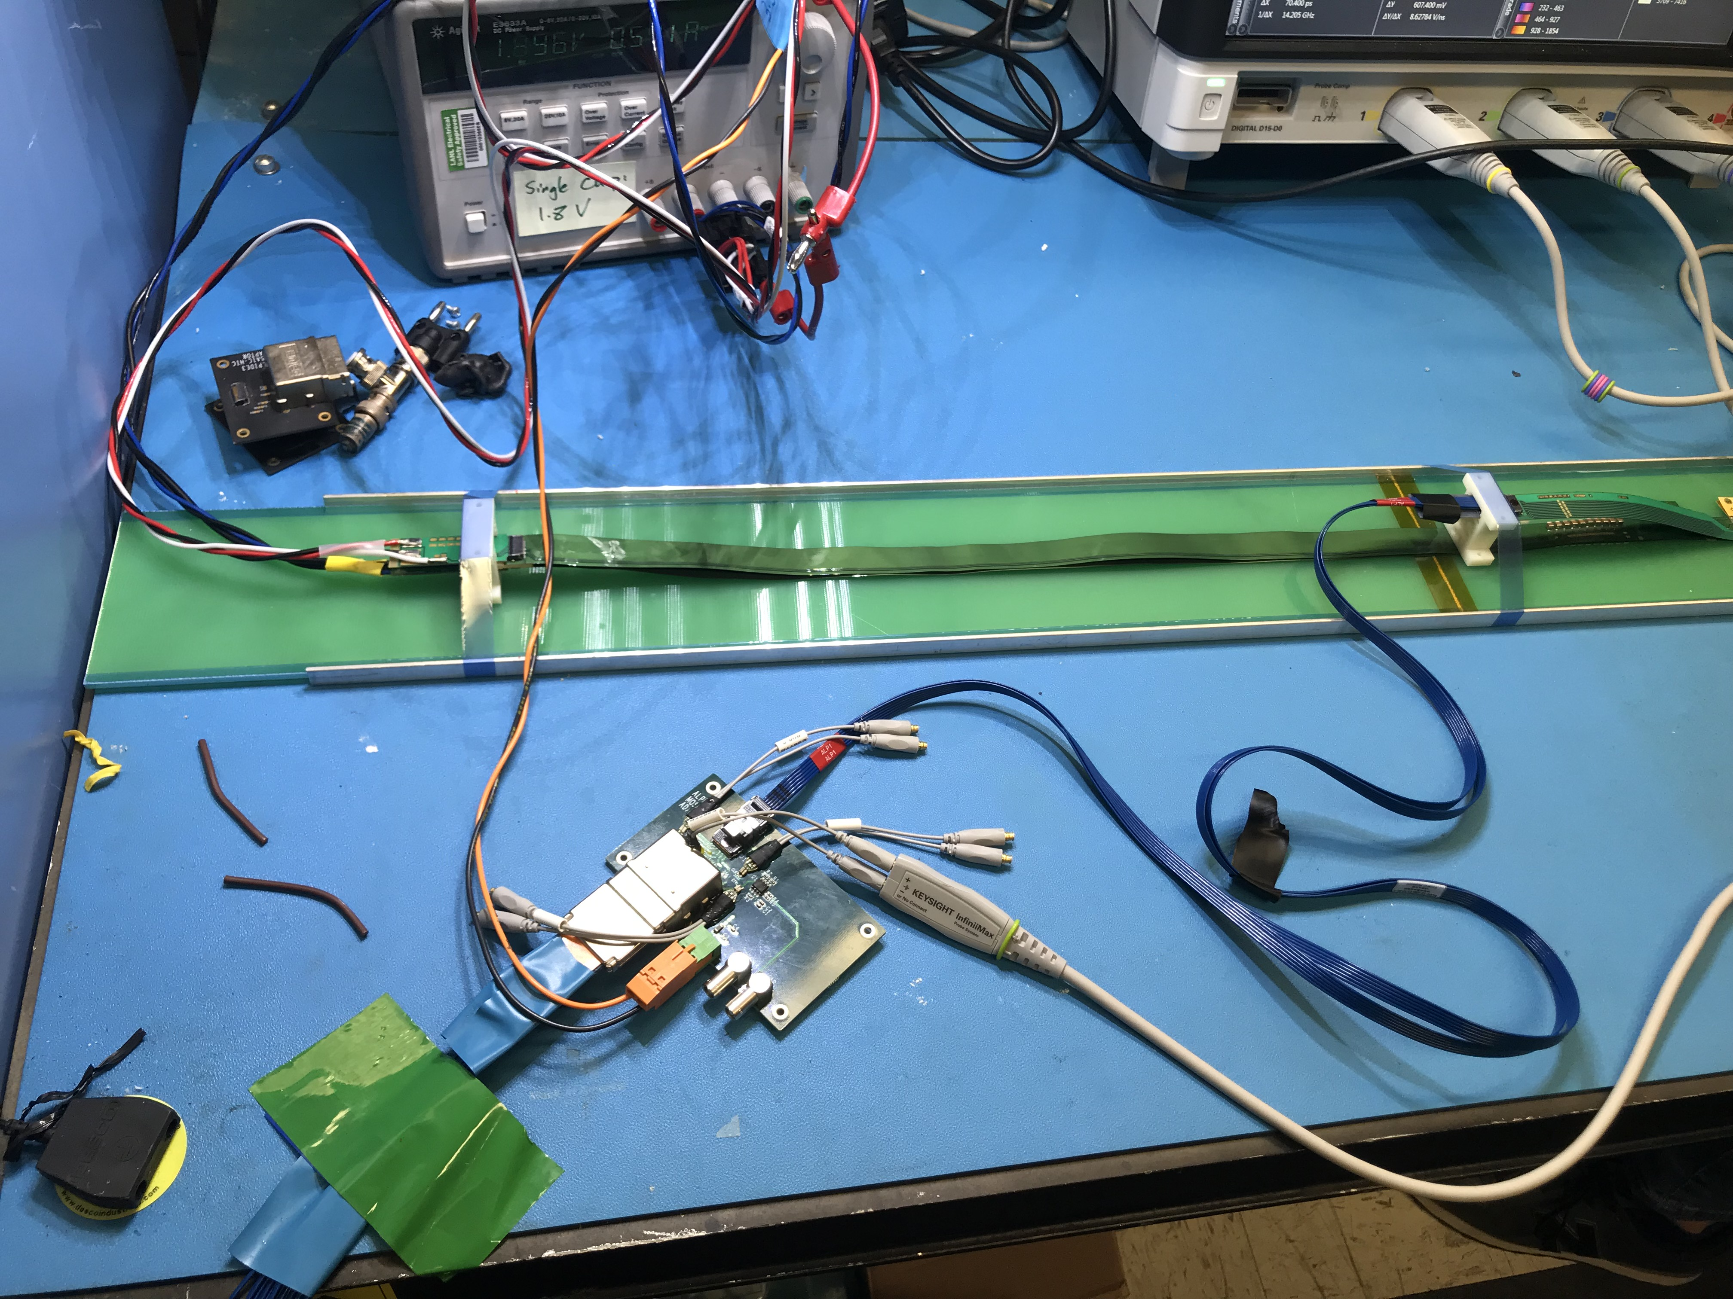
DVDD: 1.8V
AVDD: 1.8V
DV: 3.3V

