Slide 1
MVTX Status and Plan
Camelia, Grazyna, Ming Liu
05/22/2020
MVTX Bi-Weekly Meeting

Slide 2
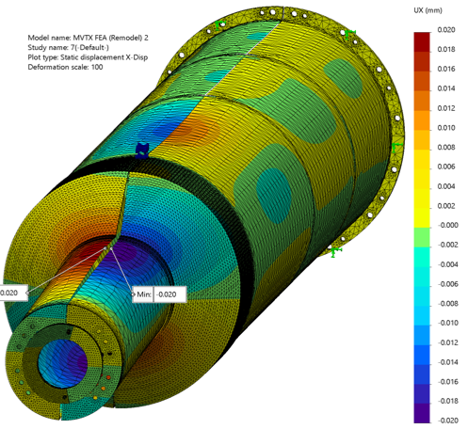
Project Status - Mechanics
Excellent Progress in Design
  One-piece EndWheel (change from ALICE/ITS):
  Nose roller-assembly (Jan. review suggestion):
  FEA analysis
Vendor selection:
  SOW in preparation
Final design review ~ Fall 2020
  was planned for 7/2020
Nice work by
MIT, LANL and LBNL

Slide 3
Readout and Electrical System
Readout system integration
  RU firmware/software updated (synced to ALICE 3/2020)
  FELIX firmware/software
    software/driver update (synced to ATLAS)
    firmware design in progress for GBT-SCA slow control
      readout firmware next - 3 GBT-link readout per RU
  8-stave telescope under development
    Possible test beam later in 2020, LANL/LBNL/FNAL?
    Online monitoring code updated
  mGTM development for MVTX at BNL
    40MHz clock required for GBT links
Power boards submitted for fabrication
    Delivery of PCB assembly ~ late June 2020
RU board test
  60 RUs waiting to be tested at CERN
    Re-planning under discussion, test at UT-A?
  Cold plates production at UT-A
    Fund being transferred to UT-A
    use UT-A machine shop
Cosmic data from a set up of:
4-satve/4-RU + 1-FELIX + 1-PU + 1-FELIX/Server + 1 GTM
Online Monitoring Plots

Slide 4
Antonello, 5/14/2020
IBSTAVE IDc | HIC assembly | Insp. after glue | Bonding | Insp. after bonding | HIC PWR test | Qualif. test | HIC+SF -> Stave | Stave PWR test | Stave test | Stave test (with long PWR extn.) | Final test (with PT100 and metrology)
TOTAL | 24 | 23 | 20 | 20 | 20 | 18 | 5 | 5 | 5 | 3 | 3
A201 | 1 | 1 | 1 | 1 | 1 | 1 | 1 | 1 | 1 | 1 | 1
A202* | 1 | Damag. | chip
A203 | 1 | 1 | 1 | 1 | 1 | 1 | 1 | 1 | 1 | 1 | 1
A204 | 1 | 1 | 1 | 1 | 1 | 1 | 1 | 1 | 1 | 1 | 1
A205 | 1 | 1 | 1 | 1 | 1 | 1 | 1 | 1 | 1
A206 | 1 | 1 | 1 | 1 | 1 | 1 | 1 | 1 | 1
B201 | 1 | 1 | 1 | 1 | 1 | 1
B202* | 1 | 1 | 1 | 1 | 1 | * | Damag. chip
B203 | 1 | 1 | 1 | 1 | 1 | 1
B204 | 1 | 1 | 1 | 1 | 1 | 1
B205 | 1 | 1 | 1 | 1 | 1 | 1
B206 | 1 | 1 | 1 | 1 | 1 | 1
F201* | 1 | 1 | 1 | 1 | 1 | * | Damag. chip
F202 | 1 | 1 | 1 | 1 | 1 | 1
F204 | 1 | 1 | 1 | 1 | 1 | 1
G202 | 1 | 1 | 1 | 1 | 1 | 1
G203 | 1 | 1 | 1 | 1 | 1 | 1
F203 | dummy
H202 | 1 | 1 | 1 | 1 | 1 | 1
H203 | 1 | 1 | 1 | 1 | 1 | 1
H204 | 1 | 1 | 1 | 1 | 1 | 1
H206 | 1 | 1 | 1 | 1 | 1 | 1
E204 | 1 | 1
E201 | 1 | 1
E202 | 1 | 1
Stave Status
Stave production re-start plan discussed with CERN, 5/14/2020
3 STAVEs ready for shipment
2 STAVEs ready for final tests
12 HICs are ready to be glued on STAVEs
3 HICs have to be bonded
Potentially ~20/84 available soon
Plan: to produce remaining 84-20 =64 staves
- MVTX: 48 staves for the full detector
Possible restart date at CERN: June 2
29 wks left until the end of 2020;
64 golden modules to be produced:
  with 80% yield -> 80 modules
  2.75 / wk , completed by Jan/Feb 2021 seems within reach!
(Origin plan: complete by the end of 2020)

Slide 5
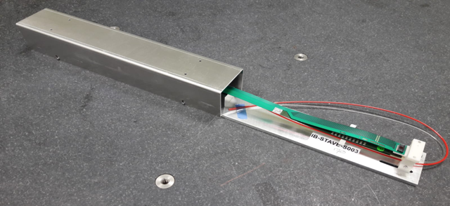
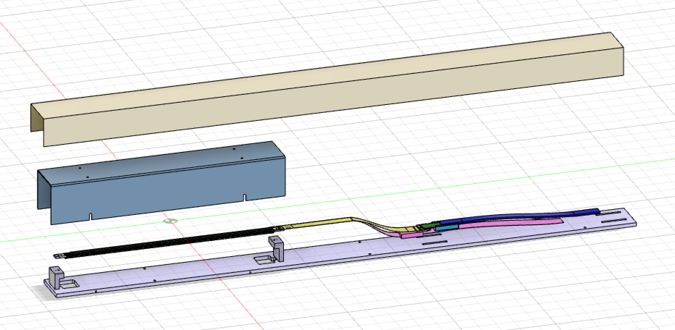
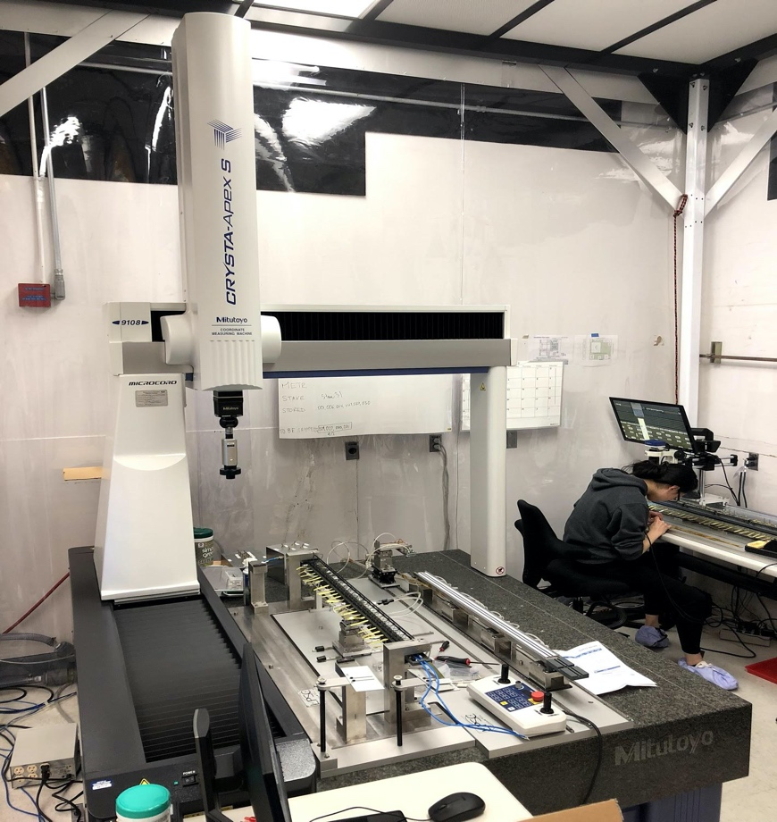
Preparation for Staves Test and Detector Assembly at LBNL
Funding received at LBNL
Stave reception and testing (currently on schedule)
  Transportation box design started.
    A default option, 10 staves/trip, is nearly ready.
    Working on better custom boxes to carry 12~14 staves/trip.
  Uncertainty:
    when can we fly to CERN in-person?
    get help from university colleagues?
Issue with the assembly/metrology space
  ALICE ITS clean tent @ LBNL will most likely be reclaimed by engineering for other purposes.
  Will have to rearrange/find new space for stave testing and detector assembly.
  We have almost a year to prepare. Schedule risk is low but requires extra work.
ALICE Clean Tent @LBNL

Slide 6
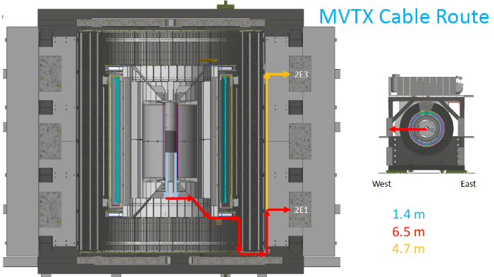
MVTX Services:
Racks and Power
Several meetings with BNL integration team recently,
finalized the preliminary design for MVTX
2E1:~0 kW
2E3: 2.32 kW
Power for individual
components

Slide 7
Simulations and 2019 Test Beam Analysis
Bi-weekly discussions, next 5/27
  Wed. 8:30PM/BNL
  sPHENIX Mattermost chat group, https://chat.sdcc.bnl.gov/sphenix/channels/2019-mvtx-testbeam
  MVTX hit cluster distribution MC tuning(Zhengyun, Sitong )
  TB data analysis framework and tutorial (Yaseer)
Improving HF tagging with MVTX
  KFParticle package

Slide 8
A New MVTX Bi-Weekly Meeting Time?
More active participants from Asia and CERN
  Current 12:00Noon/BNL = 12 midnight/China, 1AM/Korea&Japan, 6PM/CERN
  A doodle poll for “Thur-Fri” options for a 2-hr slot
  Https://doodle.com/poll/89h3mtespg5ebpft
  New time for the next Bi-Weekly meeting

Slide 9
backup

Slide 10
Where do we stand - PMP(12/2019)
Final design review -> late Fall 2020?
Delays in FY-20:
Mechanical design & prototyping
  Final design review
Carbon structure fabrication
  Most facilities closed due to COVID-19
Insertion system design, beam pipe
  Active discussions with BNL CAD and sPHENIX OSI
  Final beam pipe design completed and reviewed recently
Power system
  Power boards fabrication – ordered
  CAEN power – ready to order
  Cables – waiting for final layout for length
Stave production &RU test
  CERN schedule
  International shipping
Today
5/8/20

Slide 11
Staves – QA plan inspections/test records
    The MVTX will receive fully tested staves from ALICE.
    The full history including testing results and measurements of all of the parts of the stave are preserved in the ITS databases.
    This data is available for download.
    For simplicity, we will continue using the ALICE database for the testing that happens at LBNL. The software is already set up for this interface.
    After completion of all testing, the full set of data for the MVTX staves could then be pulled from the ALICE server.
    In any case, a full record of building and testing results will be preserved.

Slide 12
Detector Assembly - Procedure
Tested
Staves
Sized
End wheels
Assembly tooling
Sized
CYSS
Tested
Power/RDO
Half-layer assembly
Functional test
Half-layer metrology
Half-barrel assembly
Functional test
Half-barrel metrology
Half-barrel full chain
Assembly: Staves 🡪 Layers 🡪 Half-Barrels
QA: Functional test at each step
Metrology: Map the sensitive volume positions
Final validation test
Half-barrel delivered

