Slide 1
MVXT Status and Plan
Camelia Mironov, Grazyna Odyniec, Ming Liu
MVTX Bi-Weekly Meeting
11/06/2020

Slide 2
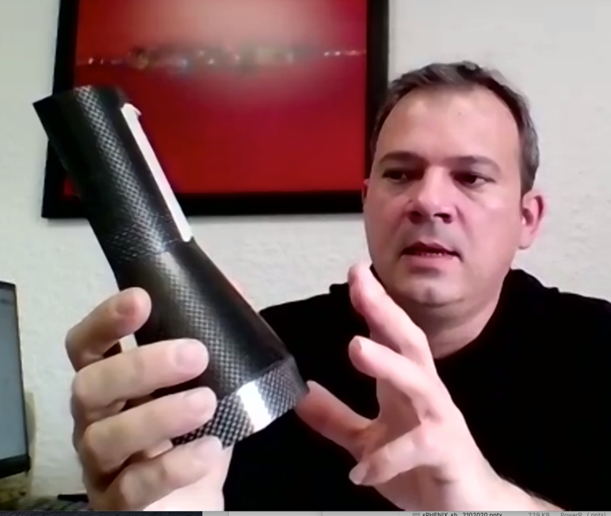
Project Status & Plan
Detector assemble fixture designed and reviewed - MIT, LANL, LBNL
1st prototype L0 EW fabricated,
next version in progress
Mechanical system
Carbon fiber production at WorkShape (Fr.)
1st test article by 11/2020, Layer-0 EW
Complete full production in ~4/2021
1st half detector available early, ~3/2021
MVTX insertion and mockup designed, MIT/LANL
Detector assembly fixture designed and reviewed
1-piece EW: PEEK → Al
Readout and control
Readout Unit Test in progress at ORNL
FELIX AMD server setup in progress at LANL
Slow control, LLA (Low-Level Arbitration) interface in progress
mGTM development – draft doc circulated
Stave production and transportation
37 Gold staves ready for shipping
Still have problems with HIC assembly machine
Transportation case tested, ready for 1st shipping 4 staves
FY21 funding expected ~Jan 2021
Early funding request for ORNL and LANL, in progress
Okey for MIT and LBNL for next a few months
MDC and MVTX detector & physics simulation
Coming months
ITS commissioning remote shift participation
Good opportunity to help us for MVTX commissioning later
Detector occupancy increase: ~<1%

Slide 3
Challenges
Pre-COVID19 Schedule
Schedule delay due to COVID-19
Carbon structure production and test/QA
1st test article, Layer-0 EW, by end of Nov. 2020
CF FDR ~Dec. 15, 2020
Start full production ~ Jan. 2021
1st half CF(EW+CYSS+SB) available in ~March 2021
2nd half CF available in April
Stave production and transportation
First test shipping, ~11/2020, 4 staves
Stave QA @LBNL, follows
Half-detector assembly at LBNL
CF and stave test fitting ~March 2021
Half-detector assembly review, ~7/2021
Complete the 2nd Half-detector by 12/2021
Lab access at LBNL, schedule etc.
Tight schedule to meet the installation dates
Today
Assembly review

Slide 4
Upcoming Reviews …
CF structure production readiness review ~ 12/15/2020
CF structures - CYSS, EW and SB
Detector assembly fixtures
X-wing design
Insertion and mock up review ~ Jan 2021 ?
Insertion design
Insertion mockup
w/ other subsystems, INTT, MBD, BP etc.

Slide 5
backup

Slide 6
Milestones in PMP, 12/2019 (targeted schedule + 2 months/contingency)
Now ~ 12/15/2020
CF structures:
- 1st half: 3/2021
- 2nd half: 4/2021
Assembly testing starts ~3/2021
Half-Detector assembly review, ~July 2021
On track … to meet the final completion milestones,
very tight schedule

Slide 7
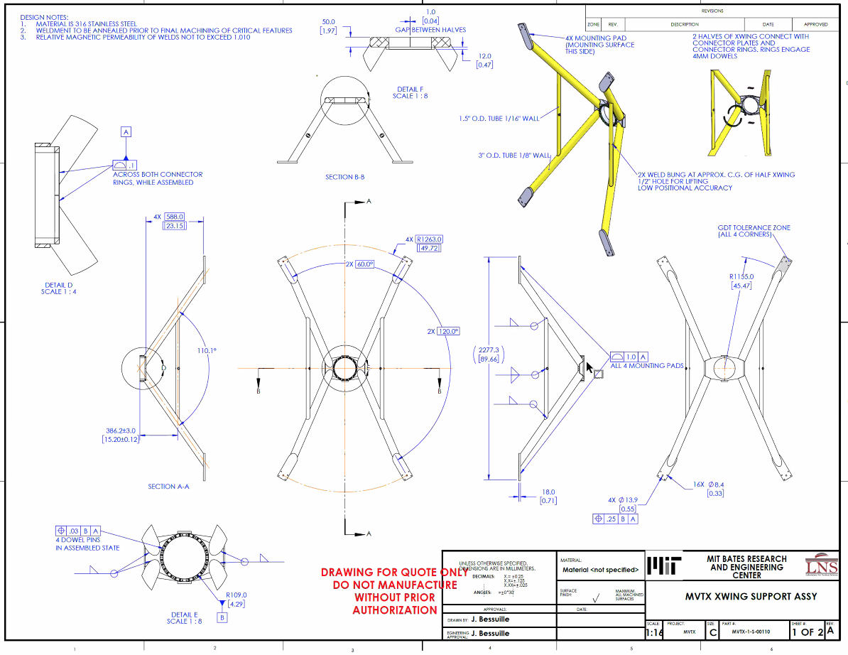
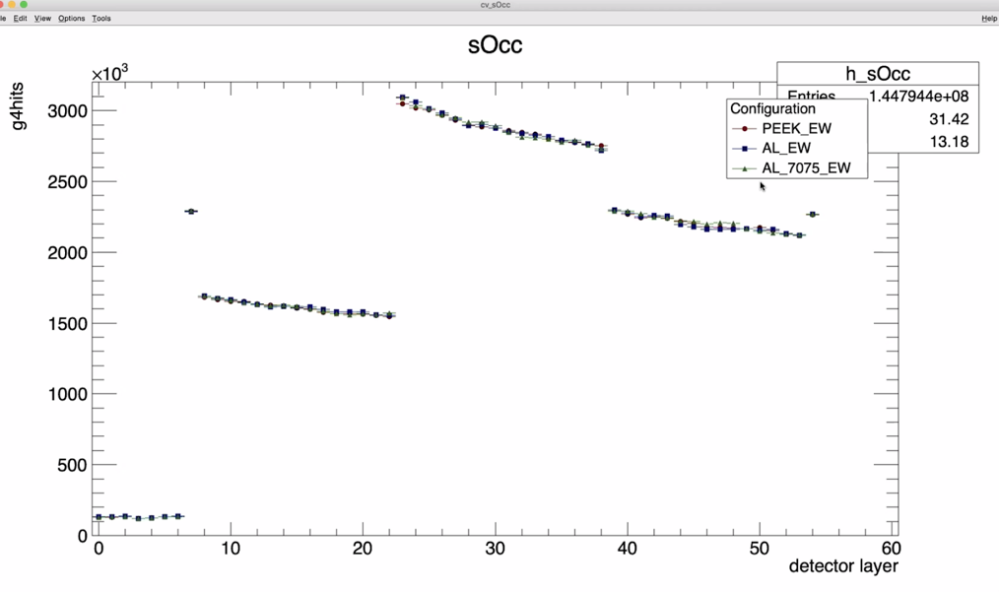
1-piece EW: to be replaced with Al,
to minimize “springb ack”
sPHENIX simulations:
PEEK, Al, AL7075

