Slide 1
MVTX Status & Plan
Ming Liu
MVTX Bi-Weekly Meeting
03/13/2020

Slide 2
Finalizing MVTX Mechanical Design
Address recommendations from 1/29/2020 FDR
Added rollers to maintain the correct gap between the detector and the beam-pipe,
modified one of the patch panels (for an easier access to cooling lines),
FEA analysis confirmed sagging is small
attaching the two North end flanges together to further reduce the overall sag of the detector (by ~x2)
Talking with others (LBL) to decide on a simplified (shorter) vendor selection procedure
Weekly mechanical design meeting, MIT/LANL, LBNL
Investigating a simplification compared to the ITS design
Analysis seemed promising, and price with vendors was checked (looks ok so far)
Internal ‘review’ with CERN (ITS lead engineer) and LBNL engineers, last Friday 3/6
Plan to finalize the design and produce a prototype to certify the design and vendor

Slide 3
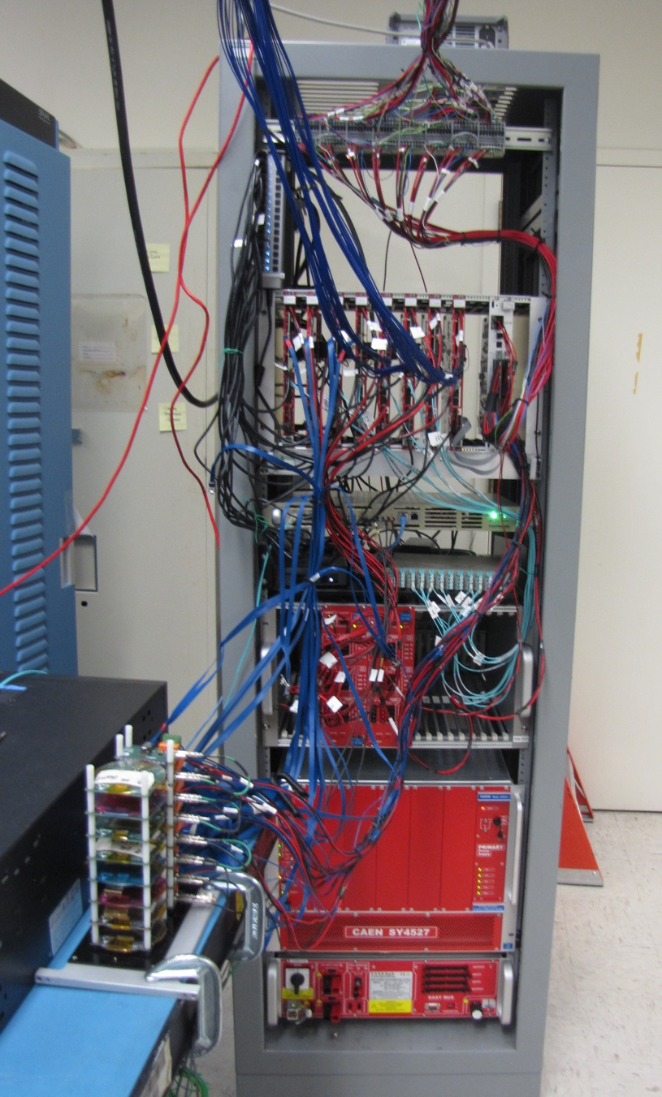
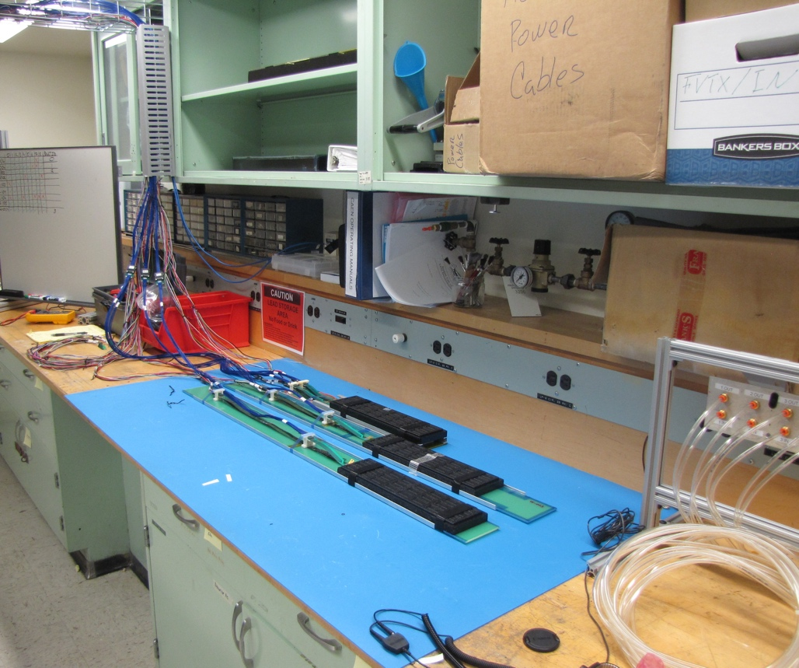
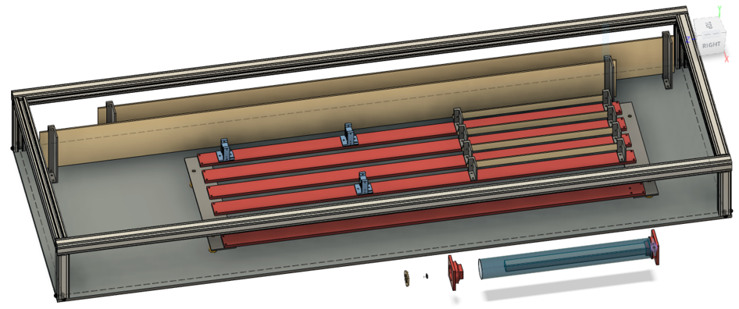
MVTX 8-Stave Telescope Setup
Successfully readout the system
2-stave + 2-HIC + 4-SingleChip, (4 staves will arrive next week with Alex)
8-RUs + 1-PU + 1-FELIX + 1-GTM + CAEN PS
11m long “final” readout cable
Telescope box designed
Weekly readout meeting
Firmware & software update
Test Beam @Fermilab, 4/22-5/4
Coronavirus outbreak?
8 RUs + PU
4 “final” cables
CAEN PS
MVTX Telescope Box
6-stave + 2-HIC
New cooling
panel for 8-stave
Trigger scope
2 Staves
8-SingleChips
2 HICs

Slide 4
Stave Production at CERN
Replacement of carbon frame cooling tubes starts this week, 3/9
HIC production in progress, 24 assembled as of 3/13
Issues with software upgrade two weeks ago
Rolled back to older version, system is working now
Production meeting with CERN next Thursday,
Cooling tube work
HICs & Stave testing
~10 staves available for shipping late March or early April
Cooling tubes:
55cm -> 70cm

