Slide 1
KFParticle Simulations
Cameron, Ming
11/01/2020

Slide 2
Exercise KFParticle Package for HF Sim
Inputs:
  B-> Jpsi + Phi, samples from Zhaozhong’s simulations
Outputs:
reco’d daughter and grand-daughter particles from KFParticles
- reco’d Bs, J/Psi and Phi, and tracks (e+/-, K+/-)
Bs -> J/Psi(e+e-) + Phi (K+K-)
Bd -> D+pi, MC sample is too small to see this exclusive channel ….
Next:
  B/L_b -> multiple displaced tracks …
  “vertex size” of the displaced vertex? IP?
    Using DCA of two tracks to estimate “vertex-size” of the daughter particles, like J/Psi, Phi?
  “DCA” of the displaced vertex momentum vector?

Slide 3
Bs_mass
3-D IP
charge
Reco’d Bs properties:
mass, 3-D DCA/Impact Parameter (IP),
charge, P, pT, y, L etc …
ptot
pT
y
Bs -> J/Psi(e+e-) + Phi (K+K-)
~ 4 tracks
L (cm)
c*Tau (cm)

Slide 4
J/Psi (mass, e+e-)
Phi (mass: K+K-)
Daughter particles:
J/Psi and Phi
3D DCA
pT
eta
Decay_L

Slide 5
Trk_1
(e+/-)
Trk_2
(e+/-)
Trk_3
(K+/-)
Trk_4
(K+/-)
mass
J/Psi -> e+ e-
Phi -> K+ K-
pT
eta
IP

Slide 6
Desired Large MC Samples: ~1M c-cbar events?
Charm Hadrons: c -> D, L_c
(LHCb) arXiv:1902.06794

Slide 7
Desired MC Samples: ~10M b-bbar ?
Beauty Hadrons: b-> B, L_b
Effective BR ~ 10⁻⁴
Exclusive decay channels:
B+ -> J/Psi + K^+ (BR = 1.0 x 10^-3)
-> D⁰ + pi⁺ (BR=4.7 x 10^-3)
-> D⁰ K⁺ (BR = 3.6 x 10^-4)
-> D⁻+ pi⁺ + pi⁺ (BR = 1.1 x 10^-3)
Bd -> D⁻ pi⁺ (BR=2.5 x 10^-3)
-> D⁻ + K⁺ (BR = 1.9 x 10^-4)
-> D⁰ + pi⁺ + pi⁻ (BR = 8.8 x 10^-4)
-> D⁻ + pi⁺ +pi⁺ + pi⁻ (BR= 6 x10^-3)
-> J/Psi + Ks(pi⁺pi⁻) (BR=8.7 x10^-4)
-> J/Psi + K⁺ pi⁻ (BR=1.2x10^-3)
Bs -> J/Psi + Phi (BR=1.1 x10^-3)
-> Ds⁻ + pi⁻ (BR= 3.0 x 10^-3)
Bc⁺ -> J/Psi + D⁰ + K⁺ (seen)
-> J/Psi + pi⁺ (seen)
L_b -> L_c(2860)⁺ + pi⁻ (BR ~< 10^-4)
-> J/Psi + Lambda (seen, ~10^-4)
-> p J/Psi + pi⁻ (BR= 2.6 x10^-5)
-> p J/Psi + K⁻ (BR = 3.2 x 10^-4)
-> Lc⁺ pi⁻ (BR = 4.9 x 10^-3)
->Lc⁺ pi⁺pi⁻pi⁻ (BR = 7.7 x10 ^-3)
Semi-leptonic decays:
B-> D + e/mu + X (BR=8.4%)
HFLAV 2019

Slide 8
Additional slides

Slide 9
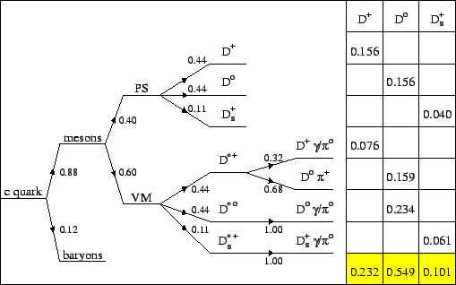
Charm Fragmentation (assumed universal FF, ee/DIS)
https://www.desy.de/~ameyer/hq/node38.html, HERA

