Slide 1
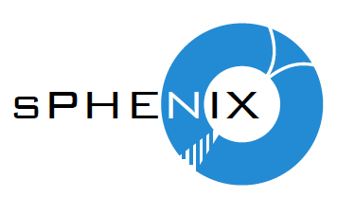
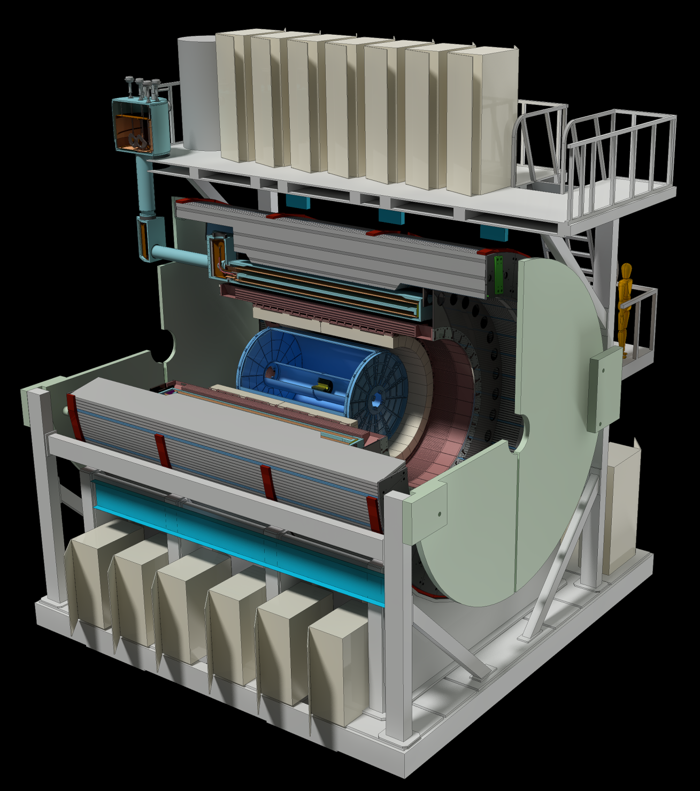

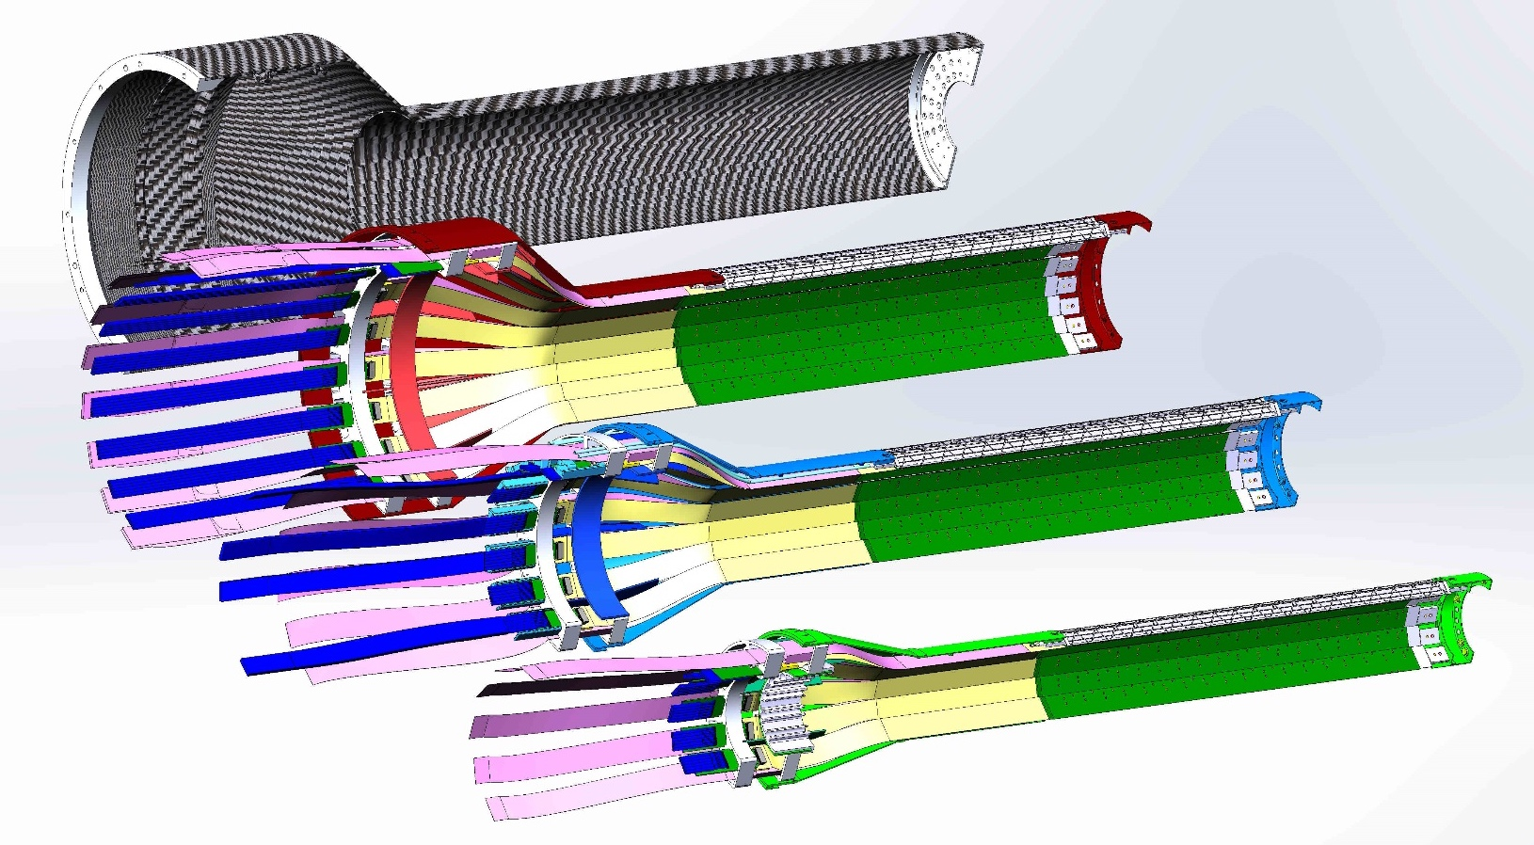
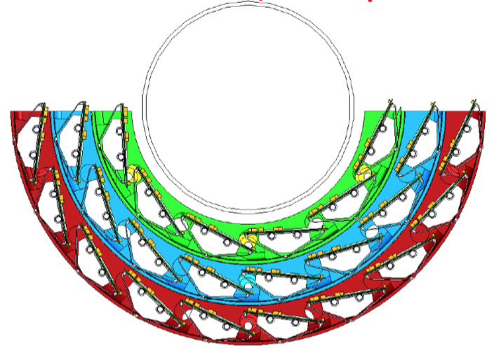
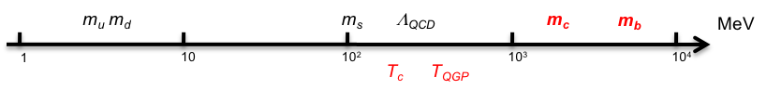

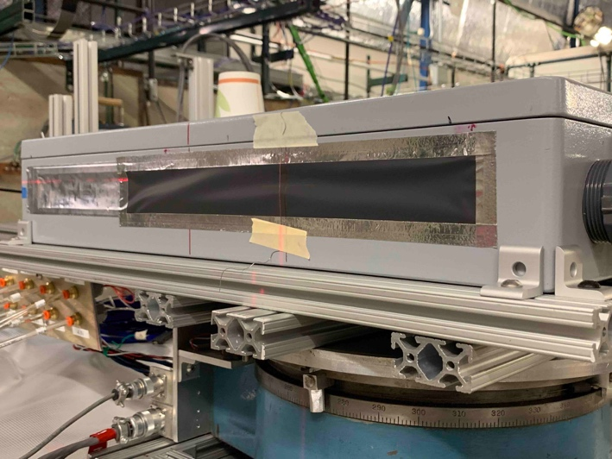
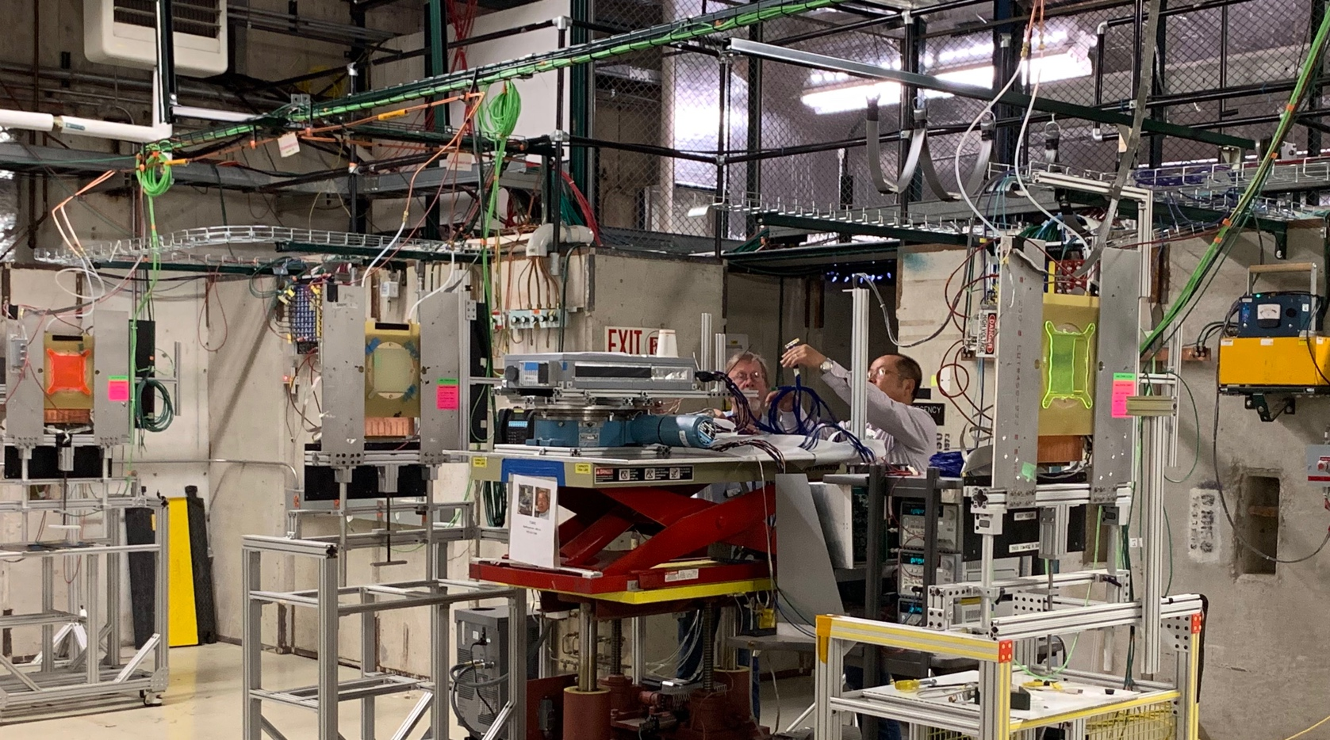

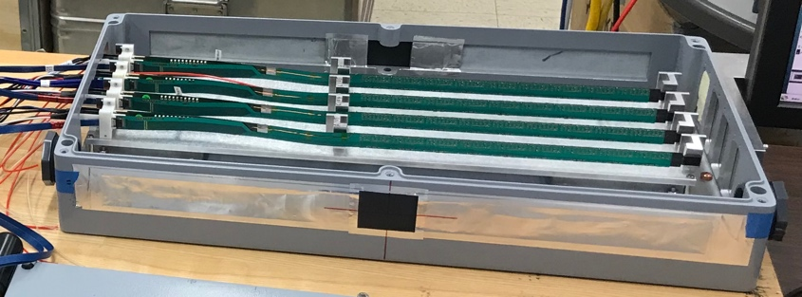
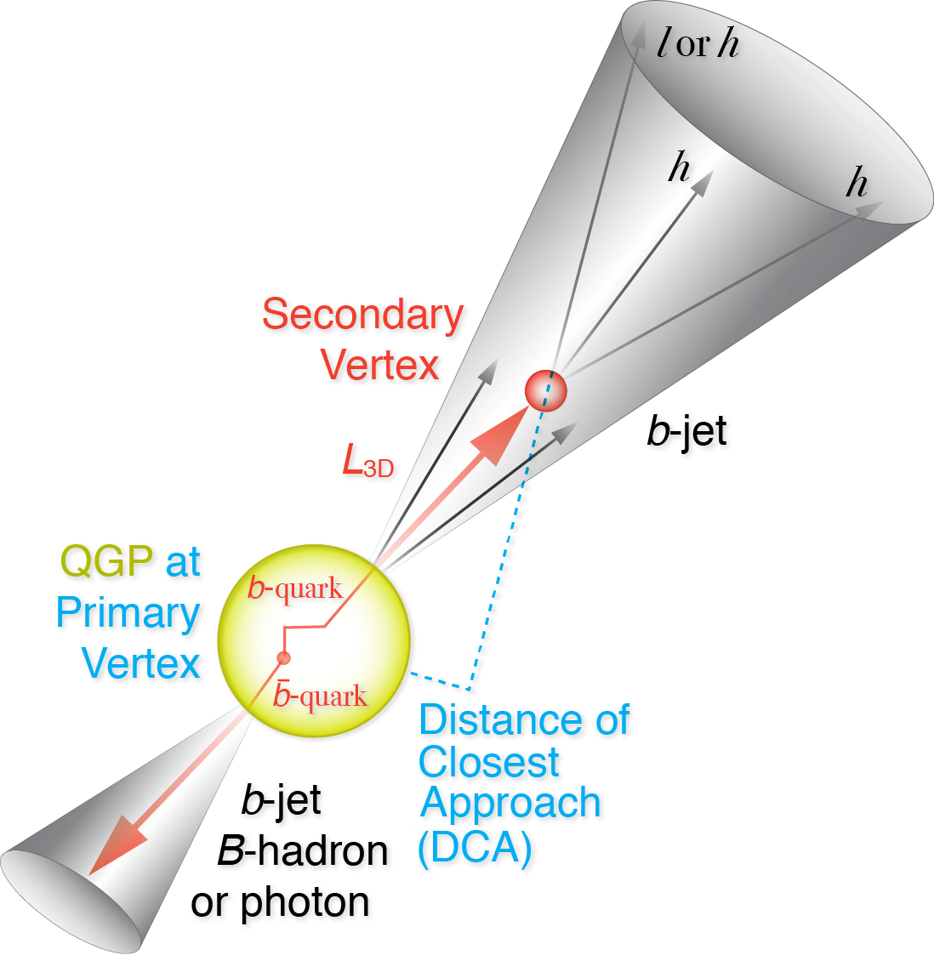
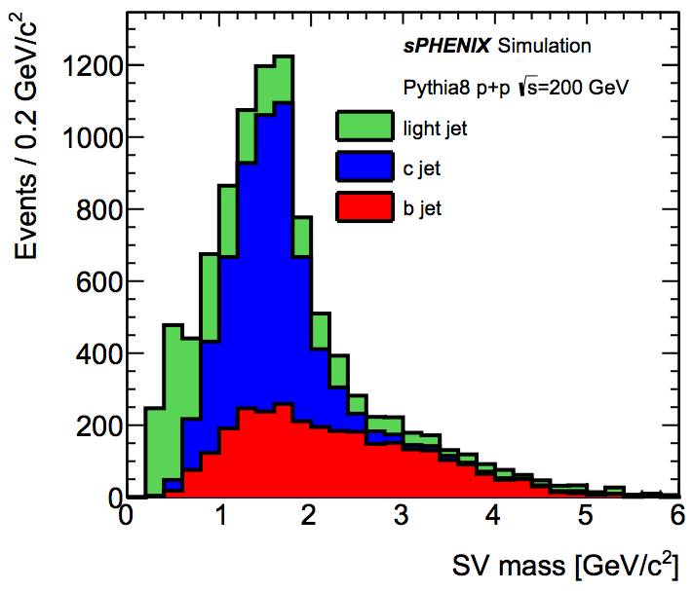



The sPHENIX MAPS-based Vertex Detector (MVTX)
Ming X. Liu, Los Alamos National Laboratory
for the sPHENIX Collaboration
Abstract
The sPHENIX detector at BNL’s Relativistic Heavy Ion Collider (RHIC) will study QGP properties with heavy bottom quark jets (B-jets) produced in high-energy heavy ion collisions. B-jets are expected to offer a unique set of observables due to the large bottom quark mass, but need to be measured across an unexplored kinematic regime, particularly at low pT where the expected mass-dependence effects are large but the underlying backgrounds are also high. We will use a three-layer Monolithic-Active-Pixel-Sensor (MAPS) based vertex detector, sensors originally developed for the ALICE ITS upgrade, to identify the signal and suppress the background. The MVTX will serve as the innermost tracking system of sPHENIX, covering 2~4 cm radially and a pseudorapidity range of |η| < 1.1. The very fine 27 µm x 29 µm pixels allow us to identify B-decay secondary vertices and B-jets in heavy ion collisions with high efficiency and high purity. In this presentation, we show the current status of R&D efforts towards custom readout and mechanical systems to integrate the MVTX detector into the sPHENIX system.
MVTX Detector Design
MVTX detector:
- 3-layer MAPS sensors, pixel size 27x29 μm²
Full azimuthal coverage: 2$π$
Z coverage: 27cm
R: 2.5 – 4.0 cm
48 9-chip-staves
sPHENIX
MVTX Detector Sensors
27cm
MVTX Readout Integration
a 9-chip stave
Physics Motivation
The MVTX detector will enable us to use heavy quarks (charm and beauty) to probe the properties of QGP at RHIC. By exploring mass dependence of various observables in open charm and open beauty productions in heavy ion collisions, we can gain deep insight of the inner workings of the QGP, and allow us to derive key QGP parameters like diffusion coefficient and systematically control the theoretical and experimental uncertainties.
One Readout Unit (RU) per stave, 48 total
- 9 x1.2 Gb/s firefly links, 1 clock, 1 control
- 3 GBT optical to FELIX per RU
8 RUs per FELIX, 6 FELIX in total
One Power Unit (PU) supports 2 RUs and 2 Staves
All sensor stave and readout electronics hardware designs are final and fully tested, ready for production or already produced
GTM
Open HF and Jet Measurements
sPHENIX note: 2018-01
Hot QCD white paper - arXiv: 1502.02730
MVTX Performance from Simulations
MVTX Prototype R&D Highlights
Advantages of ALICE MAPS(ALPIDE):
- Very fine pitch (27x29 μm²)
- High efficiency (>99%) and low noise (<10⁻⁶)
- Time resolution, as high as ~5 μs
- Ultra-thin/low mass, (50μm)
- On-pixel digitization, low power dissipation
Very successful MVTX test beam runs using 120GeV proton beams at Fermilab in the summer of 2019. A MVTX prototype telescope made of 4 production sensor staves was tested with the final readout electronics (RU, FELIX, PU) and custom designed long SamTec firefly readout cables.
With the test beam data, we have verified the performance of all hardware, from sensor staves, high-speed readout cables to the readout electronics.
A 9-chip MAPS stave:
- 0.3% X_{0,}
- active area (1.5 x 3 cm²) x 9
FPC
9 Chips
Cooling plate
Power density < 40 mW/cm²
Summary and Outlook
- 84 staves (a full 3-layer MVTX + a full 2-inner-layer spares) production in progress
- 60 frontend RU produced; FELIX and PU production in preparation
Mechanical support carbon structure preliminary design completed, in the process of vendor-selection for pre-production
Final installation in mid 2022, ready for sPHENIX day-1 physics in 2023
B-tagging in p+p and Au+Au: displaced tracks and 2nd vertex mass
sPHENIX G4 Simulations
Single track DCA resolution
Today
Other MVTX related sPHENIX presentations @QM19
Talk: Heavy flavor physics with the sPHENIX MAPS-based vertex tracker upgrade, Yuanjing Ji
FF25: The readout of the sPHENIX MAPS-based vertex detector, Alex Tkatchev
FF26: sPHENIX MAPS prototype test beam results, Cameron Dean
FF27: Mechanical design of the sPHENIX MAPS-based vertex detector, Michael Peters
HF43: sPHENIX capabilities for measuring Lambda_c in Au+Au collisions, Xing Dong
HF44: sPHENIX open heavy flavor hadron physics program, Xiaolong Chen
JT24: The sPHENIX heavy flavor jet physics program, Jin Huang

