Slide 1
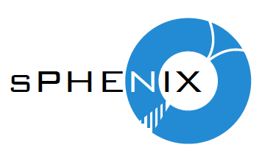
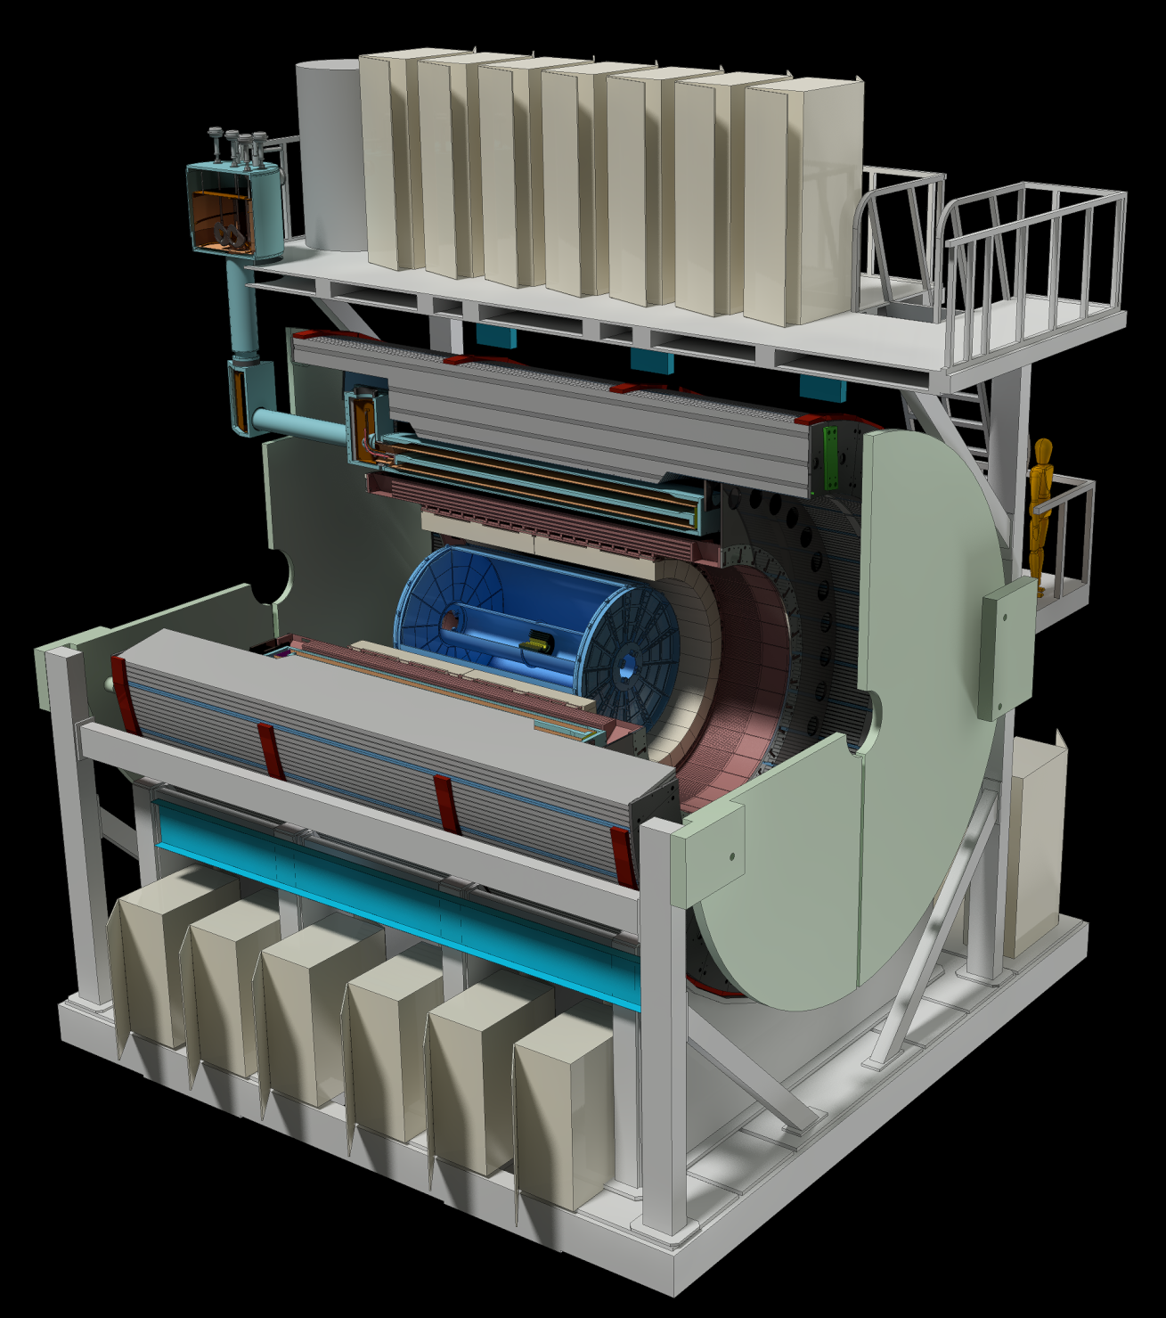

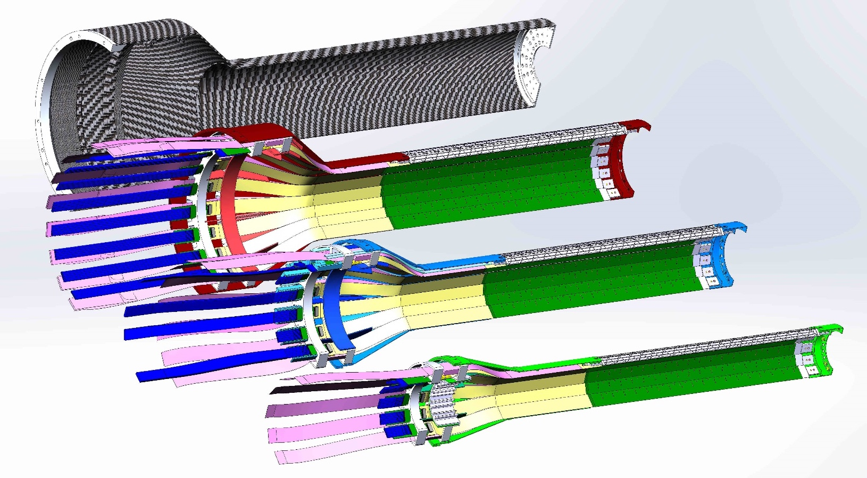
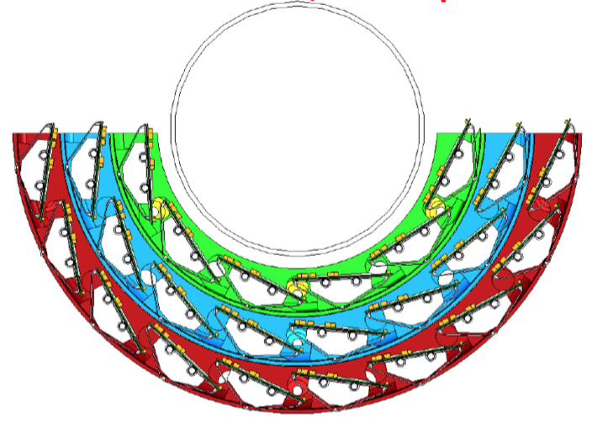
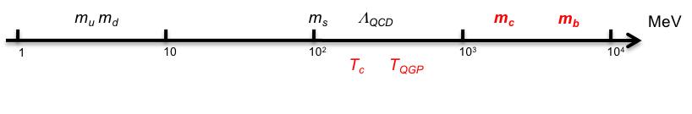
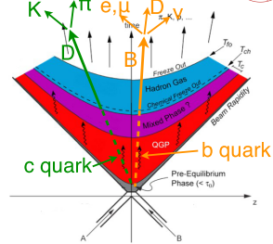

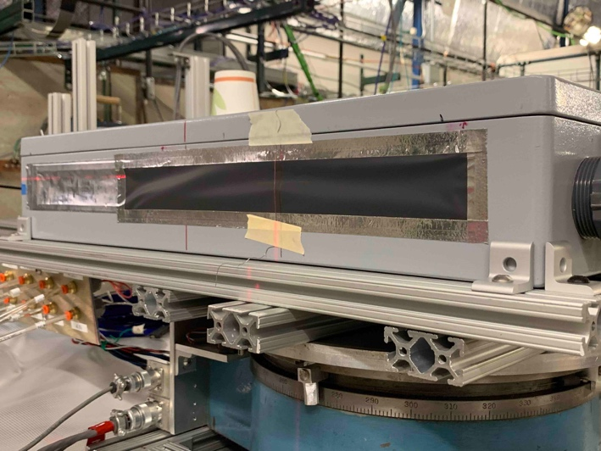
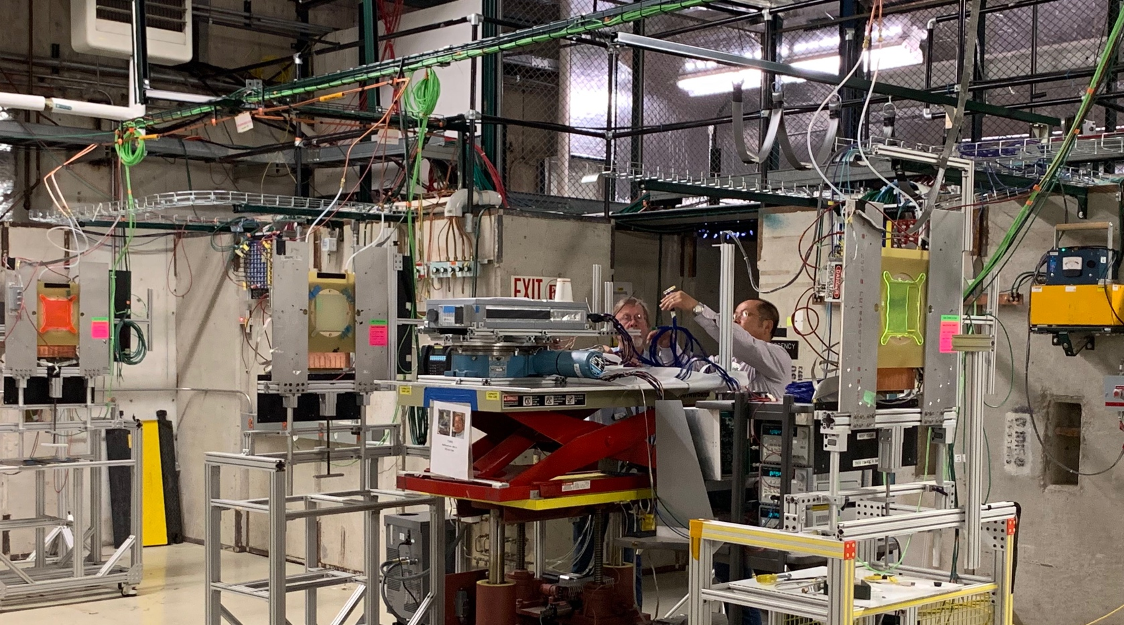

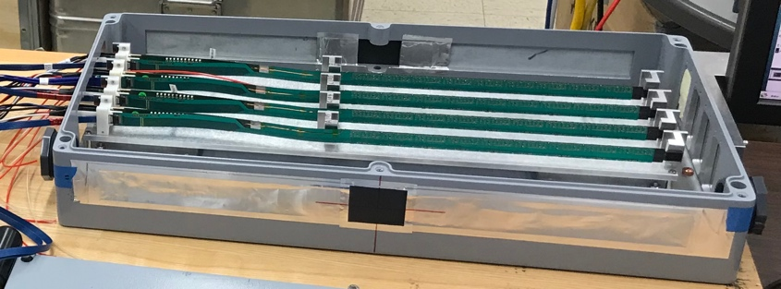
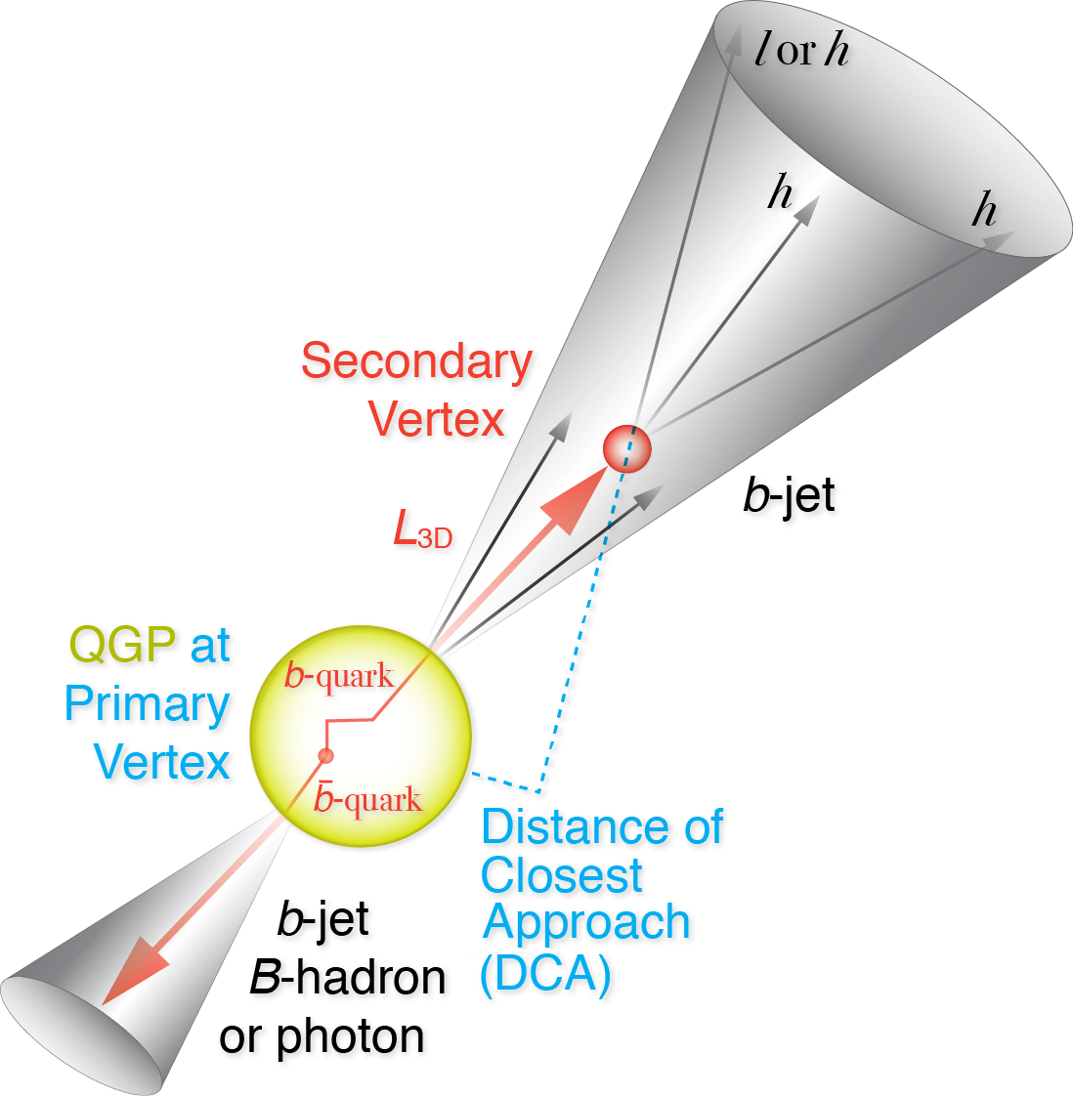
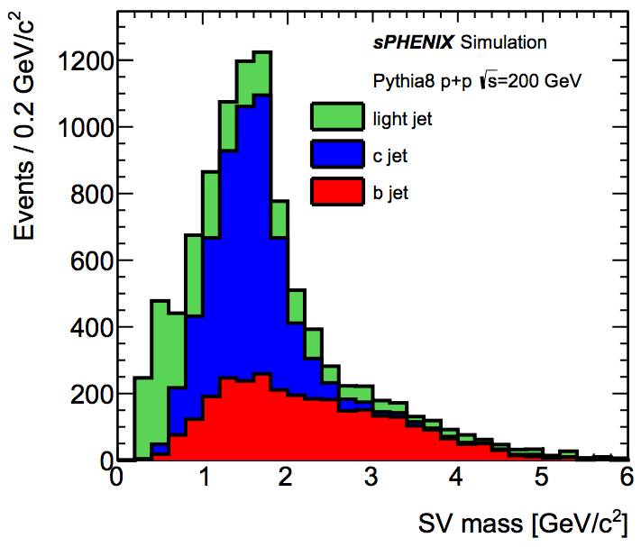



The sPHENIX MAPS-based Vertex Detector (MVTX)
Ming X. Liu, for the sPHENIX Collaboration
Abstract
The sPHENIX detector at BNL’s Relativistic Heavy Ion Collider (RHIC) will study QGP properties with heavy bottom quark jets (B-jets) produced in high-energy heavy ion collisions. B-jets are expected to offer a unique set of observables due to the large bottom quark mass, but need to be measured across an unexplored kinematic regime, particularly at low pT where the expected mass-dependence effects are large but the underlying backgrounds are also high. We will use a three-layer Monolithic-Active-Pixel-Sensor (MAPS) based vertex detector, sensors originally developed for the ALICE ITS upgrade, to identify the signal and suppress the background. The MVTX will serve as the innermost tracking system of sPHENIX, covering 2~4 cm radially and a pseudorapidity range of |η| < 1.1. The very fine 27 µm x 29 µm pixels allow us to identify B-decay secondary vertices and B-jets in heavy ion collisions with high efficiency and high purity. In this presentation, we show the current status of R&D efforts towards custom readout and mechanical systems to integrate the MVTX detector into the sPHENIX system.
MVTX Detector Design
MVTX detector:
- 3-layer MAPS sensors, pixel 27x29 μm²
- Full azimuthal coverage: 2$π$
Z coverage: 27cm
R: 2.4 – 4.0 cm
sPHENIX
MVTX Detector Sensors
27cm
MVTX Sensor Beam View
Physics Motivation
The MVTX detector will enable us to use heavy quarks (charm and beauty) to probe the properties of QGP at RHIC. By exploring mass dependence of various observables in open charm and open beauty productions in heavy ion collisions, we can gain deep insight of the inner workings of the QGP, and allow us to derive key QGP parameters like diffusion coefficient and systematically control the theoretical and experimental uncertainties.
MVTX Service Barrel
MVTX Readout Integration
One RU per stave, 48 total
- 9 x1.2 Gb/s firefly links, 1 clock, 1 control
- 3 GBT optical to FELIX per stave
3 RUs per FELIX, 6 FELIX backend in total
One PU supports 2 RUs and 2 Staves
All sensor and readout electronics hardware
designs are final and fully tested, ready for
production or already produced
HF and Jet capability
GTM
MVTX Performance from Simulations
MVTX Prototype R&D Highlights
Advantages of ALICE MAPS(ALPIDE):
- Very fine pitch (27x29 μm²)
- High efficiency (>99%) and low noise (<10⁻⁶)
- Time resolution, as high as ~5 μs
- Ultra-thin/low mass, (50μm)
- On-pixel digitization, low power dissipation
In the summer 2019, we carried out very successful MVTX test beam runs using 120GeV proton beams at Fermilab. A MVTX detector prototype telescope made of 4 production sensor staves was tested with the final readout electronics (RU, FELIX, PU) and custom designed long SamTec firefly readout cables. With the test beam data, we have verified the performance of all hardware, from sensor staves, high-speed readout cables to the full readout electronics.
MVTX Telescope
A 9-chip MAPS stave:
- 0.3% X_{0,}
- active area: 9 x (1.5 x 3 cm²)
FPC
Hit Spatial Resolution: 5 um
Hit Efficiency: >99.5%
9 Chips
Cooling plate
Power density < 40 mW/cm²
Summary and Outlook
- 84 staves (a full 3-layer MVTX + a full 2-inner-layer spares) production in progress at CERN
- 60 frontend Readout Units produced; FELIX and PU production in preparation.
Mechanical support carbon structure preliminary design completed, in the process of vendor-selection for pre-production.
Final installation in mid 2022, ready for sPHENIX day-1 physics in 2023
B-tagging in p+p and Au+Au: displaced tracks and 2nd vertex mass
Single track DCA resolution
Today
Other MVTX related sPHENIX presentations @QM19
Talk: Heavy flavor physics with the sPHENIX MAPS-based vertex tracker upgrade, Yuanjing Ji
FF25: The readout of the sPHENIX MAPS-based vertex detector, Alex Tkatchev
FF26: sPHENIX MAPS prototype test beam results, Cameron Dean
FF27: Mechanical design of the sPHENIX MAPS-based vertex detector, Michael Peter
HF43: sPHENIX capabilities for measuring Lambda_c in Au+Au collisions, Xing Dong
HF44: sPHENIX open heavy flavor hadron physics program, Xiaolong Chen
JT24: The sPHENIX heavy flavor jet physics program, Jin Huang

