Slide 1

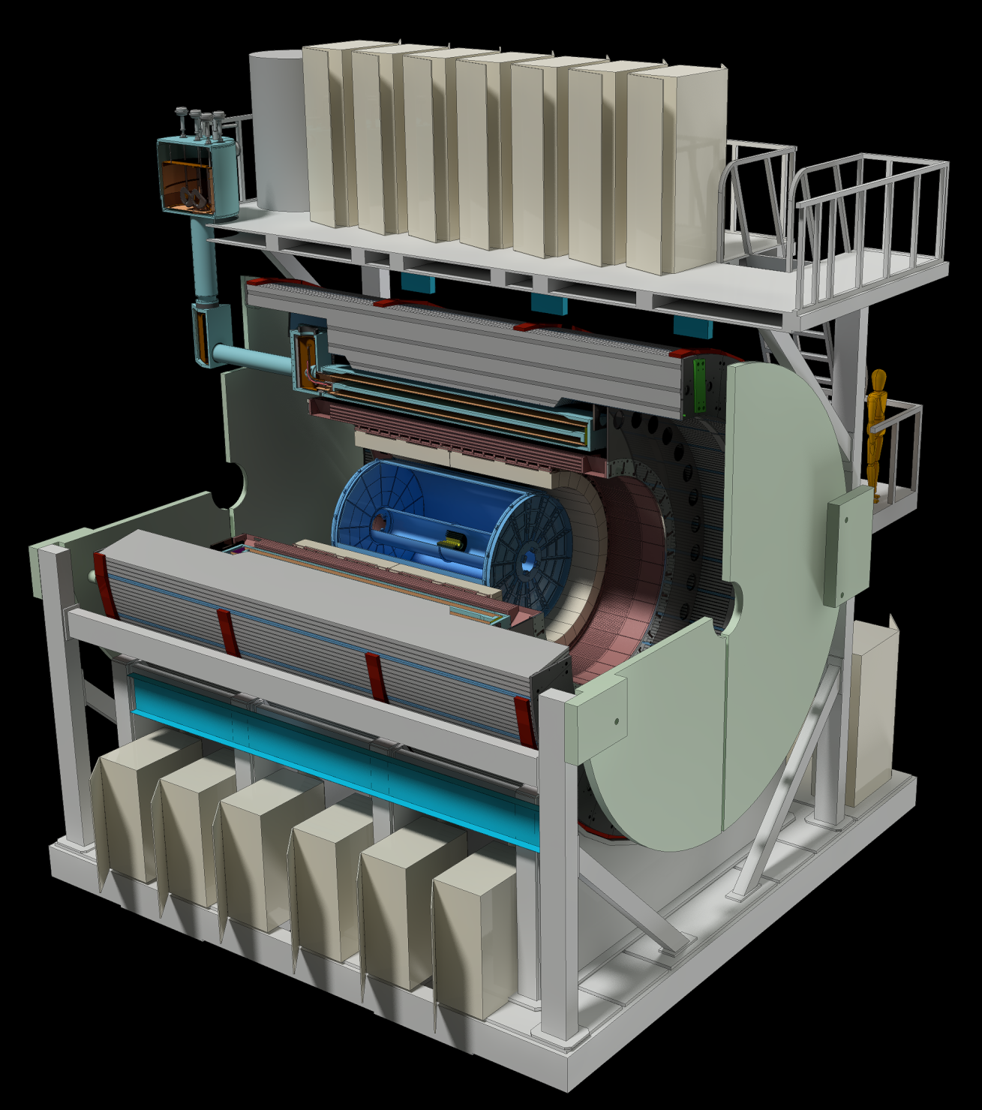
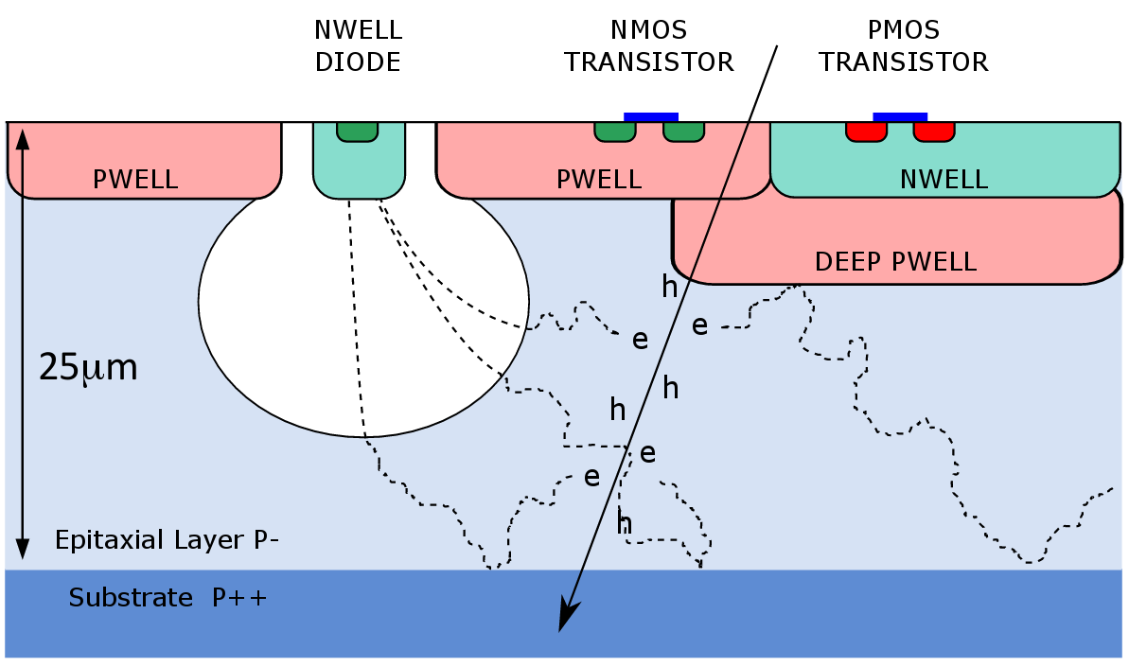
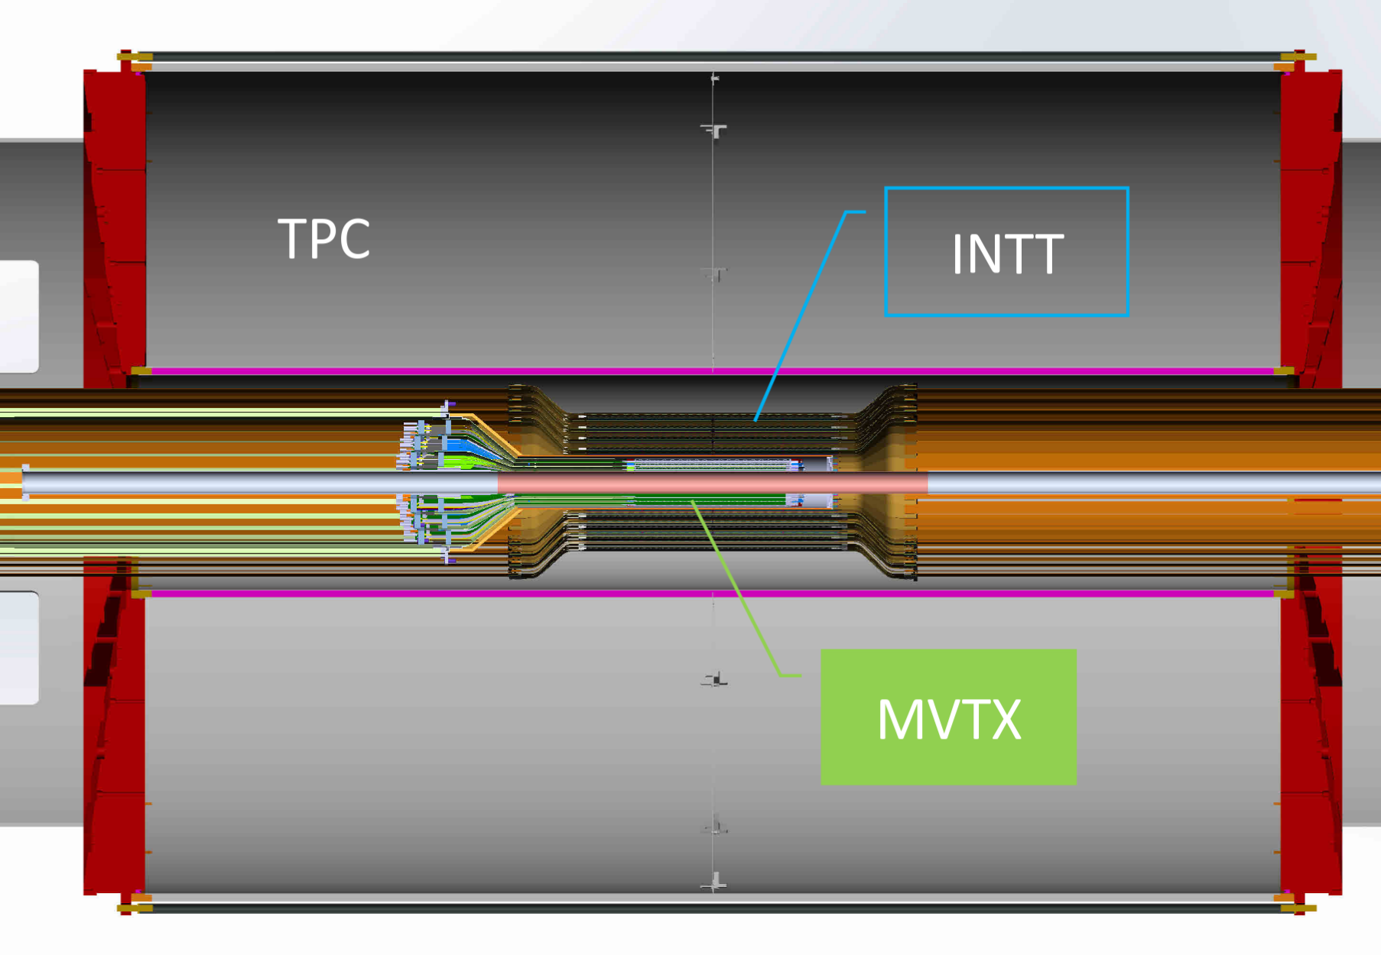
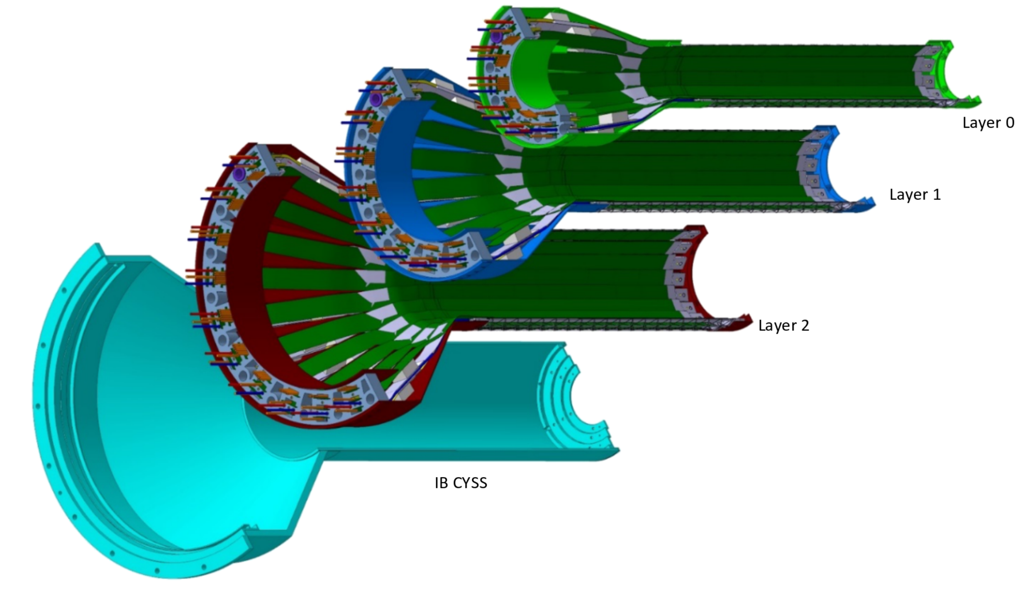
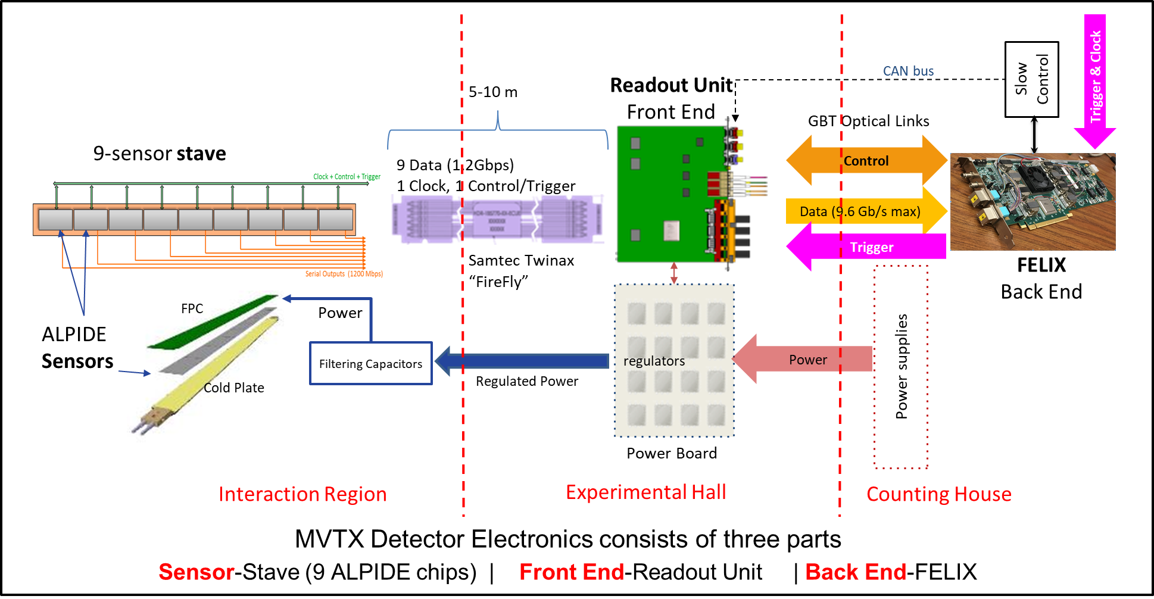
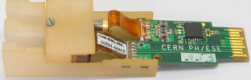
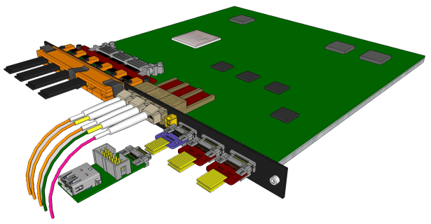
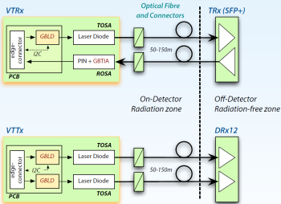
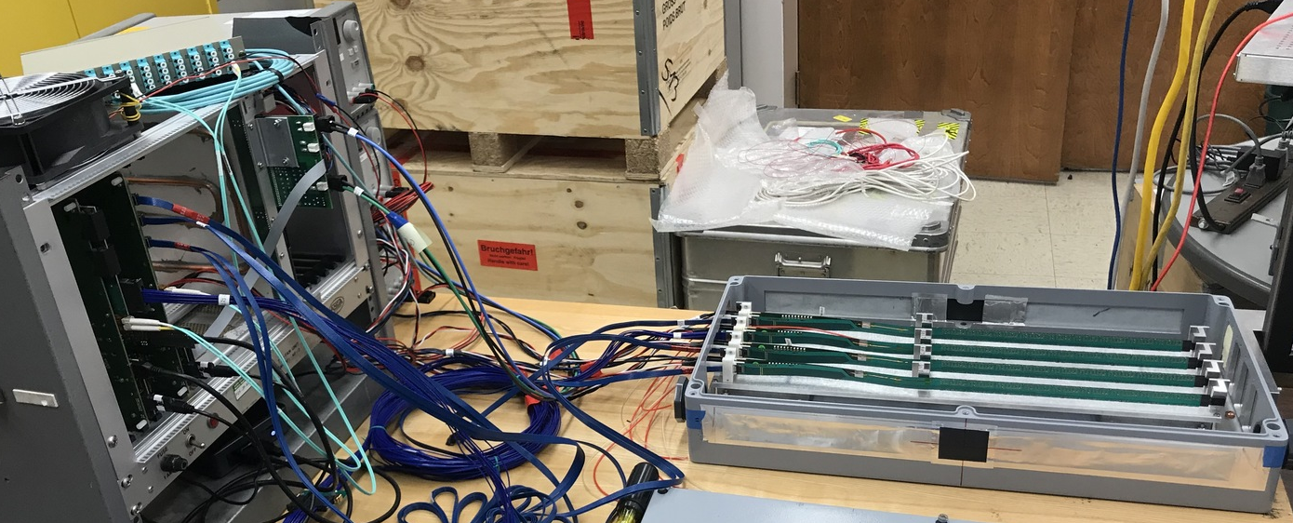
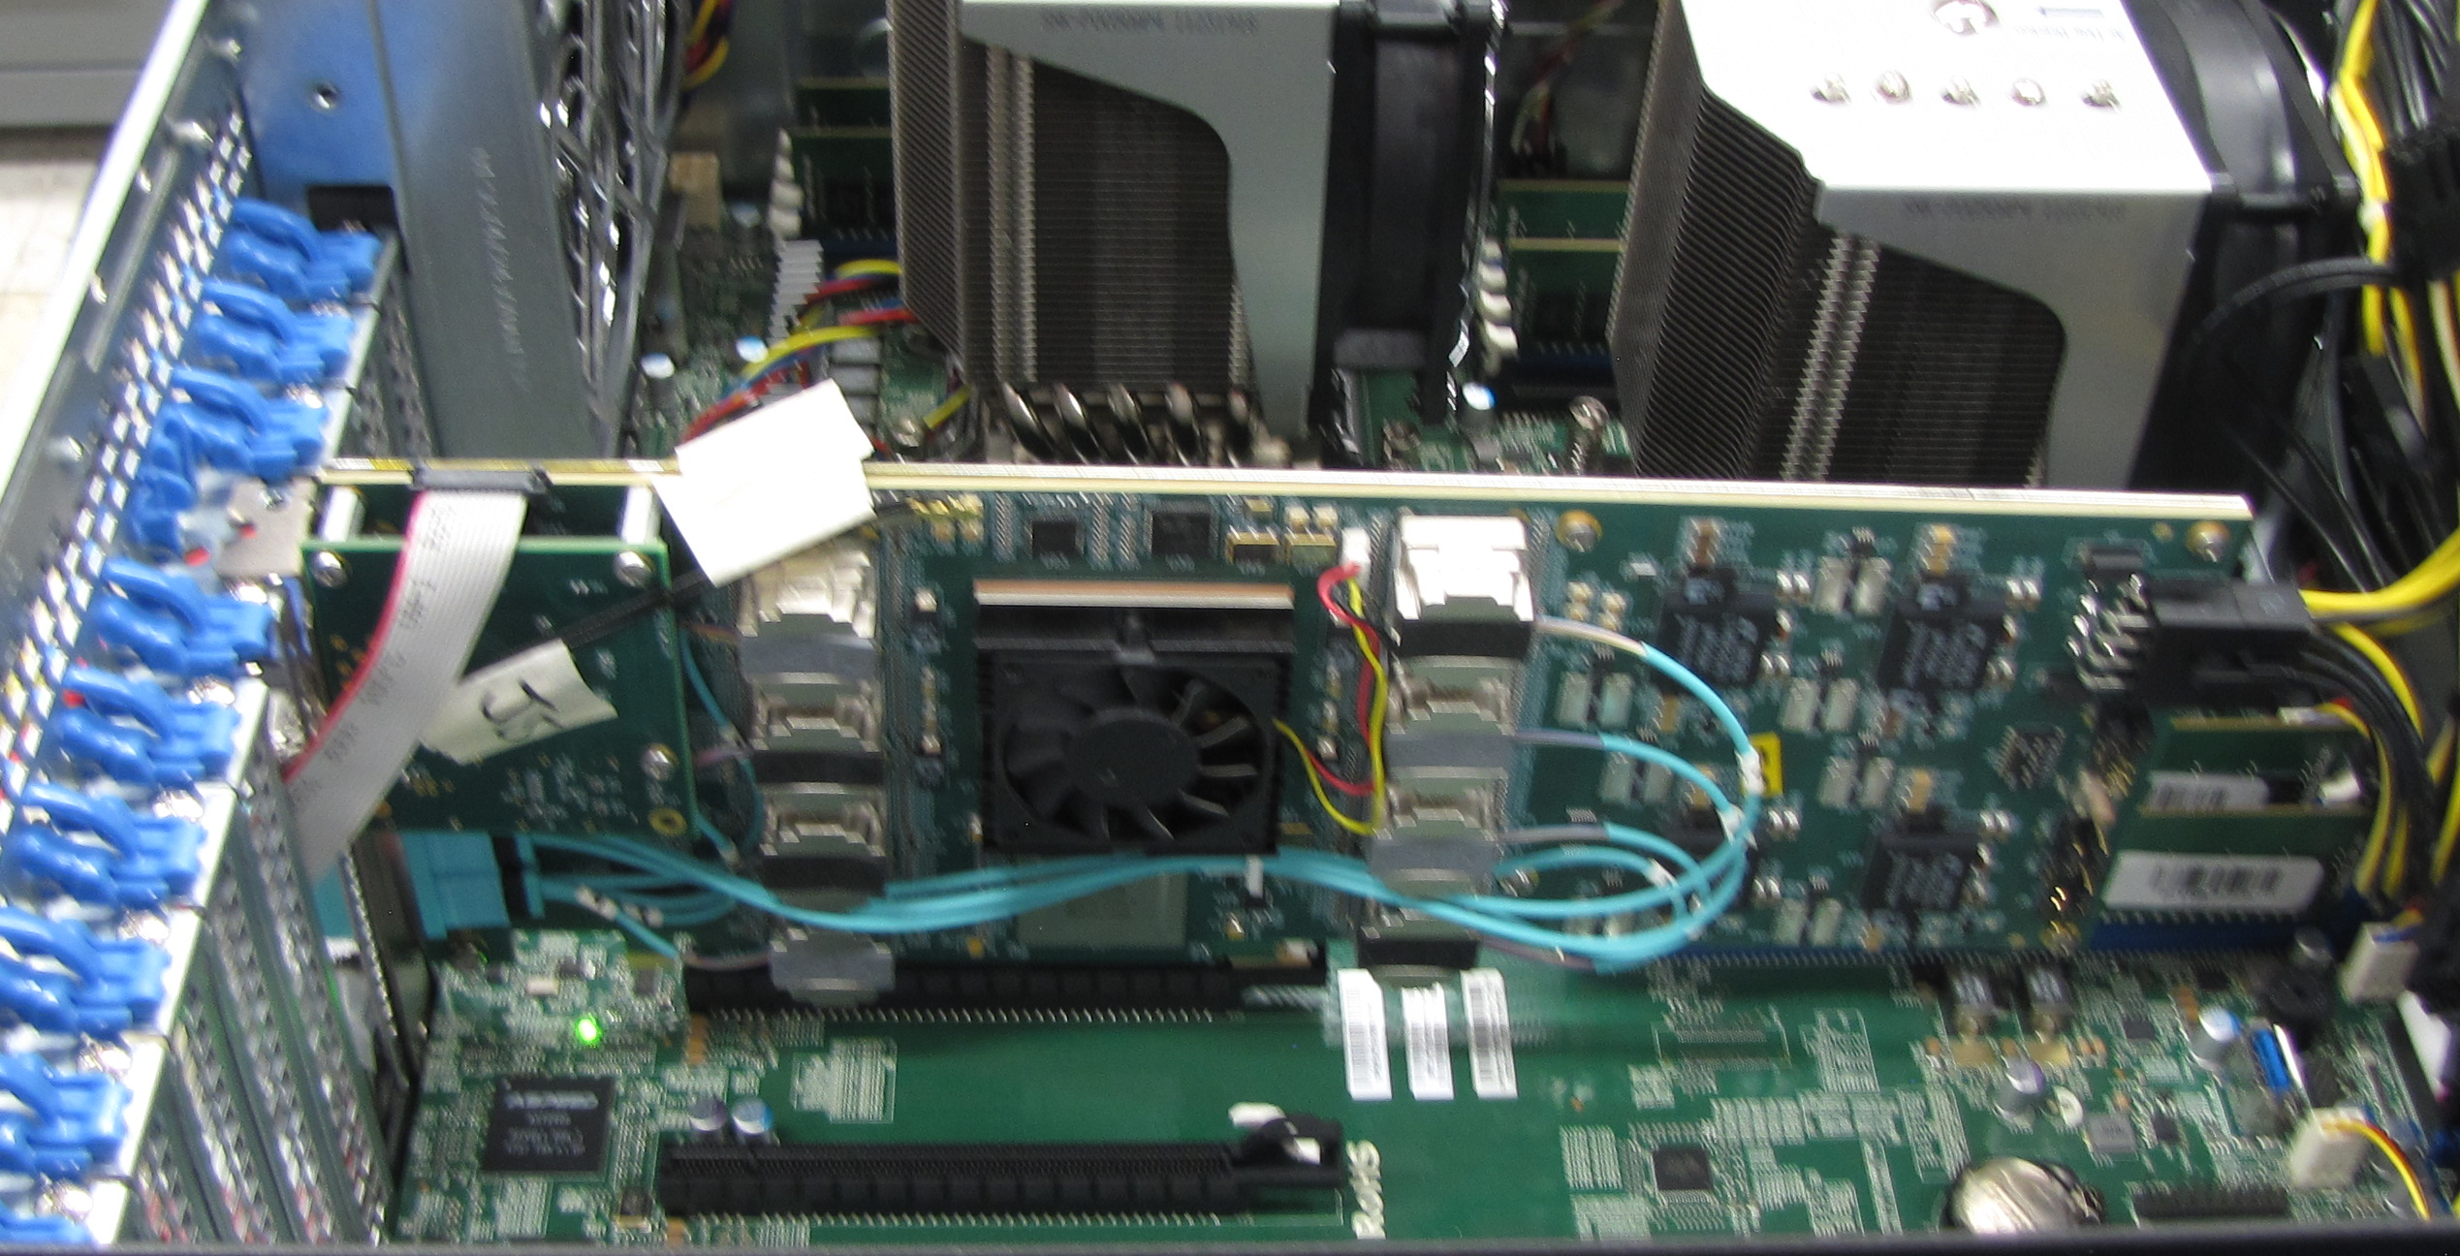

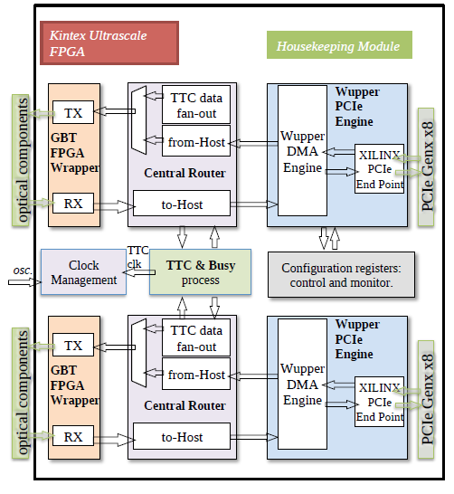
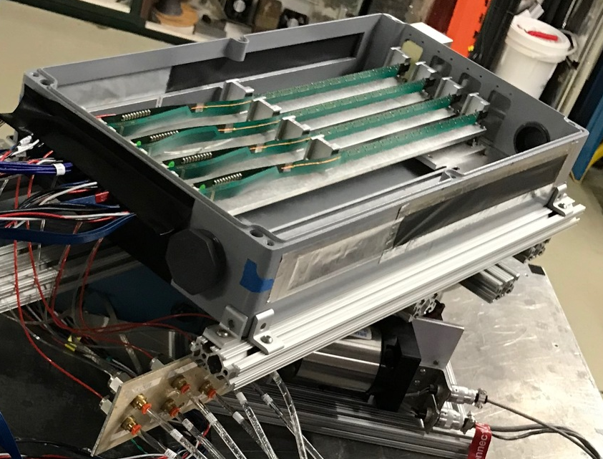
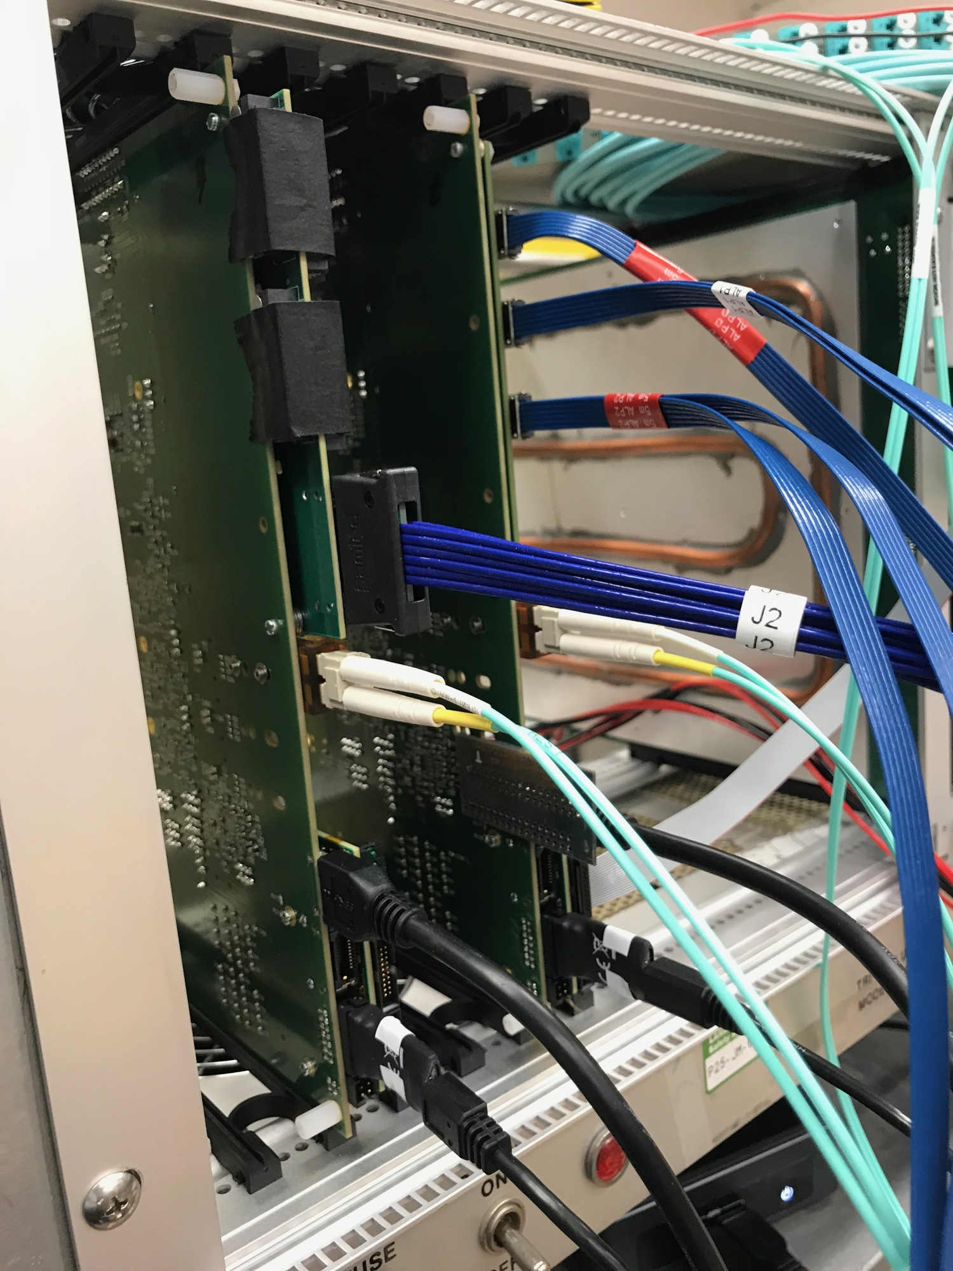
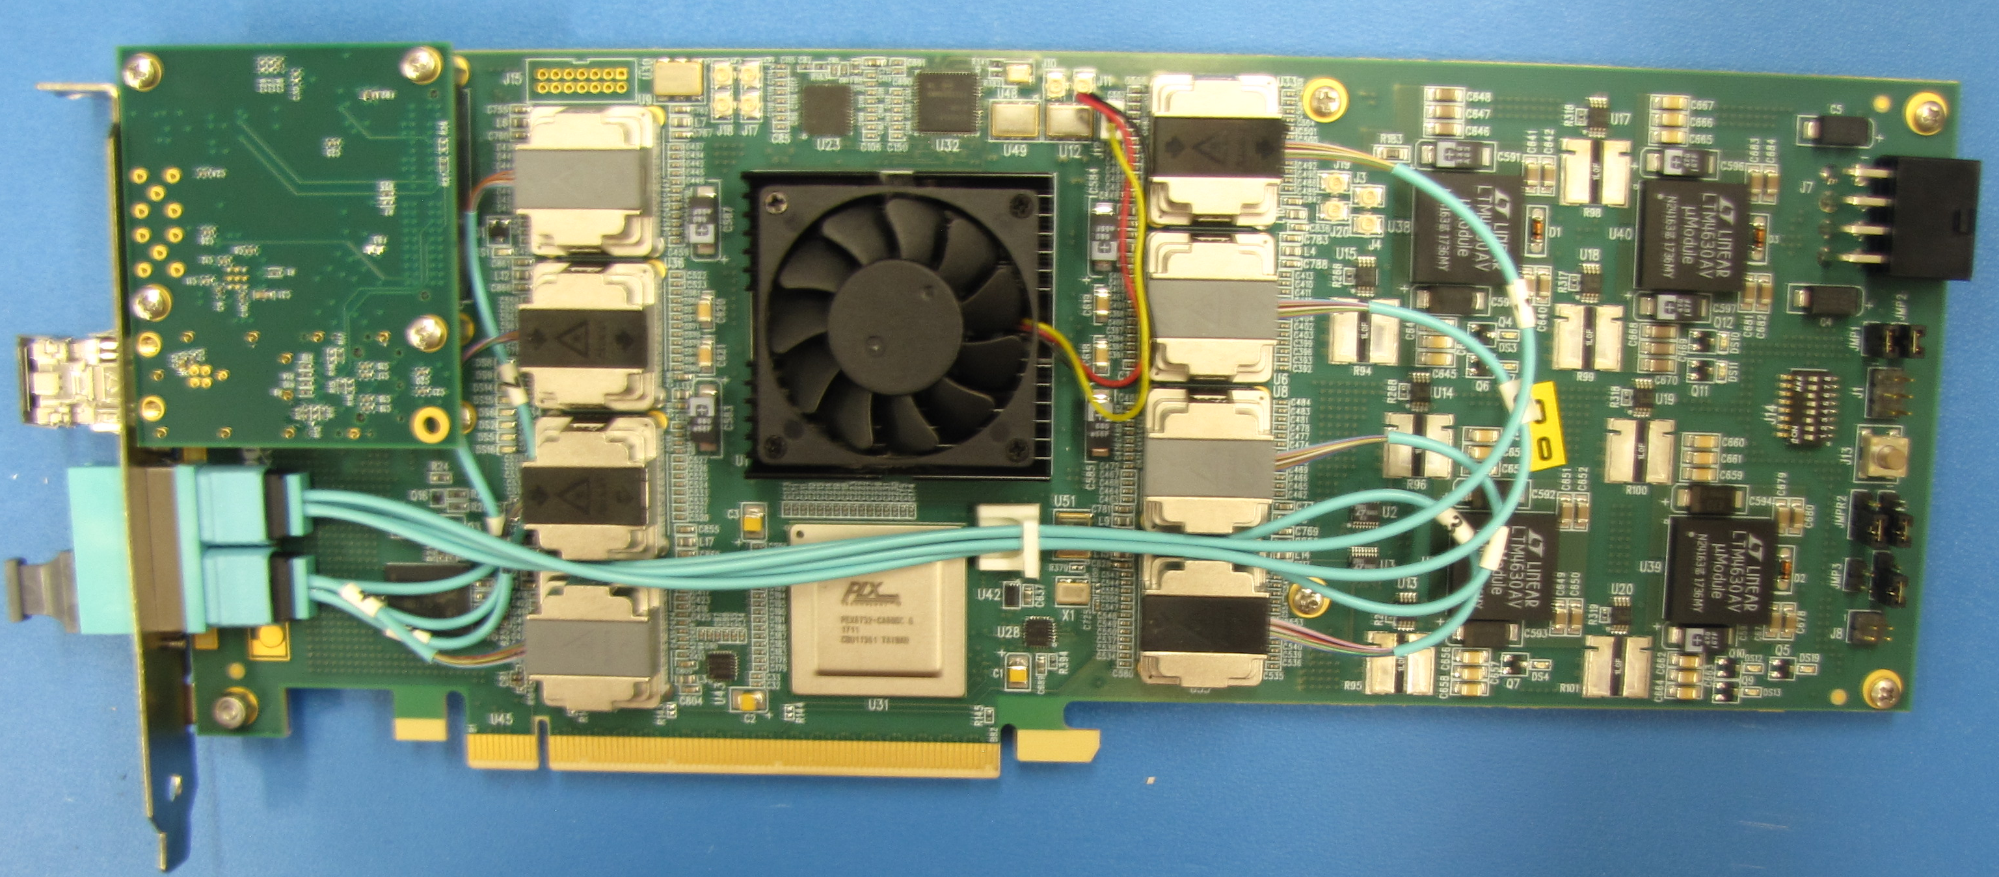


Readout of the MAPS vertex detector at sPHENIX
Sho Uemura, Alex Tkatchev, for the sPHENIX Collaboration
Abstract
The MVTX detector will serve as the micro-vertex tracking detector of the sPHENIX experiment at RHIC. It is an extremely precise silicon pixel vertex detector, with excellent displaced secondary vertex detecting capabilities. The MVTX will enable key measurements of heavy-flavor-tagged jets and B-mesons in heavy ion collisions. The detector is based on the latest generation of Monolithic Active Pixel Sensors (MAPS) technology, developed for the ALICE collaboration at CERN. The readout chain is comprised of three parts: a sensor stave assembly, a RU (Readout Unit) board, and a FELIX (Front End LInk eXchange) board. The stave assembly consists of 9 ALPIDE (ALice PIxel DEtector) sensor chips, which will send its data on 9 gigabit links over a FireFly cable to an RU board. The RU board consists of two FPGA’s, one for reading the stave data and sending data using CERN’s rad-hard GBT links over fiber to the FELIX board and a second FPGA which is used for scrubbing (SEU detection). The FELIX board consists of an FPGA that reads out the the data over the fiber link and sends its data to a 16 lane PCIe interface, placing the data to disk. We will present the R&D efforts and performance achievements for the three parts of the Readout system mentioned above.
.
Sensors and Stave
In-pixel amplification, discrimination, and hit buffering
Digital data output at 1.2 Gbps
Integrated test and masking
In pixel:
Amplification
Discrimination
3 hit storage registers
AMP
COMP
ALPIDE
1024 pixel columns
THR
Readout (zero suppression)
Readout (zero suppression)
Readout (zero suppression)
512 pixel rows
Readout (zero suppression)
MVTX READOUT SYSTEM
FELIX and Readout Unit are integrated: FELIX sends triggers and aggregates RU data
MVTX is integrated into the sPHENIX DAQ: working rcdaq plugin for FELIX and online data decoding/monitoring of ALPIDE data
Bias, Readout, Control
Stave
Clock
Chip1
Chip2
Chip3
Chip4
Chip5
Chip6
Chip7
Chip8
Chip9
Control+Trigger
To Readout Unit: Samtec FireFly twinax cable
9 independent 1.2 Gbps data streams
Common 40 MHz clock
Common control line
Serial Outputs (1.2 Gbps)
Stave– 9 chips, common clock and control, independent data lines
1 stave per Readout Unit
To stave: transition board
control and clock outputs
up to 27 inputs for 1.2 Gbps data streams from ALPIDEs
Readout Unit
The Readout Units will be located inside the experimental hall and just outside the magnet, approximately 5 meters from the staves.
Radiation tolerant: logic is triplicated in Kintex Ultrascale main FPGA, rad-hard ProAsic3 FPGA scrubs the main FPGA
Optical communication using radiation-hard CERN components: GBTx ASIC, VTRx and VTTx optical transceivers
Data readout from stave
Stave configuration, monitoring and power control
Trigger and busy management
Data building and transmission
Lab R&D
Successful readout of four Staves in internal pulsing mode, with full 15 kHz sPHENIX trigger rate and occupancy
Successful readout of multiple Staves
Transition Board
Samtec FireFly cable
VTRx
VTTx
VTRx sm
Power Boards link
2 uplink (data) to FELIX
1 uplinks (data/CTRL) to FELIX
CAN bus
1 downlink (CTRL) from FELIX
Two Readout Units Four Staves One FELIX
Diagnostic / busy IO
1 trigger downlink directly
to ensure low latency
To FELIX: rad-hard 4.8 Gbps GBT optical links
Test Beam
8 Readout Units per FELIX
Successful readout of four stave telescope using two RU’s (Readout Units)
Testing worst case performance of reading out 3 Staves read out by one RU and normal case performance with one stave connected to one RU.
The telescope took an external clock and trigger, received from GTM (sPHENIX timing and trigger) and a range of threshold, shaping, and trigger latency parameters
To Readout Units: 48 bidirectional GBT links
FELIX
Data readout from 8 Readout Units
Slow control and monitoring to/from sensors
Trigger and timing interface
Data aggregation and subevent packaging
Data transmission through PCIe to server CPU
Four Staves Two Readout Units Test Beam Block Diagram
To DAQ: 16 lane Gen3 PCIe (>100 Gbps)
6 FELIX boards for full MVTX detector

