Slide 1
MVTX Update – BiWeekly 4/26/2019
Received final review report last week, working on recommendations
Risk registry updated
WBS dictionary in progress
PMP under development
MVTX budget and schedule updated
FY19 fund request submitted to BNL
FY19 Monthly M&S and Labor cost sent to BNL, next slides
Fermilab test beam schedule – still waiting for the final word!
Likely in the week of May 20 -24, Mon-Fri

Slide 2
Final report on Silicon – MVTX/INTT
Actions. Taken:
Updated MVTX risk registry
Now in the same form of other MIE subsystem
Risk based contingency:
Cost & Schedule contingency
BNL keeps the contingency $

Slide 3
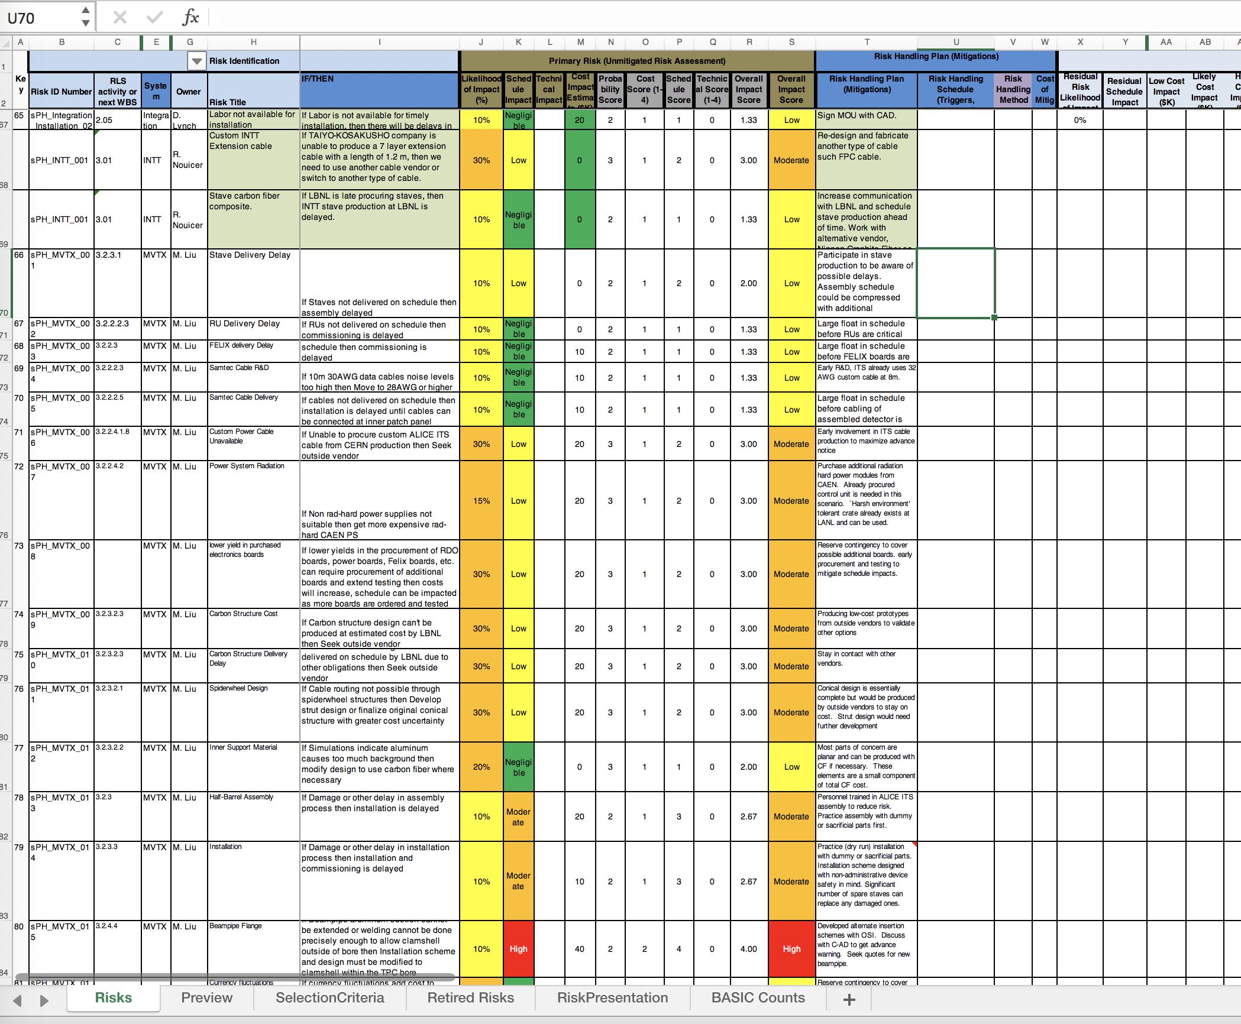
Risk Registry in P6, same as the rest of sPHENIX
MVTX draft risk registry -
https://docs.google.com/spreadsheets/d/1UzIOnXfAwbjxUcnrQVnFLN20niq43x2v2J2epF10bjg/edit?usp=sharing
MVTX

Slide 4
FY19 budget submitted to BNL for funding
Engineering design work on mechanical structures

Slide 5
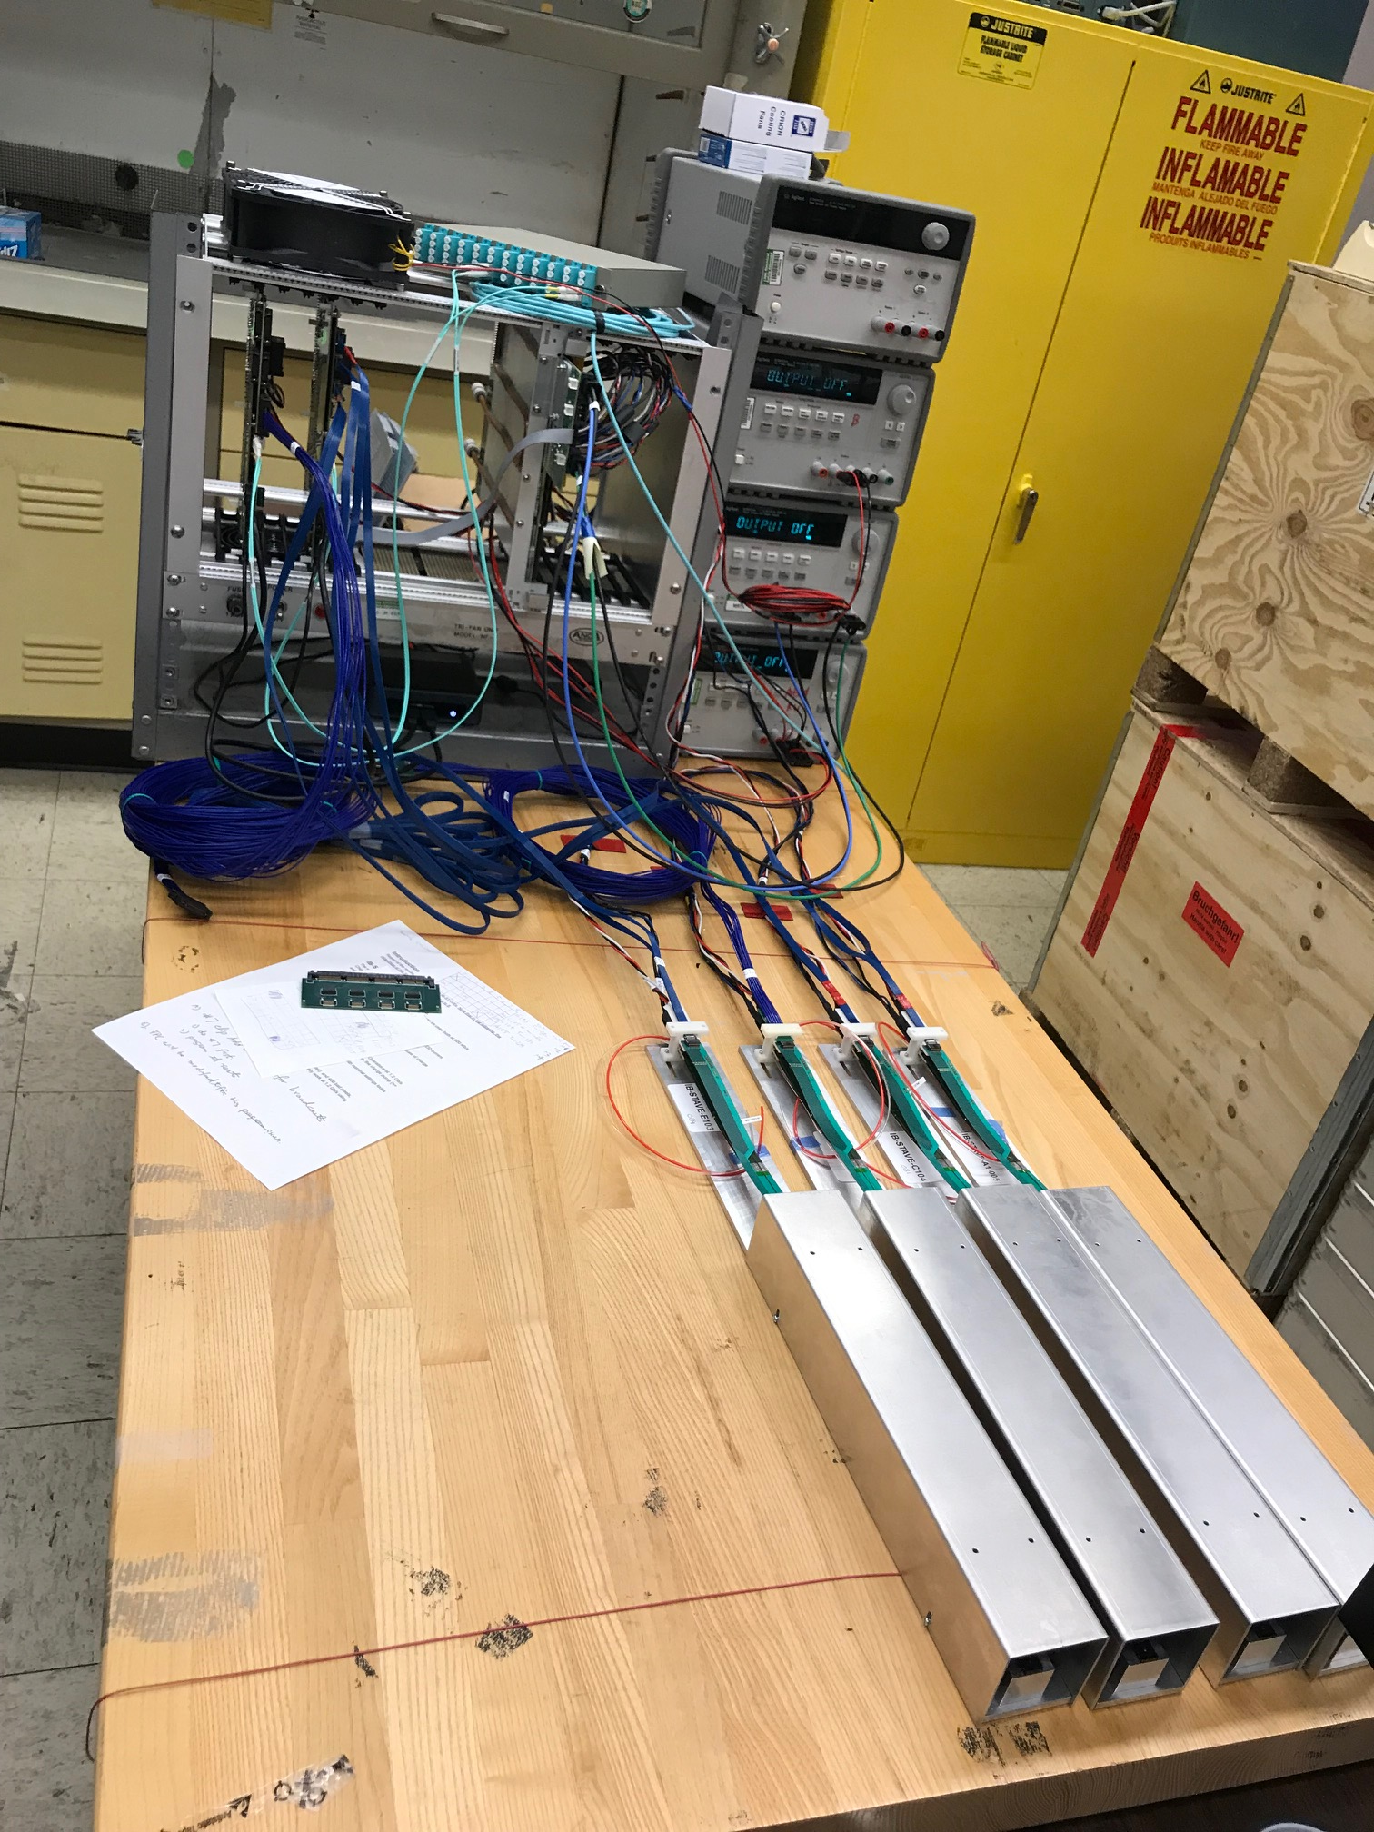
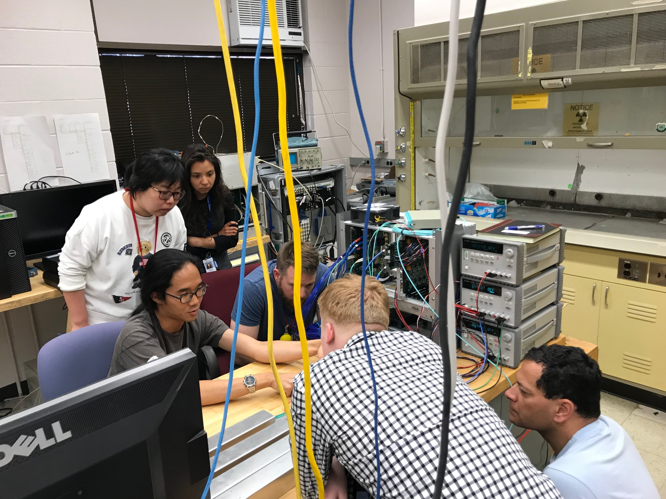
4-stave telescope progress: fully functioning
2 RUS; 1 PU
4 staves

Slide 6
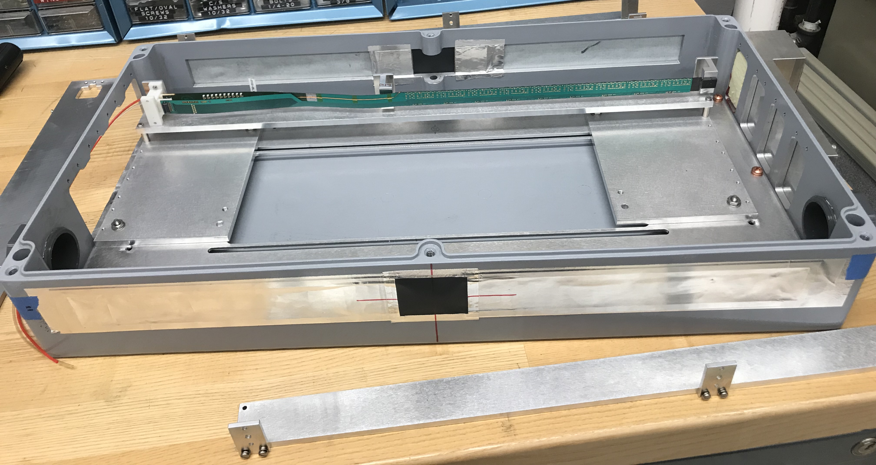
Telescope Box

Slide 7
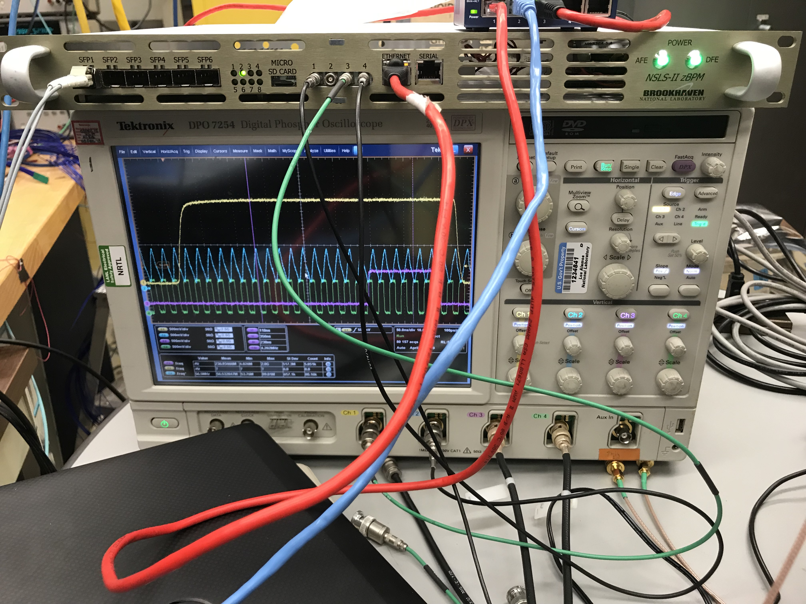
sPHENIX GTM in Operation w/ MVTX
sPHENIX GTM
sPHENIX GTM:
10kHz external trigger
6x RHIC CLK
FELIX:
clock recovered from GTM clock
captured trigger from GTM, sent to RU/ALPIDE

Slide 8
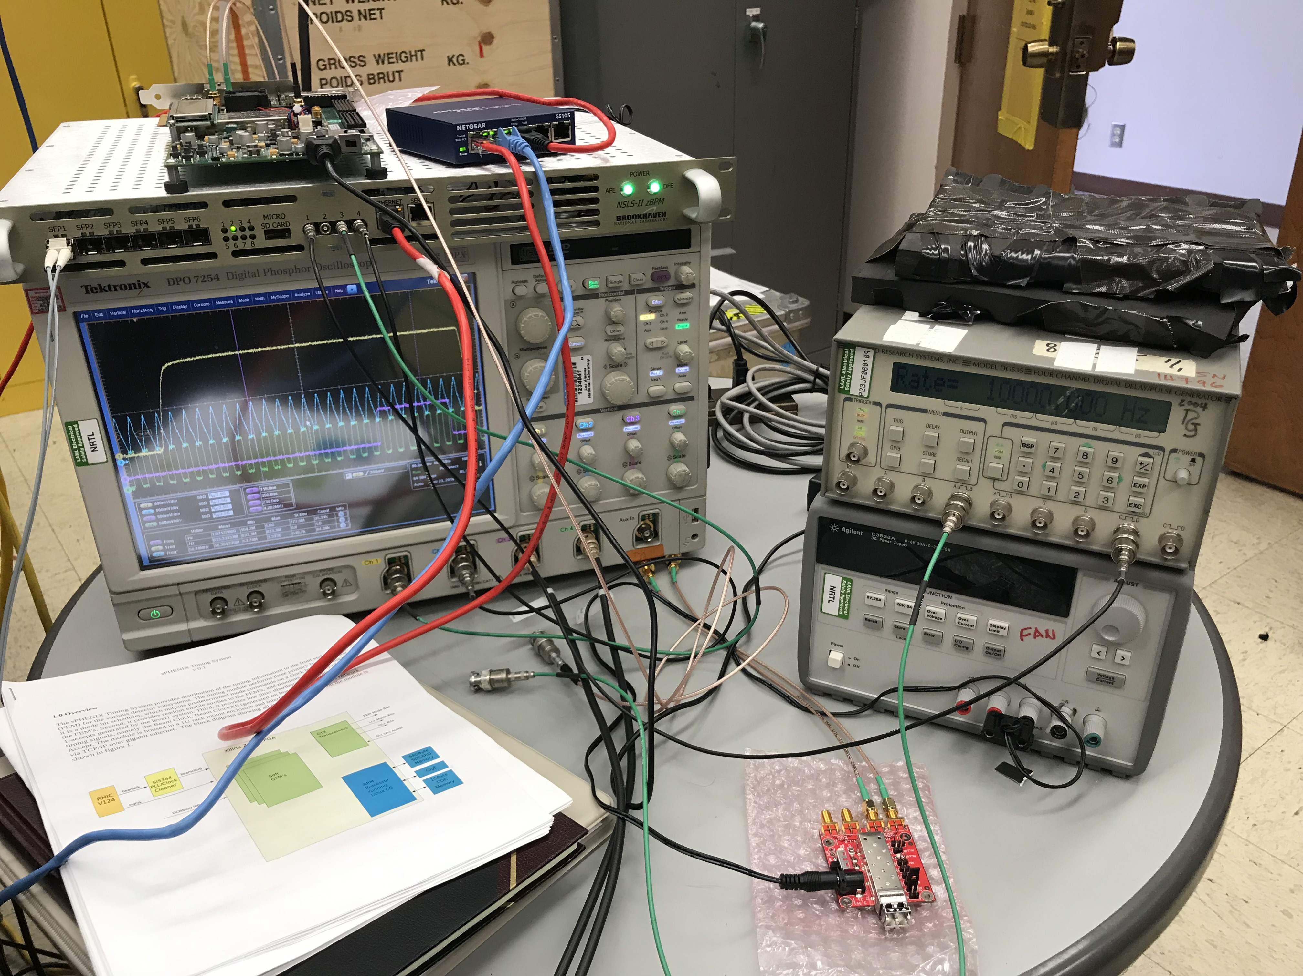
sPHENIX GTM and External Trigger
GTM
10kHz external trigger
sent to GTM

