Slide 1
MVTX Status and Plan
Ming Liu
08/16/2019

Slide 2
Response to MVTX Review Report https://docs.google.com/document/d/1vQp_DVlOix2g5oseAupGaYMREHvrNKCq6deqOzTE6Sk/edit?usp=sharing
PMP updated
  KPP, UPP
  Contingency policy
Budget updated
  EU for carbon structures
  EW: 40% → 60%
  CYSS, SB remain at 40%
New quotes for Carbon structures - in progress
  Updated CYSS/EW designs available by the end of August, MIT/LANL
  Obtain new quote from commercial companies, US and abroad
  LBNL updates cost once fund arrives (soon)
Plan to submit them to sPHENIX project office,
COB today, 8/16/2019
https://www.phenix.bnl.gov/WWW/publish/mxliu/sPHENIX/Reviews/BNL-072019/MVTX-ManagementPlan-BNL-Format-version-v10-080919.docx
https://www.phenix.bnl.gov/WWW/publish/mxliu/sPHENIX/Reviews/BNL-072019/MVTX-EU-updated-08142019.xlsx

Slide 3
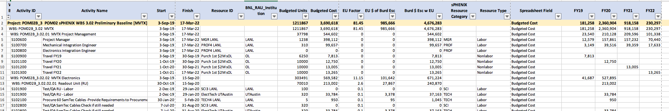
Updated P6: 8/14/2019
Total cost: $3,691 K, with Esc + EU: $4,676 K
Risk: $70K
TPC: $4,746K

Slide 4
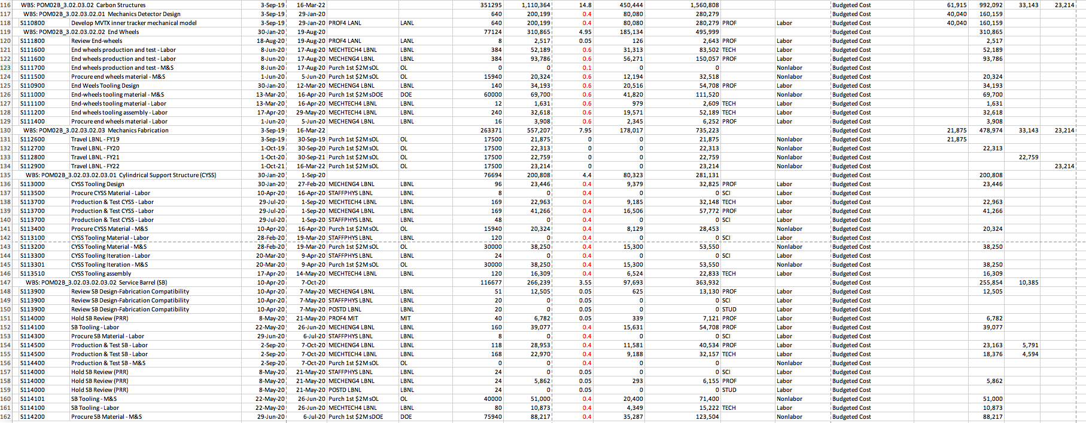
EU for Carbon Structures Updated
EW: 60%; CYSS and SB: 40%
Engineering cost estimate by LBNL to be done soon
Update quotes from commercial companies soon

Slide 5
Plan: Schedules & Milestones
Fully aligned with sPHENIX via external milestones
Schedule drivers
Day-1 physics
CERN production
Carbon structures
Early R&D in progress
LANL LDRD
  Readout
  Mechanics
BNL R&D fund
  MIT carbon structure design
  LBNL carbon structure cost estimate

Slide 6
Near Term To-Do List
Carbon structure cost estimate
  Visit CERN/WorkShape in September
  LBNL CF update
  Contact US vendors
  Prototypes
Continue mechanical system design
  CYSS, EW, SB
  Global insertion system and mockup
A full “8-stave + 8-RU + 1-FELIX + 1-PU + 1 GTM” chain test
  10 RU being shipped out from CERN to LANL
  1 PU arrived at LANL from LBNL (thank Leo, Alberto!)
  8-stave/HICs telescope frame being designed
  RU & FELIX Firmware update
  Develop slow control software
  A test beam run later this year
SamTec cables test
  LANL, UTA
RU acceptance QA at UTA
Stave acceptance QA at LBNL
FELIX production and test (jointly with sPHENIX TPC)
- Physics and Detector simulations:
Test Beam data analysis
MVTX detector response, MC
tracking optimization
c, b hadrons/jets tagging
- ITS system surface commissioning at CERN:
Now --- May 2020
A good opportunity to learn about the
system operation and controls

Slide 7
2019 Test Beam Data Analysis
Offline analysis in progress: all TB data in RCF
https://wiki.bnl.gov/sPHENIX/index.php/MAPS-based_Vertex_Detector_(MVTX)

