Slide 1
MVTX Test Beam at Fermilab
- May 13-25, 2019, very successful runs
- June 10-22, 2019, coming up now
Cameron, Sho, AlexT, Gerd, Hubert, Xiaochun, Matt, Walt, Kun, Abel, Chris, Zongze, Sanghoon, Yasser, Xuan, Martin, Xu, Molly, Ming …

Slide 2
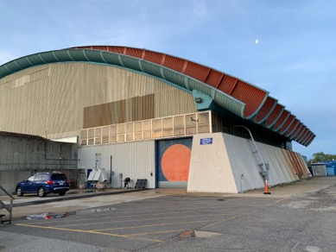

MVTX Setup @ Fermilab FTBF
MVTX

Slide 3
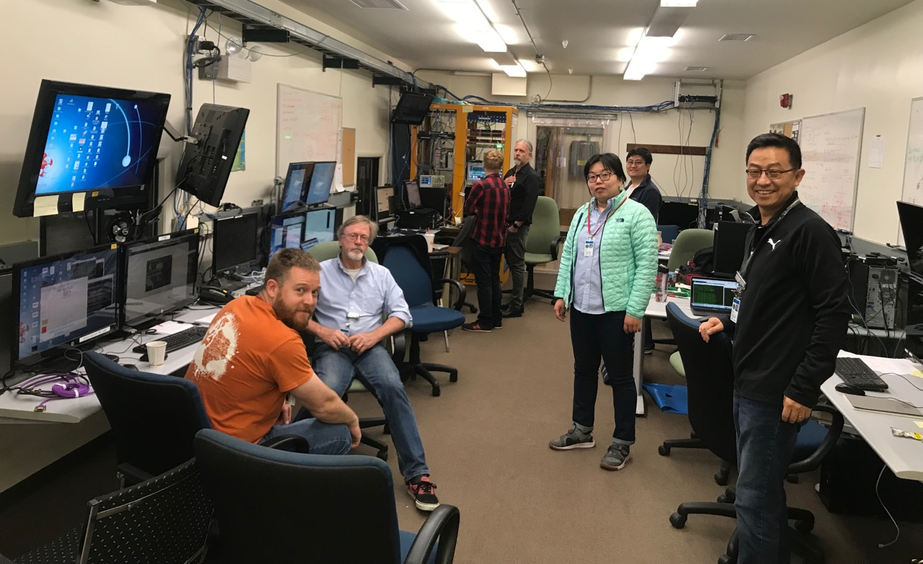
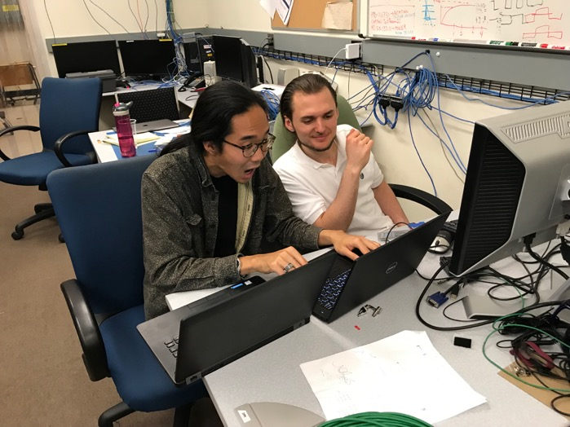
The Team
Data taking shift in the evenings: 7PM – 7AM
Beam: every other Monday –Friday 8:00AM – 8AM
Matt, Hubert, Cameron, Gerd, Zongze,
Xuan, Xiaochun, photo by Ming
Sho, AlexT
Not shown: Sanghoon, Yasser, Martin, Walt,
Kun, Abel. Molly, Xu, Chris …

Slide 4
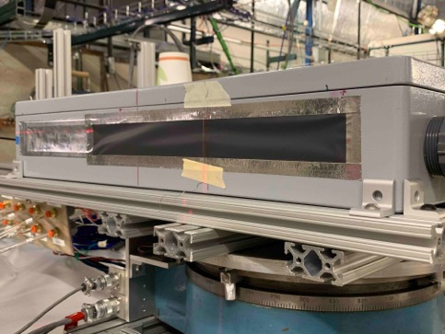
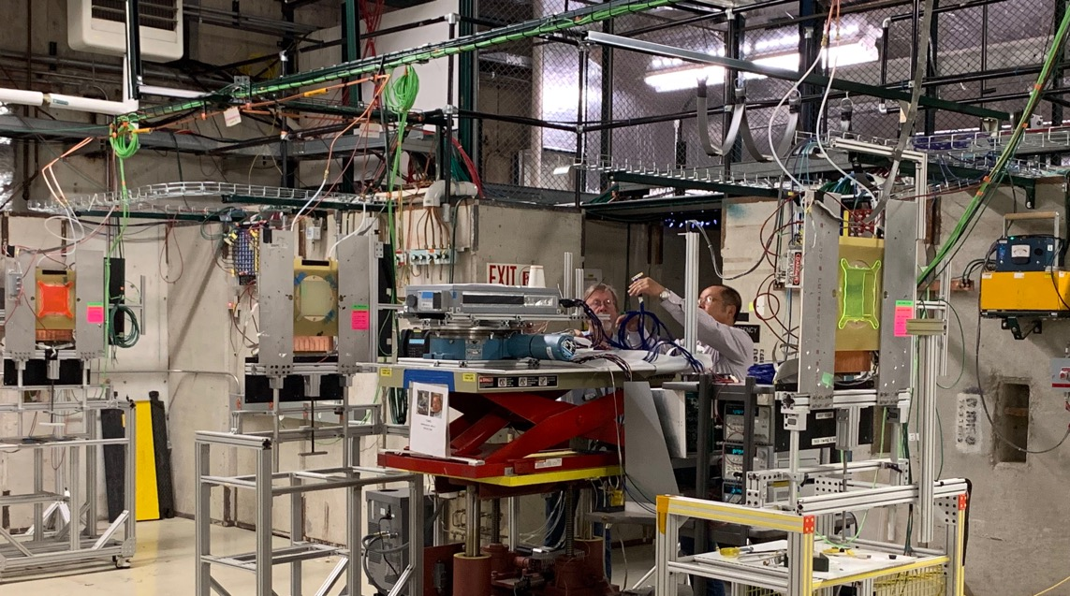
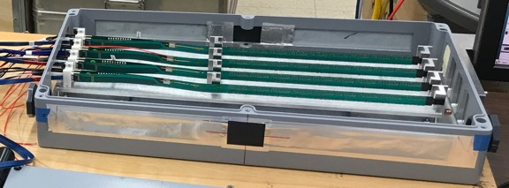
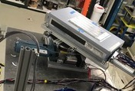
2019 MVTX Test Setup
From view
beam
Stave housing (four staves)
Stave housing sits on a motion table which can be moved in (x, y) plane perpendicular to the nominal beam direction. It can also be rotated (+40, -40) degrees (see photo on right). Operation was done at counting house.

Slide 5
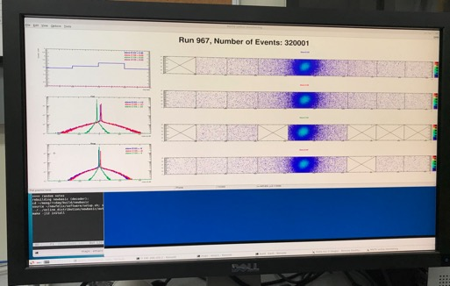
System Setup
SamTec: 11.4m
(2.6m+8.8m)
4-stave telescope
RU-2: 1 stave
- 1 fully functioning
9-chip stave;
- 3 staves with a few
broken sensors
4 staves
2 RUv1.1
1 PU
1 FELIX Server + RCDAQ
sPHENIX GTM
11.4m Custom SamTec Cable
Negative pressured cooling
RU-1: 3 staves
5m SamTec
120GeV p-beam
10kHz (30kHz)
Beam intensity:
30k ~ 120k ppp
Data & Control
Beam Trigger
Timing & Trigger
GTM
FELIX
Online Monitoring
RCDAQ
Multi-Stave + Multi-RU -> FELIX readout demonstrated
sPHENIX GTM integrated
Long readout SamTec cable certified
Cooling system demonstrated

Slide 6
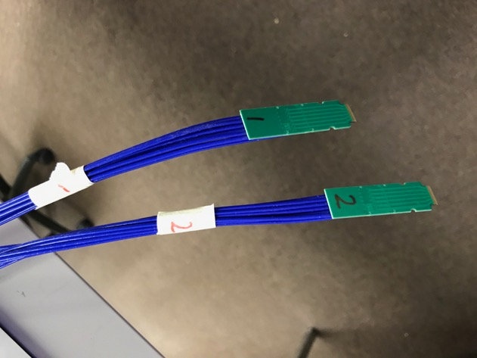
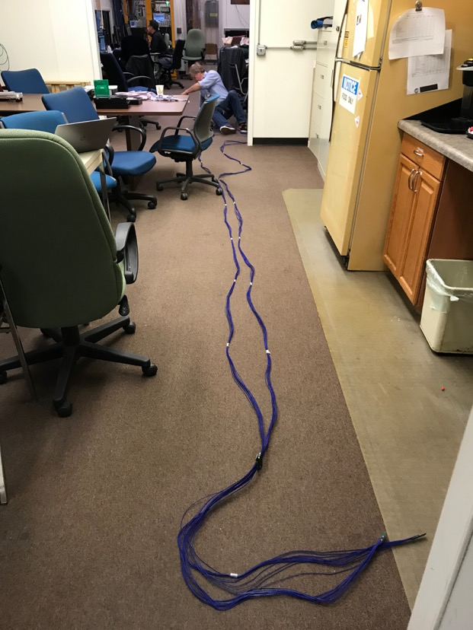
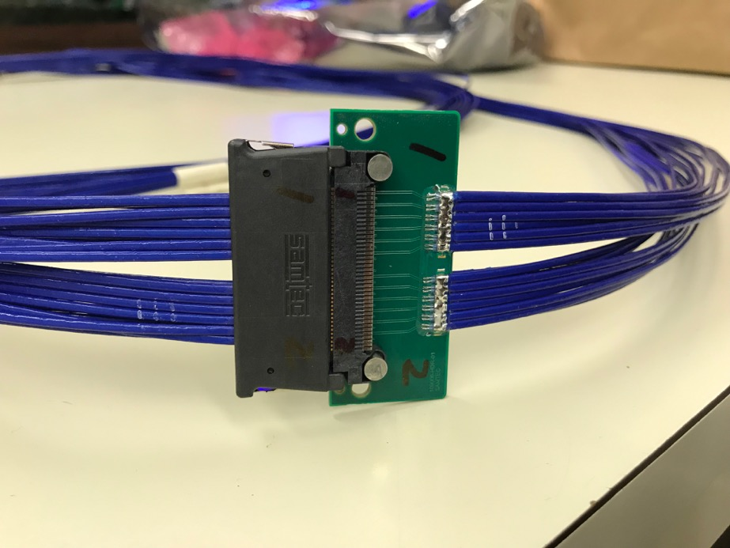
MVTX New Long SamTec Readout Cable Certified!
8.8m + 2.6m = 11.4m!
(10m desired; ALICE 8m cables)
Samples sent to MIT for mechanical integration
Mockup study

Slide 7
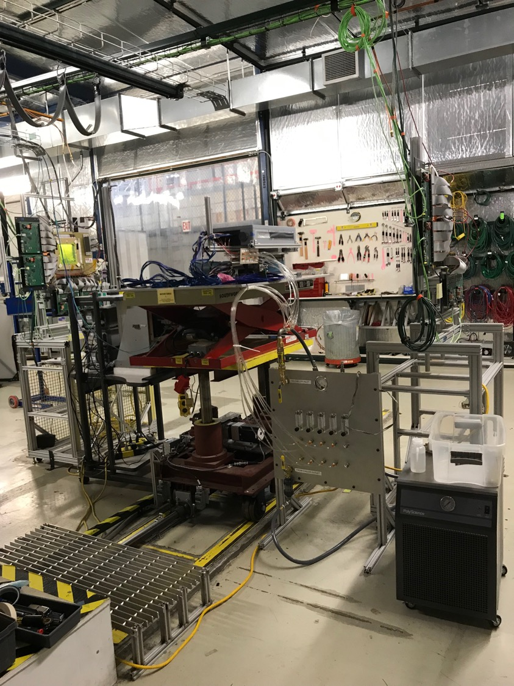
4-stave Telescope
- 120GeV p-beam;
- 5GeV e- beam
2 RUs,
PU, PS,
SamTec cables
Negative Pressure Cooling System
Motion Table
(X,Y,Phi)

Slide 8
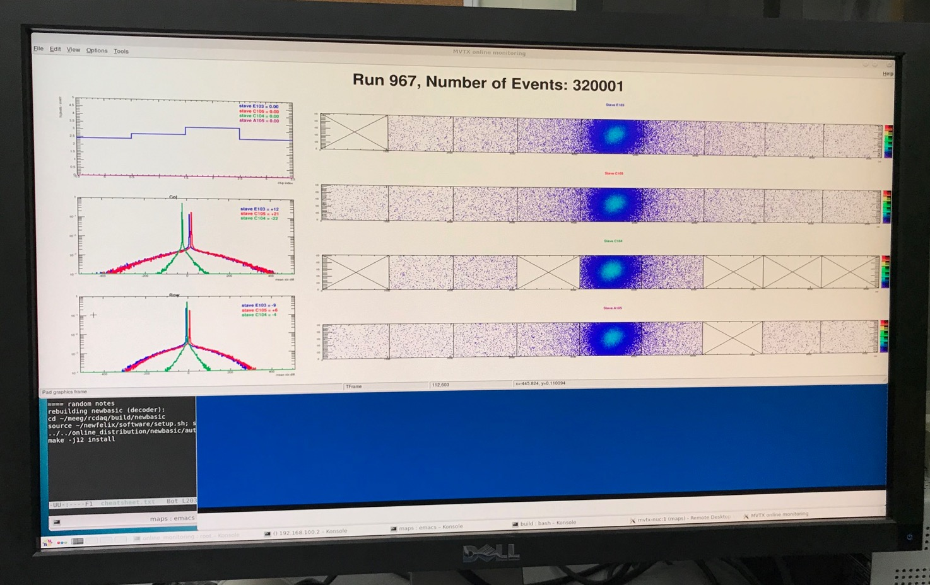
Online Display: 120 GeV proton beam
E103
C105
C104
A105
E103
Hits/Chip
C105
Delta_Col
C104
Delta_Row
A105
Beam

Slide 9
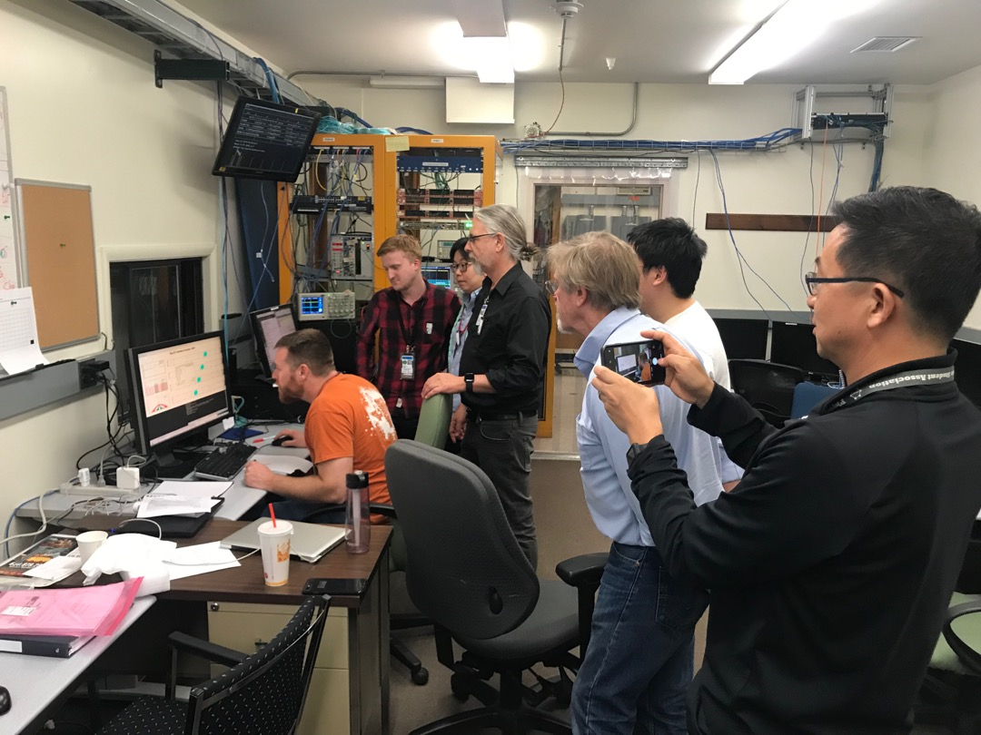
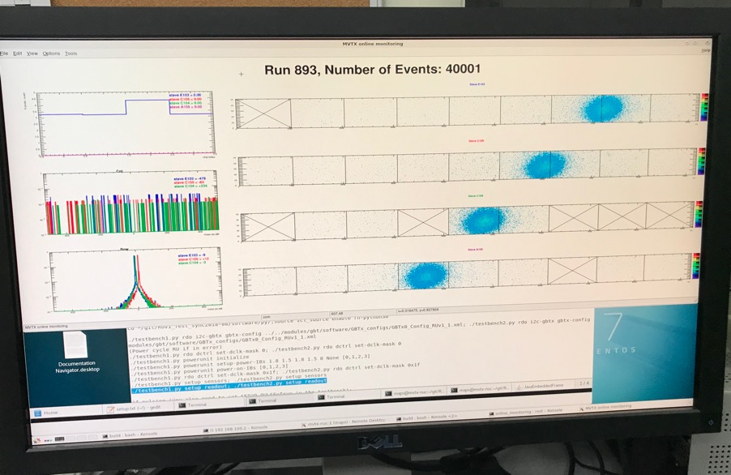
First Rotation – also Confirmed the Geometry!

Slide 10
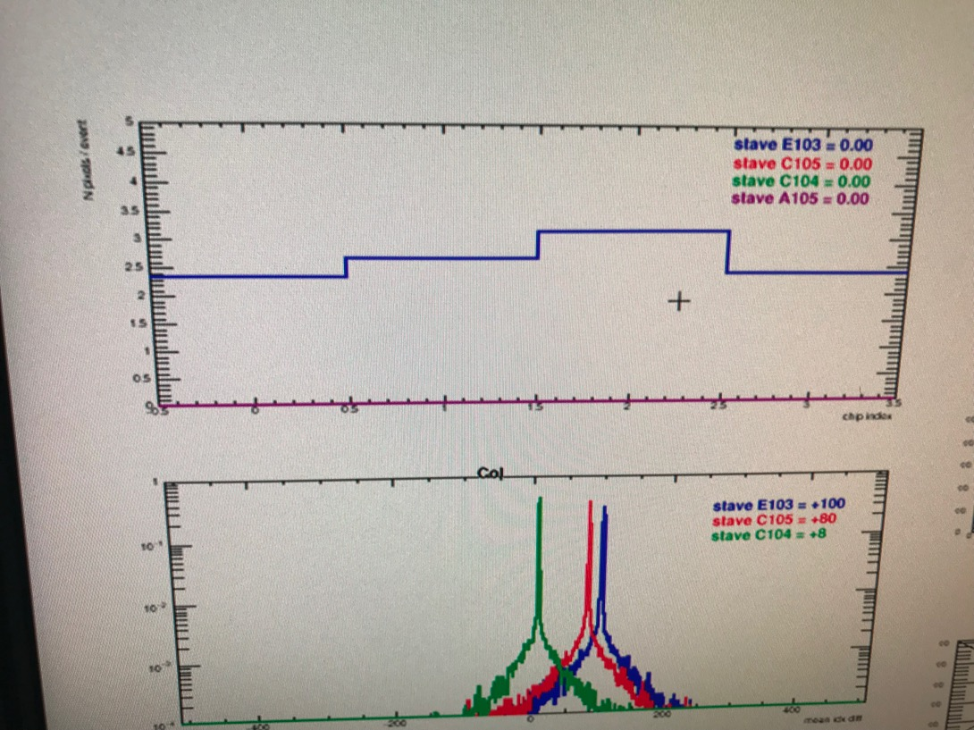
“Eyeball Tracking”
AVG pixel hits / stave: 2.5
- Same as last year TB restuls
Delta_Col (0-X): X =1,2,3
Peak_sigma_core = 0.55 pixel
Initial evaluation of hit spatial
resolution w/o clustering:
0.55 x 28um/sqrt(2) = 11 um

Slide 11
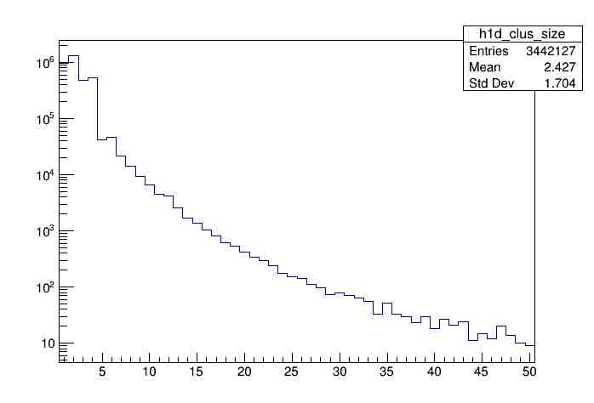
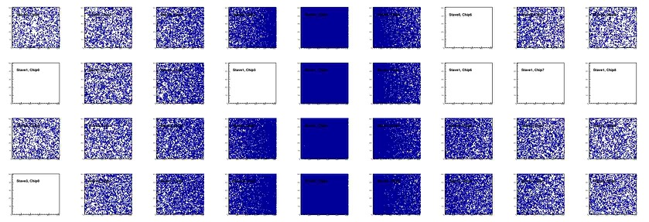
Offline Analysis: Cluster size vs Angle
Run 968, normal angle
Sanghoon, Yasser, Ming et al
Cluster Size = 2.4

Slide 12
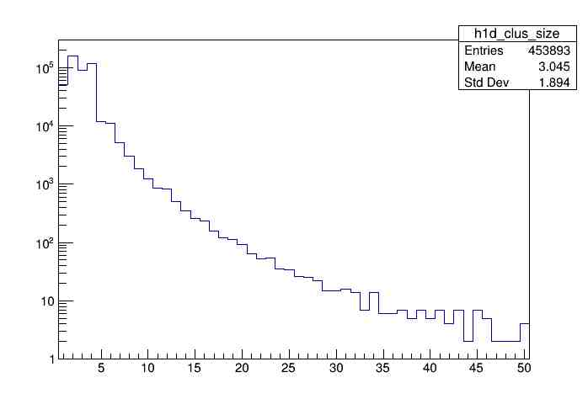
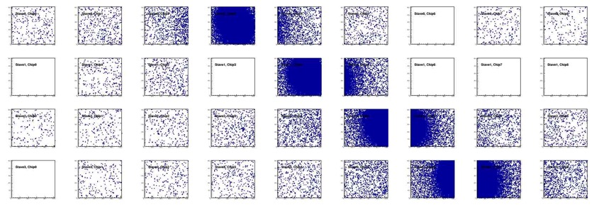
Offline Analysis: Cluster size vs Angle
Run , angle = 40
More data: Phi = 0, 10, 20, 30, 40, 45
To calibrate MC simulation,
charge sharing, cluster size etc
Cluster Size = 3.0
More work follows by Yasser, Sanghoon et al
Everyone is welcome to join the effort!
Stave geometry
Stave alignment
Clustering
Tracking
Update MVTX MC response in GEANT

Slide 13
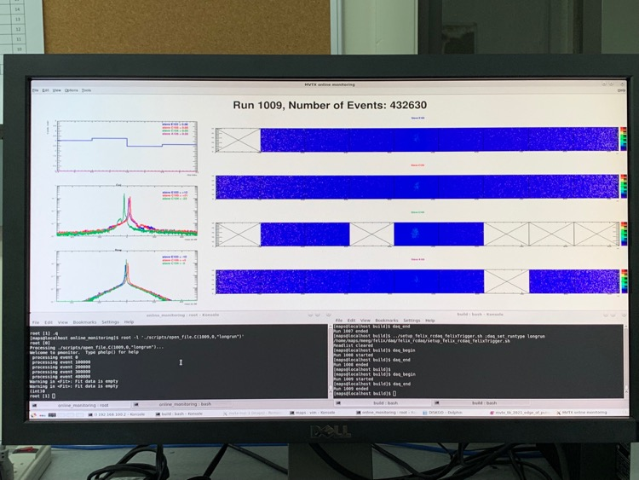
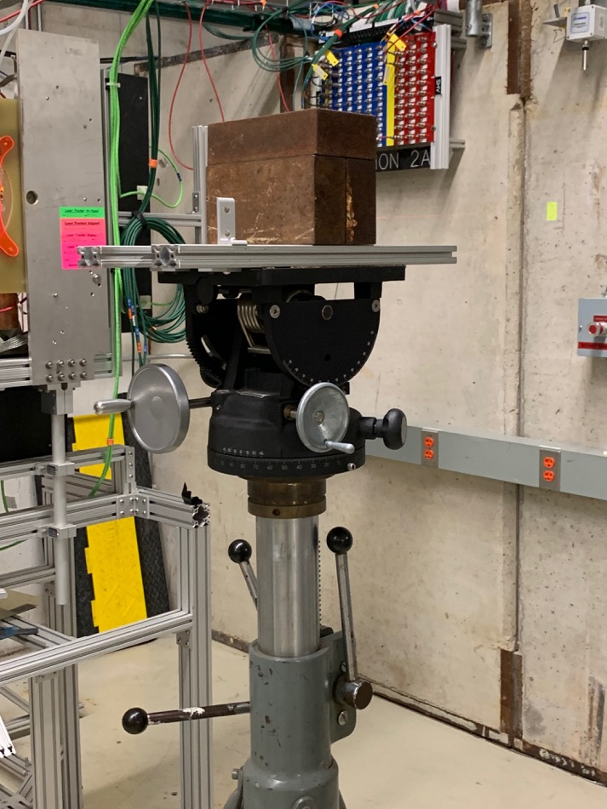
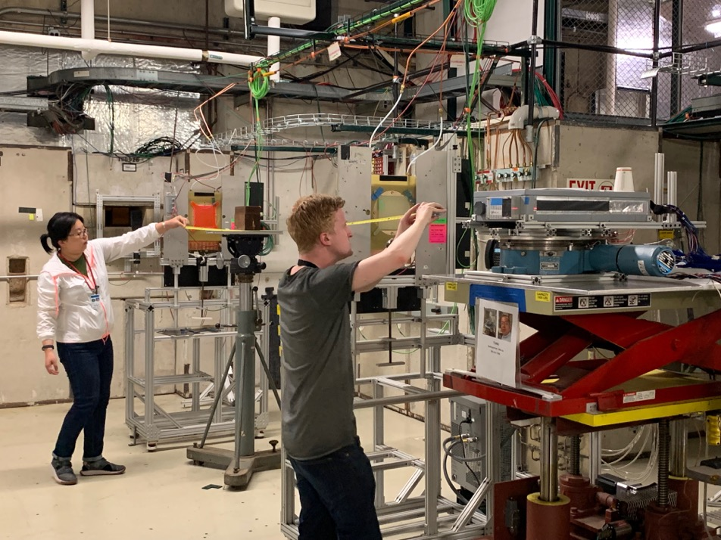
Add a 8” Thick Lead Brick “Target”

Slide 14
3-D event Display: high multiplicity p+Pb events
Cameron et al
Stave-4
Stave-3
Stave-2
Stave-1

Slide 15
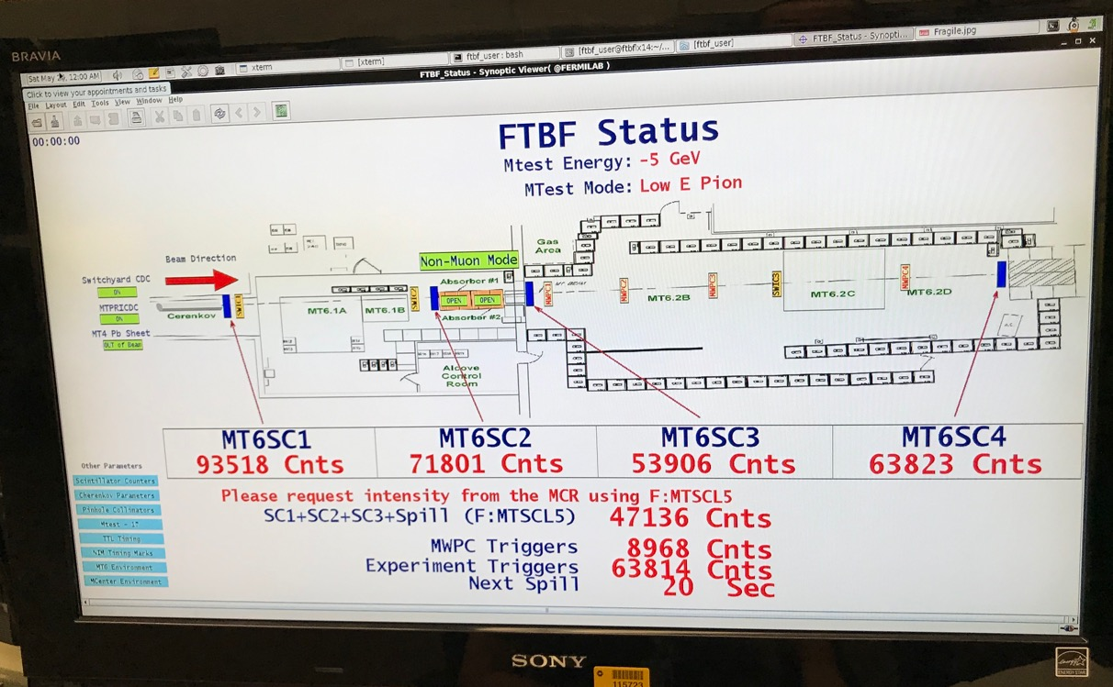
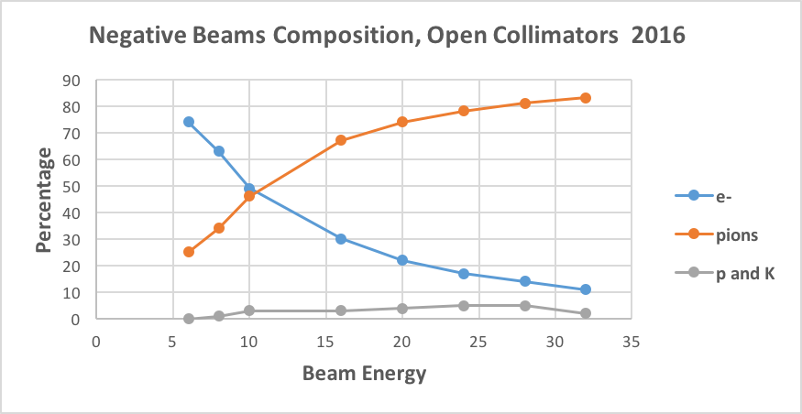
5GeV e- beam, trigger: 10~15 kHz
- stave material budget scanning
Beam composition:
~80% e-
~20% pi-

Slide 16
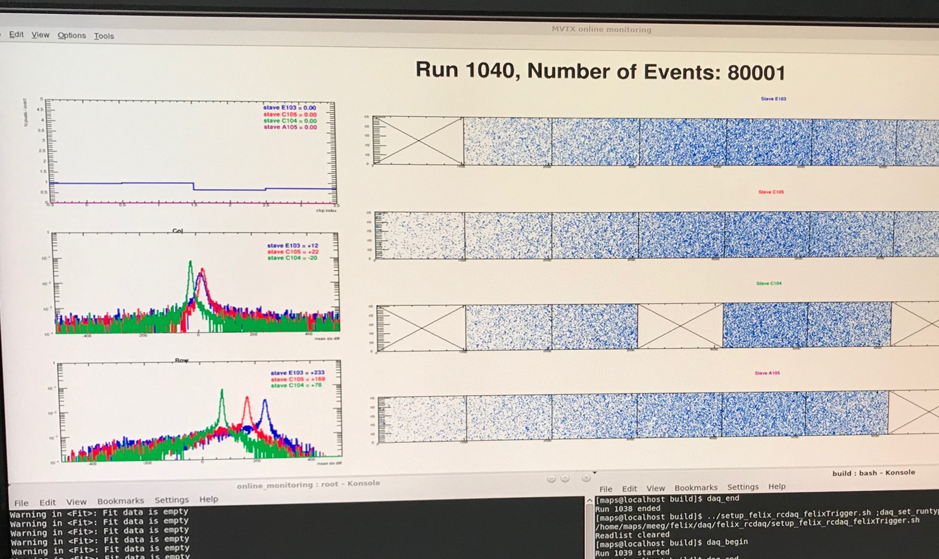
5GeV e- beam: much broad peak, ~10 pixels
Peak broadening:
120Gev p: sigma ~0.5 pixel
5GeV e- : sigma ~10 pixels

Slide 17
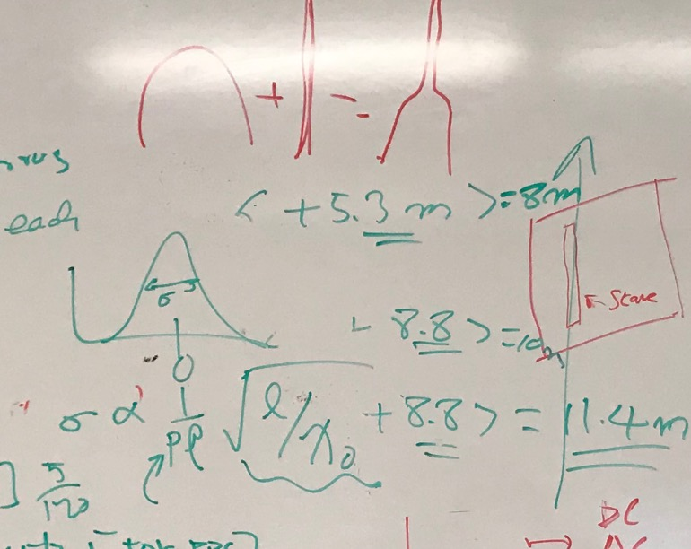

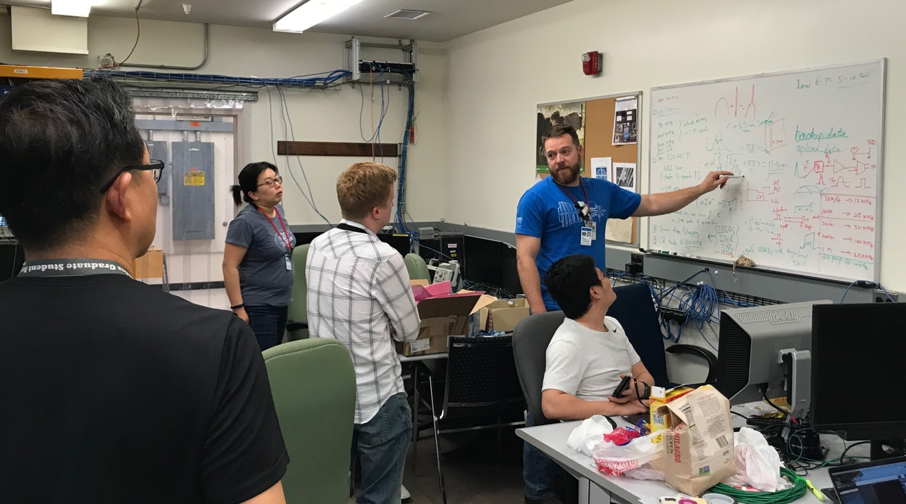
Multiple Scattering Effects

Slide 18
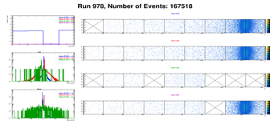
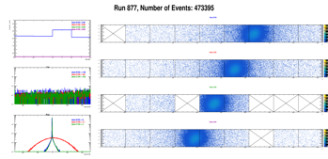
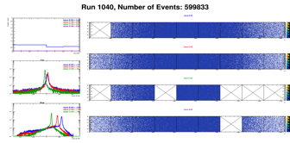
Run Types – Details being documented in MVTX wiki
Xiaochun et al
Run0978
Horizontal stave scans (many good runs)
Vertical stave scans (?)
Angular stave scans and tilted runs
Electron beam at 5 GeV (one long run)
Extruded aluminum, wire & Lead-block runs
Run0877
Run1040

Slide 19
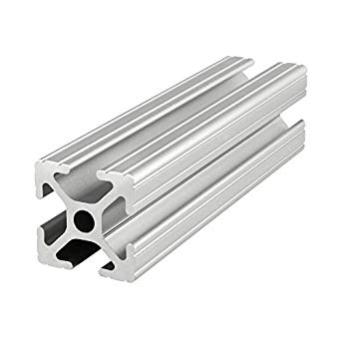
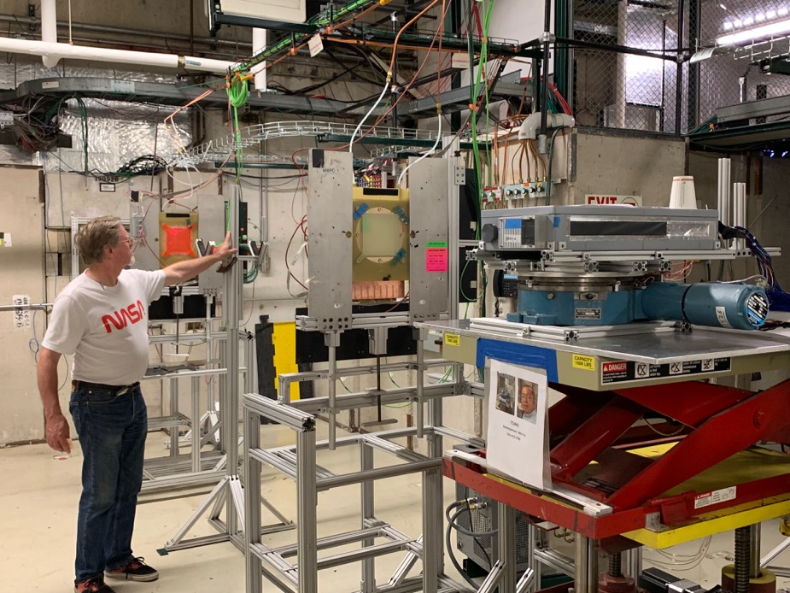
Outlook – offline analysis
Wiki page:
https://wiki.bnl.gov/sPHENIX/index.php/Test_beam_in_2019_at_FNAL
- Detector alignment
Clustering
Tracking
High multiplicity events, p+Pb
…..
Offline object recognition challenge:
Two objects placed in front of the telescope
A thin wire
80-20 Al frame
Can you reconstruct the 80-20 imagine?

Slide 20
High Intensity Runs: DAQ stretch test
Triggered mode:
TTL Trigger: 100nS
Strobe frame: 80 x 25nS = 2 uS
sPHENIXtrigger: <=15kHz
10kHz
  50K pps, 4 sec
25kHz
50kHz
100kHz: a few errors, @10^-6 level, a few “drop events” over 1M triggers
  (400K pps, 4 sec)
250kHZ: some errors, @10^-3
300kHz (1.2M pps) reached the Test Beam facility beam intensity limit
  1.2M pps, 4sec
New setting (Strobe Frame = 100nS) for 300kHz
  Error rate: a few 10^-3

Slide 21
ALPIDE Sensor Study
More detailed study during the 2nd TB next week: 6/19-22, 2019
- Many MAPS parameters to tune
“Stretched Settings” for sPHENIX trigger
MAX: 64 cells x 106nS = 6.8uS
“Default Settings”
~ 4.7 us
sPHENIX Trigger

Slide 22
MVTX Goals – the 2nd TB, 6/17-22, 2019
Test and confirm optimal MVTX operation parameters for sPHENIX
  Threshold scan, analogy shaping time etc
  Study chip hit efficiency vs trigger(strobe) latency
    dT = 1 ~ 10 uS
  Parameters predetermined from laser scan at LANL, in good progress
    Single chip readout with MOSAIC with pulsed laser (~MIP)
    Threshold and noise
    Analogy shaping time
    Strobe delay and length
Schedule & activities:
  Installation done, ORC reviewed 6/10
  Data taking, 6/19-22
  Decommissioning & send back to LANL, 6/22 (Sat)

Slide 23
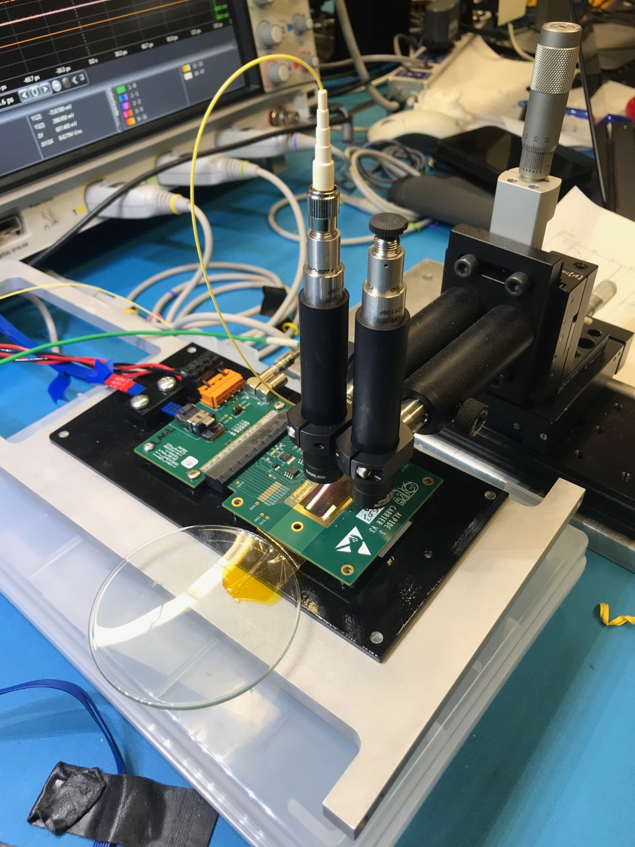
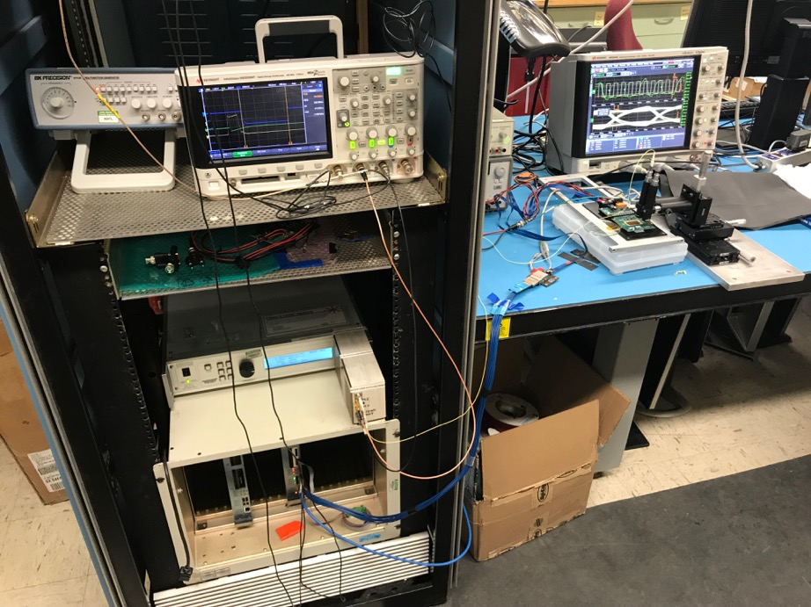
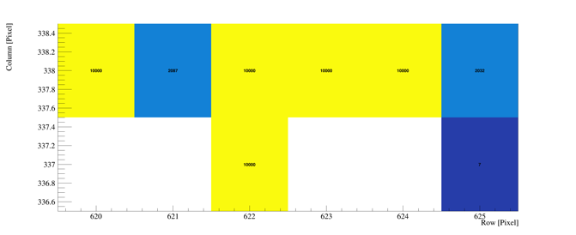
Study MAPS Performance with Pulsed Laser @LANL
Inject “MIP” signal
  850 nm laser, 4ns wide pulse, ~1 MIP
  50kHz trigger
  Find optimal MAPS operating parameters
Laser system
MOSAIC Testbench
Pixel hits

Slide 24
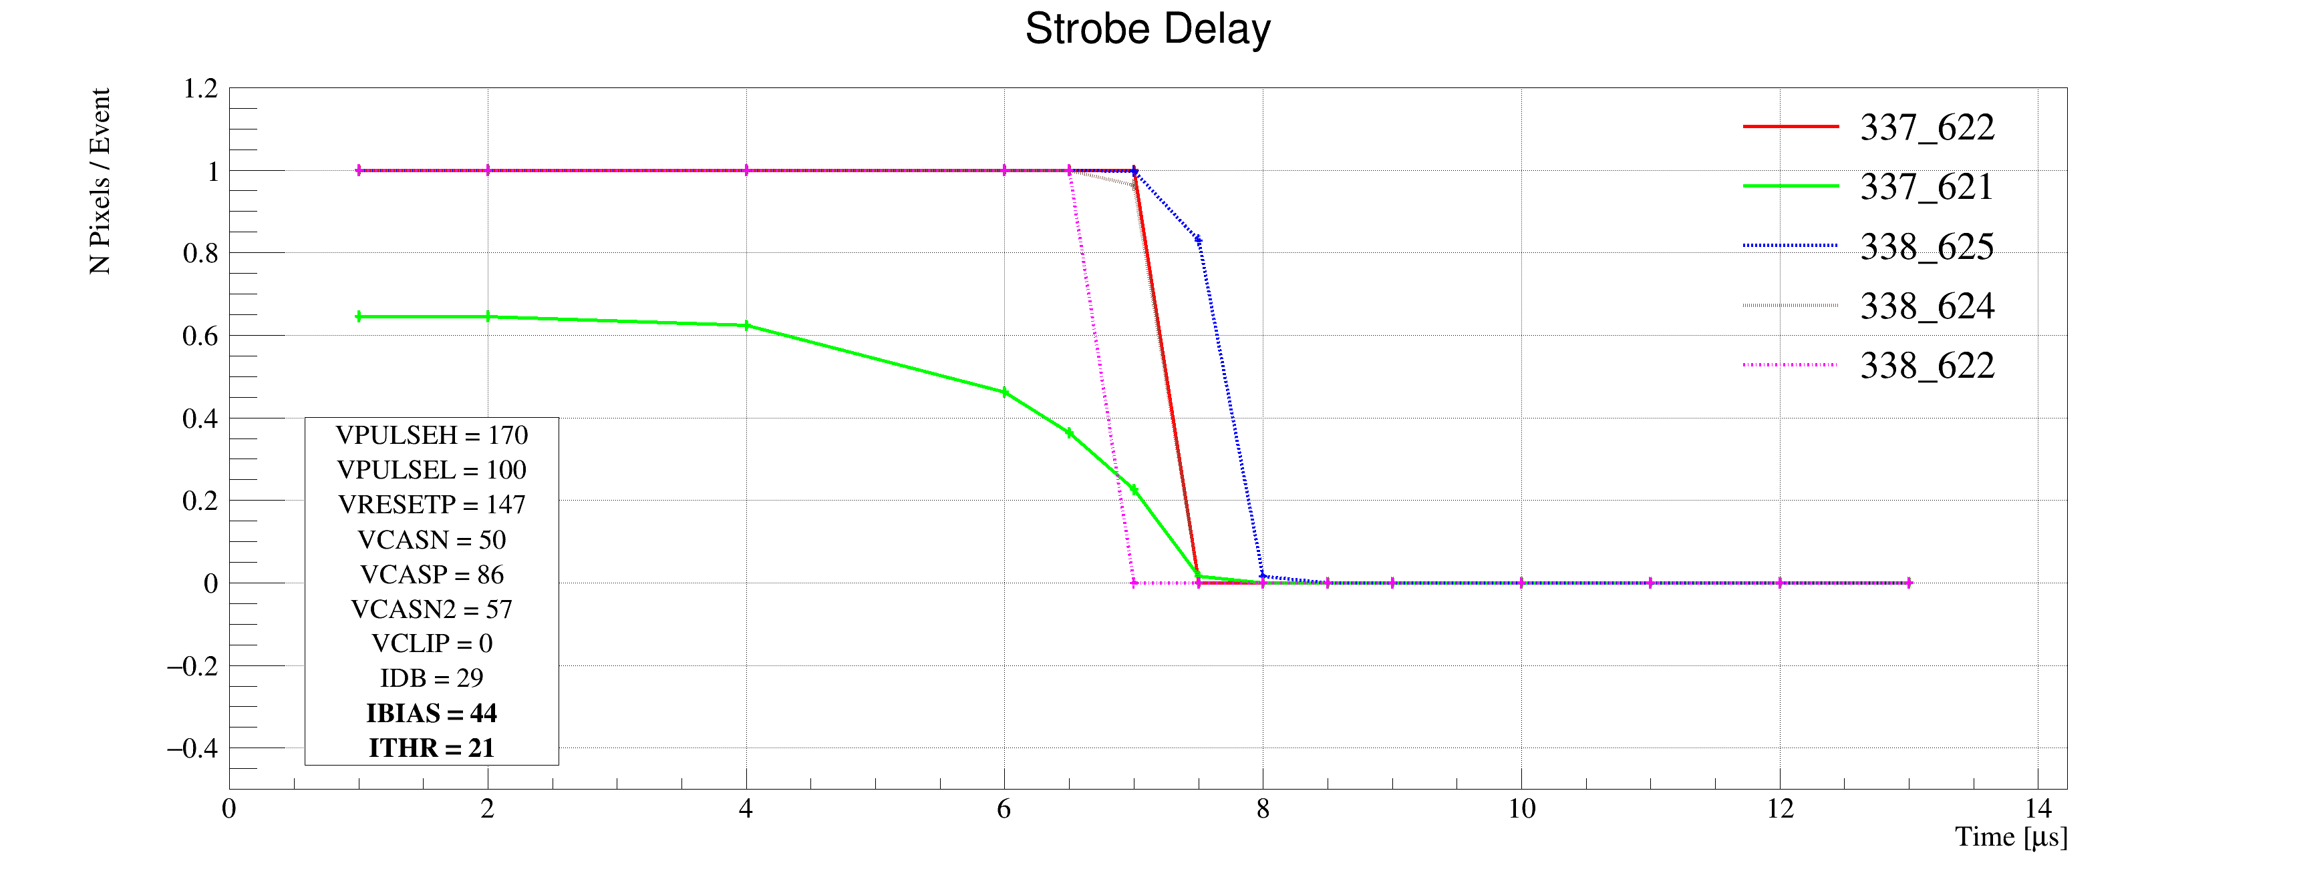
Laser Scan Data – Pixel Hit Efficiency vs Trigger Delay
One of “Stretched Settings” for sPHENIX trigger
MAX: 64 cells x 106nS = 6.8uS
Pixel (Row-Col)
Pixel (Row-Col)
~ 4.7 us
sPHENIX Trigger
~ 4.7 us
sPHENIX Trigger

Slide 25
MVTX Telescope 2nd Test Beam Run @Fermilab 6/19-21, 2019
MVTX telescope
installed
INTT
TPC

Slide 27
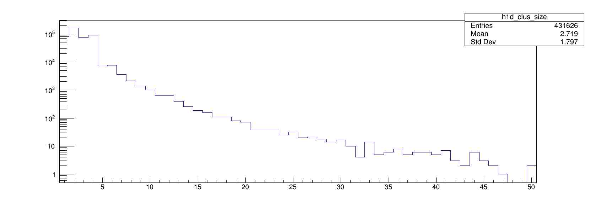
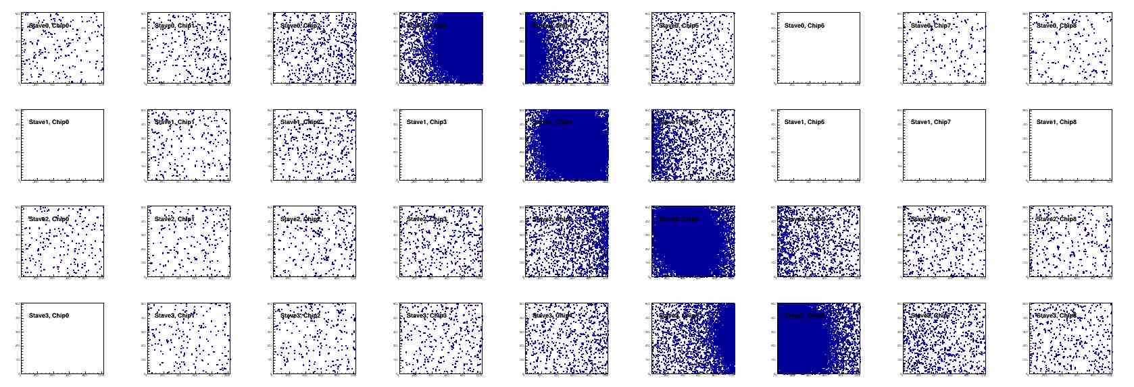
Offline Analysis: Cluster size vs Angle
Run 877, angle – 30 dgr
Cluster Size = 2.7

Slide 28
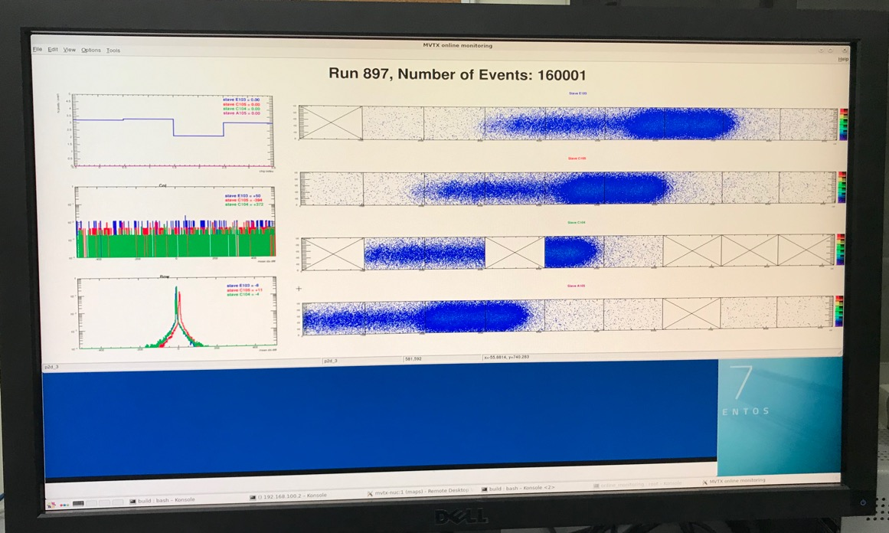
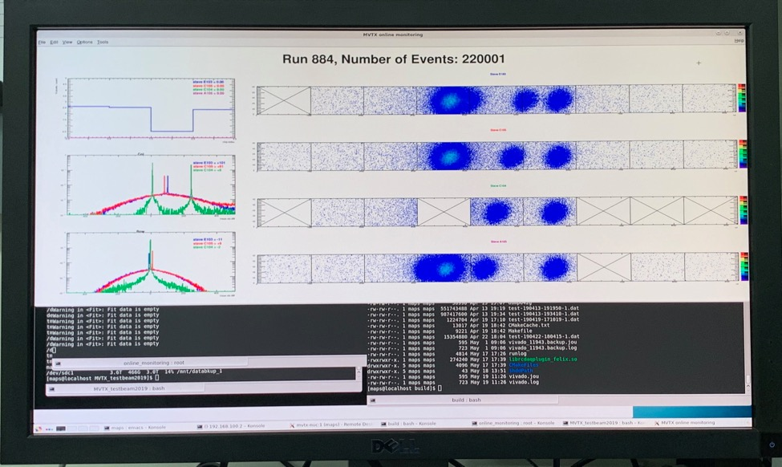
More fun …

Slide 29
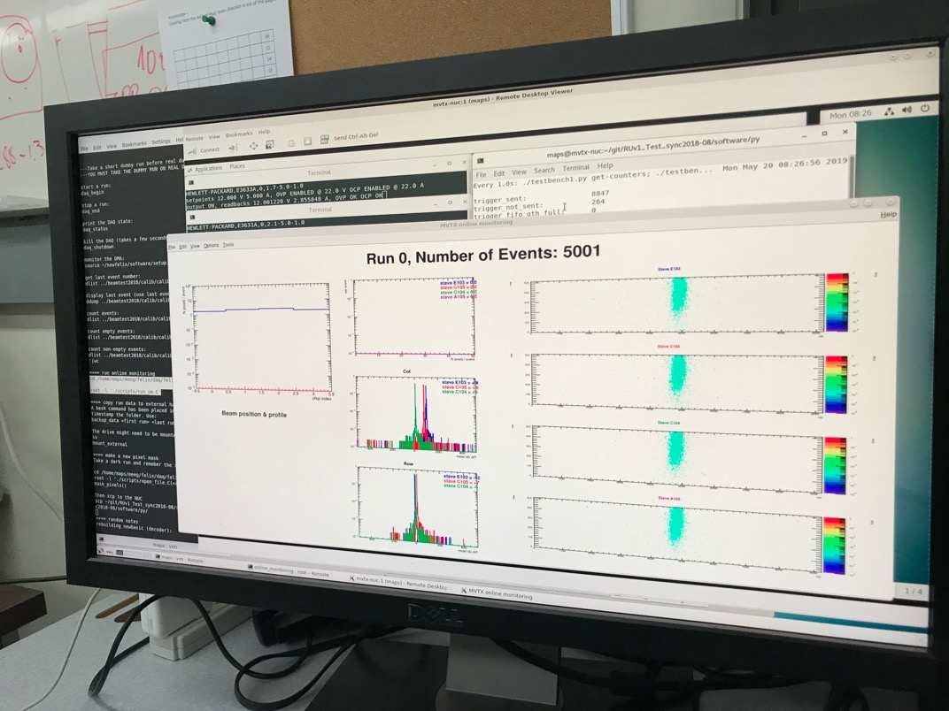
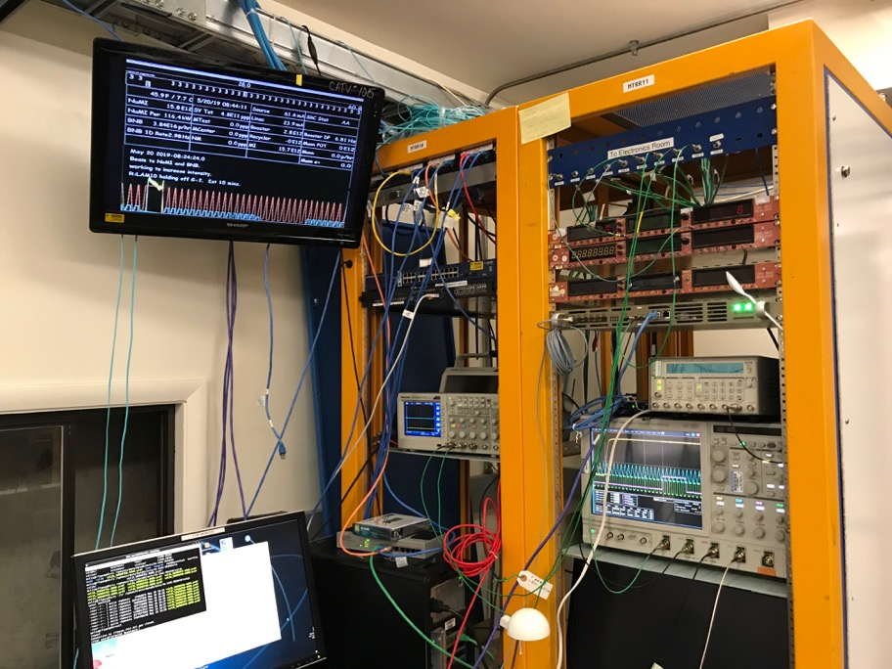
First Collision Signals: 4 sec beam every 60sec
5/20/2019
sPHENIX GTM
Beam

Slide 30
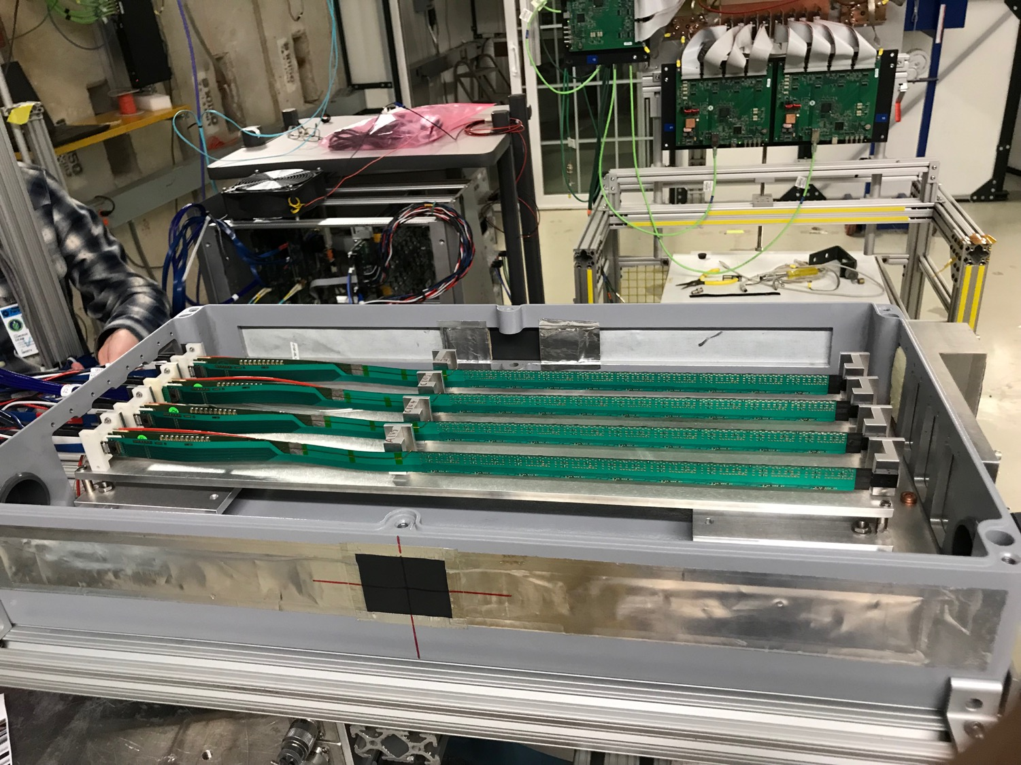

Slide 31
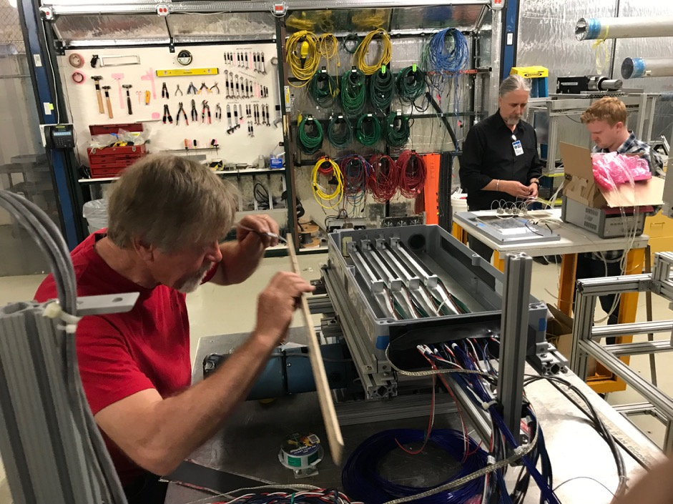
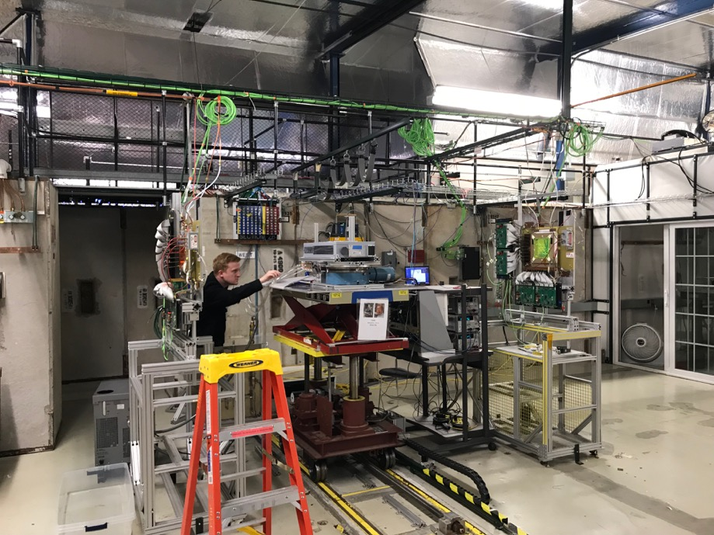
Installation

