Slide 1
MVTX Goals – the 2nd TB, 6/17-22, 2019
Test and confirm optimal MVTX operation parameters for sPHENIX
Threshold scan, analogy shaping time etc
Study chip hit efficiency vs trigger(strobe) latency
dT = 1 ~ 10 uS
Parameters predetermined from laser scan at LANL, in good progress
Single chip readout with MOSAIC with pulsed laser (~MIP)
Threshold and noise
Analogy shaping time
Strobe delay and length
Schedule & activities:
Installation done, ORC reviewed 6/10
Data taking, 6/19-22
Decommissioning & send back to LANL, 6/22 (Sat)

Slide 2
ALPIDE Sensor Study
More detailed study during the 2nd TB next week: 6/19-22, 2019
- Many MAPS parameters to tune
“Stretched Settings” for sPHENIX trigger
MAX: 64 cells x 106nS = 6.8uS
“Default Settings”
~ 4.7 us
sPHENIX Trigger

Slide 3
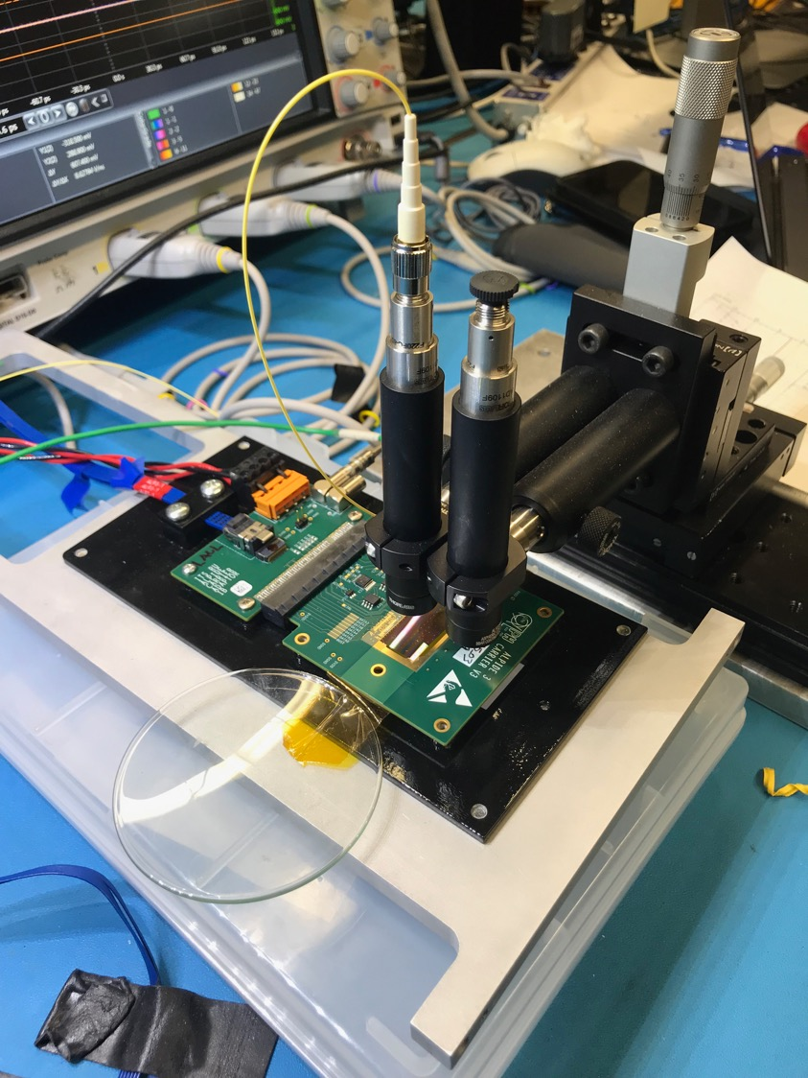
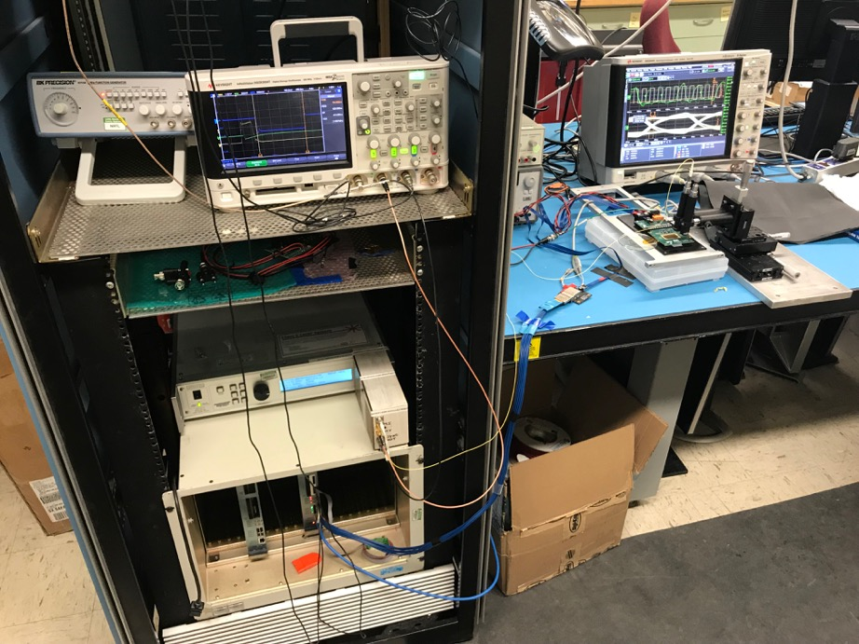
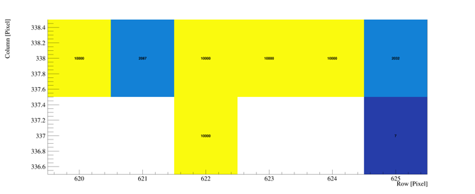
Study MAPS Performance with Pulsed Laser @LANL
Inject “MIP” signal
850 nm laser, 4ns wide pulse, ~1 MIP
50kHz trigger
Find optimal MAPS operating parameters
Laser system
MOSAIC Testbench
Pixel hits

Slide 4
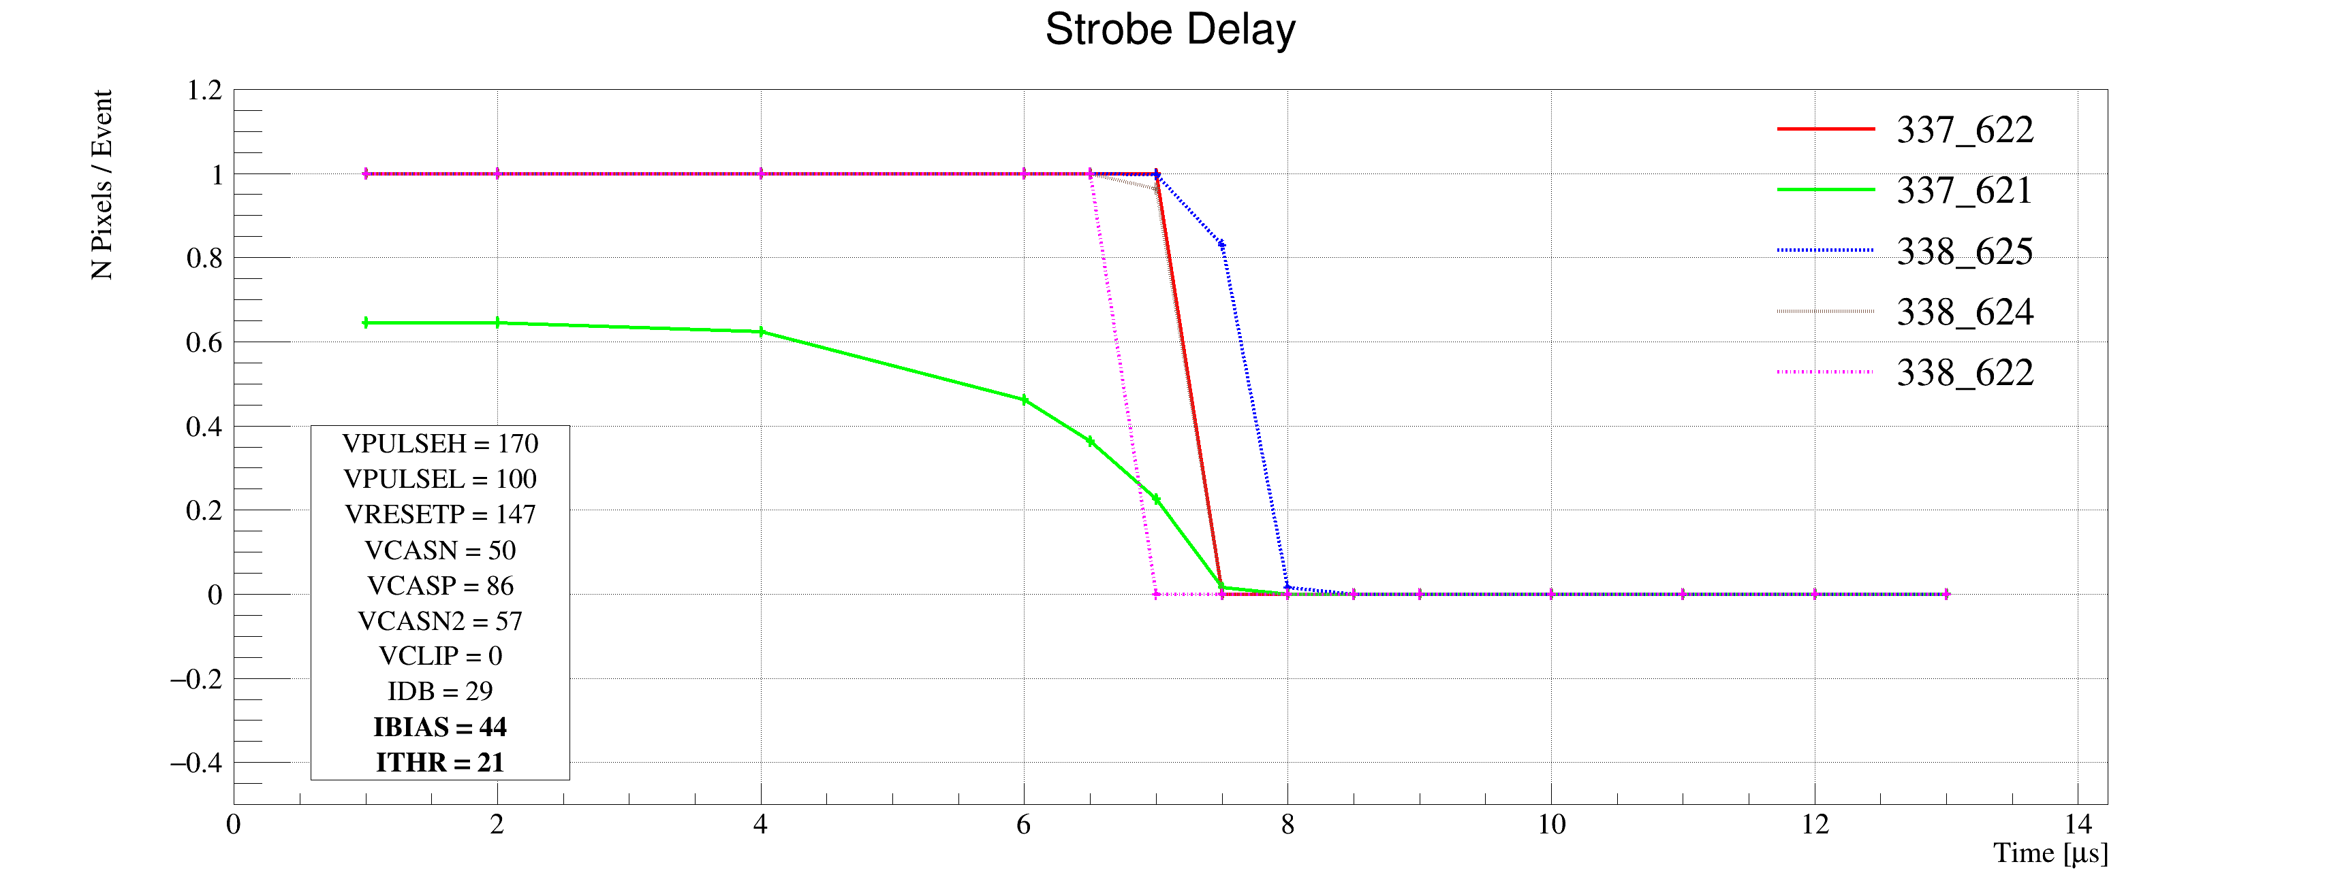
Laser Scan Data – Pixel Hit Efficiency vs Trigger Delay
One of “Stretched Settings” for sPHENIX trigger
MAX: 64 cells x 106nS = 6.8uS
Pixel (Row-Col)
Pixel (Row-Col)
~ 4.7 us
sPHENIX Trigger
~ 4.7 us
sPHENIX Trigger

Slide 5
MVTX Telescope 2nd Test Beam Run @Fermilab 6/19-21, 2019
MVTX telescope
installed
INTT
TPC

Slide 6
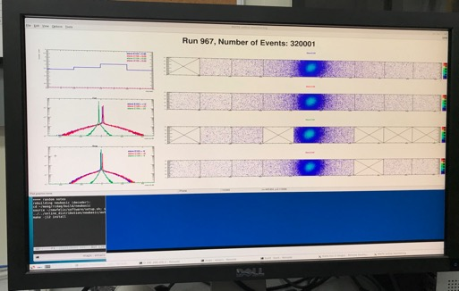
System Setup
SamTec: 11.4m
(2.6m+8.8m)
4-stave telescope
RU-2: 1 stave
- 1 fully functioning
9-chip stave;
- 3 staves with a few
broken sensors
4 staves
2 RUv1.1
1 PU
1 FELIX Server + RCDAQ
sPHENIX GTM
11.4m Custom SamTec Cable
Negative pressured cooling
RU-1: 3 staves
5m SamTec
120GeV p-beam
10kHz (30kHz)
Beam intensity:
30k ~ 120k ppp
Data & Control
Beam Trigger
Timing & Trigger
GTM
FELIX
Online Monitoring
RCDAQ
Multi-Stave + Multi-RU -> FELIX readout demonstrated
sPHENIX GTM integrated
Long readout SamTec cable certified
Cooling system demonstrated

Slide 7
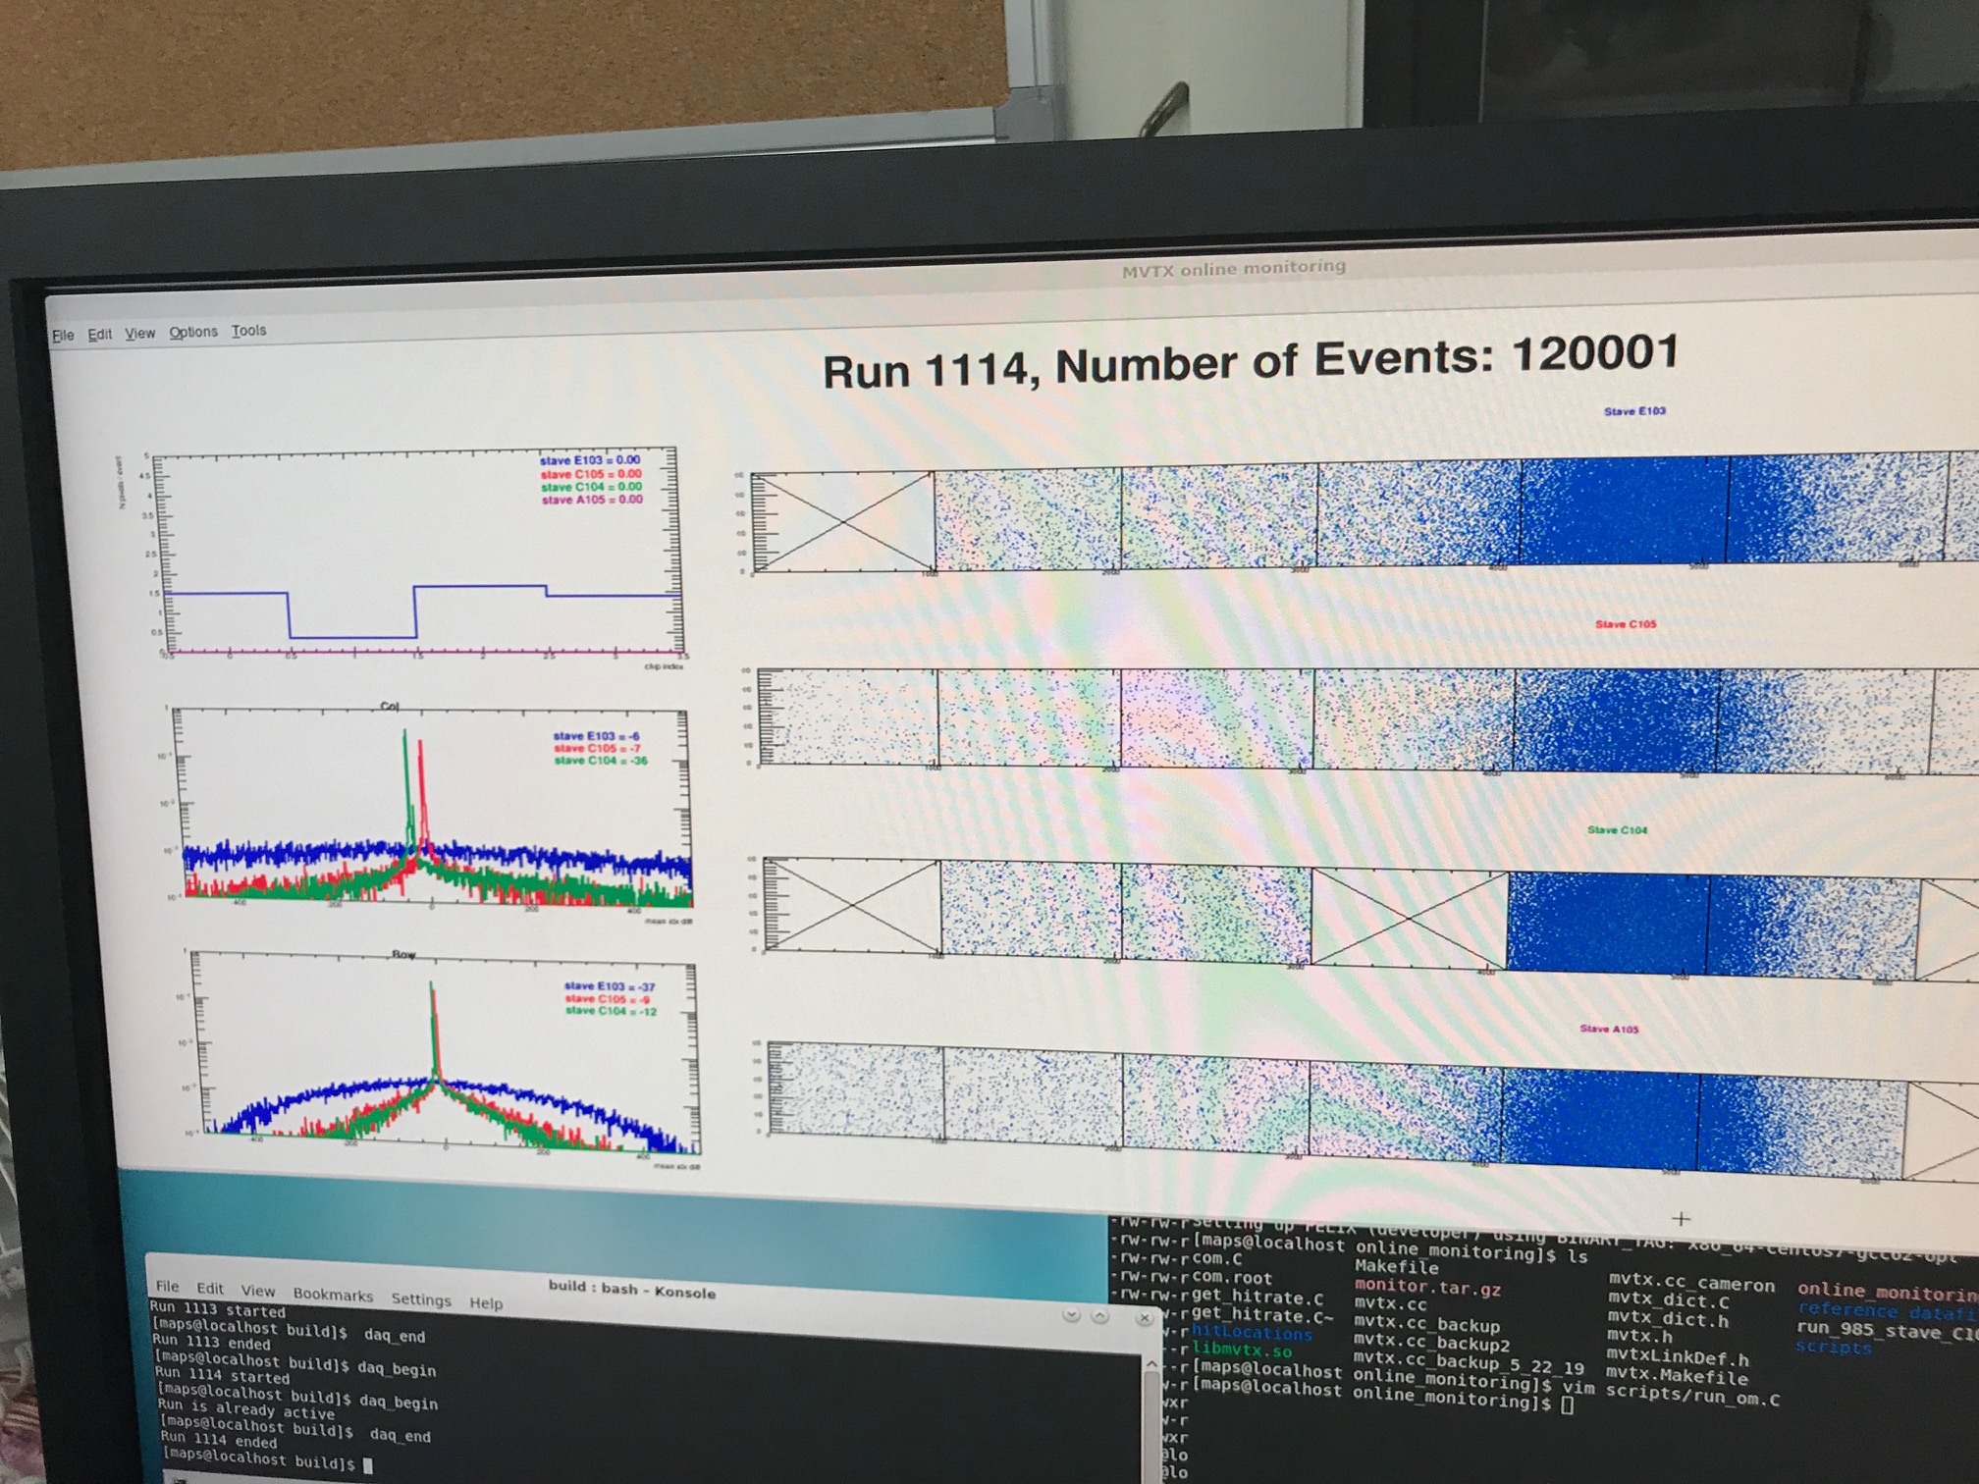

Slide 8
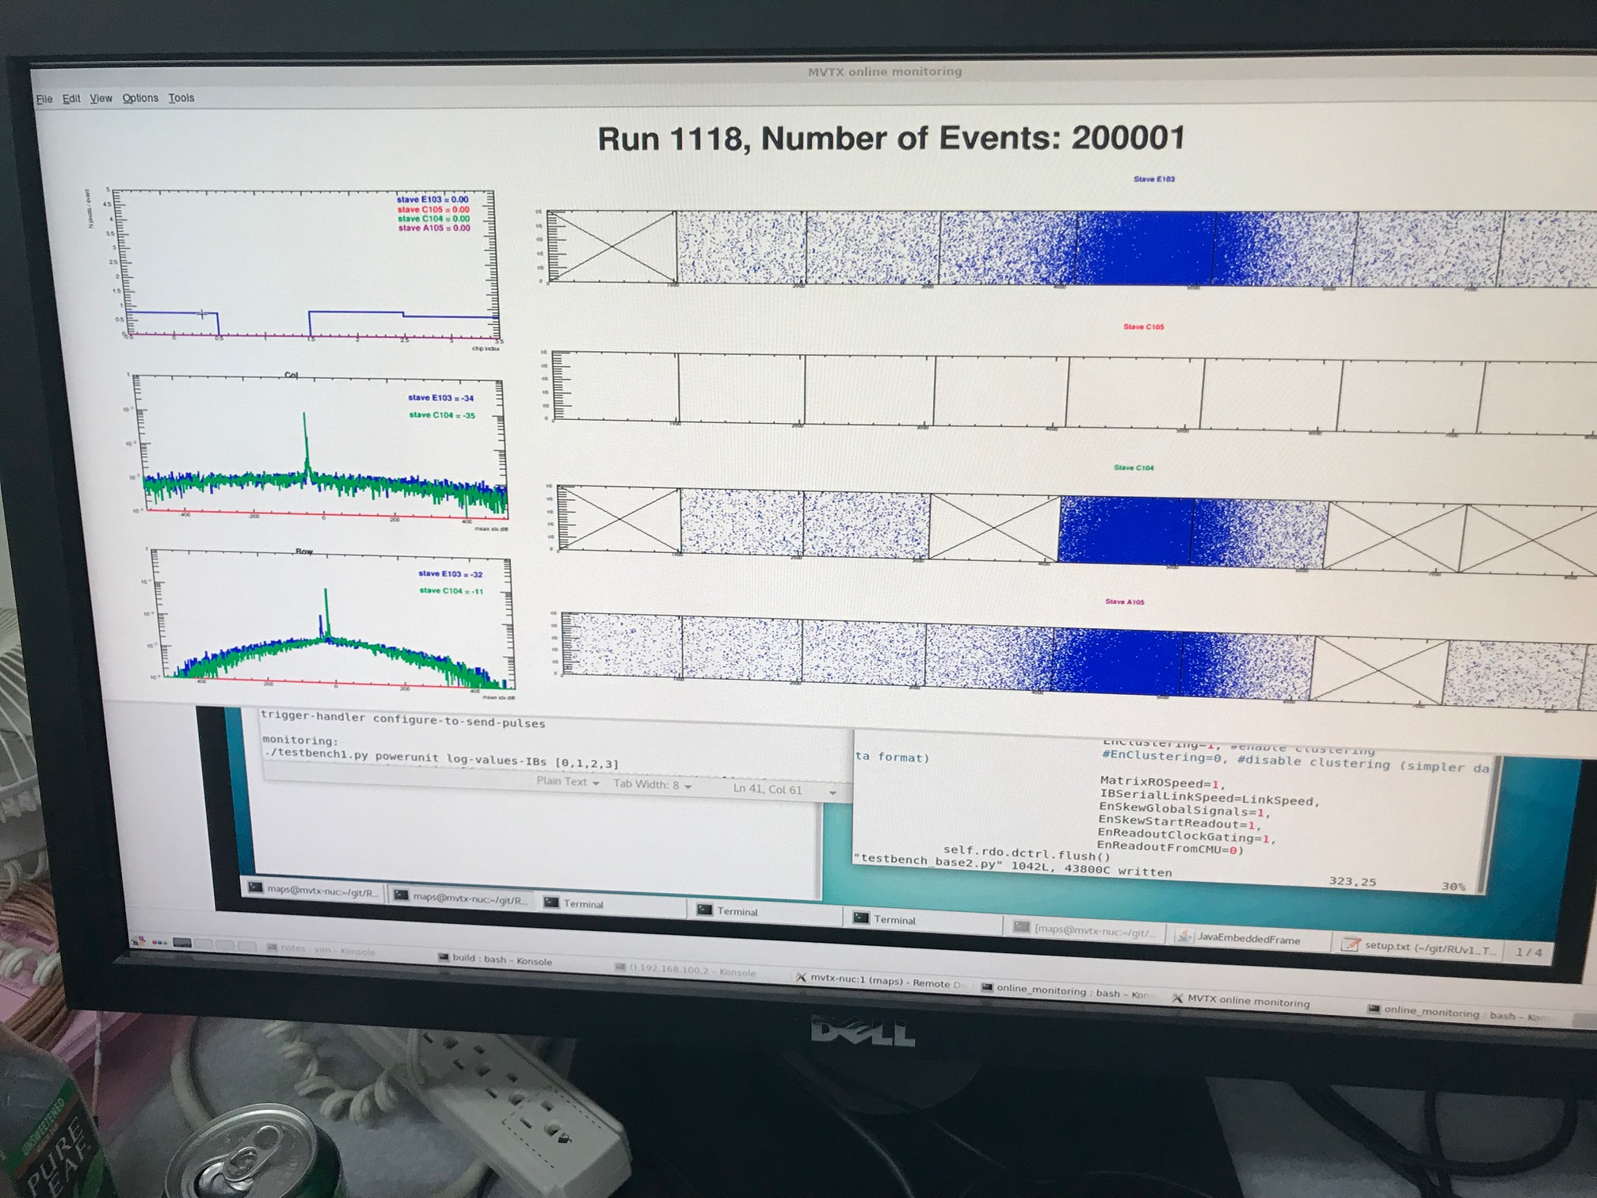

Slide 9
To Do’s
Ship them back to LANL, and also to Alex T.
Offline analysis
Alignment
Efficiency, resolution
Calibrate laser data

