Slide 1
MVTX Status & Plan
Ming Liu
sPHENIX General Meeting
8/9/2019

Slide 2
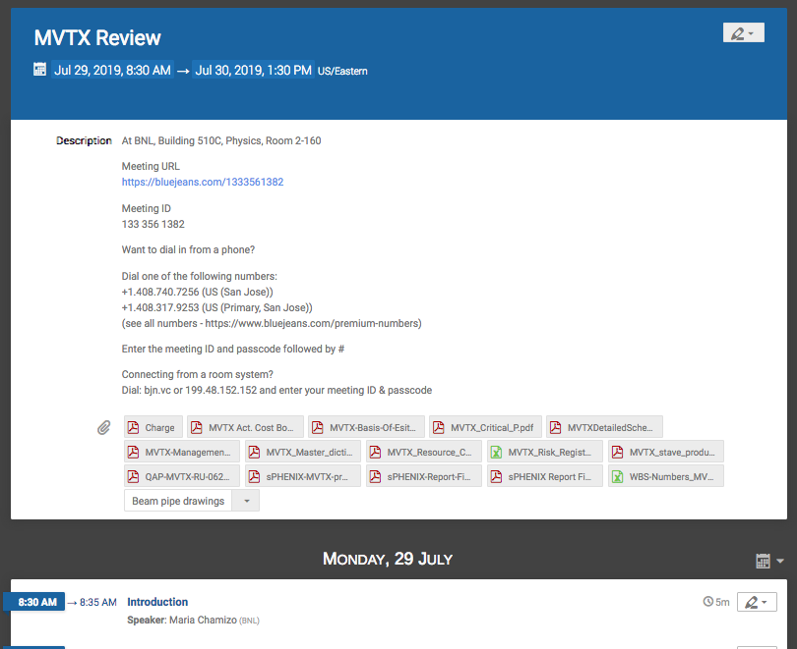
Very Successful MVTX Cost & Schedule Review
July 29-30, 2019 @BNL https://indico.bnl.gov/event/6544/
Review presentations
  Cost, Schedule, risks
  Technical details on mechanical and electrical systems
  All supporting documents
Received very positive review report
  A few action items being addressed, complete by Aug.
  Expect BNL/DOE approval in 4~6 weeks
MIT received fund from BNL for mechanical design R&D
LBNL R&D fund transfer for carbon structure cost estimate in progress
Targeted project start date ~ September 2019
  RU acceptance test/QA @UTA
  Carbon structure design and production
  Stave acceptance test/QA @LBNL
  Electronics production
Parallel effort (off-project)
  Stave & RU production at CERN

Slide 3
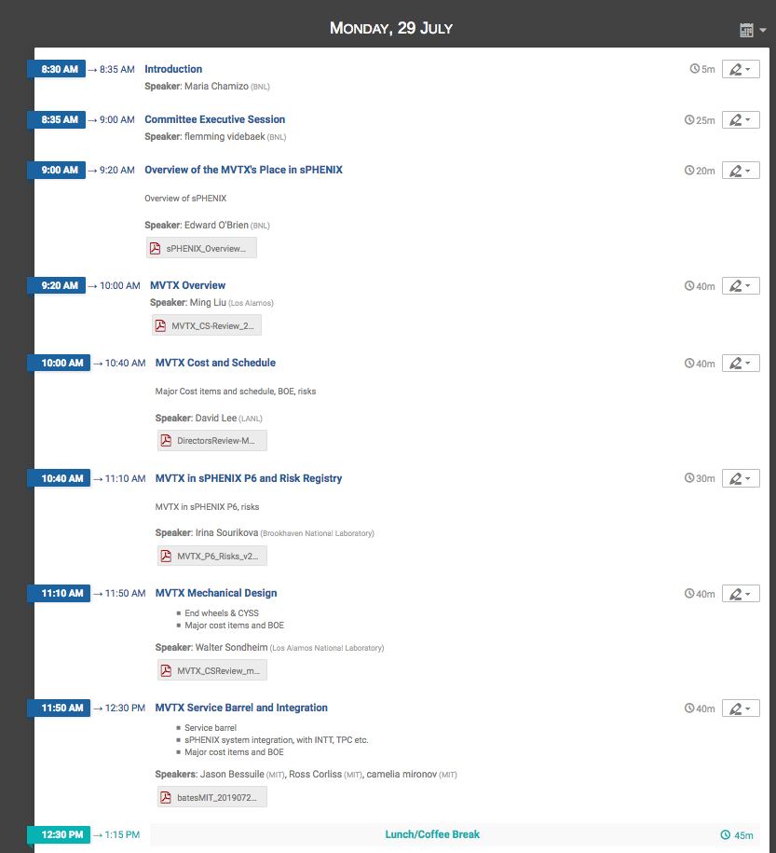
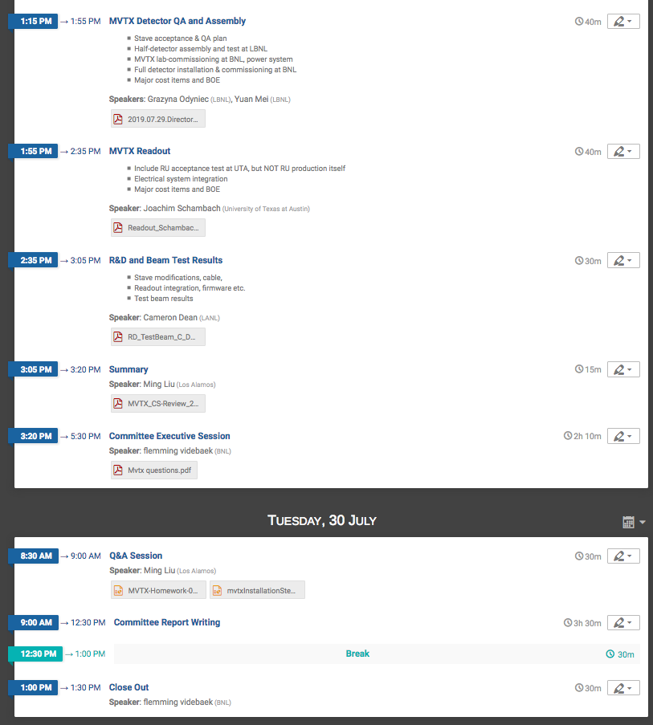
Technical progress,
Det. assembly
Readout
R&D highlights
Project cost,
schedule & risks in P6
Technical progress,
Mechanics

Slide 4
Plan: Schedules & Milestones
Fully aligned with sPHENIX via external milestones
Schedule drivers
Day-1 physics
CERN production
Carbon structures
Early R&D in progress
LANL LDRD
  Readout
  Mechanics
BNL R&D fund
  MIT carbon structure design
  LBNL carbon structure cost estimate

Slide 5
Review Report & Actions
Recommendations - Mechanics
  Increase contingency 40% -> 60% for carbon structures
    Under engineering discussions
  In parallel to LBNL effort, obtain quotations from commercial vendors
    Obtained a preliminary one, will update vendor with the latest design by the end of Aug
    Plan to visit CERN/Vendor in September for prototyping
  Add the full scale insertion mockup
    MIT plans to work on it (WBS 2.X)
Recommendations – PMP
  Include an appendix for each KPP and UPP
    PMP being updated, to complete in ~1 week
No recommendations, good
  Cost & Schedule, Risk, Electronics, stave/Ru acceptance test

Slide 6
Review Report – Cont. 1

Slide 7
Review Report – Cont. 2

Slide 8
Updated (08/09/2019): KPPs & UPPs in PMP
https://www.phenix.bnl.gov/WWW/publish/mxliu/sPHENIX/Reviews/BNL-072019/MVTX-ManagementPlan-BNL-Format-version-v10-080919.docx
KPPs from
MVTX PMP
UPPs from
MVTX PMP

Slide 9
A new appendix 2 in PMP

Slide 10
Excellent Progress with Mechanical System Design
Advanced 3-D Model developed:
Detector
Service Barrel
Global integration
PP-2: Power and Cooling
PP-1: signals
PP-3: External world

Slide 11
Walt’s talk @Review
End View of MVTX
Detectors/staves

Slide 12
Camelia’s talk @Review

Slide 13
Camelia’s talk @Review

Slide 14
2019 Test Beam Data Analysis
Offline analysis in progress: all TB data in RCF
https://wiki.bnl.gov/sPHENIX/index.php/MAPS-based_Vertex_Detector_(MVTX)

Slide 15
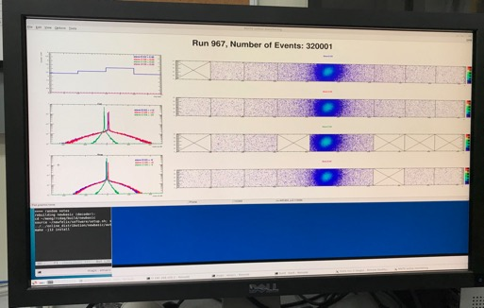
Very Successful Test Beam @Fermilab
5/20-25, 6/17-22, 2019
SamTec: 11.4m
(2.6m+8.8m)
4-stave telescope
RU-2: 1 stave
- 1 fully functioning
9-chip stave;
- 3 staves with a few
broken sensors
4 staves
2 RUv1.1
1 PU
1 FELIX Server + RCDAQ
sPHENIX GTM
11.4m Custom SamTec Cable
Negative pressured cooling for staves
RU-1: 3 staves
5m SamTec
120GeV p-beam
10kHz (30kHz)
Beam intensity:
30k ~ 120k ppp
Data & Control
Beam Trigger
Timing & Trigger
GTM
FELIX
A full system with final sensor/readout* hardware:
Multi-Stave + Multi-RU -> FELIX readout demonstrated
sPHENIX GTM integrated
Long readout SamTec cable certified
Cooling system demonstrated
* RUv1.1 identical to the final RUv2 electrically
Online Monitoring
sPHENIX
RCDAQ

Slide 16
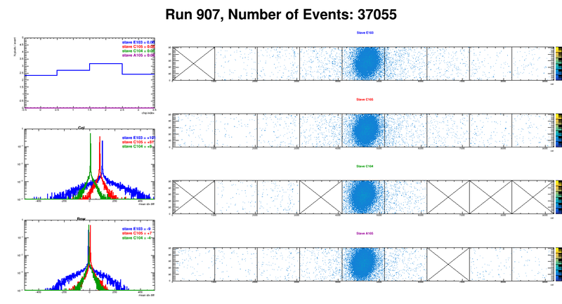
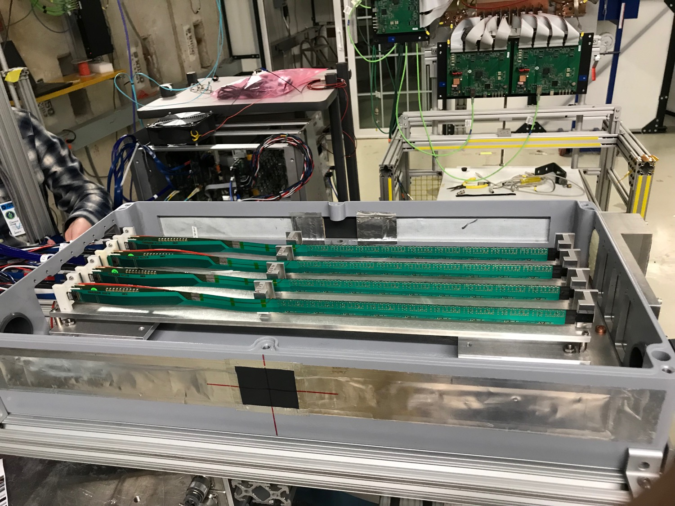
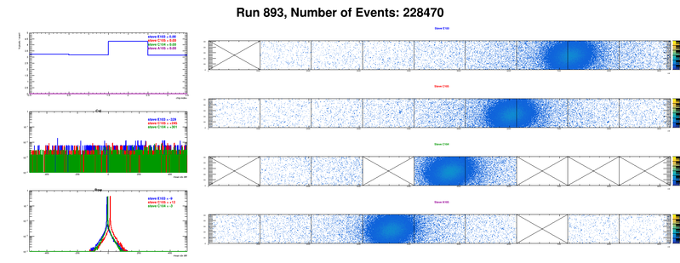
Very Rich Set of TB Data
https://wiki.bnl.gov/sPHENIX/index.php/MAPS-based_Vertex_Detector_(MVTX)
Beam angle: 0
(eta ~0)
MVTX 4-Stave Telescope
Beam angle: 40
(eta ~1)

Slide 17
Preliminary Offline Analysis: A simple straight line fit
Track hit efficiency vs Trigger Delay
From Yasser
Hit_Eff_Stave3 > 99.5%;
Eff = stave3_hits/(tracks, at least 3hits 1/2/4)
June TB Data analysis in progress
For various ALPIDE operation points, shaping time, threshold, trigger delay etc.
4
3
2
1

Slide 18
Offline Analysis: A simple straight line fit
Stave-3 Track hit resolution vs Trigger Delay
From Yasser
4
3
2
1
dX, dZ < 5um

Slide 19
Next step
Efficiency and resolution study for large incident angles
Optimize MAPS operation points, June data
Tune MC for better simulation

Slide 20
A full readout unit system test under development
MVTX – readout in 6-subgroup
  48 staves + 48 RUs + 6 FELIXs
  A complte readout chain:
  8 staves + 8 RUs + 1 Felix + 1 Server
Hardware in hand at LANL
  6 staves + 4 HICs(w/o carbon frame)
  10 RUv2.1 produced at CERN, to be shipped to LANL soon
  2 FELIX v2.0
  1 PU
  1 sPHENIX GTM
Building a telescope of:
6 staves + 2 HICs
8 RUv2.1
2 FELIX
1 PU
1 GTM
A test beam later this year
LBNL, 50MeV p-beam
LANL, 800MeV p-beam
Fermilab?

Slide 21
backup

Slide 22
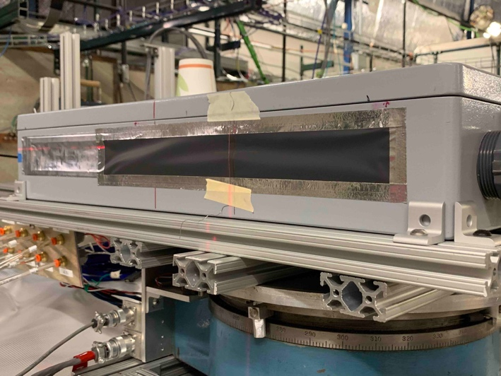
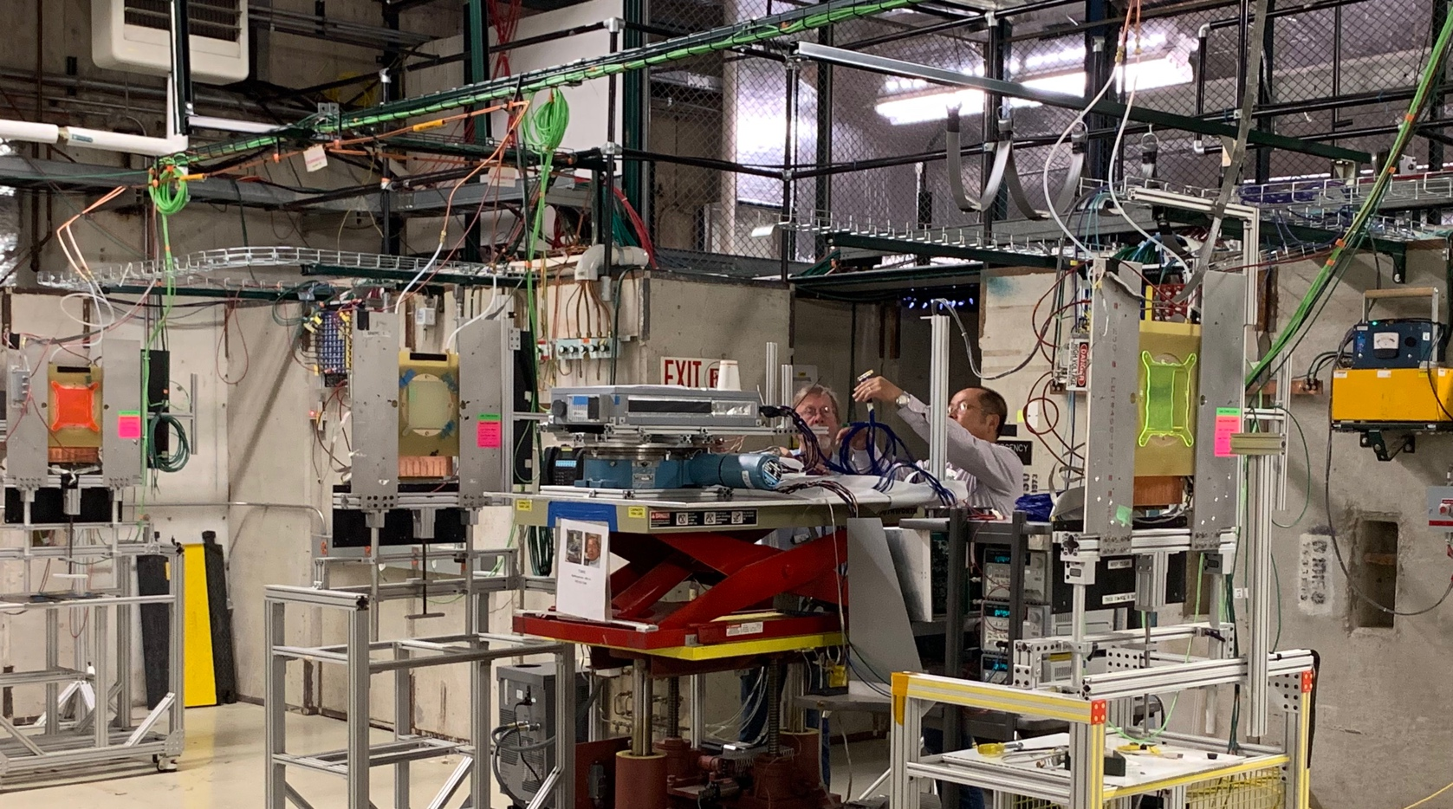
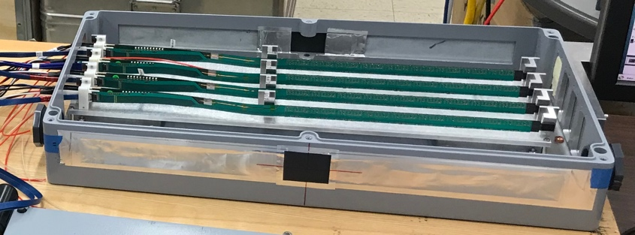
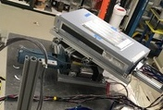
2019 MVTX Test Beam Setup @Fermilab
From view
beam
Stave housing sits on a motion table which can be moved in (x, y) plane perpendicular to the nominal beam direction. It can also be rotated (+40, -40) degrees (see photo on right). Operation was done at counting house.

Slide 23
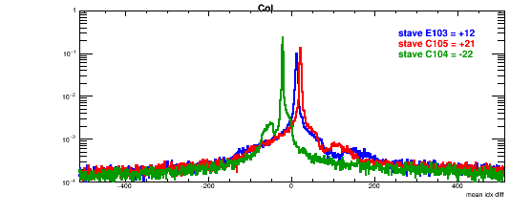
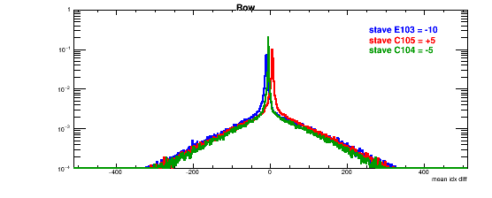
Detector Misalignment & Hit Spatial Resolution Study- Online Plots
Typically staves offset by,
Horizontally: 20 x 30um = 600 um
Vertically: 5 x 30 um = 150 um
Hit spatial resolution: (w/o clustering)
Peak_sigma_core = 0.55 (pixel size ) =15 um
Chip spatial resolution = 15/sqrt(2) = 11 um
(same as 2018 TB results)
120GeV proton beam
Delta_X/Z
Ref. Plane

