Slide 1
MVTX Project Status & Plan
09/27/2019
MVTX Review response – received feedback on Thursday
  On-going discussions with sPHENIX project office, some edits and revision of PMP doc
  Produce a formal review response report, to ALD and BNL Project Office
  Smooth funding profile for FY20, plan-B
Full mechanical insertion mockup, MVTX/INTT/TPC
  cost & schedule in WBS2.x
Plan to start the MVTX production activities as soon as funds available
  Preparation for Stave and RU acceptance test & QA in US, LBNL and UT-A
  Carbon structure prototype production, site selection etc
Updates from recent CERN Visit, 9/16-20, 2019

Slide 2
Smooth Funding Profile (FY19+20, 21,22)
From July MVTX Review:
MVTX funding profile: FY20 -22
sPHENIX MVTX Budget Profile
 | FY20 | FY21 | FY22 | Total
3.02.01 Management | $233,668 | $209,596 | $101,338 | $544,602
3.02.02 Electronics | $569,582 |  |  | $569,582
3.02.03 Mechanics and Assembly | $1,370,727 | $307,183 | $113,468 | $1,791,378
3.02.04 Integration and Infrastructure | $368,185 | $399,262 | $15,491 | $782,938
Performance Measure Baseline | $2,542,162 | $916,041 | $230,297 | $3,688,500
Contingency | $762,649 | $274,812 | $69,089 | $1,106,550
Total Project Cost | $3,304,811 | $1,190,853 | $299,386 | $4,795,050
Can we move some FY20 ($3.3M) activities to FY21 ($1.2M),
with minimal impact to the project?

Slide 3
Schedules – Smooth Funding Profile
Plan-B: ~by next week?
Fully aligned with sPHENIX via external milestones
Candidates for possible delays, from FY20 to FY21:
Carbon Structure production
PU and CAEN PS
Cooling system
Delay stave test and detector assembly work at LBNL
Recent new quotes for carbon structures:
Possible cost saving through commercial companies
Carbon structure full production possible in FY20

Slide 4
Very Productive Visit to CERN
Walt Sondheim & Ming Liu
09/16-20, 2019
  sPHENIX 84 Staves production
  sPHENIX 60 RUs test plan
  sPHENIX SamTec cable test
  Carbon structure facility visit
  ITS Commissioning activities

Slide 5
sPHENIX Stave Production Started!
sPHENIX Production from this week, 9/23/2019
  Bi-weekly meeting on Thursday 5PM/CERN (9AM/LANL)
~10 staves/month
  Limited by Wirebonding , 2~3 staves/week
Production period: ~9 months
  10/2019 – 6/2020
CERN status:
- “The FPC production is well advanced, we have already the first batch of 24 pieces available.”
- ~200 golden chips available
- “The orders for the power extension cables and for the transport plates have been sent out.“
Discussed the work-package for the wire bonding last Friday 9/20/2019, 2~3 staves/week or ~10/month,

Slide 6
Final RU Board Test at UT-A in October
60 sPHENIX RUs produced at CERN
10 RUs produced for LANL R&D
Visit UT-A, 10/14-18, 2019
Jo is available for the full week
  Alex T. plan to join for one day
  Bring 10 RUs from LANL
Develop a plan for testing 60 sPHENIX RUs
Gerd, Yasser, Cameron

Slide 7
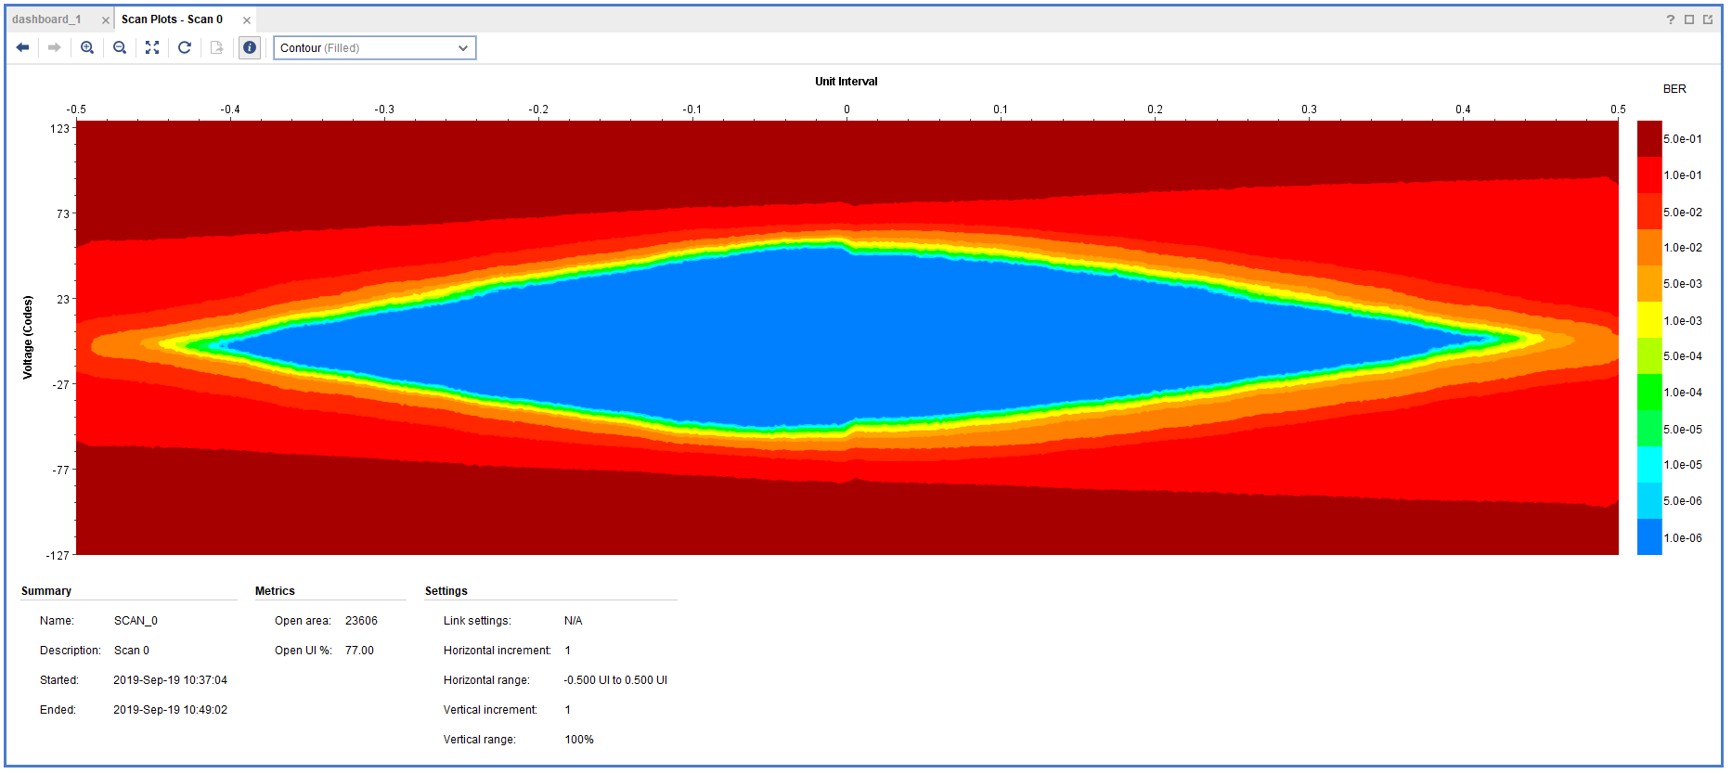
11.4m SamTec Readout Cable Test @CERN
Double looped readout cables:
  Effective length = 2 x 11.4 m = 22.8m
  Data rate: 1.2Gbps
  One overnight run, ~10hrs
  Error rate < 1.4 x10⁻¹⁴
^{Production cable: 11m (>10m)}

Slide 8
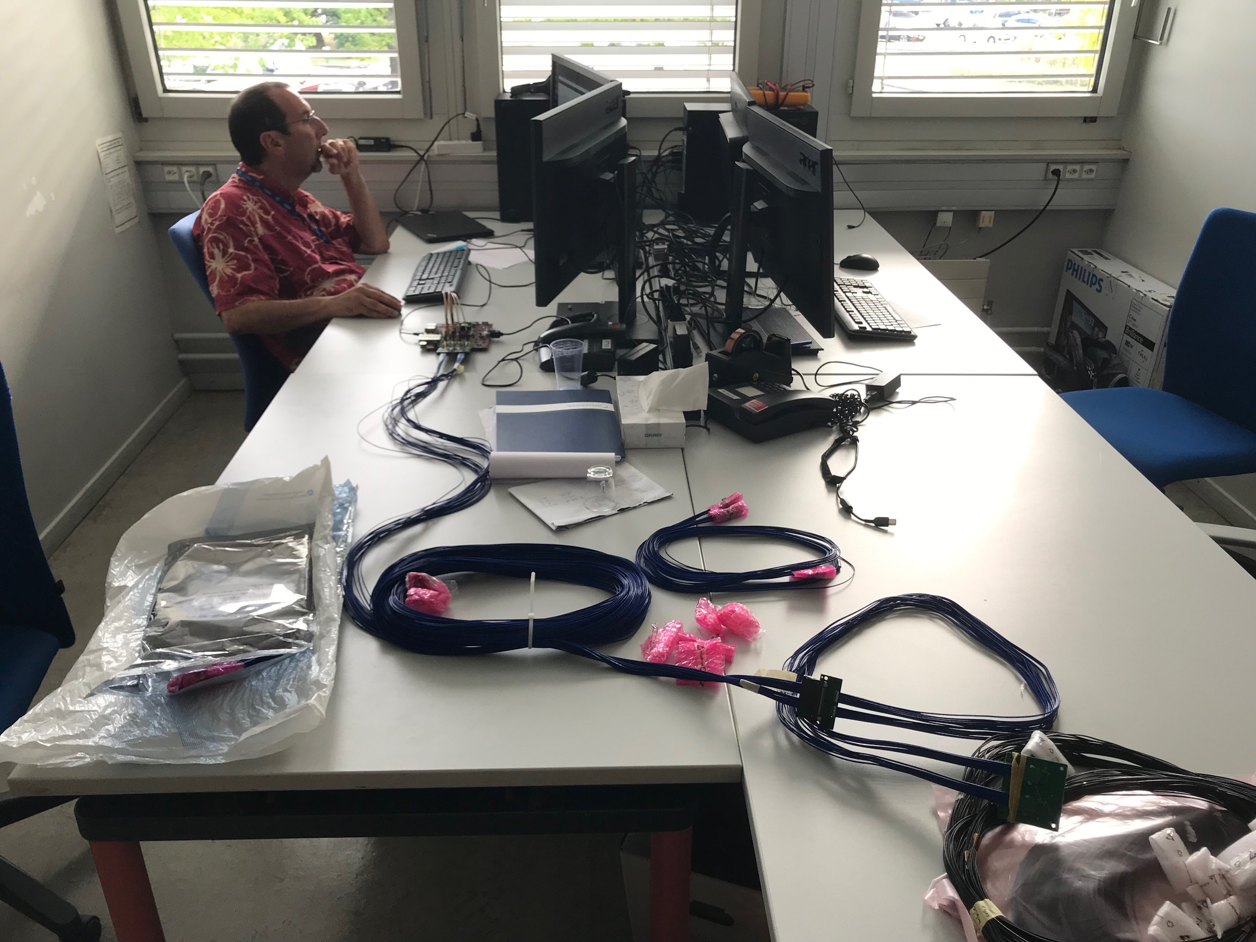
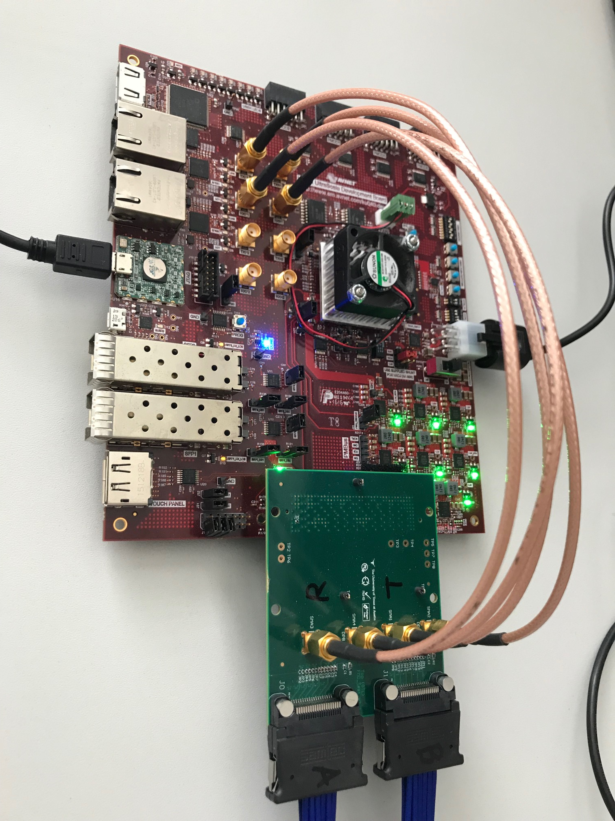
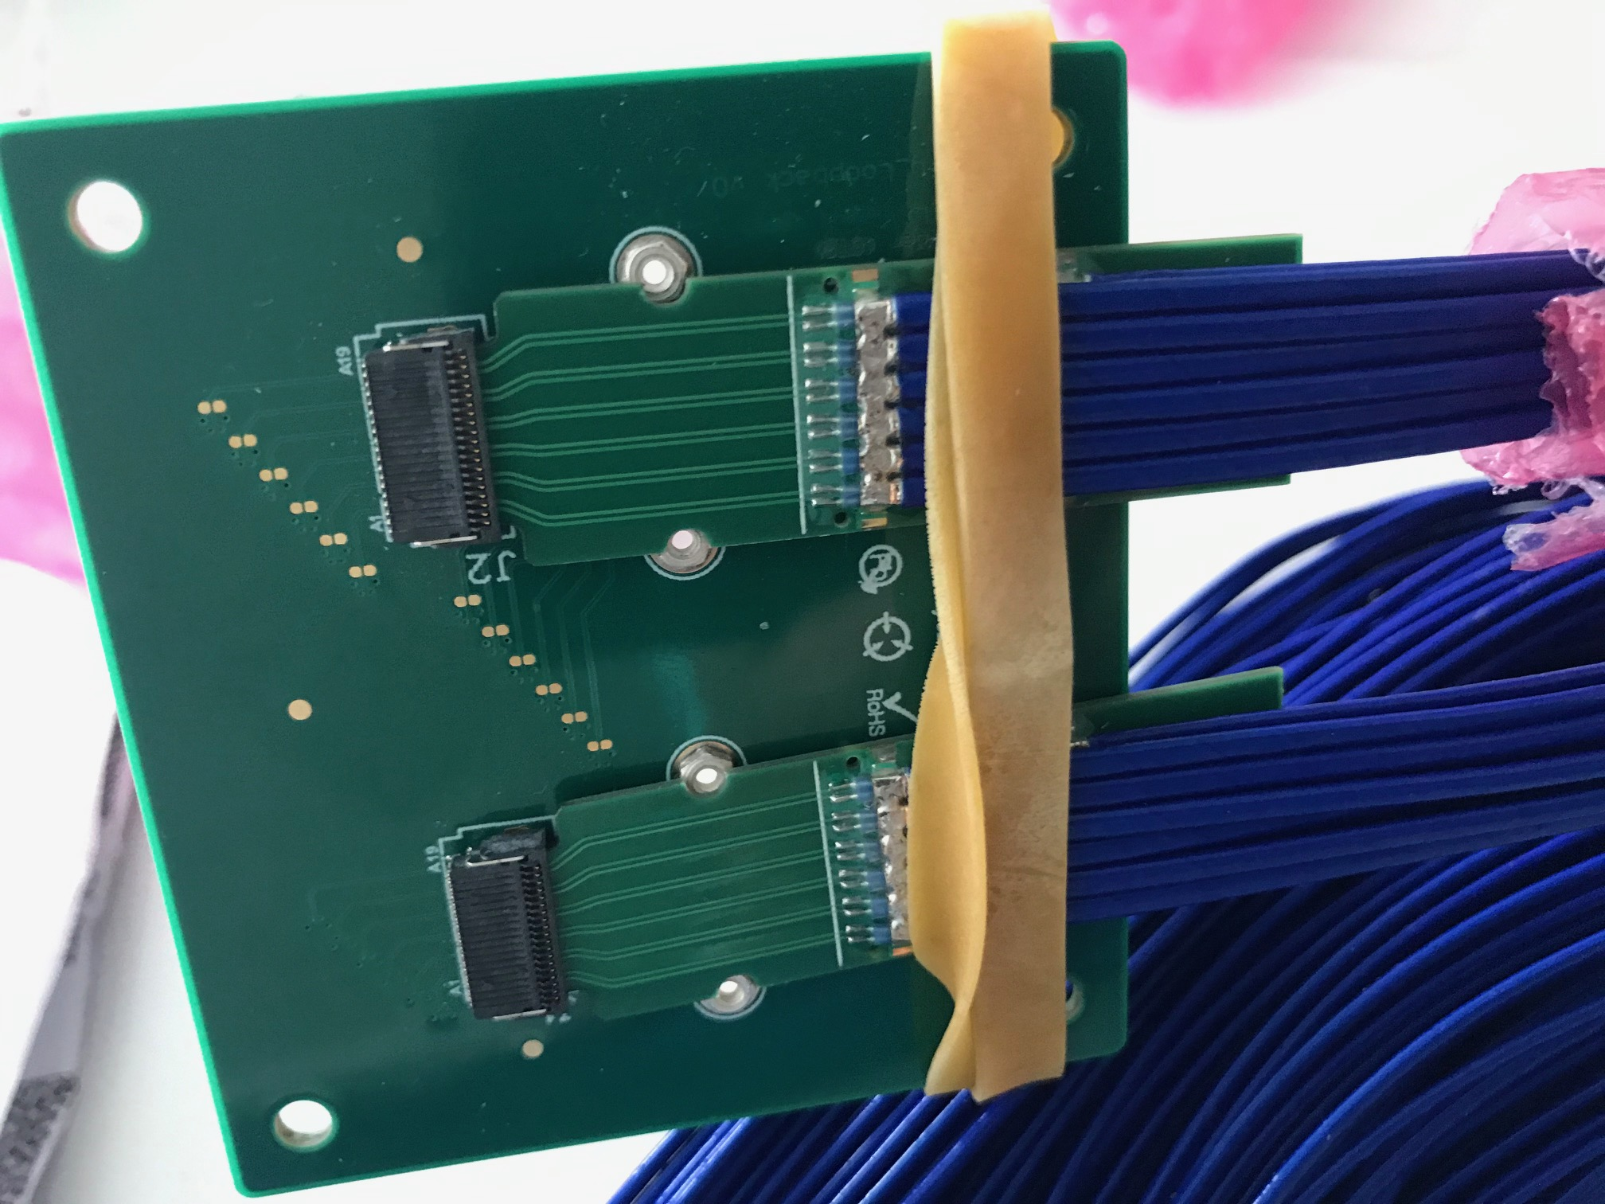
Jo is testing the sPHENIX readout cables
Nice job!

Slide 9
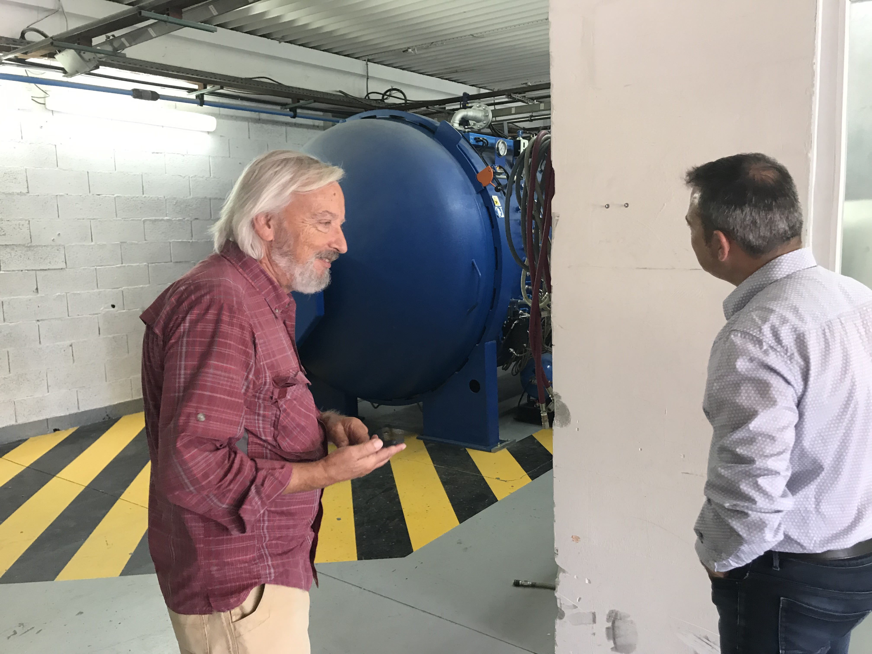
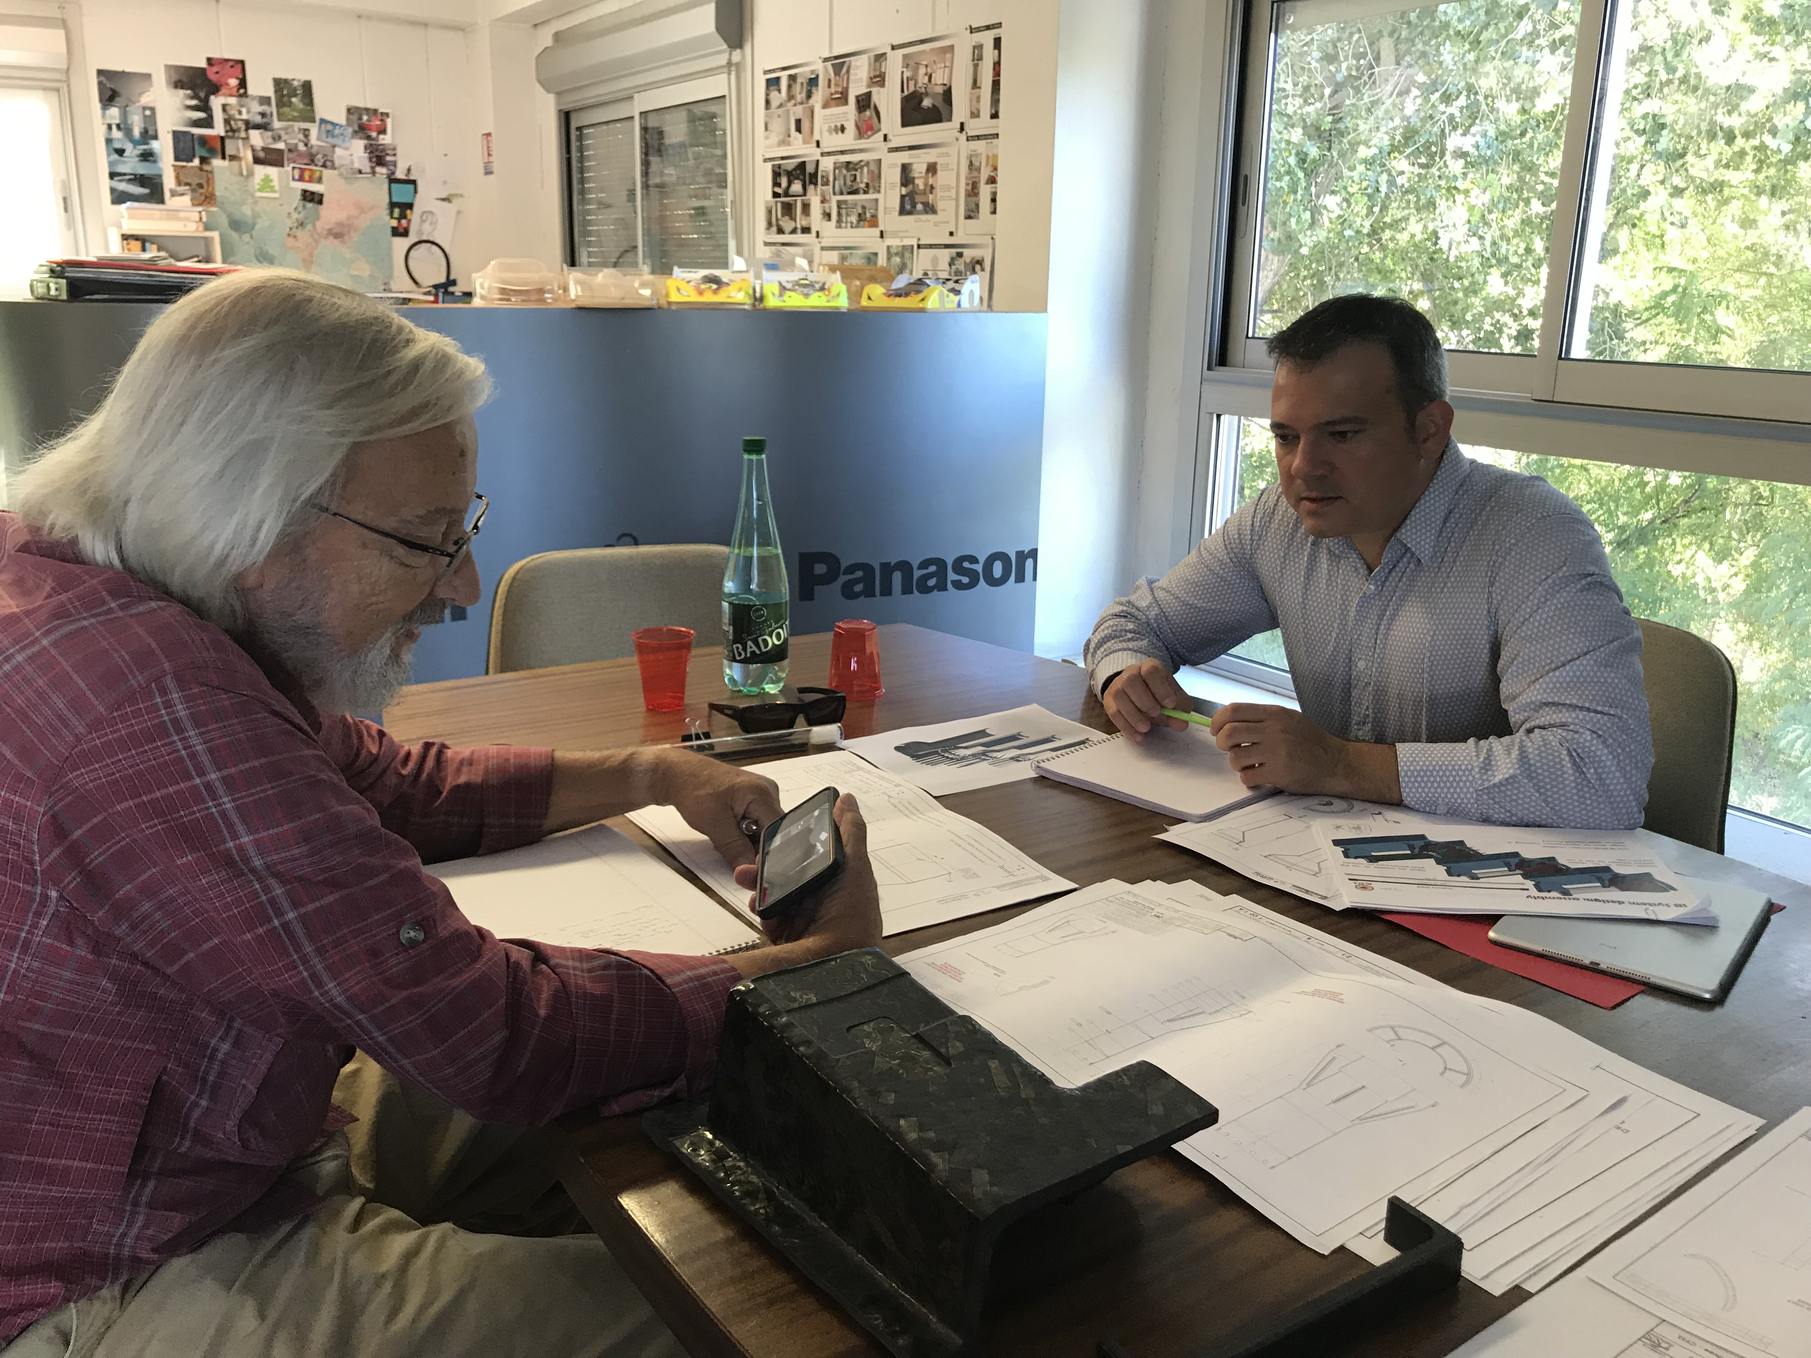
Carbon Structure Production
Visited WorkShape 9/19/2019
  Walt and Ming, Simon
WorkShape well prepared
  Updated the design files
MIT design work good progress, well ahead of time
  Early Carbon structure review for pre-production, Nov/Dec 2019?
Other companies, CA..
LBNL in progress

Slide 10
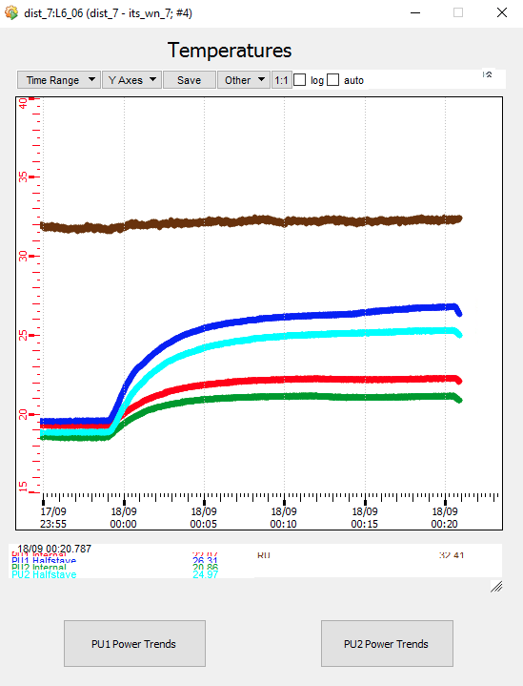
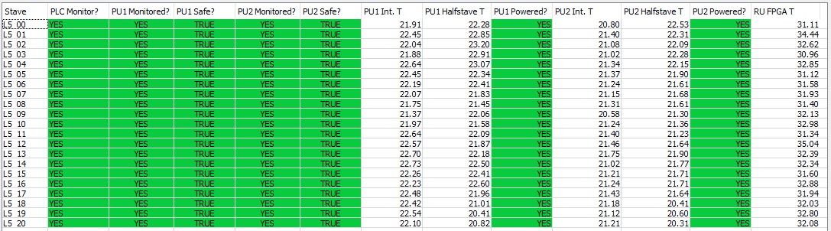
ITS Surface Commissioning
A lot of activities
Also require a lot of shifts, and EXPERTS!
Current status:
  Turn on layers, stave-be-stave, checking V,I,T
  Safety interlock important

Slide 11
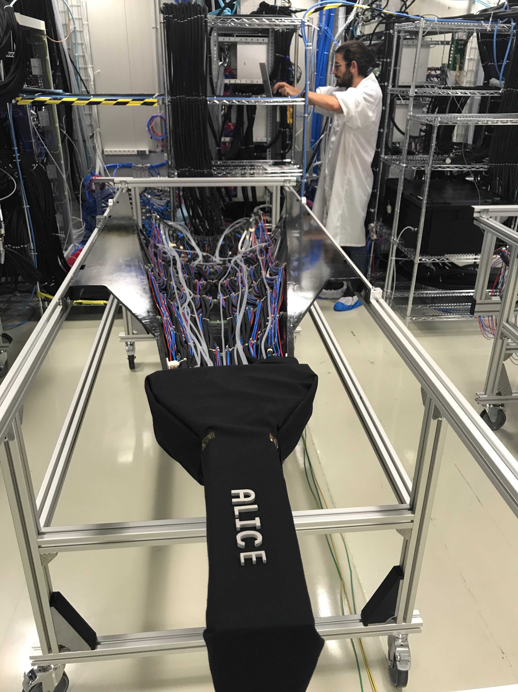
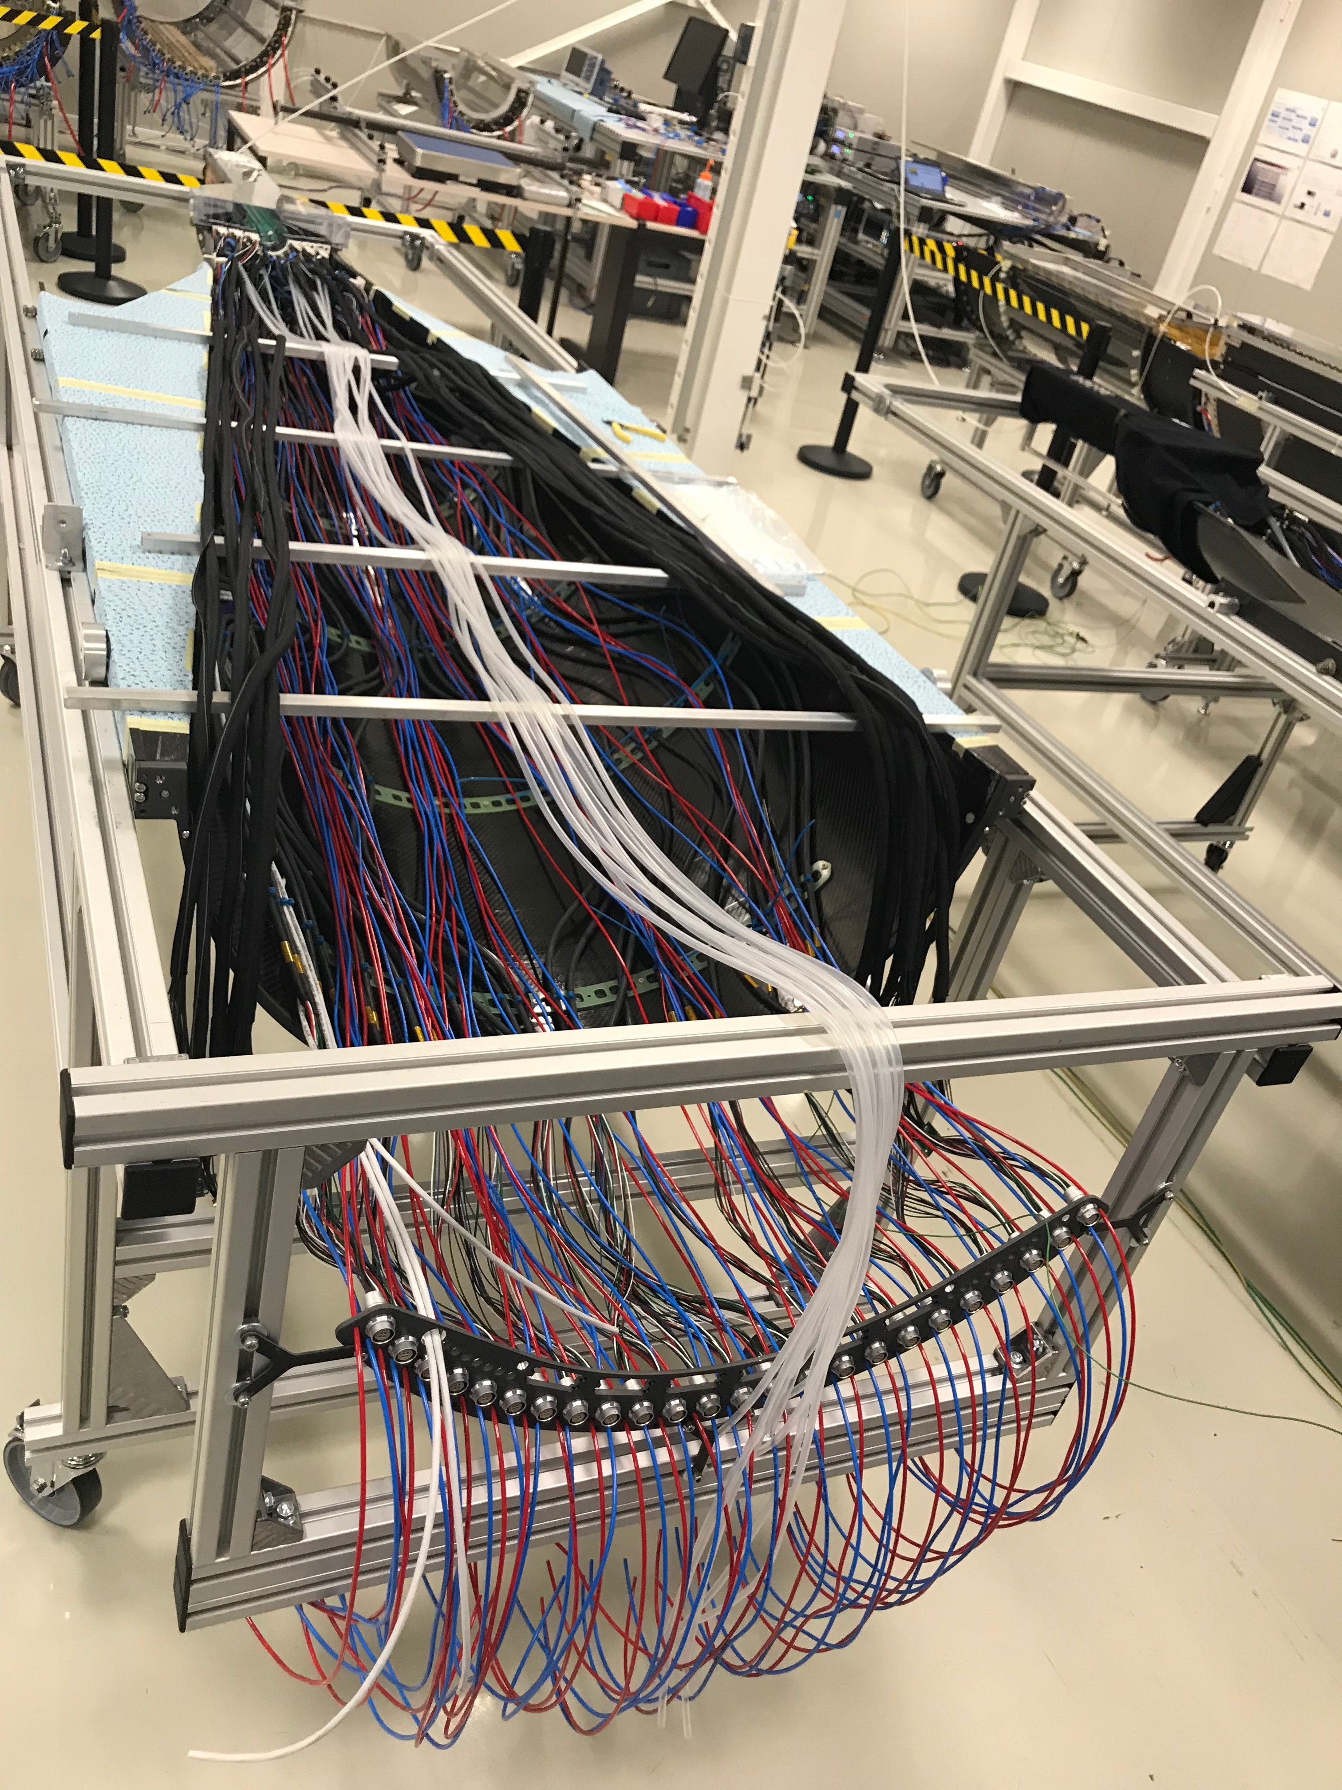
ITS/IB : top half barrel
ITS/IB : bottom half barrel

Slide 12
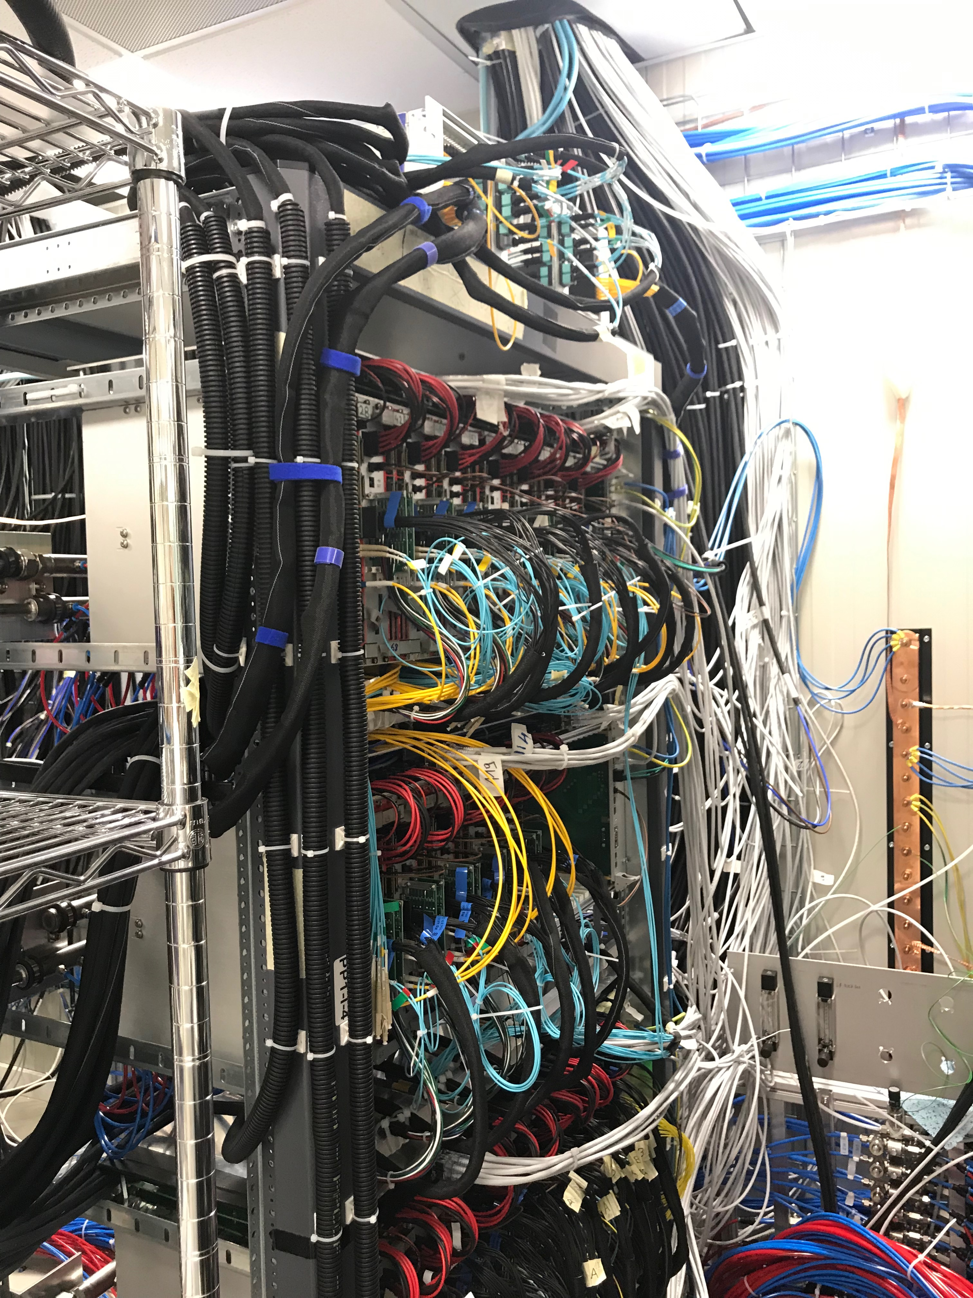
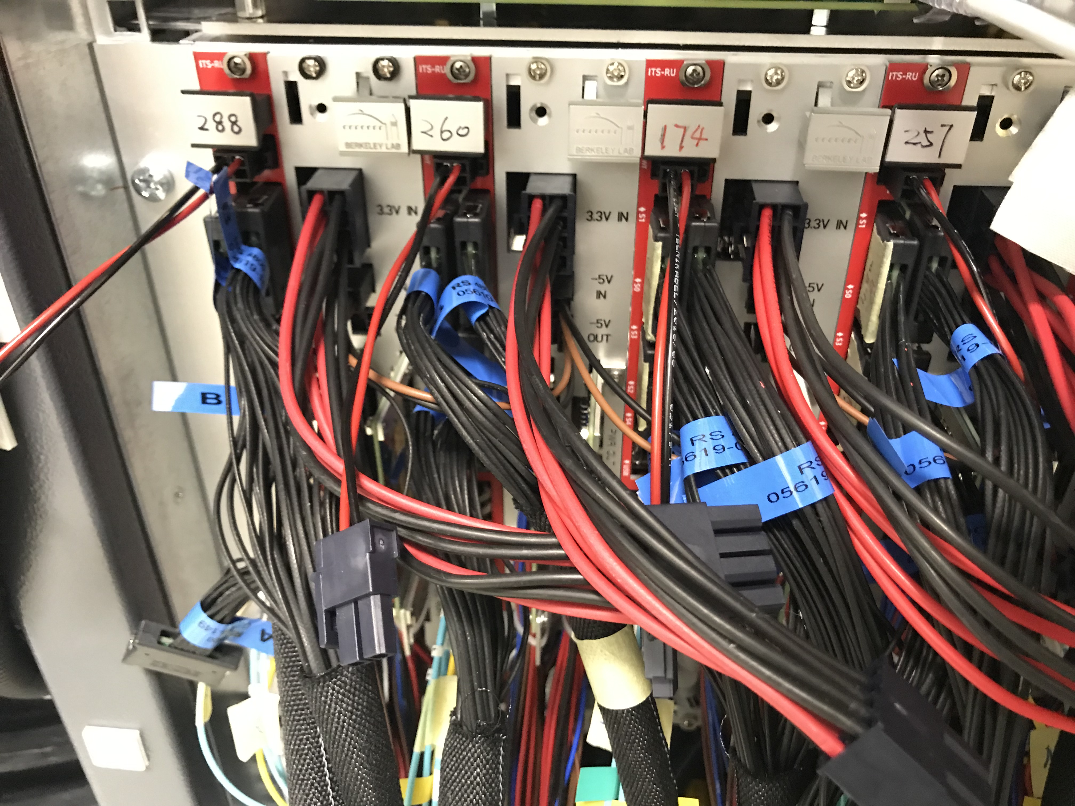
ITS/IB RU and PU, w cabels

Slide 13
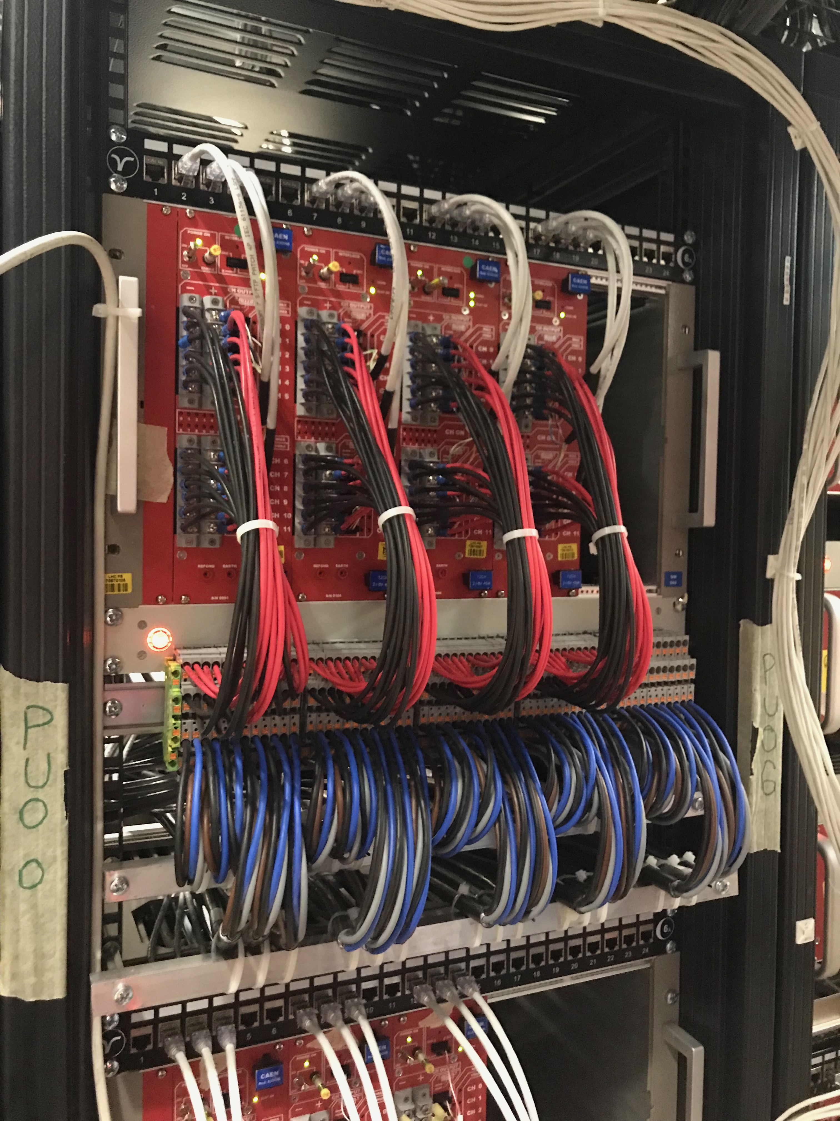
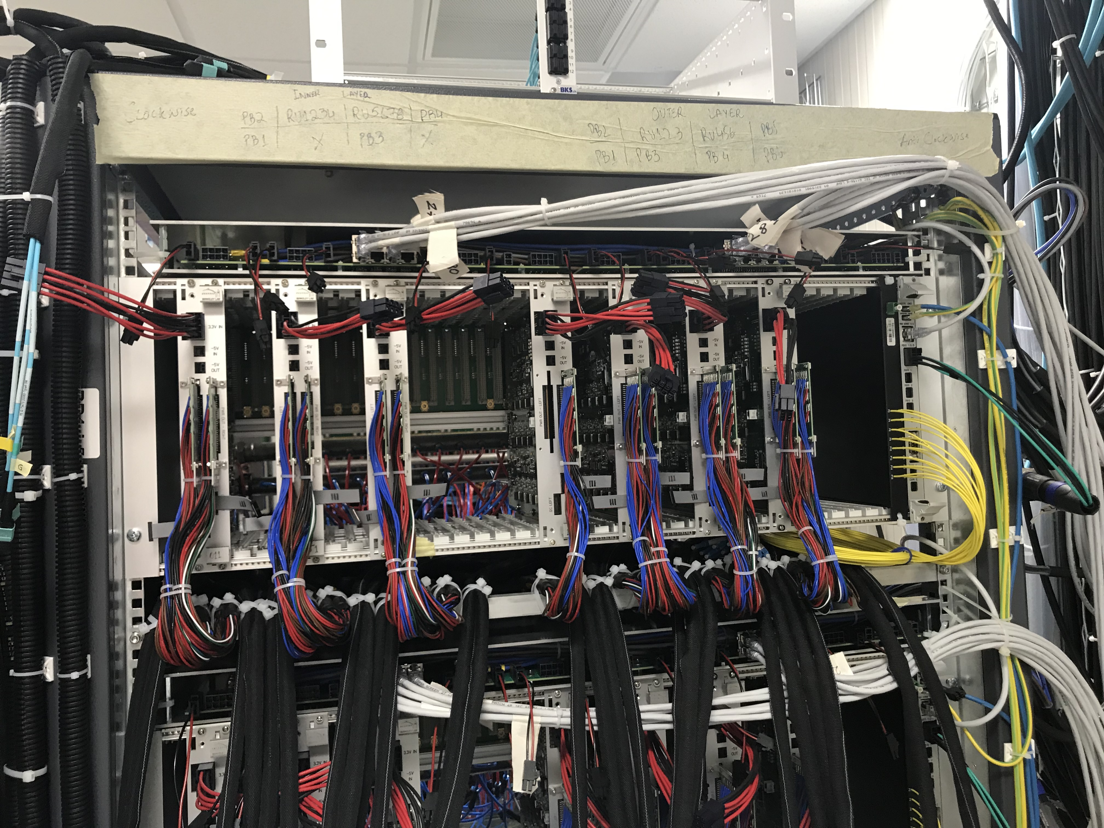
PU & CAEN PS

Slide 14
Summary: Near Term TO-DO List
Review response
  PMP document update
  Funding profile smoothing
  Response report document
Carbon structure cost estimate
  LBNL CF update
  Follow up with US vendors for quotes, Sept/Oct.
  Prototypes, select vendor(s)
Continue mechanical system design
  CYSS, EW, SB
  Global insertion system design and full mockup
A full “8-stave + 8-RU + 1-FELIX + 1-PU + 1 GTM” chain test
  10 RU available
  1 PU arrived at LANL from LBNL (thank Leo, Alberto!)
  8-stave/HICs telescope frame being designed
  RU & FELIX Firmware in progress
  Slow control software & GUI
  A possible test beam run later this year
RU acceptance QA at UTA
  Initial test in October
Prepare for stave acceptance QA at LBNL
FELIX production and test
  Jointly with sPHENIX TPC, at BNL? Or LANL?
2019 test beam data analysis
sPHENIX Stave production at CERN
We will follow up the progress closely, production, Test & QA
- bi-weekly meetings with CERN
ITS system surface commissioning at CERN
Now --- May 2020
A good opportunity to learn about the
system operation and controls;
Working on a coordinated effort within MVTX/sPHENIX,
Signup page,
https://docs.google.com/spreadsheets/d/1YBAyouW8geJHUPpzRyLlzN4ePW4YzI8glI5xI66N3ww/edit#gid=0

