Slide 1
MVTX Project Update
Dave, Ming, Ross, Grazyna, Yuan et al
3/15/2019

Slide 2
Updates from LBNL Workshop
Carbon structure cost
Mechanical design effort by LANL & MIT
Power system
Electrical integration project engineer → move to “sPHENIX” infrastructure
Electrical project management
Commissioning effort (+ MVTX staff)

Slide 3
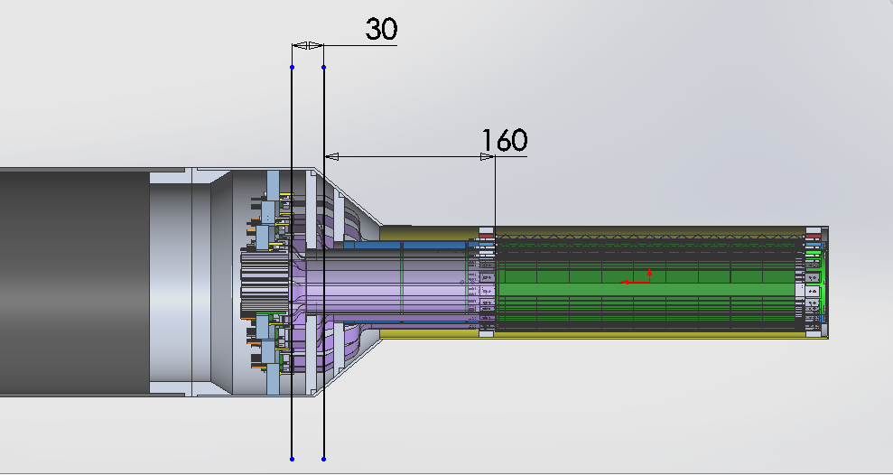
Carbon Structures
Conical sectors are expensive!
A new design under development to avoid the conical structures
From Walt: BNL workfest 3/12-13

Slide 4
Some Notes on Budget Update
The cost is $3,699K, and if we add BNL’s global contingency of 30%, the project total cost would be $3.7M x 1.3 = $4.81M
If we go with the detailed contingencies discussed at LBNL (some less but some are higher than 30%), the total project cost is $4.91M
We moved the Electrical Integration Project management (~$100K) and Commissioning effort (~$155K) from MVTX to sPHENIX
Need to double check all the numbers and update the budget in the P6 SOON

Slide 5
2 pt
2 pt

Slide 6
Upcoming Reviews
From Ed
Director’s Review April 9-11
Covers 1.X (MIE), 2.X (Infrastructure &Facility Upgrade), 3.X (INTT and MVTX)
Chaired by Jim Yeck
1.X and 2.X will be reviewed as pre-baseline pre PD-2/3 review. 3.X will be a technical review only of MVTX and INTT.
Expanded committee from Mar 2018 Director’s review. Mix of BNL and outside committee members but most local.
Dominated by parallel session
The Infrastructure topics will be covered by Mickey Chiu
The Installation/Integration topics will be covered by Glenn Young
The talk organization will be very similar to the CD-1/3A talks for both 1.X and 2.X
The talk organization for 3.X will adhere to the 1.X, 2.X slide format without the cost and schedule slides.

Slide 7
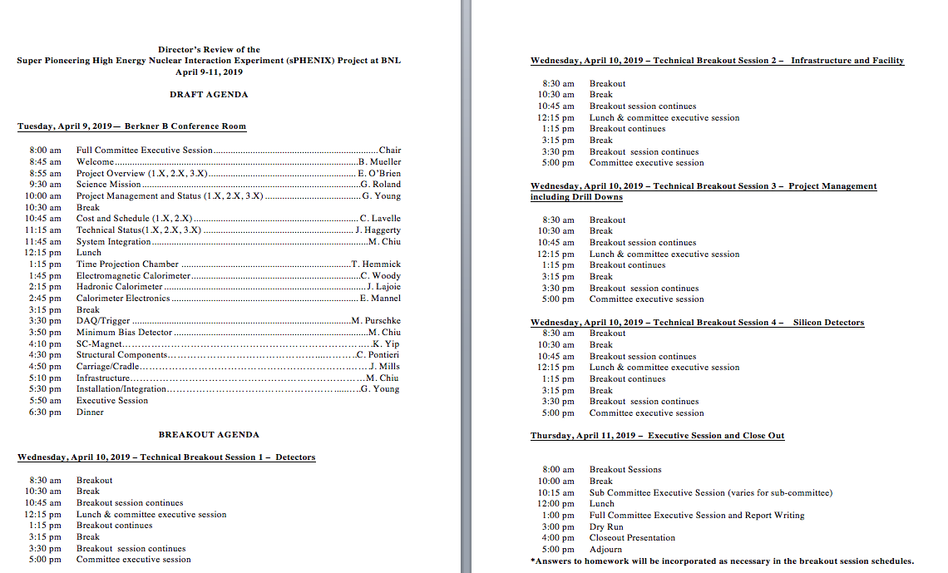
Draft Director’s Review Agenda
From Ed, 3/13/19
Under discussion

