Slide 1
MVTX Status WBS 3.2
Ming, Grazyna, Ross
MVTX bi-Weekly Meeting
1/18/2019

Slide 2
MVTX Stave and RU Procurement Status
Fund transfer for RU and Stave production at CERN
Tom Cormier updated (1/15/2019) the proposal was received at DOE.
“Elizabeth is working on her internal approval document”
84 staves and 60 RUs.
Ed sent a pledge letter to Luciano (12/14/2018) to proceed with the RU production, Luciano agreed and formally included 60 additional RUs for MVTX.
CERN/ALICE visit planned, Jan 28-Feb 1, 2019
LANL/Walt, Ming, and MIT/Bolek, Gunther, Jim, Ross et al, LBNL/Eric et al
Mechanical design and integration discussion with CERN engineers on Wed. 1/30
sPHENIX participation in ITS and MVTX stave production/QA, Mon. 1/28
Produce 5 staves for MVTX telescope, to be ready for Fermilab test beam in May
CERN recognized experiment - sPHENIX
Synergy between ALICE/ITS and sPHENIX/MVTX effort, mutually benefit

Slide 3
R&D Progress and Near Term Plan
Mechanical System Integration – dealing with thicker (dR = 0.84mm) Al beam pipe
Reconfigured the three layers of MVTX staves to give 2.0 mm of clearance from the sPHENIX aluminum beam-pipe extensions
A 3-day MVTX/HF Workshop at LBNL, 2/28 -3/2, 2019, https://sites.google.com/lbl.gov/hfmvtxlbnl2019/
1st day: HF physics
2nd day:
Dedicated engineering session to discuss the mechanical system integration and the cost of carbon structure,
with LANL, MIT, LBNL engineers, also INTT representatives, update cost & schedules
visit LBNL’s carbon factory
Physics and detector simulation & tracking discussion session
3rd day: summary of physics simulation and project update
Update carbon structure cost & schedule, to transfer project fund for MVTX design and R&D work
Upcoming Reviews – tentative schedule
sPHENIX BNL Directors Review (MIE 1.x, Facility 2.x and Silicons 3.x): week of April 8
sPHENIX PD2/3 Review (MIE only): week of May 27
Fermilab Test Beam in May 2019: MVTX + INTT (+ other subsys?)
A joint MVTX + INTT test beam proposal being developed
2 weeks, starting in the mid of May 2019

Slide 4
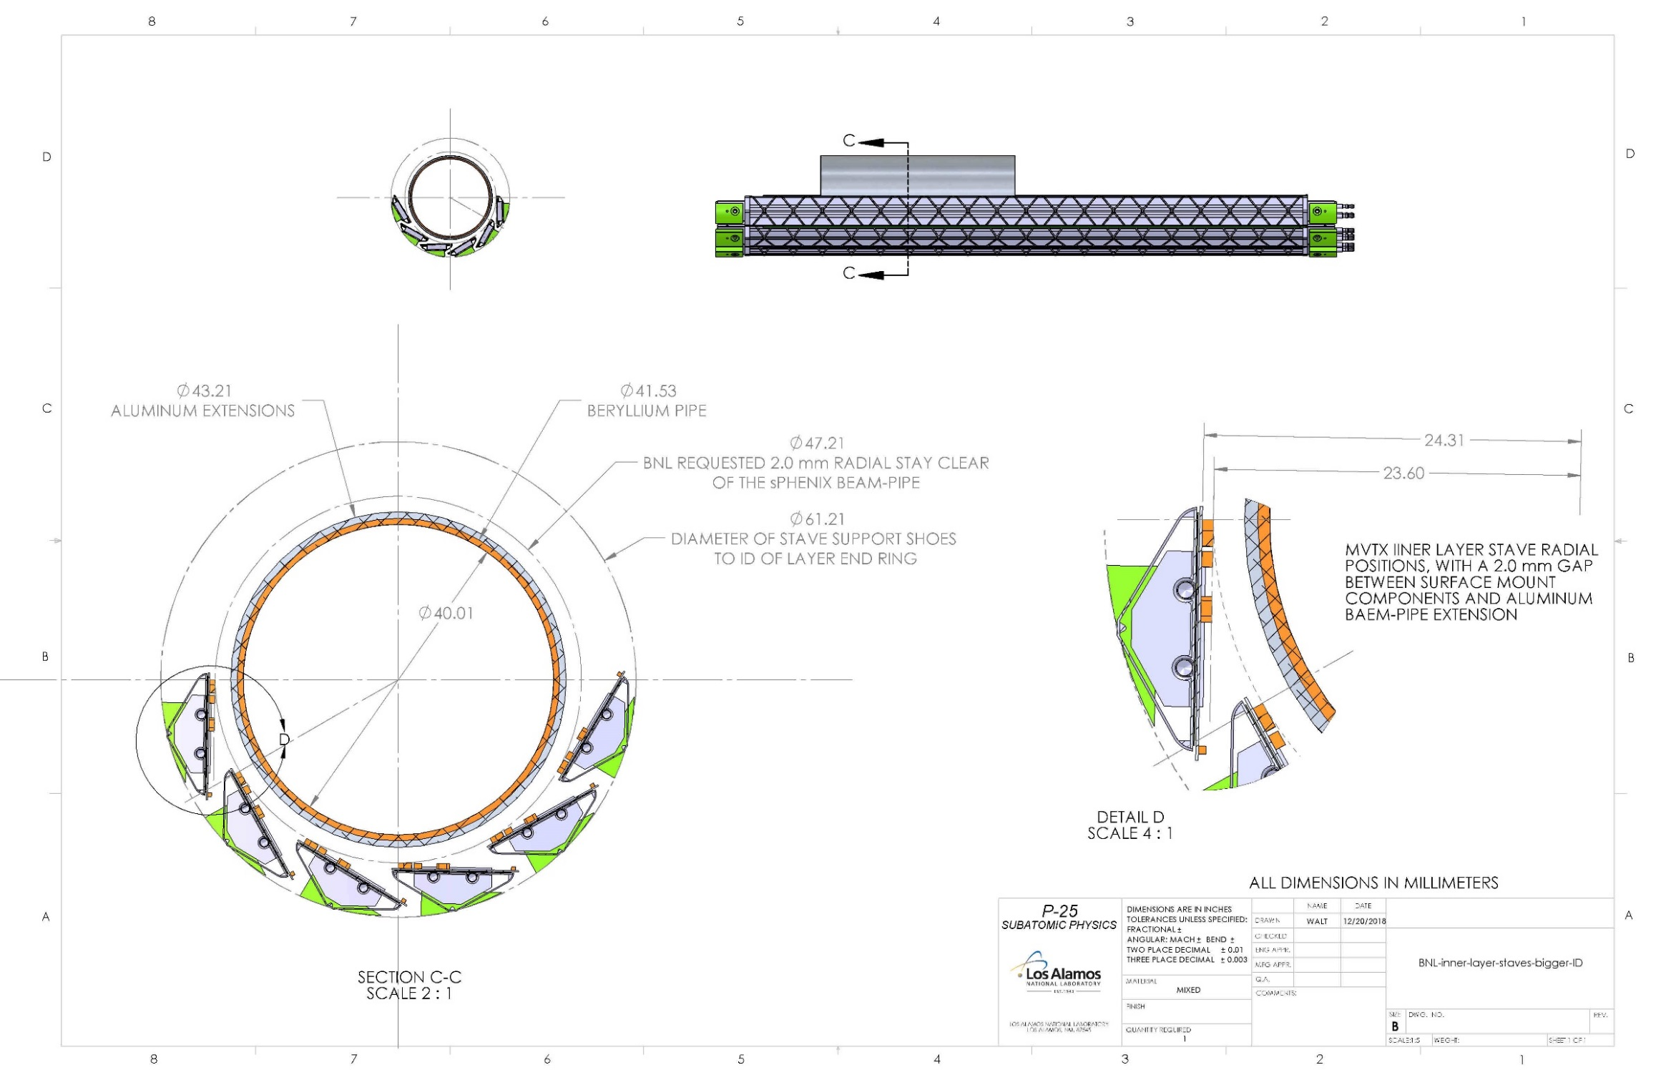
New configuration for the inner layer of the MVTX detector, 2.835 mm gap between surface mount components and aluminum extension radius of the sPHENIX beam-pipe
From Walt
Delta_R = 0.84mm

Slide 5
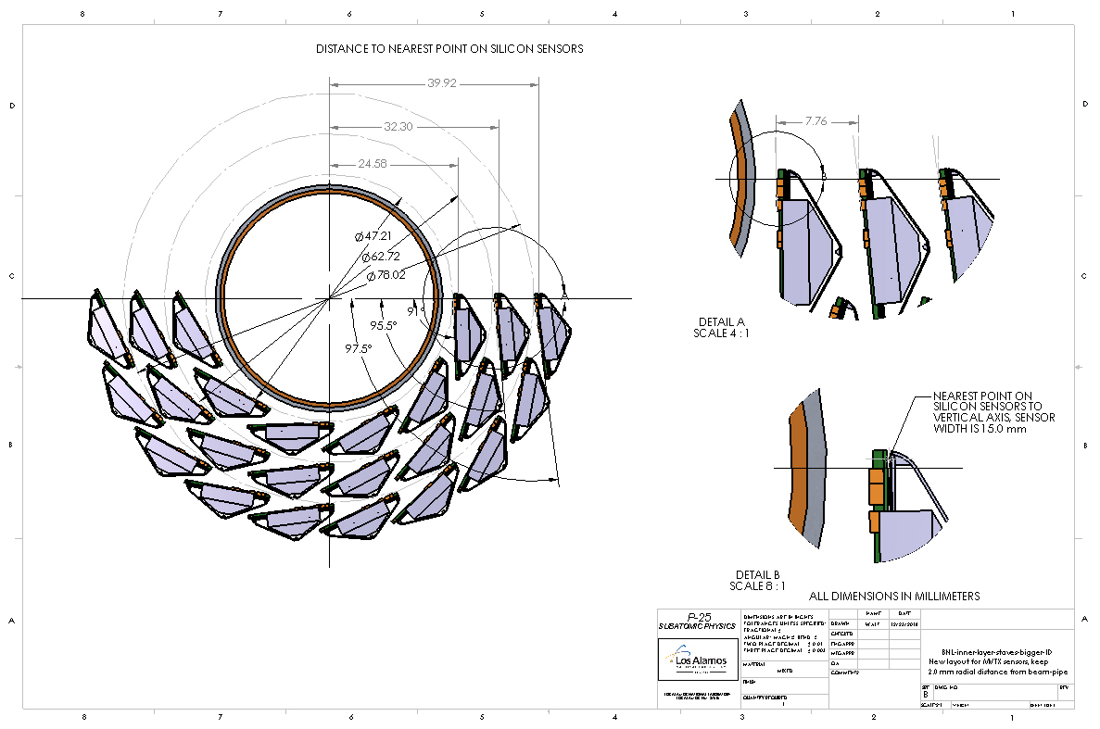
New MVTX stave configuration showing all three layers of staves:

Slide 6
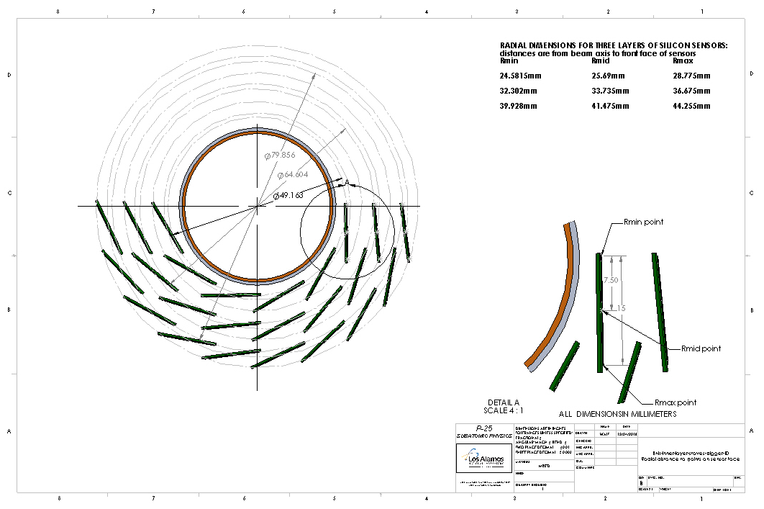
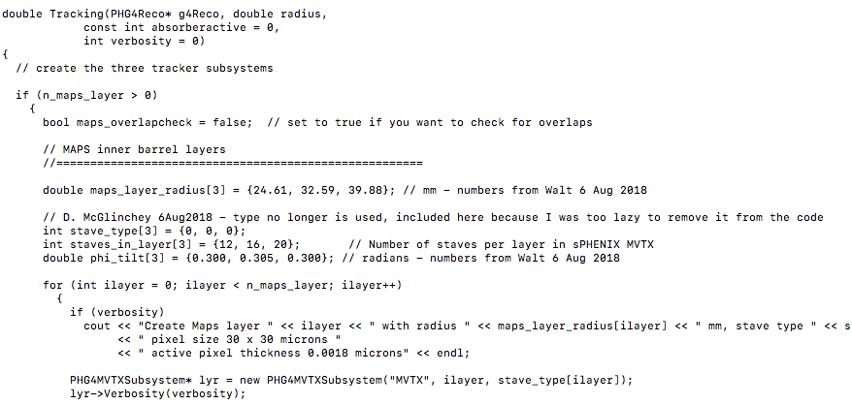
New configuration for the MVTX staves in all three layers giving the reference points for the sensors, similar to the ALICE configuration drawing:
Yasser & Darren will update MVTX geometry soon
Current MVTX geometry
parameters in GEANT

Slide 7
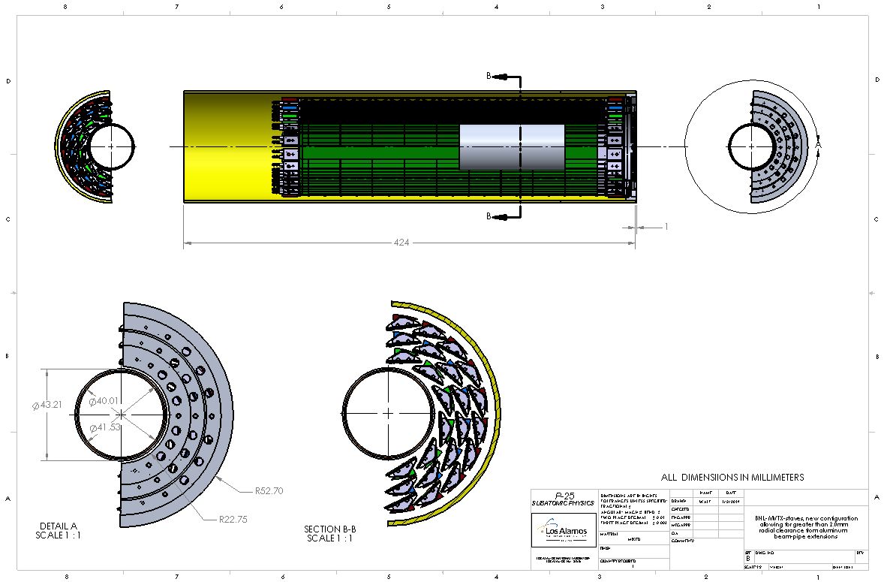
New MVTX stave configuration with end caps and bigger outer shroud,
the delta on the outer shroud went from 50.0 mm to 52.7 mm:

Slide 8
sPHENIX Asia Meeting – Mar 25-29 https://indico.bnl.gov/event/5521/
MVTX/HF physics and simulation
MVTX hardware and software tasks and plan
Asian institutions’ role & plan on MVTX
CCNU, Sun Yat-Sen, USTC et al
Yonsei, and possible Korean consortium
Possible open HF trigger development
MVTX + INTT -> dedicated “high level trigger” boards
fast event selection in continuous readout mode
Yonsei/Korean Consortium, LANL, BNL ...
Other topics - TBD

