Slide 1
MVTX Overview
(WBS 3.2)
Ming X. Liu
Los Alamos National Laboratory
sPHENIX Collaboration Meeting @NCU
03/25-27,2019

Slide 2
Outline
Document: sPH-HF-2018-001
https://indico.bnl.gov/event/4072/
MVTX science & technology
Recent reviews and R&D progress
  LBNL MVTX/HF workshop highlights
MVTX project status
  Near term plan and to-do list

Slide 3
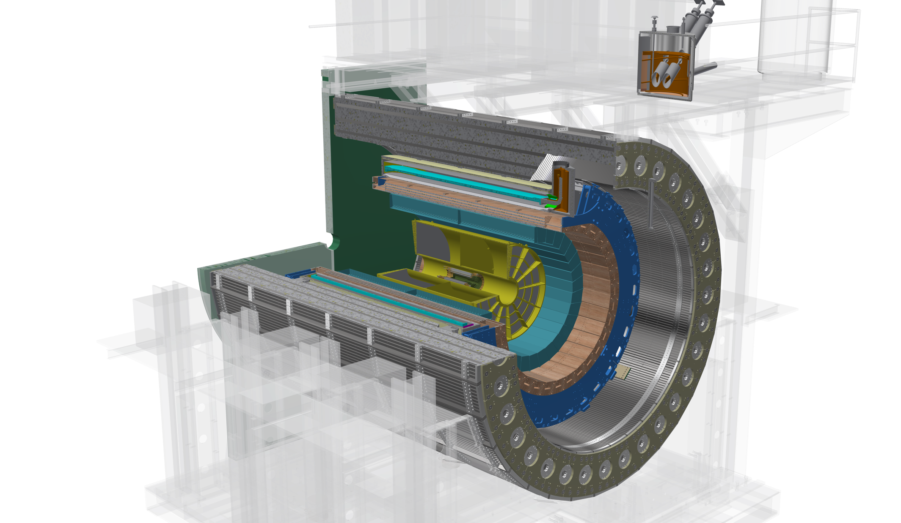
The sPHENIX Detectors
Outer HCal
SC Magnet
Inner HCal
EMCal
TPC
INTT
MVTX
Φ ~ 5m
15 kHz trigger
>10 GB/s data
Tracking system upgrade:
- MVTX (WBS3.2)
- INTT (WBS3.1)
Notes:
15kHz matched to collision rate.

Slide 4
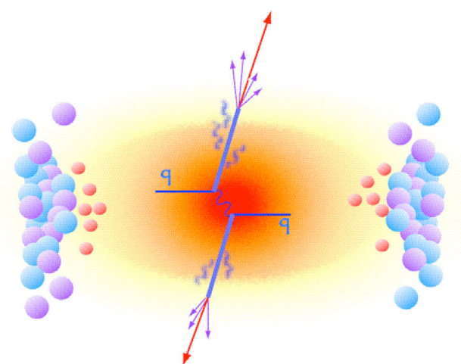
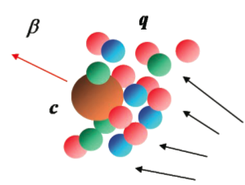
MVTX Enables the 3rd Science Pillar
Jin/Xin’s talk
Jets
Upsilons
Open Heavy Flavor
Bottom quarks are heavy (4.2 GeV)
Produced in initial collision, probe QGP evolution
Well controlled in pQCD
Access fundamental transport properties of QGP

Slide 5
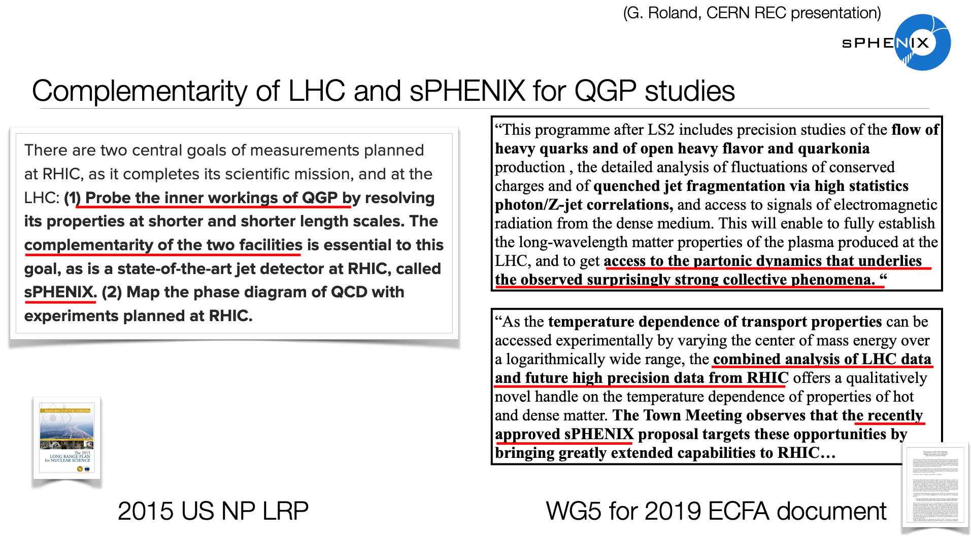
Dave’s talk from this morning

Slide 6
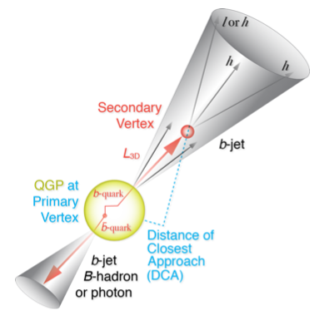
MVTX Physics Highlights
Jin/Xin’s talk
“B meson and b-jet modification”
MVTX: |eta|<1
precision vertexing
p+p, p+A, A+A
“B meson and b-jet flow”

Slide 7


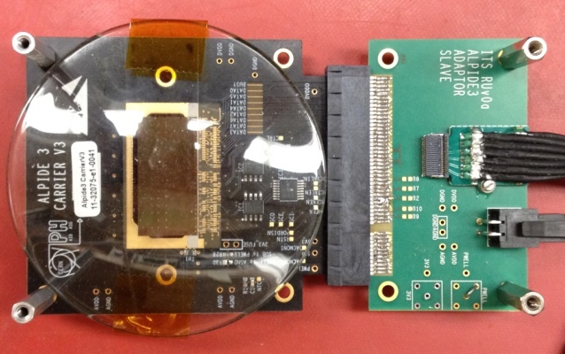
Monolithic Active Pixel Sensors (MAPS)
The Next-Generation, State-of-the-Art Pixel Tracker
Advantages of ALICE PIxel DEtector (ALPIDE) sensor:
Very fine pitch (27μm x 29μm), for superb spatial resolution
High efficiency (>99%) and low noise (<10⁻⁶), for excellent tracking
Time resolution, as low as ~5 μs, for less pileup
Ultra-thin/low mass, 50μm (~0.3% X₀), for less multiple scatterings
0.5M channels with on-pixel digitization, for zero-suppression and fast readout
Low power dissipation, 40mW/cm², for minimal service materials
An ideal detector for QGP physics!
Flexible Printed Circuit(FPC)
9 Chips
Cold plate
A 9-chip MAPS stave, 1.5cm x 27cm
ALPIDE design
ALPIDE sensor:
1.5cm x 3.0cm, 0.5M pixels
50 μm
~28 μm

Slide 8

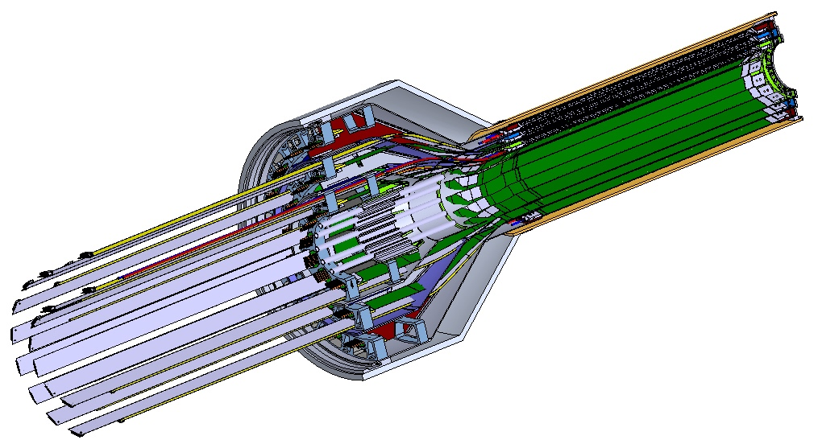
MVTX Detector – Modified from ALICE/ITS Design
Ross’ talk
Service cone: signal, power, cooling
and mechanical support
CYSS: Cylindrical Shell Structure
End-Wheel
Extended power FPC
3-layer sensor barrel
- 48 staves, 432 chips
MVTX
parameters

Slide 9

Scope of the MVTX Project
MAPS Staves & Electronics
  Readout Integration R&D (LANL LDRD)
    Frontend: ALICE/ITS, RU
    Backend: ATLAS FELIX
    Reprogram RU & FELIX into RCDAQ/sPHENIX
  Production @CERN: $1.36M
    84 ALICE/ITS-IB staves from CERN
      Acceptance test @LBNL, 48+spares(2-inner layers+)
    60 ALICE/ITS-RU from CERN
      Acceptance test @UT-Austin, 48+spares(12)
  Production & Assembly @US: ~$5M
    Production QA & assembly
      Half detector assembly & test @LBNL
      FELIX test & integration @LANL/BNL, 6+spares(2)
    Ancillary systems
      “adopt” ALICE ITS system
      Power, slow control & monitoring etc.
Mechanics & Cooling
  Modify ALICE/ITS inner tracker mechanical structures
    End Wheels
    Cylindrical structure shells
    Detector half barrels
    Detector and Service half barrels
  Mechanical system integration,
    Conceptual design (LANL LDRD)
    Design & simulations, MIT/LANL
    Composite structure production, LBNL
    Non-composite structure, MIT
    Installation tooling etc., BNL/LANL/MIT/LBNL
  Adopt ALICE cooling plant design
    Modifications to fit sPHENIX, MIT/BNL
Final test @BNL, Installation & commissioning (BNL + MVTX group)

Slide 10
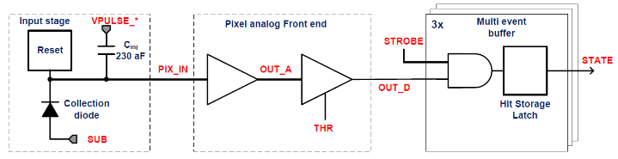
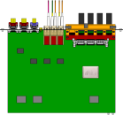

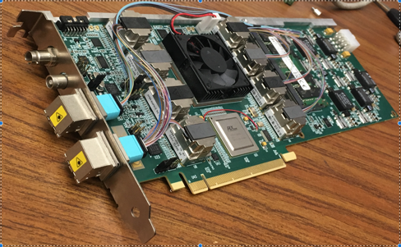

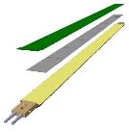
MVTX Readout, Power and Controls
CAN bus
DCS
Slow control
Mike’s talk
Trigger & Clock
Readout Unit
Front End
GBT Optical Links
one pixel
9 Data (1.2Gbps)
1 Clock, 1 Control/Trigger
Control
Data (9.6 Gb/s max)
Trigger
9-sensor Stave
Samtec Twinax “FireFly”
FELIX
Back End
FPC
Power
ATLAS Front-End Link eXchange (FELIX):
sPHENIX Data Aggregation Module(DAM)
Alpide Sensors
Flex PCB Filtering Capacitors
regulators
Power
Regulated Power
CAEN Power supplies
Cold Plate
ALPIDE pixel:
Shaping
Digitization
Zero-suppression
3x buffer
Power Board
Interaction Region
Experimental Hall
Counting House
MVTX Detector Electronics consists of three parts
Sensor-Stave (9 ALPIDE chips) | Front End-Readout Unit | Back End-FELIX/DAM

Slide 11
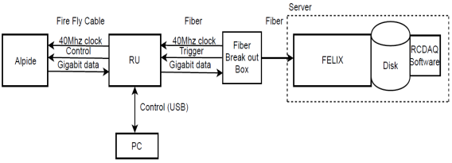
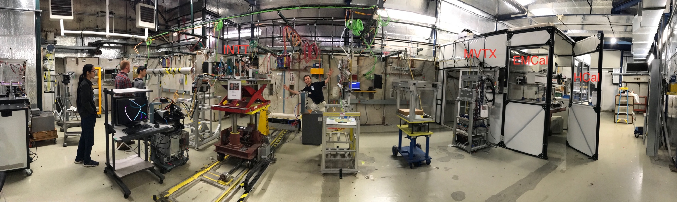
MVTX Full Readout Chain Demonstrated (3/2018)
4-MAPS
telescope
Fermilab Test Beam: Feb-Mar, 2018
Tracking spatial resolution
achieved: <5 um
120 GeV proton
beam
4-hit track
4-MAPS telescope

Slide 12
Highlights from Recent Reviews and R&D
July 2018 Stave and RU Production Readiness Review
November 2018 mechanical system integration review
April 2019 Review : “CD-1 equivalent”

Slide 13
Stave and RU Procurement Readiness
BNL Director’s Review, 7/19-20, 2018
https://indico.bnl.gov/event/4729/
To produce RU and staves as part of ALICE production
  Reduce technical risks
  Cost saving
To meet sPHENIX installation & run schedule.
DAY-1 PHYSICS
Recommendations:
RU, proceed with production
Resolve MVTX/INTT space conflict
  modify stave design, longer power cables
  build a 3-D model
  Simulation TF to optimize INTT layers
Stave radiation hardness

Slide 14
MVTX/INTT Mechanical Integration – Stave Modification
Ross’ talk
This MVTX model shown with 40cm flat power extension cables
PP-1a: signal cables
PP-1b: power cables

Slide 15
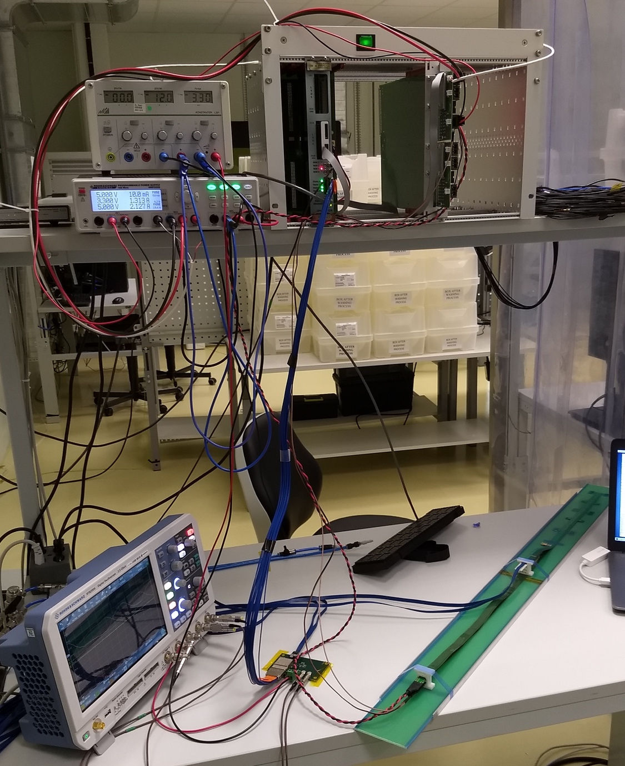
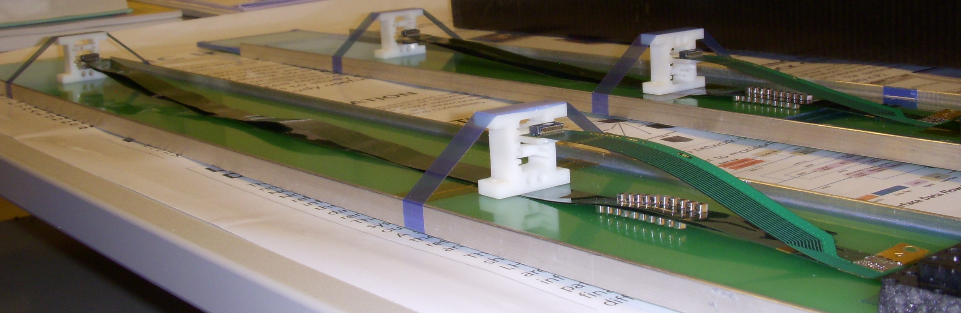
Confirmed HIC with Extended 40(60)cm Power FPC
Built and tested two HICs at CERN in the week of 9/17/2018
  No change in sensor performance (noise, threshold) observed, as expected;
Details presented by Dr. Sho Uemura at the sPHENIX general meeting on 9/23/2018
40cm PWR FPC
60cm PWR FPC
ALICE: 15cm PWR FPC
Followed identical
ALICE IB QA test procedure,
with a 8m SamTec cable!
Nice work by Alex and Sho et al!

Slide 16
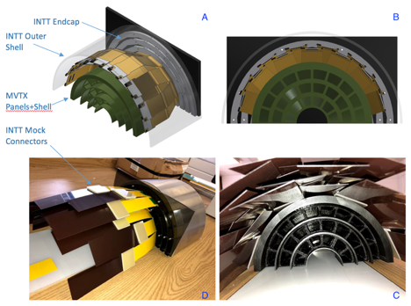
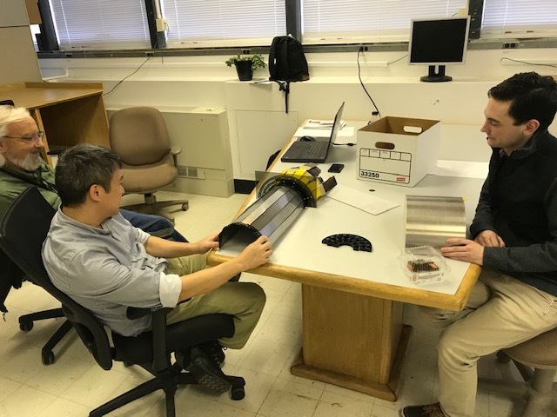
MVTX + 4-layer INTT 3-D Mockup Demonstrated
Office of System Integration
– led by Mickey & Bob,
a team of engineers and physicists
MVTX and INTT
Space conflict resolved!

Slide 17
Sensor Irradiation Test – OK at 2.7MRad
Continuous effort by ALICE (@NPI, Czech)
BNL review recommendation: test sensor up to 1MRad
https://indico.cern.ch/event/758048/

Slide 18
Address July 2018 Review Recommendations
Stave and RU procurement readiness
Completed sensor/HIC/stave evaluations at CERN
  Built, tested and confirmed two HICs with 40cm and 60cm long power FPC
  Sensors irradiated up to 2.7MRad, no issues (updated 9/18/2018).
Addressed all recommendations on stave/sensor R&D
Cost are set for staves & RUs, procurement through US-ALICE/UTK!
  Technical specs document completed for production, BNL/DOE agreed
  sPHENIX RU and stave production starts ~April 2019, practically already in progress
MVTX/INTT mechanical integration
  Mechanical design being updated and 3-D mockup demonstrated
  Inner tracking task force completed evaluation, preferred INTT-layers =2
Readout cables
  BNL approved the use of SamTec blue cables
    Electrically better & mechanically compact
    ALICE confirmed signal performance with 8m long readout cables. For MVTX, 10m very likely works (30AWG/sPHENIX vs 32AWG/ALICE), to be confirmed by on-going R&D at LANL
  Samples ordered for system integration mockup and test
https://docs.google.com/document/d/1vsm_G7ZLgqv-kBZqK0jF69T_Nx2Uwk0Zxv86jRVxybw/edit?usp=sharing
Christof, Rachid, Itaru’s talks

Slide 19
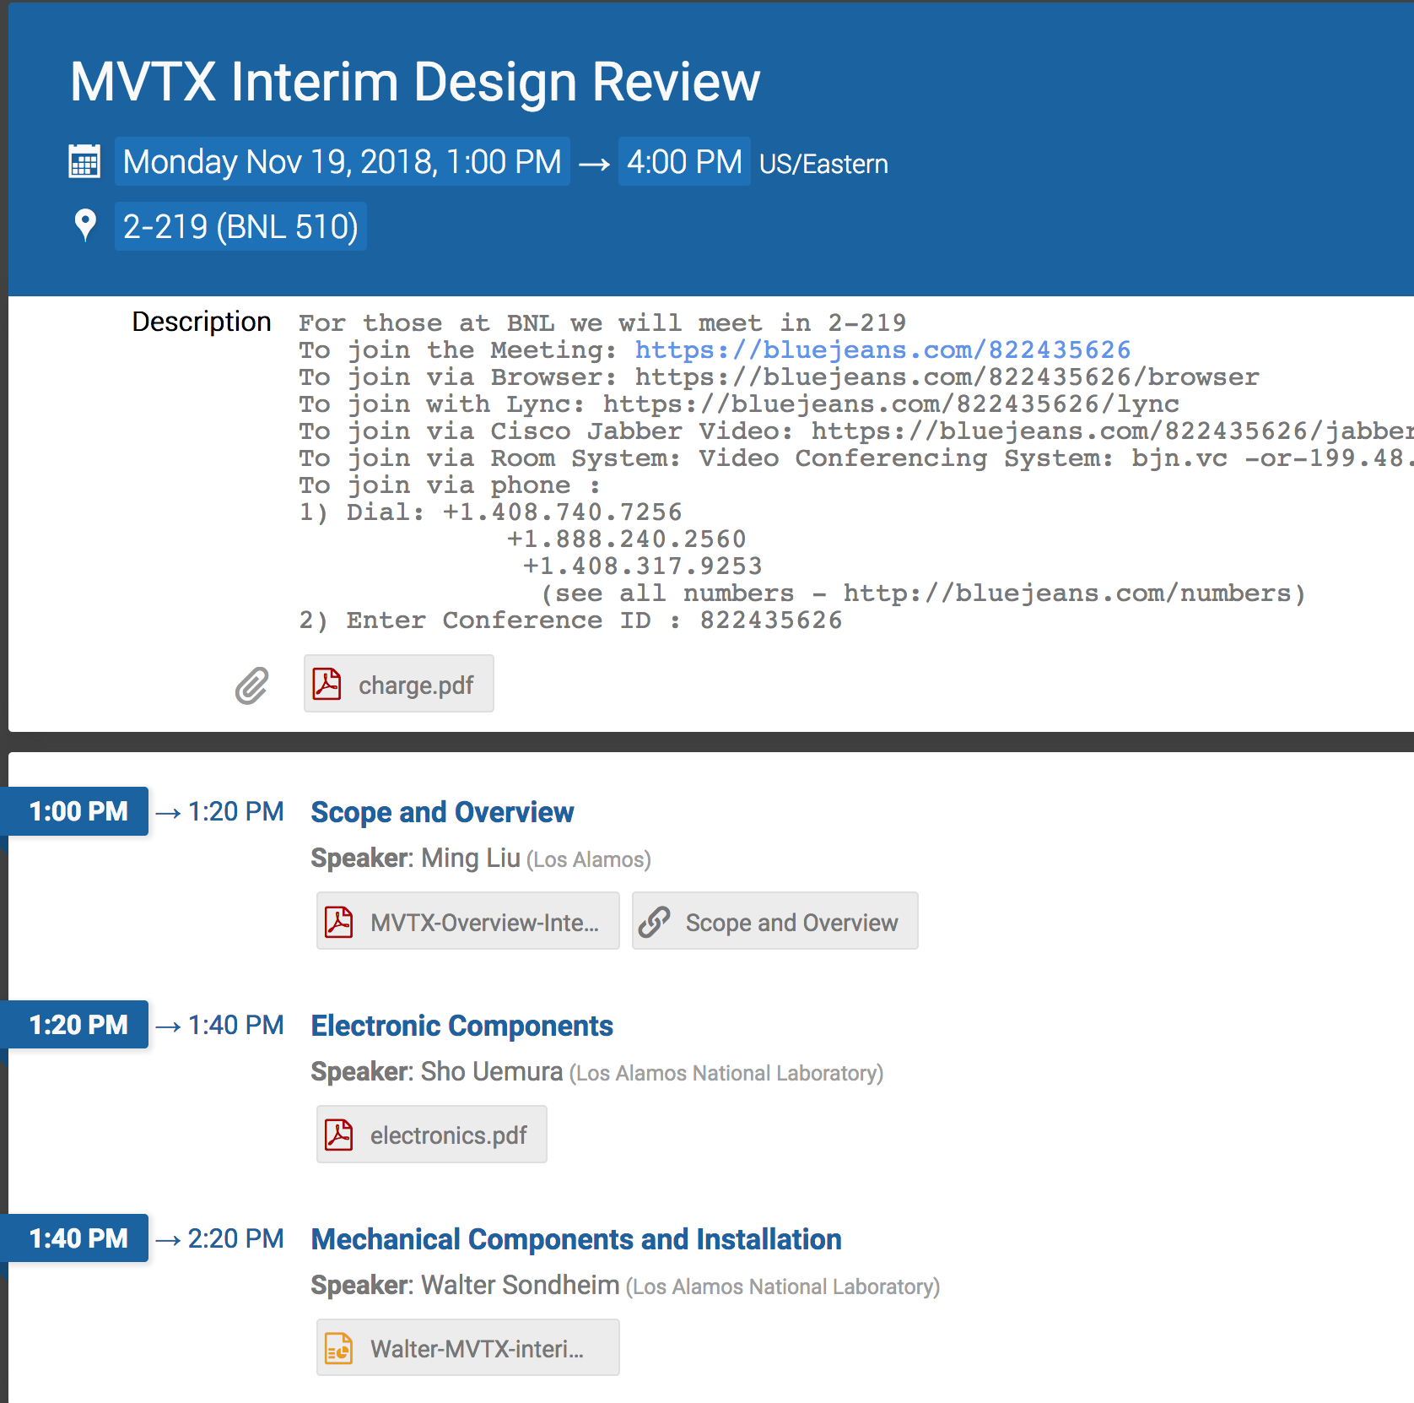
MVTX Design Interim Review
11/19/2019, led by John Haggerty
https://indico.bnl.gov/event/5351/
Detector assembly & installation in sPHENIX
No evident showstoppers
Interim design review report, draft
Ross’ talk

Slide 20
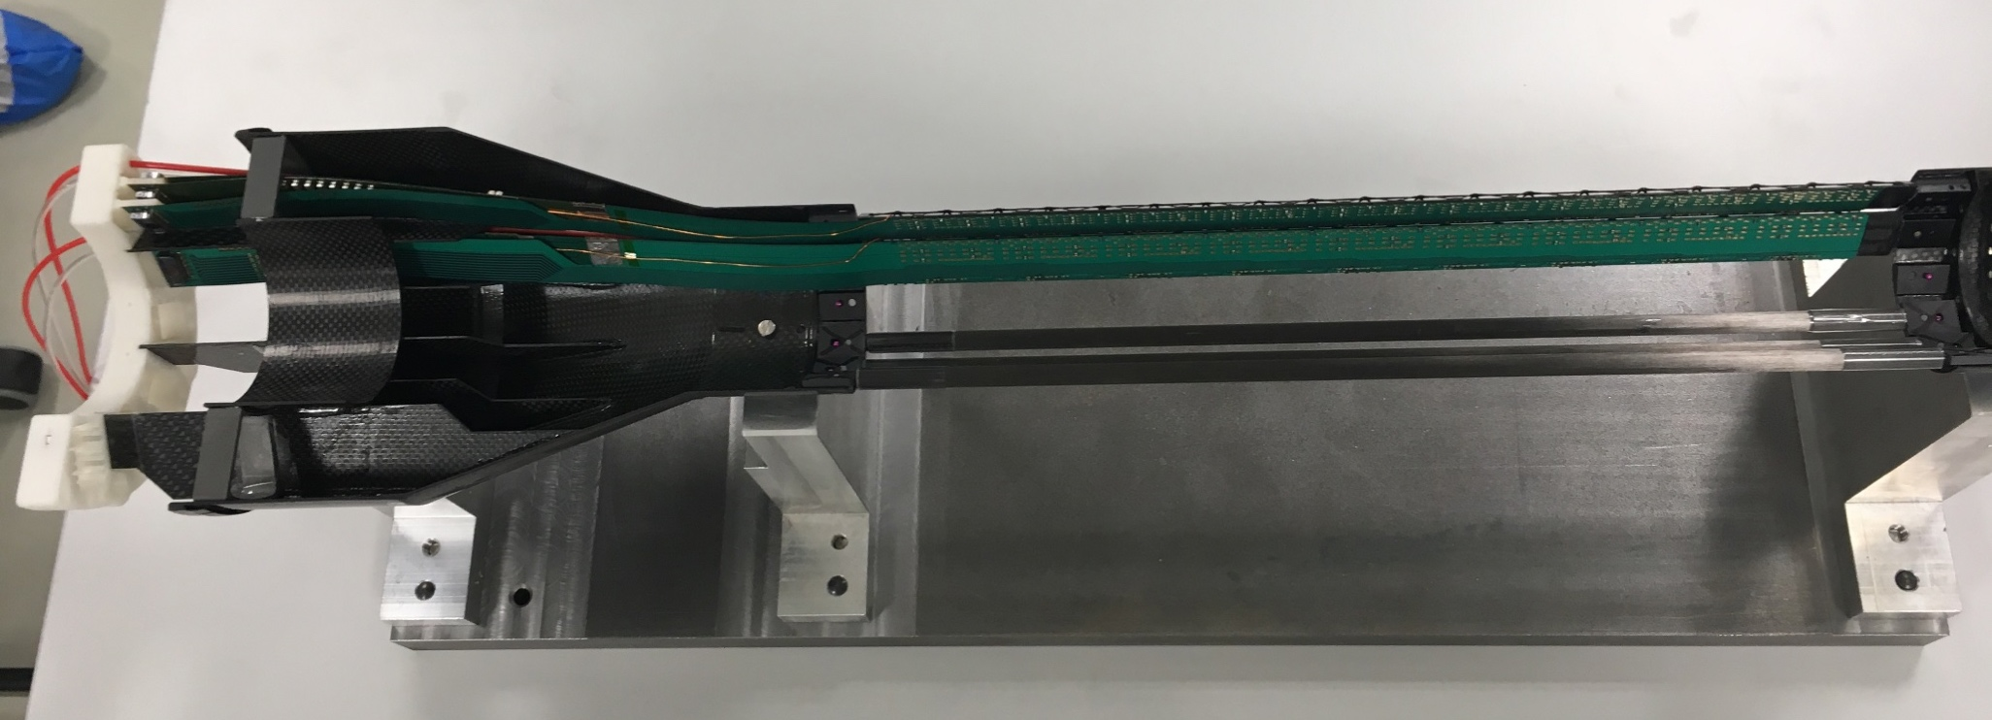
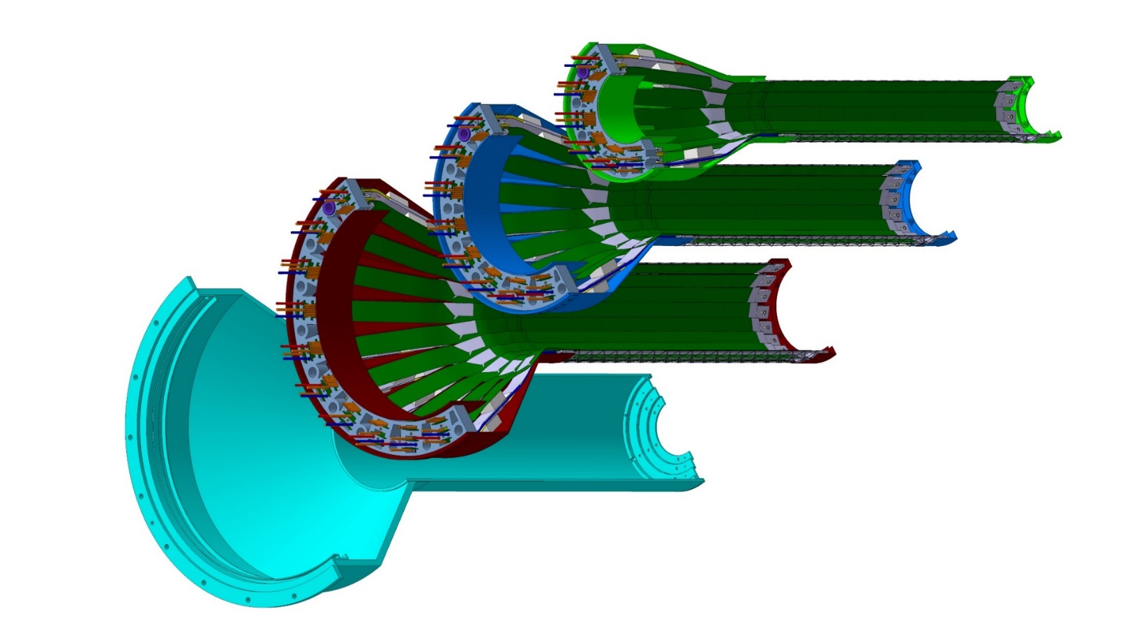
Detector Assembly & QA Plan at LBNL
staves
Precision positioning and installation of staves on end-wheels
dummies
ALICE 1st half inner layer being assembled
6/2018@CERN
Layer 0
Layer 1
Follow ALICE IB assembly procedures to build half-detectors for MVTX
QA records in DB, travelers
Modified jigs for MVTX
Build two full half-barrel detector with the service structures
Layer 2
IB CYSS
Install SamTec & power cables during half-barrel assembly with the service barrel at LBNL (under discussion)

Slide 21
ALICE jig assembly steps;

Slide 22
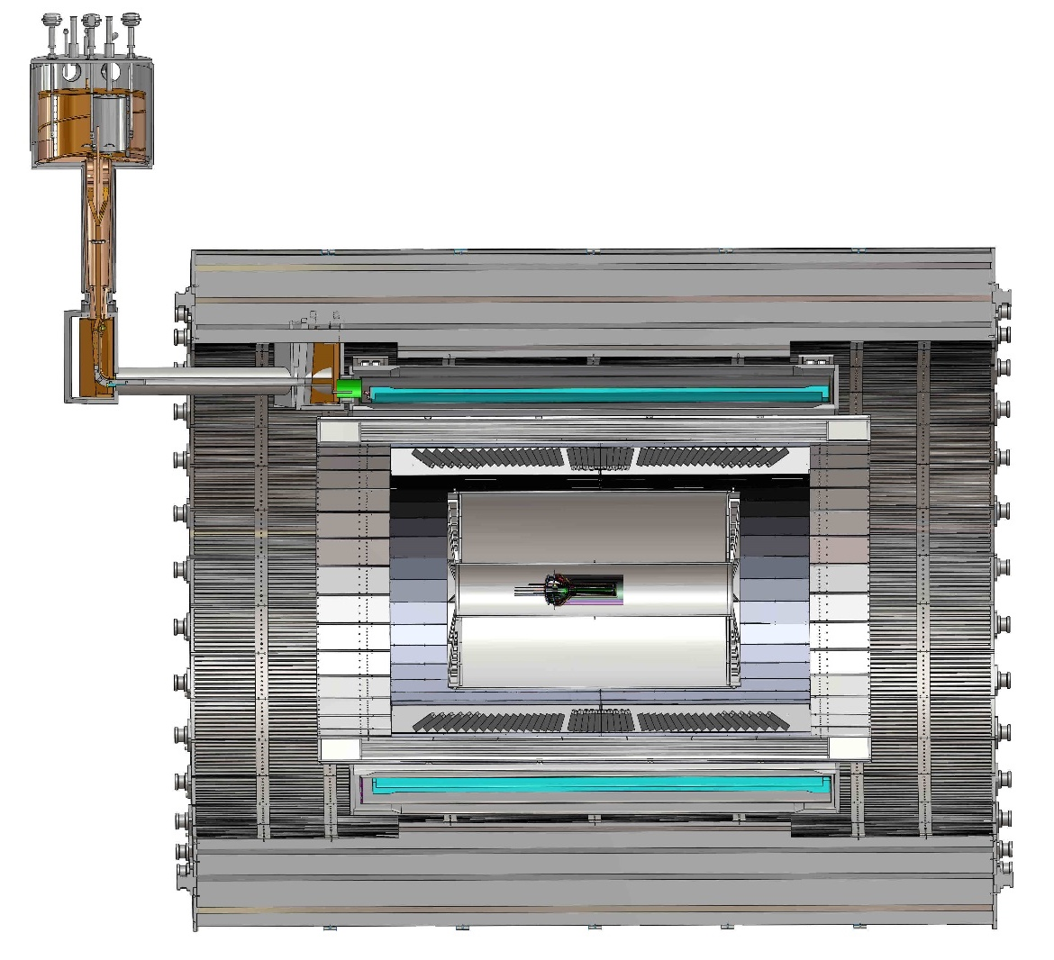
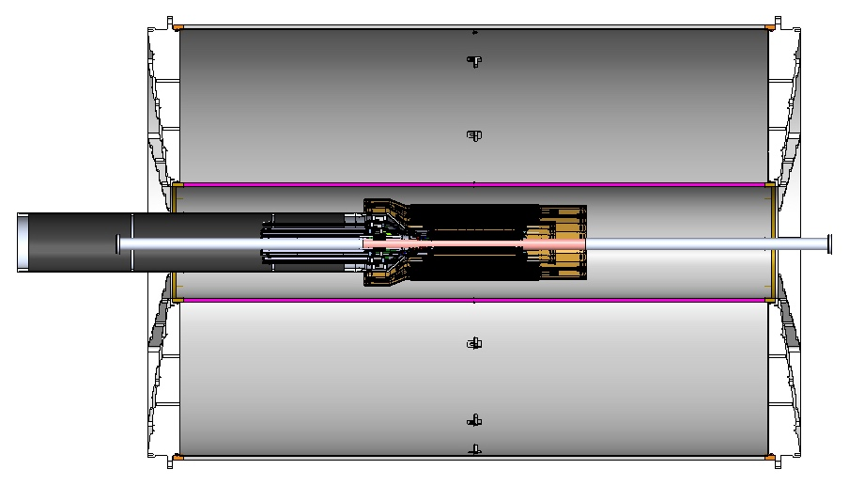
MVTX Global Mechanical System Integration
Ross’ talk
MVTX service barrel preliminary design, with two parts:
  Part-1: from MVTX to PP-1b, all power PCB, 40cm
  Part-2: length TBD later, from PP-1b to PP-2
Service Barrel
TPC
TPC
INTT
MVTX
PP-1a:
short signal cables
PP-2:
Signal and power cables
R= 209.6cm
PP-1b:
power cables
L = 350.0 cm

Slide 23
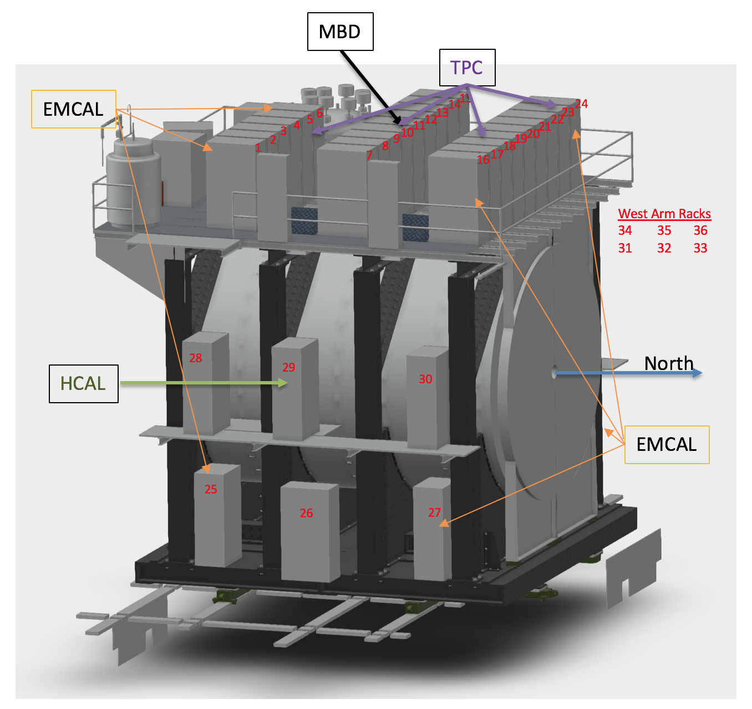
MVTX Services - Work in Progress
Service racks located close to MVTX detector
  Electronics, power etc
  “Minimal cable length”, 8m tested at CERN;
    L~7.9m
    R&D on 10m cables at LANL
48 RU and 24 PU
  1PU ->2RU
  6-U VME crates
CAEN bulk power supply
  located nearby
Cooling plant
  Location TBD
MVTX
RU/PU& PS

Slide 24
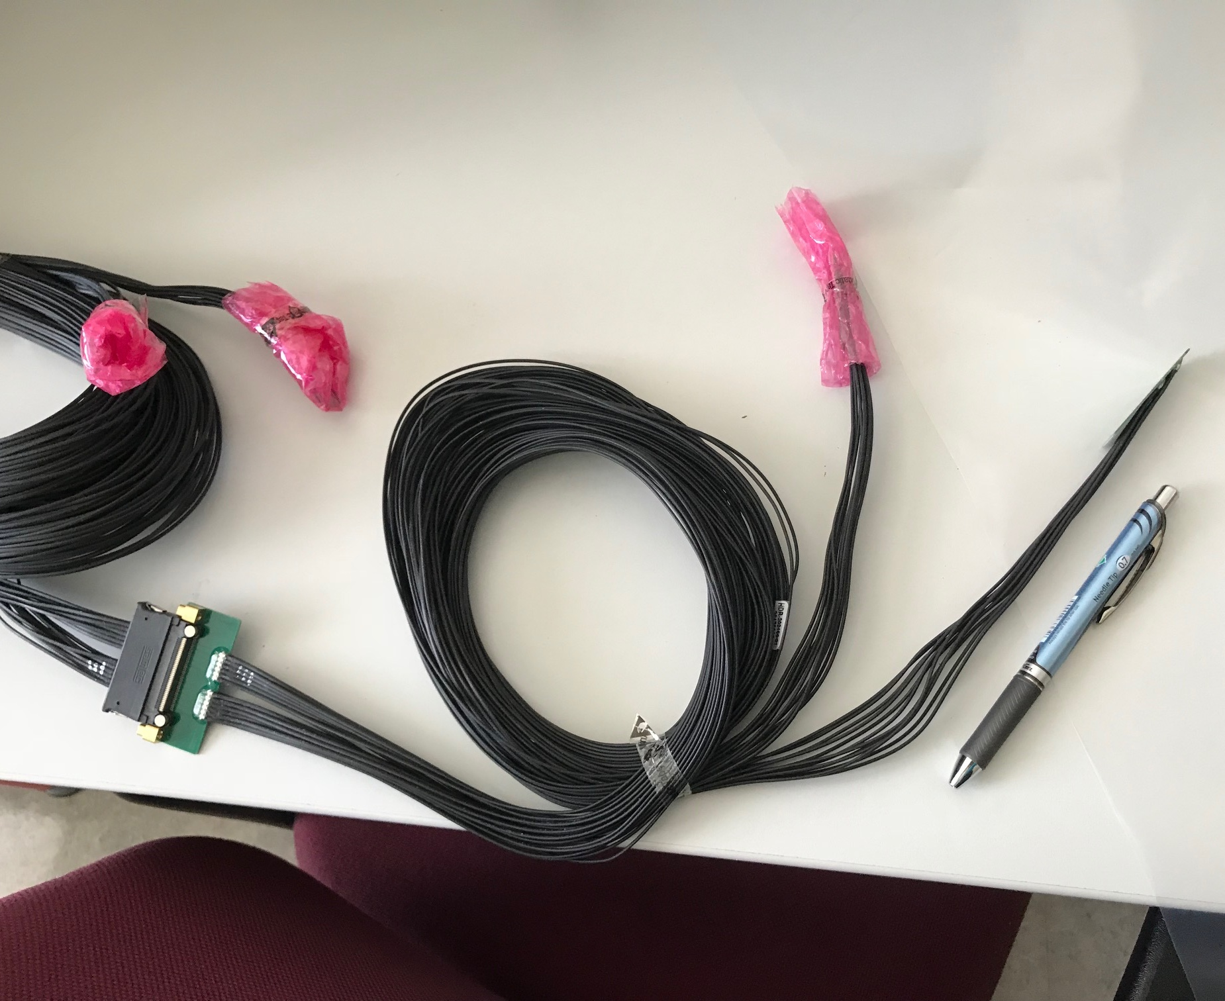
MVTX Readout and Power Cable Rout
Sho talk
ALICE ITS/IB final readout cables: ~8m
Cable-B: 5.3m
Cable-A: 2.65m
PWR
RU
PU
sPHENIX MVTX: 7.9+m
  Cable-A: 1.4 m
  Cable-B: 6.5+ m
  Power cable:4.7+ m
On-going R&D for ~10m
BNL has approved “non-halogen free” cables for sPHENIX

Slide 25
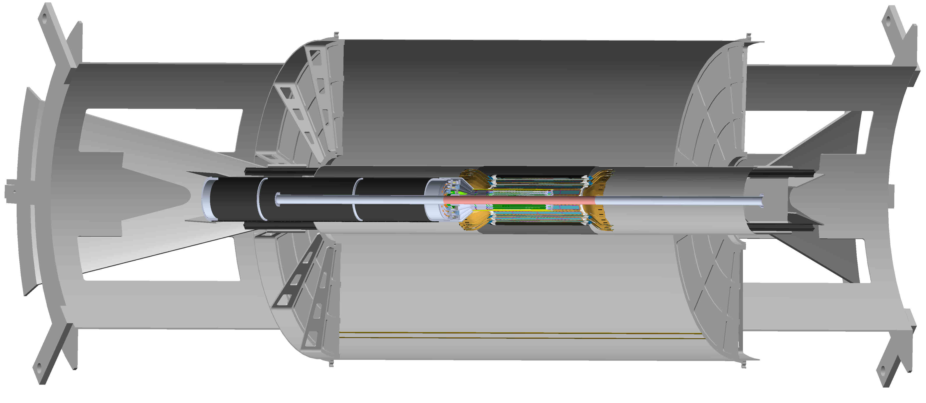
Major Topics for LBNL HF/MVTX Workshop 2/28-3/2, 2019
New HF physics program development
Total project Cost, $5M cap
Cost of the mechanical system

Slide 26
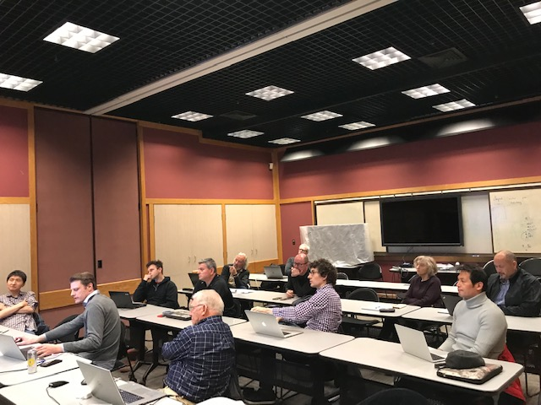
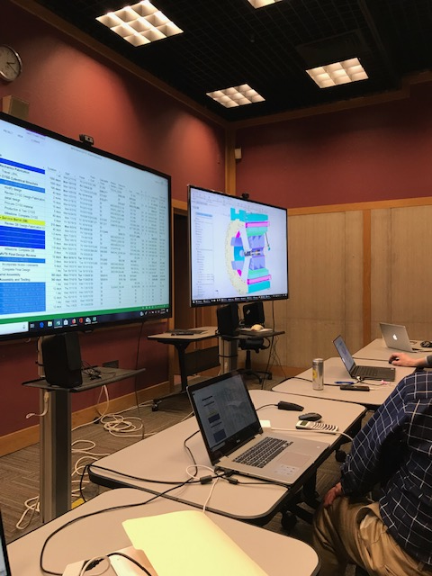
Mechanical System Discussions @LBNL
Discussed major carbon structures’
design & production cost
line by line,
also production schedule @LBNL

Slide 27
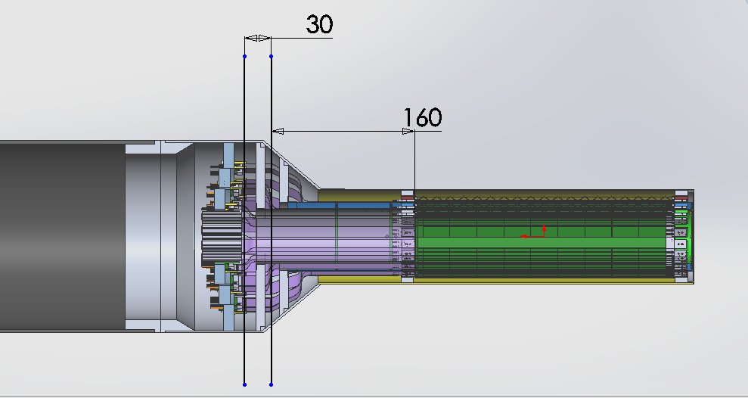
Carbon Structures – Work in Progress
Ross’ talk
Conical sectors are expensive!
A new design under development to avoid the conical structures
From Walt: BNL workfest 3/12-13

Slide 28
2 pt
2 pt

Slide 29
Latest Budget Update
The cost is $3,699K, and if we add BNL’s global contingency of 30%, the project total cost would be $3.7M x 1.3 = $4.81M
If we go with the detailed contingencies discussed at LBNL (some less but some are higher than 30%), the total project cost is $4.91M
Moved the Electrical Integration Project management (~$100K) and Commissioning effort (~$155K) from MVTX to sPHENIX
Double checking all the numbers and update the budget in the P6 SOON

Slide 30
MVTX Production Schedule Update
Stave production @CERN
  May 2019- May 2020, 84 staves
  4-stave/week
Stave acceptance test @LBNL
  MOSAIC system, 9/2019 – 5/2020
Final mechanical design work
  May 2019 – $$ available soon(?)
  CYSS, End wheels
  Service barrel and interface
MVTX detector assembly at LBNL
  LBNL ALICE ML stave production ends ~12/2019, a total of 60 ML staves
  Start MVTX detector assembly ~ late summer of 2019 (or after the completion of ALICE ML?)
MVTX full half-barrel detector test @LBNL
  Starts ~mid of 2021
  Using full readout system if ready: 24RU + 12PU + 3FELIX/2 servers

Slide 31
MVTX Schedules and Milestones, in progress (3/2019)
sPHENIX: CD1/3a PD2/3
Installation
1st collisions
CY-2018 | 2019 | 2020 | 2021 | 2022 | 2023
MVTX
Stave & RU
production
FELIX
production
Detector mechanics design & production, global interface to sPHENIX
End Wheels
CYSS
Global integration
/interface design?
Service barrel
design & production
Ready for beam;
sPHENIX day-1 run
Barrel Assembly & Testing @LBNL
Install half barrels
@sPHENIX IR
Half barrel #1
Power system
production
Half barrel #2
Half barrels
arrive @BNL
design & procure
interface to
sPHENIX rails
Design & procure
sPHENIX rails
MVTX installation & commissioning @BNL
RU, FELIX, PS, cables etc.

Slide 32
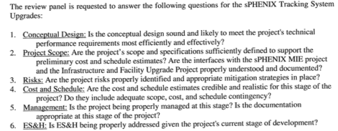
Upcoming BNL Director’s Review
“Breakout Session 4” – Silicon Upgrade
April 9-11 Reviews@BNL
Wednesday, April 10, 2019 – Breakout Session 4 – Silicon Detectors*
8:30 am MVTX Overview/Management(20+10)
9:00 am MVTX Sensors/Staves/Det Assembly(20+10)
9:30 am MVTX Electronics(20+10)
10:00 am MVTX Mechanics, Integration & Infrastructure(20+10)
10:30 am Break(15)
10:45 am MVTX Cost and Schedule(20+10)
11:15 am INTT Overview/Management(20+10)
11:45 am INTT Sensors/Staves/Det Assembly(20+10
12:15 am Lunch(60)
1:15 pm INTT Electronics(20+10)
1:45 pm INTT Mechanics, Integration & Infrastructure(20+10)
2:15 pm INTT Cost and Schedule(20+10)
2:45 pm Committee Executive Session
We will present the latest updates at the review
- ready for the final design and full production

Slide 33
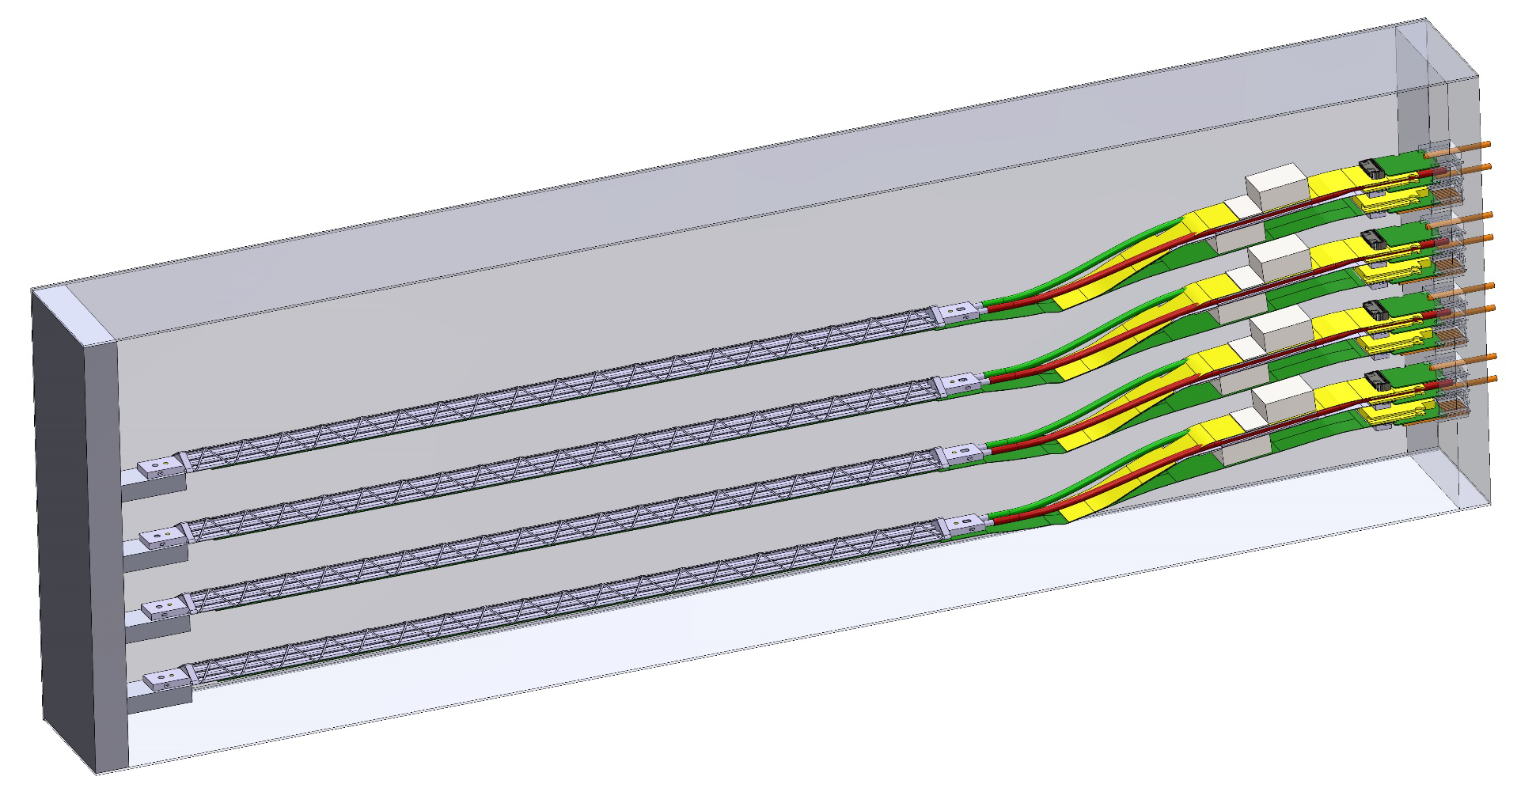
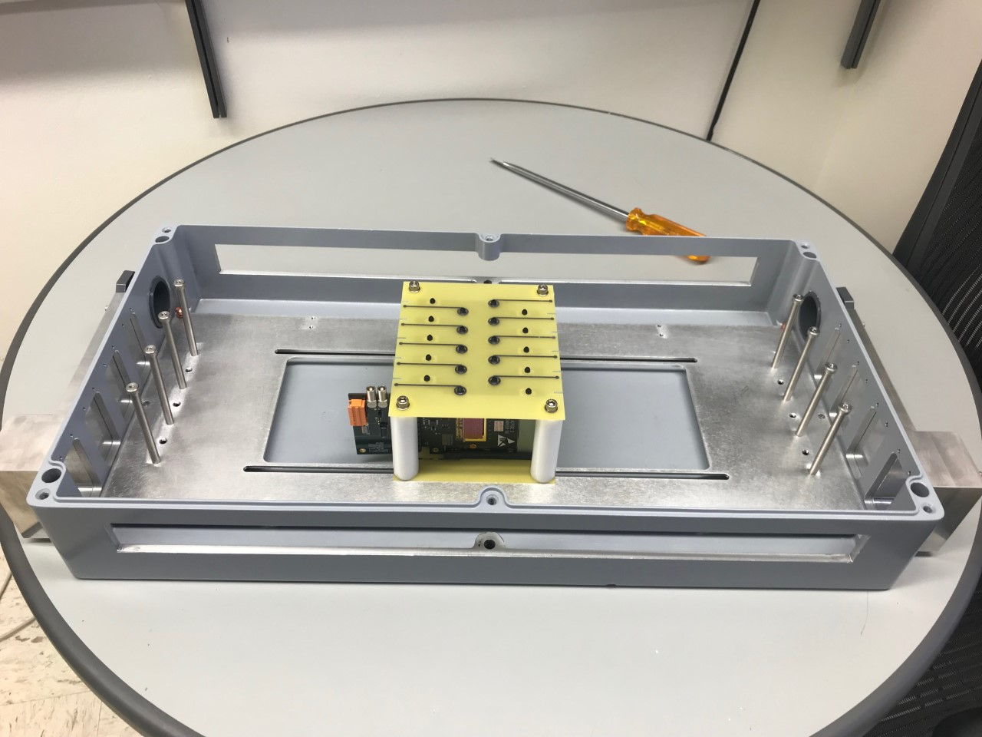
Detector R&D in Progress
4-stave Telescope
MVTX prototype telescope beam test at Fermilab
  Staves with “final” electronics and cables
  Test beam planned for May, with sPHENIX INTT
SamTec cables
  AWG30(MVTX) vs AWG32(ITS),
  ~10m cables
ALPIDE sensor characterization and optimization
  Readout and trigger optimization for sPHENIX
  Laser system setup in preparation

Slide 34
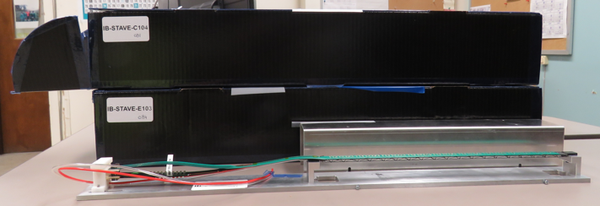
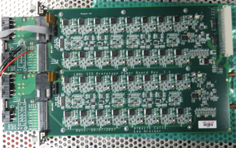
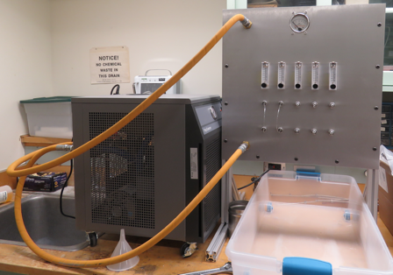
2019 Test Beam: 4-stave Telescope
From Sho
Scheduled for May 22-28, @Fermilab
Additions compared to the 2018 test beam:
  Staves (from single chips)
  Full-length MVTX signal cables (from 5 m off-the-shelf cables)
  FELIX v2.0 (from v1.5)
  Cooling system
  Power board
  sPHENIX GTM
4 ITS production stave @LANL
PU
34

Slide 35
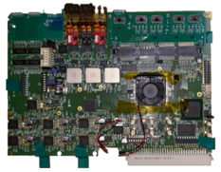
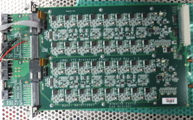
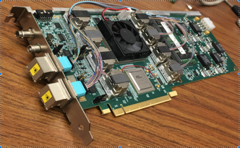
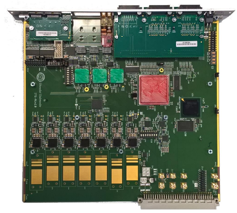
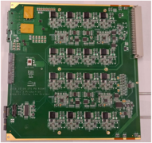
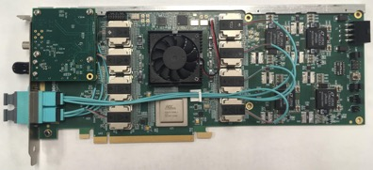
Readout Electronics
From Sho
RU v1.0
Prototype PB
FELIX v1.5
RU v2.1, Power Board in production by ALICE
FELIX v2.0 in production by ATLAS
MVTX firmware and software in sync with current ALICE and ATLAS work, with MVTX-specific logic developed under this LDRD
same functionality
production-qualified
RU v2.1
Production PB
FELIX v2.0
Key readout boards qualified and in production
@LANL ~May
in discussion
with LBNL
in hand @LANL
35

Slide 36
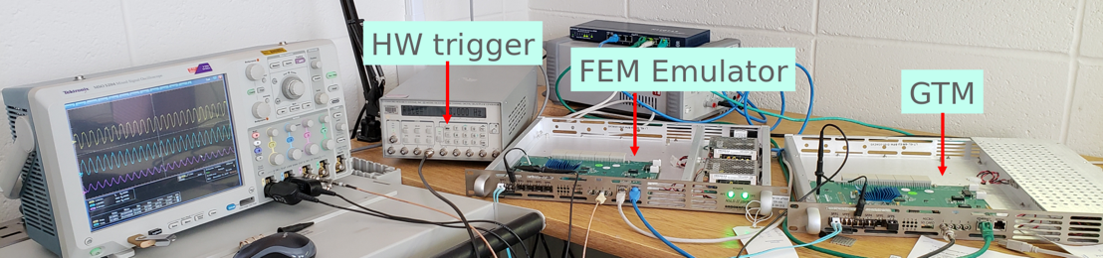
sPHENIX DAQ integration
From Sho
sPHENIX detectors implement “plugins” to tie in to the central DAQ; the MVTX plugin was demonstrated at the 2018 test beam
sPHENIX clock and trigger is distributed by Granule Timing Module (GTM): one BNL prototype at LANL
  We have implemented the “receiver” in FELIX that allows MVTX to receive a trigger from sPHENIX;
MVTX is participating in discussions for the sPHENIX DAQ design
MVTX is fully integrated with sPHENIX
36

Slide 37
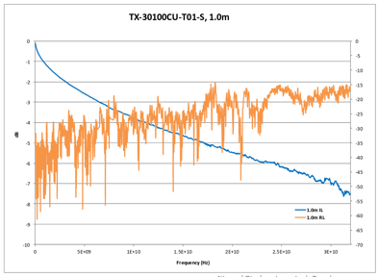
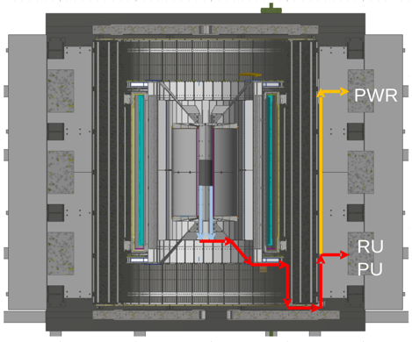
Readout Cable Testing
From Sho
BNL has approved non-halogen-free cables (30 AWG, FEP dielectric); improved signal integrity
sPHENIX cable run estimates are converging: 1.4 + 6.5 m
Ordered SamTec cables for 1.2/2.65 + 5.3/8.8 m (total length 6.5 - 11.45 m)
We will qualify these cables using stave and RU (bit error rates, statistical eye), and scope/network analyzer
We will test full-length MVTX cables in the next months
37

Slide 38
Summary of Near Term Tasks & Schedule
RU production through ALICE: 60 RUs
  Started at CERN, first batch of ALICE production ~ Dec., 2018
    sPHENIX RUs available: ~Summer 2019
  Acceptance test and QA at UT-Austin: starting ~summer 2019
Stave production through ALICE: 84 staves (ALICE Gold/Silver QA)
  sPHENIX sensor production ~April 2019
    Stave assembly starts @CERN, ~ April 2019, ~12 months to finish
  Acceptance test and QA at LBNL, ~late summer 2019
    Hand-carrying staves to LBNL, ~4 trips, ~20 staves each trip
Mechanical system integration design
  In good progress, under OSI
Carbon and non-composite structure design and fabrication
  Design & review – LANL/MIT/LBNL
  Carbon structures fabrication @LBNL
  Non-composite structure fabrication @MIT
Half-detector assembly at LBNL: starting ~ late summer 2019
  To setup assembly & test lab as soon as fund available
Safety, slow-control and monitoring in progress - Mike’s talk
MVTX detector commissioning at BNL: ~summer 2021
  Setup lab, pre-installation commissioning
  IR installation
(Physics & detector simulations, tracking improvement etc., work in progress) – Jin’s talk
Great opportunity for university
groups to join the effort & contribute!
QA & Test
Detector assembly
Control & monitoring
Simulations and analysis

Slide 39
Summary: MVTX - WBS 3.2
MS Project being updated, now in the sPHENIX P6
  Latest Cost & Schedule under review, under $5M cap
Stave and RU production through US-ALICE
  Early procurements of staves and readout units (RU) through US-Alice
    DOE and BNL agreed, DOE directly pays UTK/US-ALICE
    Received signed letter from CERN on the cost of 60 RUs and 84 Stave, ~$1.36M
    Purchase paperwork in progress at UTK, aiming to complete by ~ April 2019
MVTX detector design & construction
  About $5M to be added to the sPHENIX Management Portfolio
    As a separated project from the MIE
      Mechanical system design and fabrication
      Update baseline cost and schedule soon
      Monthly report to sPHENIX and BNL upper management
    Will NOT be part of CD-2/3 DOE review
    Engineering design work in progress, MIT/LANL et al
    Construction and assembly work in late summer 2019
  Open MVTX accounts in progress, for full production

Slide 40
sPHENIX Status and Plan
MVTX approved
by BNL/DOE

Slide 41
Thank You!

Slide 42
backup

Slide 43
sPHENIX MVTX Group: Institution Roles
Major institutions lead key tasks

Slide 44
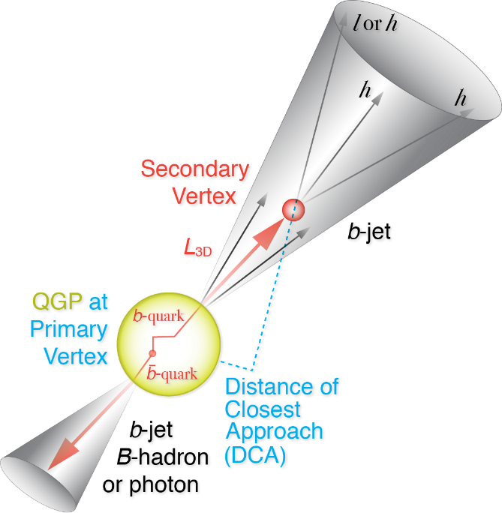
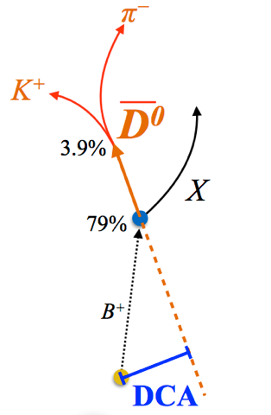
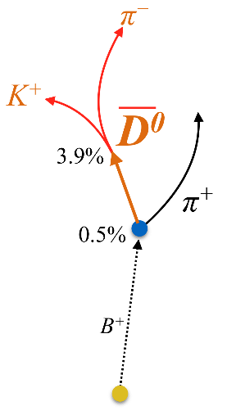
Open Charm & Beauty Production
Hadron | Abundance | cτ (μm)
D⁰ | 61% | 123
D⁺ | 24% | 312
D_{s} | 8% | 150
Λ_{c} | 6% | 60
B⁺ | 40% | 491
B⁰ | 40% | 455
B_{s} | 10% | 453
Λ_{b} | 10% | 435
b-tagged jet and cor.
p_{T}>15 GeV
60%
0.5%
p_{T}<15 GeV
Exploring and more

Slide 45
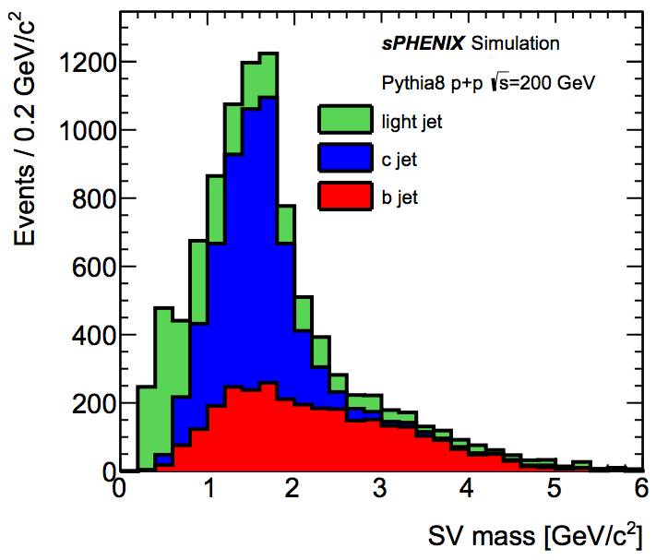
B-Hadron & b-Jet Tagging
Jin, Tony, Sanghoon
Detected using the long lifetime of bottom quark hadrons:
  Displaced tracks
  Large 2nd vertex invariant mass
Need high precision tracking and vertex determination – MVTX!
Need excellent jet detection capabilities – sPHENIX!

Slide 46
Expected Performance
Tony’s talk

Slide 47
Projected Radiation Level after 5-year Runs
sPH-TRG-2018-001
Projected sPHENIX integrated luminosities after 5-year operation
  AuAu: Lum. = 214 nb⁻¹
  pp+pAu: Lum. = 1340 pb⁻¹
PHENIX study
arXiv: 0710.2676 [nucl-ex]
Projected sPHENIX MVTX L0 fluence:
Outer layers:
L1 = 0.6 x L0; L2 = 0.4 x L0
TID = 1060krad
NIEL = 6x10¹² N_{eq}/cm²
Sensors tested to full MVTX NIEL and ~3x TID @ALICE (as of 9/18/2018)

Slide 48
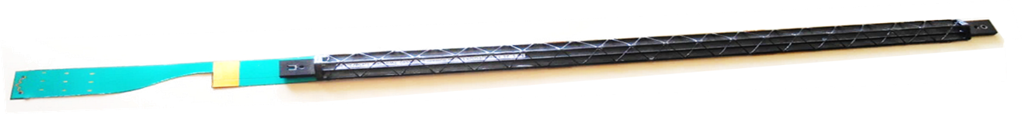
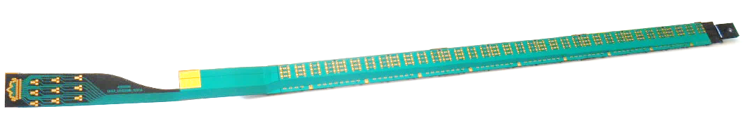
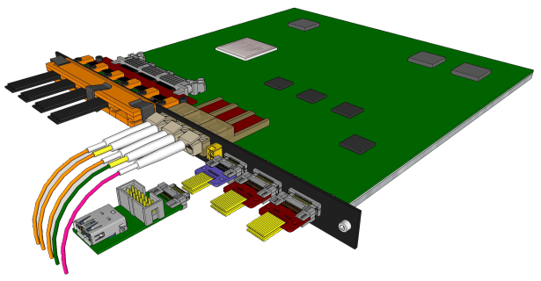
MVTX Sensors and Electronics Production
Major hardware:
  48 ALICE ALPIDE Staves + Interface Cables
  48 Front End Electronics (ALICE RUv2)
  6 Back End Electronics (ATLAS FELIX v2)
  6 EBDC Linux servers
  24 Power Boards + CAEN Supplies + Cables
  48 Stave to RU cables
  144 data fiber optic cables (3 fibers x 48 FEE)
Stave production: total 84, 75% spares
  Two inner layers: 12+16=28
  10% spares: 8 staves
RU production: 60 in total, 25% spares
ALICE ITS/IB stave
ALICE ITS RU

Slide 49
Design & Production Plan
Detector Assembly and Integration
Detailed sharing of engineering design, FEA/simulations, review and fabrication discussed
Engineering resources at LANL/MIT/LBNL

Slide 50
Stave and RU Production QA Plan Documents Available
https://indico.bnl.gov/event/4729/
Staves
Purchase 84 staves from ALICE/CERN
  48 + 28(spares for 2 inner layers) + 8 spares
  Production following the completion of ALICE ITS/IB
  Starting ~Oct. 2018, will last 6-12 months
  Fully tested at CERN before shipping to US
    All Gold/Silver staves (same as ALICE IB)
    A LANL postdoc (Dr. Yasser Morales) oversees production QA at CERN
Acceptance QA at LBNL
  Full test and QA
    Electrical
    Mechanical
  Detector assembly at LBNL
Readout Units
Purchase 60 RUs from ALICE/CERN
  48 + 12 spares(20%)
  To be part of ALICE production
    Cost saving
    Minimize technical risks
  Initial test at CERN
Acceptance QA at UT-Austin
  Full test
  LANL as the 2nd test site

Slide 51
Stave Production and Shipping etc.
Hand carry staves from CERN to LBNL, 4 trips
Preliminary design from CERN for stave transportation plates
  To be produced at CERN, paid by LBNL/sPHENIX
Extended design from CERN
for MVTX
ALICE ITS IB

Slide 52


MXTX Model with Correct Length Power Cables:
Ross’s talk
New shorter 40 cm overall length for power extension cables from stave, more than 220. mm shorter than was shown in previous model, same length service-barrel – 1200.0mm, location for a new patch panel 1B.
Updated inner layer power extension cable – overall length 40.0 cm, as agreed to by ALICE at CERN

Slide 53
MVTX detector in sPHENIX
MVTX detector with service cylinder
Support brackets for TPC and INTT
TPC volume, length 2,160.0 mm
INTT detector, 2 layers

Slide 54




Signal Cable Design
From Sho
The Samtec twinax cables carry clock (40 MHz), control (40 Mbps bidirectional), data (9x1.2 Gbps)
ALICE is using halogen-free cables (32 AWG, LDPE dielectric) due to CERN LSZH requirement; 2.65 + 5.3 m cables have been tested and are now in production
RU
RU
Stave
Stave

Slide 55


Type-A
Type-B
Type-A

Slide 56

Two HICs Produced and Tested at CERN w/ Extended Power Cables
NO noticeable difference in sensor performance, as expected, 9/2018
MVTX: 40cm flex power PCB
MVTX: 60cm flex power PCB
ALICE IB: 15cm

Slide 57
HICs Test Results from CERN (9/2018)
After: same ALICE HICs, replaced power FPCs
Before: 2 ALICE IB HICs
Thr.
HIC1
Noise
Thr.
Noise
HIC2
Noise level: ~4 e’s; Threshold: ~180e’s; MIP: ~1000 e’s
Chip-8
Chip-0

Slide 58

FPC Extension for Connection to Electrical Services
From Antonello Di Mauro
The connection to the service cables is achieved by a double FPC extension which is soldered to the HIC
x-section at interconnection between FPC and extensions
AVDD
AVDD
AVDD
AVDD
DVDD
FPC
AVDD
DVDD
AGND
AGND
Flex power extension
AVDD
DVDD
AGND
FPC
AGND
DGND
DVDD
DVDD
AGND
DGND
DVDD
AGND
DGND
FPC
DGND
DGND
Flex power extension
DGND
signal lines (FPC)
Modified for sPHENIX:
15cm -> 40cm
digital power
analogue power

Slide 59





From Antonello Di Mauro
FPC Extension for Connection to Electrical Services
2-layer flex, PI: 50 µm, Cu: 35 µm, solder mask: 20 µm
analogue
analogue
Unchanged
digital
DGND
AGND
Longer copper traces ~30cm
for sPHENIX, no other components
digital
The two flexes are connected together, AVDD is transferred from top to bottom
digital
AVDD
DVDD
The PWR extension is connected to the FPC by iron soldering and wings are cut.

Slide 60



Stave
Production stave consists of three flex circuits: one signal FPC that carries the ALPIDE sensors, two power FPCs that carry AVDD and DVDD
For MVTX mechanical integration, the power FPCs must be lengthened to 40 cm (from 15 cm)
  We qualified 40 and 60 cm FPCs at CERN: identical performance
4 staves at LANL
MVTX stave modifications have been qualified, and we have our first 4 staves
60

Slide 61
sPHENIX/MVTX IB Stave Assembly
Procedure at CERN by ALICE ITS Group
Prepare sensors and FPC
Glue 9 sensors to FPC
Wire bonding 9 sensors to FPC
Solder power flex PCB to FPC
Glue HIC to coldplate/carbon space frame
A stave is ready for QA
CMM

Slide 62

2018 Fermilab Test Beam Highlights
Sho’s talk
INTT
MVTX EMCal HCal
Demonstrated full high-speed readout chain at Fermilab test beam in Feb - Mar 2018
Sensors + RU + FELIX + RCDAQ/sPHENIX
Track spatial
resolution: ~5 um
120 GeV protons
4-hit track
High hit efficiency: > 99.5%
4-MAPS telescope

Slide 63






LANL LDRD Activity Highlights
MAPS evaluation
Readout integration
4-sensor telescope
Test beam at Fermilab
Mechanical & cooling
Readout R&D
Signal integrity & cables
RU
Cooling system
prototype
stave
4-ALPIDE Telescope;
5m-long SamTec cables
Service cone R&D
Sensor source test
FPC power extension R&D

