Slide 1

MVTX Overview
Document: sPH-HF-2018-001
https://indico.bnl.gov/event/4072/
Ming Liu
Pre-QM sPHENIX Collaboration Meeting
November 1-2, 2019
Fudan Univ., China

Slide 2

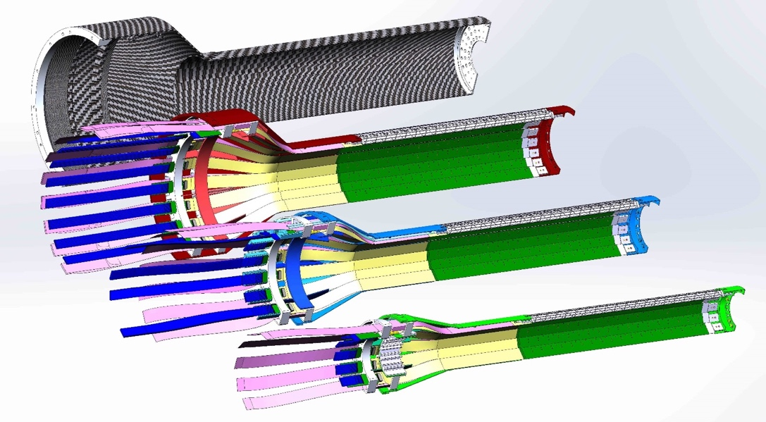
MVTX Detector
Service cone: signal, power, cooling
and mechanical support
CYSS: Cylindrical Shell Structure
End-Wheel
Extended power FPC
MVTX
parameters
3-layer sensor barrel
- 48 staves, 27.1cm long
- 432 chips

Slide 3
Scope of the MVTX Project – WBS 3.02
Mechanical system (3.02.03, 3.02.04)
  MVTX detector mechanical structures
    Design & simulations
    End Wheels
    Cylindrical support structure
    Service barrels
  Mechanical system integration
    Service barrel support & interface to sPHENIX
    Installation tooling etc.
    Adopt ALICE cooling parameters
    Detector safety
  Detector assembly
    Stave QA & detector assembly @LBNL
Electronics (3.02.02)
  Readout Integration
    RU QA & assembly @UT-A
    Backend: ATLAS FELIX production
    FELIX boards test @LANL/BNL
    Frontend RU services: daughter cards, transition boards, cables etc.
  Ancillary systems - “adopt” ALICE ITS system
    Power, slow control & monitoring etc.
A separate BNL R&D project, provides Staves & RUs
- no cost to MVTX project
- 84 ALICE/ITS-IB (modified) staves from CERN;
48+spares(2-inner layers+10%), in production
- 60 ALICE/ITS-RU from CERN
48+spares(12, 25%) , all produced

Slide 4
Project Status Update: 11/01/2019
Confirmed long SamTec readout cables recently – last key electrical integration hardware R&D
  11.4m long cables, > 10m desired length
MVTX mechanical design: excellent progress
  Obtained quotes from outside companies based on preliminary designs for CYSS and End-Wheels
  MVTX/sPHENIX integration/insertion workfest , 11/14 @BNL, MVTX/INTT/TPC…
Early R&D fund released from BNL
  MVTX mechanical engineering design, MIT/LANL
  Preparation for Stave and RU acceptance test, LBNL, UT-Austin
July 2019 MVTX Cost & Schedule Review Response submitted
  WBS, PMP, Risk Registry, P6 updated
  Updated PMP and review response submitted to DOE
  We are ready for full production
Plan to start the MVTX production activities as soon as funds available
  Preparation for Stave and RU acceptance test & QA in US, LBNL and UT-A
  Carbon structure prototype production, site selection etc
Stave and RU production
  Stave production in progress at CERN
  60 MVTX RUs delivered to CERN
  Power mezzanine and transition boards produced at UT-A

Slide 5
Funding Profile (FY19+20, 21,22)
From July MVTX Review:
MVTX funding profile: FY20 -22
sPHENIX MVTX Budget Profile
 | FY20 | FY21 | FY22 | Total
3.02.01 Management | $233,668 | $209,596 | $101,338 | $544,602
3.02.02 Electronics | $569,582 |  |  | $569,582
3.02.03 Mechanics and Assembly | $1,370,727 | $307,183 | $113,468 | $1,791,378
3.02.04 Integration and Infrastructure | $368,185 | $399,262 | $15,491 | $782,938
Performance Measure Baseline | $2,542,162 | $916,041 | $230,297 | $3,688,500
Contingency | $762,649 | $274,812 | $69,089 | $1,106,550
Total Project Cost | $3,304,811 | $1,190,853 | $299,386 | $4,795,050
Can we move some FY20 ($3.3M) activities to FY21 ($1.2M),
with minimal impact to the project?

Slide 6
Schedules – Smooth Funding Profile?
Possible Plan-B for FY20?
Fully aligned with sPHENIX via external milestones
Candidates for possible delays, from FY20 to FY21:
Carbon Structure production
PU and CAEN PS
Cooling system
Delay stave test and detector assembly work at LBNL
Recent new quotes for carbon structures: CYSS & EndWheels
Possible cost saving through commercial companies
Carbon structure full production possible in FY20, w/ big saving

Slide 7
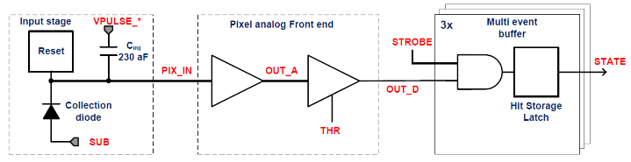
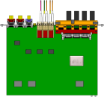

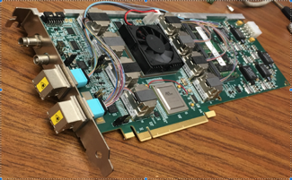

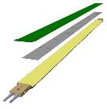
MVTX Readout, Power and Controls Hardware Tested
Hardware status: Staves in production; RU produced, SamTec, PU & FELIX ready for production
CAN bus
DCS
Slow control
Mike’s talk
Trigger & Clock
Readout Unit
Front End
GBT Optical Links
one pixel
9 Data (1.2Gbps)
1 Clock, 1 Control/Trigger
Control
Data (9.6 Gb/s max)
Trigger
9-sensor Stave
Samtec Twinax “FireFly”, ~10m
FELIX
Back End
FPC
Power
ATLAS Front-End Link eXchange (FELIX):
sPHENIX Data Aggregation Module(DAM)
Alpide Sensors
Flex PCB Filtering Capacitors
regulators
Power
Regulated Power
CAEN Power supplies
Cold Plate
ALPIDE pixel:
Shaping
Digitization
Zero-suppression
3x buffer
Power Board
Interaction Region
Experimental Hall
Counting House
MVTX Detector Electronics consists of three parts
Sensor-Stave (9 ALPIDE chips) | Front End-Readout Unit | Back End-FELIX/DAM

Slide 8
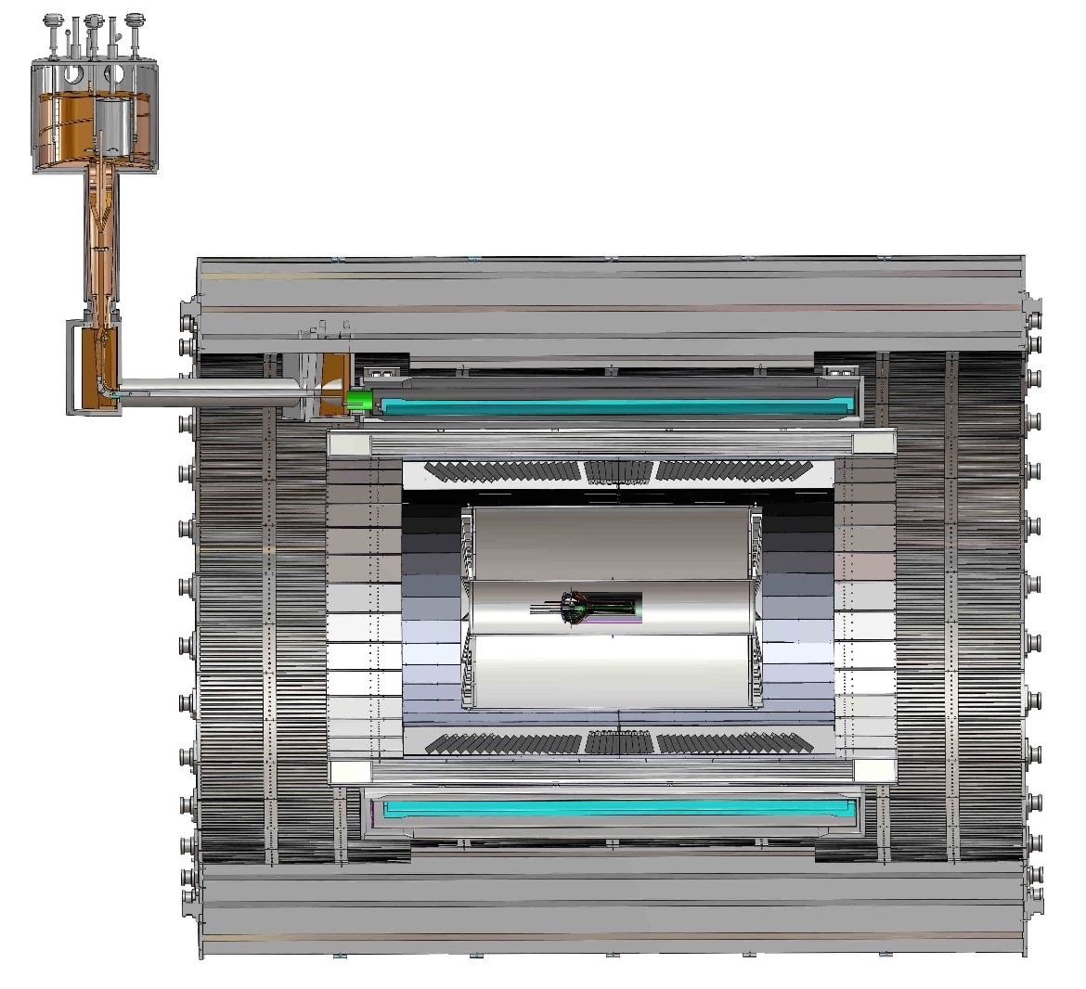
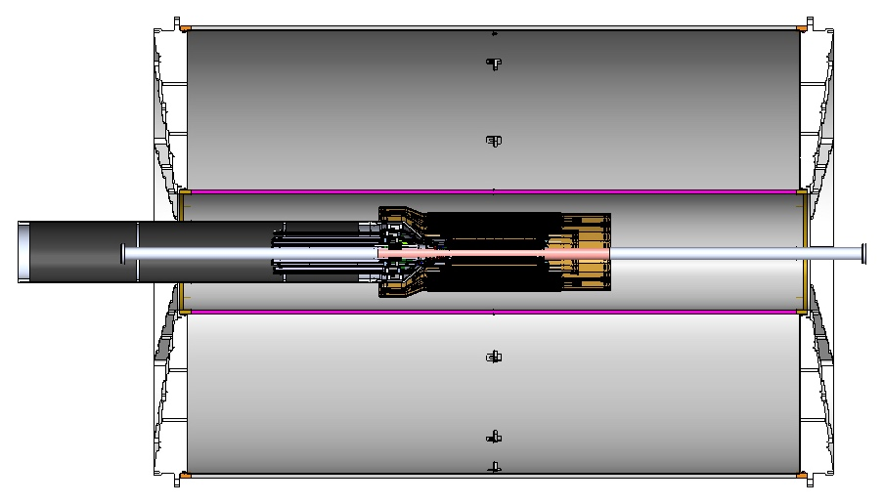
MVTX Global Mechanical System Integration
MVTX mechanical system preliminary design:
  Part-1: from MVTX staves to PP-1, all power PCB, 40cm
  Part-2: length TBD later, from PP-1 to PP-3
Service Barrel
TPC
TPC
INTT
MVTX
PP-1:
signal cables
PP-3:
Signal and power cables
R= 209.6cm
PP-2:
power cables
L = 350.0 cm

Slide 9
Detector Supporting Structures: Part-1
Near final design completed for CYSS, End-Wheels
Obtained quotes from outside companies based on the latest designs for CYSS and End-Wheels
LBNL cost estimate in progress
Next:
Vendor selection
Pre-production

Slide 10
MVTX Service Barrel – Part-2
PP-2:
power cables
PP-1:
signal cables
PP-3:
Signal and power cables

Slide 11
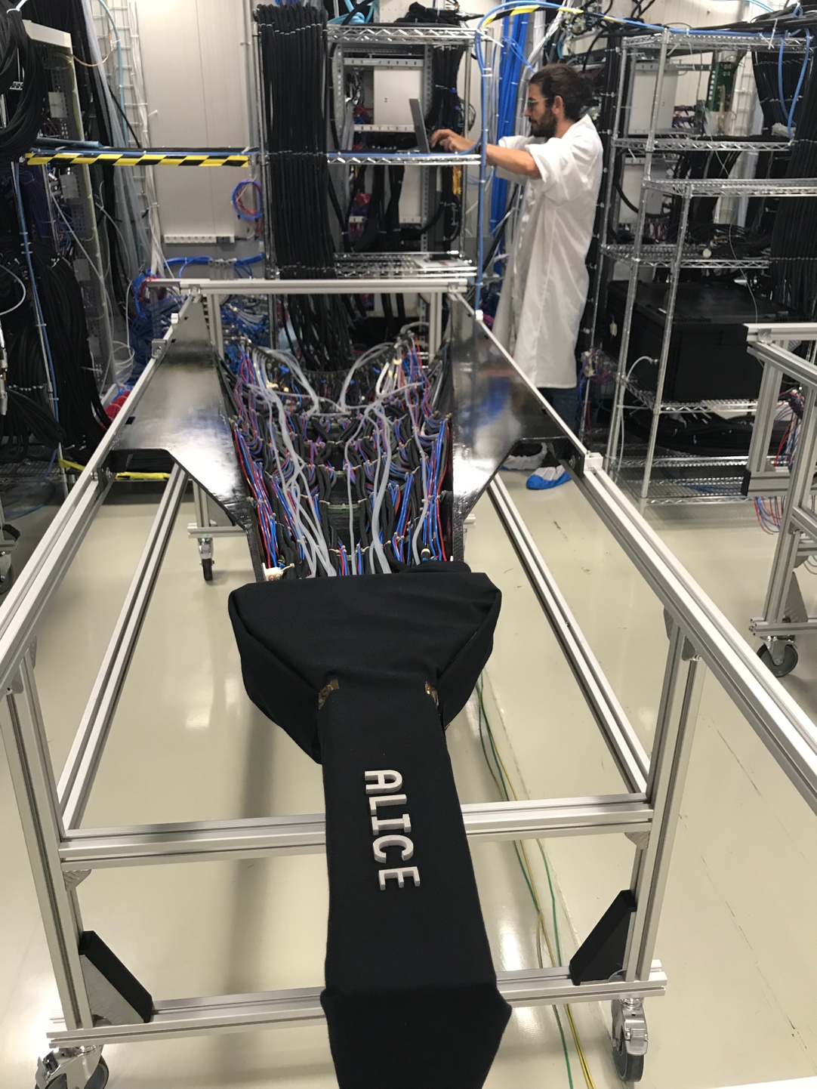
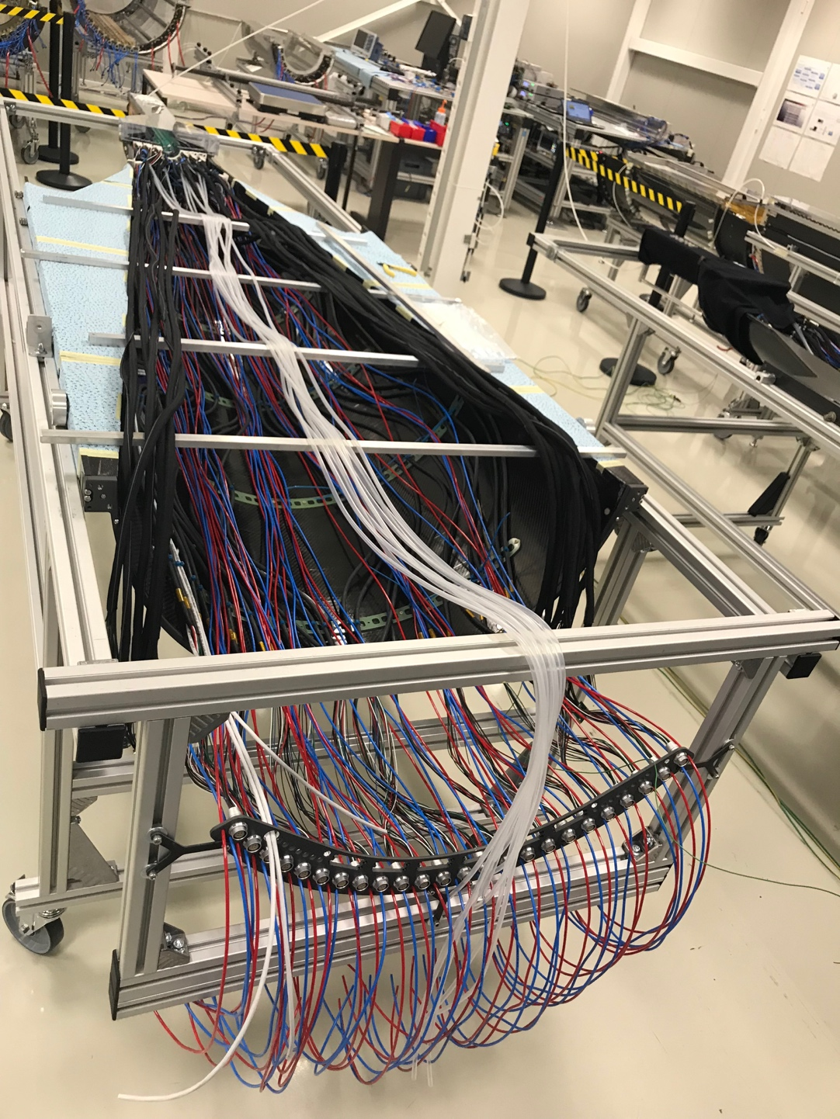
ITS/IB Commissioning Setup @CERN, 9/2019
9/2019@CERN
ITS/IB : top half barrel
ITS/IB : bottom half barrel

Slide 12
MVTX Global Mechanical System Integration

Slide 13
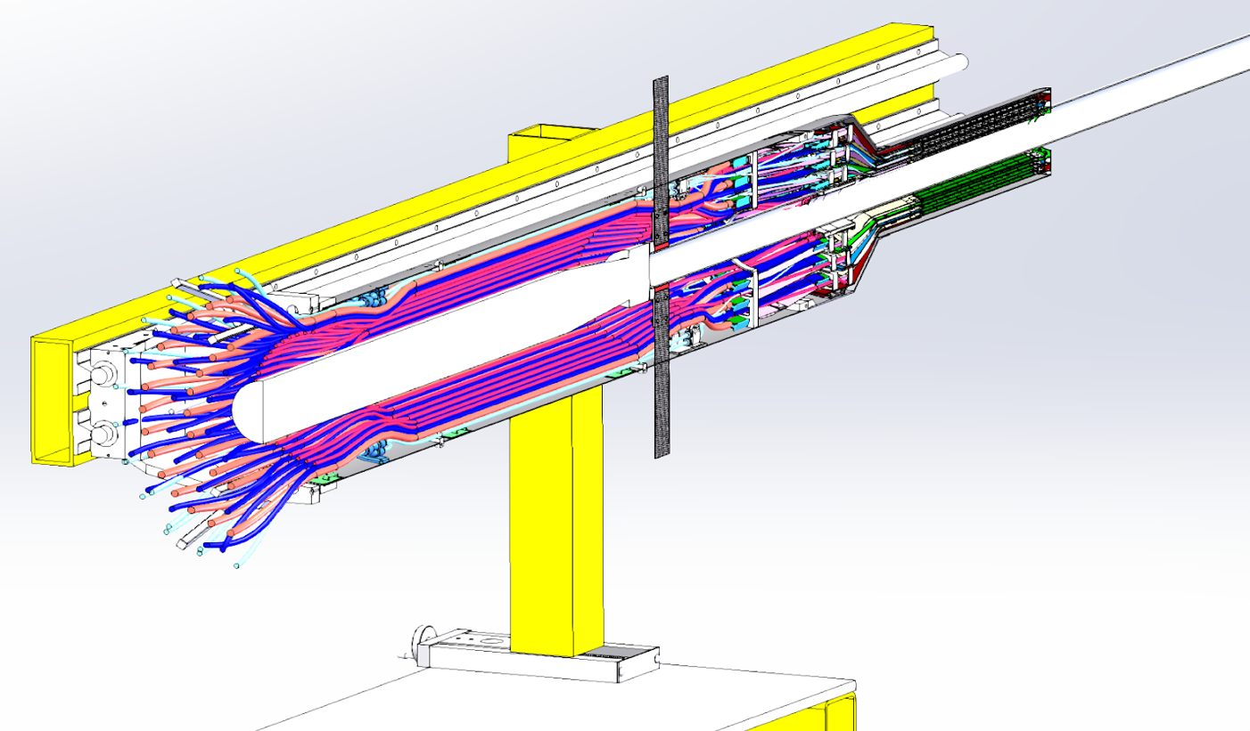
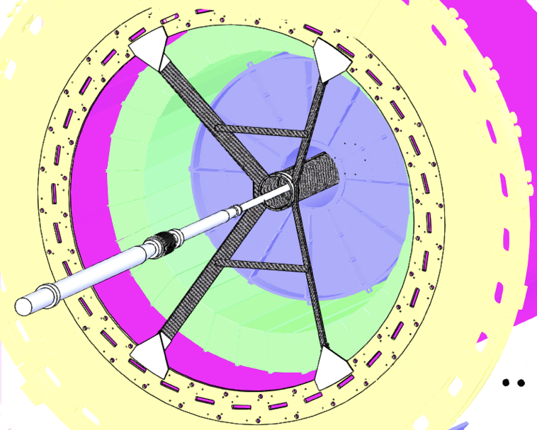
MVTX Installation & Insertion System
(WBS 2.x)
Active discussions on mechanical design and fabrications
  MIT, LANL, LBNL
  CYSS, End-Wheels, Service Barrel
One-day MVTX/sPHENIX insertion system workshop
11/14/2019@BNL, Russ/OSI, Camelia et al
MVTX, INTT, TPC …
MVTX Installation Mockup

Slide 14
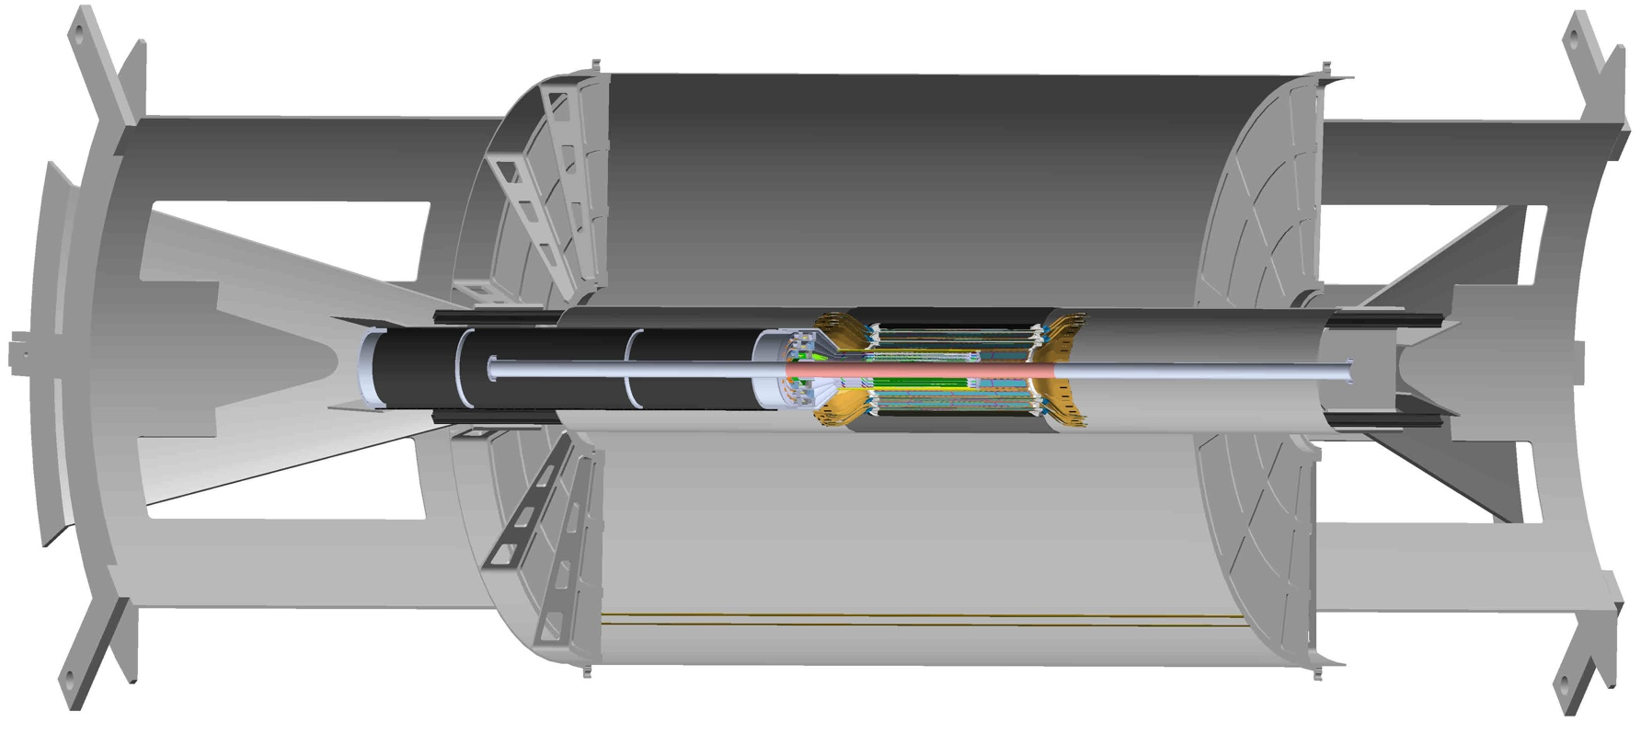
Beam Pipe Extension by CAD
(WBS 2.x)
sPHENIX engineers meeting regularly with the CAD vacuum group;
CAD will do some test welds to beam pipe
material of the same OD to confirm;
Beam pipe modification in the MoU with CAD.

Slide 15
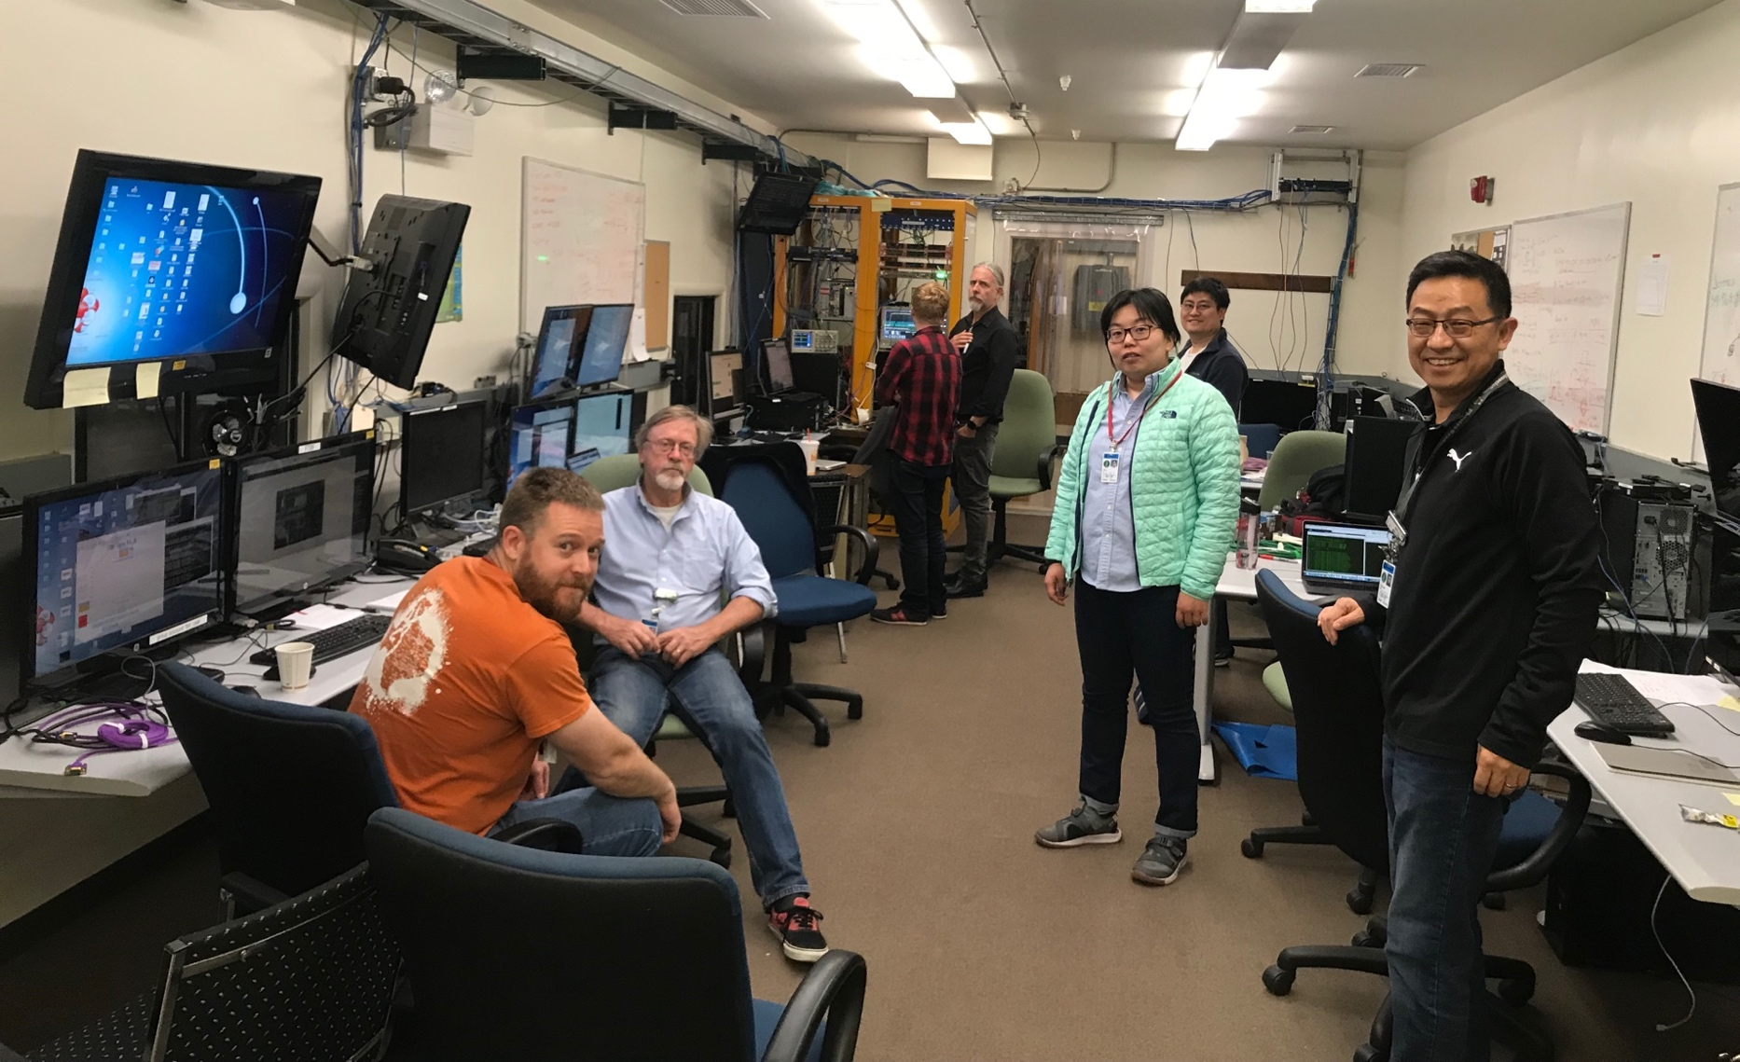
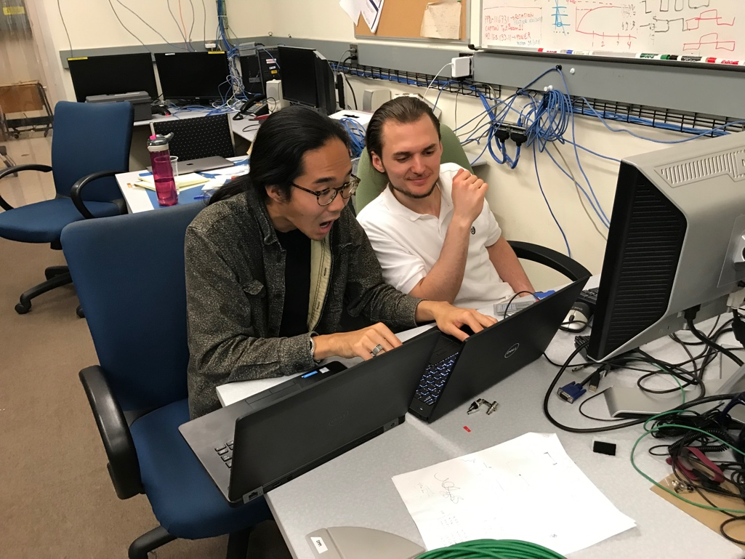
2019 Fermilab Test Beam Highlights

Slide 16
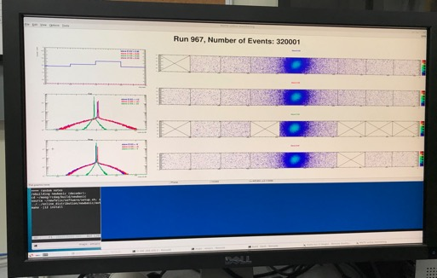
Very Successful Test Beam @Fermilab
5/20-25, 6/17-22, 2019
SamTec: 11.4m
(2.6m+8.8m)
4-stave telescope
RU-2: 1 stave
- 1 fully functioning
9-chip stave;
- 3 staves with a few
broken sensors
4 staves
2 RUv1.1
1 PU
1 FELIX Server + RCDAQ
sPHENIX GTM
11.4m Custom SamTec Cable
Negative pressured cooling for staves
RU-1: 3 staves
5m SamTec
120GeV p-beam
10kHz (30kHz)
Beam intensity:
30k ~ 120k ppp
Data & Control
Beam Trigger
Timing & Trigger
GTM
FELIX
Online Monitoring
RCDAQ
A full system with final sensor/readout* hardware:
Multi-Stave + Multi-RU -> FELIX readout demonstrated
sPHENIX GTM integrated
Long readout SamTec cable certified
Cooling system demonstrated
* RUv1.1 identical to the final RUv2 electrically

Slide 17
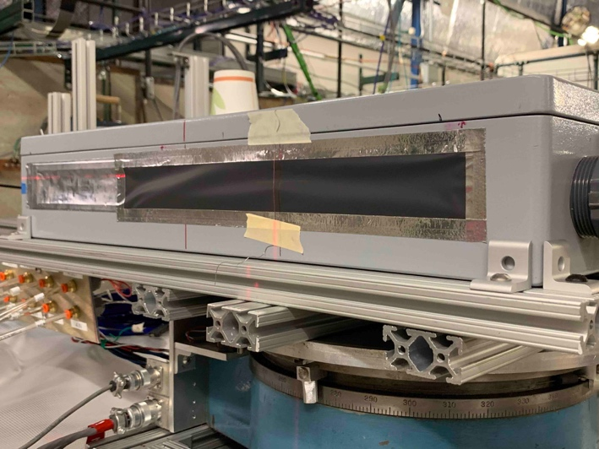
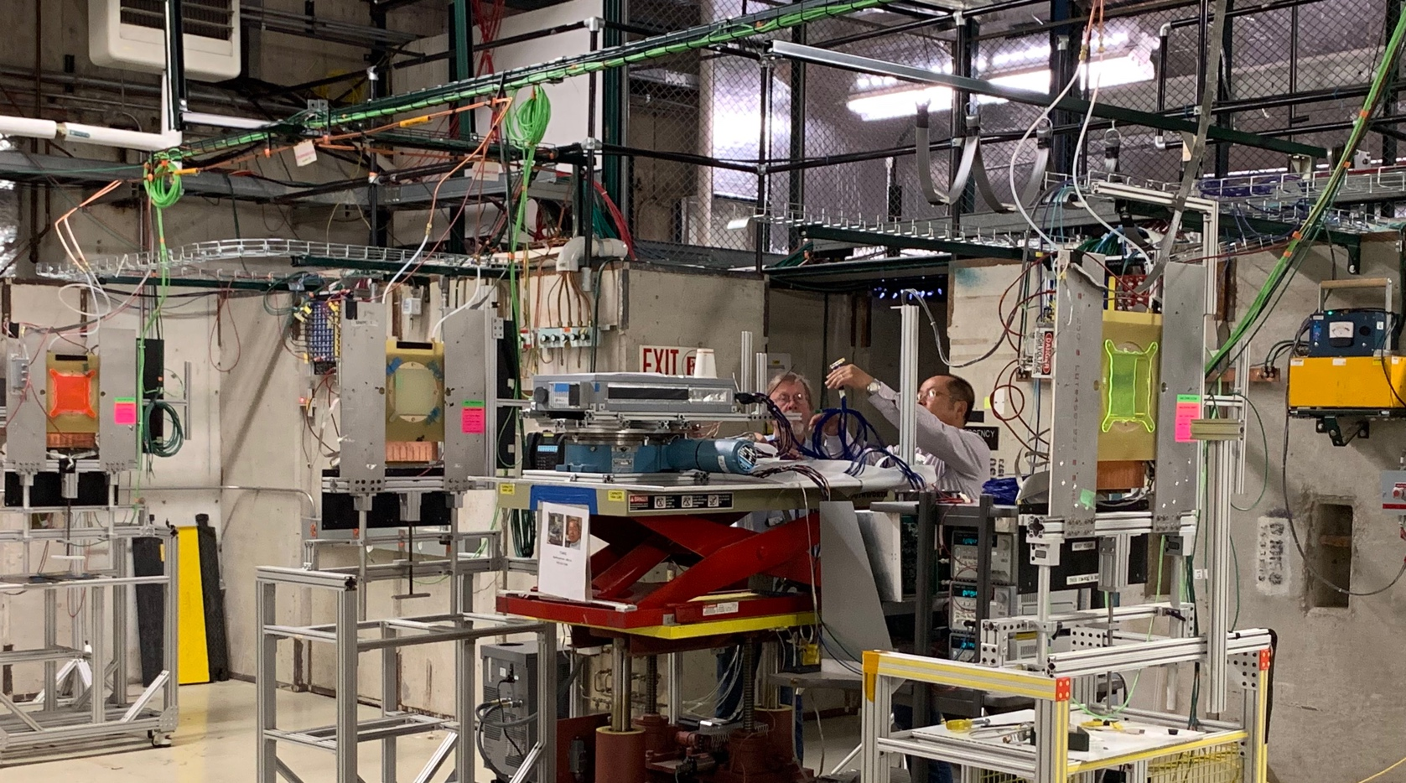
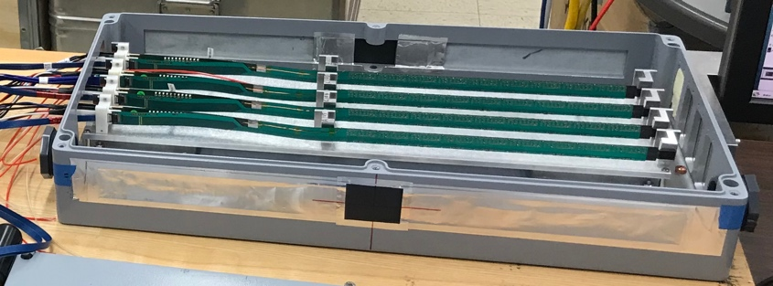
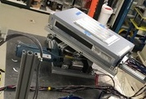
2019 MVTX Test Setup
From view
beam
Stave housing (four staves)
Stave housing sits on a motion table which can be moved in (x, y) plane perpendicular to the nominal beam direction. It can also be rotated (+40, -40) degrees (see photo on right). Operation was done at counting house.

Slide 18
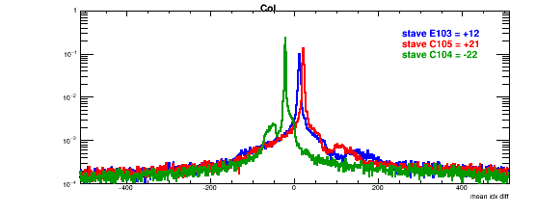
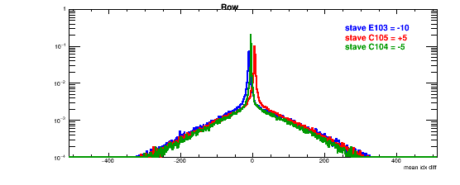
Online Analysis:
Detector Misalignment & Hit Spatial Resolution
Typical stave offset,
Horizontally: 20 x 30um = 600 um
Vertically: 5 x 30 um = 150 um
Col #: dX
Hit spatial resolution:
peak_sigma_core = 0.55 (pixel size ) =15 um
Chip spatial resolution = 15/sqrt(2) = 11 um
Row #: dY
Delta_X/Y
Ref plane

Slide 19
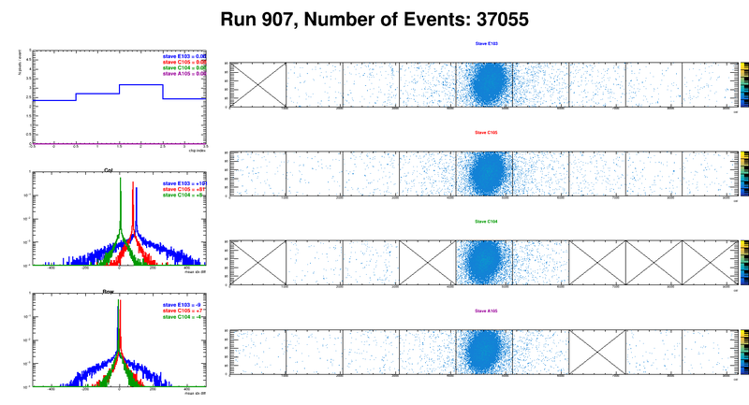
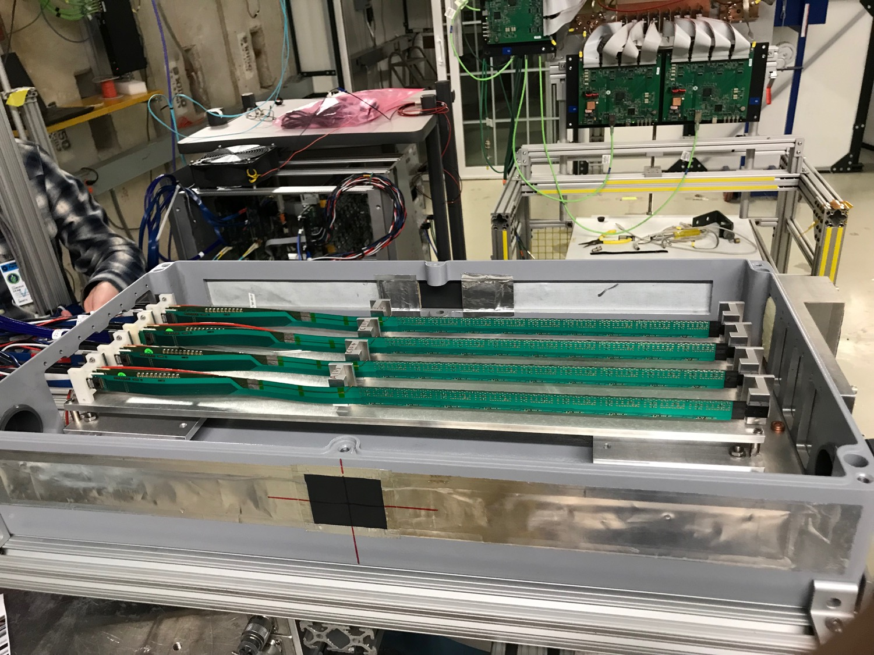
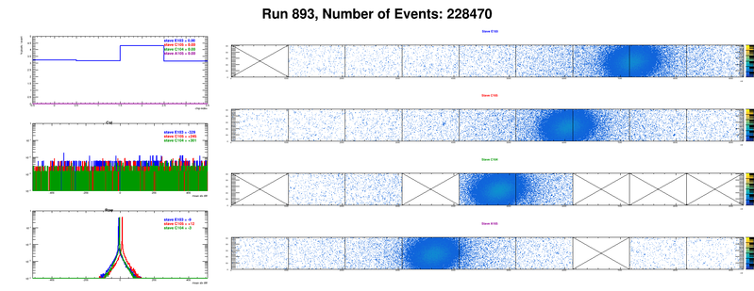
Offline analysis in progress: all TB data in RCF
https://wiki.bnl.gov/sPHENIX/index.php/MAPS-based_Vertex_Detector_(MVTX)
Beam angle: 0
(eta ~0)
MVTX 4-Stave Telescope
Beam angle: 40
(eta ~1)

Slide 20
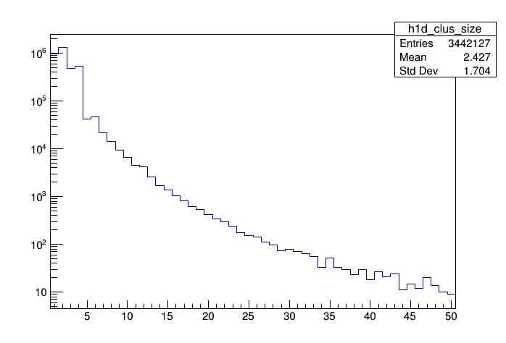
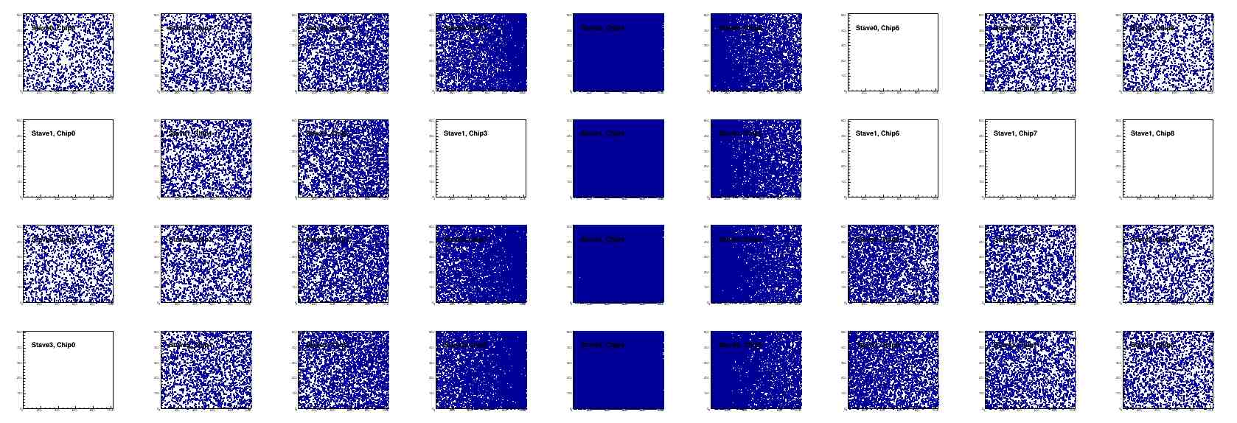
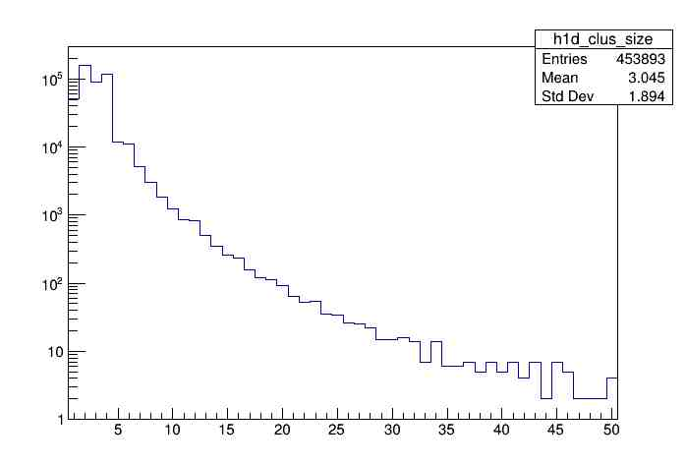
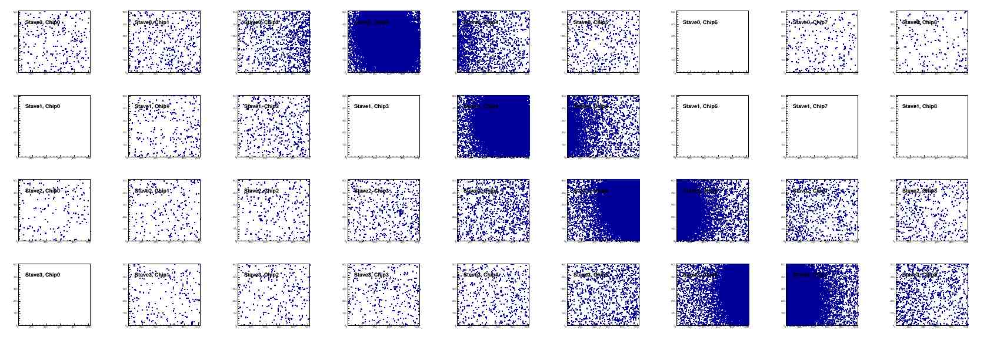
Offline Analysis: Cluster size vs Angle
To calibrate MC simulations and tracking
Stave geometry, alignment
Clustering
@ 0-degree
Cluster Size ~ 2.4
@ 40-deg
Cluster Size ~ 3.0

Slide 21
ALPIDE Sensor Operation Optimization
“Stretched Settings” for sPHENIX trigger study
- Pile up integration time ~ 8uS
64 cells x 106nS = 6.8uS
“ALICE Default Settings”
- “Pile up” integration time ~ 5uS
sPHENIX Trigger Latency ~ 4.7uS
sPHENIX Trigger Latency ~ 6.8uS

Slide 22
Preliminary Offline Analysis: A simple straight line fit
Track hit efficiency vs Trigger Delay
From Yasser
Hit_Eff_Stave3 > 99.5%;
Eff = stave3_hits/(tracks, at least 3hits 1/2/4)
June TB Data analysis in progress
For various ALPIDE operation points, shaping time, threshold, trigger delay etc.
4
3
2
1

Slide 23
Offline Analysis: A simple straight line fit
Stave-3 Track hit resolution vs Trigger Delay
From Yasser
4
3
2
1
dX, dZ < 5um

Slide 24
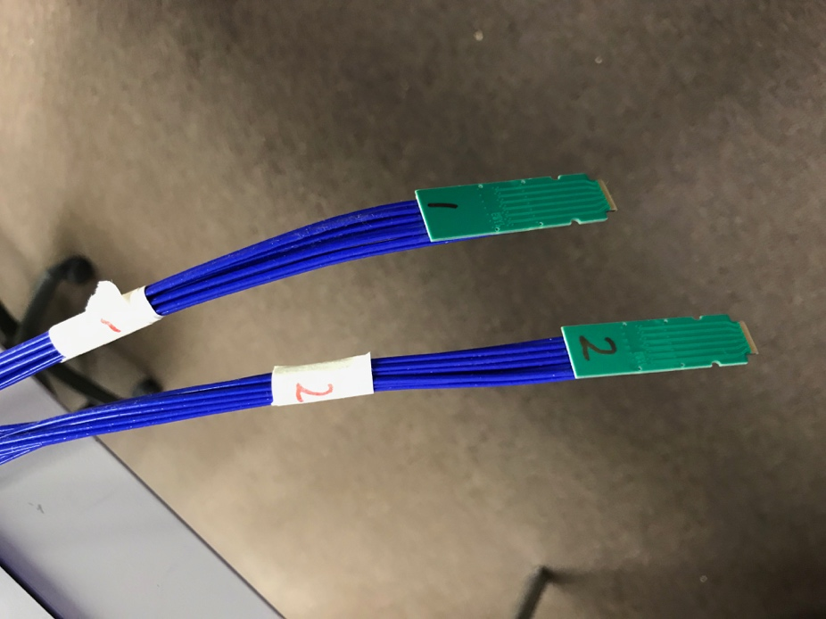
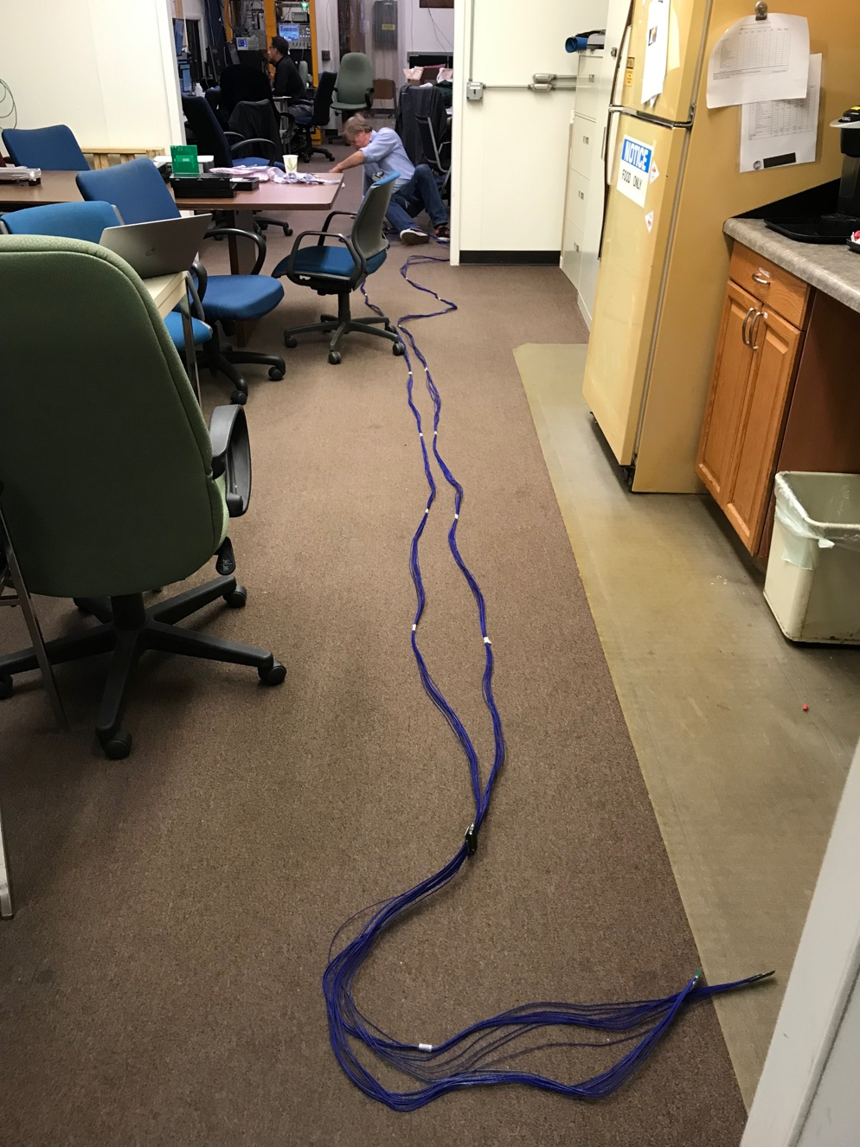
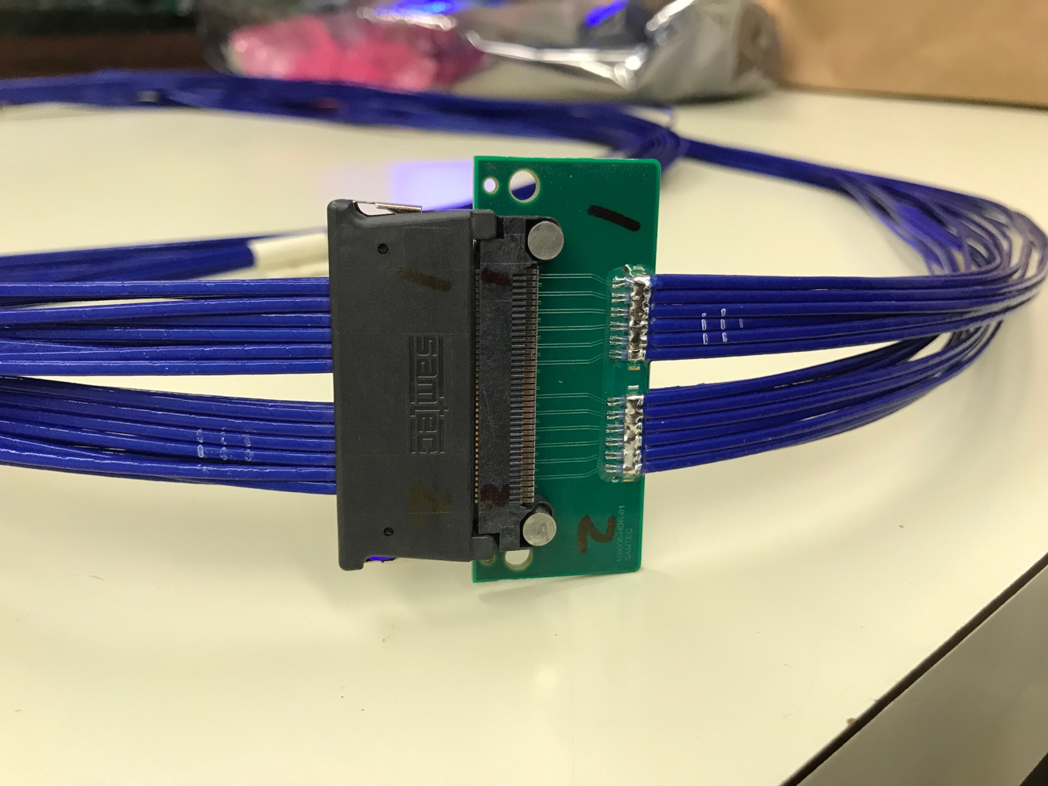
Confirmed New MVTX Long SamTec Readout Cables
8.8m + 2.6m = 11.4m (10m desired for sPHENIX; ALICE 8m cables)

Slide 25
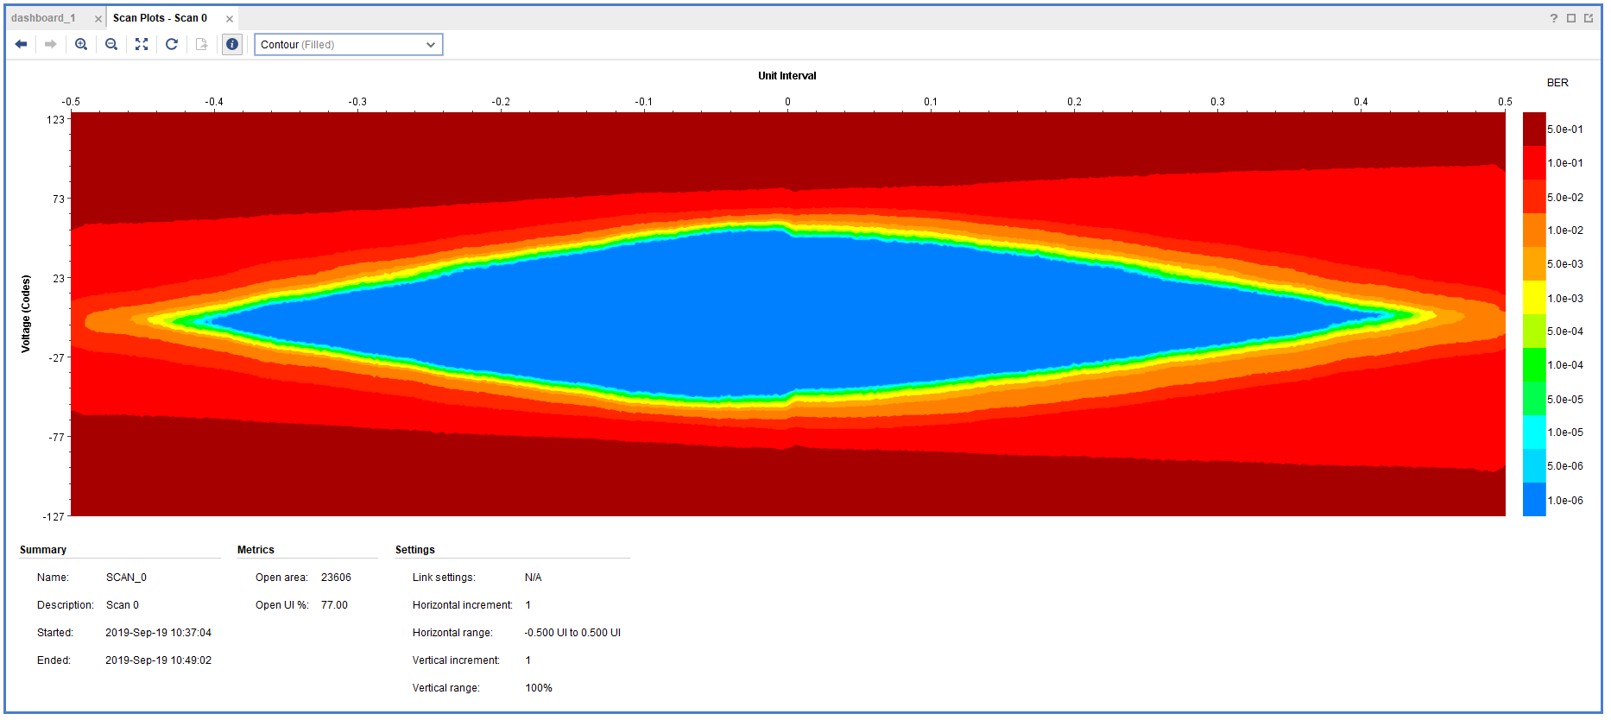
11.4m SamTec Readout Cable Tested @CERN
Double looped readout cables:
  Effective length = 2 x 11.4 m = 22.8m
  Data rate: 1.2Gbps
  One overnight run, ~10hrs
  Error rate < 1.4 x10⁻¹⁴
Production cable: 11m (>10m)

Slide 26
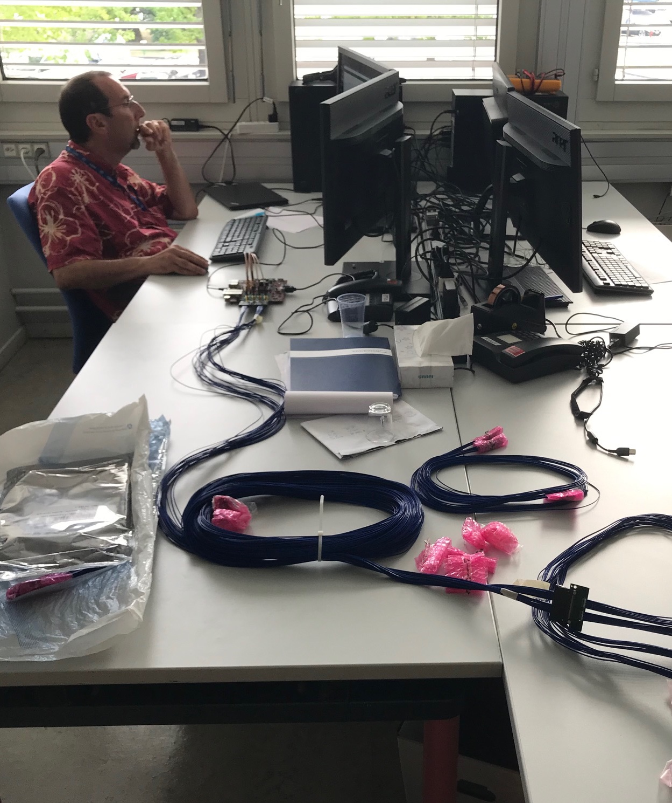
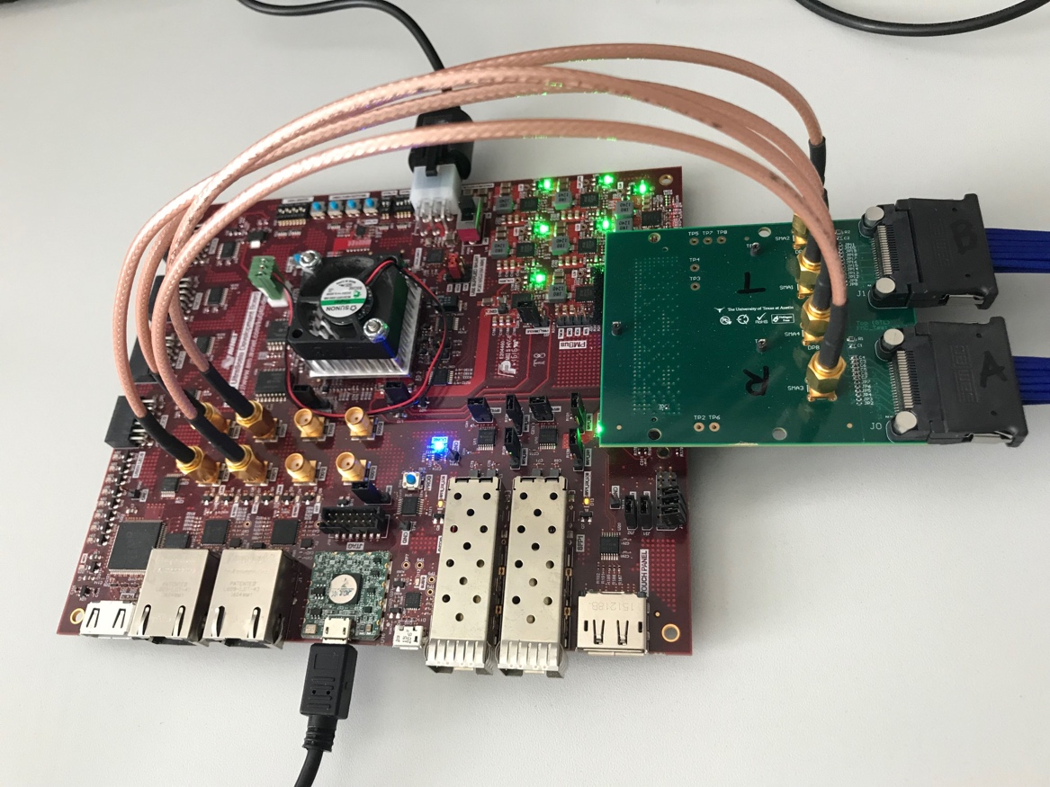
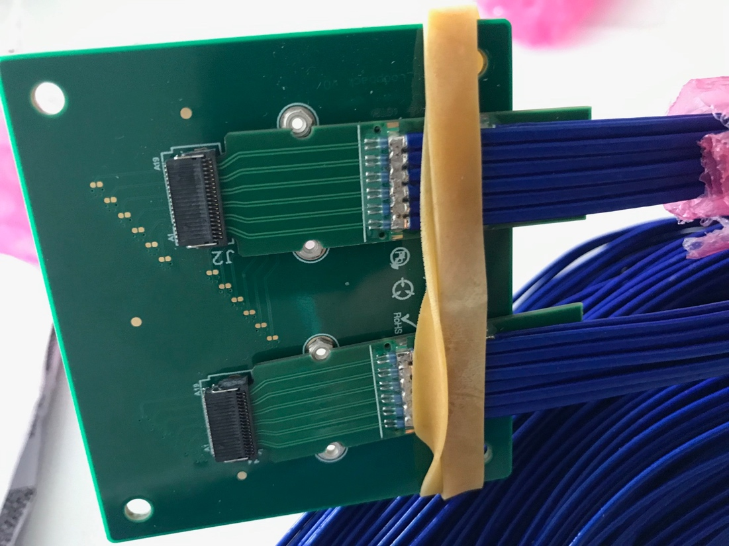
Jo is testing the sPHENIX readout cables
Nice job!

Slide 27
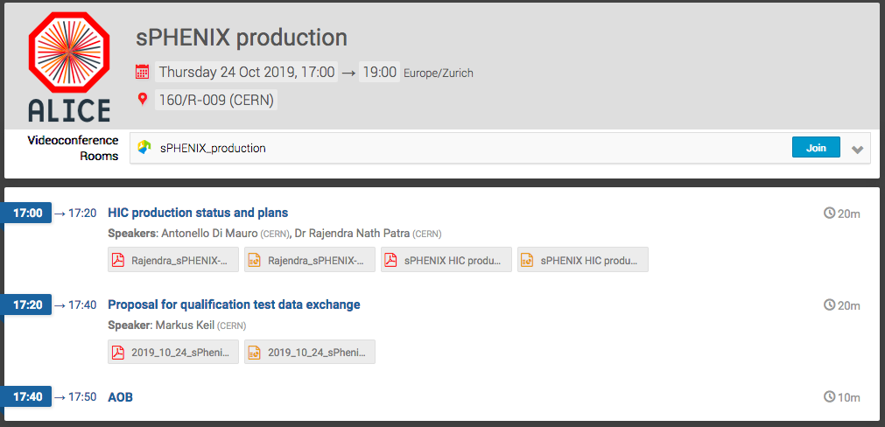
sPHENIX Stave Production Started @CERN
First stave production kick-off meeting 10/24
- “The FPC production is well advanced, we have already the first batch of 24 pieces available.”
- ~100 golden chips available
- 1st sPHENIX HIC produced, “GOLD”, IBHIC-A201
sPHENIX Production started in 9/2019
  Bi-weekly meeting on Thursday 5PM/CERN (9AM/LANL)
~10 staves/month
  Limited by Wire bonding , 2~3 staves/week
Production period: ~10 months
  Complete by the end of 2020
Produce 12 HICs in 2019
First ~21 staves available, 3/2020

Slide 28
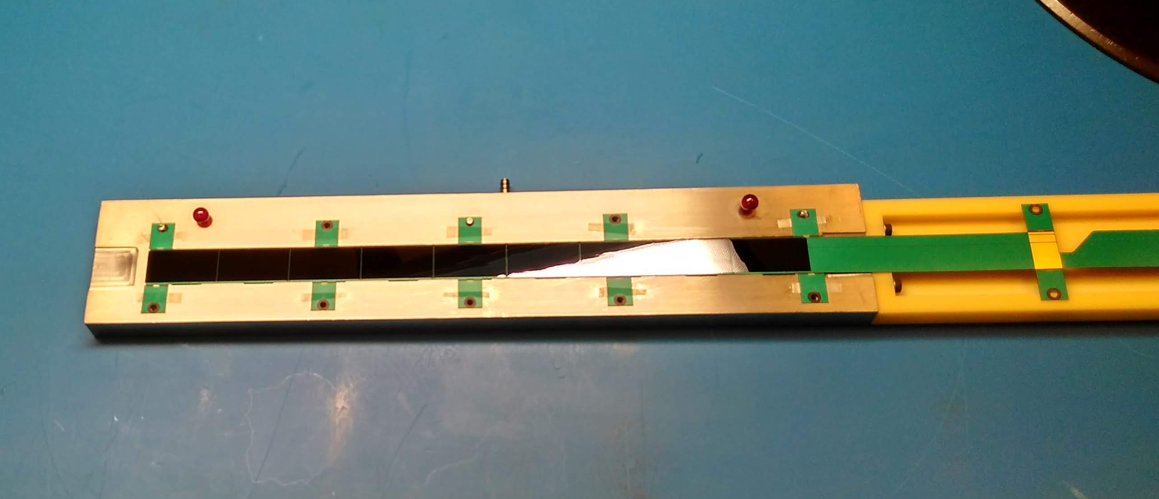
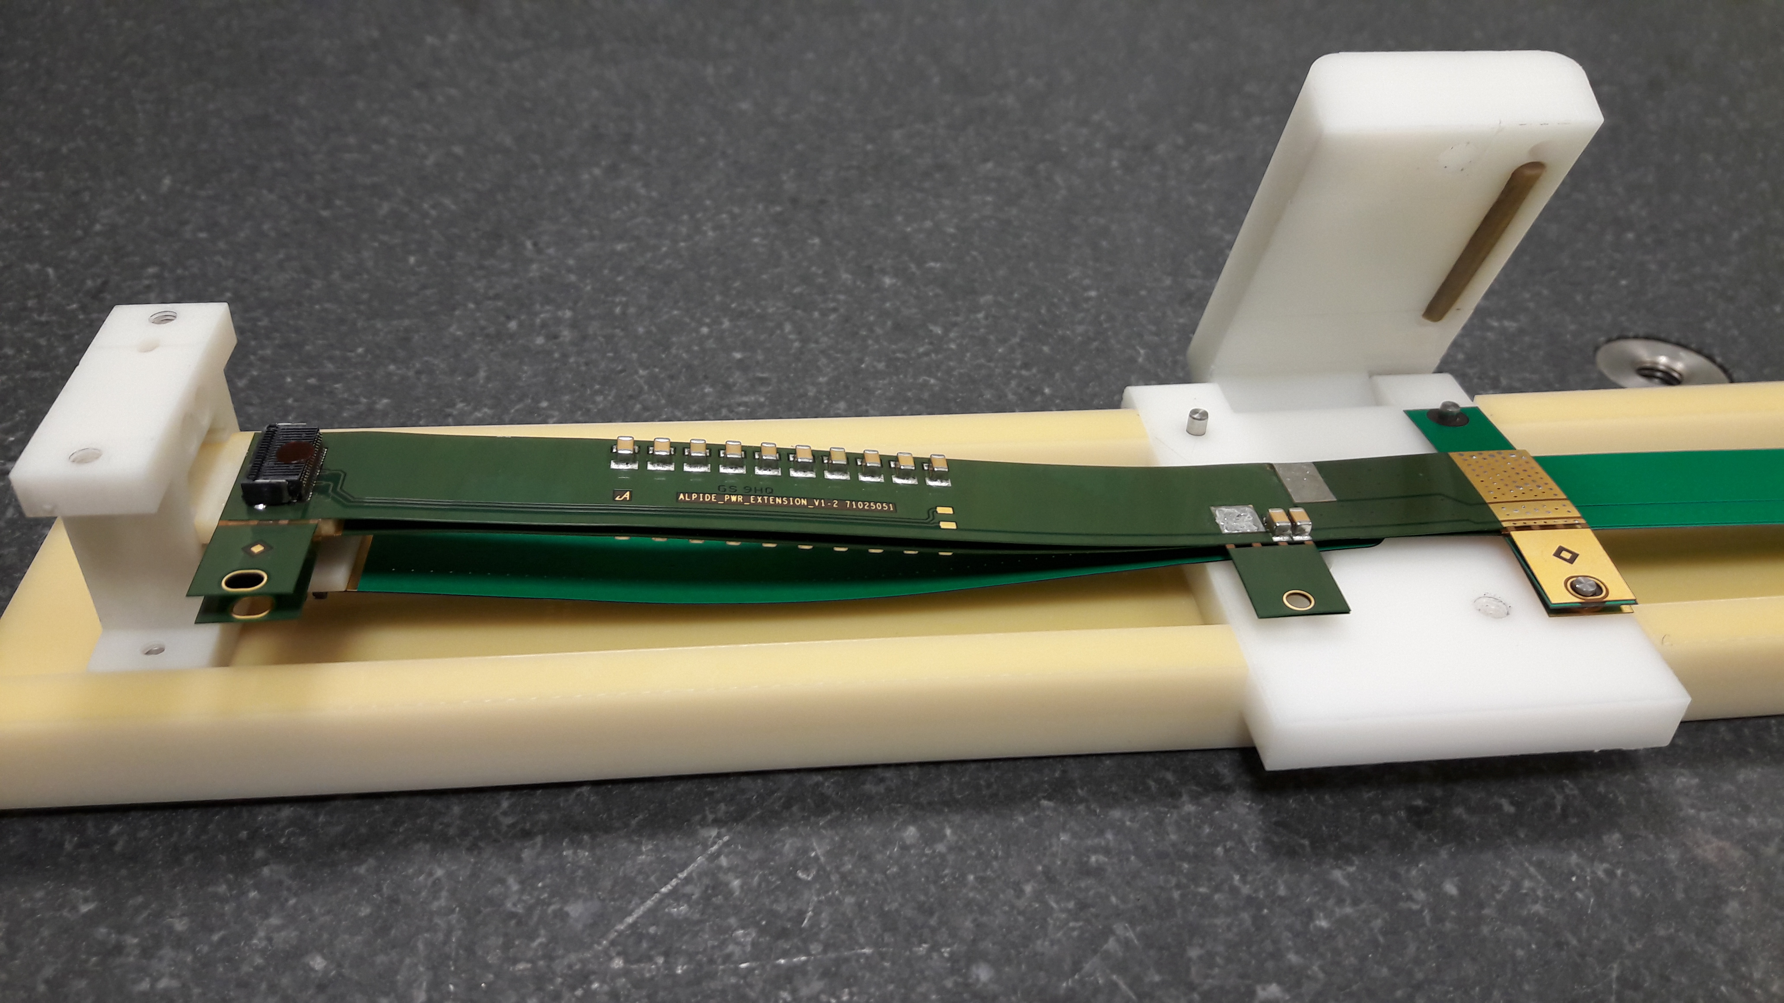
1st sPHENIX HIC Produced at CERN
- IBHIC-A201 & PWR extension clamp
Power extension clamp
First sPHENIX HIC

Slide 29
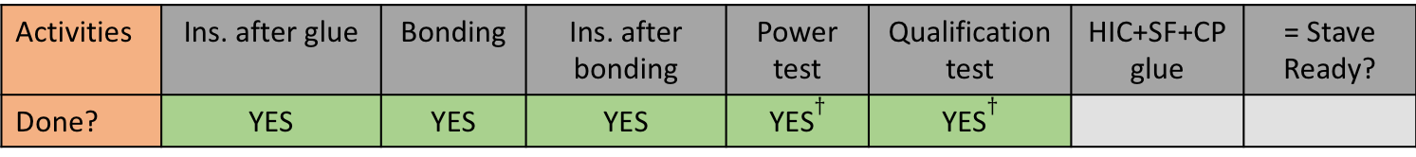
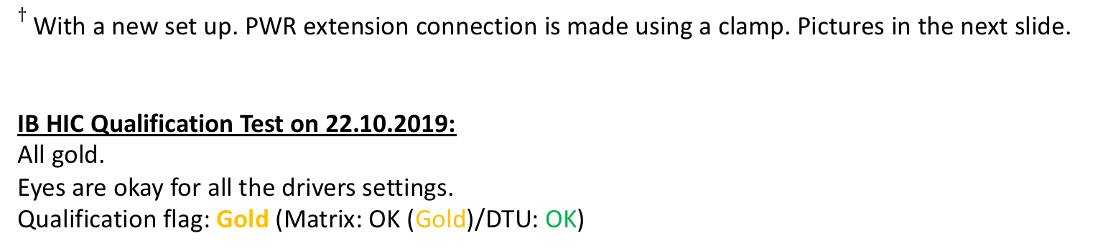
IBHIC-A201
Accepted ALPIDE Chips from T847786 19T: A1*, A2, A4, A5, B1, B3, B7, C2, C3
*Dust removed from the back side.
Activities | Ins. after glue | Bonding | Ins. after bonding | Power test | Qualification test | HIC+SF+CP glue | = Stave Ready?
Done? | YES | YES | YES | YES$†$ | YES$†$
$†$ With a new set up. PWR extension connection is made using a clamp. Pictures in the next slide.
IB HIC Qualification Test on 22.10.2019:
All gold.
Eyes are okay for all the drivers settings.
Qualification flag: Gold (Matrix: OK (Gold)/DTU: OK)

Slide 30
Final Production RU Boards Tested at UT-A
60 sPHENIX RUs produced at CERN
10 RUs produced for LANL R&D
Tested 10 RU @UT-A, 10/14-18, 2019
  All tested good, found one bad optical transceiver (1/30)
  Jo, Yasser, Gerd
  Alex T. joined for one day, readout firmware/software plan
Plan to test the 60 sPHENIX RUs later

Slide 31
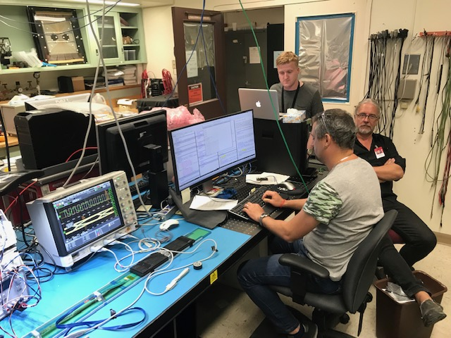
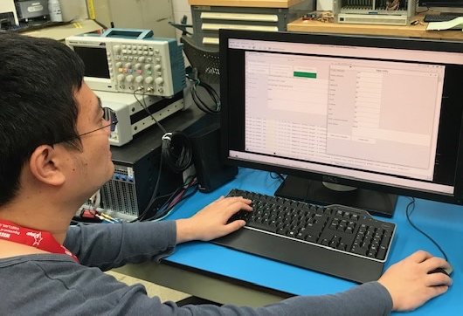
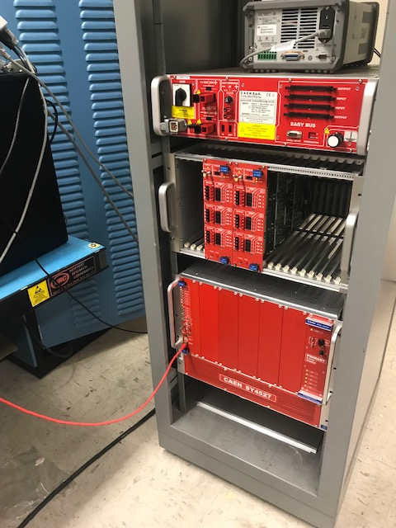
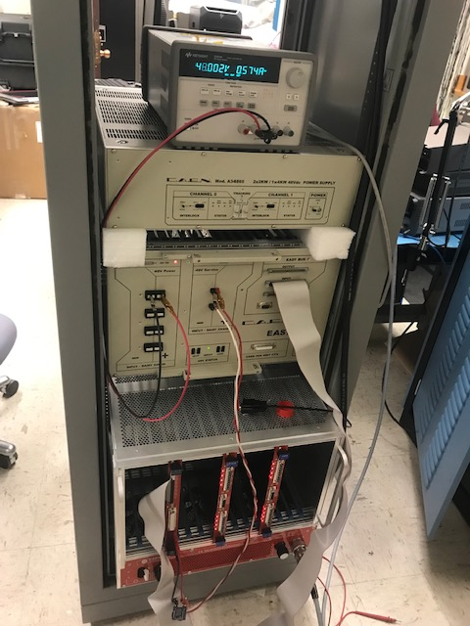
R&D at LANL
Full ITS/IB QA testbench in operation
Python GUI developed for telescope readout and control operation
CAEN PS being tested
Run Control
GUI
Stave testbench

Slide 32
A Full Readout Chain System Test
MVTX – readout in 6-subgroup
  48 staves + 48 RUs + 6 FELIXs
  A complete readout chain:
  8 staves + 8 RUs + 1 Felix + 1 RCDAQ Server
Hardware in hand at LANL
  6 staves + 4 HICs(w/o carbon frame)
  10 RUv2.1
  2 FELIX v2.0
  2 PU
  1 sPHENIX GTM
Build a telescope of:
6 staves + 2 HICs
8 RUv2.1
1 FELIX
1 PU
1 GTM
A test beam later this year or 2020 (TBD)
LBNL, 50MeV p-beam
LANL, 800MeV p-beam
Fermilab?

Slide 33
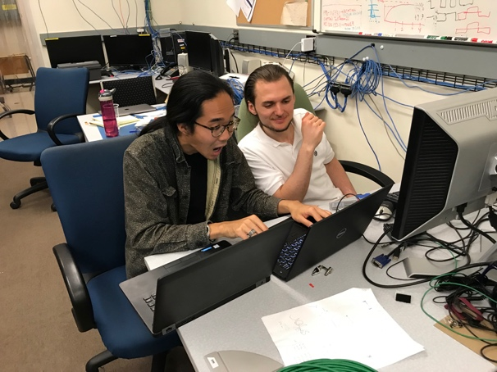
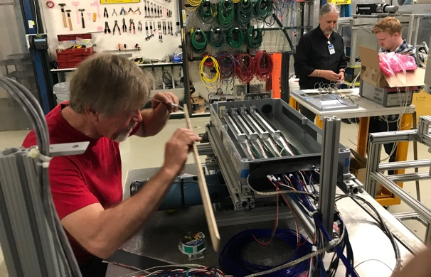
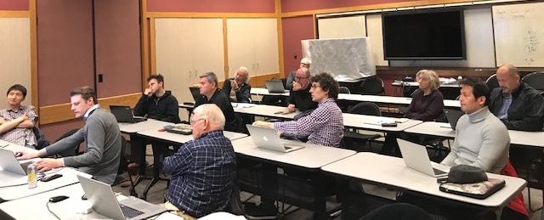
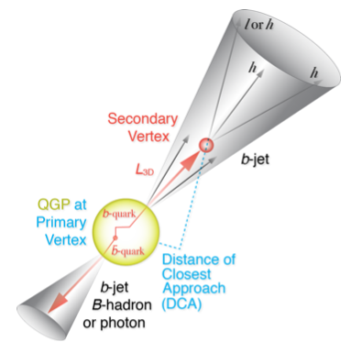
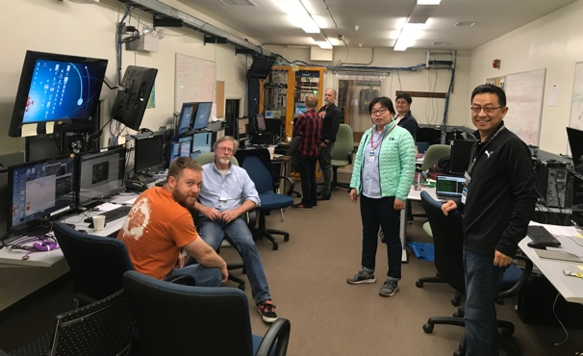
Summary
Completed key R&D for readout integration
  Full 9-chip stave readout per RU
  Multi-RU readout per FELIX
  Long readout cables
  sPHENIX GTM
Completed preliminary mechanical design
  Vendor selection
  Carbon structure (pre)production
  Insertion mockup
Improve MC detector response, clustering – in progress
  Calibration data with incident angles, 0, 10,20,30,40,45
Stave and RU production at CERN - in good progress
  Acceptance test & QA in US
July MVTX review response submitted to DOE
  Expect project $$ distributed soon
We are ready for the full production and the physics!

Slide 34
backup

Slide 35
Near Term To-Do List
Continue mechanical system design
  CYSS, EW, SB
  Global insertion system design and full mockup
Carbon structure production
  LBNL CF update
  Follow up with US vendors for quotes
  Select vendor(s) for pre-production
RU acceptance QA at UTA
Prepare for stave acceptance QA at LBNL
FELIX production and test
  Jointly with sPHENIX TPC, at BNL? Or LANL?
2019 test beam data analysis
sPHENIX Stave production at CERN
We will follow up the progress closely, production, Test & QA
- bi-weekly meetings with CERN
ITS system surface commissioning at CERN
Now --- May 2020
A good opportunity to learn about the
system operation and controls;
Working on a coordinated effort within MVTX/sPHENIX,
Signup page,
https://docs.google.com/spreadsheets/d/1YBAyouW8geJHUPpzRyLlzN4ePW4YzI8glI5xI66N3ww/edit#gid=0
A full “8-stave + 8-RU + 1-FELIX + 1-PU + 1 GTM” chain test
  10 RU available
  1 PU arrived at LANL from LBNL
  8-stave/HICs telescope frame being designed
  RU & FELIX Firmware update in progress
  Slow control software & GUI
  A possible test beam run later this year

Slide 36
sPHENIX Timeline

Slide 37
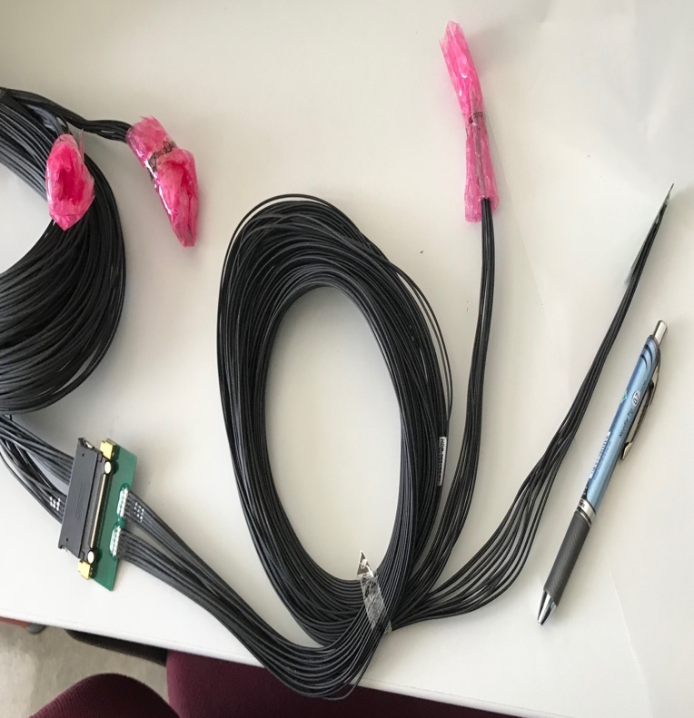
MVTX Readout and Power Cable Route
ALICE ITS/IB final readout cables: ~8m
Cable-B: 5.3m
Cable-A: 2.65m
PWR
RU
PU
sPHENIX MVTX: 7.9+m
  Cable-A: 1.4 m
  Cable-B: 6.5+ m
  Power cable:4.7+ m
Desired ~10m
BNL has approved “non-halogen free” cables for sPHENIX

Slide 38


Carbon Structure Production
Visited WorkShape 9/19/2019
  Walt and Ming, Simon
WorkShape well prepared
  Updated the design files
MIT design work good progress, well ahead of time
  Early Carbon structure review for pre-production, Nov/Dec 2019?
Other companies, CA..
  Received quotes for CYSS, End-Wheels
LBNL in progress

Slide 39


ITS/IB RU and PU, w/ cables

Slide 40


PU & CAEN PS
CAEN PS

Slide 41
MVTX Goals – the 2nd TB, 6/17-22, 2019
Test and confirm optimal MVTX operation parameters for sPHENIX
  Threshold scan, analogy shaping time etc.
  Study chip hit efficiency vs trigger(strobe) latency
    dT = 1 ~ 10 uS
    Impact on occupancy & pileup
Parameters predetermined from laser scan at LANL, in good progress
    Single chip readout with MOSAIC with pulsed laser (~MIP)
    Threshold and noise
    Analogy shaping time
    Strobe delay and length

Slide 42



Study MAPS Performance with Pulsed Laser @LANL
Inject “MIP” signal, focused laser beam
  850 nm laser, 4ns wide pulse, ~1 MIP
  50kHz trigger
  Find optimal MAPS operating parameters
Laser system
MOSAIC Testbench
Pixel hits

Slide 43

Laser Scan Data – Pixel Hit Efficiency vs Trigger Delay
One of “Stretched Settings” for sPHENIX trigger
MAX: 64 cells x 106nS = 6.8uS
Pixel (Row-Col)
Pixel (Row-Col)
~ 4.7 us
sPHENIX Trigger
~ 4.7 us
sPHENIX Trigger latency

Slide 44

MVTX Test Beam, May 2019
MVTX

Slide 45

4-stave Telescope
120GeV p-beam
2 RUs,
PU,
PS
Negative Pressure Cooling System
Motion Table
(X,Y,Phi)

Slide 46


First Collision Signals
sPHENIX GTM

Slide 47


Staves, RUs, PU etc.
2 RUs
PU

Slide 48

120GeV p-beam
120GeV p-beam
Telescope
Telescope
RUs & PU
Cooling System;
negative pressure
@-30%ATMP (-5PSI)

Slide 49

When MAPS parameters off the optimal point, less hits collected

Slide 50

No hits seen when MAPS parameters far-off the optimal point

Slide 51


Installation

Slide 52
3-D event Display: p+Pb collision
Cameron
Stave-4
Stave-3
Stave-2
Stave-1

Slide 53


Offline Analysis: Cluster size vs Angle
Run 877, angle – 30 dgr
Cluster Size = 2.7

Slide 54
Offline Analysis: Cluster size vs Angle
Run , angle = 40
Cluster Size ~ 3.0
More work follows by Yasser, Sanghoon et al
Everyone is welcome to join the effort!
Stave geometry
Stave alignment
Clustering
Tracking
Update MVTX MC response in GEANT

Slide 55



Run Types – Details being documented in MVTX wiki
From Xiaochun
Run0978
Horizontal stave scans (many good runs)
Vertical stave scans
Angular stave scans and tilted runs
Electron beam at 5 GeV (one long run)
Extruded aluminum & Lead-block runs
Run0877
Run1040

Slide 56

Data run-log in sPHENIX Wiki,
Nice work by Xiaochun et al. @GSU
Jin’s test beam analysis framework
Offline analysis in progress

