Slide 1

MVTX Overview
Document: sPH-HF-2018-001
https://indico.bnl.gov/event/4072/
Ming Liu
Pre-QM sPHENIX Collaboration Meeting
November 1-2, 2019
Fudan Univ., China

Slide 2

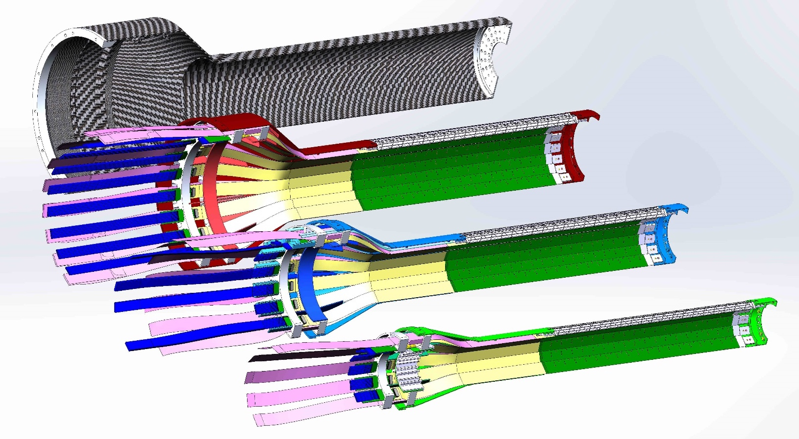
MVTX Detector
Service cone: signal, power, cooling
and mechanical support
CYSS: Cylindrical Shell Structure
End-Wheel
Extended power FPC
MVTX
parameters
3-layer sensor barrel
- 48 staves, 27.1cm long
- 432 chips

Slide 3
Scope of the MVTX Project - WBS3.2
To be updated with review
MVTX sensor & Electronics
  Detector assembly & integration: $4.8M
    QA & assembly
      RU boards @UT-A
      Half detectors @LBNL
      FELIX boards @LANL/BNL, 6+spares(2)
    Ancillary systems - “adopt” ALICE ITS system
      Power, slow control & monitoring etc.
  Readout integration
    Frontend: ALICE/ITS RU
    Backend: ATLAS FELIX
Mechanical system
  Modify ALICE/ITS detector support structures
    End Wheels
    Cylindrical structure shells
    Service half barrels
  Mechanical system integration,
    Design & simulations, MIT/LANL
    Composite structure production, LBNL and other possible commercial vendors
    Non-composite structure, MIT
    Installation tooling etc., LANL/MIT/LBNL/BNL
  Adopt ALICE cooling plant design
    Modified to fit sPHENIX, MIT/BNL
  Production @CERN: $1.4M, a separate BNL R&D project
    - 84 ALICE/ITS-IB (modified) staves from CERN
      In production, complete by 2020
      acceptance test @LBNL, 48+spares(2-inner layers+)
    - 60 ALICE/ITS-RU from CERN
      All produced, acceptance test @UT-Austin, 48+spares(12)

Slide 4
Project Status Update: 11/01/2019
Confirmed long SamTec readout cables recently – last key integration R&D hardware
  11.4m long cables, > 10m desired length
MVTX mechanical design: excellent progress
  Obtained quotes from outside companies based on preliminary designs for CYSS and End-Wheels
  MVTX/sPHENIX integration/insertion workfest , 11/14 @BNL, MVTX/INTT/TPC…
Early R&D fund released
  MVTX mechanical engineering design, MIT/LANL
  Preparation for Stave and RU acceptance test, LBNL, UT-Austin
July 2019 MVTX Cost & Schedule Review Response submitted
  WBS, PMP, Risk Registry, P6 updated
  Updated PMP and review response submitted to DOE
  We are ready for full production
Plan to start the MVTX production activities as soon as funds available
  Preparation for Stave and RU acceptance test & QA in US, LBNL and UT-A
  Carbon structure prototype production, site selection etc
Stave and RU production
  Stave production in progress at CERN
  60 MVTX RUs delivered to CERN
  Power mezzanine and transition boards produced at UT-A

Slide 5
Funding Profile (FY19+20, 21,22)
From July MVTX Review:
MVTX funding profile: FY20 -22
sPHENIX MVTX Budget Profile
 | FY20 | FY21 | FY22 | Total
3.02.01 Management | $233,668 | $209,596 | $101,338 | $544,602
3.02.02 Electronics | $569,582 |  |  | $569,582
3.02.03 Mechanics and Assembly | $1,370,727 | $307,183 | $113,468 | $1,791,378
3.02.04 Integration and Infrastructure | $368,185 | $399,262 | $15,491 | $782,938
Performance Measure Baseline | $2,542,162 | $916,041 | $230,297 | $3,688,500
Contingency | $762,649 | $274,812 | $69,089 | $1,106,550
Total Project Cost | $3,304,811 | $1,190,853 | $299,386 | $4,795,050
Can we move some FY20 ($3.3M) activities to FY21 ($1.2M),
with minimal impact to the project?

Slide 6
Schedules – Smooth Funding Profile?
Possible Plan-B for FY20?
Fully aligned with sPHENIX via external milestones
Candidates for possible delays, from FY20 to FY21:
Carbon Structure production
PU and CAEN PS
Cooling system
Delay stave test and detector assembly work at LBNL
Recent new quotes for carbon structures: CYSS & EndWheels
Possible cost saving through commercial companies
Carbon structure full production possible in FY20, w/ big saving

Slide 7
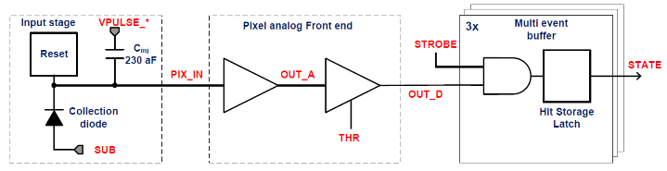
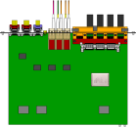

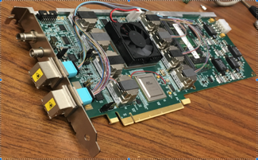

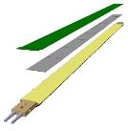
MVTX Readout, Power and Controls Hardware Tested
CAN bus
DCS
Slow control
Mike’s talk
Trigger & Clock
Readout Unit
Front End
GBT Optical Links
one pixel
9 Data (1.2Gbps)
1 Clock, 1 Control/Trigger
Control
Data (9.6 Gb/s max)
Trigger
9-sensor Stave
Samtec Twinax “FireFly”, ~10m
FELIX
Back End
FPC
Power
ATLAS Front-End Link eXchange (FELIX):
sPHENIX Data Aggregation Module(DAM)
Alpide Sensors
Flex PCB Filtering Capacitors
regulators
Power
Regulated Power
CAEN Power supplies
Cold Plate
ALPIDE pixel:
Shaping
Digitization
Zero-suppression
3x buffer
Power Board
Interaction Region
Experimental Hall
Counting House
MVTX Detector Electronics consists of three parts
Sensor-Stave (9 ALPIDE chips) | Front End-Readout Unit | Back End-FELIX/DAM

Slide 8
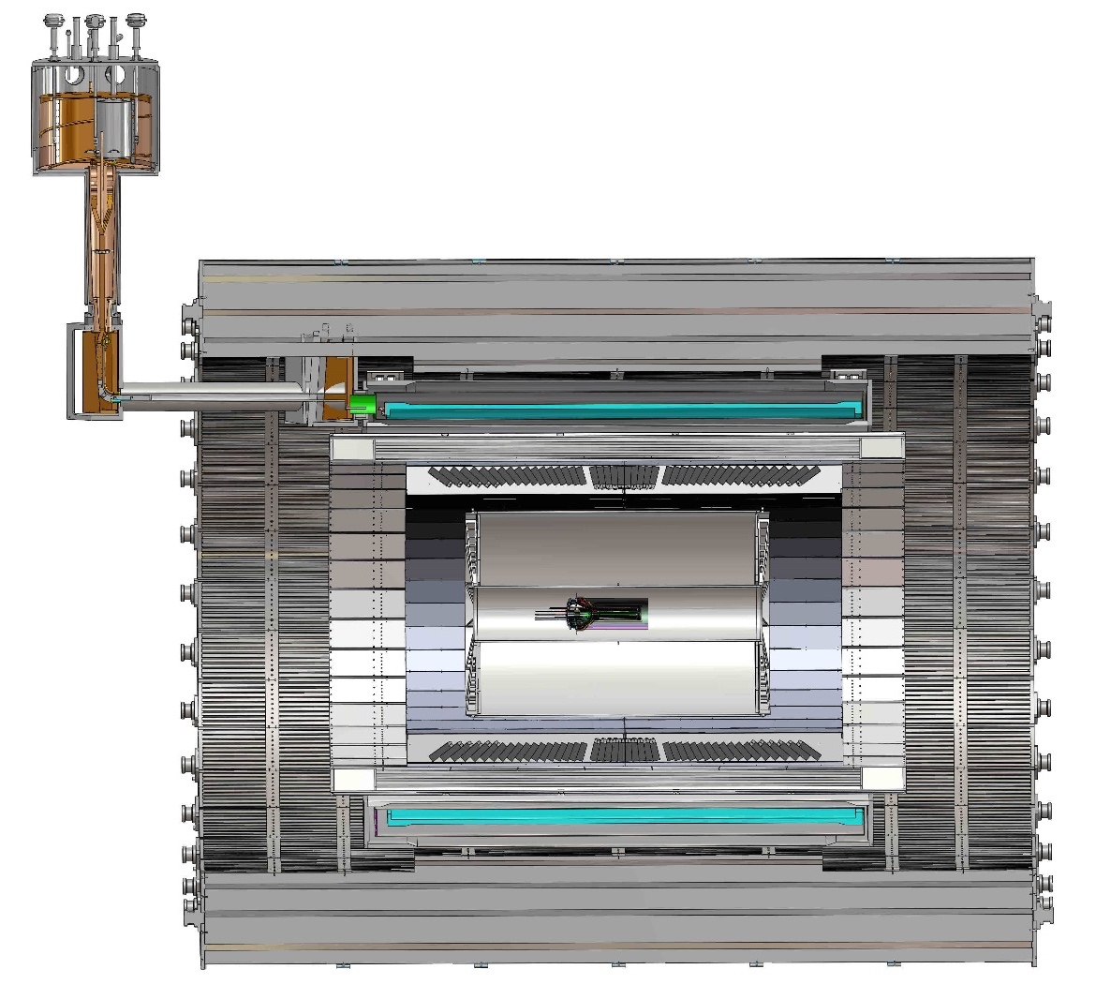
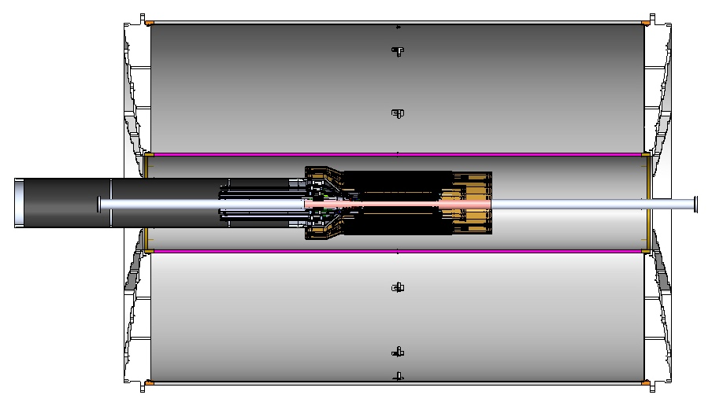
MVTX Global Mechanical System Integration
MVTX system preliminary design, with two parts:
  Part-1: from MVTX to PP-1b, all power PCB, 40cm
  Part-2: length TBD later, from PP-1b to PP-2
Service Barrel
TPC
TPC
INTT
MVTX
PP-1a:
short signal cables
PP-2:
Signal and power cables
R= 209.6cm
PP-1b:
power cables
L = 350.0 cm

Slide 9
MVTX – Half Detector

Slide 10
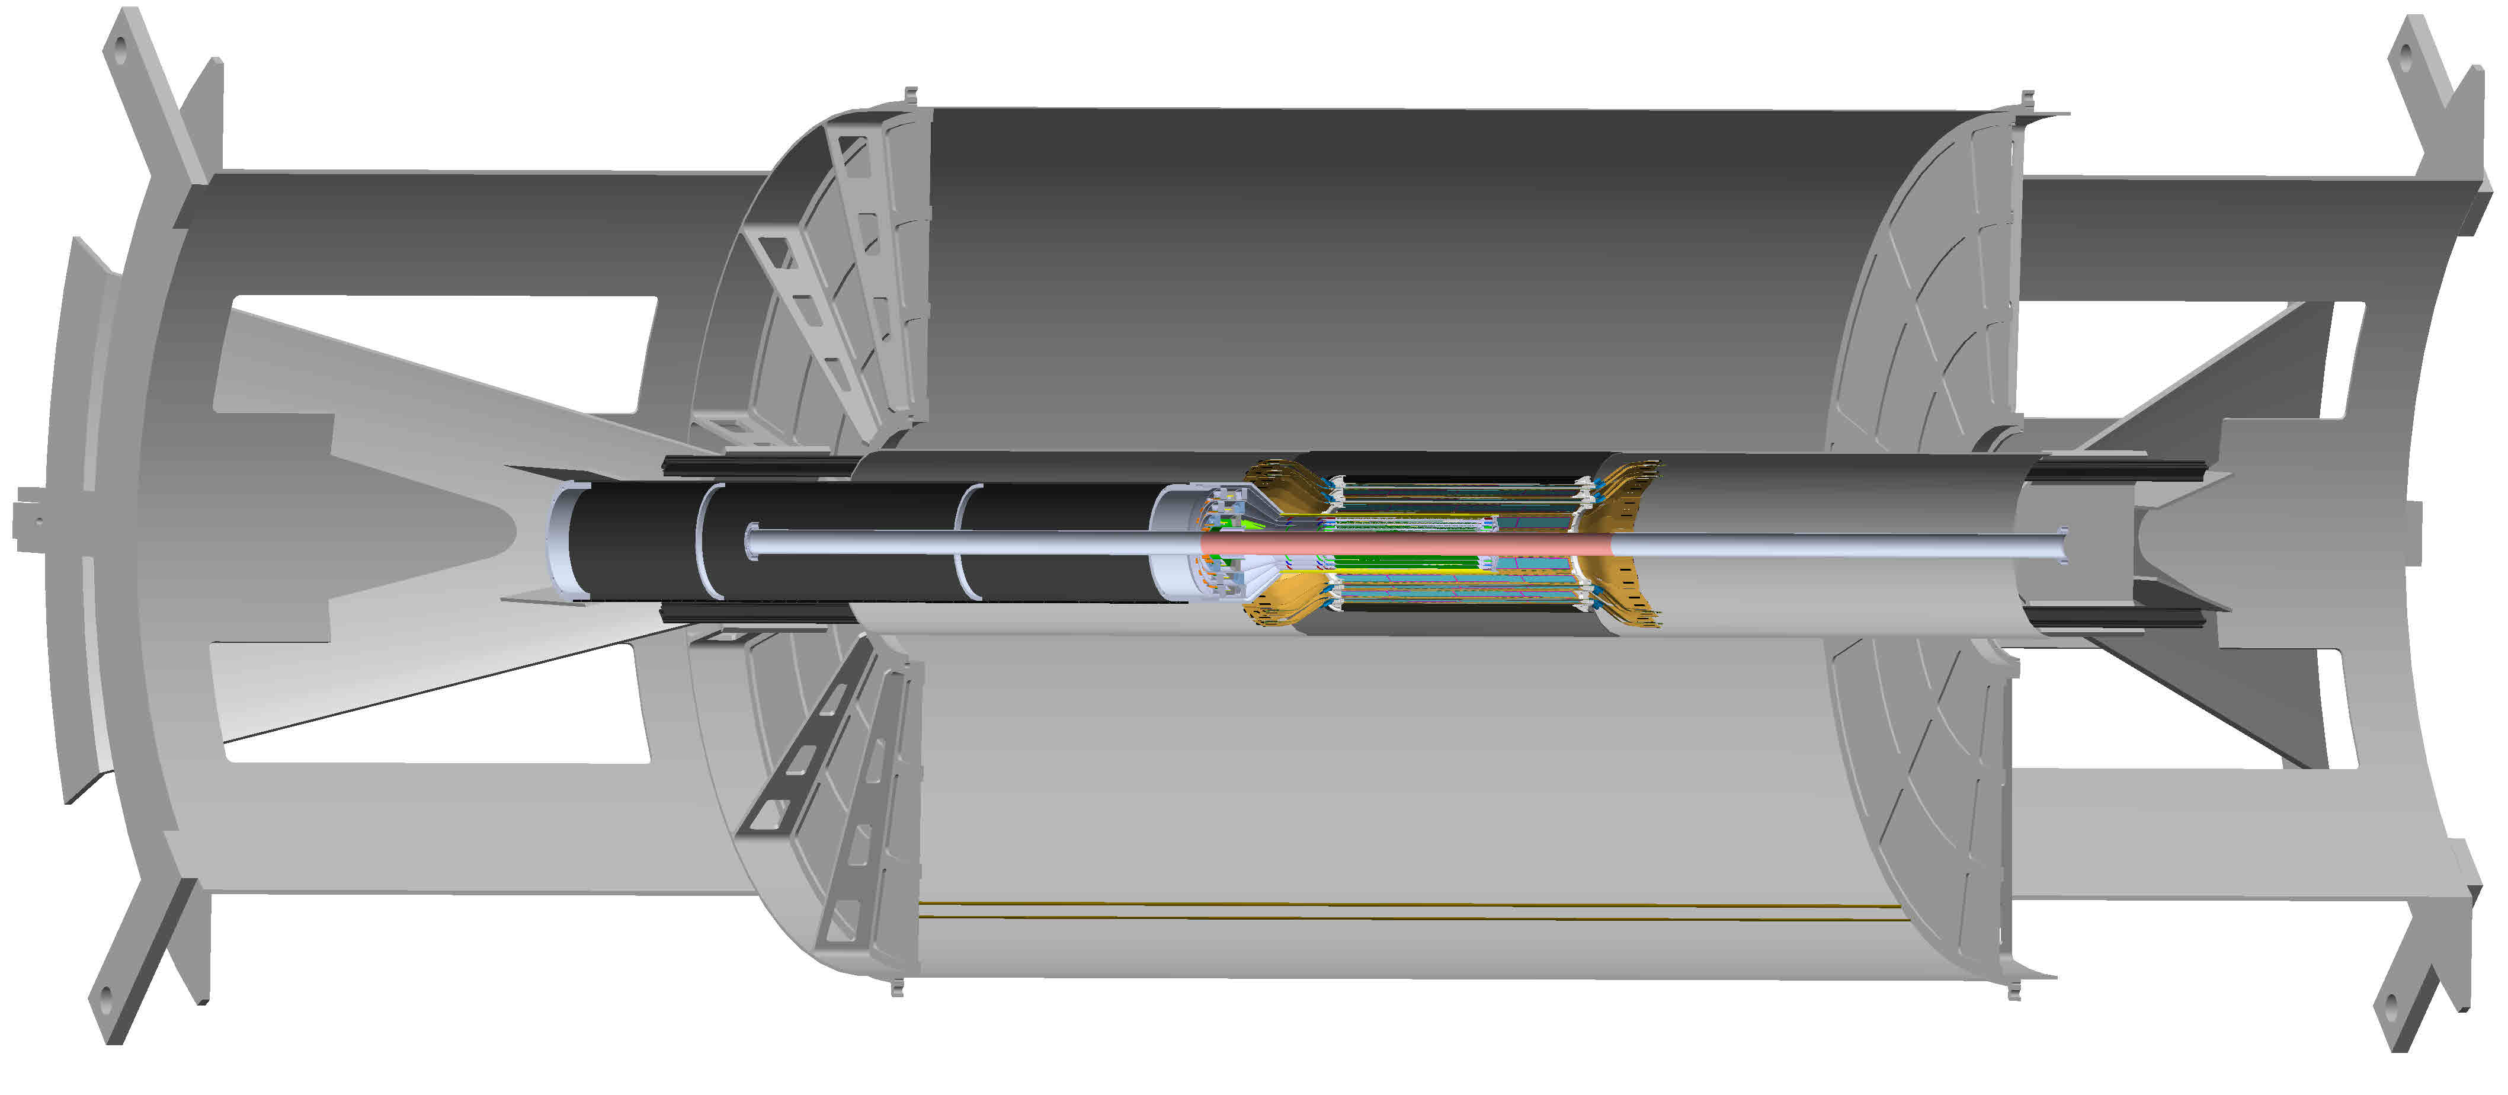
MVTX detector in sPHENIX
MVTX detector with service cylinder
Support brackets for TPC and INTT
TPC volume, length 216 cm
INTT detector, 2 layers

Slide 11
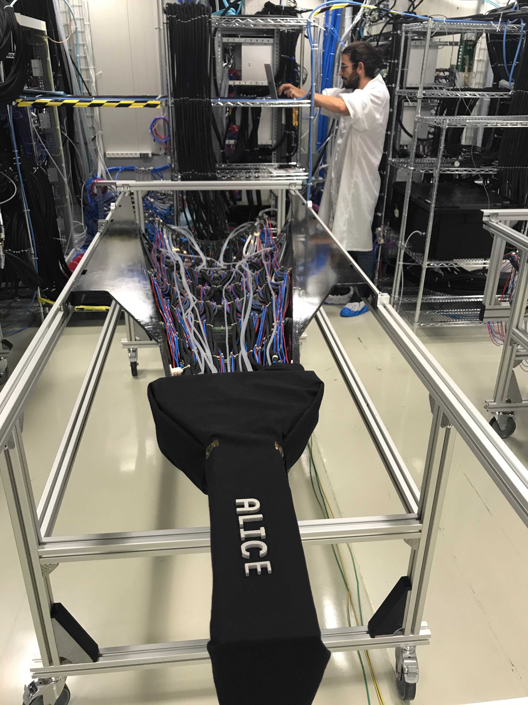
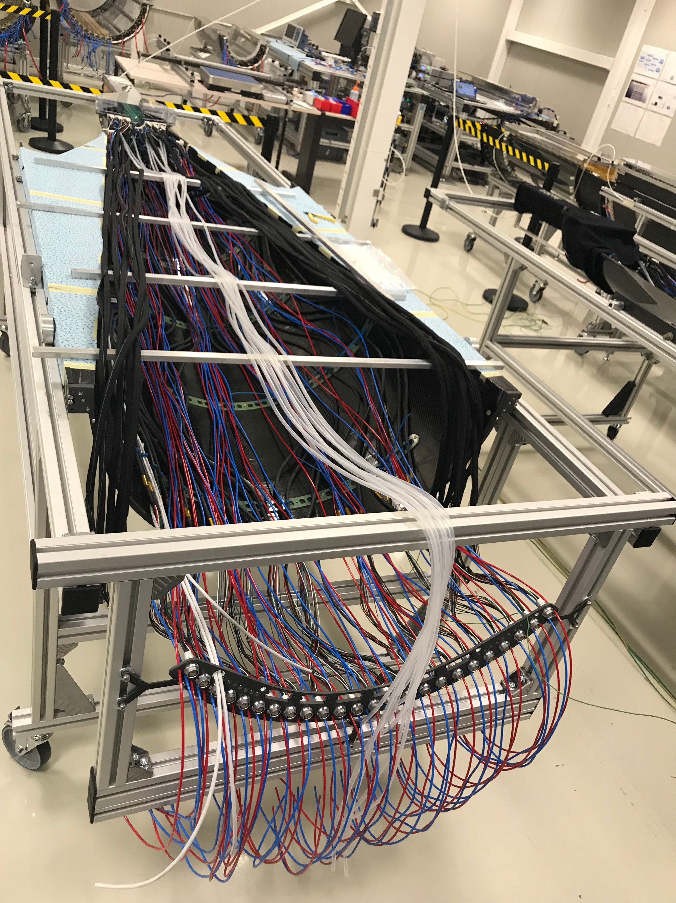
ITS/IB Commissioning @CERN, 9/2019
9/2019@CERN
ITS/IB : top half barrel
ITS/IB : bottom half barrel

Slide 12
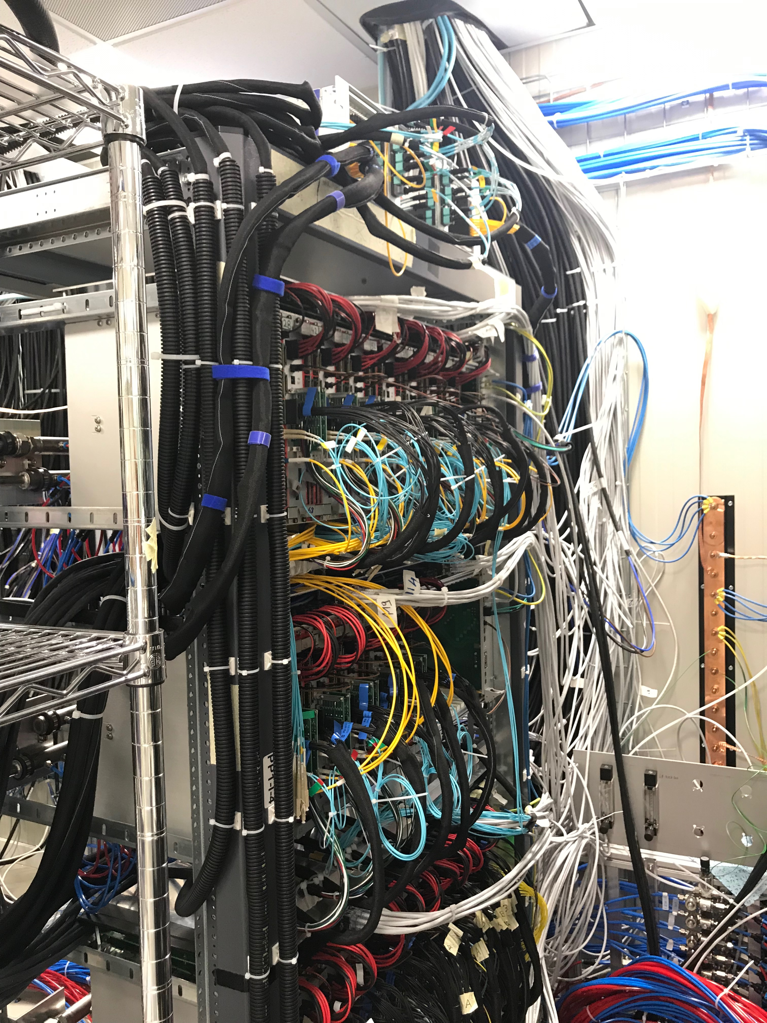
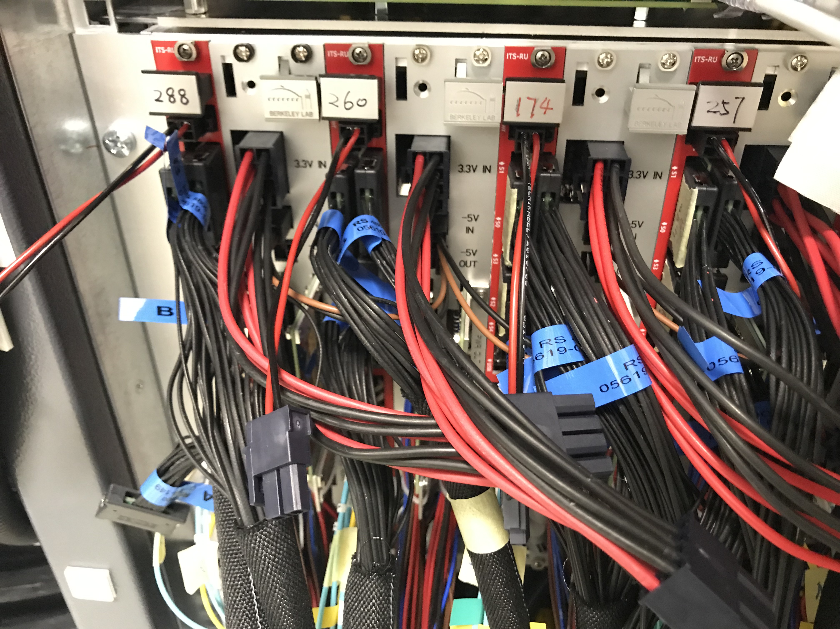
ITS/IB RU and PU, w cables

Slide 13
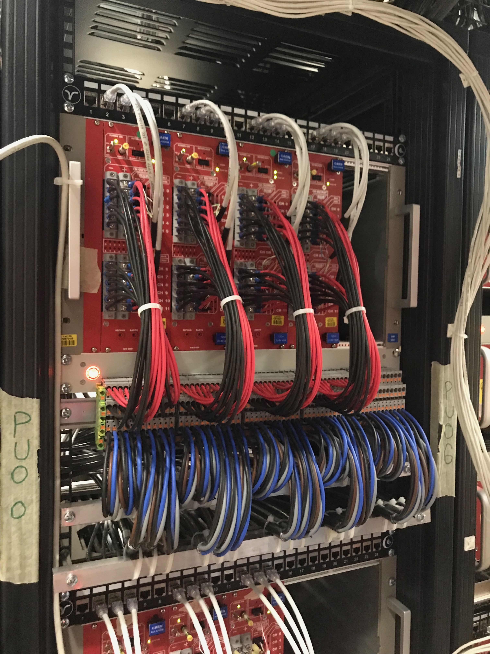
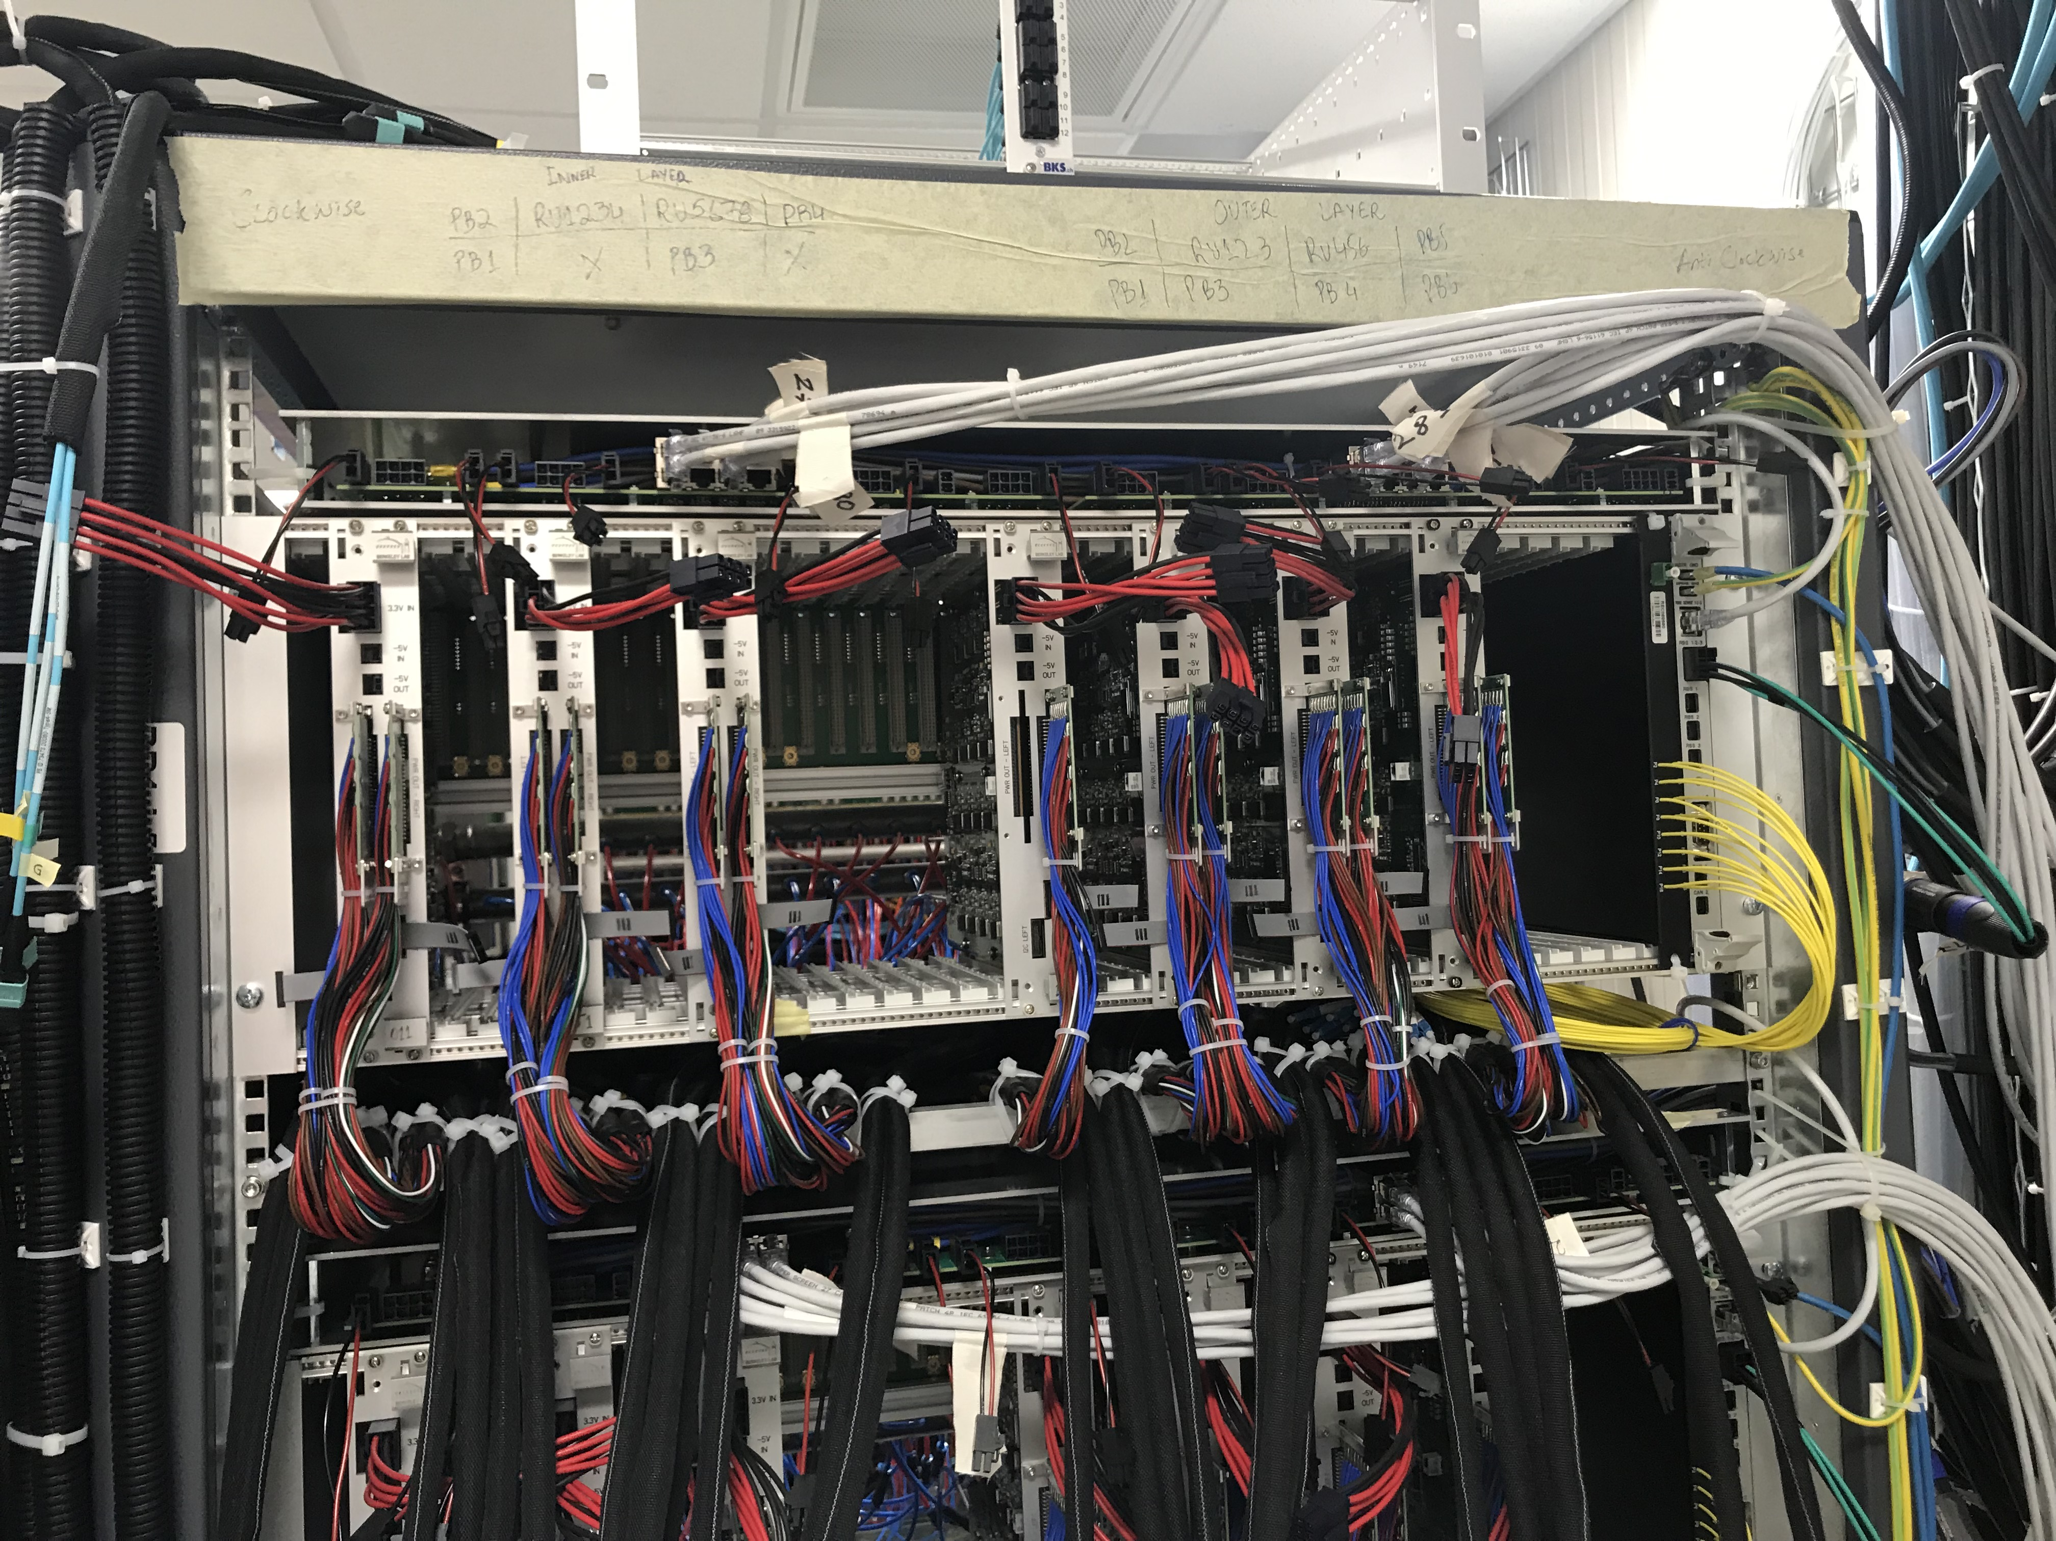
PU & CAEN PS

Slide 14
Preliminary Mechanical Design Completed
Active discussions on mechanical design and fabrications
  MIT, LANL, LBNL
One-day MVTX/sPHENIX insertion mock up workshop
11/14/2019 @BNL, Russ, Camelia et al
MVTX, INTT, TPC …

Slide 15
MVTX Insertion – Mockup in WBS2.x

Slide 16
2019 Fermilab Test Beam Highligts

Slide 17
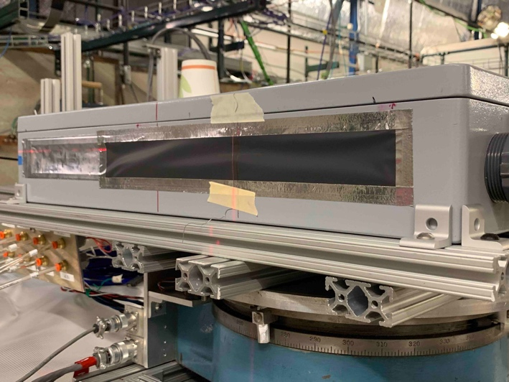
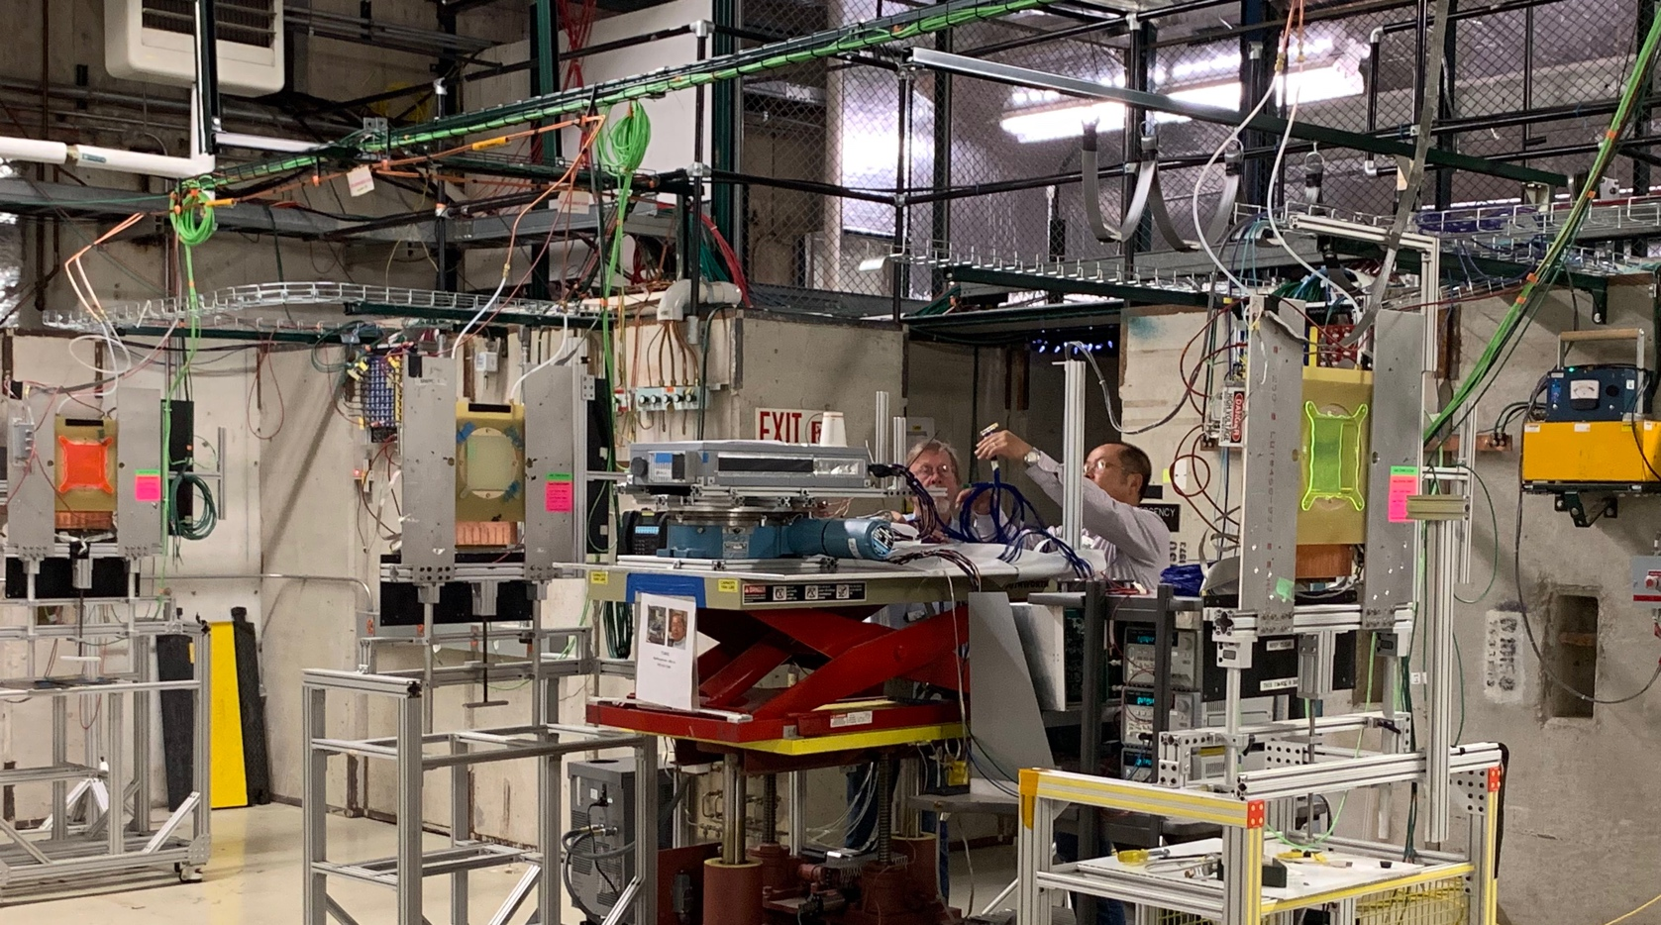
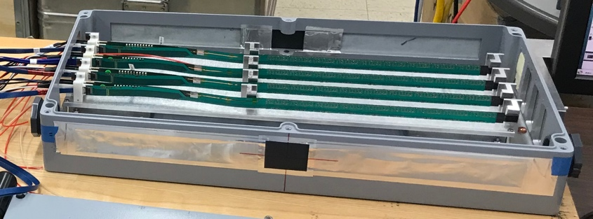
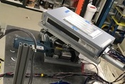
2019 MVTX Test Setup
From view
beam
Stave housing (four staves)
Stave housing sits on a motion table which can be moved in (x, y) plane perpendicular to the nominal beam direction. It can also be rotated (+40, -40) degrees (see photo on right). Operation was done at counting house.

Slide 18
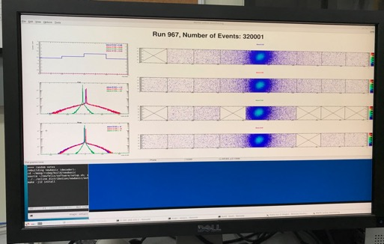
Very Successful Test Beam @Fermilab
5/20-25, 6/17-22, 2019
SamTec: 11.4m
(2.6m+8.8m)
4-stave telescope
RU-2: 1 stave
- 1 fully functioning
9-chip stave;
- 3 staves with a few
broken sensors
4 staves
2 RUv1.1
1 PU
1 FELIX Server + RCDAQ
sPHENIX GTM
11.4m Custom SamTec Cable
Negative pressured cooling for staves
RU-1: 3 staves
5m SamTec
120GeV p-beam
10kHz (30kHz)
Beam intensity:
30k ~ 120k ppp
Data & Control
Beam Trigger
Timing & Trigger
GTM
FELIX
Online Monitoring
RCDAQ
A full system with final sensor/readout* hardware:
Multi-Stave + Multi-RU -> FELIX readout demonstrated
sPHENIX GTM integrated
Long readout SamTec cable certified
Cooling system demonstrated
* RUv1.1 identical to the final RUv2 electrically

Slide 19
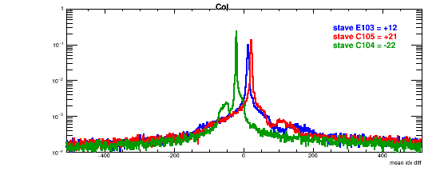
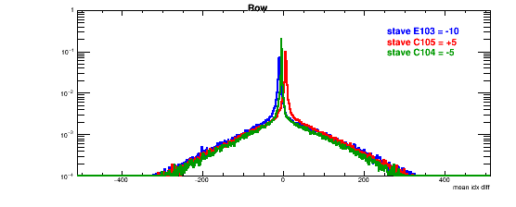
Online Analysis:
Detector Misalignment & Hit Spatial Resolution
Typically staves offset by,
Horizontally: 20 x 30um = 600 um
Vertically: 5 x 30 um = 150 um
Hit spatial resolution:
peak_sigma_core = 0.55 (pixel size ) =15 um
Chip spatial resolution = 15/sqrt(2) = 11 um
Delta_X/Y
Ref plane

Slide 20
ALPIDE Sensor Operation Optimization
“Stretched Settings” for sPHENIX trigger study
- Pile up integration time ~ 8uS
64 cells x 106nS = 6.8uS
“ALICE Default Settings”
- “Pile up” integration time ~ 5uS
sPHENIX Trigger Latency ~ 4.7uS
sPHENIX Trigger Latency ~ 6.8uS

Slide 21
Offline Analysis
From Yasser

Slide 22
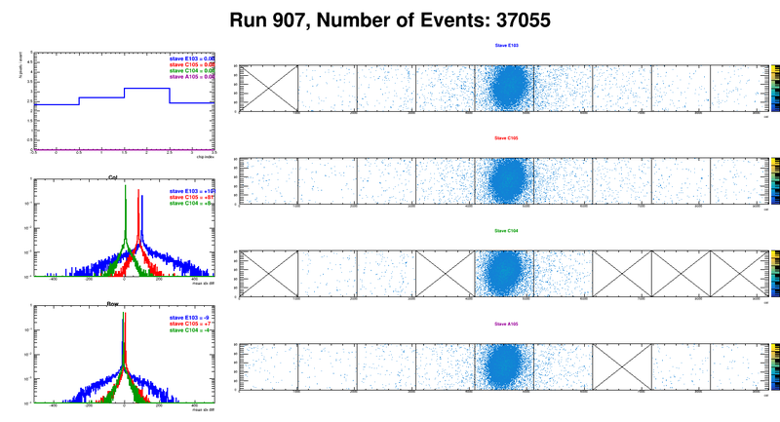
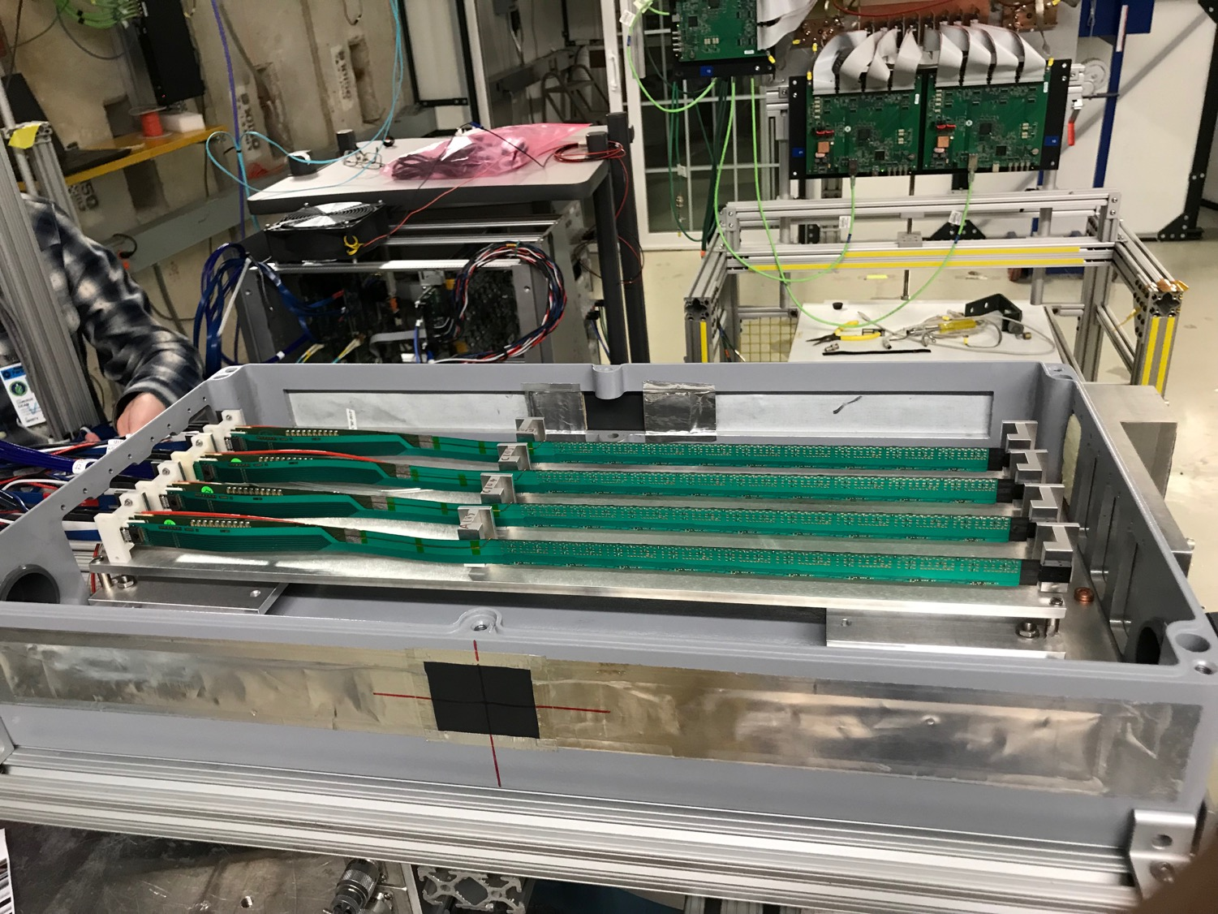
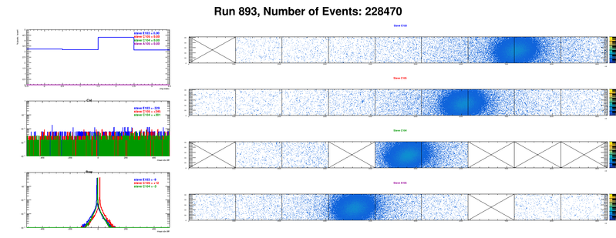
Offline analysis in progress: all TB data in RCF
https://wiki.bnl.gov/sPHENIX/index.php/MAPS-based_Vertex_Detector_(MVTX)
Beam angle: 0
(eta ~0)
MVTX 4-Stave Telescope
Beam angle: 40
(eta ~1)

Slide 23
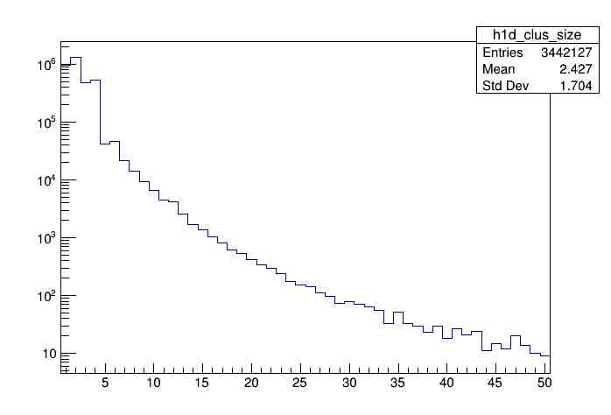
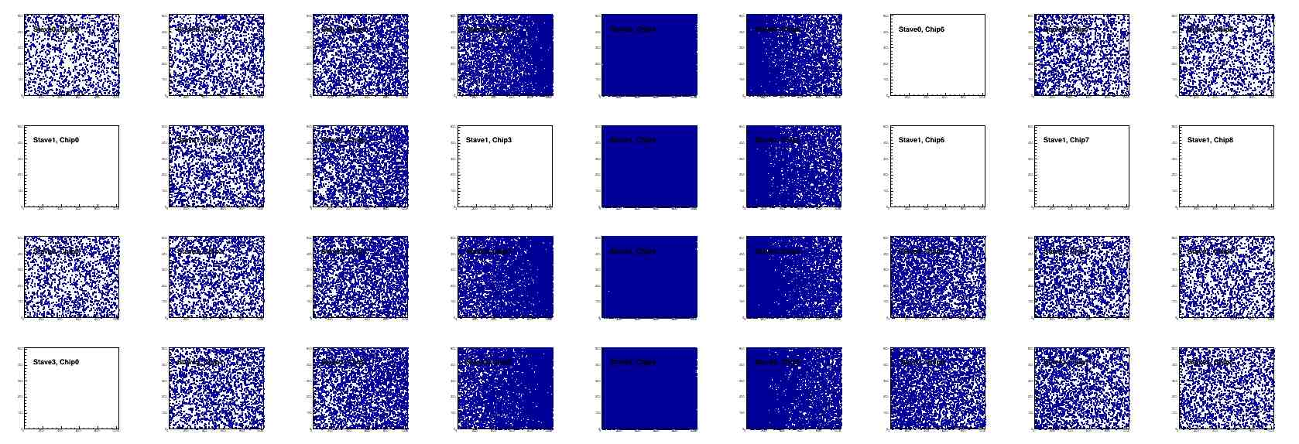
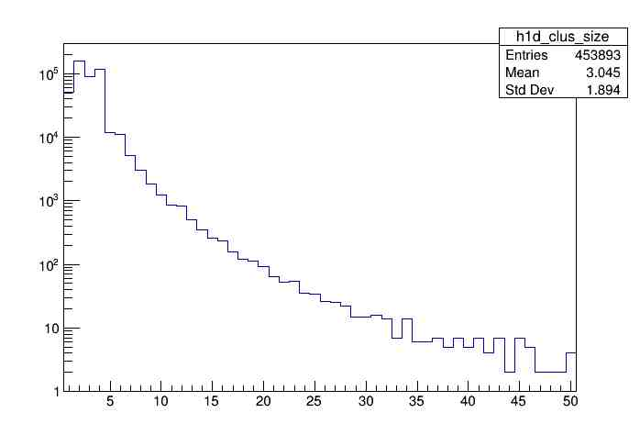
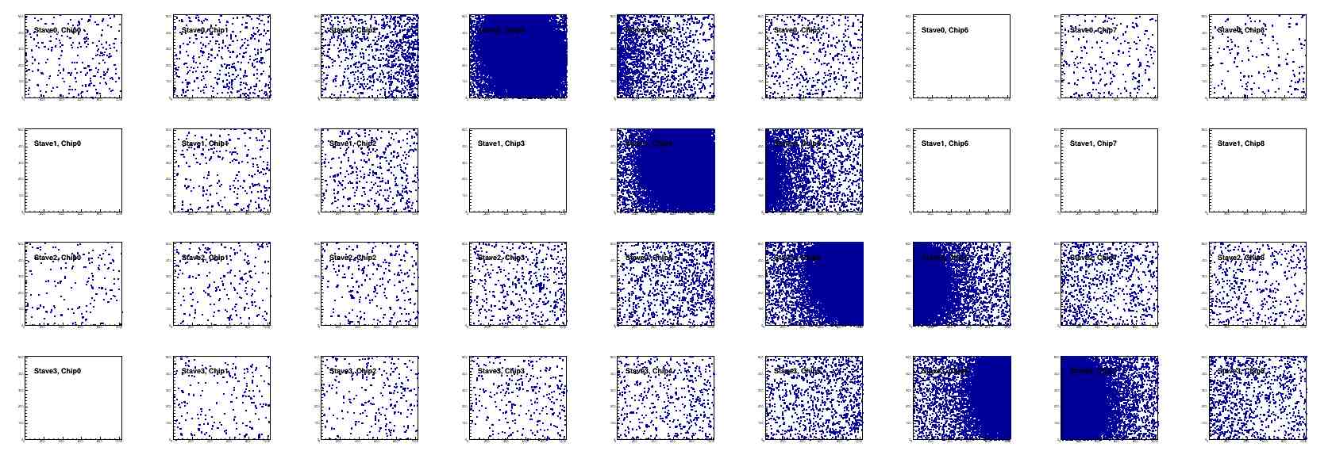
Offline Analysis: Cluster size vs Angle
To calibrate MC simulations and tracking
Stave geometry, alignment
Clustering
@ 0-degree
Cluster Size ~ 2.4
@ 40-deg
Cluster Size ~ 3.0

Slide 24
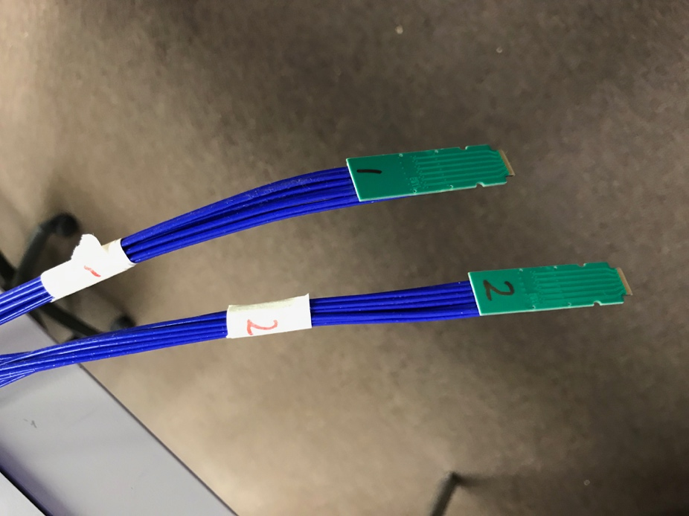
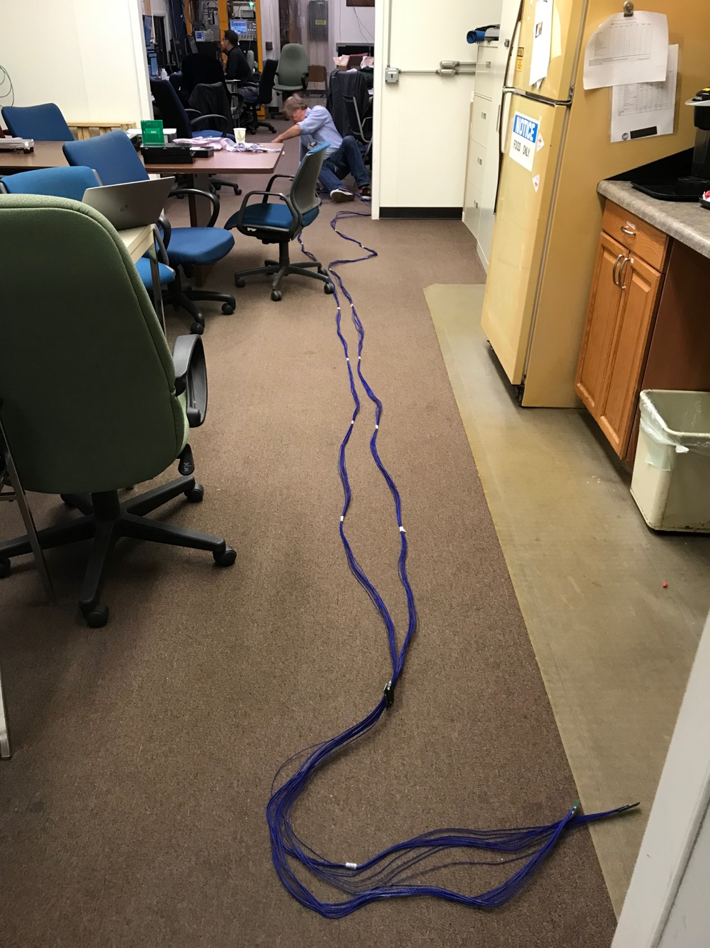
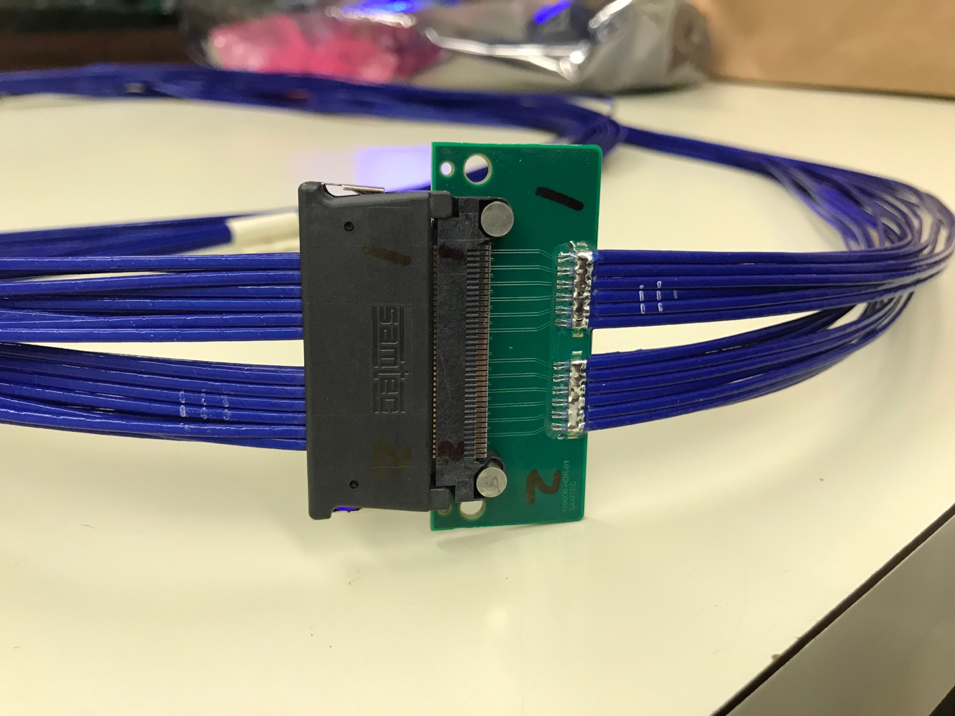
Confirmed New MVTX Long SamTec Readout Cables
8.8m + 2.6m = 11.4m (10m desired for sPHENIX; ALICE 8m cables)

Slide 25
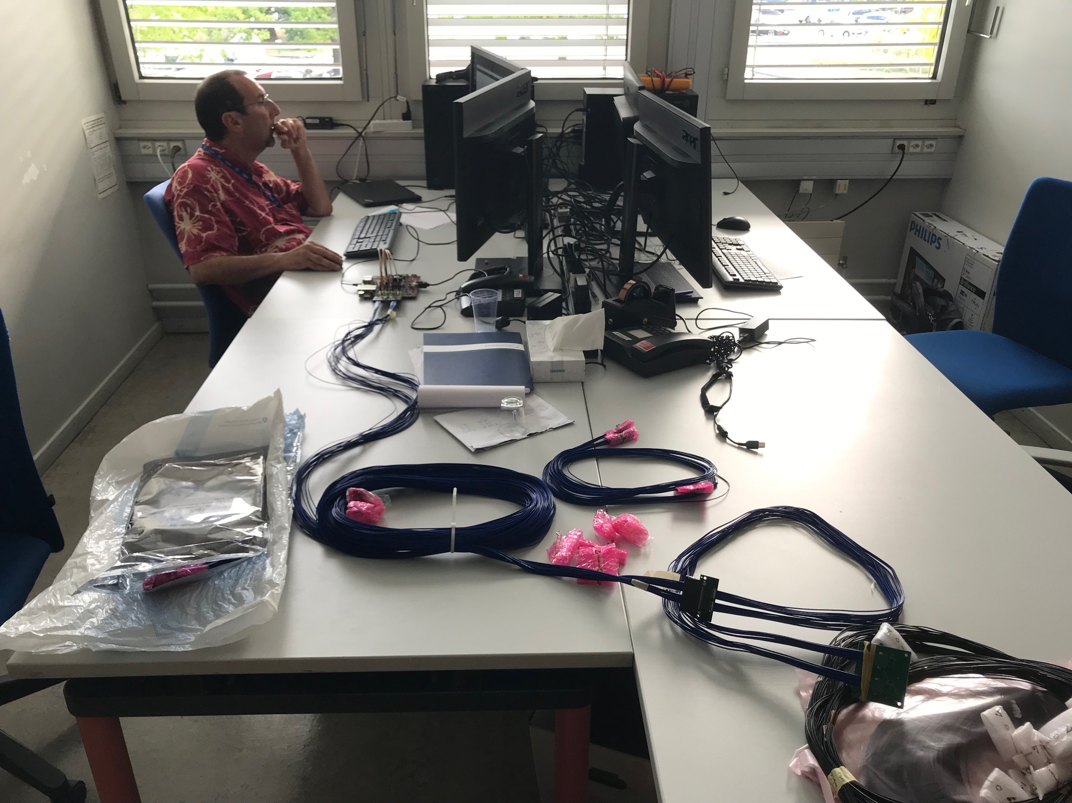
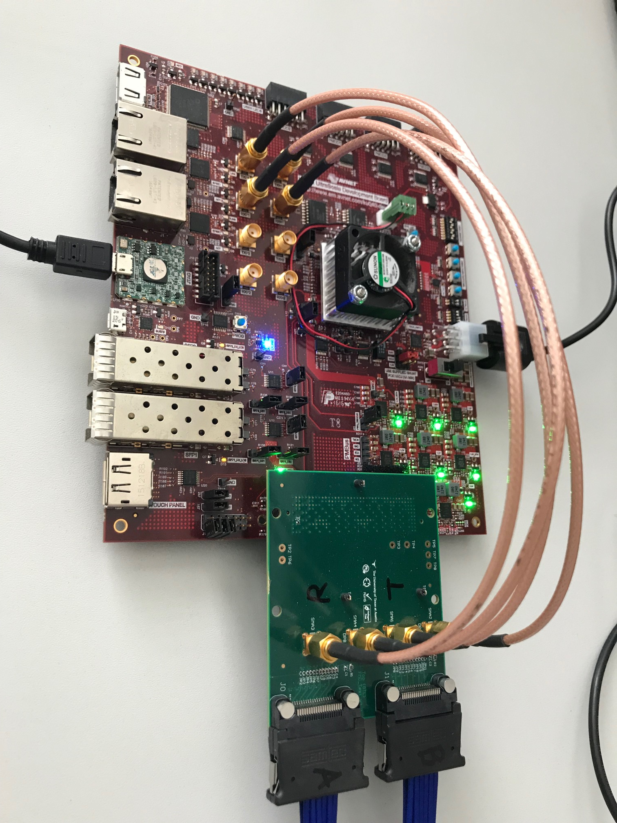
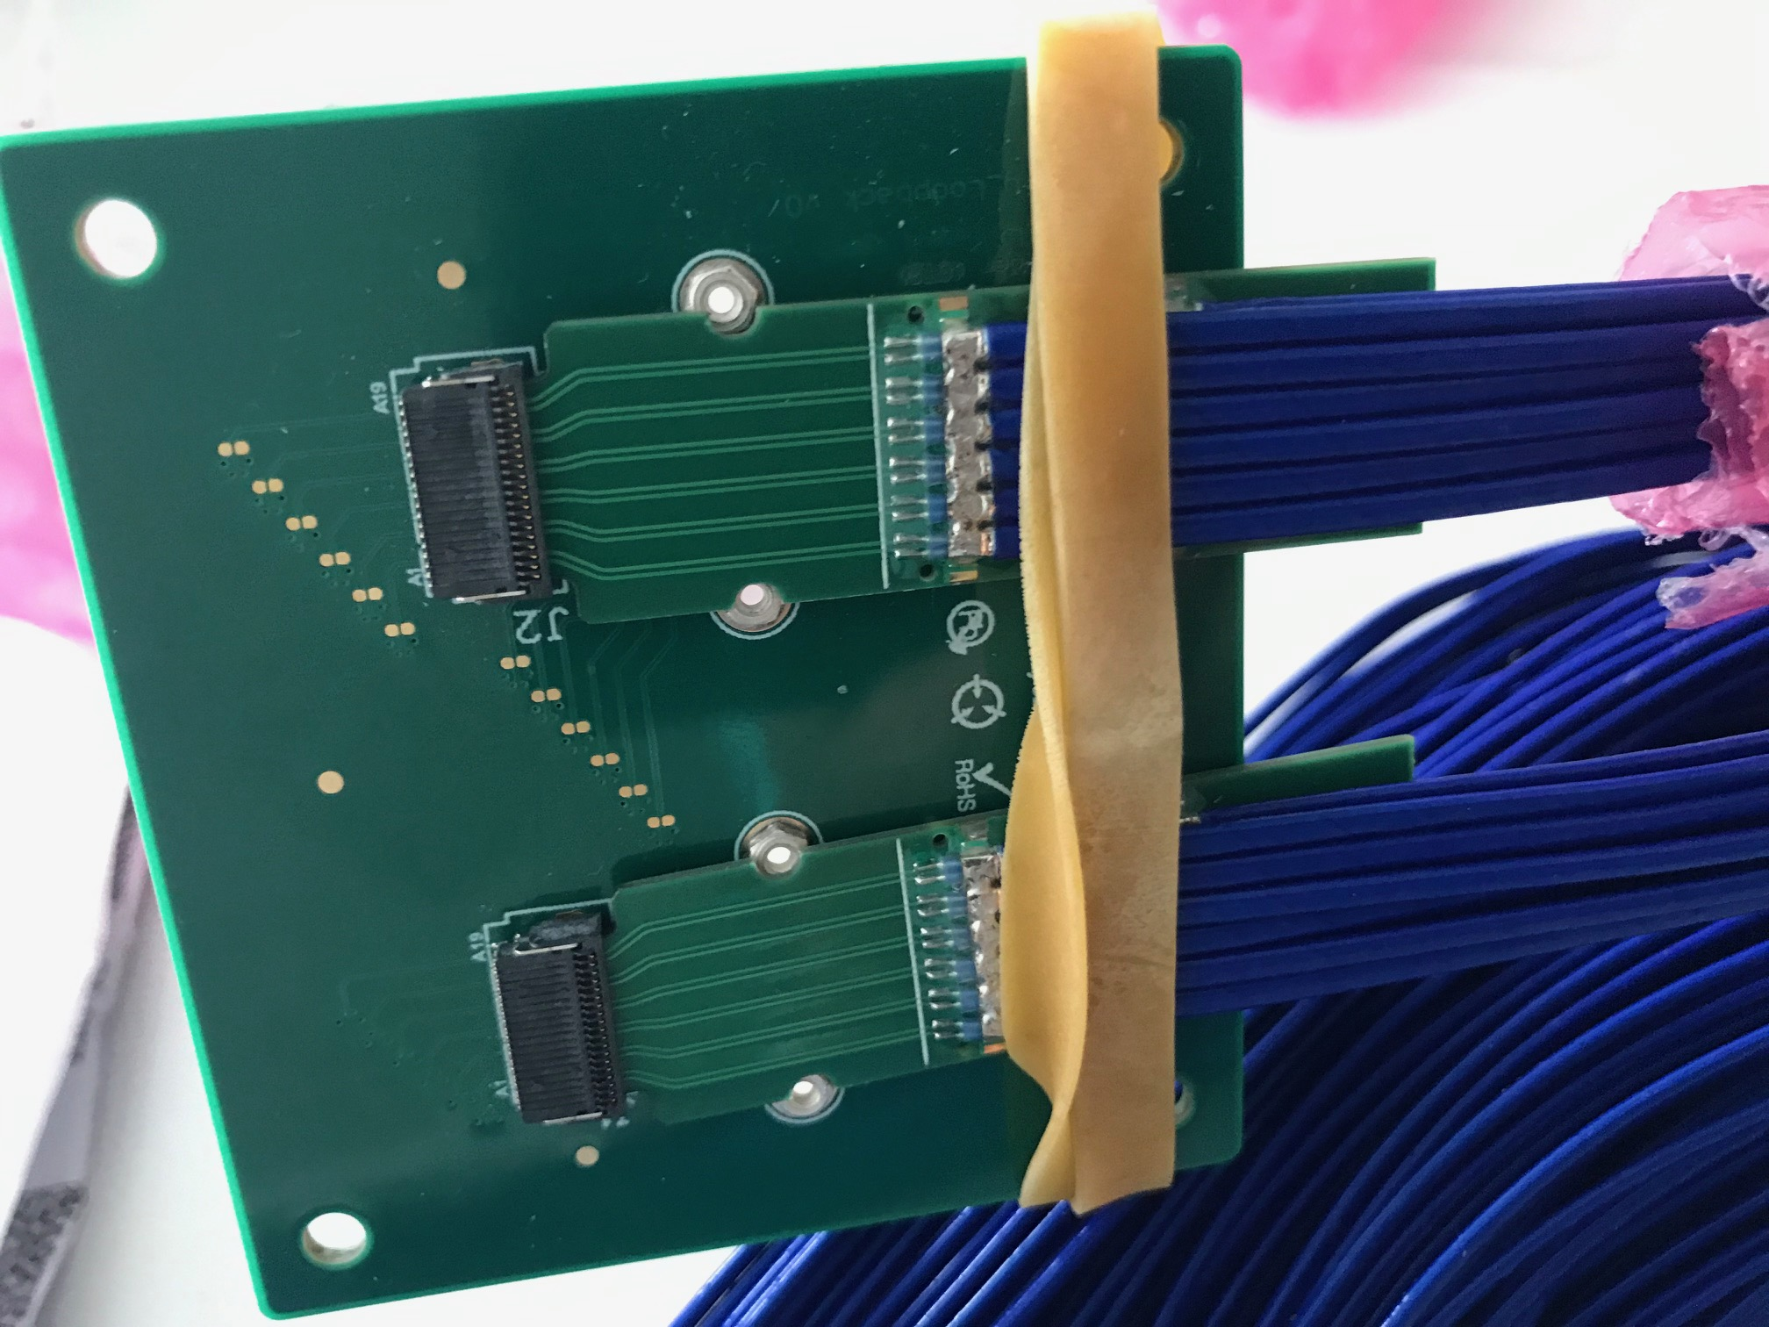
Jo is testing the sPHENIX readout cables
Nice job!

Slide 26
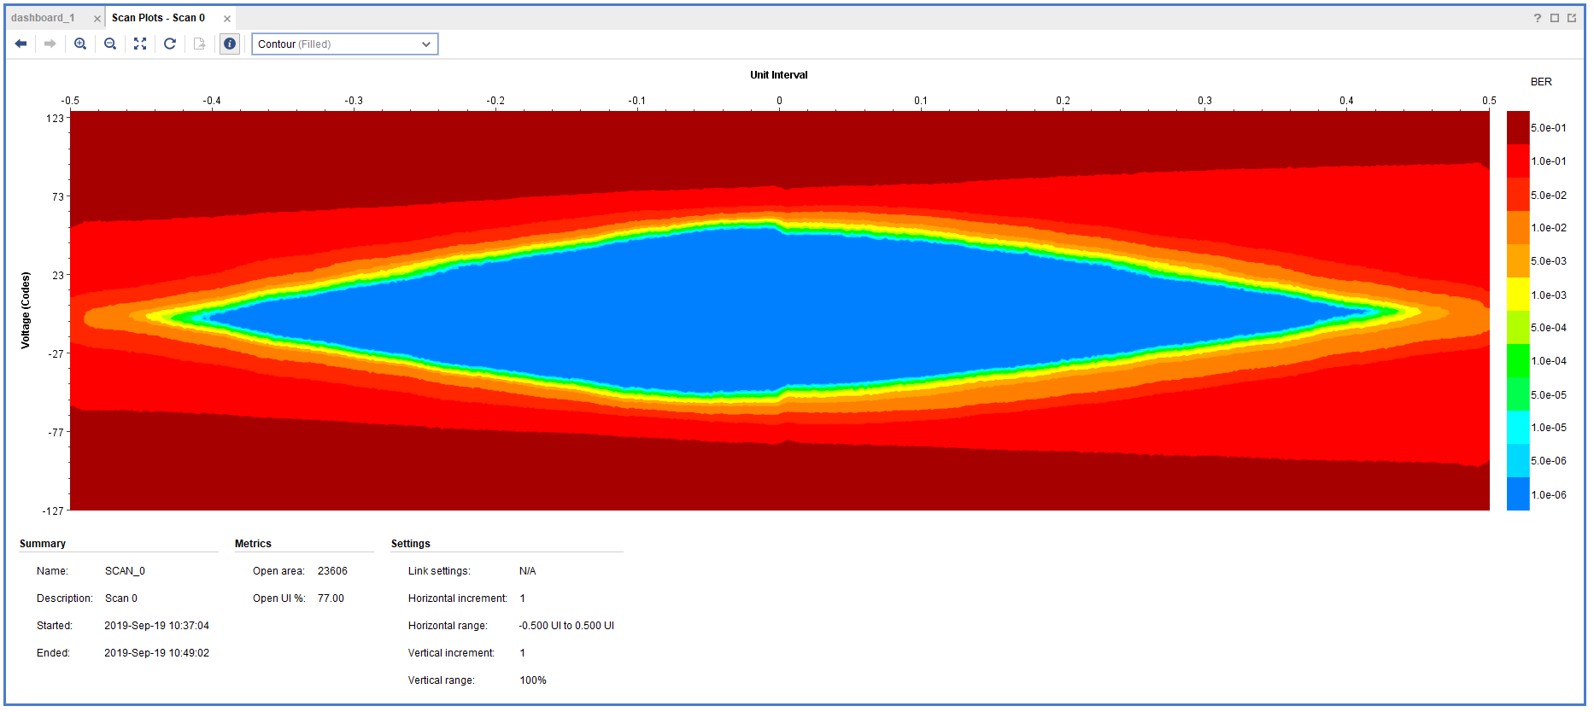
11.4m SamTec Readout Cable Test @CERN
Double looped readout cables:
  Effective length = 2 x 11.4 m = 22.8m
  Data rate: 1.2Gbps
  One overnight run, ~10hrs
  Error rate < 1.4 x10⁻¹⁴
^{Production cable: 11m (>10m)}

Slide 27
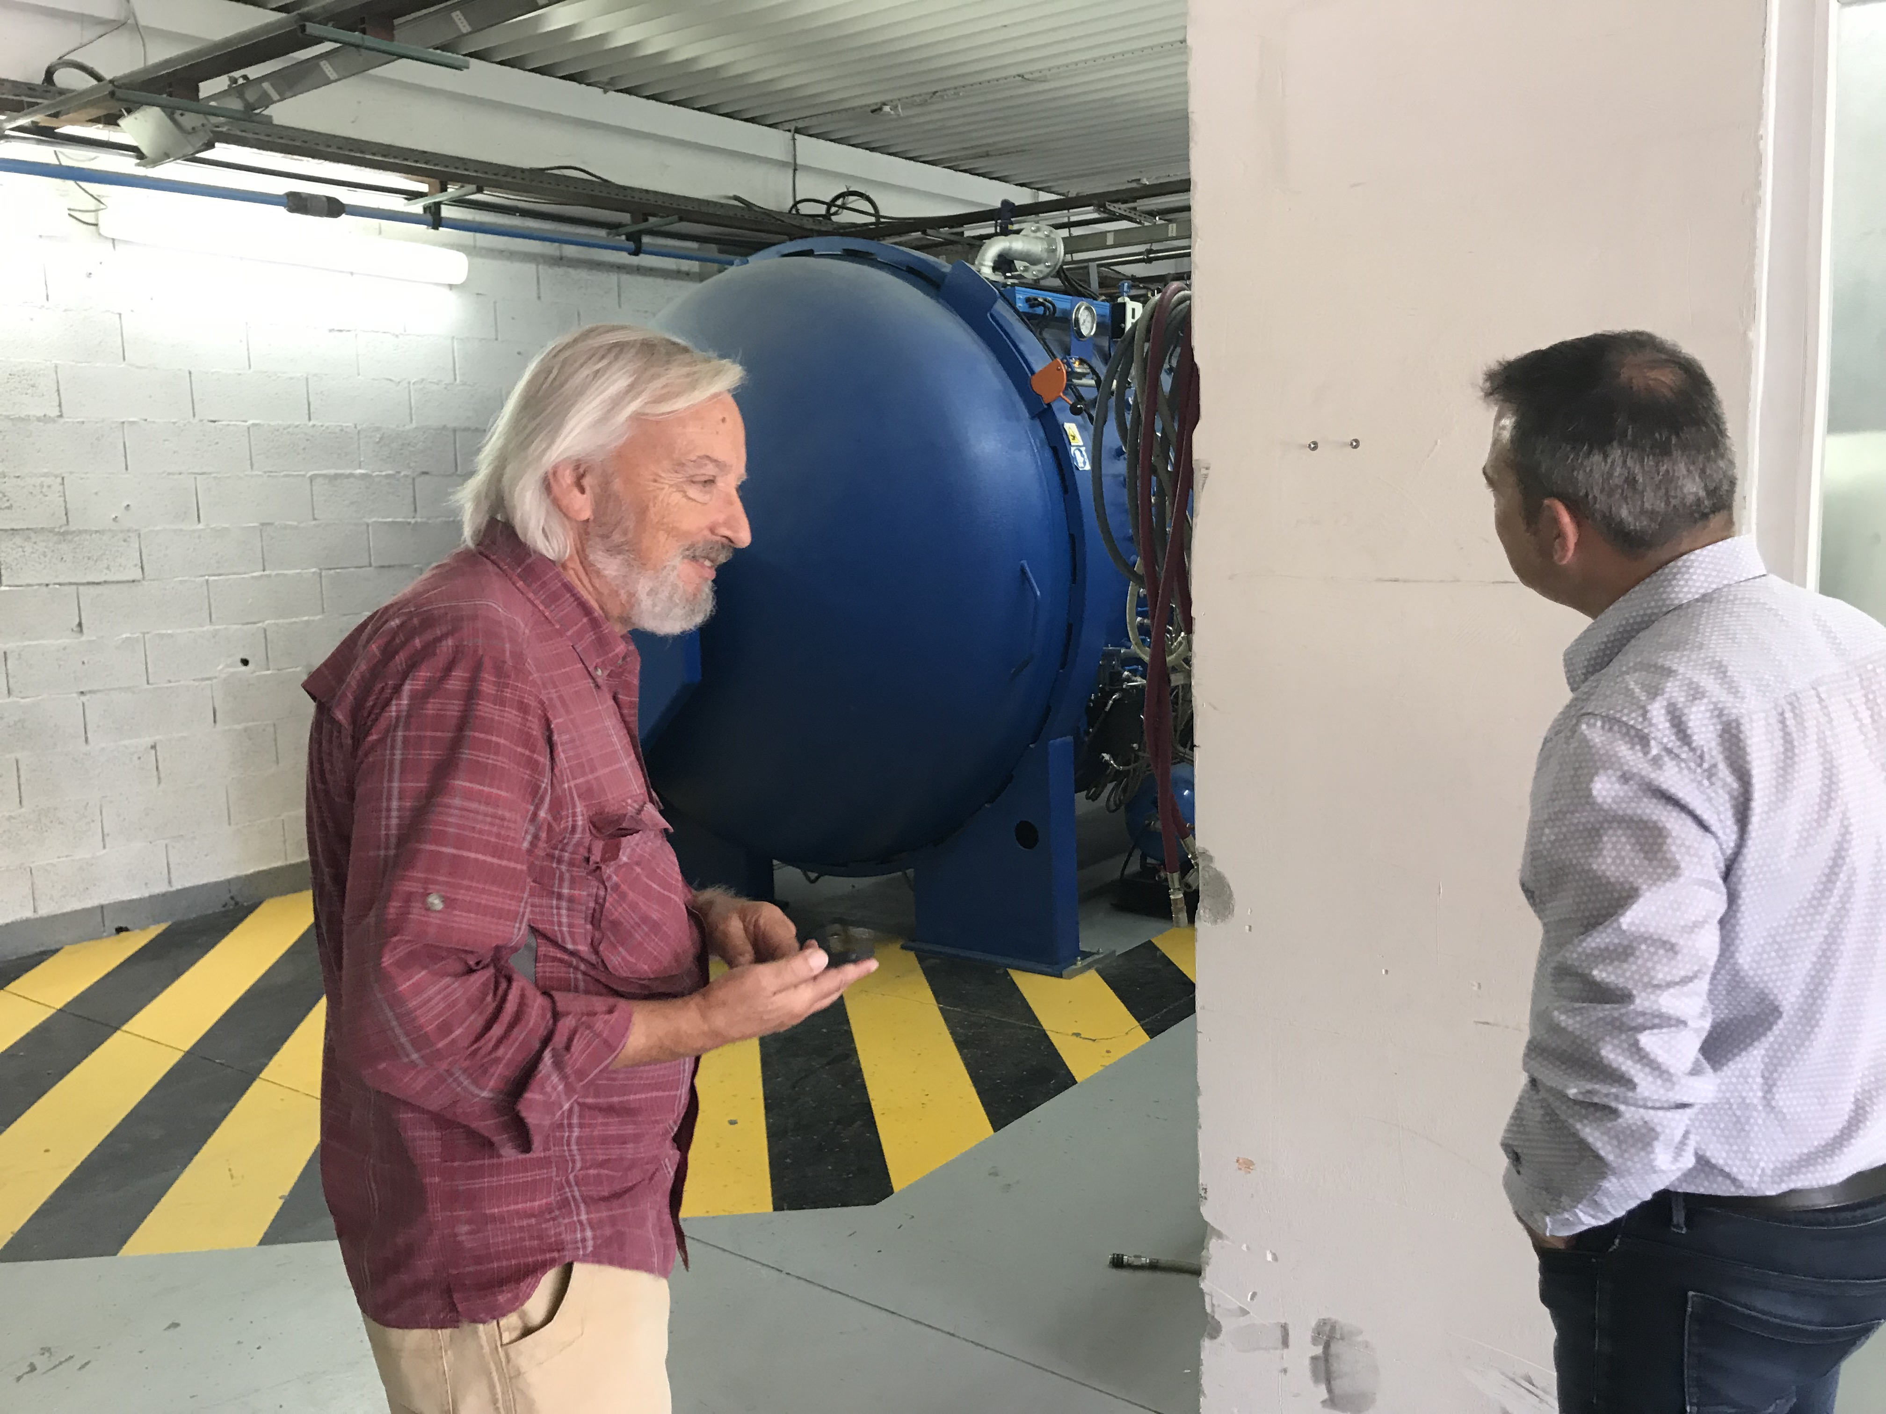
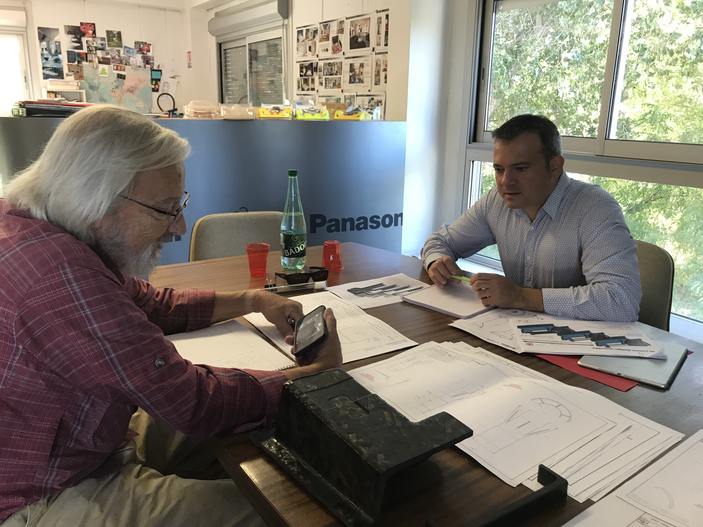
Carbon Structure Production
Visited WorkShape 9/19/2019
  Walt and Ming, Simon
WorkShape well prepared
  Updated the design files
MIT design work good progress, well ahead of time
  Early Carbon structure review for pre-production, Nov/Dec 2019?
Other companies, CA..
  Received quotes for CYSS, End-Wheels
LBNL in progress

Slide 28
sPHENIX Stave Production Started!
sPHENIX Production started in 9/2019
  Bi-weekly meeting on Thursday 5PM/CERN (9AM/LANL)
~10 staves/month
  Limited by Wire bonding , 2~3 staves/week
Production period: ~10 months
  Complete by the end of 2020
First stave production tick-off meeting 10/14
Show Antonello’s slides
- “The FPC production is well advanced, we have already the first batch of 24 pieces available.”
- ~200 golden chips available
- “The orders for the power extension cables and for the transport plates have been sent out.“
Discussed the work-package for the wire bonding last Friday 9/20/2019, 2~3 staves/week or ~10/month,

Slide 29
Final RU Board Tested at UT-A in October
60 sPHENIX RUs produced at CERN
10 RUs produced for LANL R&D
Visited UT-A, 10/14-18, 2019
Jo was available for the full week
Alex T. joined for one day to discuss readout firmware/software plan
10 RUs from LANL tested, all good!
  One bad transceiver, 1 out of 30, <~ 5%
Develop a plan for testing 60 sPHENIX RUs
Gerd, Yasser, Alex

Slide 30
R&D at LANL
Full ITS/IB QA testbench in operation
Python GUI developed for telescope readout and control operation
CAEN PS being tested

Slide 31
Summary: Near Term TO-DO List
Carbon structure cost estimate
  LBNL CF update
  Follow up with US vendors for quotes
  Select vendor(s) for pre-productoin
Continue mechanical system design
  CYSS, EW, SB
  Global insertion system design and full mockup
A full “8-stave + 8-RU + 1-FELIX + 1-PU + 1 GTM” chain test
  10 RU available
  1 PU arrived at LANL from LBNL
  8-stave/HICs telescope frame being designed
  RU & FELIX Firmware update in progress
  Slow control software & GUI
  A possible test beam run later this year
RU acceptance QA at UTA
  Initial test in October, 10RUs
Prepare for stave acceptance QA at LBNL
FELIX production and test
  Jointly with sPHENIX TPC, at BNL? Or LANL?
2019 test beam data analysis
sPHENIX Stave production at CERN
We will follow up the progress closely, production, Test & QA
- bi-weekly meetings with CERN
ITS system surface commissioning at CERN
Now --- May 2020
A good opportunity to learn about the
system operation and controls;
Working on a coordinated effort within MVTX/sPHENIX,
Signup page,
https://docs.google.com/spreadsheets/d/1YBAyouW8geJHUPpzRyLlzN4ePW4YzI8glI5xI66N3ww/edit#gid=0

Slide 32
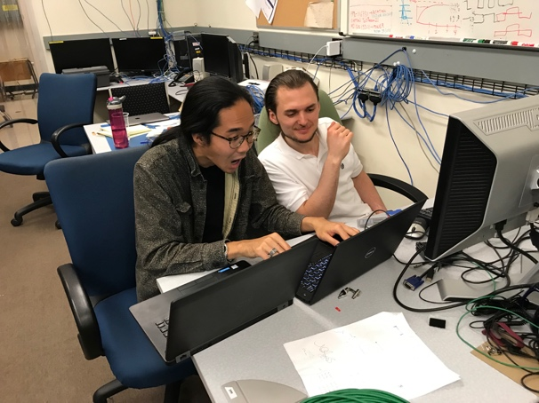
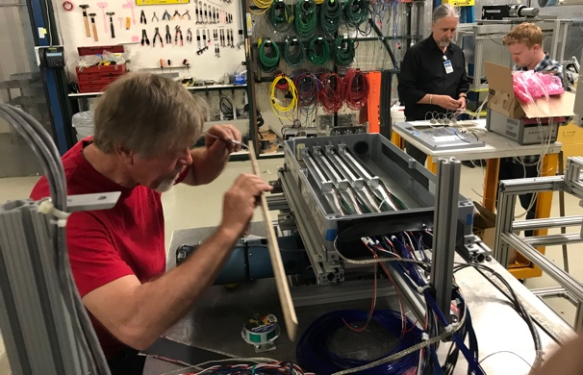
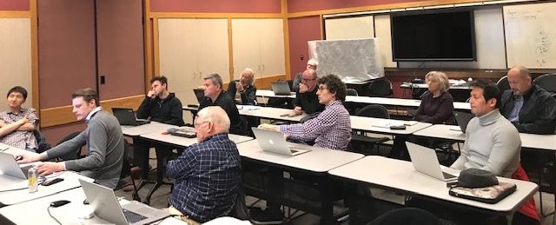
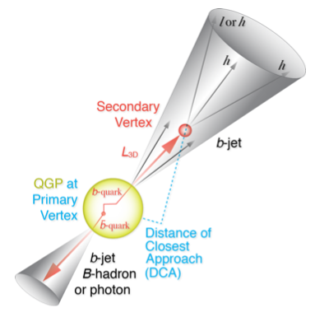
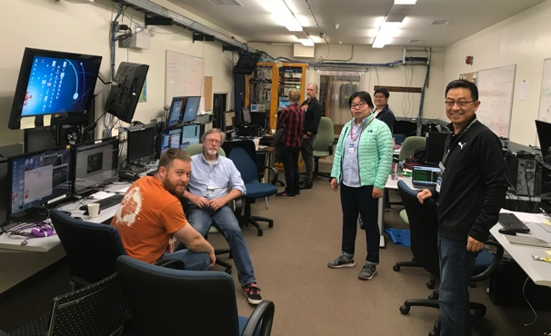
Summary
Completed essential R&D for readout integration
  Full 9-chip stave readout per RU
  Multi-RU readout per FELIX
  Long readout cables
  sPHENIX GTM
Completed preliminary mechanical design
Improve MC detector response, clustering – in progress
  Calibration data with incident angles, 0, 10,20,30,40,45
Stave and RU production at CERN - in good progress
July MVTX review response submitted to DOE
We are ready for the full production and the physics!

Slide 34
sPHENIX Timeline

Slide 35
Very Productive Visit to CERN
Walt Sondheim & Ming Liu
09/16-20, 2019
  sPHENIX 84 Staves production
  sPHENIX 60 RUs test plan
  sPHENIX SamTec cable test
  Carbon structure facility visit
  ITS Commissioning activities

Slide 36
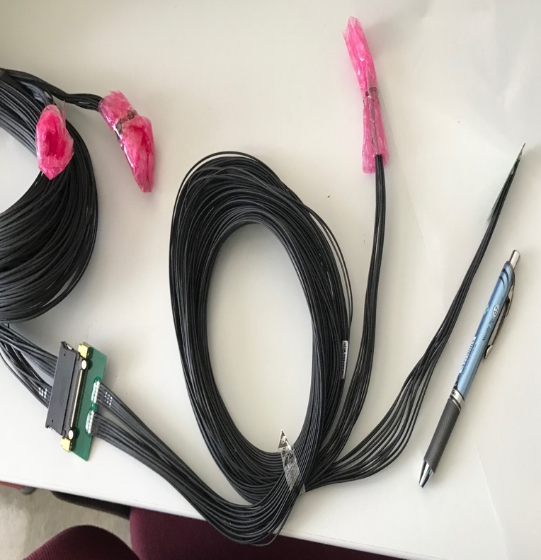
MVTX Readout and Power Cable Route
ALICE ITS/IB final readout cables: ~8m
Cable-B: 5.3m
Cable-A: 2.65m
PWR
RU
PU
sPHENIX MVTX: 7.9+m
  Cable-A: 1.4 m
  Cable-B: 6.5+ m
  Power cable:4.7+ m
Desired ~10m
BNL has approved “non-halogen free” cables for sPHENIX

Slide 37
MVTX Project Status & Plan
09/27/2019
MVTX Review response – received feedback on Thursday
  On-going discussions with sPHENIX project office, some edits and revision of PMP doc
  Produce a formal review response report, to ALD and BNL Project Office
  Smooth funding profile for FY20, plan-B
Full mechanical insertion mockup, MVTX/INTT/TPC
  cost & schedule in WBS2.x
Plan to start the MVTX production activities as soon as funds available
  Preparation for Stave and RU acceptance test & QA in US, LBNL and UT-A
  Carbon structure prototype production, site selection etc
Updates from recent CERN Visit, 9/16-20, 2019

Slide 38
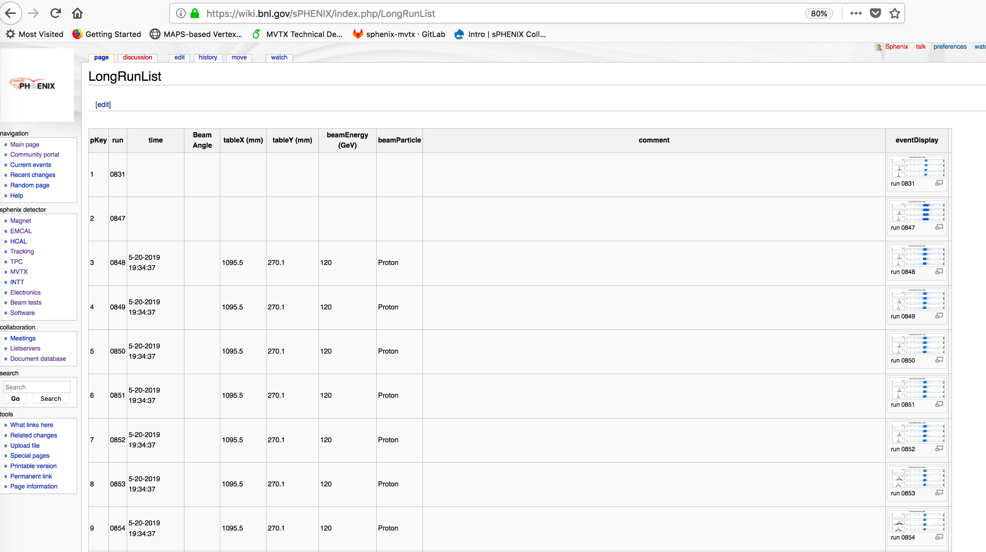
Data run-log in sPHENIX Wiki,
Nice work by Xiaochun et al. @GSU
Jin’s test beam analysis framework
Offline analysis in progress

Slide 39
MVTX Goals – the 2nd TB, 6/17-22, 2019
Test and confirm optimal MVTX operation parameters for sPHENIX
  Threshold scan, analogy shaping time etc.
  Study chip hit efficiency vs trigger(strobe) latency
    dT = 1 ~ 10 uS
    Impact on occupancy & pileup
Parameters predetermined from laser scan at LANL, in good progress
    Single chip readout with MOSAIC with pulsed laser (~MIP)
    Threshold and noise
    Analogy shaping time
    Strobe delay and length

Slide 40
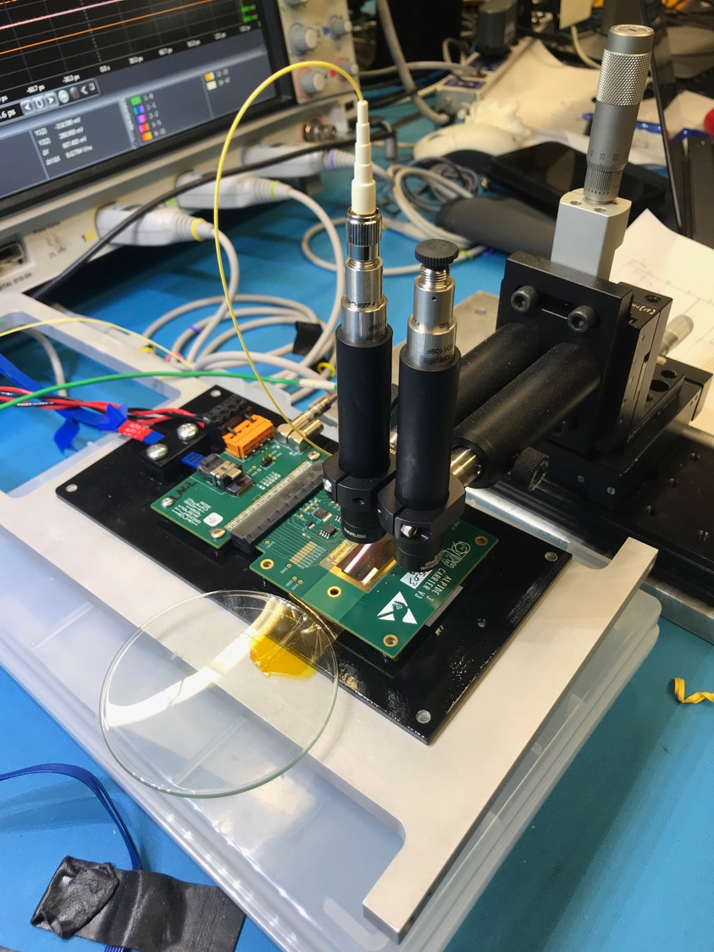
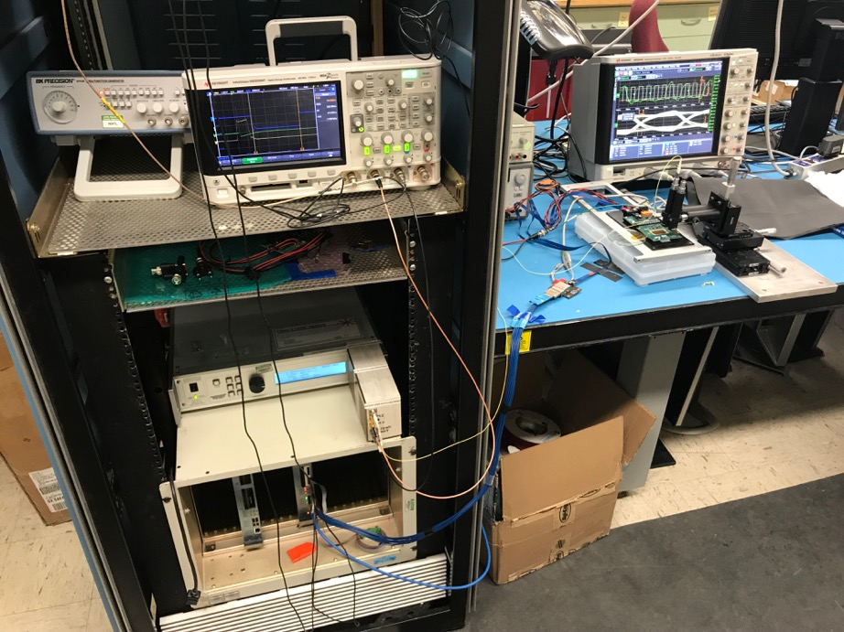
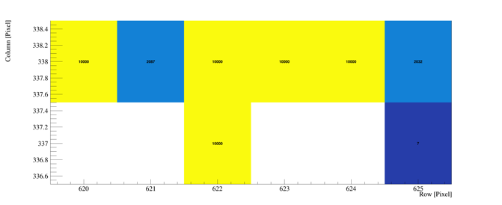
Study MAPS Performance with Pulsed Laser @LANL
Inject “MIP” signal, focused laser beam
  850 nm laser, 4ns wide pulse, ~1 MIP
  50kHz trigger
  Find optimal MAPS operating parameters
Laser system
MOSAIC Testbench
Pixel hits

Slide 41
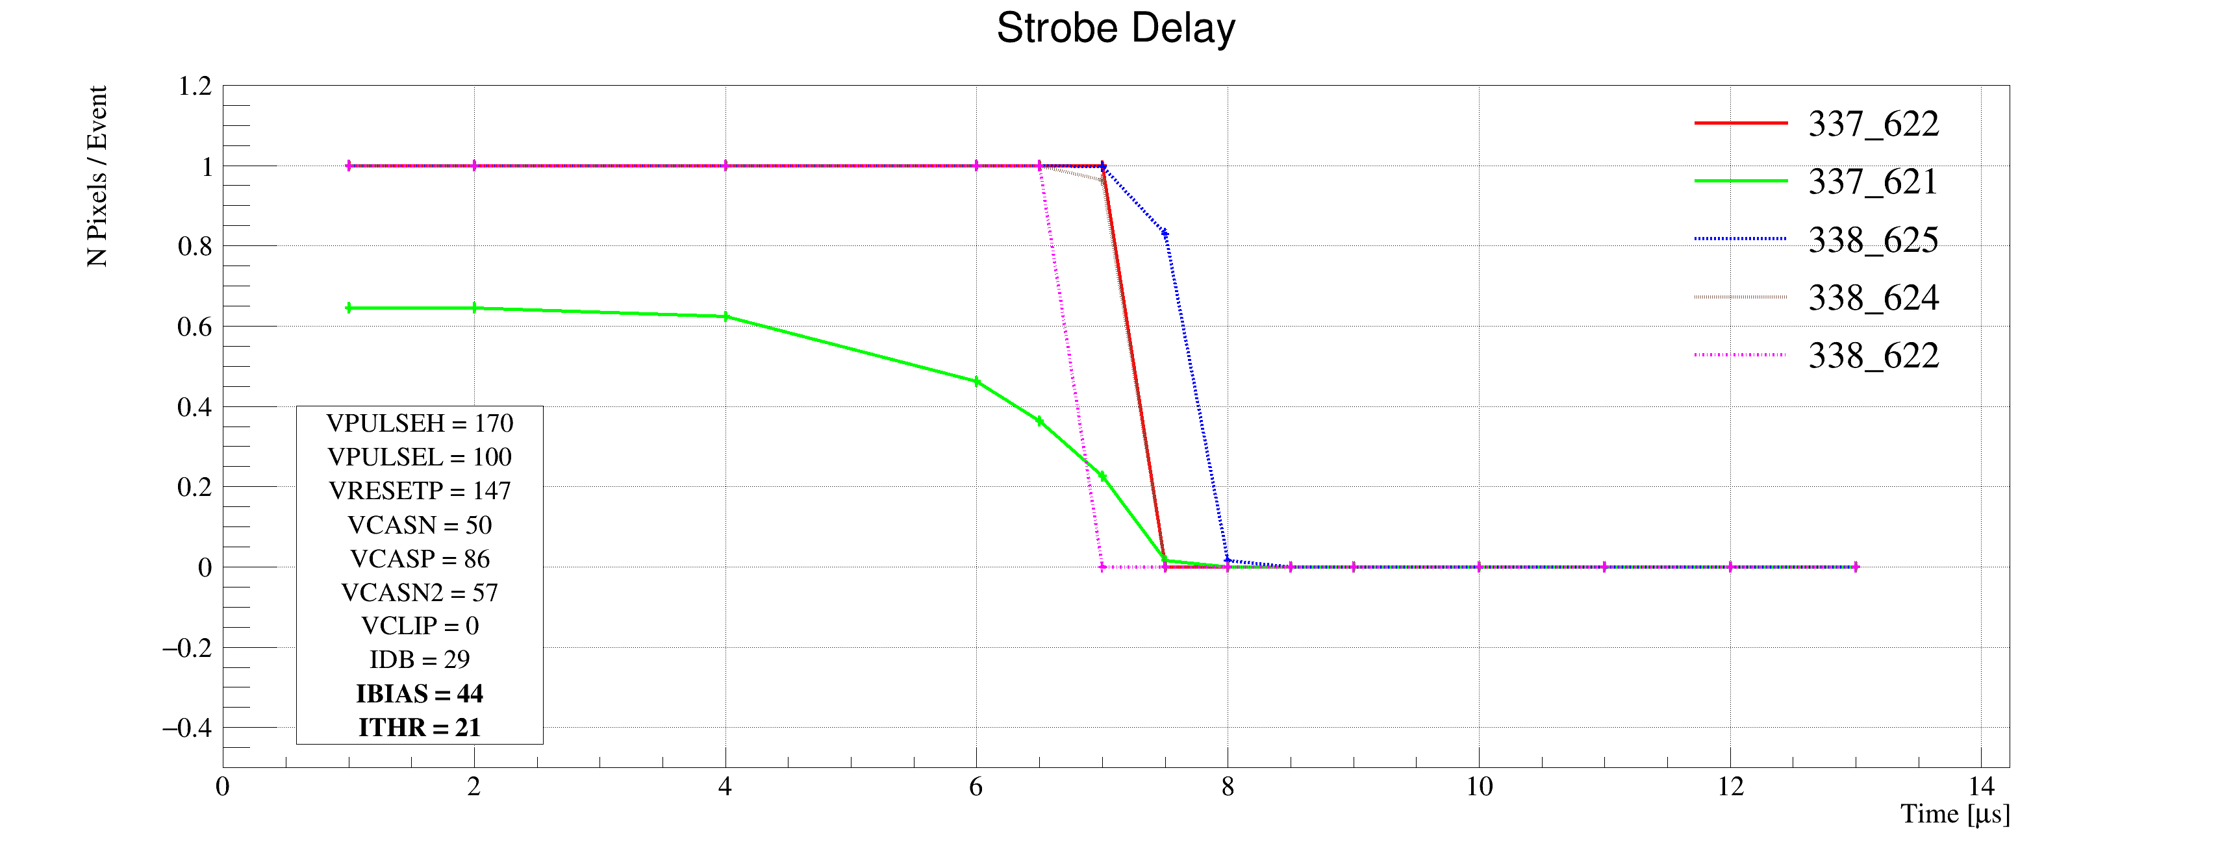
Laser Scan Data – Pixel Hit Efficiency vs Trigger Delay
One of “Stretched Settings” for sPHENIX trigger
MAX: 64 cells x 106nS = 6.8uS
Pixel (Row-Col)
Pixel (Row-Col)
~ 4.7 us
sPHENIX Trigger
~ 4.7 us
sPHENIX Trigger latency

Slide 42
MVTX experts help ALICE/ITS – to help us!
Dave’s talk
from Monday
ITS surface commissioning now:
~ May 2020
Great opportunity to learn about ITS/MVTX detectors
Training on technical details
Developing tools
Build up operation experience

Slide 43
MVTX Schedules and Milestones (3/2019) concerns & challenges
sPHENIX: CD1/3a PD2/3
Installation
1st collisions
CY-2018 | 2019 | 2020 | 2021 | 2022 | 2023
MVTX
Stave & RU
production
FELIX
production
Funding delays –
Stave production delayed at CERN
- Impact on following test & assembly
- preparation work @LBNL, UT-A
Lack of R&D $ for mech. desgin work
- MIT, LBNL, LANL
- “advanced cash” running out MIT, LANL
Detector mechanics design & production, global interface to sPHENIX
End Wheels
CYSS
Global integration
/interface design
Service barrel
design & production
Ready for beam;
sPHENIX day-1 run
Barrel Assembly & Testing @LBNL
Install half barrels
@sPHENIX IR
Half barrel #1
Power system
production
Half barrel #2
Half barrels
arrive @BNL
design & procure
interface to
sPHENIX rails
Running low in schedule contingency …
Design & procure
sPHENIX rails
MVTX installation & commissioning @BNL
RU, FELIX, PS, cables etc.

Slide 44
Report from April BNL PD2/3 Reviews: Silicon Detectors - MVTX, INTT

Slide 45
MVTX Risks - all in P6 now
WBS, PMP documents updated
Schedule & Labor profile updated in P6
(Glenn, Irina )
Need project fund NOW to meet the goals!

Slide 47
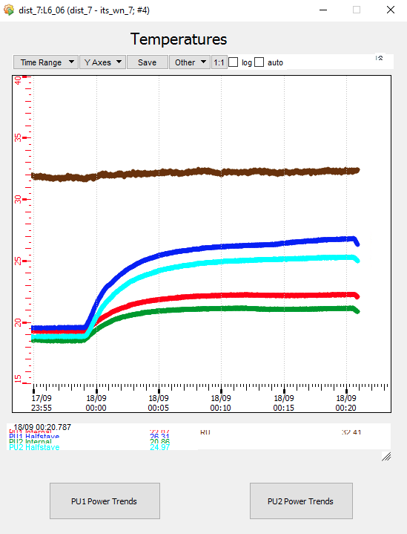
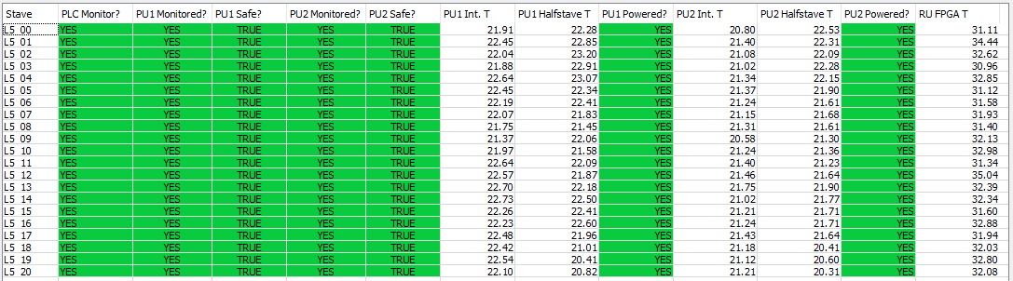
ITS Surface Commissioning
A lot of activities
Also require a lot of shifts, and EXPERTS!
Current status:
  Turn on layers, stave-be-stave, checking V,I,T
  Safety interlock important

Slide 49



R&D Highlights
Very successful TB at Fermilab, 5/13-25, 2019
  Confirmed the long 11.4m SamTec readout cable
  Confirmed the full stave readout
  Confirmed multi-RU readout per FELIX
  Confirmed sPHENIX GTM with FELIX
A 2nd TB, study optimal MAPS operation points
  Parasitic with INTT+TPC, 6/17-21
Preliminary mechanical design developed
  To prototype CYSS and Layer-2 End-Wheel this summer
  France, Italy, CERN, contacted and under discussion
Improve MC detector response, clustering – in progress
  Took calibration data with incident angles, 0, 10,20,30,40,45
TB later at LBNL/LANL – in preparation
  Scan stave material budget with 50MeV p-beam
  8-stave + 8-RU +1-PU + 1-FELIX + 1-GTM + RCDAQ, the full complete readout chain
    Hardware will be available soon

Slide 50



Monolithic Active Pixel Sensors (MAPS)
The Next-Generation, State-of-the-Art Pixel Tracker
Advantages of ALICE PIxel DEtector (ALPIDE) sensor:
Very fine pitch (27μm x 29μm), for superb spatial resolution
High efficiency (>99%) and low noise (<10⁻⁶), for excellent tracking
Time resolution, as low as ~5 μs, for less pileup
Ultra-thin/low mass, 50μm (~0.3% X₀), for less multiple scatterings
0.5M channels with on-pixel digitization, for zero-suppression and fast readout
Low power dissipation, 40mW/cm², for minimal service materials
An ideal detector for QGP physics!
Flexible Printed Circuit(FPC)
9 Chips
Cold plate
A 9-chip MAPS stave, 1.5cm x 27cm
ALPIDE design
ALPIDE sensor:
1.5cm x 3.0cm, 0.5M pixels
50 μm
~28 μm

Slide 51


MVTX Full Readout Chain Demonstrated (3/2018)
4-MAPS
telescope
Fermilab Test Beam: Feb-Mar, 2018
Tracking spatial resolution
achieved: <5 um
120 GeV proton
beam
4-hit track
4-MAPS telescope

Slide 52

MVTX Test Beam, May 2019
MVTX

Slide 53



Run Types – Details being documented in MVTX wiki
From Xiaochun
Run0978
Horizontal stave scans (many good runs)
Vertical stave scans
Angular stave scans and tilted runs
Electron beam at 5 GeV (one long run)
Extruded aluminum & Lead-block runs
Run0877
Run1040

Slide 54

4-stave Telescope
120GeV p-beam
2 RUs,
PU,
PS
Negative Pressure Cooling System
Motion Table
(X,Y,Phi)

Slide 55


First Collision Signals
sPHENIX GTM

Slide 56


Staves, RUs, PU etc.
2 RUs
PU

Slide 57

120GeV p-beam
120GeV p-beam
Telescope
Telescope
RUs & PU
Cooling System;
negative pressure
@-30%ATMP (-5PSI)

Slide 58

When MAPS parameters off the optimal point, less hits collected

Slide 59

No hits seen when MAPS parameters far-off the optimal point

Slide 60


Installation

Slide 61


The Team @Fermilab
Data taking shift in the evenings: 7PM – 7AM
Beam: every other Monday –Friday 8:00AM – 8AM
Matt, Hubert, Cameron, Gerd, Zongze,
Xuan, Xiaochun, photo by Ming
Sho, AlexT
Not shown: Sanghoon, Yasser, Martin, Walt,
Abel. Chris …

Slide 62
3-D event Display: p+Pb collision
Cameron
Stave-4
Stave-3
Stave-2
Stave-1

Slide 63


Offline Analysis: Cluster size vs Angle
Run 877, angle – 30 dgr
Cluster Size = 2.7

Slide 64
Offline Analysis: Cluster size vs Angle
Run , angle = 40
Cluster Size ~ 3.0
More work follows by Yasser, Sanghoon et al
Everyone is welcome to join the effort!
Stave geometry
Stave alignment
Clustering
Tracking
Update MVTX MC response in GEANT

