Slide 1

MVTX Overview
Document: sPH-HF-2018-001
https://indico.bnl.gov/event/4072/
Ming Liu
LANL
sPHENIX Collaboration Meeting
July 8-9, 2019, Lehigh University, PA

Slide 2

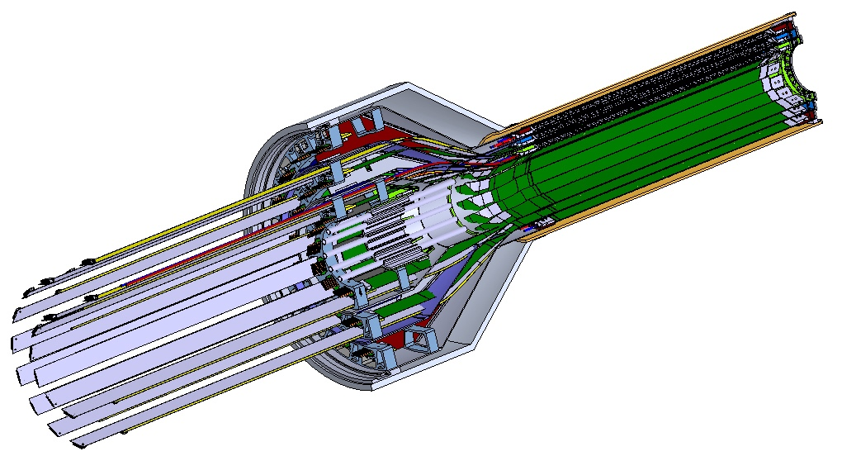
MVTX Detector – Modified from ALICE/ITS Design
Service cone: signal, power, cooling
and mechanical support
CYSS: Cylindrical Shell Structure
End-Wheel
Extended power FPC
3-layer sensor barrel
- 48 staves, 432 chips
MVTX
parameters

Slide 3
Scope of the MVTX Project - WBS3.2
MVTX sensor & Electronics
  Readout Integration
    Frontend: ALICE/ITS RU
    Backend: ATLAS FELIX
  Assembly & production @US: ~$5M
    QA & assembly
      RU boards @UT-A
      Half detectors @LBNL
      FELIX boards @LANL/BNL, 6+spares(2)
    Ancillary systems - “adopt” ALICE ITS system
      Power, slow control & monitoring etc.
Mechanical system
  Modify ALICE/ITS mechanical structures
    End Wheels
    Cylindrical structure shells
    Service half barrels
  Mechanical system integration,
    Design & simulations, MIT/LANL
    Composite structure production, LBNL
    Non-composite structure, MIT
    Installation tooling etc., BNL/LANL/MIT/LBNL
  Adopt ALICE cooling plant design
    Modifications to fit sPHENIX, MIT/BNL
  Production @CERN: $1.36M, a separate BNL project
    - 84 ALICE/ITS-IB (modified) staves from CERN
      Acceptance test @LBNL, 48+spares(2-inner layers+)
    - 60 ALICE/ITS-RU from CERN
      Acceptance test @UT-Austin, 48+spares(12)

Slide 4
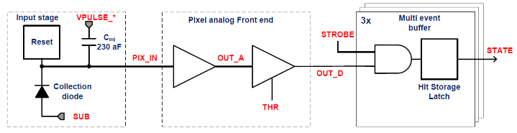
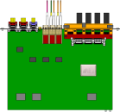

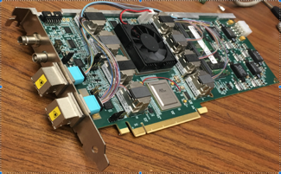

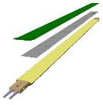
MVTX Readout, Power and Controls
CAN bus
DCS
Slow control
Mike’s talk
Trigger & Clock
Readout Unit
Front End
GBT Optical Links
one pixel
9 Data (1.2Gbps)
1 Clock, 1 Control/Trigger
Control
Data (9.6 Gb/s max)
Trigger
9-sensor Stave
Samtec Twinax “FireFly”, ~10m
FELIX
Back End
FPC
Power
ATLAS Front-End Link eXchange (FELIX):
sPHENIX Data Aggregation Module(DAM)
Alpide Sensors
Flex PCB Filtering Capacitors
regulators
Power
Regulated Power
CAEN Power supplies
Cold Plate
ALPIDE pixel:
Shaping
Digitization
Zero-suppression
3x buffer
Power Board
Interaction Region
Experimental Hall
Counting House
MVTX Detector Electronics consists of three parts
Sensor-Stave (9 ALPIDE chips) | Front End-Readout Unit | Back End-FELIX/DAM

Slide 5
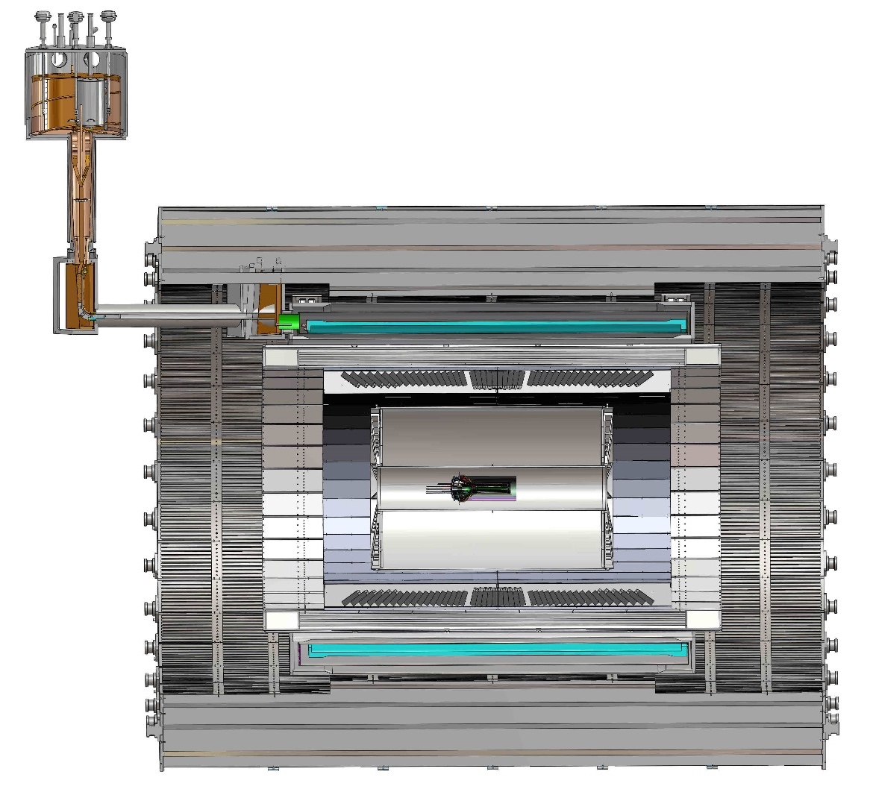
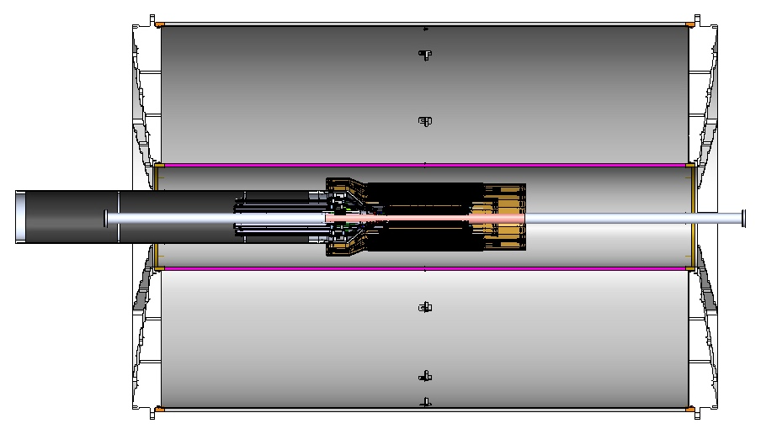
MVTX Global Mechanical System Integration
MVTX system preliminary design, with two parts:
  Part-1: from MVTX to PP-1b, all power PCB, 40cm
  Part-2: length TBD later, from PP-1b to PP-2
Service Barrel
TPC
TPC
INTT
MVTX
PP-1a:
short signal cables
PP-2:
Signal and power cables
R= 209.6cm
PP-1b:
power cables
L = 350.0 cm

Slide 6
Preliminary Mechanical Design Completed
Ross’ talk
https://indico.bnl.gov/event/6377/
MVTX, INTT, TPC …

Slide 7
Project Status Update
Confirmed long SamTec readout cables recently – last key integration R&D
  11.4m long cables, > 10m desired length
MVTX mechanical design: excellent progress
  Asked for quotes from outside companies based on preliminary designs
  sPHENIX integration workfest scheduled 7/10 @BNL, MVTX/INTT/TPC…
Release of early R&D fund in progress
  MVTX mechanical engineering design, MIT/LANL
  Preparation for Stave and RU acceptance test, LBNL, UT-Austin
MVTX Cost & Schedule Review – we are ready for full production
  July 29-30 @BNL
  WBS, PMP, Risk Registry, P6 being updated
Stave and RU production at CERN
  DOE Fund arrived at UTK/US-ALICE
  Procurement in progress
    CERN is ready to proceed with stave production
    60 MVTX RUs delivered to CERN
  Power mezzanine and transition boards produced at UT-A

Slide 8
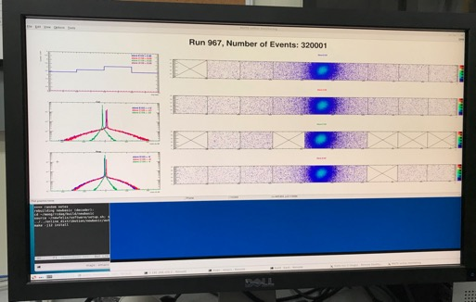
Very Successful Test Beam @Fermilab
5/20-25, 6/17-22, 2019
SamTec: 11.4m
(2.6m+8.8m)
4-stave telescope
RU-2: 1 stave
- 1 fully functioning
9-chip stave;
- 3 staves with a few
broken sensors
4 staves
2 RUv1.1
1 PU
1 FELIX Server + RCDAQ
sPHENIX GTM
11.4m Custom SamTec Cable
Negative pressured cooling for staves
RU-1: 3 staves
5m SamTec
120GeV p-beam
10kHz (30kHz)
Beam intensity:
30k ~ 120k ppp
Data & Control
Beam Trigger
Timing & Trigger
GTM
FELIX
Online Monitoring
RCDAQ
A full system with final sensor/readout* hardware:
Multi-Stave + Multi-RU -> FELIX readout demonstrated
sPHENIX GTM integrated
Long readout SamTec cable certified
Cooling system demonstrated
* RUv1.1 identical to the final RUv2 electrically

Slide 9
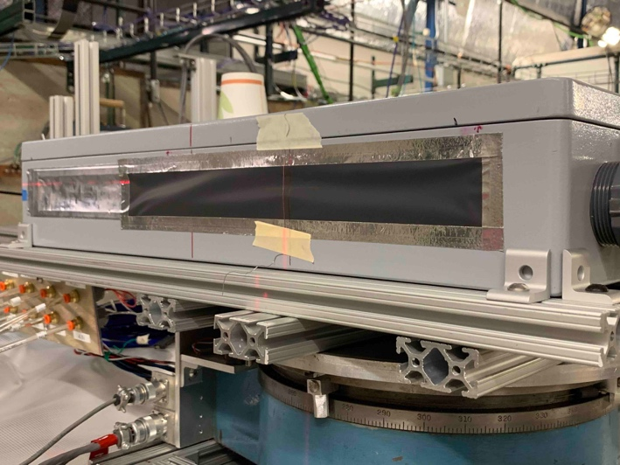
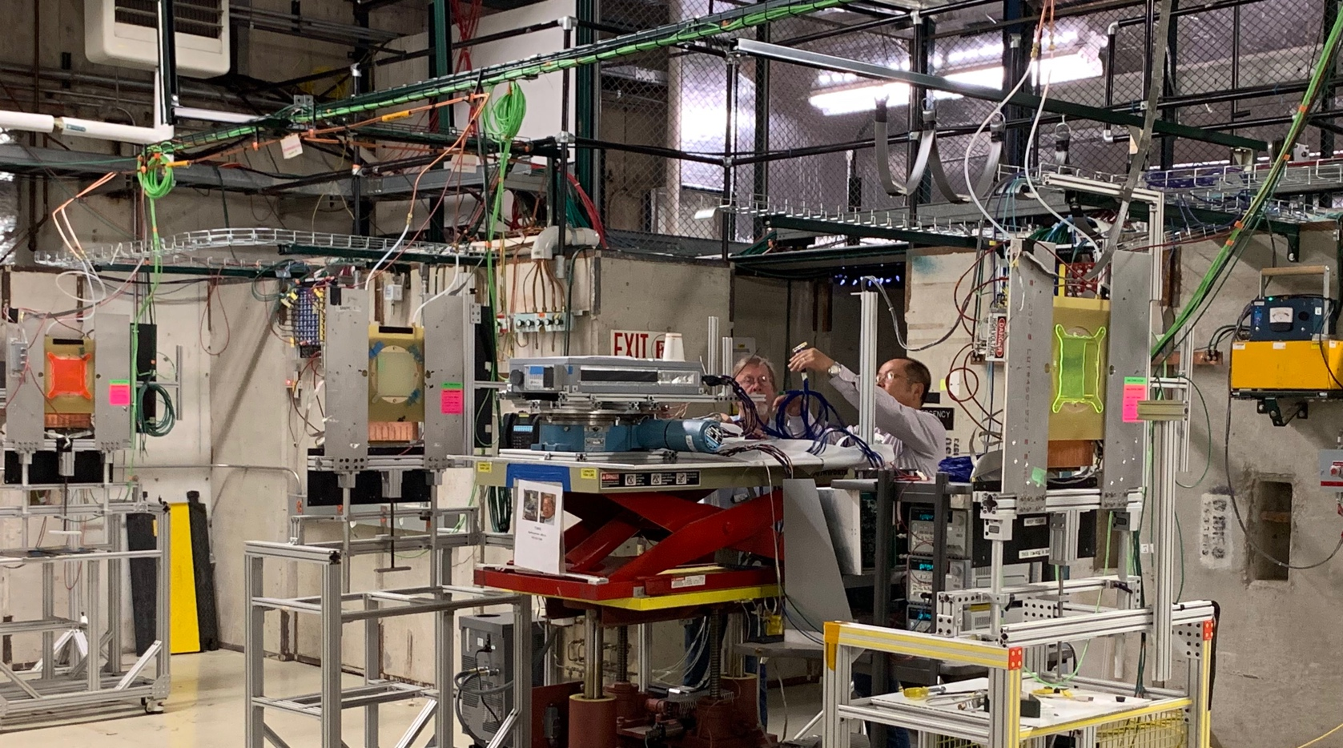
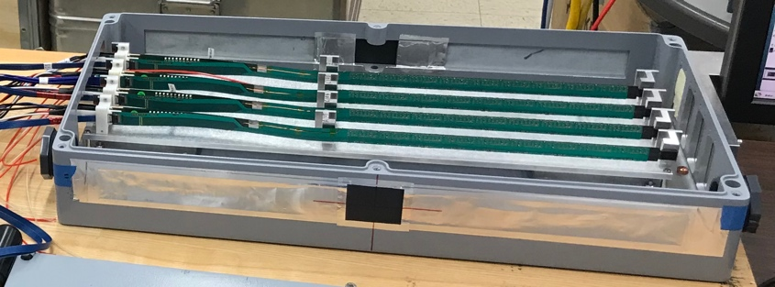
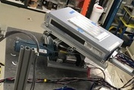
2019 MVTX Test Setup
From view
beam
Stave housing (four staves)
Stave housing sits on a motion table which can be moved in (x, y) plane perpendicular to the nominal beam direction. It can also be rotated (+40, -40) degrees (see photo on right). Operation was done at counting house.

Slide 10
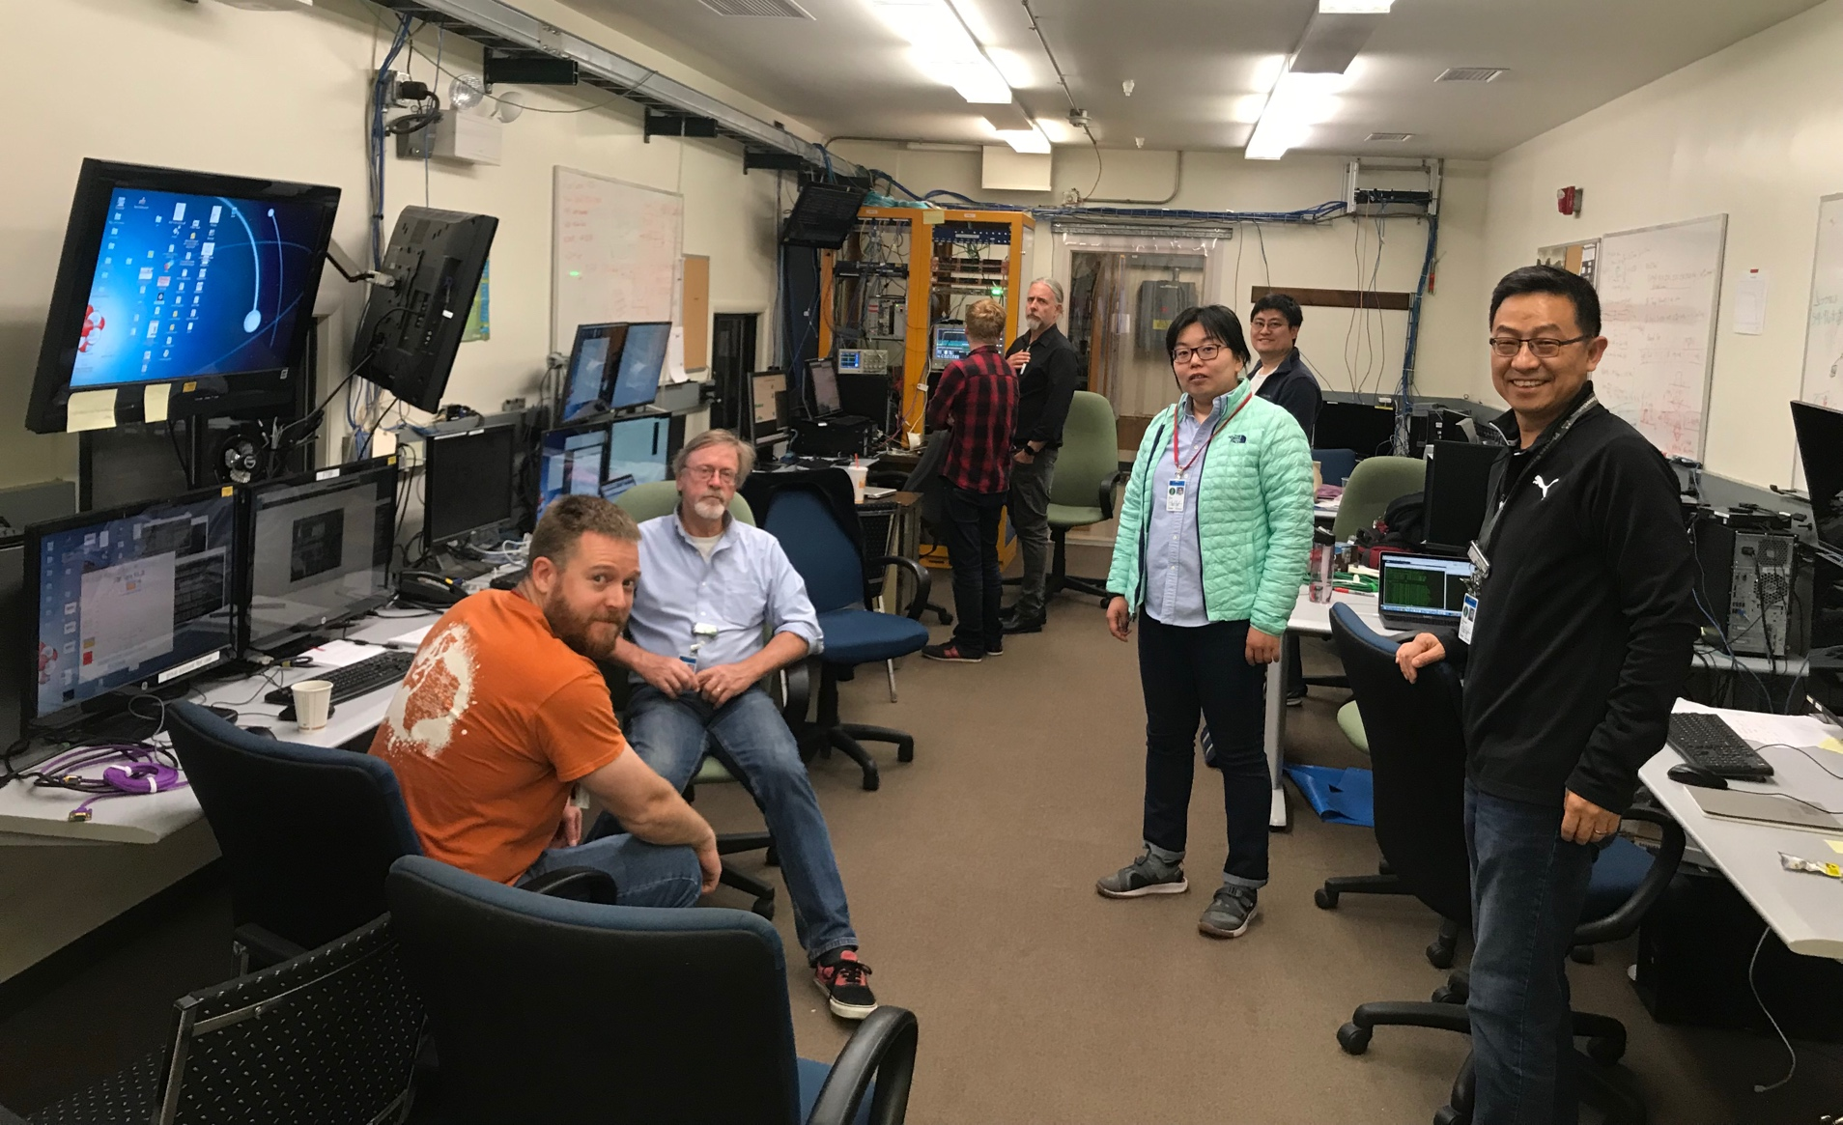
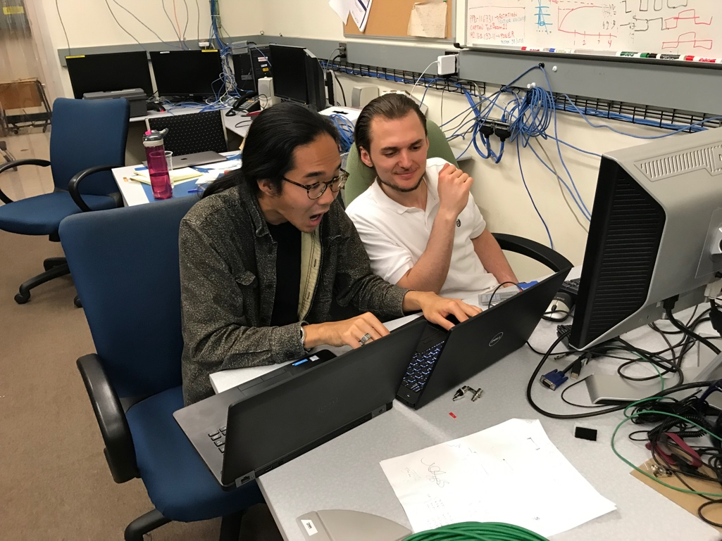
The Team @Fermilab
Data taking shift in the evenings: 7PM – 7AM
Beam: every other Monday –Friday 8:00AM – 8AM
Matt, Hubert, Cameron, Gerd, Zongze,
Xuan, Xiaochun, photo by Ming
Sho, AlexT
Not shown: Sanghoon, Yasser, Martin, Walt,
Abel. Chris …

Slide 11
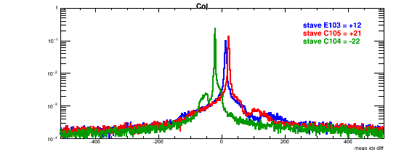
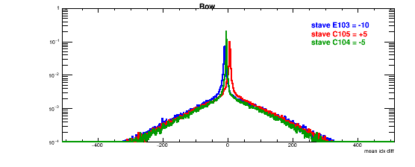
Detector Misalignment & Hit Spatial Resolution
Typically staves offset by,
Horizontally: 20 x 30um = 600 um
Vertically: 5 x 30 um = 150 um
Hit spatial resolution:
peak_sigma_core = 0.55 (pixel size ) =15 um
Chip spatial resolution = 15/sqrt(2) = 11 um
Delta_X/Y
Ref plane

Slide 12
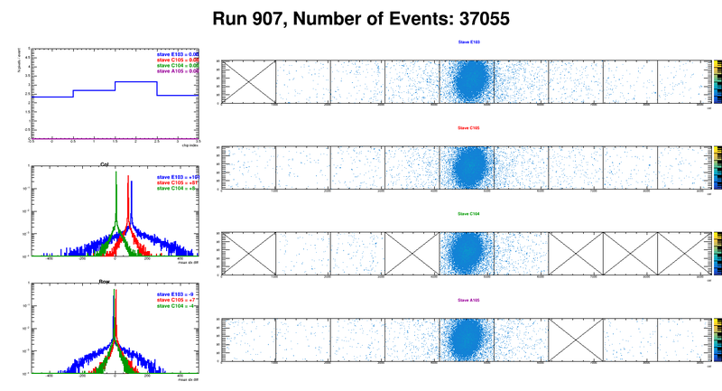
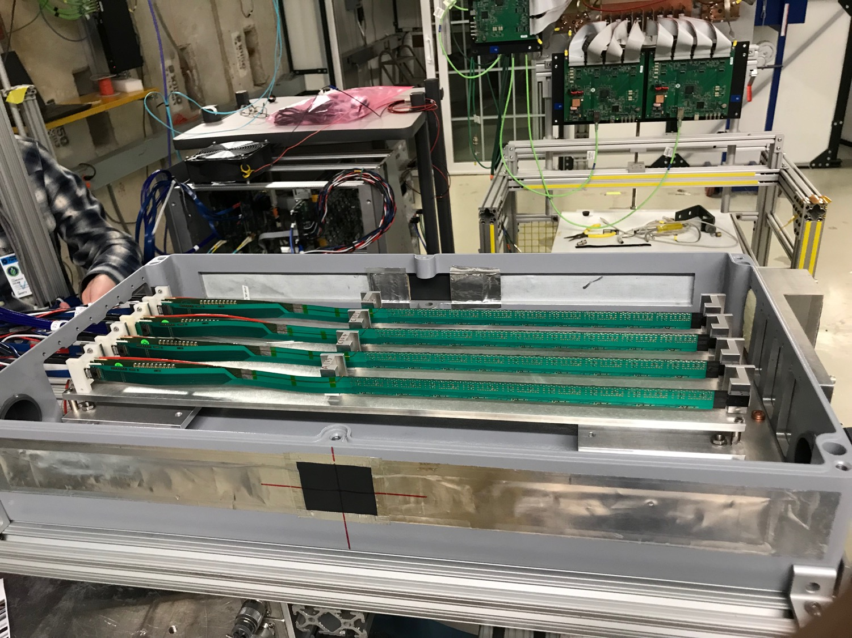
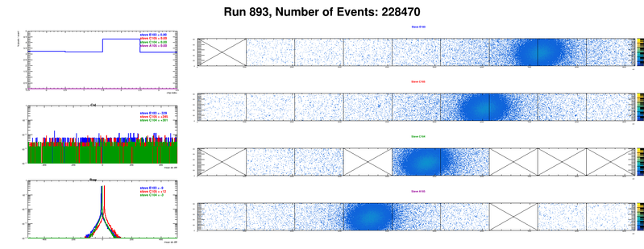
Offline analysis in progress: all TB data in RCF
https://wiki.bnl.gov/sPHENIX/index.php/MAPS-based_Vertex_Detector_(MVTX)
Beam angle: 0
(eta ~0)
MVTX 4-Stave Telescope
Beam angle: 40
(eta ~1)

Slide 13
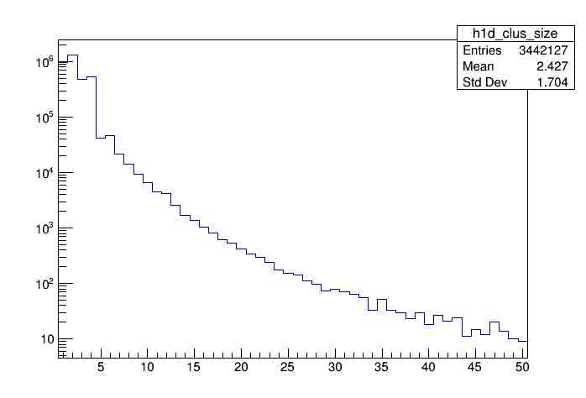
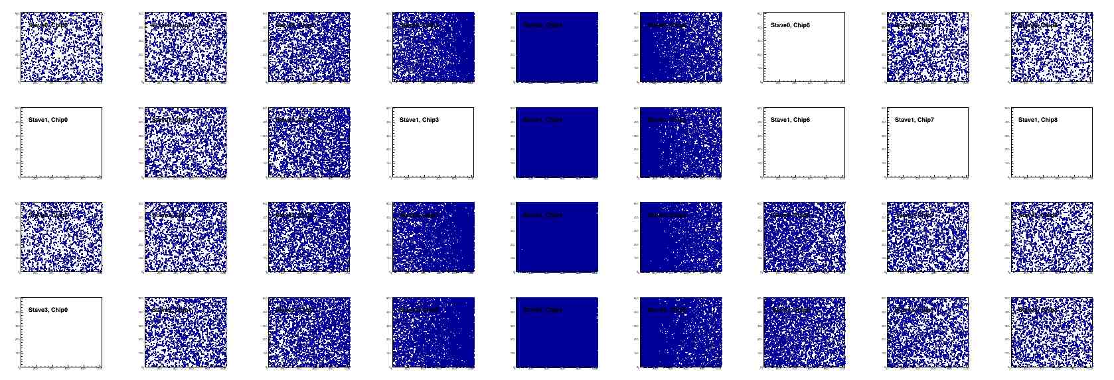
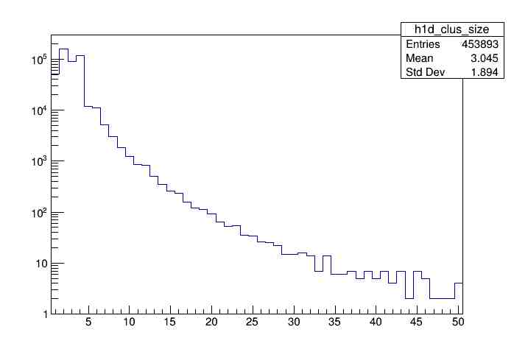
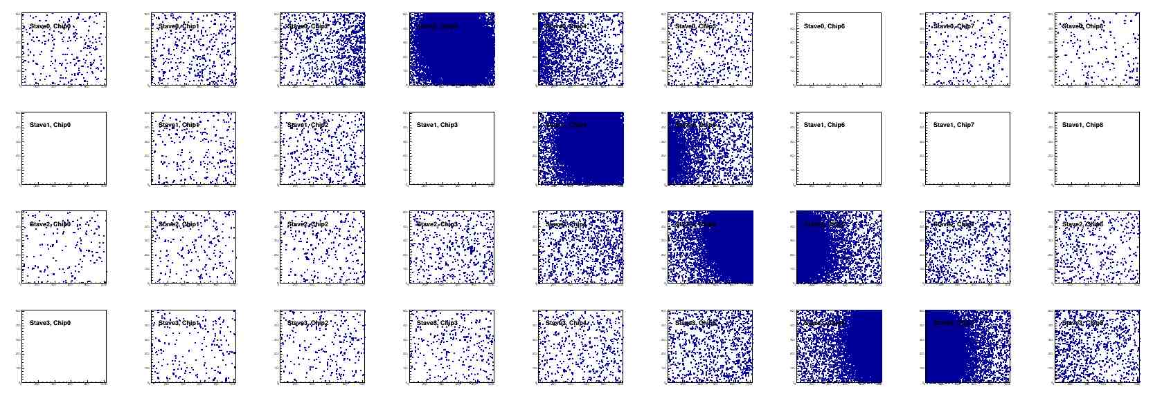
Offline Analysis: Cluster size vs Angle
To calibrate MC simulations and tracking
Stave geometry, alignment
Clustering
@ 0-degree
Cluster Size ~ 2.4
@ 40-deg
Cluster Size ~ 3.0

Slide 14
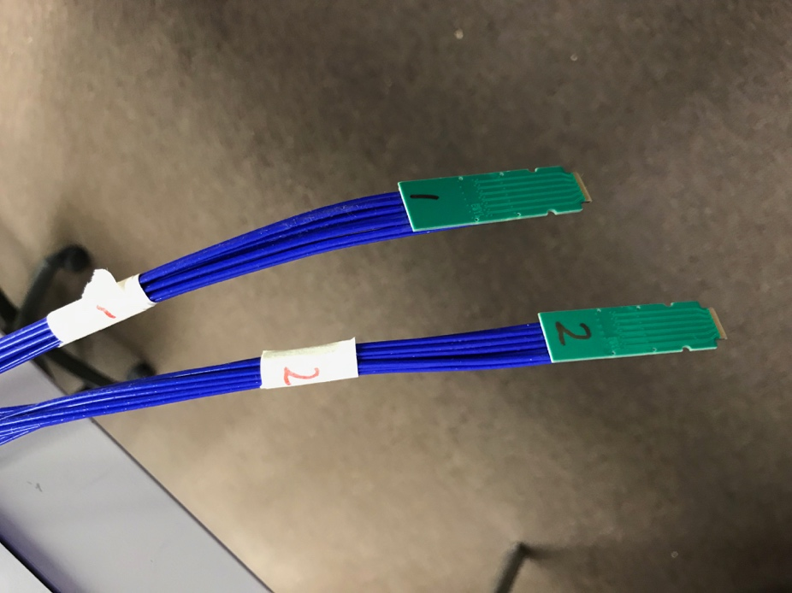
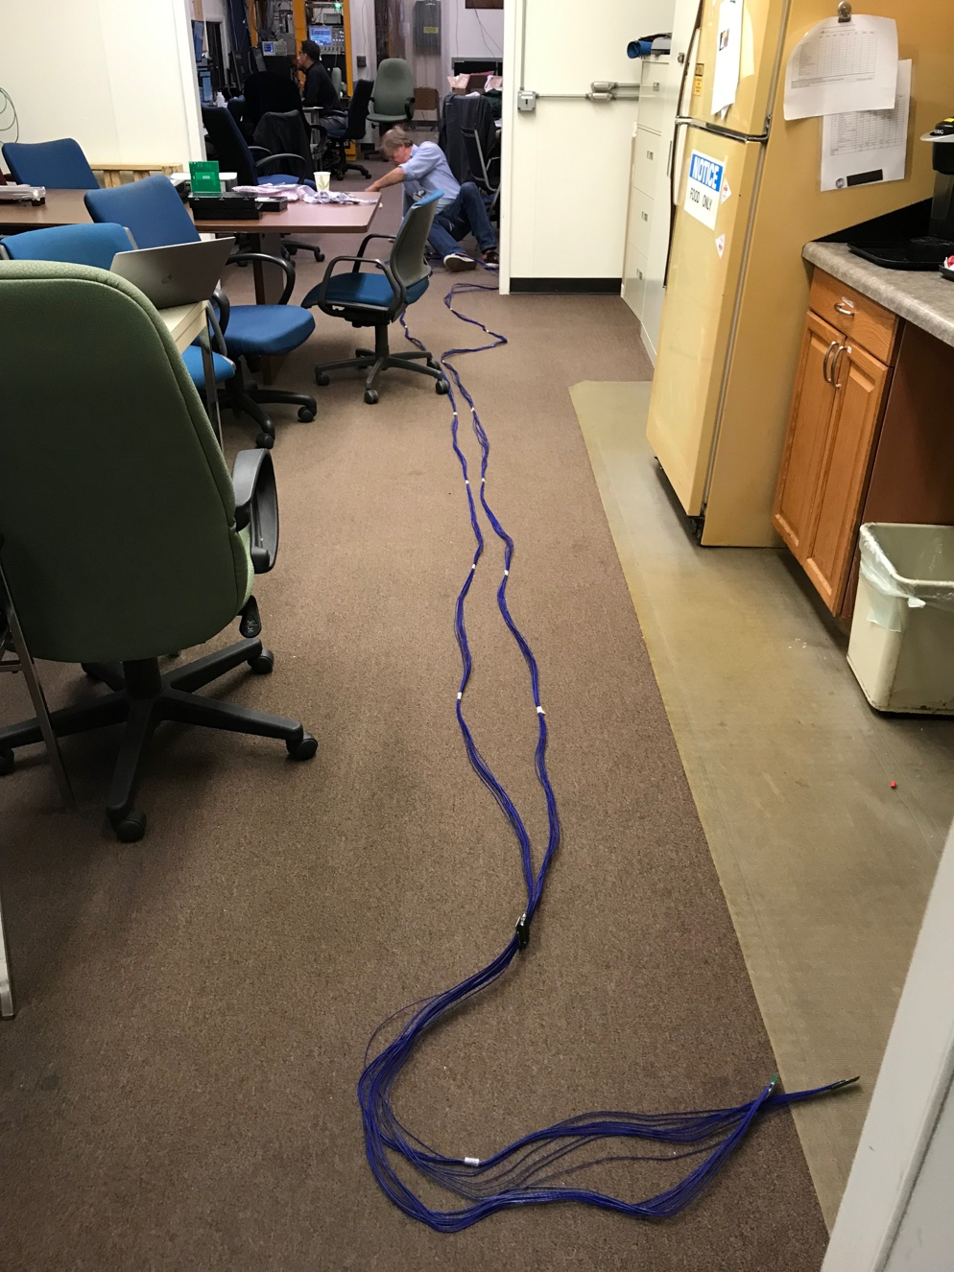
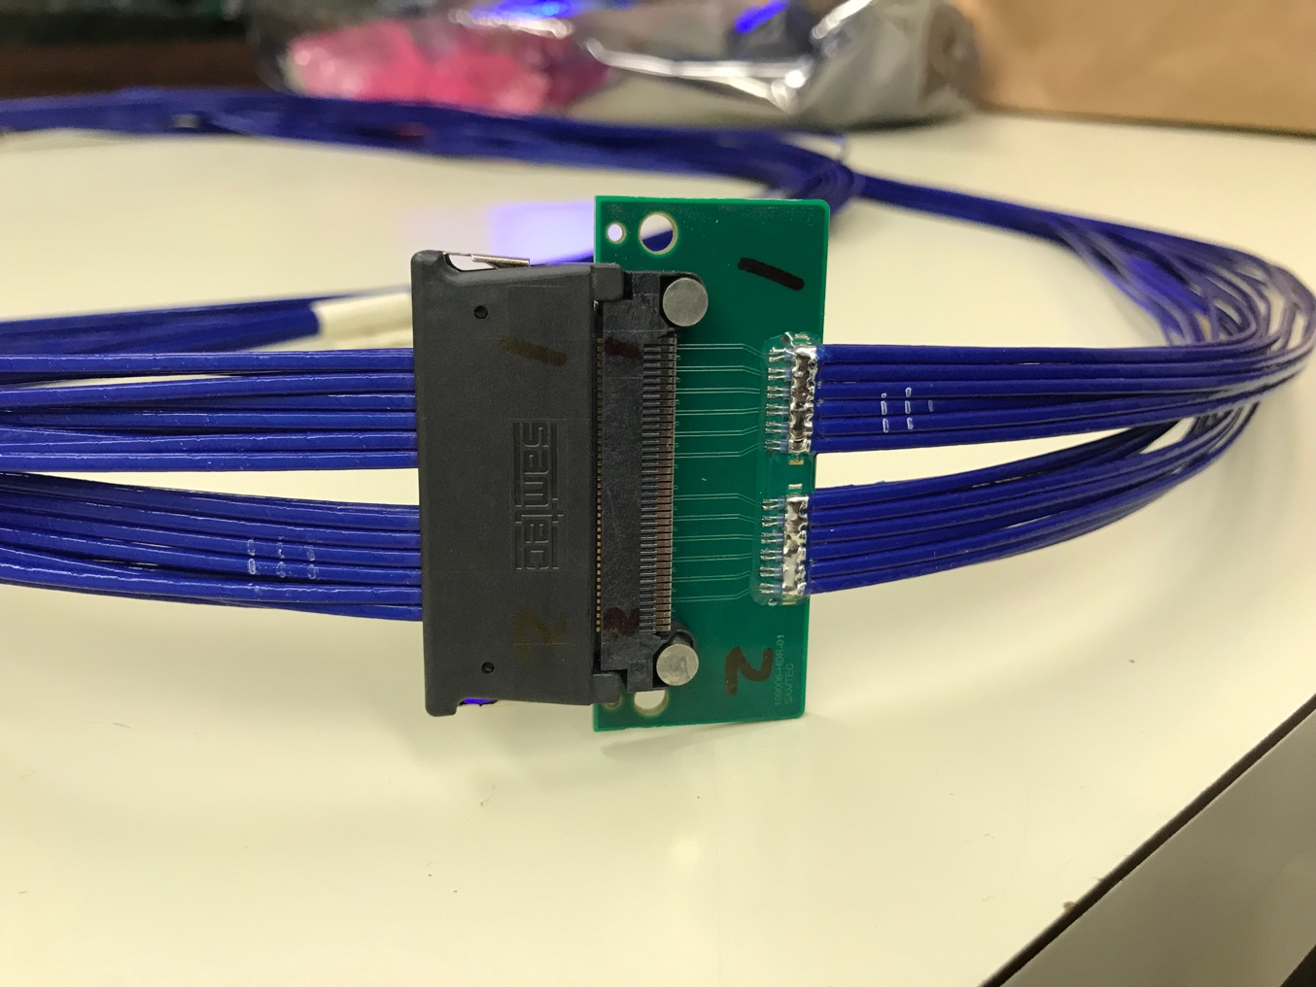
Confirmed New MVTX Long SamTec Readout Cables
8.8m + 2.6m = 11.4m (10m desired for sPHENIX; ALICE 8m cables)

Slide 15
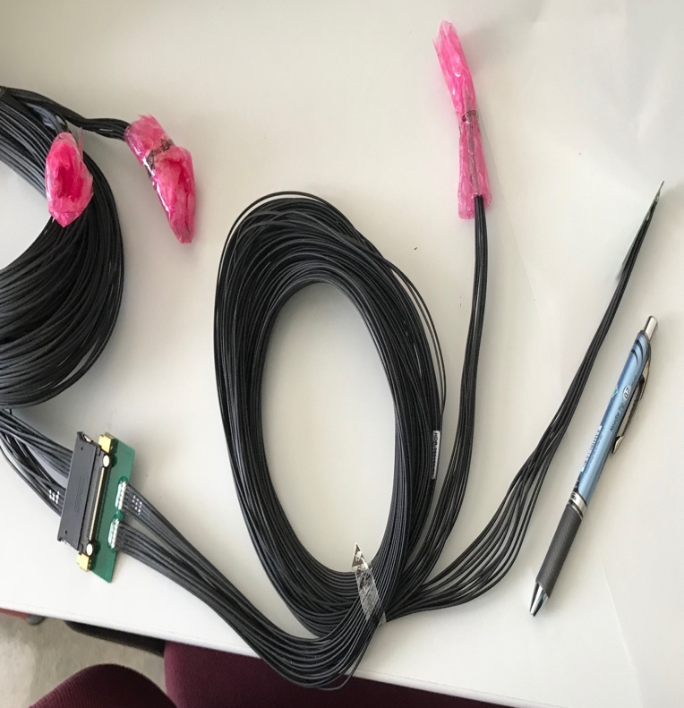
MVTX Readout and Power Cable Route
ALICE ITS/IB final readout cables: ~8m
Cable-B: 5.3m
Cable-A: 2.65m
PWR
RU
PU
sPHENIX MVTX: 7.9+m
  Cable-A: 1.4 m
  Cable-B: 6.5+ m
  Power cable:4.7+ m
Desired ~10m
BNL has approved “non-halogen free” cables for sPHENIX

Slide 16
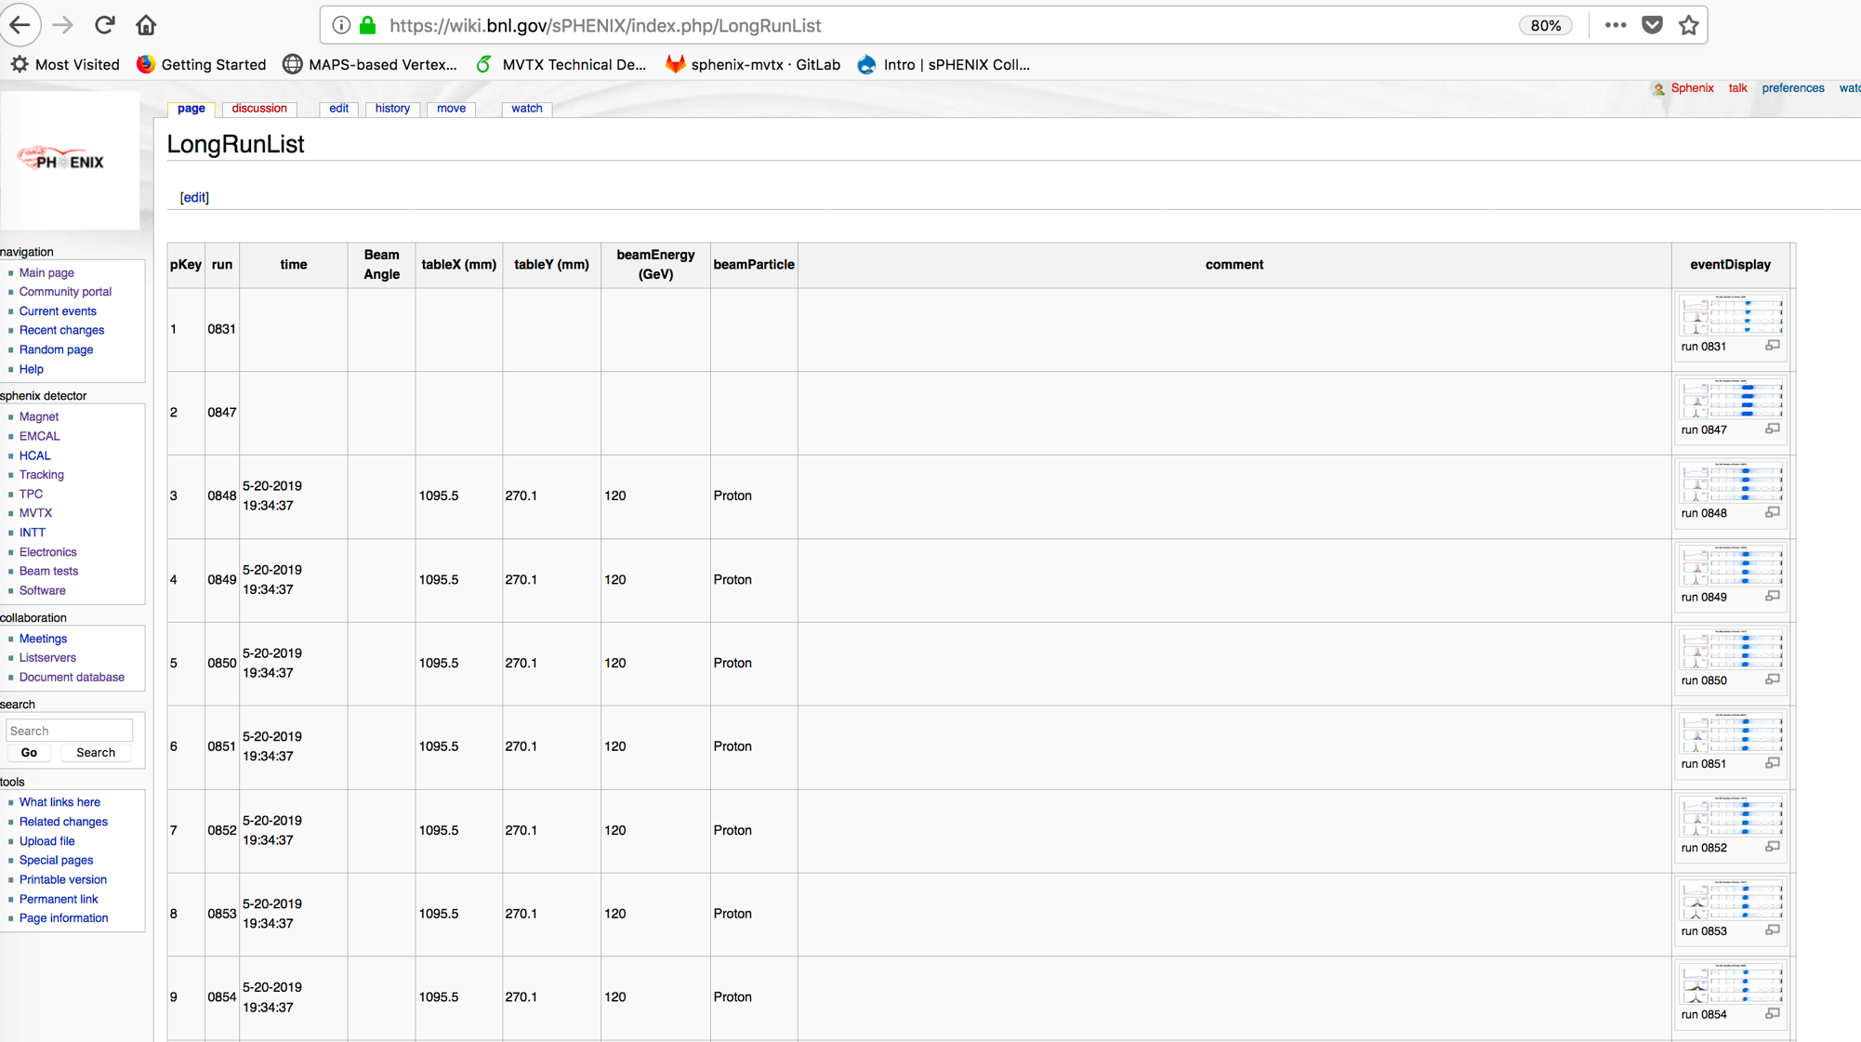
Data run-log in sPHENIX Wiki,
Nice work by Xiaochun et al. @GSU
Jin’s test beam analysis framework
Offline analysis in progress

Slide 17
MVTX Goals – the 2nd TB, 6/17-22, 2019
Test and confirm optimal MVTX operation parameters for sPHENIX
  Threshold scan, analogy shaping time etc.
  Study chip hit efficiency vs trigger(strobe) latency
    dT = 1 ~ 10 uS
    Impact on occupancy & pileup
Parameters predetermined from laser scan at LANL, in good progress
    Single chip readout with MOSAIC with pulsed laser (~MIP)
    Threshold and noise
    Analogy shaping time
    Strobe delay and length

Slide 18
ALPIDE Sensor Operation Optimization
“Stretched Settings” for sPHENIX trigger study
- Pile up integration time ~ 8uS
64 cells x 106nS = 6.8uS
“ALICE Default Settings”
- “Pile up” integration time ~ 5uS
sPHENIX Trigger Latency ~ 4.7uS
sPHENIX Trigger Latency ~ 6.8uS

Slide 19
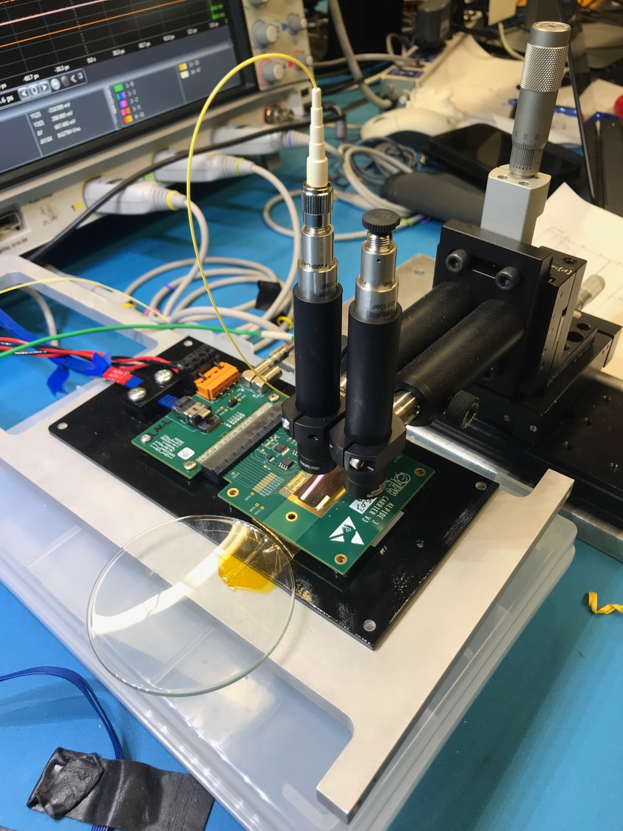
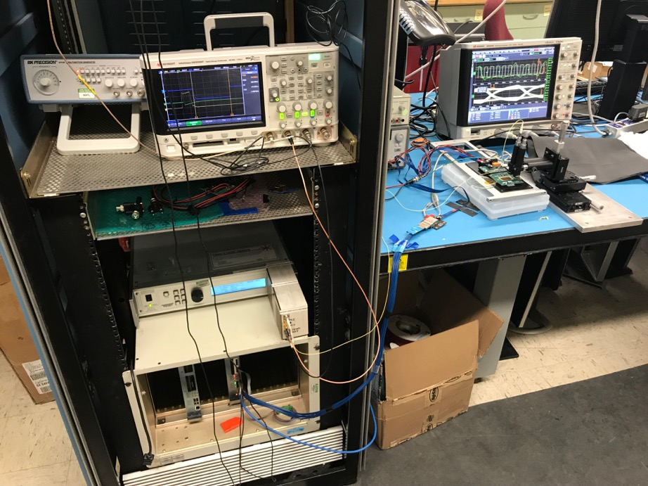
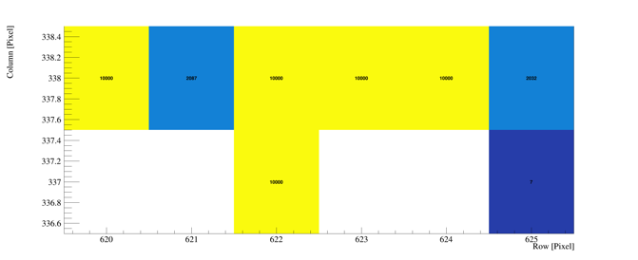
Study MAPS Performance with Pulsed Laser @LANL
Inject “MIP” signal, focused laser beam
  850 nm laser, 4ns wide pulse, ~1 MIP
  50kHz trigger
  Find optimal MAPS operating parameters
Laser system
MOSAIC Testbench
Pixel hits

Slide 20
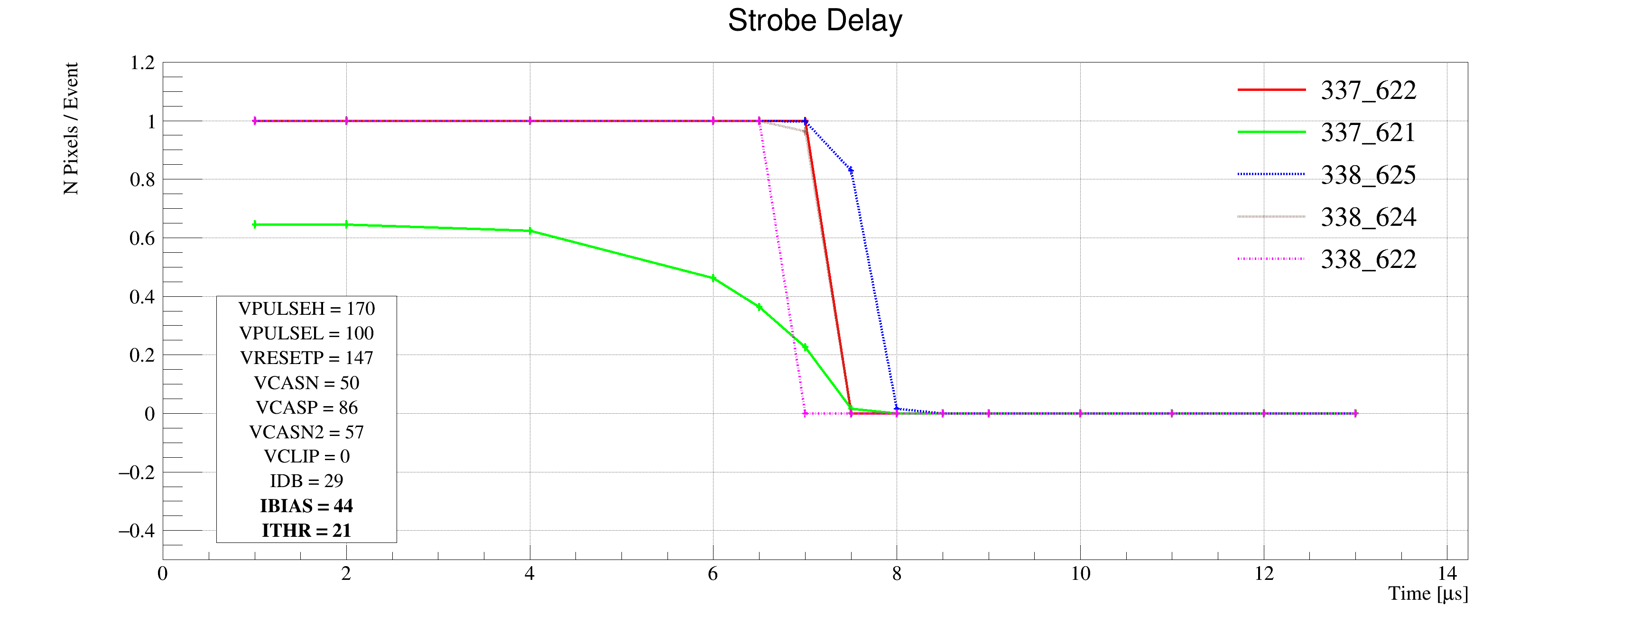
Laser Scan Data – Pixel Hit Efficiency vs Trigger Delay
One of “Stretched Settings” for sPHENIX trigger
MAX: 64 cells x 106nS = 6.8uS
Pixel (Row-Col)
Pixel (Row-Col)
~ 4.7 us
sPHENIX Trigger
~ 4.7 us
sPHENIX Trigger latency

Slide 21
MVTX experts help ALICE/ITS – to help us!
Dave’s talk
from Monday
ITS surface commissioning now:
~ May 2020
Great opportunity to learn about ITS/MVTX detectors
Training on technical details
Developing tools
Build up operation experience

Slide 22
MVTX Schedules and Milestones (3/2019) concerns & challenges
sPHENIX: CD1/3a PD2/3
Installation
1st collisions
CY-2018 | 2019 | 2020 | 2021 | 2022 | 2023
MVTX
Stave & RU
production
FELIX
production
Funding delays –
Stave production delayed at CERN
- Impact on following test & assembly
- preparation work @LBNL, UT-A
Lack of R&D $ for mech. desgin work
- MIT, LBNL, LANL
- “advanced cash” running out MIT, LANL
Detector mechanics design & production, global interface to sPHENIX
End Wheels
CYSS
Global integration
/interface design
Service barrel
design & production
Ready for beam;
sPHENIX day-1 run
Barrel Assembly & Testing @LBNL
Install half barrels
@sPHENIX IR
Half barrel #1
Power system
production
Half barrel #2
Half barrels
arrive @BNL
design & procure
interface to
sPHENIX rails
Running low in schedule contingency …
Design & procure
sPHENIX rails
MVTX installation & commissioning @BNL
RU, FELIX, PS, cables etc.

Slide 23
Report from April BNL PD2/3 Reviews: Silicon Detectors - MVTX, INTT

Slide 24
MVTX Risks - all in P6 now
WBS, PMP documents updated
Schedule & Labor profile updated in P6
(Glenn, Irina )
Need project fund NOW to meet the goals!

Slide 25
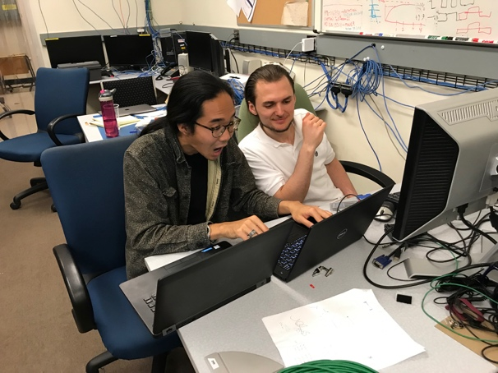
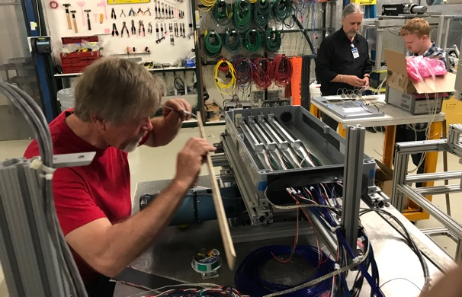
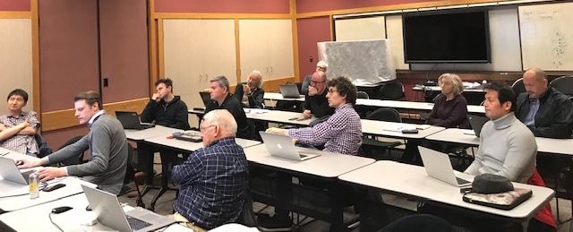
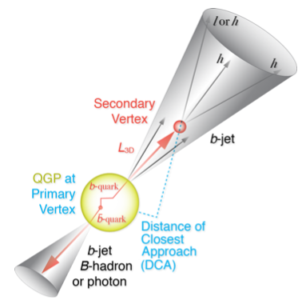
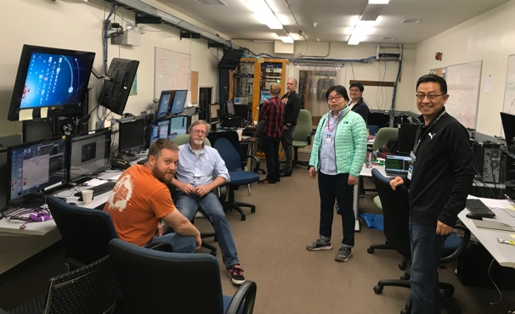
Summary
Completed essential R&D for readout integration
  Full 9-chip stave readout per RU
  Multi-RU readout per FELIX
  Long readout cables
  sPHENIX GTM
Completed preliminary mechanical design
Improve MC detector response, clustering – in progress
  Calibration data with incident angles, 0, 10,20,30,40,45
Stave and RU production at CERN - in good progress
MVTX Cost & Schedule review, July 29-30 @BNL
We are ready for the full production and the physics!

Slide 27
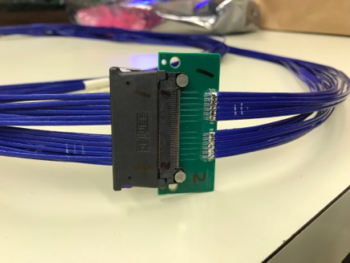
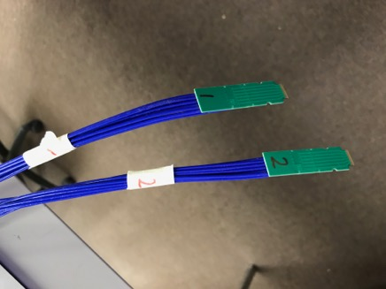
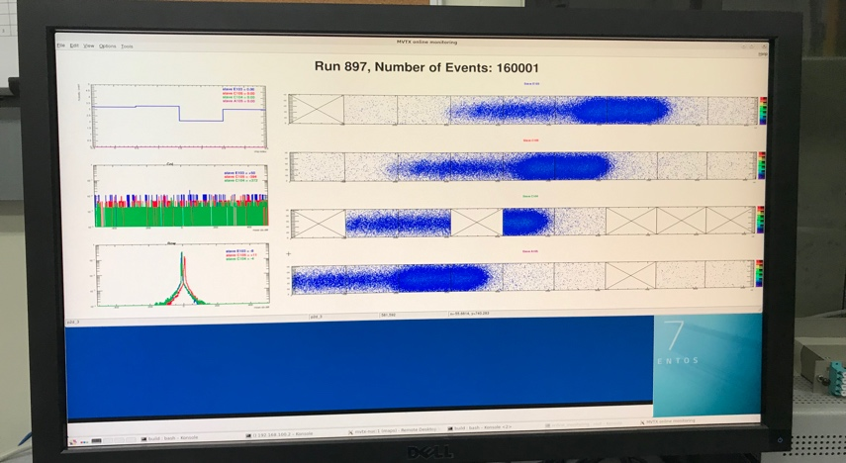
R&D Highlights
Very successful TB at Fermilab, 5/13-25, 2019
  Confirmed the long 11.4m SamTec readout cable
  Confirmed the full stave readout
  Confirmed multi-RU readout per FELIX
  Confirmed sPHENIX GTM with FELIX
A 2nd TB, study optimal MAPS operation points
  Parasitic with INTT+TPC, 6/17-21
Preliminary mechanical design developed
  To prototype CYSS and Layer-2 End-Wheel this summer
  France, Italy, CERN, contacted and under discussion
Improve MC detector response, clustering – in progress
  Took calibration data with incident angles, 0, 10,20,30,40,45
TB later at LBNL/LANL – in preparation
  Scan stave material budget with 50MeV p-beam
  8-stave + 8-RU +1-PU + 1-FELIX + 1-GTM + RCDAQ, the full complete readout chain
    Hardware will be available soon

Slide 28


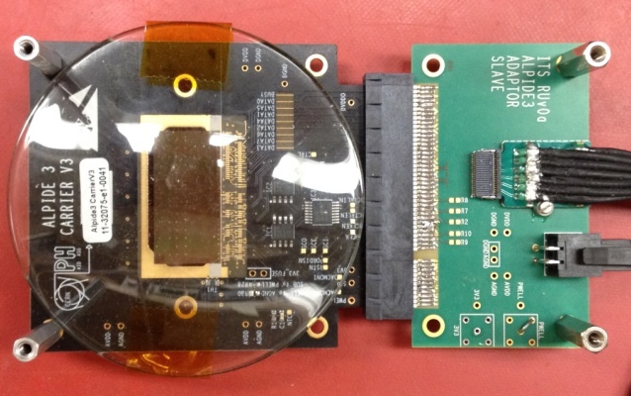
Monolithic Active Pixel Sensors (MAPS)
The Next-Generation, State-of-the-Art Pixel Tracker
Advantages of ALICE PIxel DEtector (ALPIDE) sensor:
Very fine pitch (27μm x 29μm), for superb spatial resolution
High efficiency (>99%) and low noise (<10⁻⁶), for excellent tracking
Time resolution, as low as ~5 μs, for less pileup
Ultra-thin/low mass, 50μm (~0.3% X₀), for less multiple scatterings
0.5M channels with on-pixel digitization, for zero-suppression and fast readout
Low power dissipation, 40mW/cm², for minimal service materials
An ideal detector for QGP physics!
Flexible Printed Circuit(FPC)
9 Chips
Cold plate
A 9-chip MAPS stave, 1.5cm x 27cm
ALPIDE design
ALPIDE sensor:
1.5cm x 3.0cm, 0.5M pixels
50 μm
~28 μm

Slide 29
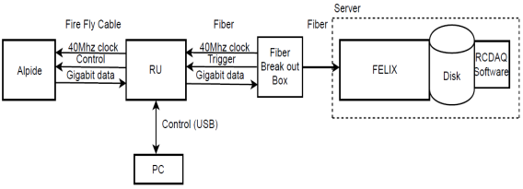
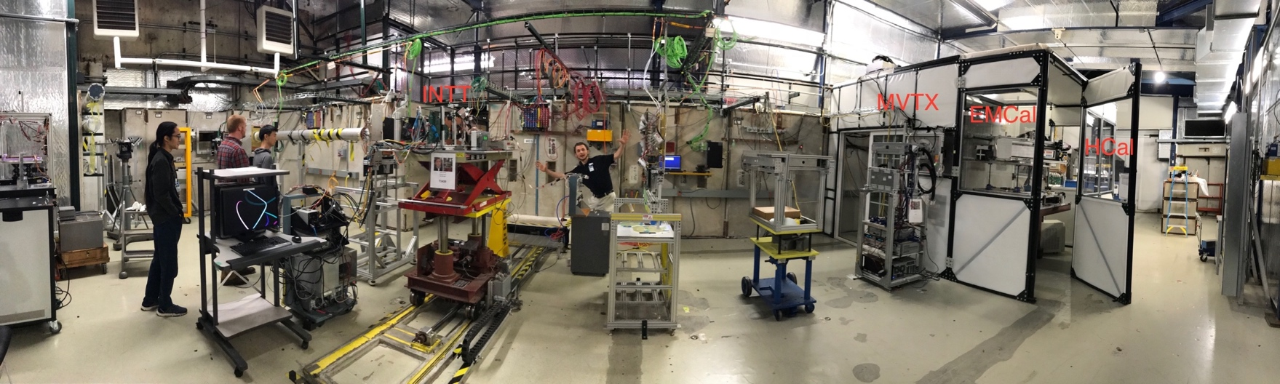
MVTX Full Readout Chain Demonstrated (3/2018)
4-MAPS
telescope
Fermilab Test Beam: Feb-Mar, 2018
Tracking spatial resolution
achieved: <5 um
120 GeV proton
beam
4-hit track
4-MAPS telescope

Slide 30
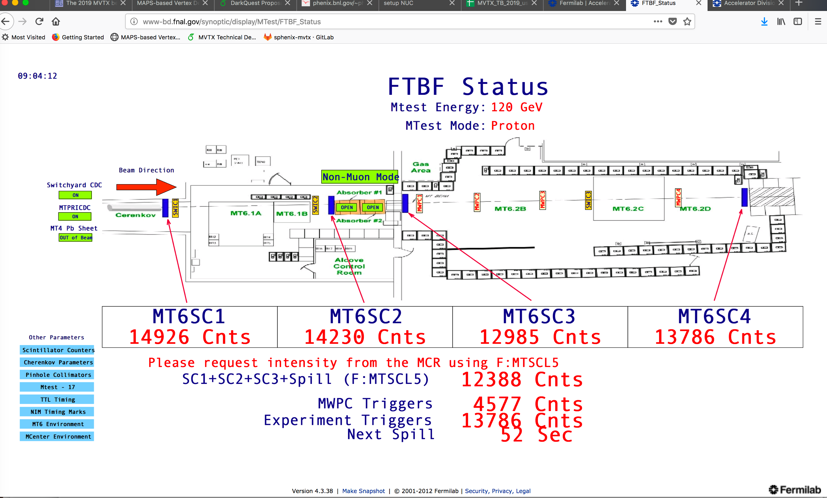
MVTX Test Beam, May 2019
MVTX

Slide 31
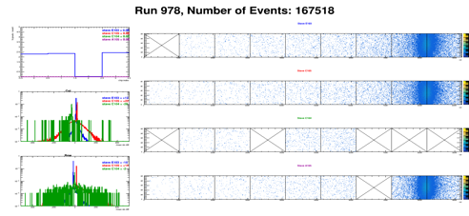
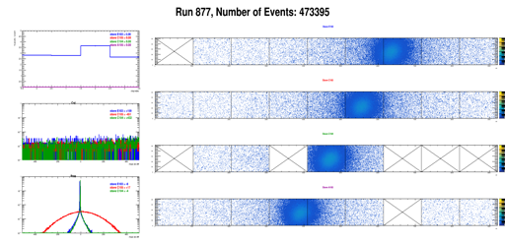
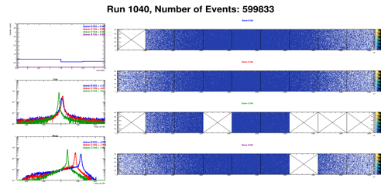
Run Types – Details being documented in MVTX wiki
From Xiaochun
Run0978
Horizontal stave scans (many good runs)
Vertical stave scans
Angular stave scans and tilted runs
Electron beam at 5 GeV (one long run)
Extruded aluminum & Lead-block runs
Run0877
Run1040

Slide 32
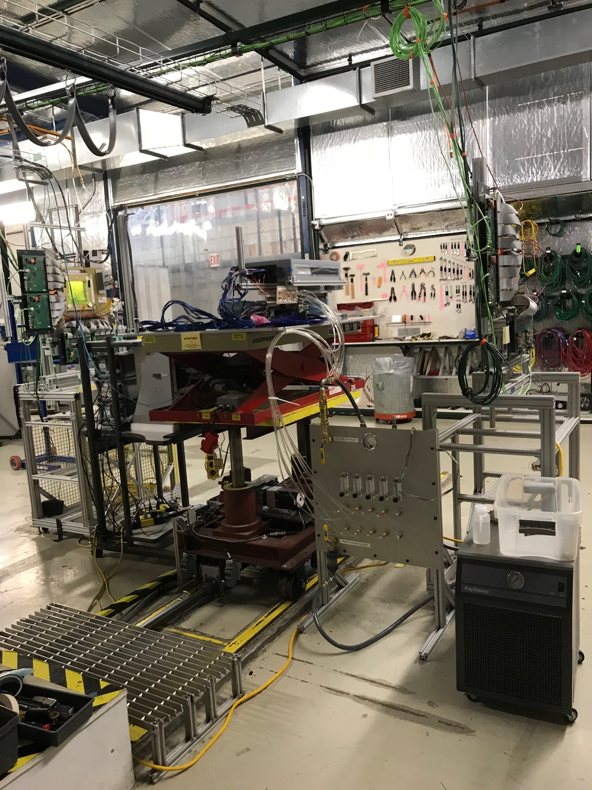
4-stave Telescope
120GeV p-beam
2 RUs,
PU,
PS
Negative Pressure Cooling System
Motion Table
(X,Y,Phi)

Slide 33
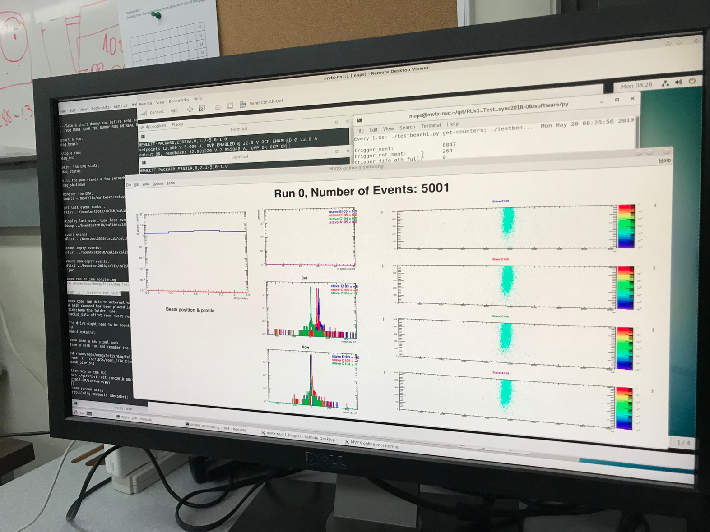
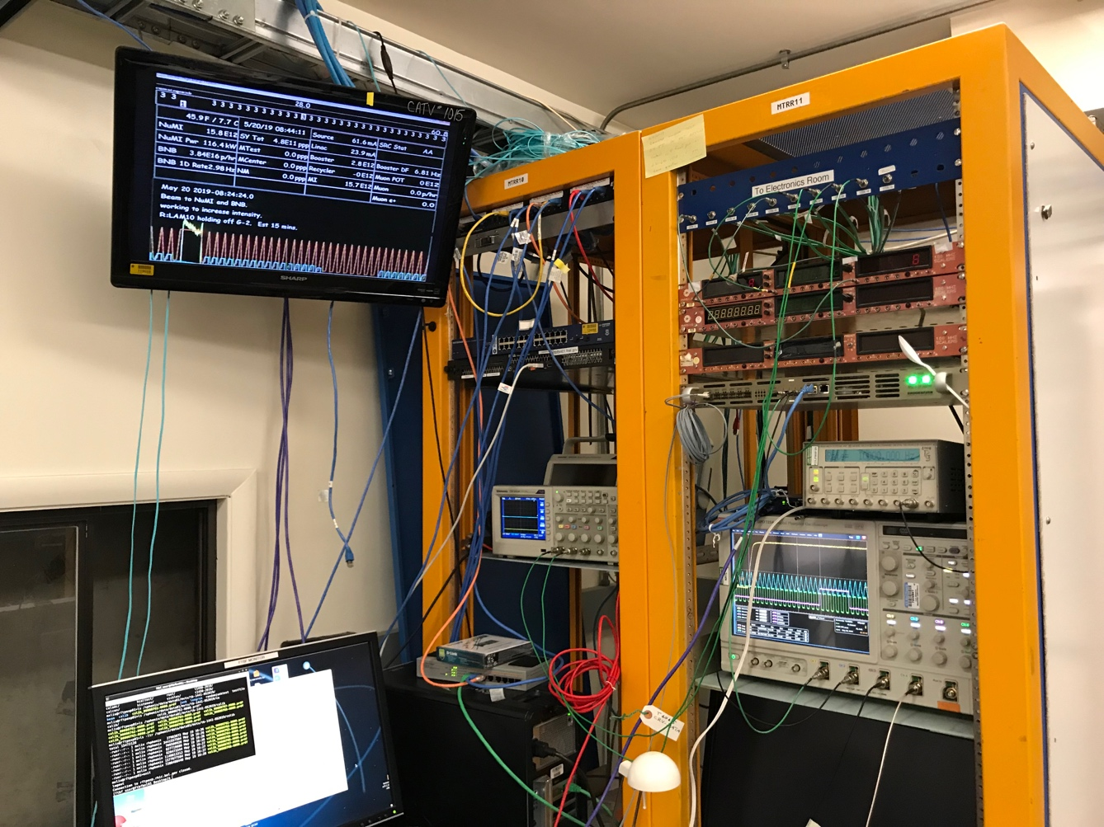
First Collision Signals
sPHENIX GTM

Slide 34


Staves, RUs, PU etc.
2 RUs
PU

Slide 35

120GeV p-beam
120GeV p-beam
Telescope
Telescope
RUs & PU
Cooling System;
negative pressure
@-30%ATMP (-5PSI)

Slide 36

When MAPS parameters off the optimal point, less hits collected

Slide 37

No hits seen when MAPS parameters far-off the optimal point

Slide 38


Installation

Slide 39
3-D event Display: p+Pb collision
Cameron
Stave-4
Stave-3
Stave-2
Stave-1

Slide 40


Offline Analysis: Cluster size vs Angle
Run 877, angle – 30 dgr
Cluster Size = 2.7

Slide 41
Offline Analysis: Cluster size vs Angle
Run , angle = 40
Cluster Size ~ 3.0
More work follows by Yasser, Sanghoon et al
Everyone is welcome to join the effort!
Stave geometry
Stave alignment
Clustering
Tracking
Update MVTX MC response in GEANT

Slide 42
MVTX – Half Detector

