Slide 1

MVTX Overview
Ming Liu
LANL
sPHENIX Collaboration Meeting
July 8-9, 2019, Lehigh University, PA

Slide 2

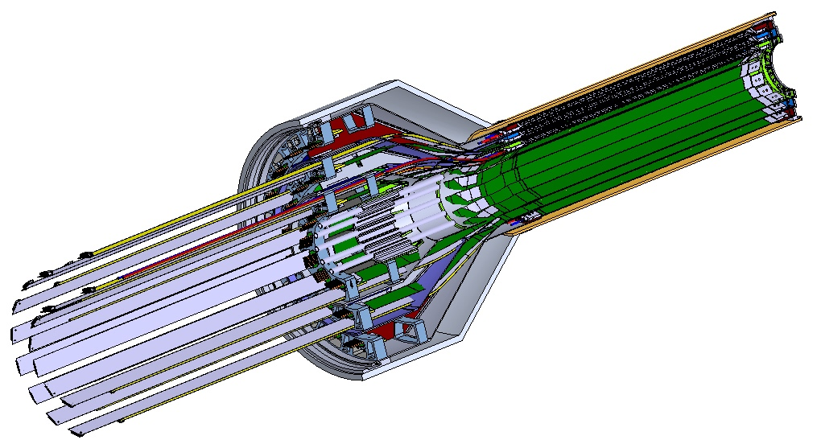
MVTX Detector – Modified from ALICE/ITS Design
Service cone: signal, power, cooling
and mechanical support
CYSS: Cylindrical Shell Structure
End-Wheel
Extended power FPC
3-layer sensor barrel
- 48 staves, 432 chips
MVTX
parameters

Slide 3
Scope of the MVTX Project
MAPS Staves & Electronics
  Readout Integration
    Frontend: ALICE/ITS RU
    Backend: ATLAS FELIX
  Production & Assembly @US: ~$5M
    QA & assembly
      RU boards @UT-A
      Half detectors @LBNL
      FELIX boards @LANL/BNL, 6+spares(2)
    Ancillary systems - “adopt” ALICE ITS system
      Power, slow control & monitoring etc.
Mechanical system
  Modify ALICE/ITS mechanical structures
    End Wheels
    Cylindrical structure shells
    Service half barrels
  Mechanical system integration,
    Design & simulations, MIT/LANL
    Composite structure production, LBNL
    Non-composite structure, MIT
    Installation tooling etc., BNL/LANL/MIT/LBNL
  Adopt ALICE cooling plant design
    Modifications to fit sPHENIX, MIT/BNL
  Production @CERN: $1.36M, a separate project
    84 ALICE/ITS-IB staves from CERN
      Acceptance test @LBNL, 48+spares(2-inner layers+)
    60 ALICE/ITS-RU from CERN
      Acceptance test @UT-Austin, 48+spares(12)

Slide 4
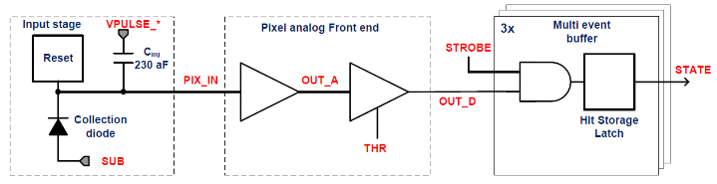
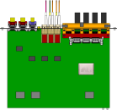

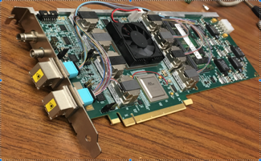

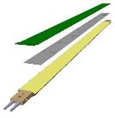
MVTX Readout, Power and Controls
CAN bus
DCS
Slow control
Mike’s talk
Trigger & Clock
Readout Unit
Front End
GBT Optical Links
one pixel
9 Data (1.2Gbps)
1 Clock, 1 Control/Trigger
Control
Data (9.6 Gb/s max)
Trigger
9-sensor Stave
Samtec Twinax “FireFly”, ~10m
FELIX
Back End
FPC
Power
ATLAS Front-End Link eXchange (FELIX):
sPHENIX Data Aggregation Module(DAM)
Alpide Sensors
Flex PCB Filtering Capacitors
regulators
Power
Regulated Power
CAEN Power supplies
Cold Plate
ALPIDE pixel:
Shaping
Digitization
Zero-suppression
3x buffer
Power Board
Interaction Region
Experimental Hall
Counting House
MVTX Detector Electronics consists of three parts
Sensor-Stave (9 ALPIDE chips) | Front End-Readout Unit | Back End-FELIX/DAM

Slide 5
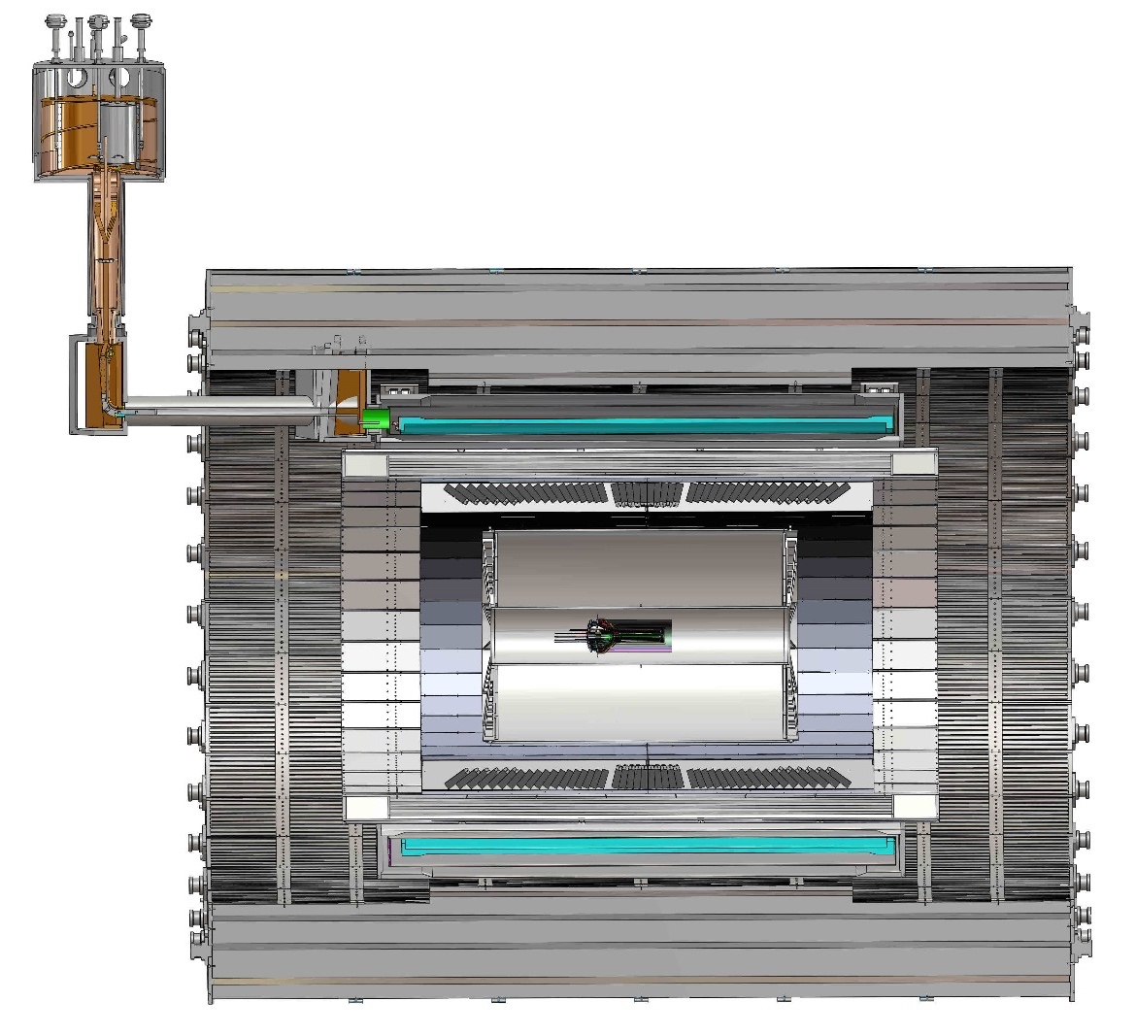
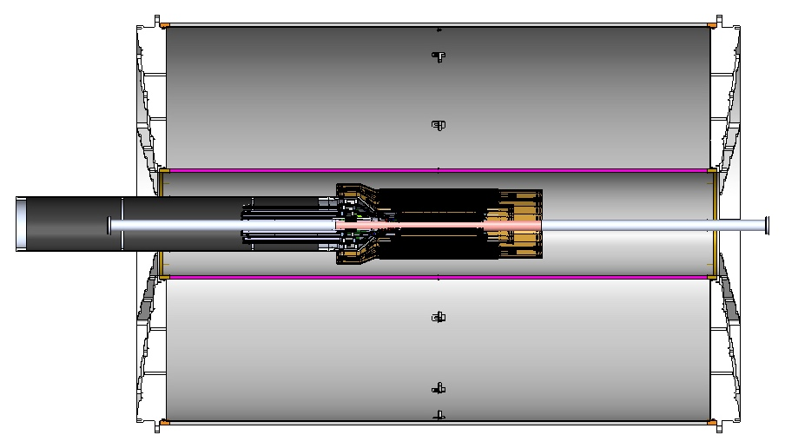
MVTX Global Mechanical System Integration
MVTX system preliminary design, with two parts:
  Part-1: from MVTX to PP-1b, all power PCB, 40cm
  Part-2: length TBD later, from PP-1b to PP-2
Service Barrel
TPC
TPC
INTT
MVTX
PP-1a:
short signal cables
PP-2:
Signal and power cables
R= 209.6cm
PP-1b:
power cables
L = 350.0 cm

Slide 6
Preliminary Mechanical Design Completed
Ross’ talk
https://indico.bnl.gov/event/6377/
MVTX, INTT, TPC …

Slide 7
Project Status
Confirmed long SamTec readout cables recently – last key integration R&D
  11.4m long cables, > 10m desired length
MVTX mechanical design: excellent progress
  Asked for quotes from outside companies based on preliminary designs
  sPHENIX integration workfest scheduled 7/10 @BNL, MVTX/INTT/TPC…
Release of early R&D fund in progress
  MVTX mechanical engineering design, MIT/LANL
  Preparation for Stave and RU acceptance test, LBNL, UT-Austin
MVTX Cost & Schedule Review – we are ready for full production
  July 29-30 @BNL
  WBS, PMP, Risk Registry, P6 being updated
Stave and RU production at CERN
  DOE Fund arrived at UTK
  Procurement paperwork in progress (any day from now if not done yet)
  CERN is ready to proceed with stave production

Slide 8
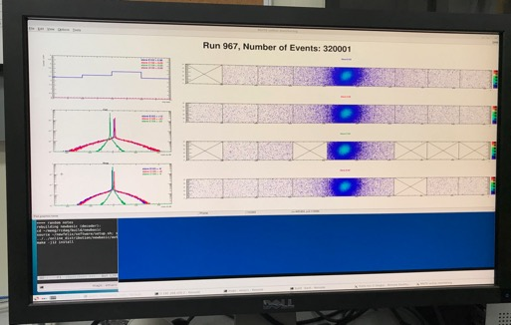
Very Successful Test Beam @Fermilab
5/20-25, 6/17-22, 2019
SamTec: 11.4m
(2.6m+8.8m)
4-stave telescope
RU-2: 1 stave
- 1 fully functioning
9-chip stave;
- 3 staves with a few
broken sensors
4 staves
2 RUv1.1
1 PU
1 FELIX Server + RCDAQ
sPHENIX GTM
11.4m Custom SamTec Cable
Negative pressured cooling for staves
RU-1: 3 staves
5m SamTec
120GeV p-beam
10kHz (30kHz)
Beam intensity:
30k ~ 120k ppp
Data & Control
Beam Trigger
Timing & Trigger
GTM
FELIX
Online Monitoring
RCDAQ
A full system with final sensor/readout* hardware:
Multi-Stave + Multi-RU -> FELIX readout demonstrated
sPHENIX GTM integrated
Long readout SamTec cable certified
Cooling system demonstrated
* RUv1.1 identical to the final RUv2 electrically

Slide 9
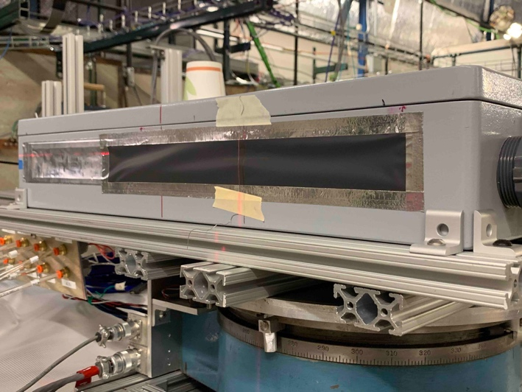
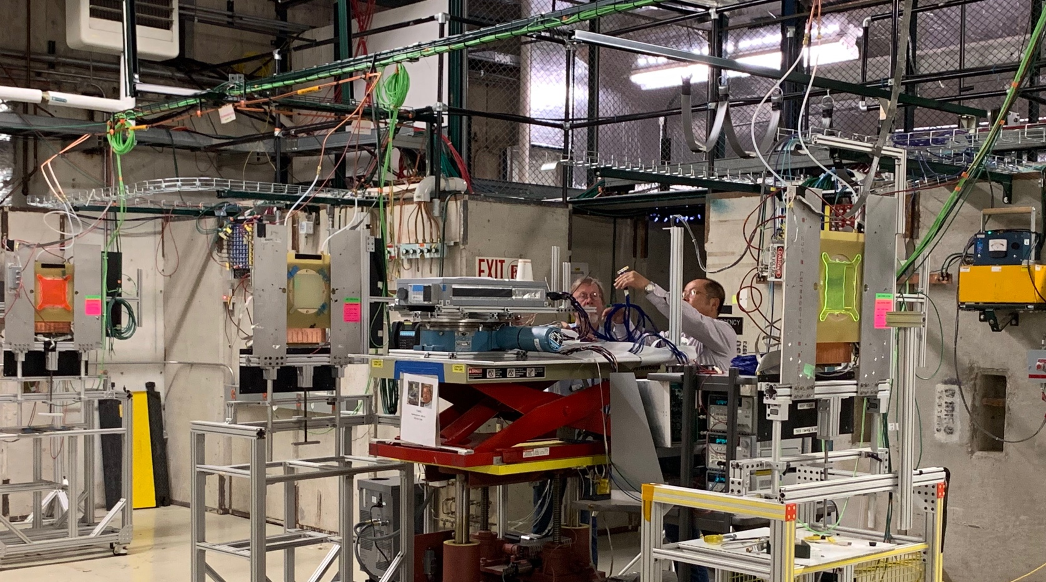
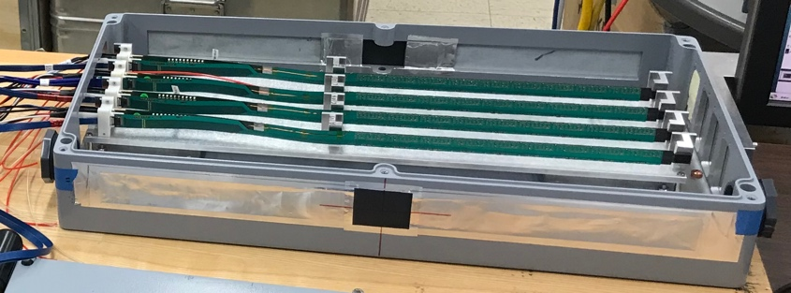
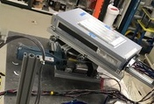
2019 MVTX Test Setup
From view
beam
Stave housing (four staves)
Stave housing sits on a motion table which can be moved in (x, y) plane perpendicular to the nominal beam direction. It can also be rotated (+40, -40) degrees (see photo on right). Operation was done at counting house.

Slide 10
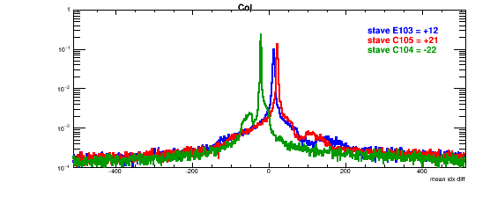
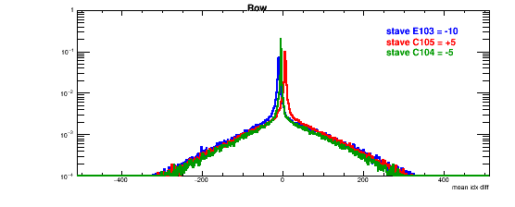
Detector Misalignment, Hit Spatial Resolution
Typically staves offset by,
Horizontally: 20 x 30um = 600 um
Vertically: 5 x 30 um = 150 um
Hit spatial resolution:
peak_sigma_core = 0.55 (pixel size ) =15 um
Chip spatial resolution = 15/sqrt(2) = 11 um
Delta_X/Y
Ref plane

Slide 11
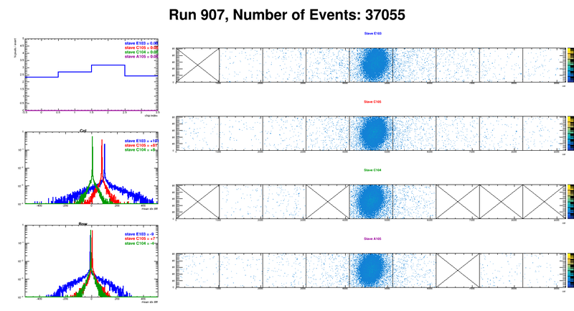
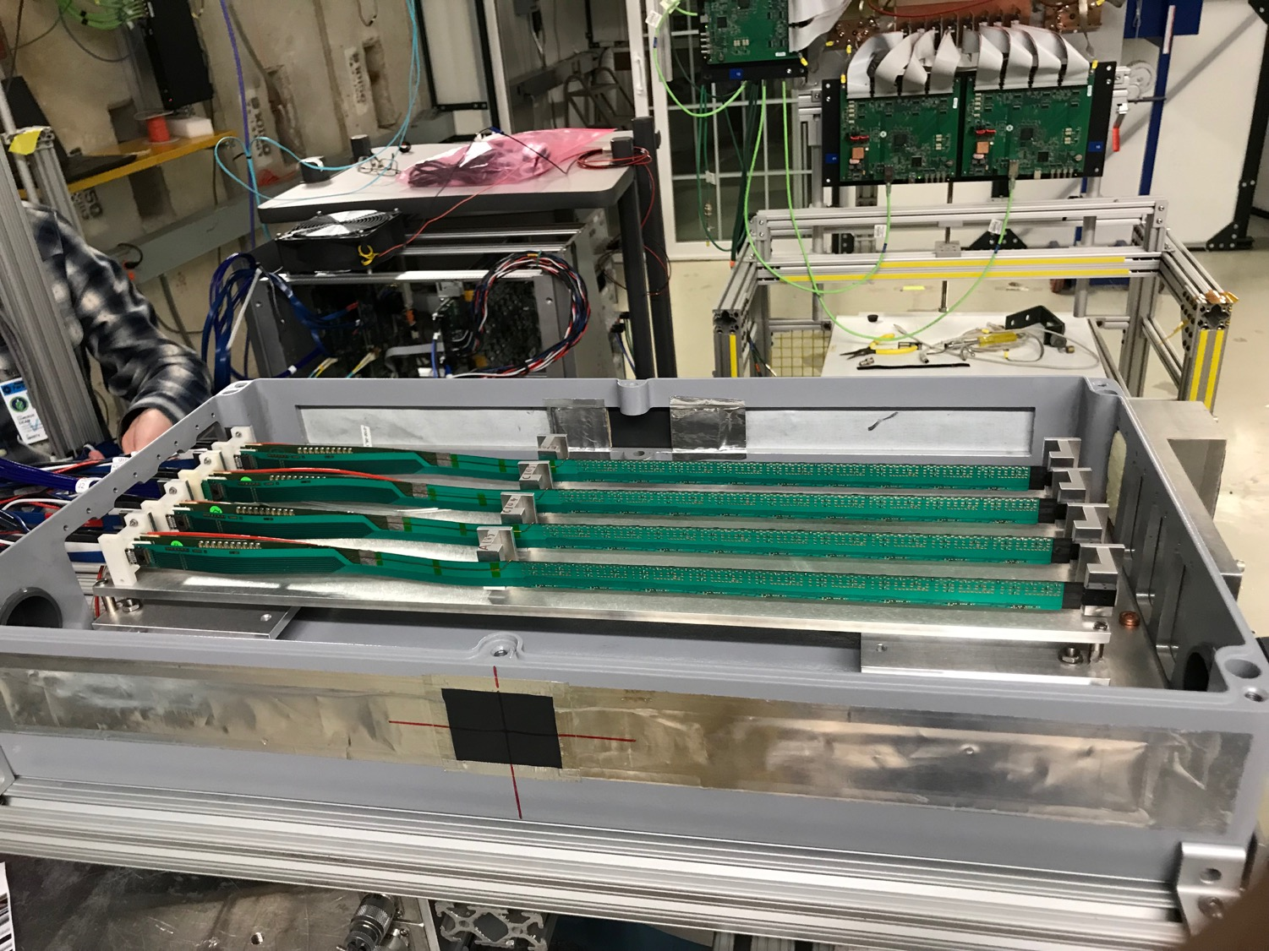
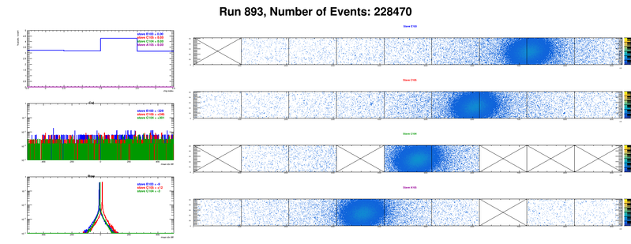
Offline analysis in progress: all TB data in RCF
https://wiki.bnl.gov/sPHENIX/index.php/MAPS-based_Vertex_Detector_(MVTX)
Beam angle: 0
(eta ~0)
MVTX 4-Stave Telescope
Beam angle: 40
(eta ~1)

Slide 12
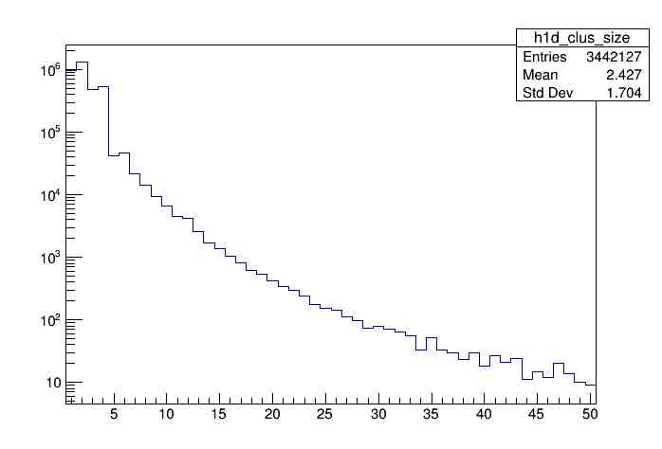
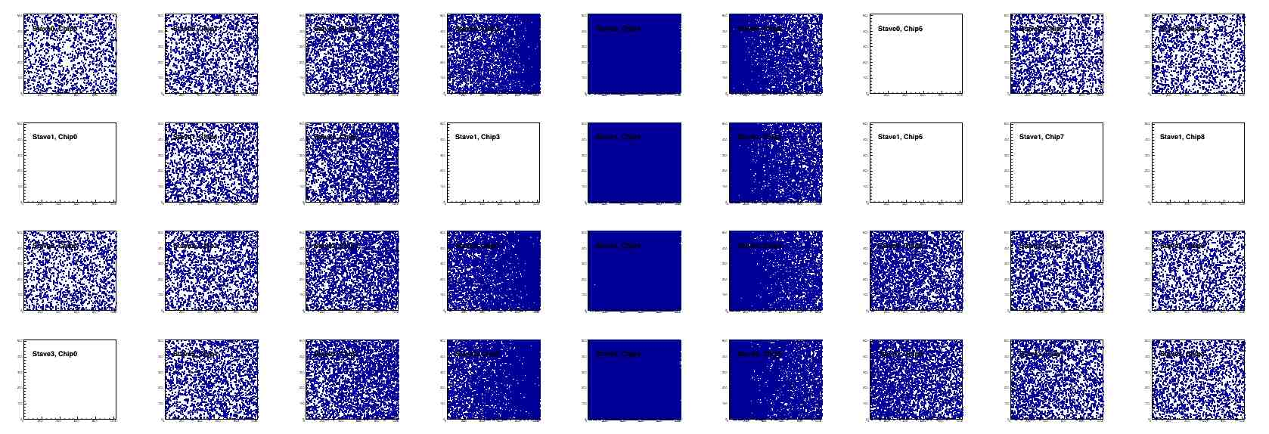
Offline Analysis: Cluster size vs Angle
Run 968, normal angle
Cluster Size ~ 2.4

Slide 13
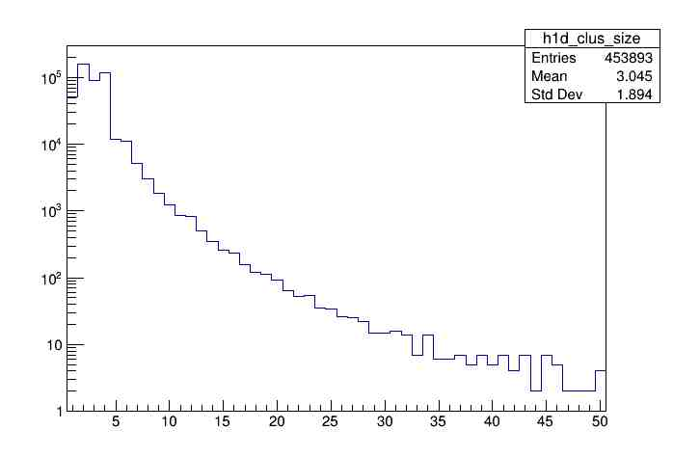
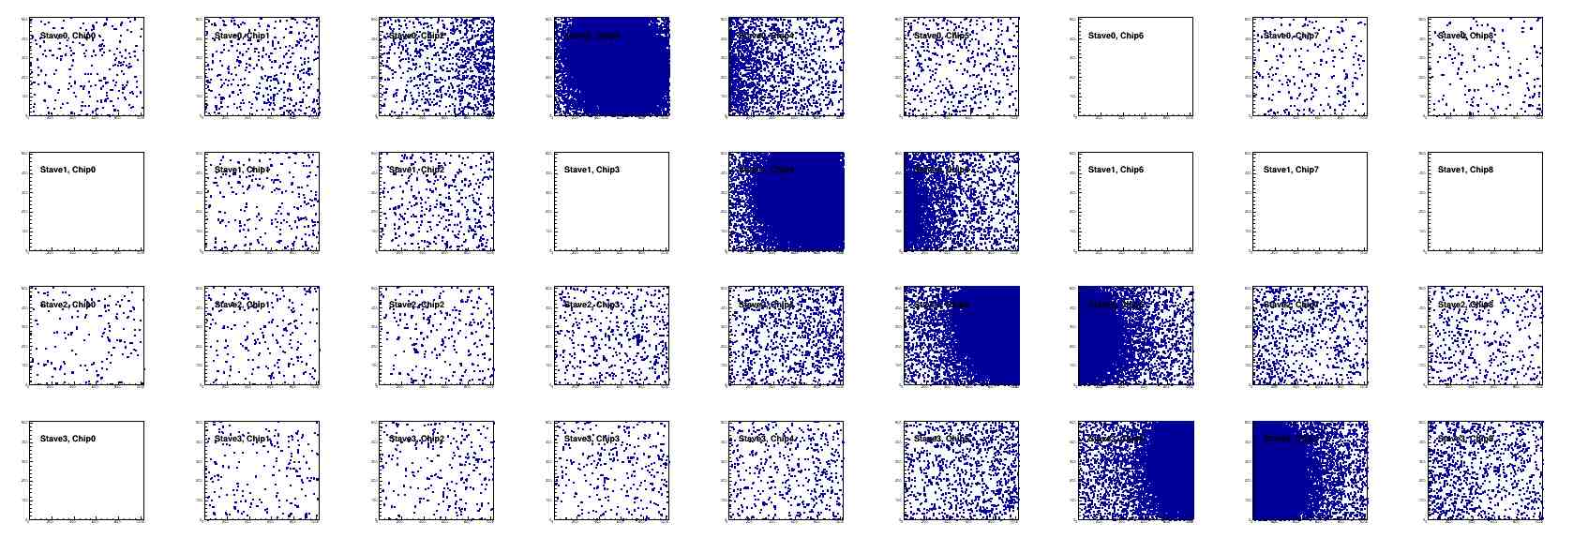
Offline Analysis: Cluster size vs Angle
Run , angle = 40
Cluster Size ~ 3.0
More work follows by Yasser, Sanghoon et al
Everyone is welcome to join the effort!
Stave geometry
Stave alignment
Clustering
Tracking
Update MVTX MC response in GEANT

Slide 14
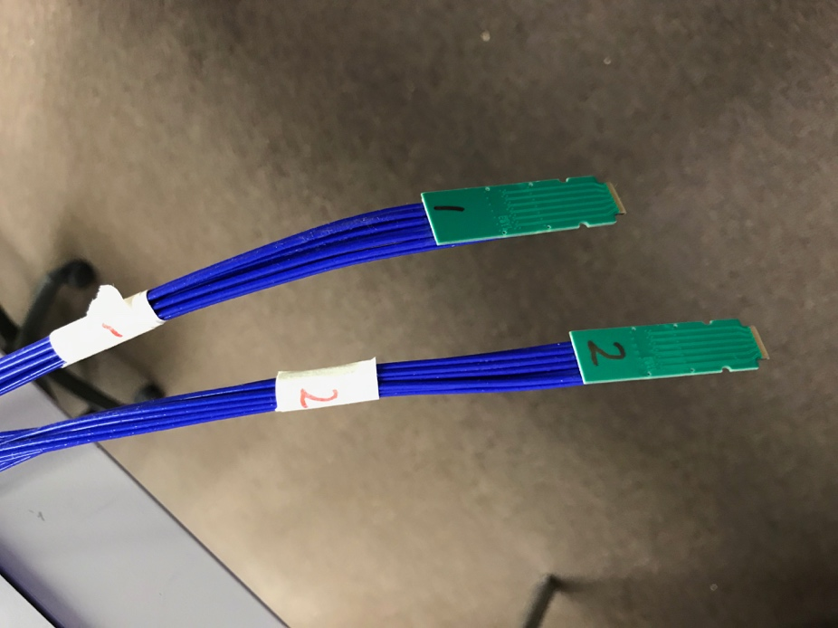
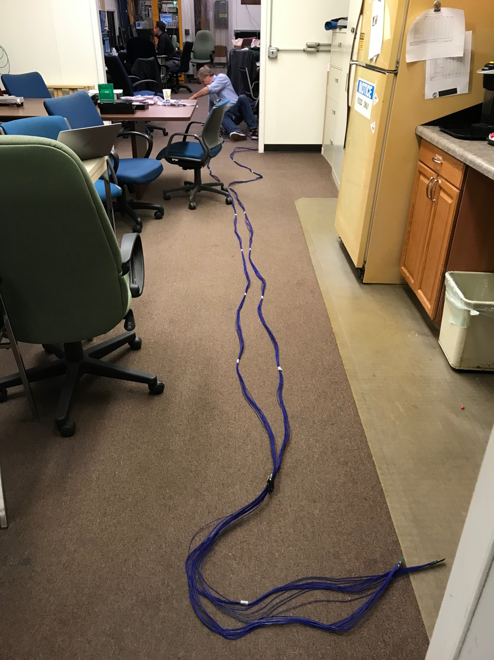
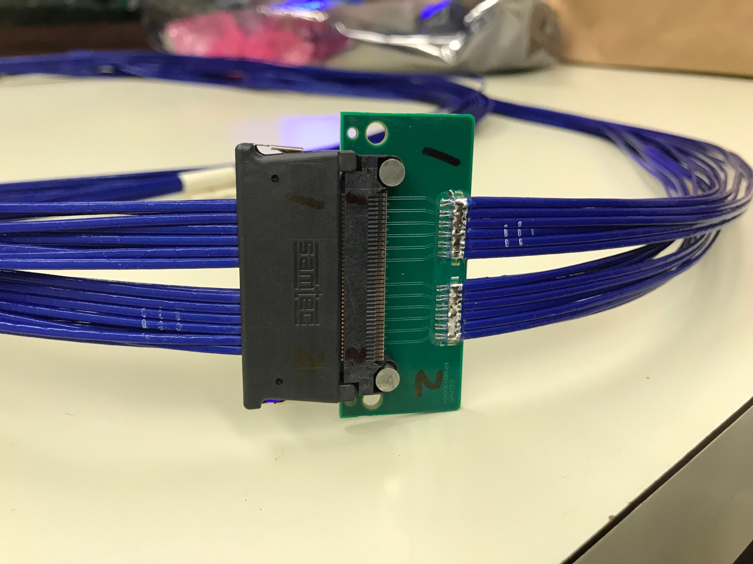
Confirmed New MVTX Long SamTec Readout Cables
8.8m + 2.6m = 11.4m (10m desired for sPHENIX; ALICE 8m cables)

Slide 15
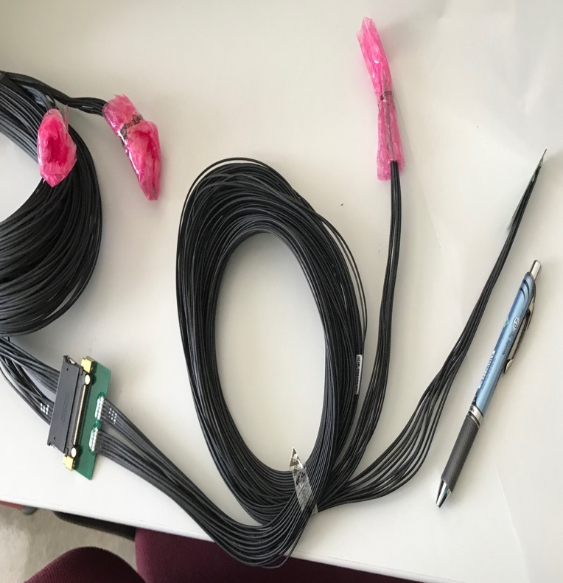
MVTX Readout and Power Cable Route
ALICE ITS/IB final readout cables: ~8m
Cable-B: 5.3m
Cable-A: 2.65m
PWR
RU
PU
sPHENIX MVTX: 7.9+m
  Cable-A: 1.4 m
  Cable-B: 6.5+ m
  Power cable:4.7+ m
Desired ~10m
BNL has approved “non-halogen free” cables for sPHENIX

Slide 16
MVTX Goals – the 2nd TB, 6/17-22, 2019
Test and confirm optimal MVTX operation parameters for sPHENIX
  Threshold scan, analogy shaping time etc.
  Study chip hit efficiency vs trigger(strobe) latency
    dT = 1 ~ 10 uS
Parameters predetermined from laser scan at LANL, in good progress
    Single chip readout with MOSAIC with pulsed laser (~MIP)
    Threshold and noise
    Analogy shaping time
    Strobe delay and length

Slide 17
ALPIDE Sensor Operation Optimization
“Stretched Settings” for sPHENIX trigger study
MAX: 64 cells x 106nS = 6.8uS
“ALICE Default Settings”
sPHENIX Trigger Latency ~ 4.7uS
sPHENIX Trigger Latency ~ 6.8uS

Slide 18
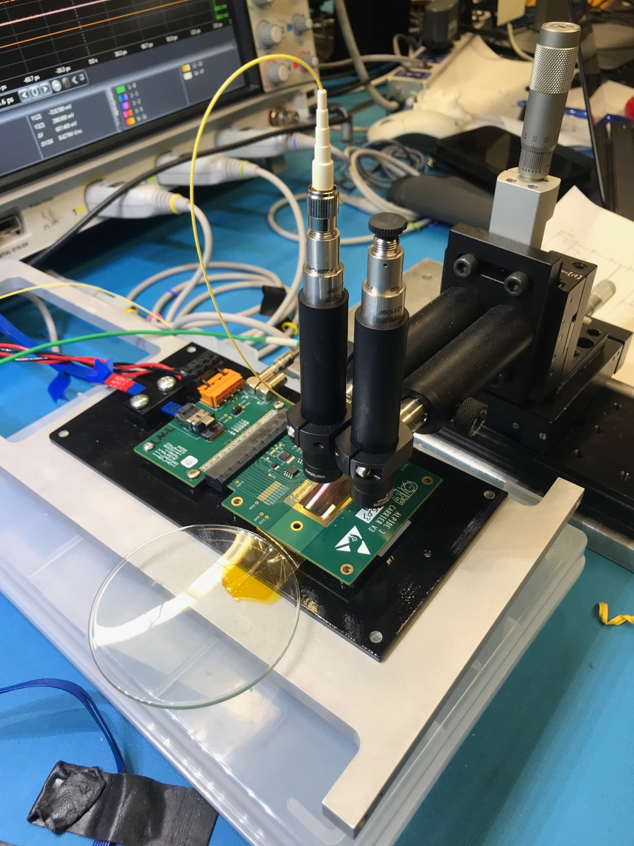
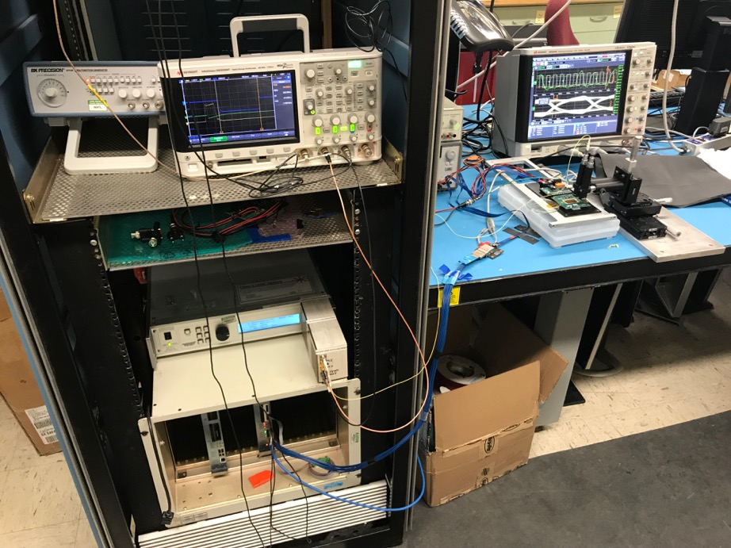
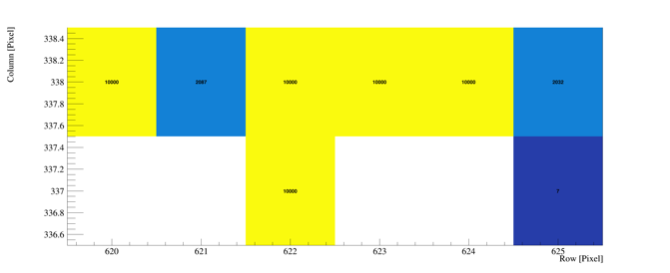
Study MAPS Performance with Pulsed Laser @LANL
Inject “MIP” signal, focused laser beam
  850 nm laser, 4ns wide pulse, ~1 MIP
  50kHz trigger
  Find optimal MAPS operating parameters
Laser system
MOSAIC Testbench
Pixel hits

Slide 19
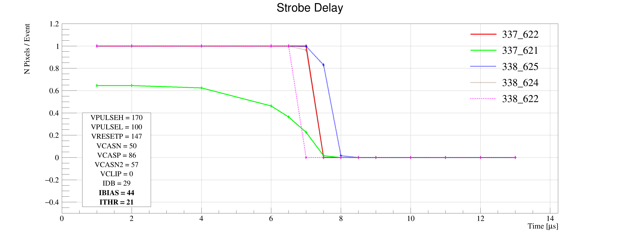
Laser Scan Data – Pixel Hit Efficiency vs Trigger Delay
One of “Stretched Settings” for sPHENIX trigger
MAX: 64 cells x 106nS = 6.8uS
Pixel (Row-Col)
Pixel (Row-Col)
~ 4.7 us
sPHENIX Trigger
~ 4.7 us
sPHENIX Trigger latency

Slide 20
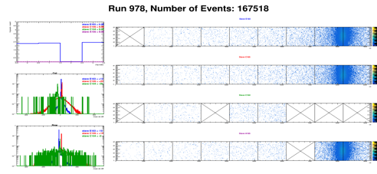
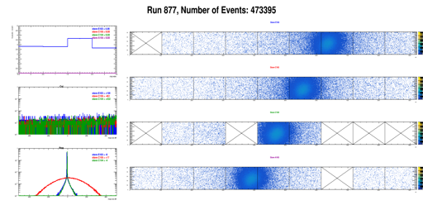
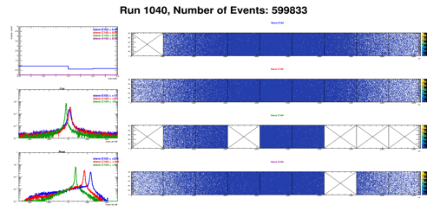
Run Types – Details being documented in MVTX wiki
From Xiaochun
Run0978
Horizontal stave scans (many good runs)
Vertical stave scans
Angular stave scans and tilted runs
Electron beam at 5 GeV (one long run)
Extruded aluminum & Lead-block runs
Run0877
Run1040

Slide 21
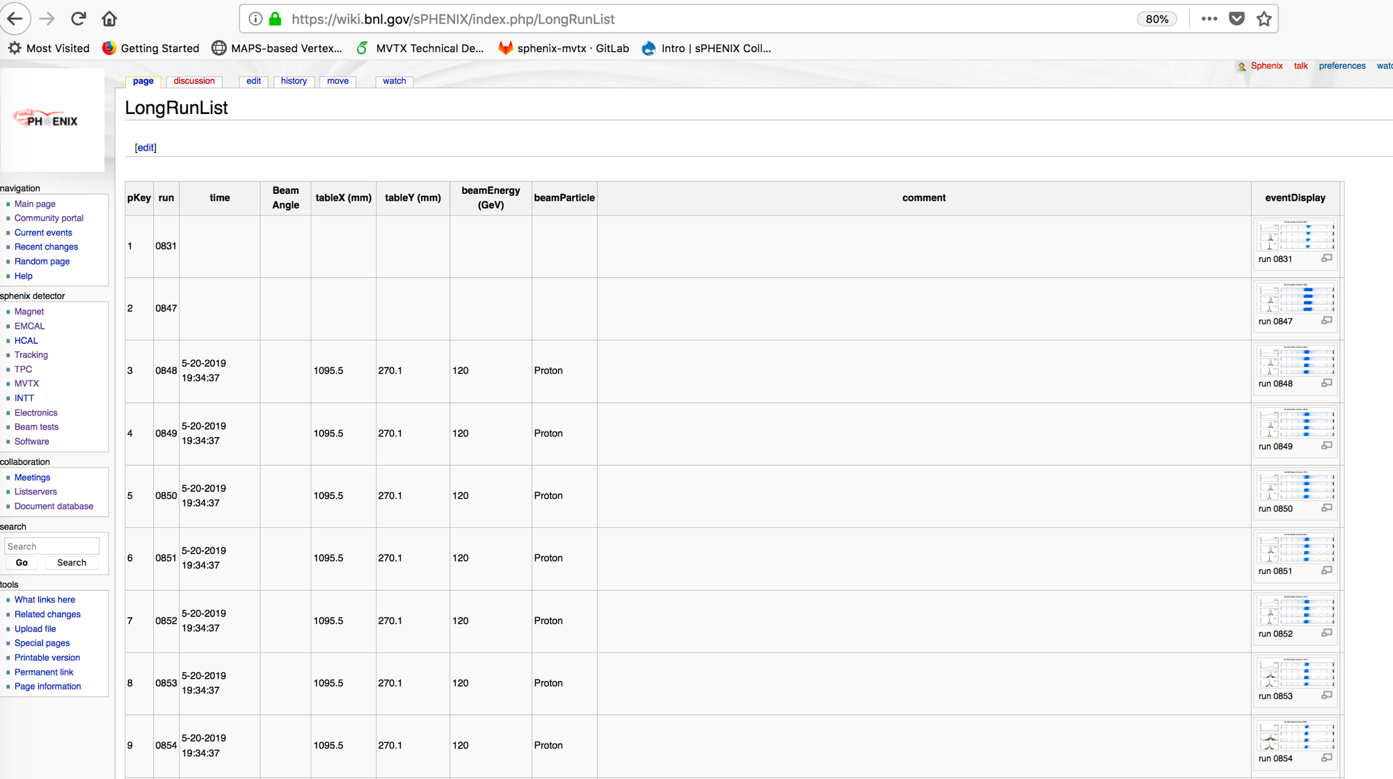
Data run-log in sPHENIX Wiki,
Nice work by Xiaochun et al. @GSU
Jin’s test beam analysis framework
Offline analysis in progress

Slide 22
MVTX Schedules and Milestones in progress (3/2019)
sPHENIX: CD1/3a PD2/3
Installation
1st collisions
CY-2018 | 2019 | 2020 | 2021 | 2022 | 2023
MVTX
Stave & RU
production
FELIX
production
Detector mechanics design & production, global interface to sPHENIX
End Wheels
CYSS
Global integration
/interface design
Service barrel
design & production
Ready for beam;
sPHENIX day-1 run
Barrel Assembly & Testing @LBNL
Install half barrels
@sPHENIX IR
Half barrel #1
Power system
production
Half barrel #2
Half barrels
arrive @BNL
design & procure
interface to
sPHENIX rails
Design & procure
sPHENIX rails
MVTX installation & commissioning @BNL
RU, FELIX, PS, cables etc.

Slide 23
MVTX experts help ALICE/ITS – to help us!
Dave’s talk
from Monday
ITS surface commissioning now:
~ May 2020
Great opportunity to learn about ITS/MVTX detectors
Training on technical details
Developing tools
Build up operation experience

Slide 24
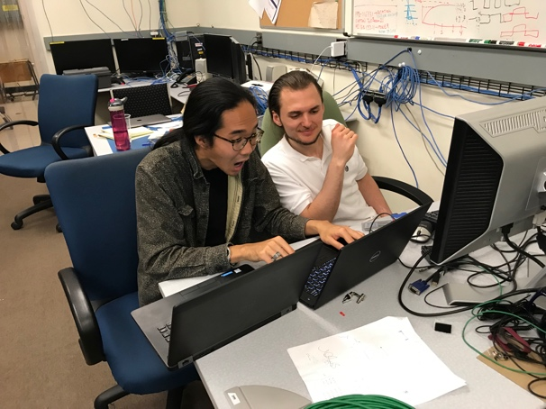
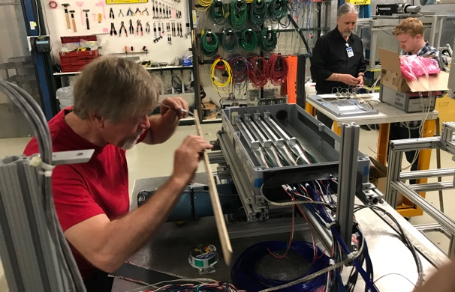
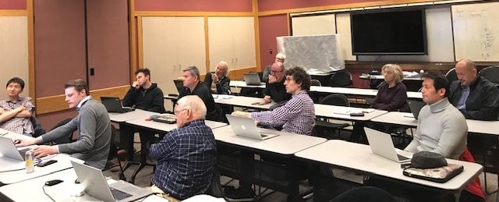
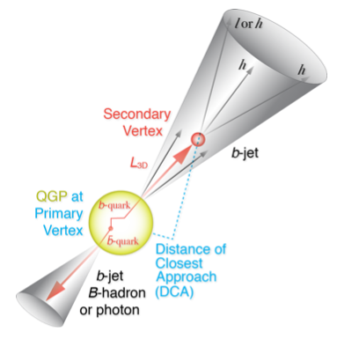
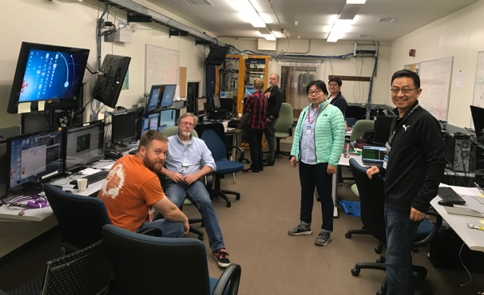
Summary
Completed essential R&D for readout integration
  Full 9-chip stave readout per RU
  Multi-RU readout per FELIX
  Long readout cables
  sPHENIX GTM
Completed preliminary mechanical design
Improve MC detector response, clustering – in progress
  Calibration data with incident angles, 0, 10,20,30,40,45
Stave and RU production at CERN - in good progress
MVTX Cost & Schedule review, July 29-30 @BNL
We are ready for the full production and the physics!

Slide 26
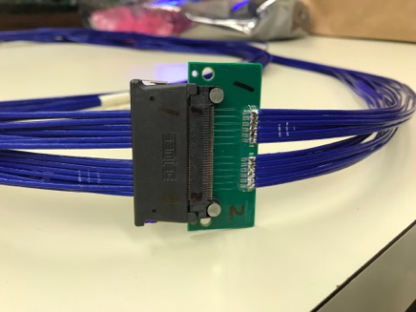
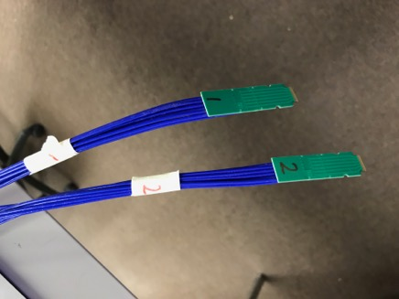
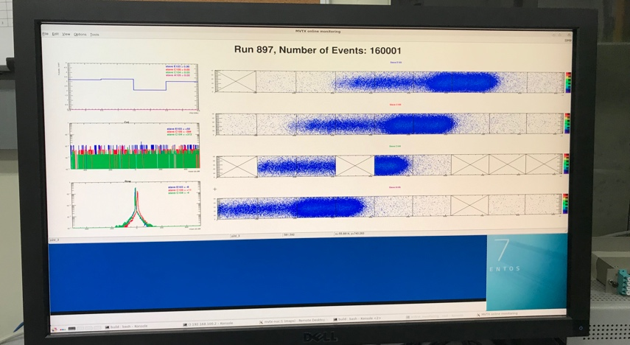
R&D Highlights
Very successful TB at Fermilab, 5/13-25, 2019
  Confirmed the long 11.4m SamTec readout cable
  Confirmed the full stave readout
  Confirmed multi-RU readout per FELIX
  Confirmed sPHENIX GTM with FELIX
A 2nd TB, study optimal MAPS operation points
  Parasitic with INTT+TPC, 6/17-21
Preliminary mechanical design developed
  To prototype CYSS and Layer-2 End-Wheel this summer
  France, Italy, CERN, contacted and under discussion
Improve MC detector response, clustering – in progress
  Took calibration data with incident angles, 0, 10,20,30,40,45
TB later at LBNL/LANL – in preparation
  Scan stave material budget with 50MeV p-beam
  8-stave + 8-RU +1-PU + 1-FELIX + 1-GTM + RCDAQ, the full complete readout chain
    Hardware will be available soon

Slide 27


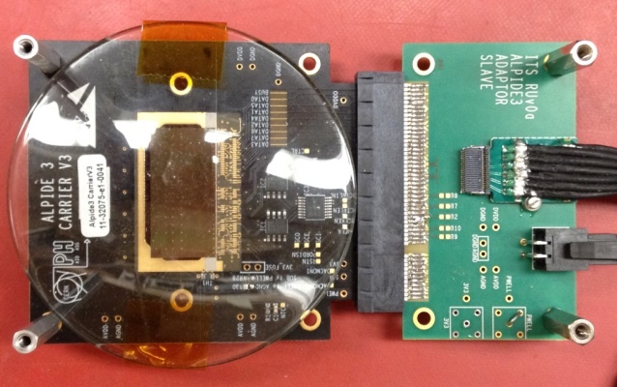
Monolithic Active Pixel Sensors (MAPS)
The Next-Generation, State-of-the-Art Pixel Tracker
Advantages of ALICE PIxel DEtector (ALPIDE) sensor:
Very fine pitch (27μm x 29μm), for superb spatial resolution
High efficiency (>99%) and low noise (<10⁻⁶), for excellent tracking
Time resolution, as low as ~5 μs, for less pileup
Ultra-thin/low mass, 50μm (~0.3% X₀), for less multiple scatterings
0.5M channels with on-pixel digitization, for zero-suppression and fast readout
Low power dissipation, 40mW/cm², for minimal service materials
An ideal detector for QGP physics!
Flexible Printed Circuit(FPC)
9 Chips
Cold plate
A 9-chip MAPS stave, 1.5cm x 27cm
ALPIDE design
ALPIDE sensor:
1.5cm x 3.0cm, 0.5M pixels
50 μm
~28 μm

Slide 28
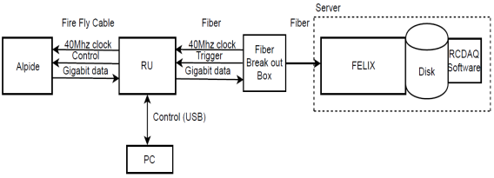
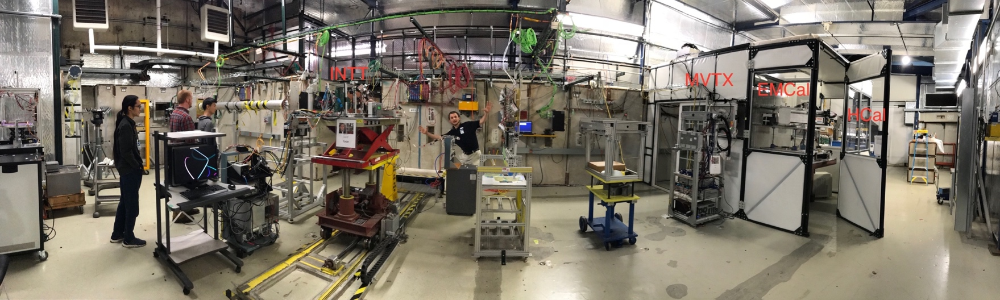
MVTX Full Readout Chain Demonstrated (3/2018)
4-MAPS
telescope
Fermilab Test Beam: Feb-Mar, 2018
Tracking spatial resolution
achieved: <5 um
120 GeV proton
beam
4-hit track
4-MAPS telescope

Slide 29
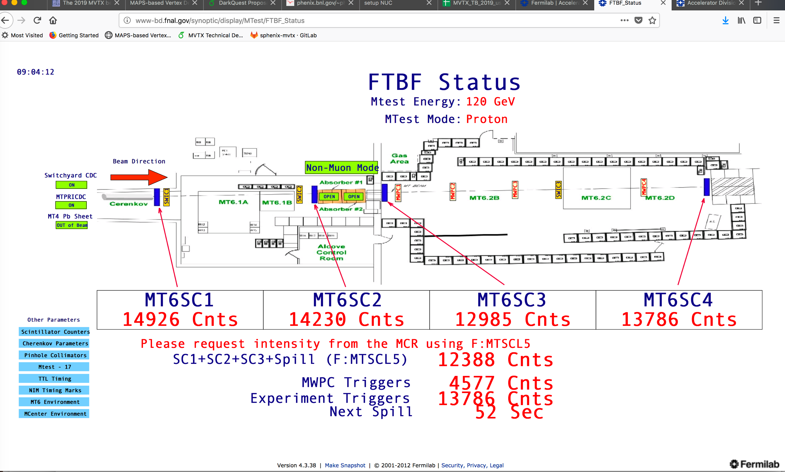
MVTX Test Beam, May 2019
MVTX

Slide 30
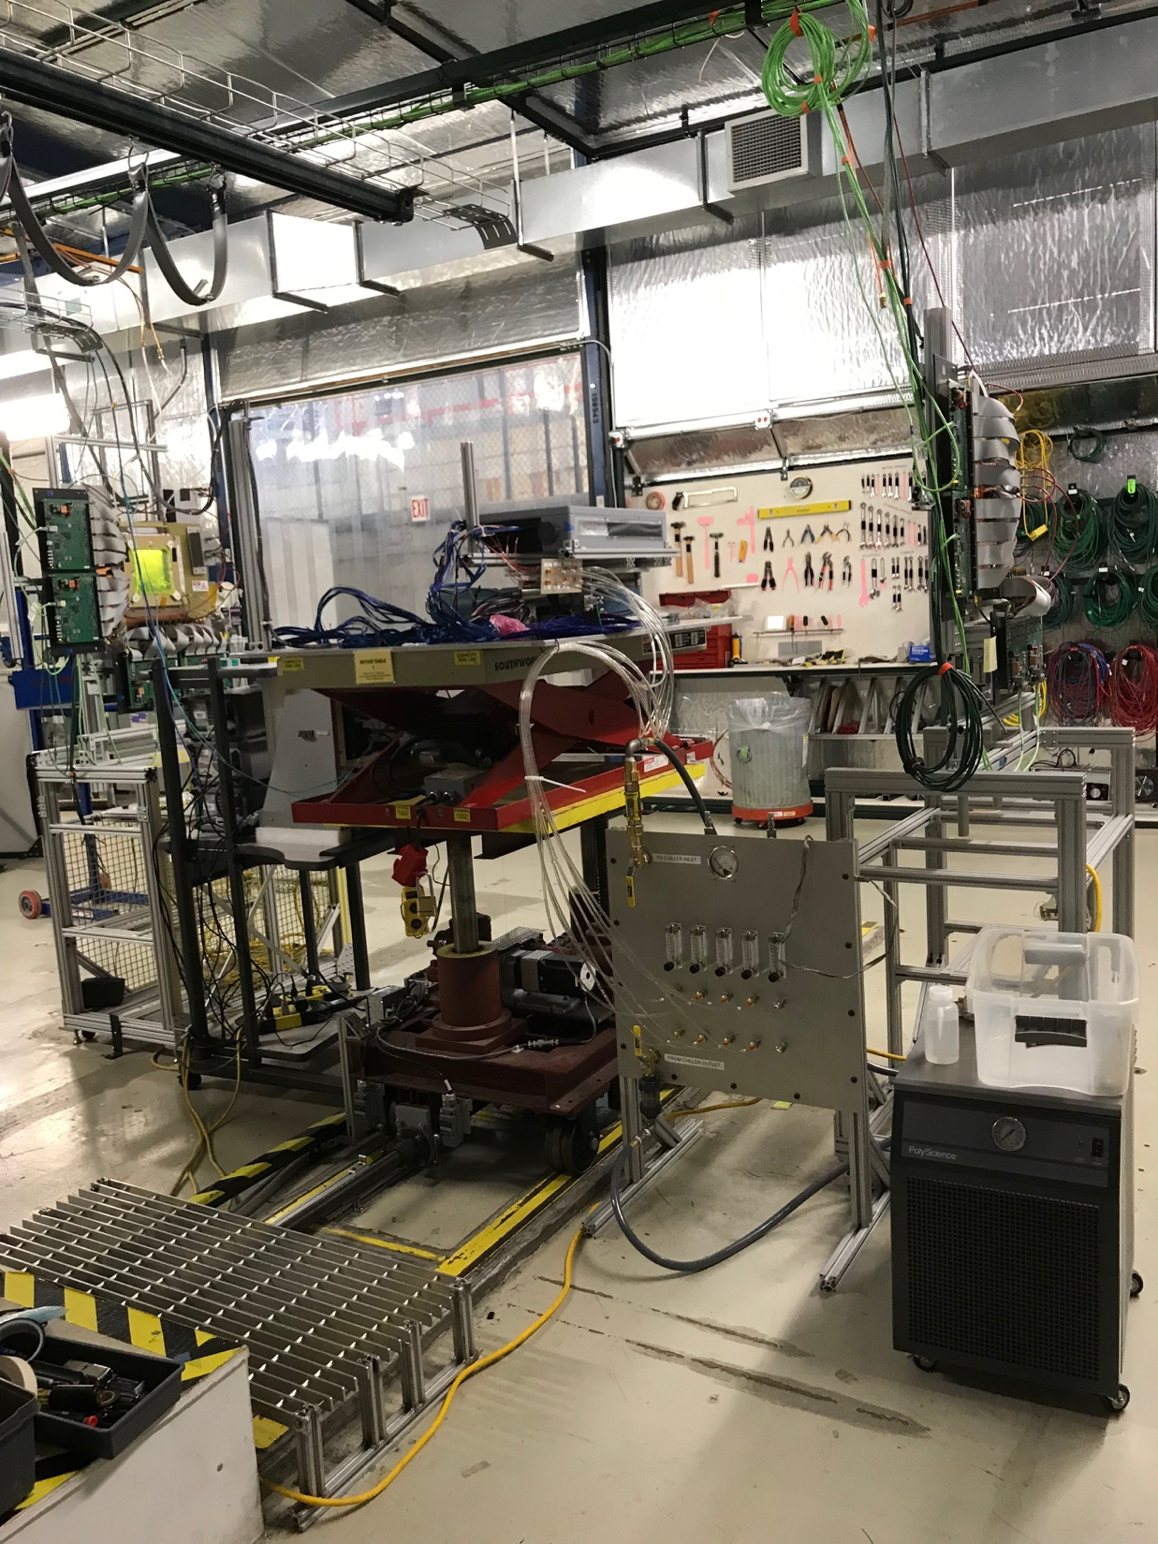
4-stave Telescope
120GeV p-beam
2 RUs,
PU,
PS
Negative Pressure Cooling System
Motion Table
(X,Y,Phi)

Slide 31
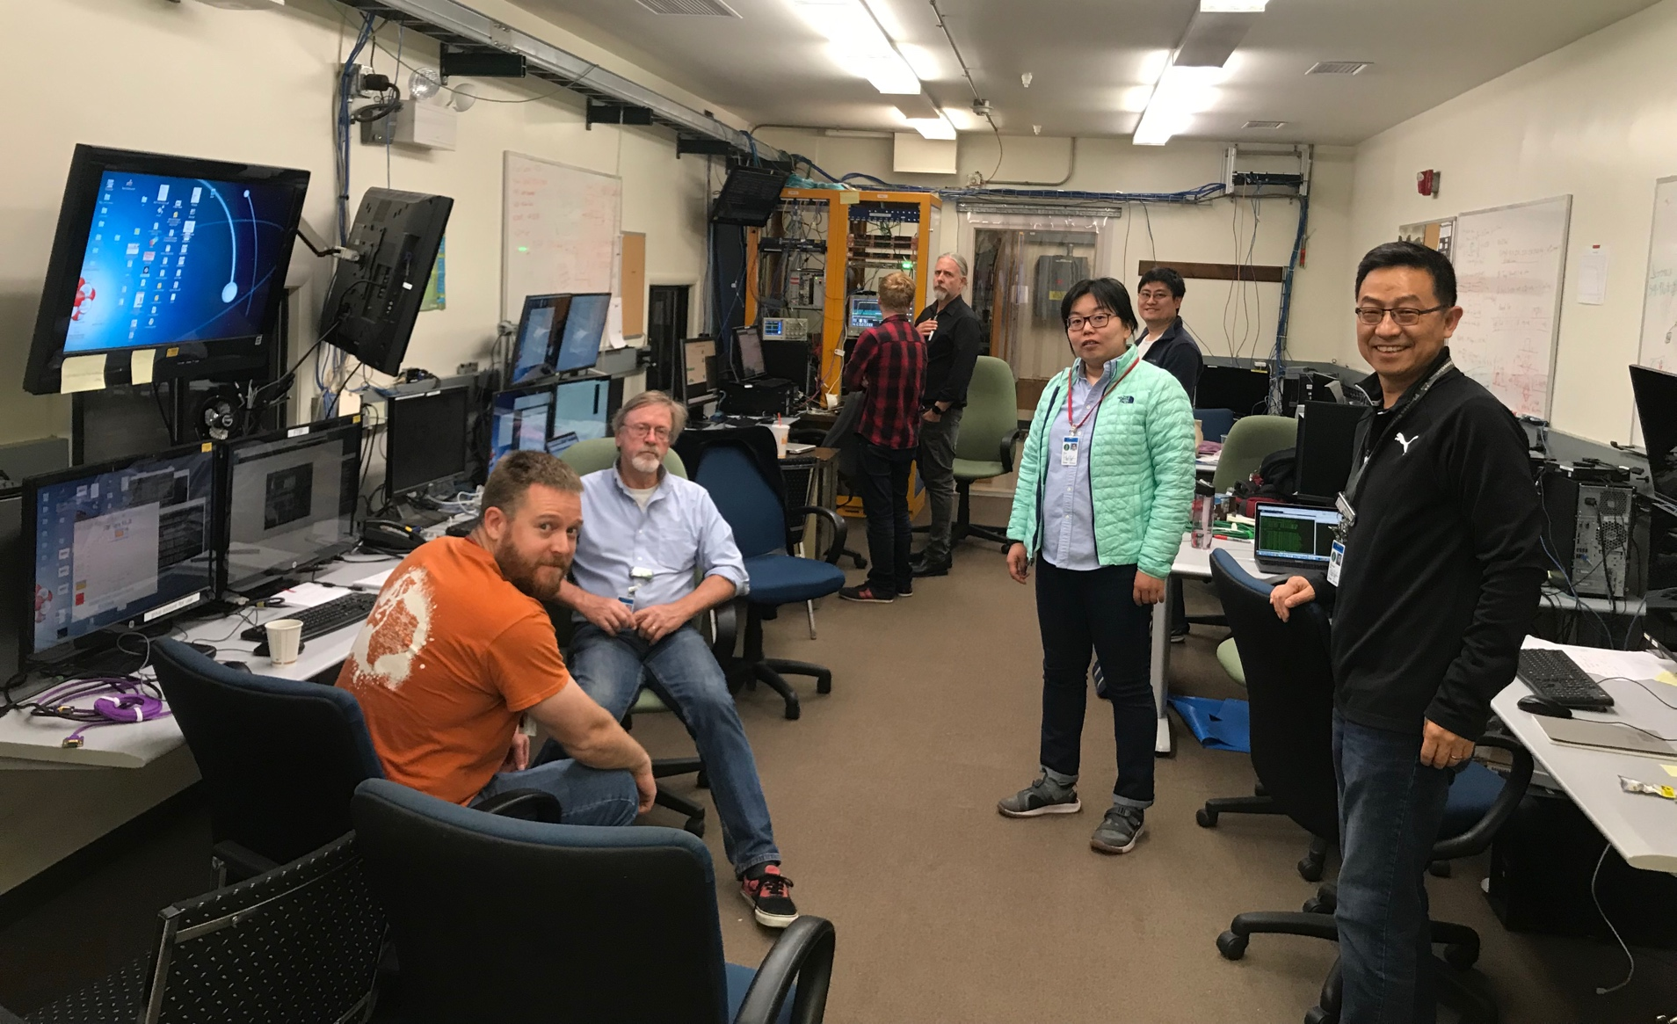
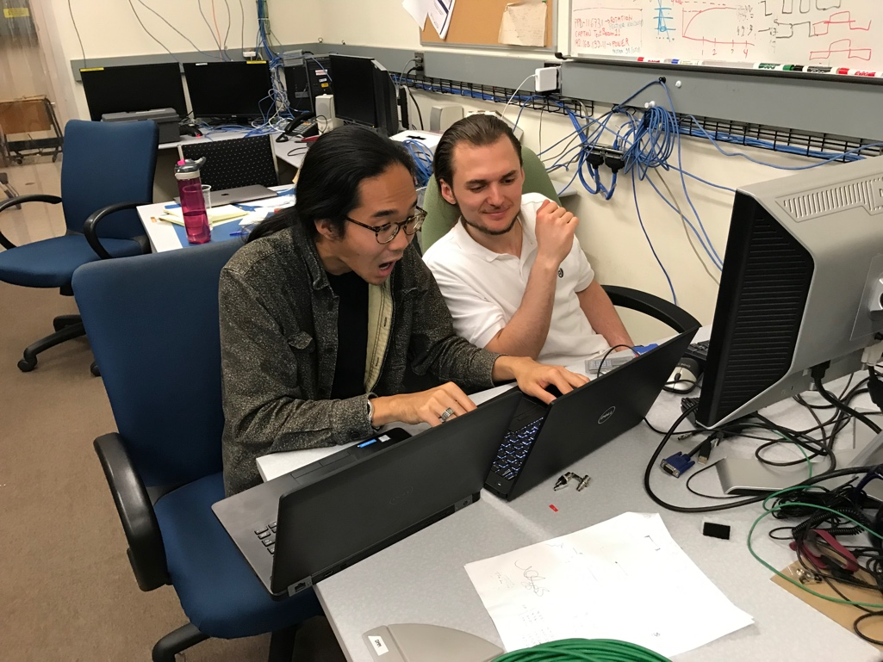
The Team @Fermilab
Data taking shift in the evenings: 7PM – 7AM
Beam: every other Monday –Friday 8:00AM – 8AM
Matt, Hubert, Cameron, Gerd, Zongze,
Xuan, Xiaochun, photo by Ming
Sho, AlexT
Not shown: Sanghoon, Yasser, Martin, Walt,
Abel. Chris …

Slide 32
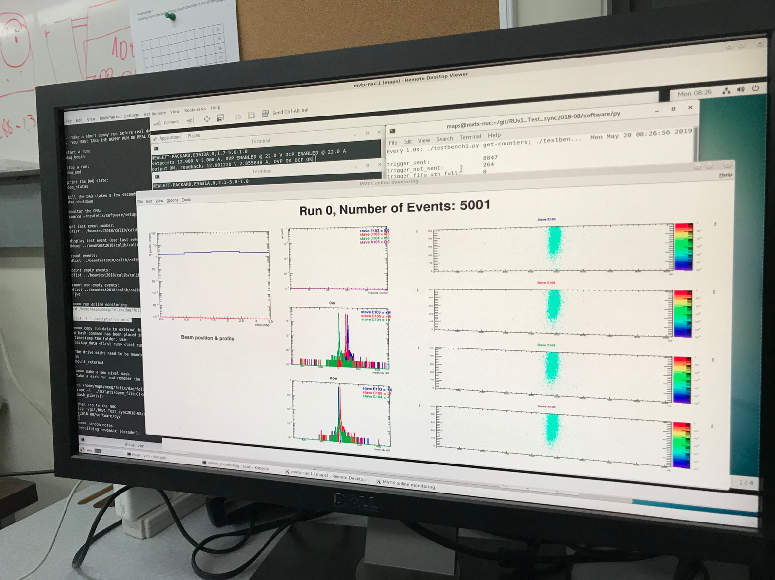
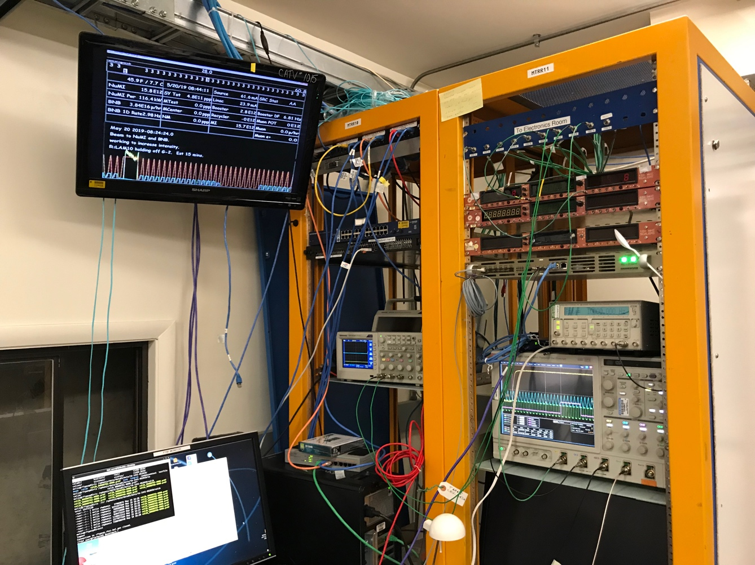
First Collision Signals
sPHENIX GTM

Slide 33


Staves, RUs, PU etc.
2 RUs
PU

Slide 34

120GeV p-beam
120GeV p-beam
Telescope
Telescope
RUs & PU
Cooling System;
negative pressure
@-30%ATMP (-5PSI)

Slide 35

When MAPS parameters off the optimal point, less hits collected

Slide 36

No hits seen when MAPS parameters far-off the optimal point

Slide 37


Installation

Slide 38
3-D event Display: p+Pb collision
Cameron
Stave-4
Stave-3
Stave-2
Stave-1

Slide 39


Offline Analysis: Cluster size vs Angle
Run 877, angle – 30 dgr
Cluster Size = 2.7

Slide 40
MVTX – Half Detector

