Slide 1
MVTX TB @Fermilab May 22 – 29, 2019
03/15/2019
Essential goals for LDRD:
  Demonstrate full readout chain with new “final” hardware at high rate (~15kHz)
    4 staves + 2 RUs + 1 PU + 1 FELIX + RCDAQ
  New “final” hardware
    Production staves, RU(1.1), FELIX(2.0), PU, readout cables, stave cooling
  Reproduce last TB results on tracking efficiency and spatial resolution
    Offline simulation and analysis
Stretch goals for sPHENIX:
  sPHENIX GTM (v0) integration (LANL+BNL/DAQ)
  Online monitoring and slow control (via USB, MIT/GSU et al)
  Scan stave material budget (requires low E beam, sPHENIX, ALICE/ITS, later at LBNL?)
  Exercise “Continue Readout” mode and offline data decoding (sPHENIX/DAQ)
Summary of timeline
  Ship telescope to Ferimlab, by 5/10(Friday). It will take 1 week to get them there
  Travel to Fermilab. 5/19 (Sunday)
  Preinstallation test and setup, training, ORC review etc. 5/20-21(Mon-Tue)
  Installation at TB facility beam line 5/22 (Wed, day time)
  Operation and data taking 5/22 – 5/28 (all evenings)
    Online monitoring & offline data analysis 5/22-28
  Disassemble setup 5/29(Wed), and ship the detectors to LANL
    Possible extension for more data taking with TPC/INTT if needed, June 12 - July 8
1 or 2 shifts per evening?
- 6PM - 6AM
2~3 people per shift

Slide 2
Preparation for Test Beam in May
Firmware & software update:
  2x (2-stave + 1 RU) -> 1 FELIX - AlexT, Sho, in progress
  PU integration, controls and monitoring via USB - Sho, Cameron, Ming, GSU/Xu et al
  GTM integration - Sho, Alex, Gerd + BNL, done!
  8m SamTec cables & transition boards – Gerd, Cameron, Sho, Ming … ; plan-B ready (5m cables)
  VME cage hosting 2RU + 1 PU, done!
Telescope box & cooling
  Box design and fabrication - Abel, Hubert, Matt
  4 stave installation - Hubert, Abel, Ming
  Cooling test & evaluation - Matt, Abel, Ming
System integration & test at LANL in April/May. -- training for operation, debugging etc.
  Setup cosmic trigger – Matt, Xuan et al
  System test – Cameron, Yasser, Sho, Gerd, Ming… all
Offline analysis -- can use more help from sPHENIX
  4-stave telescope geometry & simulation – Yasser, Ming, (Sanghoon, Darren)
  Offline analysis – Yasser, Cameron, Sanghoon et al
  Use old TB data for analysis – training for all
    4-stave decoder is ready (Sho)
Online monitoring & slow control
  GSU & MIT, Sho/Ming, Jo’s - help
  (V,I,T) of staves and PU/RU via USB
ORC docs --- Sho
Shipping, training, schedule, travel, installation --- Ming et al

Slide 3
Manpower & Schedule
Activities
  Ship telescope setup to Fermilab, latest 5/10(Fri),
    Hand-carry 4 staves and electronics boards (RU, FELIX etc)
    Travel to Fermilab on 5/19 (Sunday) or earlier
  Preinstallation test and setup 5/20-21(Mon-Tue) – mostly LANL folks
    Full time: Yasser, Hubert, Cameron, Walt, Ming, Xu(GSU), Gerd …
    Part time: Xuan, Kun, Matt
  Installation at TB facility beam line 5/22 (Wed):
    LANL folks + sPHENIX helpers
  Operation and data taking 5/22 – 5/28 (all evening): LANL + sPHENIX helper
    Full time: Yasser, Hubert, new PD/Cameron, Ming, Walt, Xu (GSU), Gerd
    Part time: Xuan, Kun, Matt, Cesar, Darren(TBD), Sanghoon, other sPHENIX folks?
  Online monitoring & offline data analysis 5/22-28: LANL + sPHENIX helpers
    Full time: Yasser, Hubert, Cameron, Xu (GSU), Ming …
    Part time: Xuan, Kun, Matt, Other sPHENIX helpers
  Disassemble setup 5/29(Wed), and ship the detectors to LANL: - mostly LANL folks
    Yasser, Hubert, Cameron, Ming, Kun et al
“Remote” helpers:
  Alex T., Sho, Jo et al
  sPHENIX offline/online analysis
Preparation work & training at LANL
  Build 4-stave telescope in Feb/Mar
  Test cooling system, evaluate
  Operate telescope with cosmic rays in April
  Offline data analysis
  Detector online monitoring, V, I, T etc.
  Lab training for operation and analysis, RU/FELIX, RCDAQ etc

Slide 4
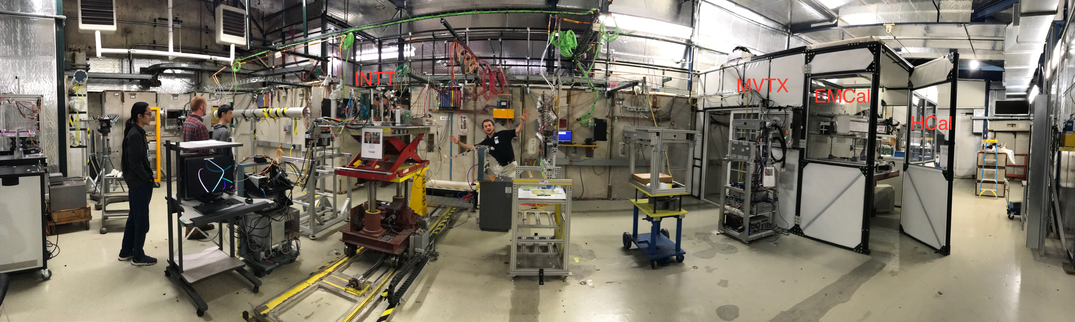
TM6.2 Room Layout
MVTX Telescope setup on the motion table:
MVTX telescope
MVTX crate (2-RU + 1 PU)
3.3V HP PS
One Linux server/RCDAQ in CH

Slide 5
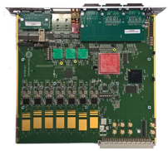
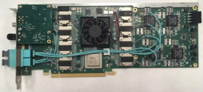
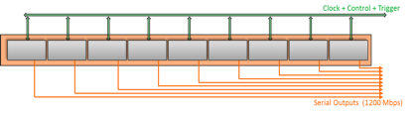

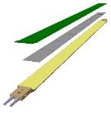
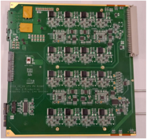
System overview
Readout Unit
Front End
FELIX
Back End
~8m twinax
GBT Optical Links
9-sensor stave
Control
Data (9x1.2Gbps), Clock, Control/Trigger
Data (3x3.2 Gbps)
Trigger
PCIe
FPC
USB
Clock/Trigger
ALPIDE Sensors
Power supplies
Regulated power
Power
Cold Plate
DAQ and Slow Control
sPHENIX GTM
Power Board
Interaction Region
Experimental Hall
Counting House

Slide 6
More information

Slide 7
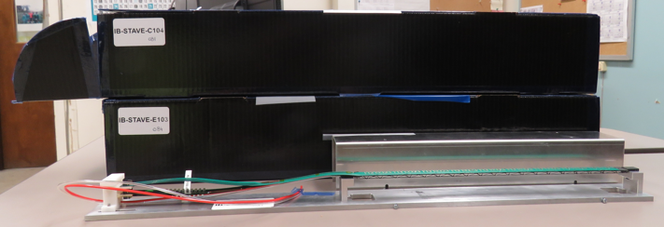
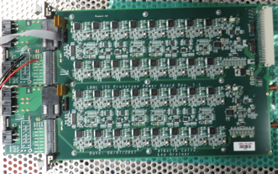
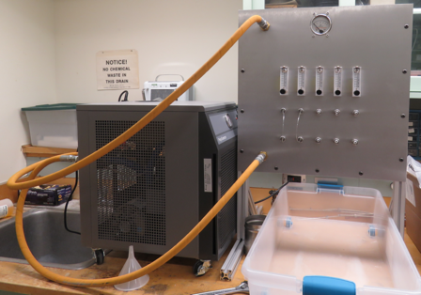
2019 test beam: 4-stave telescope
Sho’s talk
Scheduled for May 22-29, at Fermilab
Additions compared to the 2018 test beam:
  Staves (from single chips)
  Full-length MVTX signal cables (from 5 m off-the-shelf cables)
  FELIX v2.0 (from v1.5)
  Cooling system
  Power board
  sPHENIX GTM
Full test of all components of the MVTX detector - LDRD “stretch goal”

Slide 8
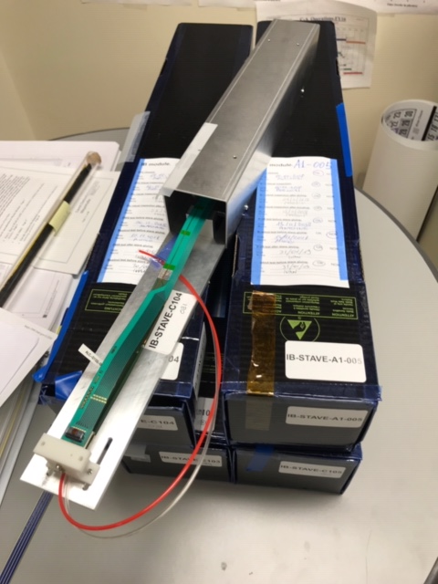
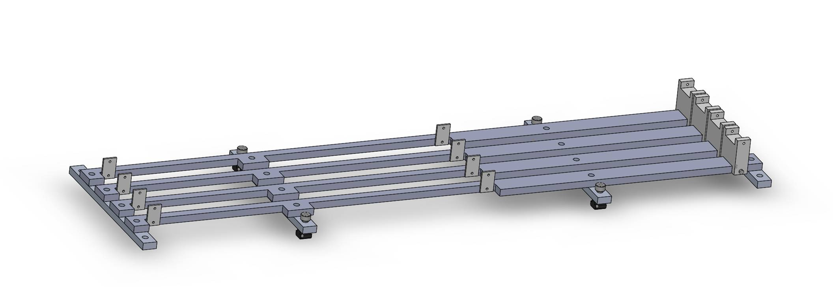
Mechanical design
Telescope box design completed, sent for fabrication
  One stave can be offset by (0.5,0.5)cm for material scanning

Slide 9
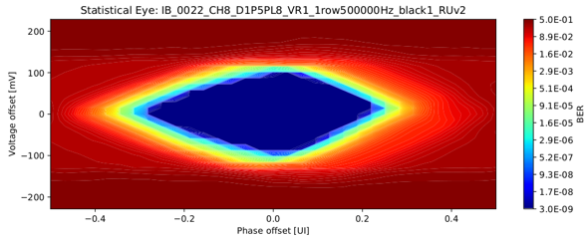
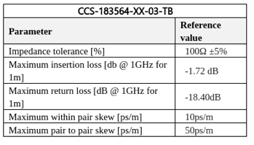
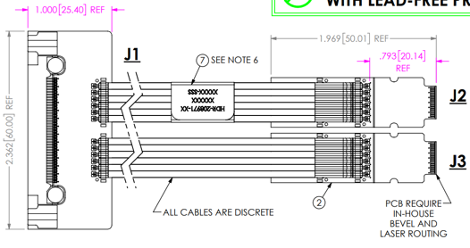
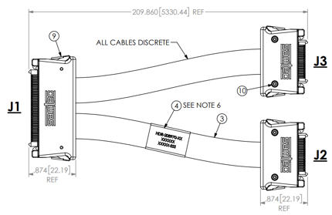
ALICE/ITS Signal cable design
The Samtec twinax cables carry clock (40 MHz), control (40 Mbps bidirectional), data (9x1.2 Gbps)
ALICE is using halogen-free cables (32 AWG, LDPE dielectric) due to CERN LSZH requirement; 2.65 + 5.3 m cables have been tested and are now in production
RU
RU
Stave
Stave

Slide 10
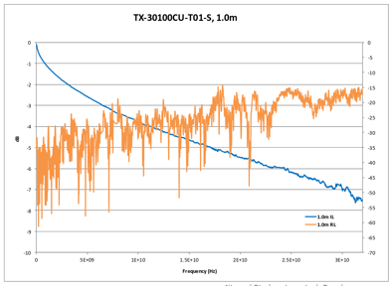
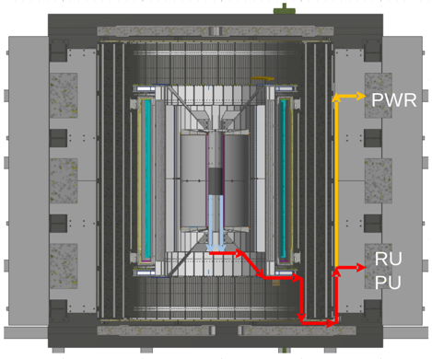
sPHENIX MVTX Cable testing
BNL has approved non-halogen-free cables (30 AWG, FEP dielectric); improved signal integrity
sPHENIX cable run estimates are converging: 1.4 + 6.5 m
We have Samtec quotes for 1.2/2.65 + 5.3/8.8 m (total length 6.5 - 11.45 m), will order soon
We will qualify these cables using stave and RU (bit error rates, statistical eye), and scope/network analyzer
We will test full-length MVTX cables in the next months

